Slide 1
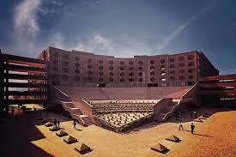
VERTO-GUIDE
Sazid Ali
Dena Verma
Nikhilesh Dubey

Slide 2

Introduction
Verto Guide is a computer system or website that promotes and assists the making and modification of digital. A shared user interface is generally used, which results in several users functioning together in a very cooperative environment.

Slide 3

DFD
admin
user
Verto Guide
mentor
student

Slide 4
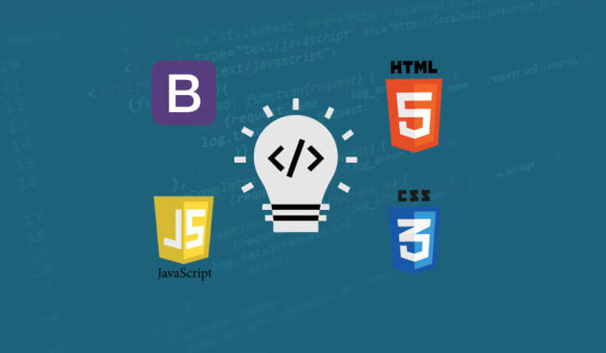
Technologies Used
HTML: HTML describes the structure of a Web page.
Bootstrap: Bootstrap is a free front-end framework for faster and easier web development.
JavaScript: JavaScript is the programming language of HTML and the Web.
CSS: CSS describes how HTML elements are to be displayed on screen, paper, or in other media.
PHP: PHP is a widely-used, open source scripting language.

Slide 5




Project Overview
Module 1: Map
Module 2: Request
Module 3: Search Books
Module 4: Academic Hub

Slide 6
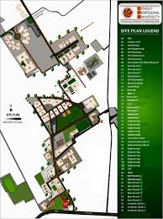
Module 1: Map to LPU
VERTO Map is a user-friendly mapping technology and local business information hub. In its absolute form, VERTO Map is comprised of high-resolution images. It includes most locations in Lovely Professional University.

Slide 7
Module 2: Request
Through the request module, one can submit any queries or complaints on the website, much similar to the Request Management System(RMS) present in the LPU-UMS.
The user can submit queries/complaints and at the back-end, the admin can view the requests.

Slide 8
Use case diagram: Request
admin
View requests
student
Enter suggestions/requests
Submit requests

Slide 9
Module 3: Search Books
In this module, the user can search books available in the database.
There are two criterion for book search:
Search by book title
Search using keywords: if the user does not remember the book title, he/she can search the book by entering the keyword(s).

Slide 10
Use case diagram: Search Books
admin
Book listing
student
Enter book title/keyword
View and access books

Slide 11
Module 4: Academic Hub
This module shows the study material of various subjects.
We have developed a full-fledged website wherein students do not need to go anywhere else seeking for study materials of different subjects.
This also helps the faculty as they would not need to upload the study material for every subject manually.
It acts as a centralized hub of knowledge.

Slide 12
Use case diagram: Academic hub
mentor
s
upload study material
student
Select subject
View study material
Download study material

Slide 13


