Slide 1

Advancing Brain Tumor Imaging: Merging Machine Learning with Traditional Diagnostics
Brain tumors are a serious health challenge, and accurate diagnosis is crucial for successful treatment. While traditional diagnostic methods face challenges in distinguishing tumors from normal brain tissue, advancements in deep learning offer promising opportunities to improve accuracy and efficiency in tumor identification. This presentation explores a novel approach that combines transfer learning and reference-based feature enhancement to enhance brain tumor imaging, leveraging the contrast between normal and tumor tissues to improve segmentation and classification accuracy.
by Nikhilesh Meher, Meet Sharma, Lakshay Roodkee

Slide 2
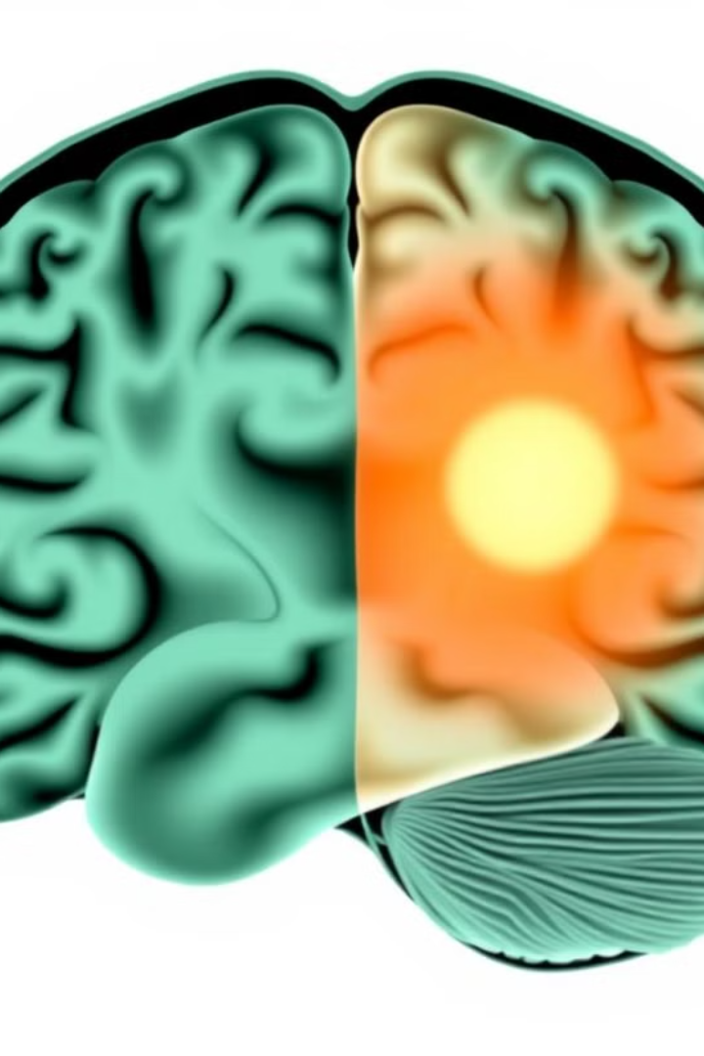
Abstract
Brain tumors pose a significant health threat, and accurate diagnosis is vital for effective treatment. Traditional diagnostic methods face challenges due to the diverse nature of tumor growth, genetic profiles, and microscopic similarities to normal brain tissue. While deep learning models have shown improvements in tumor classification, they often overlook valuable external information, such as the appearance of a normal brain. In this study, we introduce a novel framework that integrates transfer learning with reference-based feature enhancement, inspired by the way radiologists compare healthy brain regions to identify tumors. Our approach uses normal brain images as references to enhance feature extraction, improving the detection of tumor-related features. By incorporating these references into the learned feature space of tumor images, we achieve more precise feature extraction and classification compared to traditional methods.

Slide 3
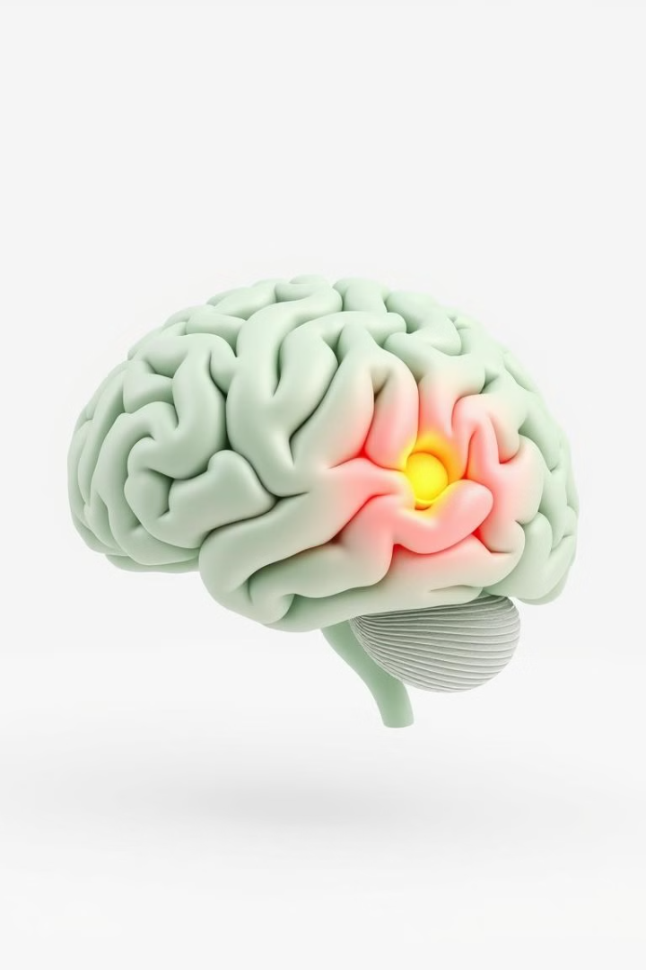
Problem Statement
1
Current Challenge
Existing deep learning models for brain tumor detection primarily focus on tumor features, neglecting the use of healthy brain images as a reference point. This limitation can impact accuracy in tumor segmentation and classification due to the variability in tumor shapes, sizes, and textures.
2
Impact
The limited accuracy in tumor segmentation and classification can have significant consequences for treatment planning and patient outcomes. Precisely identifying tumor boundaries and classifying tumor types are critical for determining the most effective treatment strategies.
3
Key Limitation
A key limitation of existing models is the difficulty in aligning multimodal tumor images (T1, T2, FLAIR) with monomodal healthy brain images, leading to reduced diagnostic precision. This inconsistency in modality makes it challenging to effectively compare features between different types of brain scans.
4
Need
A robust framework is needed that compares healthy and tumor-affected brain regions to enhance detection and segmentation accuracy. By leveraging the contrast between normal and abnormal tissues, we can improve the ability to distinguish tumors from surrounding brain tissue.

Slide 4

Scope of Project
This project focuses on developing an advanced deep learning framework for brain tumor segmentation. The core component of this framework is the incorporation of a Feature Alignment Module (FAM) for effective comparison between multimodal tumor images (T1, T2, FLAIR) and monomodal healthy images. This module addresses the challenge of feature comparison between different modalities by aligning features extracted from healthy and tumor-affected brain images. The expected outcome is to enhance segmentation and classification by highlighting tumor-related features more effectively, leading to accurate tumor segmentation. The model's performance will be validated using publicly available datasets like BraTS2022 and proprietary in-house datasets to ensure robust evaluation.

Slide 5
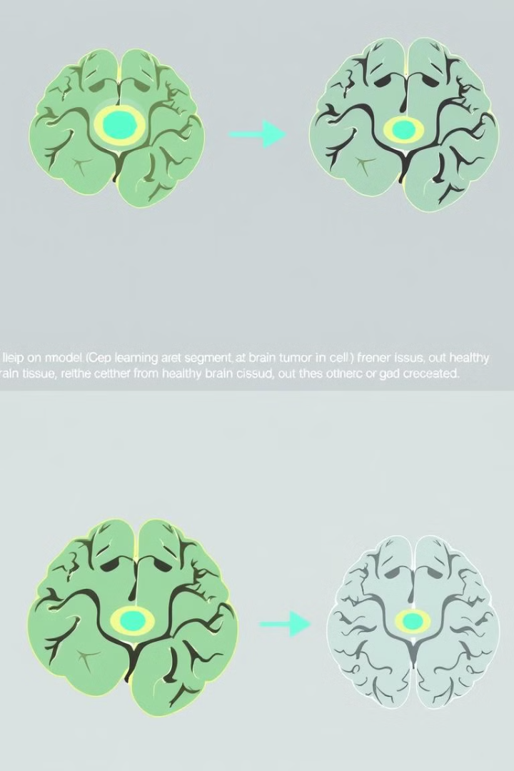
Objective
Develop a Novel Deep Learning Framework
Build a deep learning-based framework for brain tumor segmentation using multimodal tumor images and monomodal healthy images for accurate comparison. The framework should leverage the strengths of transfer learning and feature alignment techniques to enhance segmentation accuracy.
Incorporate Feature Alignment Module (FAM)
Implement a Feature Alignment Module to align and compare features from multimodal tumor brain images and monomodal healthy brain images, addressing the challenge of feature inconsistency between different modalities. The FAM should effectively highlight differences between healthy and tumor tissues.
Improve Tumor Segmentation Accuracy
Enhance the model's ability to identify and segment tumor regions by highlighting tumor-related features. This will lead to more precise tumor delineation, which is crucial for treatment planning and monitoring.
Validate Using Diverse Datasets
Evaluate the model's performance using publicly available datasets like BraTS2022 and proprietary in-house datasets for robust validation. This ensures that the model performs well on a wide range of data, reflecting real-world clinical scenarios.

Slide 6

Literature Survey
Study
Method
Key Findings
Accuracy
Balasooriya
CNN-based model for classifying five types of brain tumors.
Demonstrated high efficiency in classifying multiple tumor types.
99.68%
Pashaei
KE-CNN model combining CNN with Extreme Learning Machines.
Showed promising results in leveraging CNNs to enhance image feature detection.
93.68%
Das
CNN-based classification model using advanced image preprocessing techniques.
Highlighted the importance of preprocessing in medical image analysis for classification tasks.
94.39%
Gumaei
Hybrid approach combining RELM model and min-max normalization preprocessing.
Demonstrated that combining multiple feature extraction techniques can improve classification performance.
94.23%

Slide 7
Literature Survey
Study
Method
Key Findings
Accuracy
Sultan
CNN architecture with two convolutional layers, ReLU, and max-pooling layers.
Achieved reasonable performance with a simple network architecture.
88.68%
Sajjad
Three-stage system combining segmentation, data augmentation, and transfer learning.
Proved the effectiveness of these techniques in improving tumor detection and classification.
94.58%
Deepak
Transfer Learning approach using a pre-trained GoogLeNet model.
Demonstrated that TL techniques can be highly efficient in medical imaging tasks.
98%
Afshar
Capsule Network (CapsNet) architecture for classifying multiple tumor types.
Showed that CapsNet can outperform traditional models in capturing intricate details in medical images.
90.89%

Slide 8

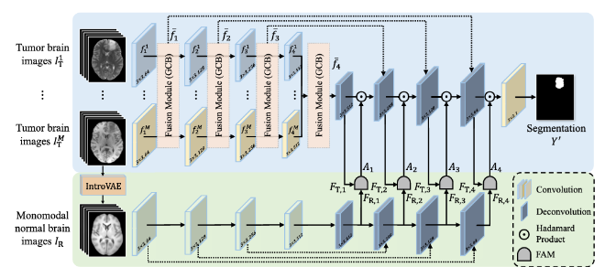
Architecture Diagram
The proposed framework consists of two networks: the segmentation backbone (blue region) and the normal appearance network (green region). The segmentation backbone learns features from multimodal tumor brain images (I1T,..., IMT) and outputs tumor segmentation results Y'. A global correlation block (GCB) is used in the segmentation backbone to fuse features learned from different modalities. The normal appearance network learns features from monomodal normal brain images IR reconstructed by an introspective variational autoencoder (IntroVAE). At each decoding level, features from both networks are sent to the feature alignment module (FAM) to perform feature alignment and comparison, generating an attention map. This attention map highlights and enhances tumor-related features in the segmentation backbone, improving segmentation accuracy.

Slide 9





Feature Alignment Module (FAM)
Input Features
The FAM receives input features from both the segmentation backbone and the normal appearance network. These features represent the learned information from multimodal tumor images and monomodal healthy brain images, respectively.
Feature Alignment
The FAM utilizes a feature alignment technique to align the features from both networks. This alignment process ensures that the corresponding features from different modalities are properly matched and compared.
Attention Map Generation
Based on the aligned features, the FAM generates an attention map. This map highlights regions where there are significant differences between the tumor features and the normal brain features. These differences can indicate the presence of tumor-related characteristics.
Feature Enhancement
The attention map is then used to enhance the tumor-related features in the segmentation backbone. This enhancement process strengthens the signal from tumor regions, improving their detectability and segmentation accuracy.

Slide 10

Conclusion
The proposed model is to be evaluated using publicly available datasets like BraTS2022, Brain Tumor MRI Dataset, and proprietary in-house datasets. Data augmentation techniques are to be applied to address class imbalance, ensuring that the model was robust to variations in data distribution. The model is expected to achieve a classification accuracy which surpasses EfficientNetV2-M alone. These results can demonstrate the effectiveness of incorporating normal brain images as references in enhancing feature extraction and classification accuracy. The model's ability to learn from both tumor and healthy brain tissues can contribute to its superior performance in identifying abnormal regions.

Slide 11
References
[1] He J, Wang J, Han Z, Li B, Lv M, Shi Y: Cancer detection for small-size and ambiguous tumors based on semantic FPN and transformer. Cancer detection for small-size and ambiguous tumors based on semantic FPN and transformer - PMC (nih.gov)
[2] Who.int., Cancer, 2024, Online, https://who.int/news-room/fact-sheets/detail/ cancer. (Accessed 02 March 2024).
[3] S.A. Ansar, S. Aggarwal, S. Arya, M.A. Haq, V. Mittal, F. Gared, An intuitionistic approach for the predictability of anti-angiogenic inhibitors in cancer diagnosis, Sci. Rep. 13 (1) (2023) 1–14.
[4] K. Herholz, K.-J. Langen, C. Schiepers, J.M. Mountz, Brain tumors, in: Seminars in Nuclear Medicine, vol. 42, Elsevier, 2012, pp. 356–370.
[5] A. Gudigar, U. Raghavendra, A. Hegde, M. Kalyani, E.J. Ciaccio, U.R. Acharya, Brain pathology identification using computer aided diagnostic tool: A systematic review, Comput. Methods Programs Biomed. 187 (2020) 105205.
[6] S.P. Singh, L. Wang, S. Gupta, B. Gulyas, P. Padmanabhan, Shallow 3D CNN for detecting acute brain hemorrhage from medical imaging sensors, IEEE Sens. J. 21 (13) (2020) 14290–14299.
[7] M. Puttagunta, S. Ravi, Medical image analysis based on deep learning approach, Multimedia Tools Appl. 80 (16) (2021) 24365–24398.
[8] F. Bashir-Gonbadi, H. Khotanlou, Brain tumor classification using deep convolu tional autoencoder-based neural network: Multi-task approach, Multimedia Tools Appl. 80 (13) (2021) 19909–19929.
[9] Ramazan İncir, Ferhat Bozkurt, Improving brain tumor classification with combined convolutional neural networks and transfer learning, (https://www.sciencedirect.com/science/article/pii/S0950705124006154)

