Slide 1
Insurance Policy
Prepared for: Valued Client
January 05, 2026

Slide 2
Policy Information
Please contact us for detailed policy information.

Slide 3
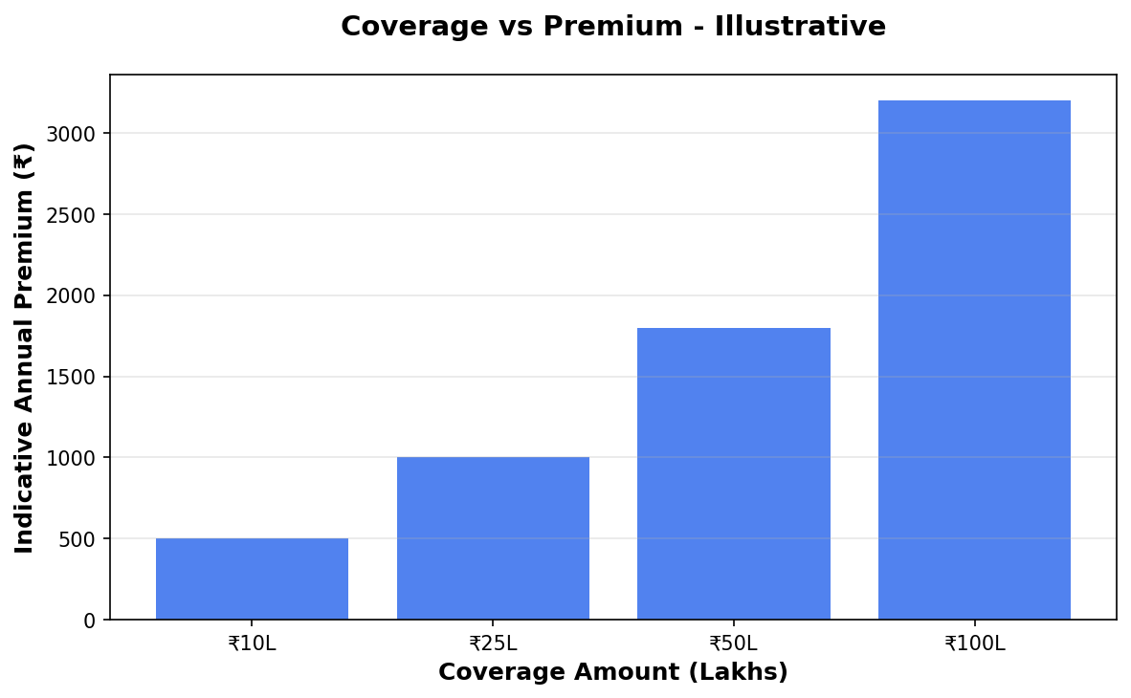
Coverage vs Premium Analysis
Higher coverage ensures your family is safe, with affordable premiums.

Slide 4
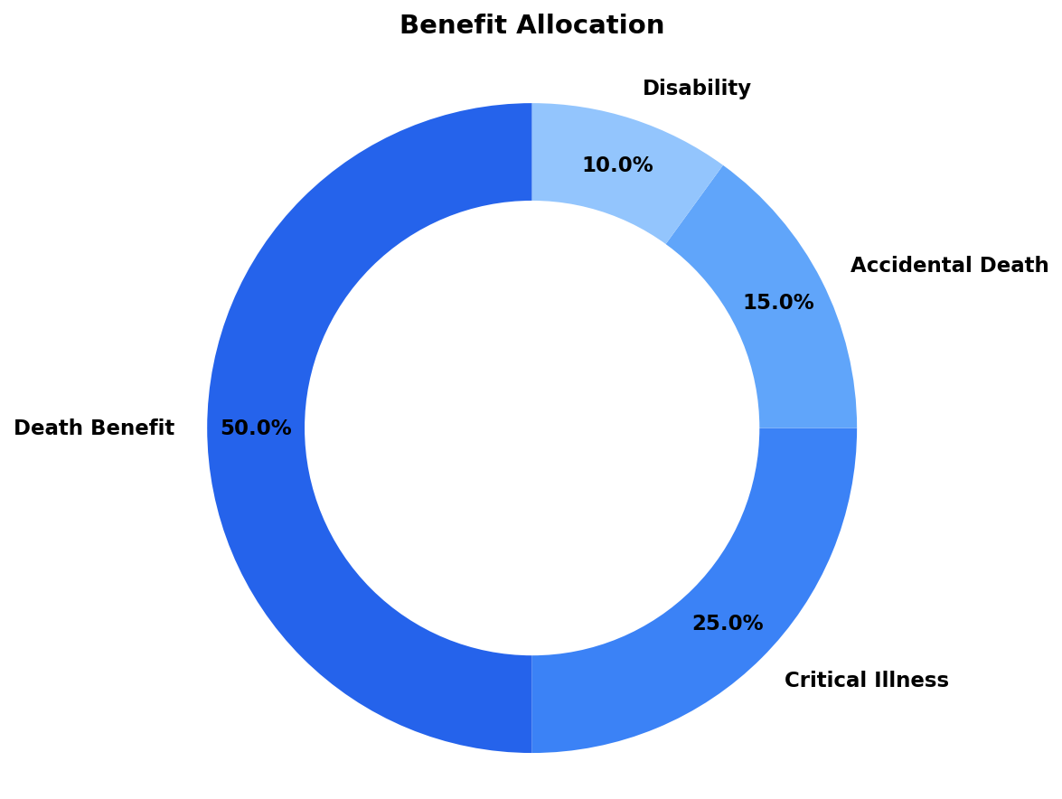
Your Investment Allocation
Your money is diversified to ensure both safety and growth.

Slide 5
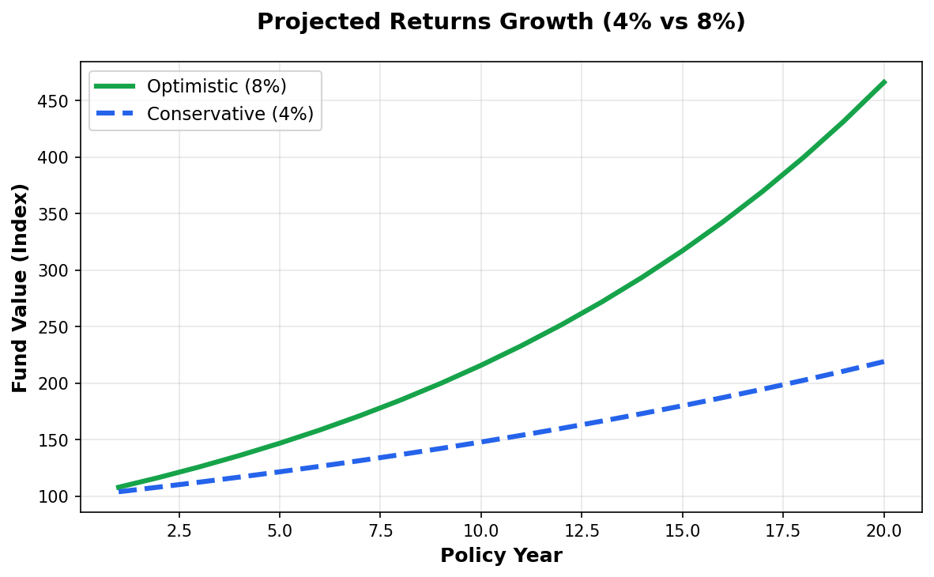
Projected Returns Simulation
See how your fund grows significantly over 20 years with compound interest.

Slide 6
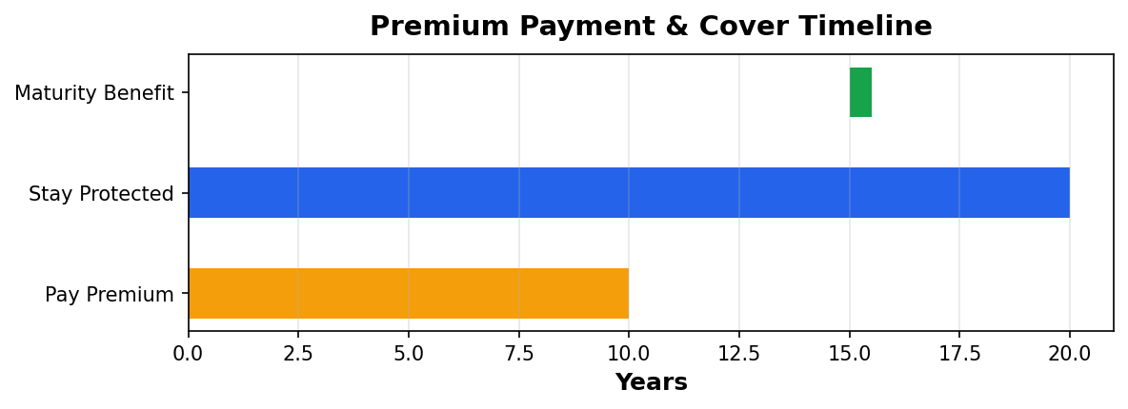
Long-Term Protection Timeline
You pay for a limited period, but get protection for the full term.

Slide 7
Important Disclaimer
All illustrations, premium amounts, and coverage details presented in this document are indicative and based on approved policy information available at the time of preparation.
Actual premium rates, coverage amounts, and policy terms may vary based on individual circumstances, age, health conditions, and underwriting guidelines.
This presentation does not constitute a guarantee of coverage or returns. Please refer to the official policy document for complete terms and conditions.
For accurate quotations and personalized policy recommendations, please consult with our licensed insurance advisors.

