Slide 1
TERM INSURANCE POLICY - GOLD PLAN
Prepared for: Nikhil Gaikwad
December 29, 2025

Slide 2
Client Profile: Nikhil Gaikwad
Client Name: Nikhil Gaikwad
Age: 36 years
Seeking: Comprehensive life cover for family protection and financial security.
Goal: Ensure continued financial stability for loved ones in his absence.

Slide 3
Why Comprehensive Life Insurance Matters for You
**Ensuring Family's Financial Security:** Provides a vital financial safety net for your family.
**Peace of Mind:** Offers reassurance that your loved ones are protected financially, no matter what the future holds.
**Income Replacement:** Helps your family maintain their lifestyle and cover ongoing expenses.
**Debt Protection:** Can assist in managing outstanding financial obligations, preventing burden on your family.

Slide 4
Key Benefits of the Gold Plan Term Insurance
**Comprehensive Life Cover:** The Gold Plan provides extensive protection for your family's future.
**Flexible Sum Assured:** Choose coverage up to $1 Million to suit your family's specific needs.
**Adaptable Policy Term:** Select a policy term ranging from 10 to 40 years.
**Convenient Premium Payment Options:** Pay premiums Monthly, Quarterly, or Annually.
**Streamlined Claim Process:** Claims are settled within 7 working days, provided all required documents (Death Certificate, Policy Document, ID Proof) are submitted, following intimation within 24 hours.
**Important Note:** This policy does NOT offer guaranteed returns. It is a pure risk cover.

Slide 5
Indicative Coverage and Premium Overview (Gold Plan)

Slide 6
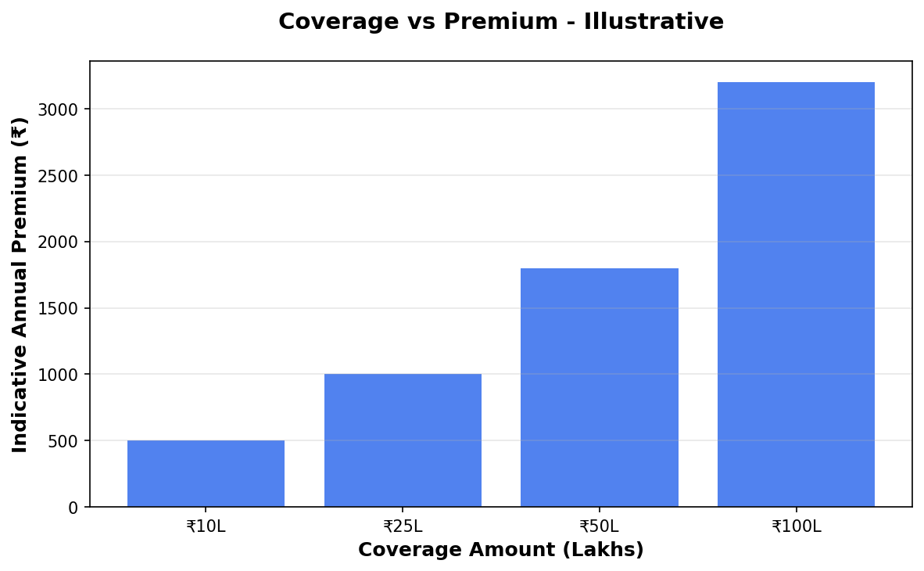
Coverage vs Premium

Slide 7
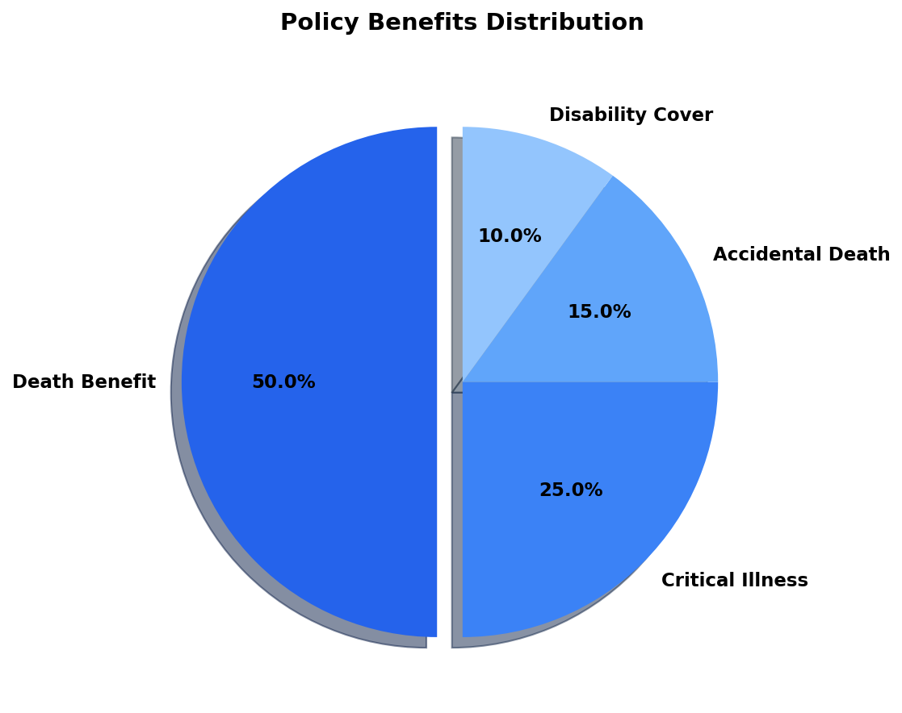
Benefits Overview

Slide 8
Important Disclaimer
All illustrations, premium amounts, and coverage details presented in this document are indicative and based on approved policy information available at the time of preparation.
Actual premium rates, coverage amounts, and policy terms may vary based on individual circumstances, age, health conditions, and underwriting guidelines.
This presentation does not constitute a guarantee of coverage or returns. Please refer to the official policy document for complete terms and conditions.
For accurate quotations and personalized policy recommendations, please consult with our licensed insurance advisors.

