Slide 1
TERM INSURANCE POLICY - GOLD PLAN
Prepared for: Nikhil Gaikwad
December 29, 2025

Slide 2
Your Financial Future: A Personalized Overview
Client: Nikhil Gaikwad
Age: 30 years old
Key Needs Identified:
- Protecting your family's financial well-being
- Ensuring financial security in unforeseen circumstances
- Gaining peace of mind for the future

Slide 3
Why Term Insurance is Essential for You
**Comprehensive Life Cover:** The Gold Plan provides extensive protection for your loved ones.
**Financial Security:** Ensures your family maintains their lifestyle and meets financial obligations in your absence.
**Peace of Mind:** Knowing your family is protected allows you to focus on today, without worrying about tomorrow's uncertainties.
**Affordable Protection:** Designed to offer significant coverage at premiums that fit your budget.

Slide 4
Key Benefits of the Gold Plan Term Insurance
**Comprehensive Life Cover:** Provides financial protection for your family.
**Flexible Sum Assured:** Up to $1 Million to meet your family's specific needs.
**Adaptable Policy Term:** Choose a term from 10 to 40 years.
**Convenient Premium Payments:** Options for Monthly, Quarterly, or Annually.
**Simplified Claim Process:** Intimate claims within 24 hours via our portal.
**Efficient Claim Settlement:** Claims are settled within 7 working days upon submission of all required documents (Death Certificate, Policy Document, ID Proof).
**Important Note:** This policy is a pure risk cover and does NOT offer guaranteed returns. Premiums are subject to market tax rates.

Slide 5
Indicative Coverage Options & Premium Frequency

Slide 6
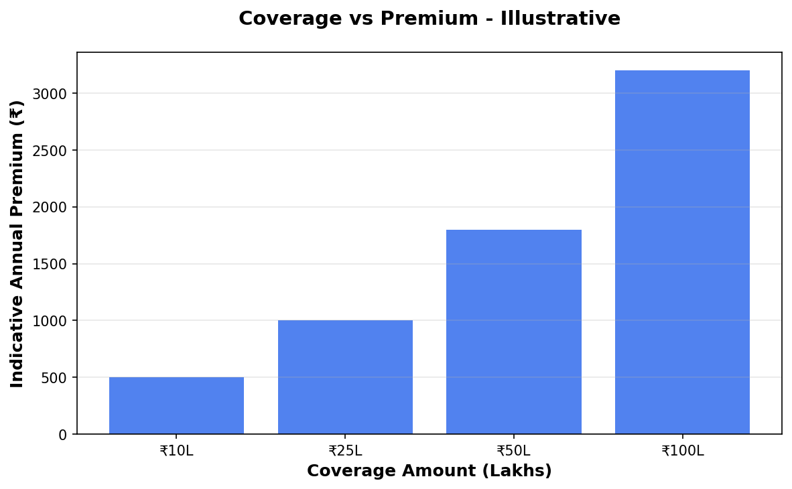
Coverage vs Premium

Slide 7
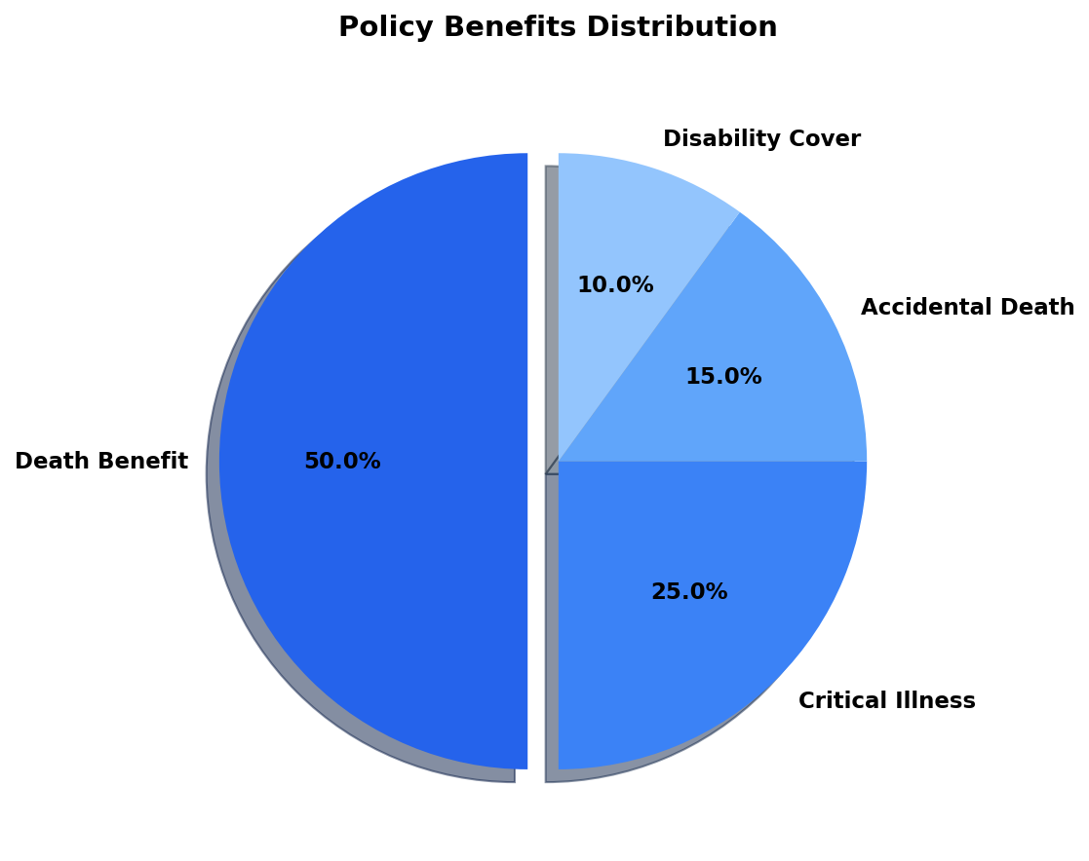
Benefits Overview

Slide 8
Important Disclaimer
All illustrations, premium amounts, and coverage details presented in this document are indicative and based on approved policy information available at the time of preparation.
Actual premium rates, coverage amounts, and policy terms may vary based on individual circumstances, age, health conditions, and underwriting guidelines.
This presentation does not constitute a guarantee of coverage or returns. Please refer to the official policy document for complete terms and conditions.
For accurate quotations and personalized policy recommendations, please consult with our licensed insurance advisors.

