Slide 1
TERM INSURANCE POLICY - GOLD PLAN
Prepared for: Nikhil Gaikwad
December 29, 2025

Slide 2
Client Profile Summary: Nikhil Gaikwad
Client Name: Nikhil Gaikwad
Age: 36 years
Primary Goal: Secure the financial future and studies of his children.
Need: Comprehensive life cover to provide financial security for his family in his absence.

Slide 3
Why Term Insurance is Essential for Nikhil
Protecting Your Family's Future: Ensures financial security for your loved ones, especially your children, should the unexpected happen.
Securing Children's Education: Provides a safety net to fund your children's studies and aspirations, regardless of life's uncertainties.
Peace of Mind: Offers the assurance that your family's financial well-being is safeguarded.
Affordable Protection: The Gold Plan provides comprehensive life cover with affordable premiums.

Slide 4
Gold Plan Term Insurance: Key Benefits and Features
Comprehensive Life Cover: Designed to provide substantial financial protection for your family.
Flexible Sum Assured: Coverage options up to $1 Million to meet your family's needs.
Flexible Policy Term: Choose a policy term from 10 to 40 years to align with your long-term plans.
Convenient Premium Payments: Options for Monthly, Quarterly, or Annually.
Simple Claim Process: Intimate claims within 24 hours via our portal, settled within 7 working days upon submission of required documents (Death Certificate, Policy Document, ID Proof).
Important Note: This policy does NOT offer guaranteed returns; it is a pure risk cover. Premiums are subject to market tax rates.

Slide 5
Coverage and Indicative Premium Overview for Nikhil Gaikwad
['Please note: The figures presented below are indicative and subject to underwriting and final policy terms. Actual premiums may vary.']

Slide 6
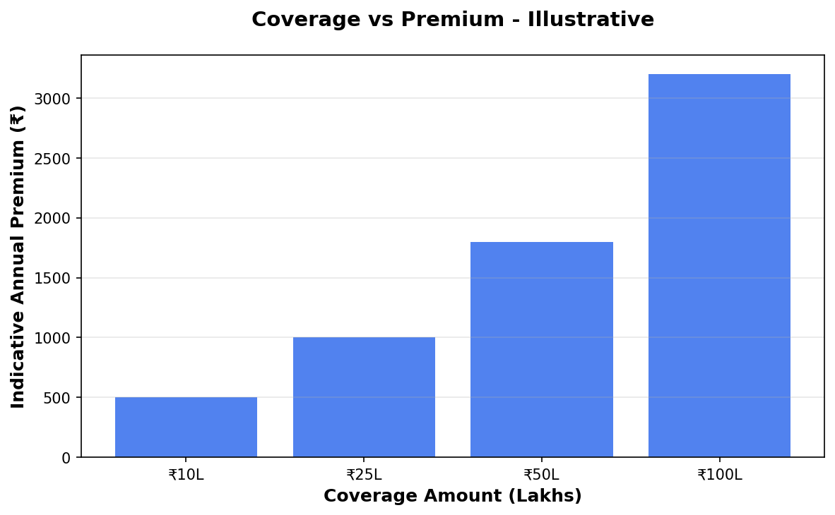
Coverage vs Premium

Slide 7
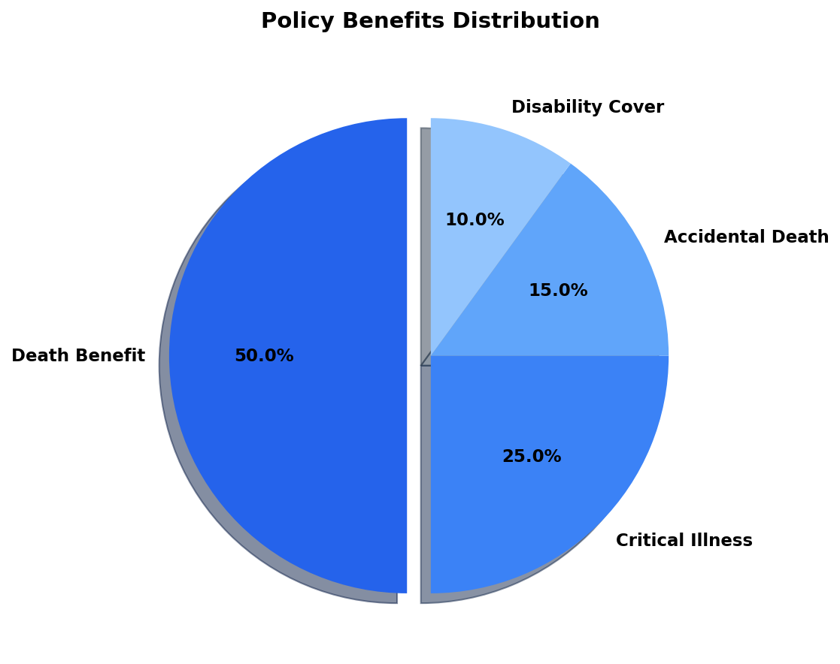
Benefits Overview

Slide 8
Important Disclaimer
All illustrations, premium amounts, and coverage details presented in this document are indicative and based on approved policy information available at the time of preparation.
Actual premium rates, coverage amounts, and policy terms may vary based on individual circumstances, age, health conditions, and underwriting guidelines.
This presentation does not constitute a guarantee of coverage or returns. Please refer to the official policy document for complete terms and conditions.
For accurate quotations and personalized policy recommendations, please consult with our licensed insurance advisors.

