Slide 1
Gold Plan Term Insurance
Prepared for: Nikhil Gaikwad
December 29, 2025

Slide 2
Your Financial Security: A Personalized Overview
Client: Nikhil Gaikwad
Age: 49 years
Primary Goal: Ensuring continued financial stability for your loved ones.
Key Need: Protecting your family's future in your absence.

Slide 3
Securing Your Family's Future with Gold Plan Term Insurance
Financial Protection: Provide a safety net for your family's financial needs.
Peace of Mind: Ensure your loved ones are cared for, even in unforeseen circumstances.
Fulfilling Responsibilities: Help cover living expenses, education costs, or outstanding debts for your family.
Ensuring Continuity: Maintain your family's lifestyle and financial goals, providing security in your absence.

Slide 4
Gold Plan Term Insurance: Key Features & Benefits
Comprehensive Life Cover: Designed to ensure financial security for your family.
Affordable Premiums: Provides significant cover with competitive premium rates.
Flexible Sum Assured: Choose coverage up to $1 Million.
Adjustable Policy Term: Select a term from 10 to 40 years to suit your planning.
Convenient Premium Payments: Options for Monthly, Quarterly, or Annually.
Efficient Claim Process: Claims settled within 7 working days after submission of required documents (Death Certificate, Policy Document, ID Proof).
Pure Risk Cover: This policy is a pure risk cover and does NOT offer guaranteed returns.

Slide 5
Indicative Coverage & Premium Structure

Slide 6
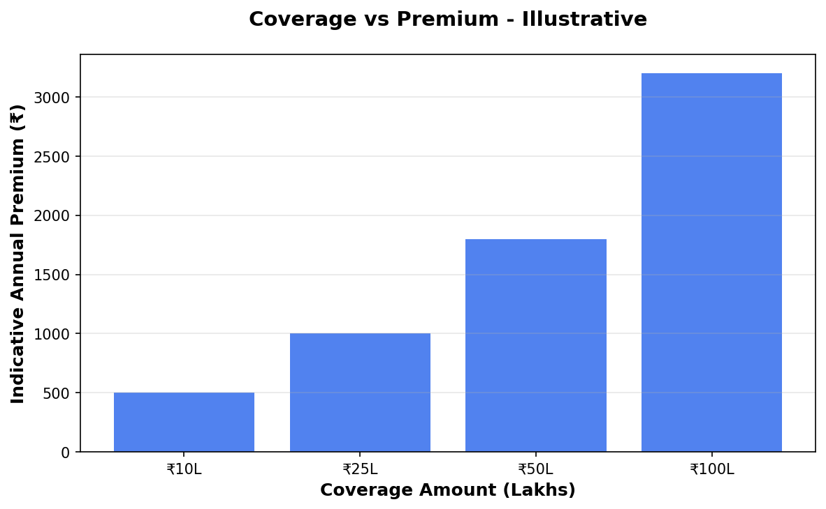
Coverage vs Premium

Slide 7
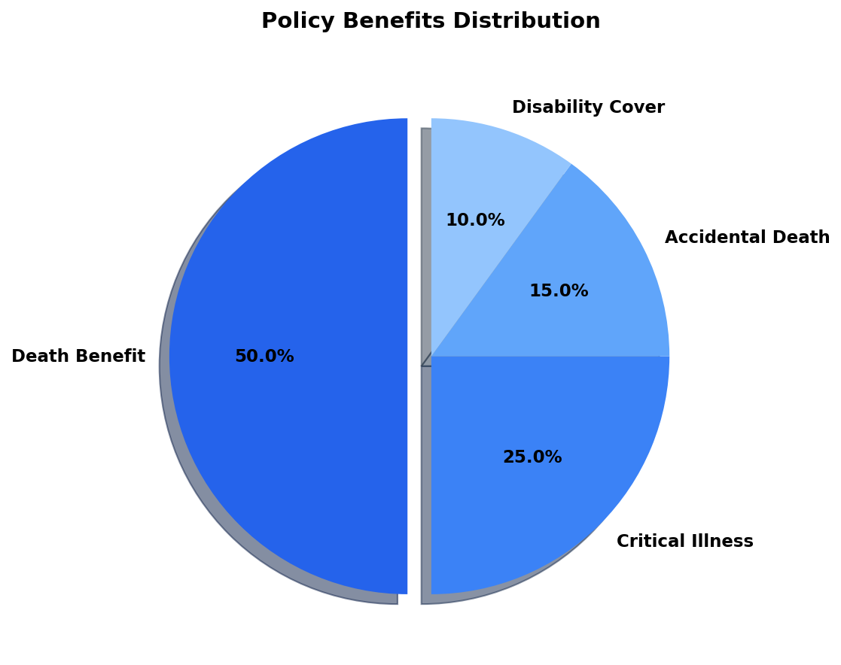
Benefits Overview

Slide 8
Important Disclaimer
All illustrations, premium amounts, and coverage details presented in this document are indicative and based on approved policy information available at the time of preparation.
Actual premium rates, coverage amounts, and policy terms may vary based on individual circumstances, age, health conditions, and underwriting guidelines.
This presentation does not constitute a guarantee of coverage or returns. Please refer to the official policy document for complete terms and conditions.
For accurate quotations and personalized policy recommendations, please consult with our licensed insurance advisors.

