Slide 1
Insurance Policy
Prepared for: Valued Client
December 30, 2025

Slide 2
Policy Information
Please contact us for detailed policy information.

Slide 3
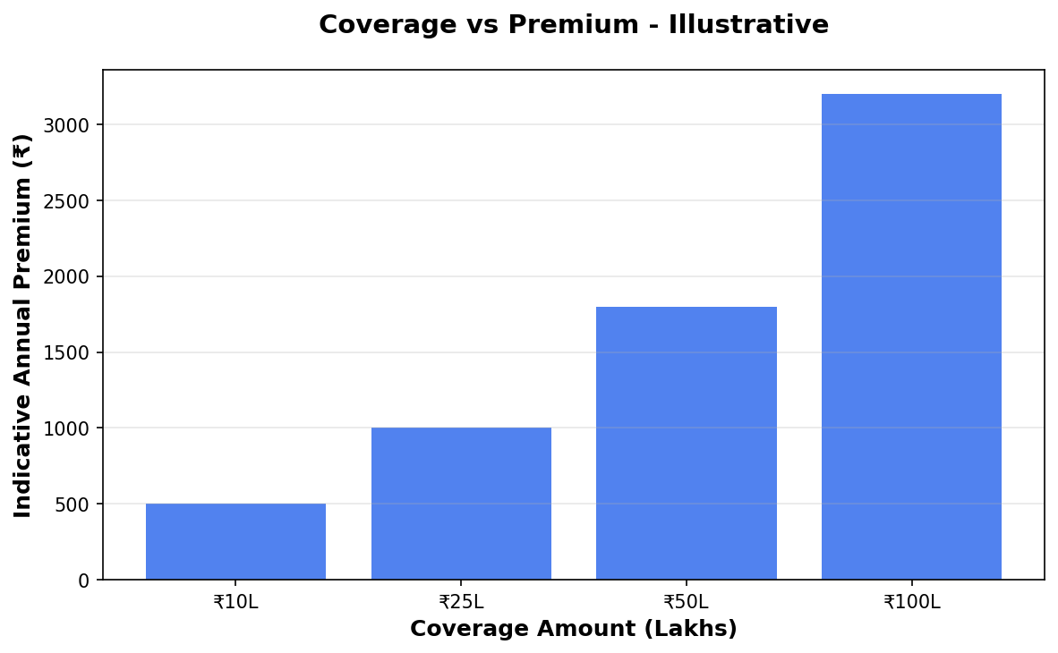
Coverage vs Premium

Slide 4
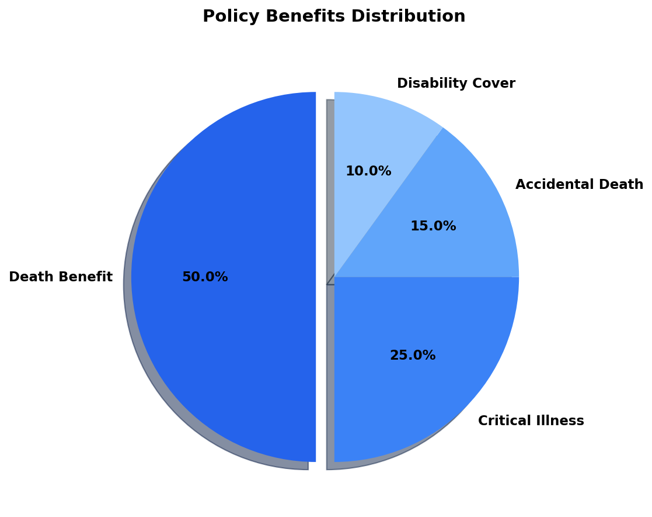
Benefits Overview

Slide 5
Important Disclaimer
All illustrations, premium amounts, and coverage details presented in this document are indicative and based on approved policy information available at the time of preparation.
Actual premium rates, coverage amounts, and policy terms may vary based on individual circumstances, age, health conditions, and underwriting guidelines.
This presentation does not constitute a guarantee of coverage or returns. Please refer to the official policy document for complete terms and conditions.
For accurate quotations and personalized policy recommendations, please consult with our licensed insurance advisors.

