Slide 1
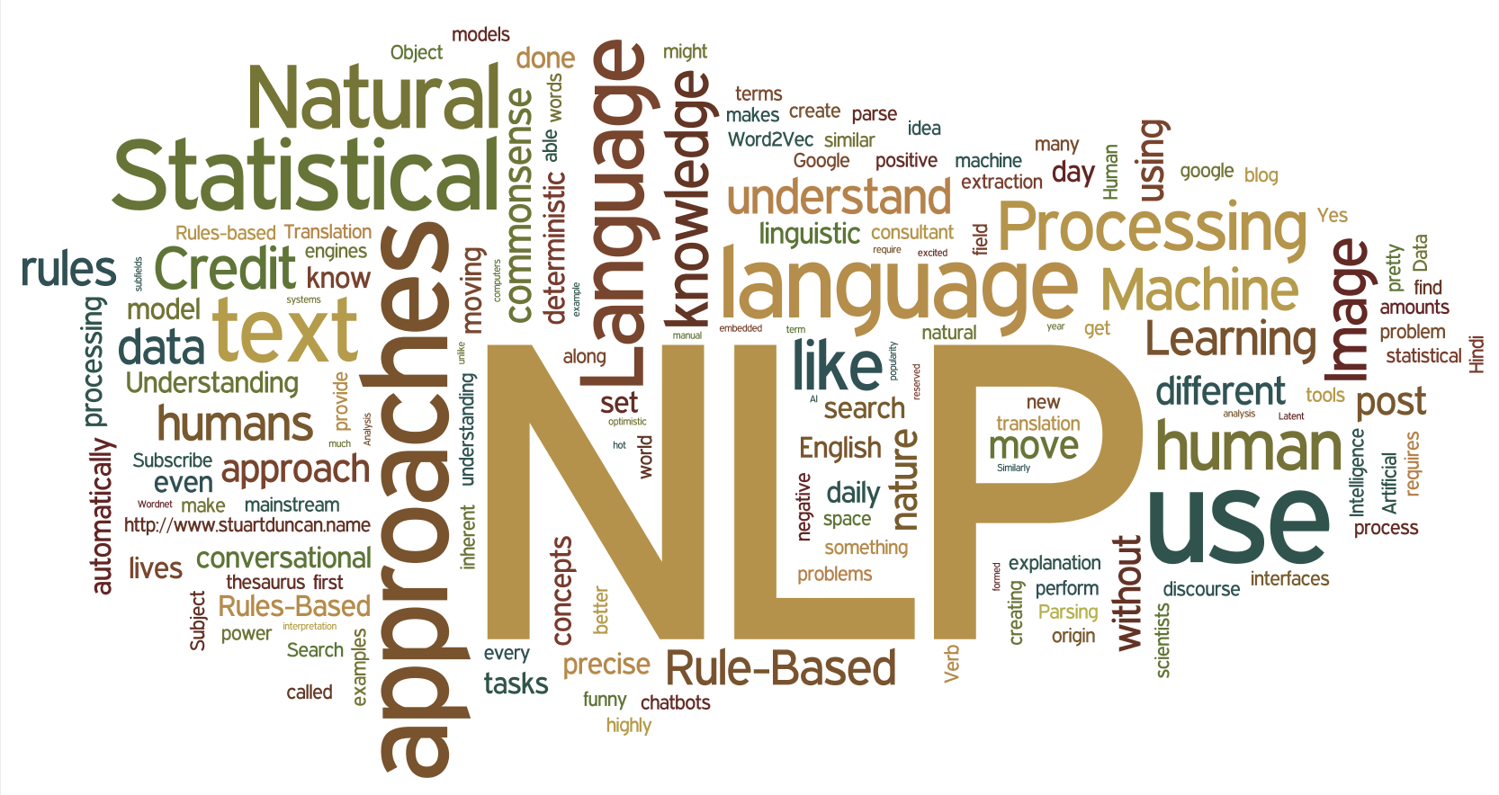
Natural Language Processing Using Python
By
Nikhil Gharge

Slide 2
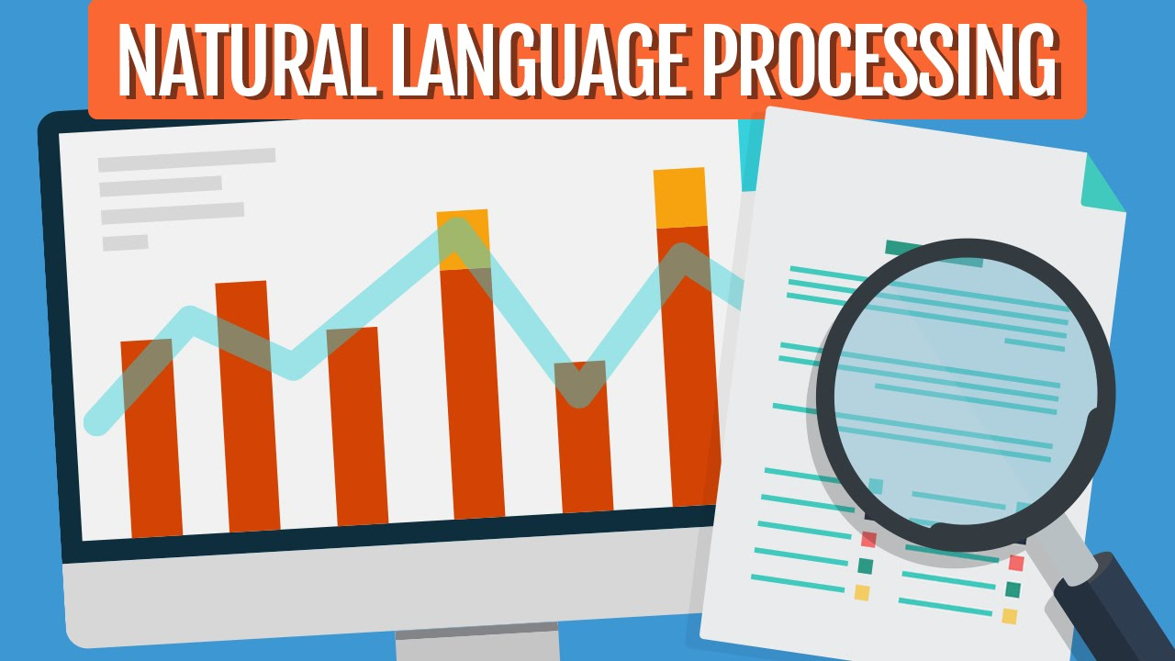
Introduction
As long as computers have been around, programmers have been trying to write programs that understand languages like English.
The reason is pretty obvious — humans have been writing things down for thousands of years and it would be really helpful if a computer could read and understand all that data.
Computers can’t yet truly understand English in the way that humans do — but they can already do a lot! In certain limited areas, due to increase in usage of NLP technology.
You might be able to save a lot of time by applying NLP techniques in real time applications.

Slide 3
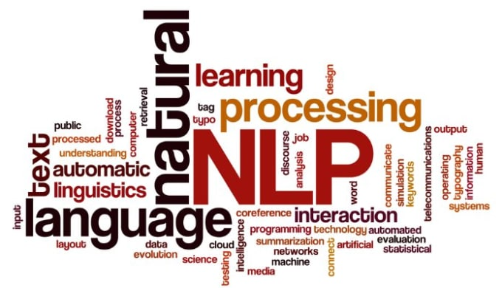
What Is NLP ?
The full form of NLP is Natural Language Processing.
Natural Language Processing, is the sub-field of AI that is focused on enabling computers to understand and process human languages.
NLP is a field in machine learning with the ability of a computer to understand, analyse, manipulate, and potentially generate human language.
The general example of NLP is speech recognition using google voice search.

Slide 4
History of NLP
1948 - 1st NLP application
– dictionary look-up system
– developed at Birkbeck College, London
1949 - American interest
– WWII code breaker Warren Weaver
– He viewed German as English in code.
1966 - Machine Translation worked only word by word
– Over-promised under-delivered.
– NLP brought the first hostility of research funding
– NLP gave AI a bad name before AI had a name.

Slide 5
Process of NLP
Data Cleaning
Preprocessing of Data
a. Lowercase
b. Tokenization
c. Stop words removal
d. Stemming
e. Lemmatization
Vectorizing data
a. N-Grams

Slide 6
Data Cleaning
While reading data, we get data in the structured or unstructured format. A structured format has a well-defined pattern whereas unstructured data has no proper structure.
In between the 2 structures, we have a semi-structured format which is a comparably better structured than unstructured format.
So, we have to clean data and make into structure format.

Slide 7
Pre-processing Data
Cleaning up the text data is necessary to highlight attributes that we’re going to want our machine learning system to pick up on.
Cleaning (or pre-processing) the data typically consists of a number of steps:
a) Remove punctuation
b) Tokenization
c) Remove stop words
d) Stemming
e) Lemmatizing

Slide 8
a) Remove punctuation
Punctuation can provide grammatical context to a sentence which supports our understanding.
But for our vectorizer which counts the number of words and not the context, it does not add value, so we remove all special characters.
e.g.: How are you?->How are you
b) Tokenization
Tokenizing separates text into units such as sentences or words.
It gives structure to previously unstructured text.
e.g.: Plata o Plomo-> ‘Plata’,’o’,’Plomo’.

Slide 9
c) Remove stopwords
Stopwords are common words that will likely appear in any text.
They don’t tell us much about our data so we remove them.
e.g.: silver or lead is fine for me-> silver, lead, fine.
d) Stemming
Stemming helps reduce a word to its stem form.
It often makes sense to treat related words in the same way.
It removes suffices, like “ing”, “ly”, “s”, etc. by a simple rule-based approach.
It reduces the corpus of words but often the actual words get neglected.
e.g.: Entitling,Entitled->Entitl

Slide 10
e) Lemmatizing
Lemmatizing derives the canonical form (‘lemma’) of a word. i.e. the root form.
It is better than stemming as it uses a dictionary-based approach i.e. a morphological analysis to the root word.
e.g.: Entitling, Entitled->Entitle
Vectorizing Data
Vectorizing is the process of encoding text as integers i.e. numeric form to create feature vectors so that machine learning algorithms can understand our data.
There are two process:
a) Bag-Of-Words
b) N-Grams

Slide 11
a) Bag-Of-Words
Bag of Words (BOW) or Count Vectorizer describes the presence of words within the text data.
It gives a result of 1 if present in the sentence and 0 if not present.
Therefore, creates a bag of words with a document-matrix count in each text document.
b) N-Grams
N-grams are simply all combinations of adjacent words or letters of length n that we can find in our source text.
N-grams with n=1 are called unigrams. Similarly, bigrams (n=2), trigrams (n=3) and so on can also be used.
Unigrams usually don’t contain much information as compared to bigrams and trigrams.
The basic principle behind n-grams is that they capture the letter or word is likely to follow the given word.
The longer the n-gram (higher n), the more context you have to work with.

Slide 12

NLP Implementations
These are some of the successful implementations of Natural Language Processing (NLP):
Search engines like Google, Yahoo, etc. Google search engine understands that you are a tech guy so it shows you results related to you.
Social websites feed like the Facebook news feed. The news feed algorithm understands your interests using natural language processing and shows you related Ads and posts more likely than other posts.
Speech engines like Apple Siri.
Spam filters like Google spam filters. It’s not just about the usual spam filtering, now spam filters understand what’s inside the email content and see if it’s a spam or not.

Slide 13
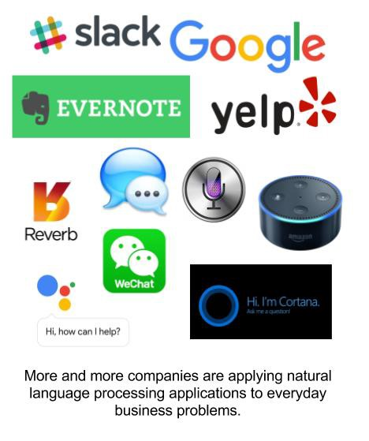
NLP in Real Life
Information Retrieval (Google finds relevant and similar results).
Information Extraction (Gmail structures events from emails).
Machine Translation (Google Translate translates language from one language to another).
Text Simplification (Rewordify simplifies the meaning of sentences). Shashi Tharoor tweets could be used(pun intended).
Sentiment Analysis (Hater News gives us the sentiment of the user).
Text Summarization (Smmry or Reddit’s autotldr gives a summary of sentences).

Slide 14

Spam Filter (Gmail filters spam emails separately).
Auto-Predict (Google Search predicts user search results).
Auto-Correct (Google Keyboard and Grammarly correct words otherwise spelled wrong).
Speech Recognition (Google WebSpeech or Vocalware).
Question Answering (IBM Watson’s answers to a query).
Natural Language Generation (Generation of text from image or video data.)

Slide 15

Natural Language Toolkit
NLTK is a leading platform for building Python program to work with human language data.
Provides a suite of text processing libraries for classification, tokenization, stemming, tagging, parsing, and semantic reasoning.
NLTK also is very easy to learn, actually, it’s the easiest natural language processing (NLP) library.
Installing NLTK :
Type !pip install nltk in the Jupyter Notebook
Otherwise, type conda install -c conda-forge nltk .This should work in most cases.

Slide 16

Implementation of Bag of Words

Slide 17
Bag of Words
A very well-known model in NLP is the Bag of Words model. It is a model used to preprocess the texts to classify before fitting the classification algorithms on the observations containing the texts.
In this part, you will understand and learn how to:
Clean texts to prepare them for the Machine Learning models.
Create a Bag of Words model.
Apply Machine Learning models onto this Bag of Worlds model.

Slide 18
Process of Bag of Words
Importing dataset
Importing Libraries
Cleaning the Texts
Creating Bag of Words Model
Finding the dependent and independent Variables
Splitting the data into Training and Test set.
Fitting the algorithm to the Training data
Predicting the test set results
Making the Confusion Matrix

