Slide 1
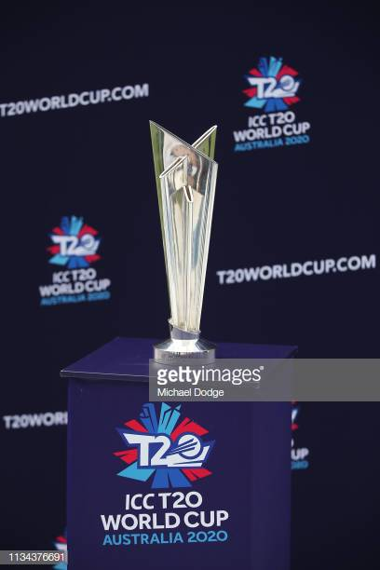
Predicting Winner of ICC T-20 Cricket World Cup 2020 using Machine Learning Techniques
By
Nikhil Sayaji Gharge (10517429)

Slide 2
Table of Contents
Introduction
Literature Review
Methodology
Implementation
Results and Discussion
Conculsion and Future Work
References

Slide 3
Introduction
Cricket has been one of the most popular sports among people with more than 2 billion followers.
T20 format of cricket which is the shortest format is gaining popularity among cricket followers.

Slide 4
Research Question
How to predict the winner of ICC T20 World Cup 2020 in Australia using various machine learning algorithms?

Slide 5
Objectives
Exploring previous research on cricket as sport.
Developing a design tool.
Implementation of tool.
Evaluating the tool.
Determining future directions.

Slide 6
2. Literature Review
Base paper: Outcome Prediction of ODI Cricket Matches using Decision Trees and MLP Networks by Kumar J., Kumar R. and Kumar P. (2018).
Main Goal: To predict the outcome of One-day Internationals (ODI) using Machine Learning Techniques.
Explain in brief about the project:
1. Dataset acquired from www.cricinfo.com.
2. Features included are grounds, team past performances, Home-game advantage and innings.
3. In this supervised classification problem, two classifiers such as Multilayer perceptron and Decision Tree were used for testing and evaluation purpose.
4. Best Model : MLP – 57.4%

Slide 7
My work
The approach considered for predicting the winner of T20 World Cup 2020 is based on three different stages of the tournament.
For each stage, predictive analysis is carried out to identify the winner of each matches.
(Kumar, Kumar and Kumar, 2018) conducted a study where-in they have predicted outcome of a ODI match but they have not predicted the winner for any major ICC tournaments.
Also, a prediction tool has been developed which will predict the winner of T20 World Cup 2020 with the help of certain factors as inputs and ML classifiers.

Slide 8
Methodology
This research project follows the CRISP-DM process (What is the CRISP-DM methodology?, no date). The methodology of our project is explained in a detailed manner by adhering to the steps in the CRISP-DM process which are as follows:
Business Understanding – To predict the winner of ICC T20 World Cup 2020 in Australian region.
Data Understanding – Year-wise data from 2005 - 2019 was acquired to understand the significance of each features which eventually will help to solve business problem.
Data Preparation – Performing data pre-processing steps on year-wise data from 2005 – 2019 and generating a final T20_Categorical csv file comprising of 135 features and 16 target variables.

Slide 9
Methodology
Modelling - In this section, four machine learning techniques used in this study are presented briefly which are described as follows:
Support Vector Machines (SVM)
Artificial Neural Network (ANN)
Logistic Regression (LR)
Decision Tree (DT)

Slide 10

Support Vector Machines (SVM)
Support Vector Machines can be used for both Classification and Regression problems.
Support Vector Machine model will be trained on T20 dataset to check whether the data is linearly separable.
SVM will create maximum margin hyperplane with the help of support vectors which will be a decision boundary between various classes/ participating teams.
The values of each attributes/features in the T20 dataset would be the values of the specific coordinates/ vectors in the n-dimensional space.
The most important parameters that will be considered in the SVM which can boost the performance of model are Kernel, C-value and random_state.
Thus with the help of hyper-parameter tuning, SVM will classify the results of each match and will predict the winner of T20 World Cup in Australia.

Slide 11
Artificial Neural Network
ANN is inspired by the human brain and works in a similar fashion like the brain in information processing.
For implementing ANN, the most important Machine Learning parameters were output dimensions, activation function, input dimensions, hidden layers, batch size, no of epochs, loss function and optimizer.
The input layer will comprise of all features in the dataset whereas the output layer will consist of the target variable.
The neurons with the help of the activation function will help to pass the information between the hidden layers.
And lastly, the number of epochs and batch size will determine the accuracy depending upon the value assigned to it.
Thus with the help of hyper-parameter tuning, ANN will classify the results of each match and will predict the winner of T20 World Cup in Australia.

Slide 12
Logistic Regression
LR is a supervised category of ML algorithm which is used for classification problems.
Logistic Regression Model can work on datasets that can have one more independent variable to predict the outcome.
Logistic Regression is used to predict the binary outcome given a set of independent variables.
For calculating probability estimate output in the form of 0/1, logistic regression is found to be the most efficient algorithm as concluded by (Chandrayan, 2019).
The most important parameters that will be considered in the Logistic Model which can boost the performance of the model are multi-class and random_state.
Thus with the help of hyper-parameter tuning, Logistic Regression will classify the results of each match and will predict the winner of T20 World Cup in Australia.

Slide 13
Decision Tree
Decision Tree is a supervised learning algorithm used for both regression and classification problems.
In Decision Tree, simple decision rules have been learnt from different data features.
In our case, features included Teams, Ground, Margin, Innings, and Venue. Those decisions based on the features were then used to predict the target variable which was Winner (respective teams) in T20 dataset.
In the decision tree, leaves represent 16 different teams which were participating in the T20 World Cup.
Internal nodes represent the features which were 135 and the value of the features was represented by the branches in the internal nodes.
Two most parameters which were taken into consideration to predict the results of T20 world cup were criterion and random_state.
Optimal values for these parameters will be obtained after performing GridSearch and K-fold Cross-validation on Decision Tree Model

Slide 14
Use-case of each model
Models | Linear | Non-linear | Dataset | Classification | Regression
SVM | YES | YES | Small or medium sized datasets | Yes | Yes
ANN | No | Yes | Large datasets | Yes | Yes
LR | Yes | Yes | Small or medium sized datasets | Yes | No
DT | No | Yes | complex Datasets | Yes | Yes

Slide 15
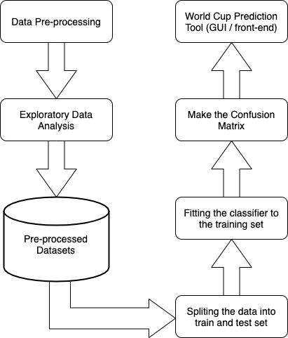
System Design and Implementation
Steps in implementation are as follows:
Data Pre-processing
Exploratory Data Analysis
Pre-Processed Datasets
Splitting the datasets into train and test set
Fitting the classifier to the training set
Make the confusion matrix
World Cup Prediction Tool (GUI/ front-end)

Slide 16
Datasets
T20 Categorical Dataset ( After encoding the target data using Labelencoder and Onehotencoding)
T20 Labelled Dataset (Without encoding the target data)
Total Records | Feature Variables | Target Variables
1198 | 135 | 16 (Multi-class classification problem)
Total Records | Feature Variables | Target Variable
1198 | 135 | 1

Slide 17
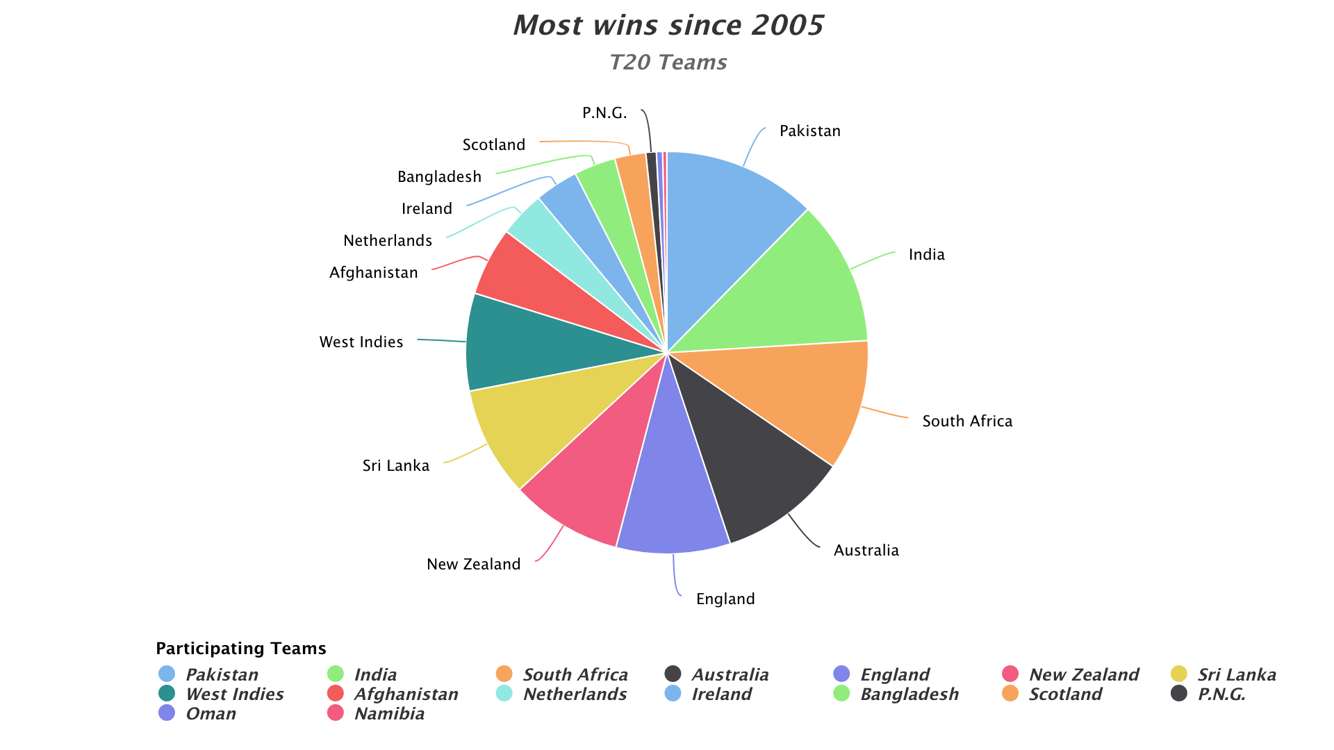

Slide 18
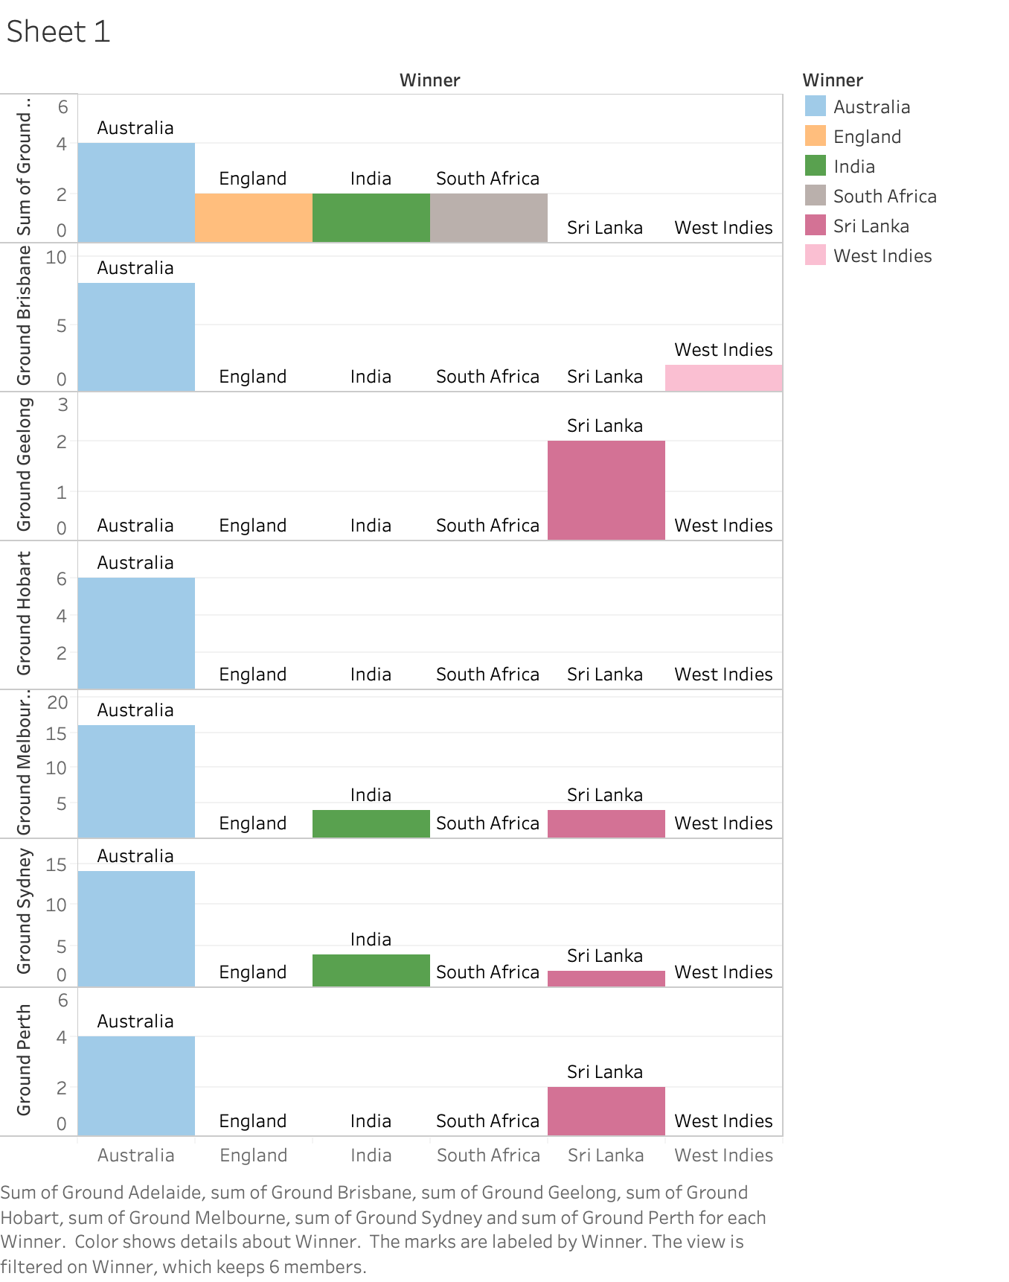
Ground Level Analysis

Slide 19
Grid-Search
Models Deployed | Hyperparameter
Support Vector Machines (SVM) | Kernel – Linear and Random state = 0
Artificial Neural Network (ANN) | Hidden layers – 10, Activation Function for Hidden layer – relu, Activation function for output layer – softmax, loss-function – categorical_crossentrophy and optimizer – adam.
Logistic Regression | Multi-class – ovr and Random state - 0
Decision Tree | Criterion – entropy and Random state - 0

Slide 20
Evaluation
For evaluating the performance of classifiers, various performance metrics such as Confusion Matrix, Accuracy, precision, recall and F1-score were taken into consideration.
Among the classifiers, SVM performed the best with an accuracy of 80.03%.

Slide 21
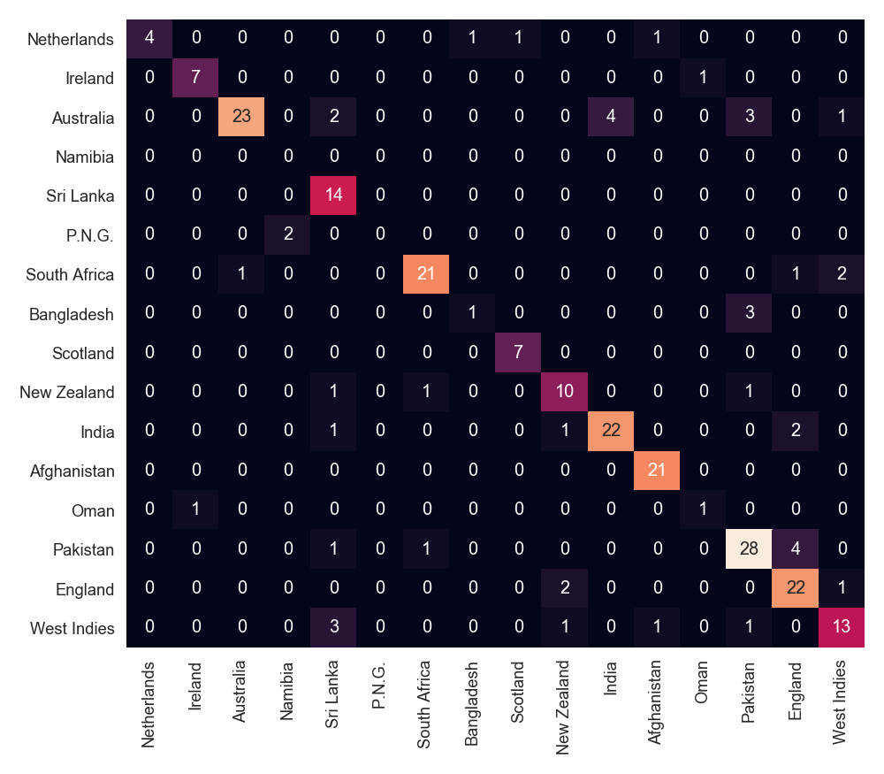
Confusion Matrix for SVM

Slide 22
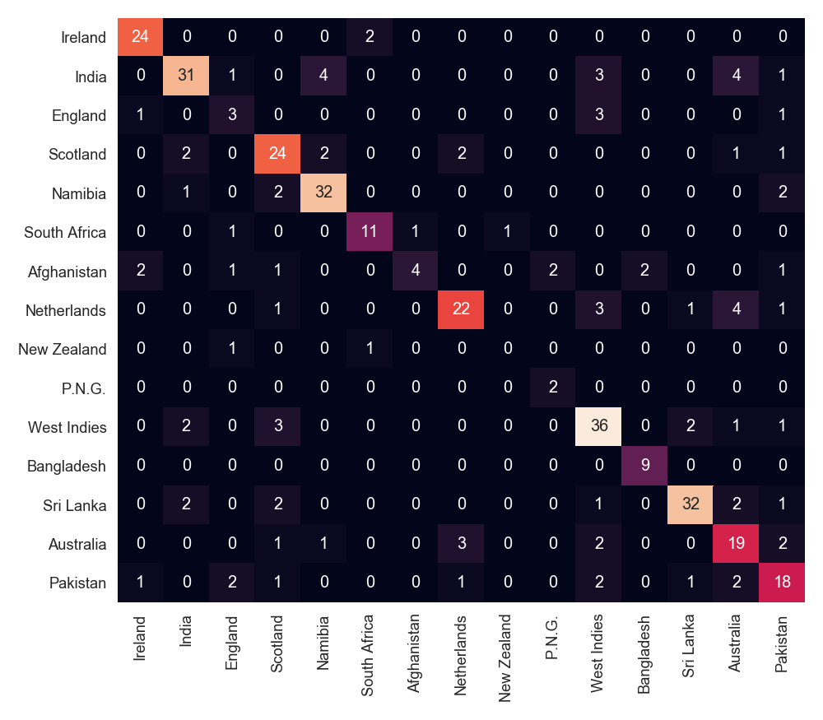
Confusion Matrix for ANN

Slide 23
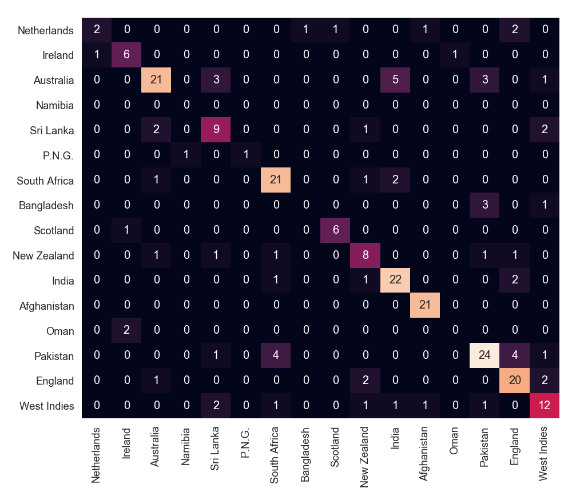
Confusion Matrix for LR

Slide 24
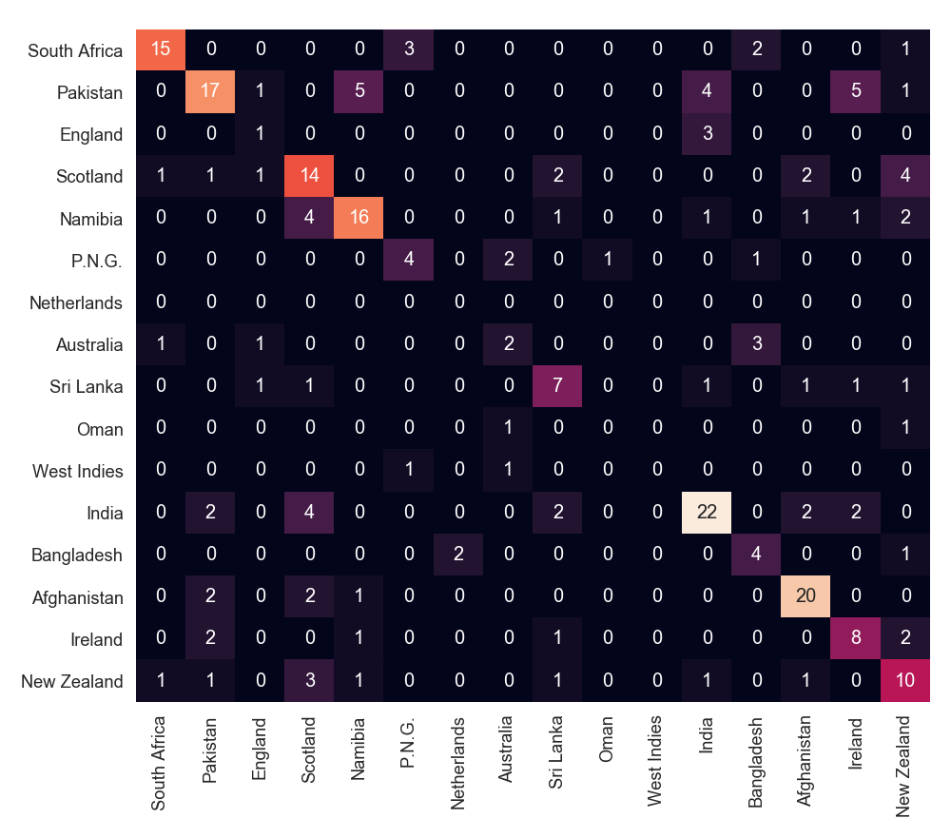
Confusion Matrix for DT

Slide 25
Comparison Table- Classification Models
Models | Accuracy
SVM | 80.03%
ANN | 75%
LR | 72%
DT | 55%
MLP (Kumar et al., 2018) | 57.14%
DT (Kumar et al., 2018) | 55.1%

Slide 26
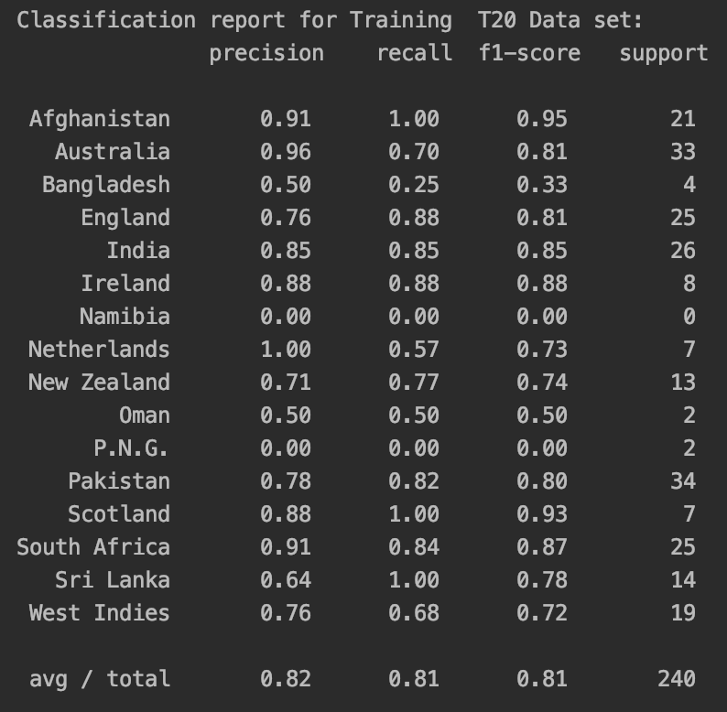
Precision, Recall and F1-score for SVM.

Slide 27
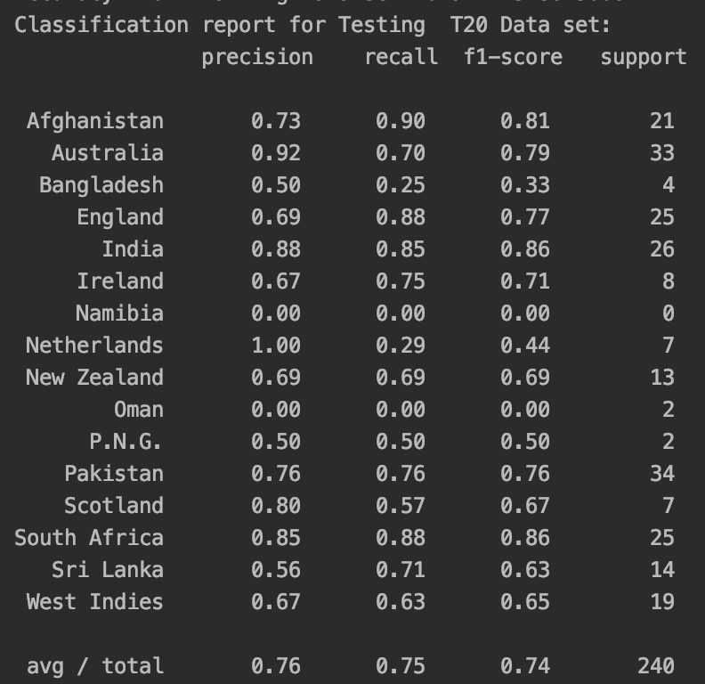
Precision, Recall and F1-score for ANN

Slide 28
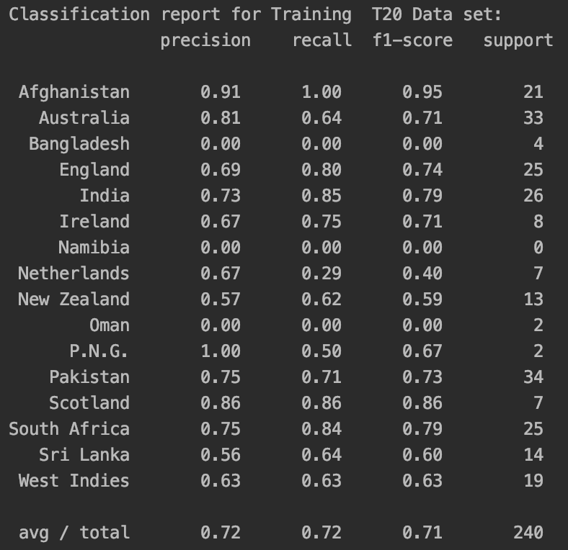
Precision, Recall and F1-score for LR

Slide 29
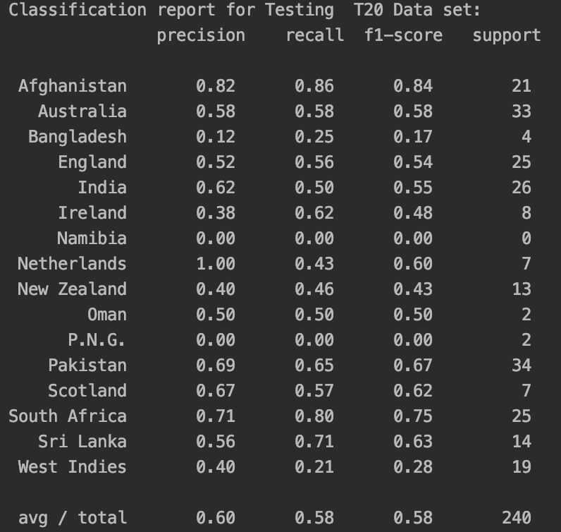
Precision, Recall and F1-score for DT

Slide 30
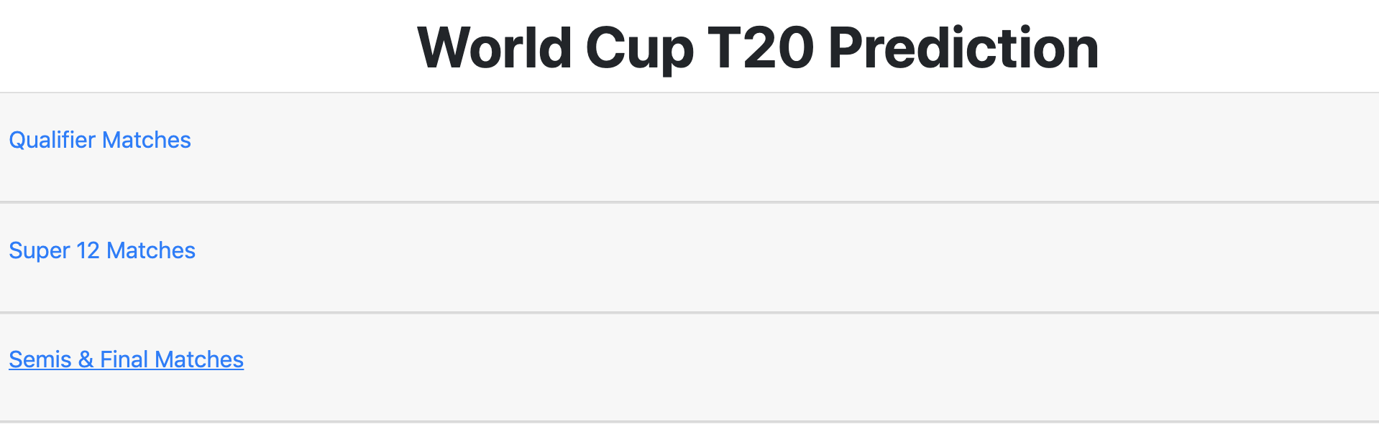
Deployment
This World Cup T20 prediction tool will predict the winner of ICC T20 World Cup 2020 in the Australia region.
This Tournament consist of three stages like Qualifiers, Super 12s , Semifinals and the final.

Slide 31
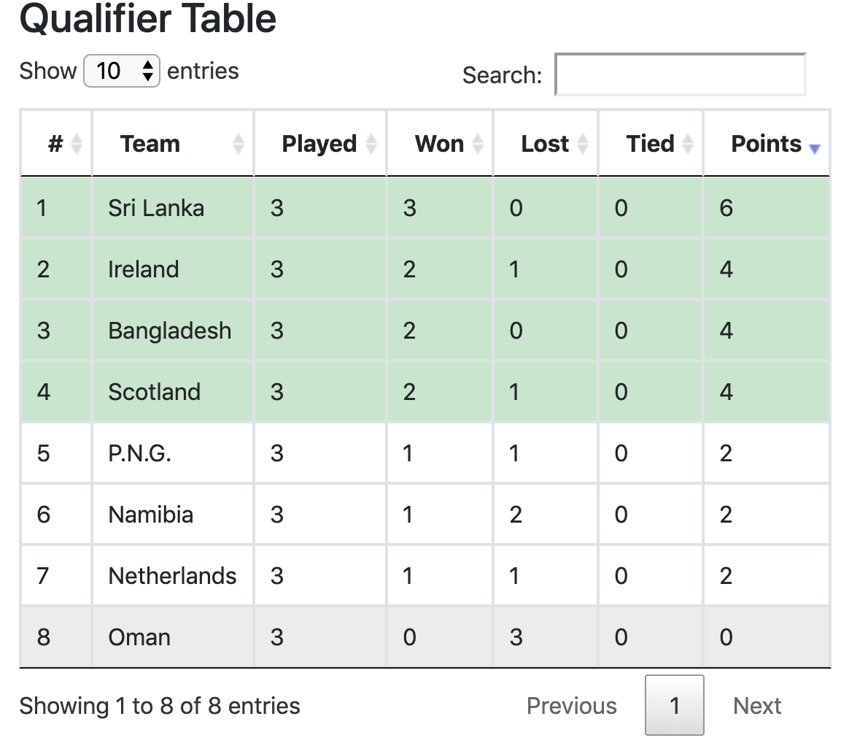
Qualifiers Table: As we can see from the fig top 4 team that are qualified for super 12s are Sri Lanka, Ireland, Bangladesh and Scotland.

Slide 32
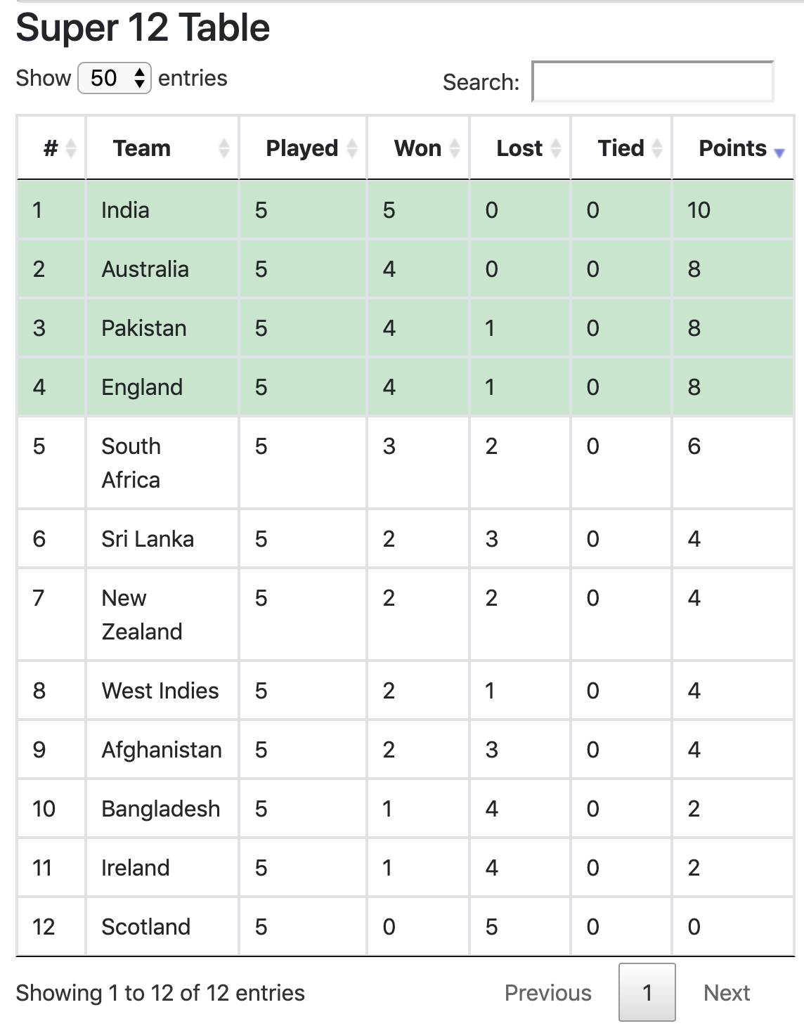
Super 12 Table: In all 12 teams will compete against each other to qualify for the semifinals. As w can see from the table, India, Australia, Pakistan and England have qualified for the semifinal stage.

Slide 33
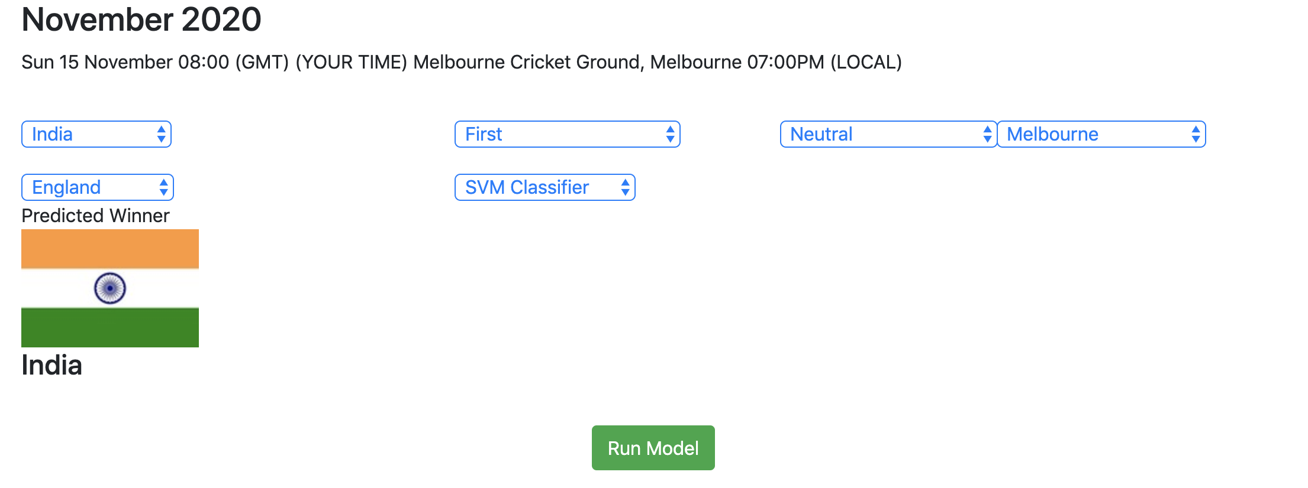
Prediction of Final Match

Slide 34
Conclusion and Future Work
Developed T20 World Cup Prediction tool to identify the winner of ICC T20 World Cup 2020 in Australia.
Data was extracted from ESPNCricInfo (Cricket Records - Find ICC Cricket Stats Online | ESPNcricinfo.com, 2019).
Among the four classifiers used, SVM performed the best with accuracy of 80.03%.
As for future work, during evaluation process more features could be added or removed. More number of entries can be added in the dataset.
This tool can be used to predict other versions of T20 leagues such as Big Bash League, Bangladesh Premier League, etc.

Slide 35
References
2020 ICC Men’s T20 World Cup - Wikipedia (2019) Wikipedia. Available at: https://en.wikipedia.org/wiki/2020_ICC_Men%27s_T20_World_Cup (Accessed: 27 December 2019).
Aburas, A., Mehtab, M. and Mehtab, Y. (2019) ‘ICC World Cup Prediction Based Data Analytics and Business Intelligent (BI) Techniques’, in Proceedings - 2018 International Conference on Cyber-Enabled Distributed Computing and Knowledge Discovery, CyberC 2018, pp. 273–279. doi: 10.1109/CyberC.2018.00056.
Bailey, M. and Clarke, S. R. (2006) ‘Predicting the match outcome in one day international cricket matches, while the game is in progress’, Journal of Sports Science and Medicine, 5(4), pp. 480–487.
Bird, R. S. (2018) Decision Trees — A simple way to visualize a decision, Medium. Available at: https://medium.com/greyatom/decision-trees-a-simple-way-to-visualize-a-decision-dc506a403aeb (Accessed: 22 December 2019).
Brownlee, J. (2019) Supervised and Unsupervised Machine Learning Algorithms, Machine Learning Mastery. Available at: https://machinelearningmastery.com/supervised-and-unsupervised-machine-learning-algorithms/ (Accessed: 22 December 2019).
Bunker, R. P. and Thabtah, F. (2019) ‘A machine learning framework for sport result prediction’, Applied Computing and Informatics, 15(1), pp. 27–33. doi: https://doi.org/10.1016/j.aci.2017.09.005.
Chandrayan, P. (2019) Logistic Regression For Dummies: A Detailed Explanation, Medium. Available at: https://towardsdatascience.com/logistic-regression-for-dummies-a-detailed-explanation-9597f76edf46 (Accessed: 22 December 2019).
Cricket Records - Find ICC Cricket Stats Online | ESPNcricinfo.com (2019). Available at: http://stats.espncricinfo.com/ci/engine/records/index.html (Accessed: 22 December 2019).
Harshit, G. J. and Rajkumar, S. (2016) ‘A Review Paper on Cricket Predictions Using Various Machine Learning Algorithms and’, International Journal for Research in Applied Science & Engineering Technology (IJRASET), pp. 27–32.
Hp, S. (2019) Logistic regression in Statistics and Machine learning, Medium. Available at: https://medium.com/@hpsuresh12345/logistic-regression-60694a973bee (Accessed: 22 December 2019).
India, T. T. of (2020) Cricket Score, Schedule, Latest News, Stats & Videos | Cricbuzz.com, CricBuzz. Available at: https://www.cricbuzz.com/ (Accessed: 2 January 2020).
Jhanwar, M. G. and Pudi, V. (2016) Predicting the outcome of ODI cricket matches: A team composition based approach, CEUR Workshop Proceedings.
Kaluarachchi, A. and Aparna, S. V (2010) ‘CricAI: A classification based tool to predict the outcome in ODI cricket’, in 2010 Fifth International Conference on Information and Automation for Sustainability, pp. 250–255. doi: 10.1109/ICIAFS.2010.5715668.

Slide 36
References
Kn, S. (2017) ‘Analysis on Attributes Deciding Cricket Winning’, International Research Journal of Engineering and Technology (IRJET), 4(3), pp. 1105–1107. Available at: https://irjet.net/archives/V4/i3/IRJET-V4I3269.pdf.
Kumar, J., Kumar, R. and Kumar, P. (2018) ‘Outcome Prediction of ODI Cricket Matches using Decision Trees and MLP Networks’, in 2018 First International Conference on Secure Cyber Computing and Communication (ICSCCC), pp. 343–347. doi: 10.1109/ICSCCC.2018.8703301.
Lamsal, R. and Choudhary, A. (2018) ‘Predicting Outcome of Indian Premier League (IPL) Matches Using Machine Learning’, ArXiv. ArXiv. Available at: http://arxiv.org/abs/1809.09813.
Naik, A. et al. (2018) ‘Winning Prediction Analysis in One-Day-International ( ODI ) Cricket Using Machine Learning Techniques’, International Journal of Emerging Technology and Computer Science, 3(2).
Passi, K. and Pandey, N. (2018) ‘Predicting Players’ Performance in One Day International Cricket Matches Using Machine Learning’, Academy and Industry Research Collaboration Center (AIRCC), pp. 111–126. doi: 10.5121/csit.2018.80310.
Pathak, N. and Wadhwa, H. (2016) ‘Applications of Modern Classification Techniques to Predict the Outcome of ODI Cricket’, Procedia Computer Science. Elsevier, 87, pp. 55–60. doi: 10.1016/J.PROCS.2016.05.126.
Schlenker, L. (2019) Artificial Neural Networks: Man vs Machine? - Group Futurista, Group Futurista. Available at: https://groupfuturista.com/blog/artificial-neural-networks-man-vs-machine/ (Accessed: 22 December 2019).
Shukla, L. (2019) Choosing a Machine Learning Model - Towards Data Science, Medium. Available at: https://towardsdatascience.com/part-i-choosing-a-machine-learning-model-9821eecdc4ce (Accessed: 22 December 2019).
Simple Tutorial on SVM and Parameter Tuning in Python and R | HackerEarth Blog (2017) Medium. Available at: https://www.hackerearth.com/blog/developers/simple-tutorial-svm-parameter-tuning-python-r/ (Accessed: 22 December 2019).
Singhvi, A. et al. (2015) ‘Prediction of the outcome of a Twenty-20 Cricket Match’, Computer Science Journal.
Thenmozhi, D. et al. (2019) ‘MoneyBall - Data mining on cricket dataset’, in ICCIDS 2019 - 2nd International Conference on Computational Intelligence in Data Science, Proceedings, pp. 1–5. doi: 10.1109/ICCIDS.2019.8862065.
Twenty20 - Wikipedia (2019) Wikipedia. Available at: https://en.wikipedia.org/wiki/Twenty20 (Accessed: 27 December 2019).
Viswanadha, S. et al. (2017) ‘Dynamic winner prediction in twenty20 cricket: Based on relative team strengths’, CEUR Workshop Proceedings, 1971(September), pp. 41–50.
What is the CRISP-DM methodology? (2018) SmartVision. Available at: https://www.sv-europe.com/crisp-dm-methodology/ (Accessed: 24 December 2019).

