Slide 1
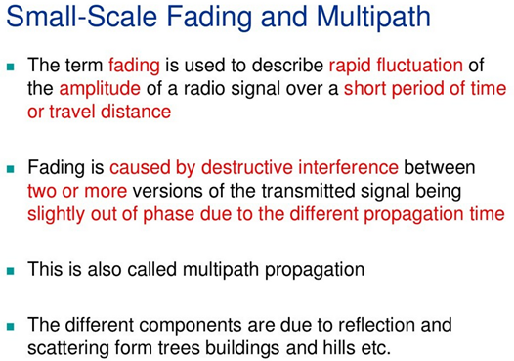

Slide 2
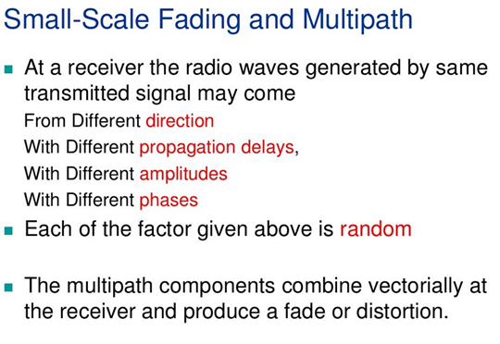

Slide 3
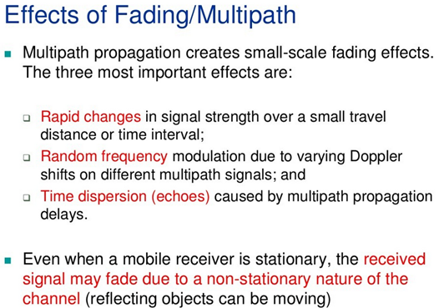

Slide 4
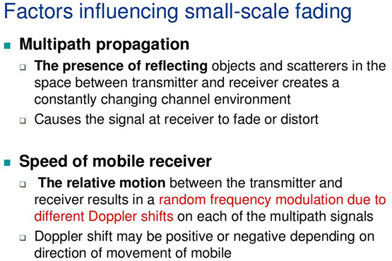

Slide 5
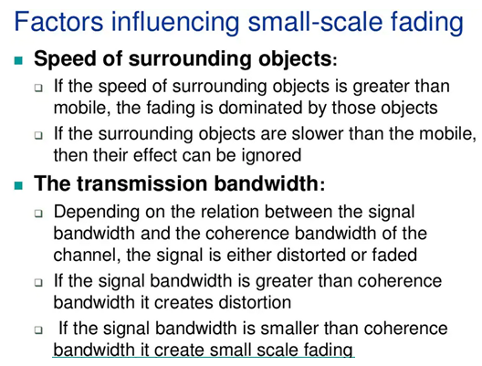

Slide 6
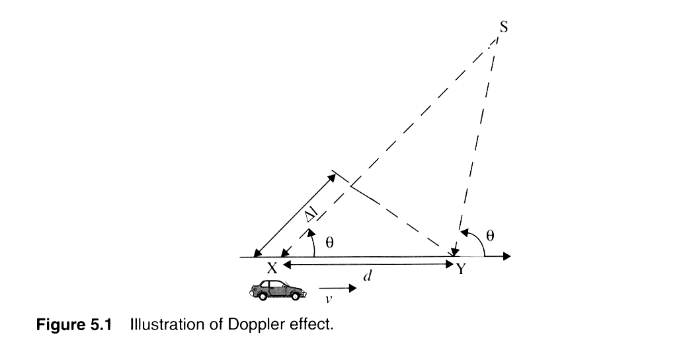
Doppler Shift Geometry

Slide 7
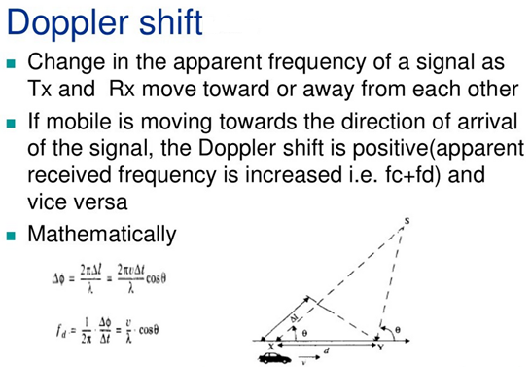
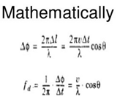

Slide 8
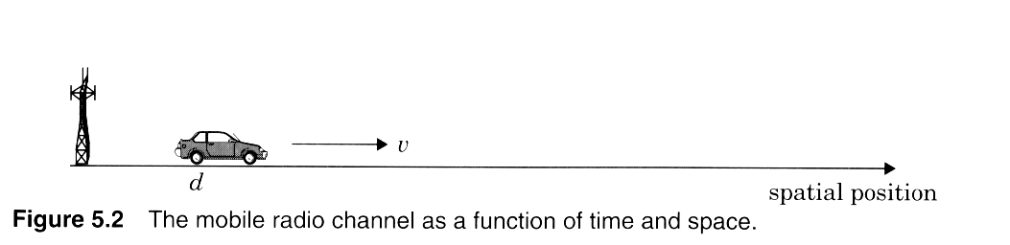
Channel issues
Notes:
Fig. 3.2

Slide 9
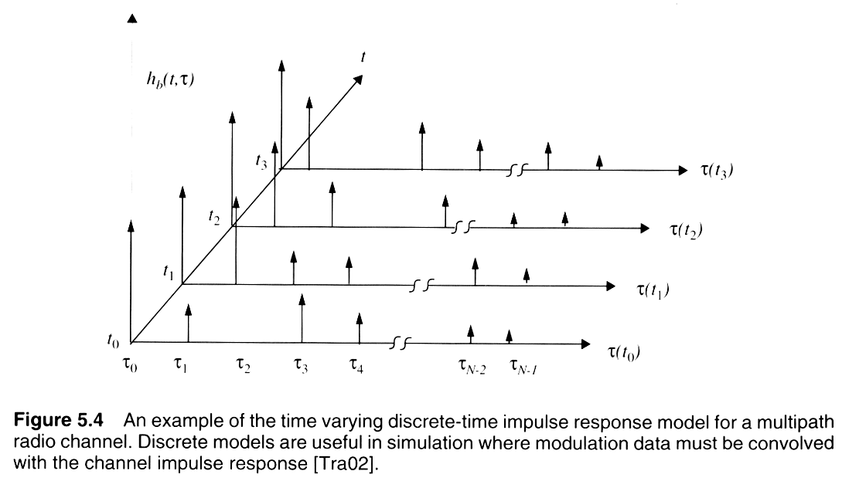
Time-varying impulse response
Notes:
Fig. 2.3

Slide 10
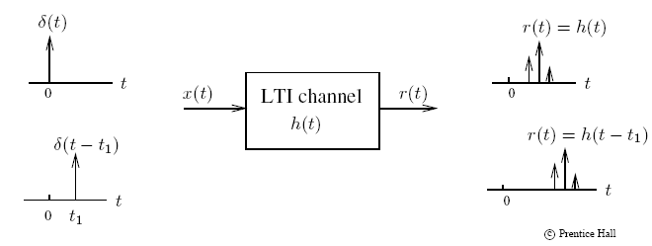
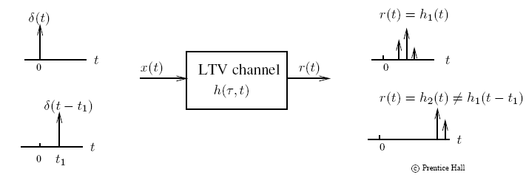
Linear Time Invariant (LTI) channel
Linear Time Variant (LTV) channel

Slide 11
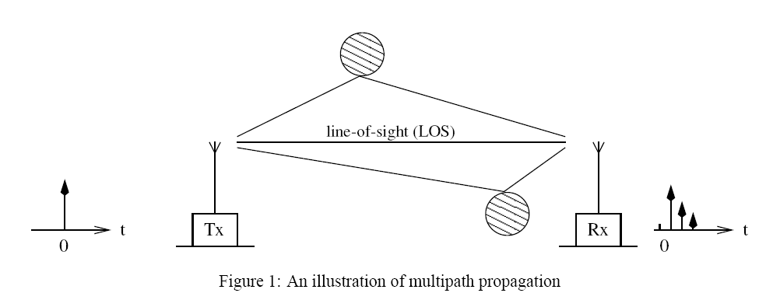
Multipath propagation

Slide 12
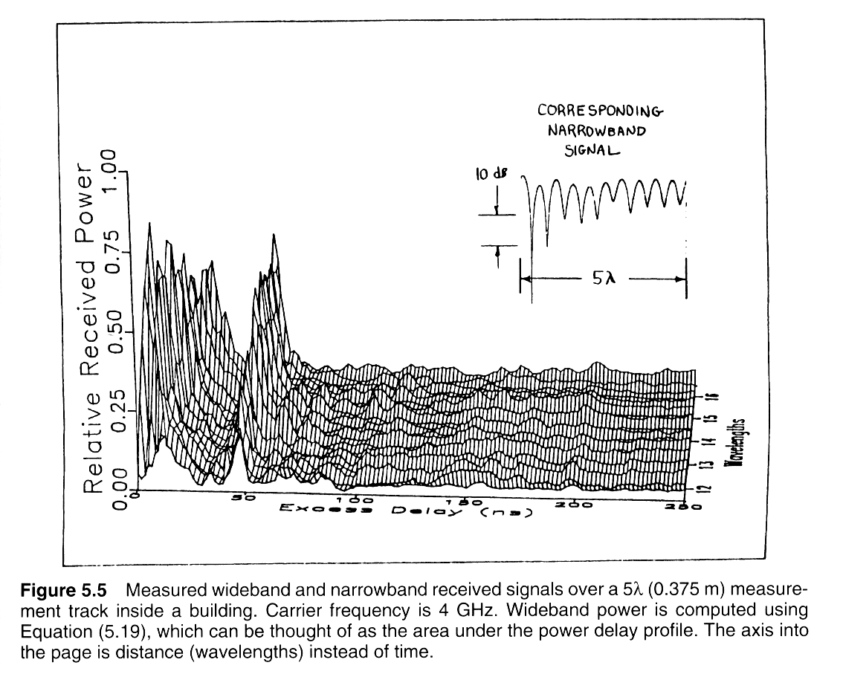
Measured impulse responses

Slide 13
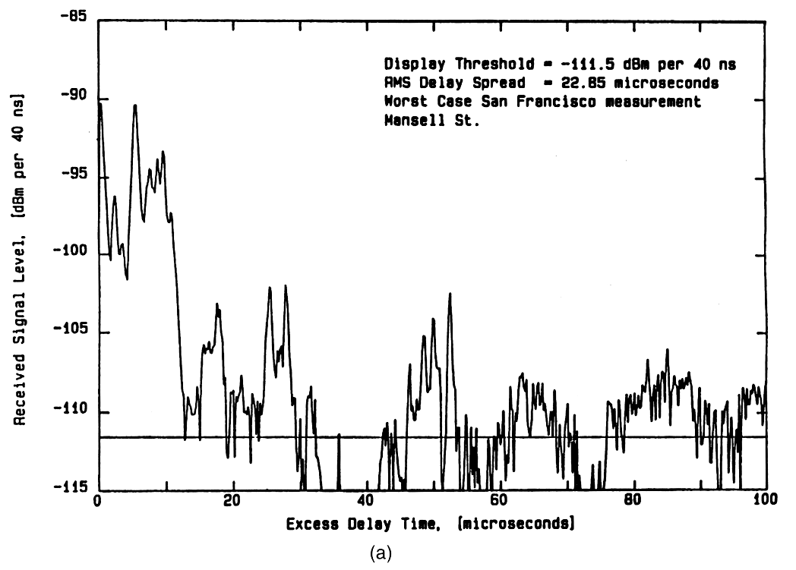
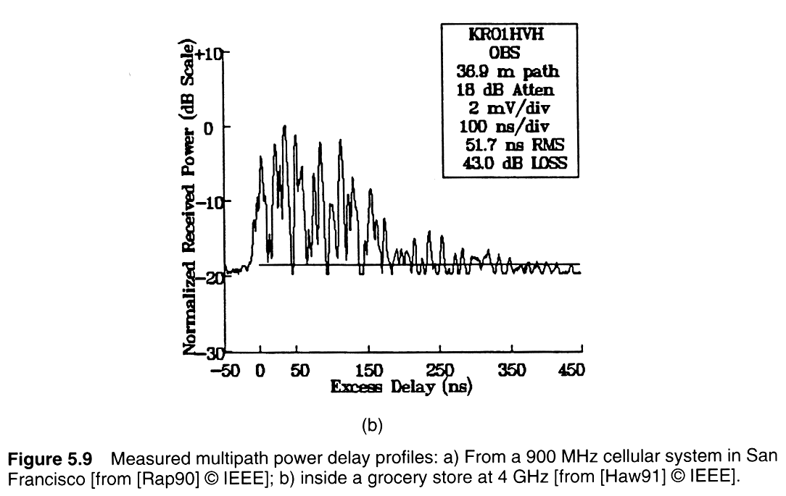
Measured power delay profiles
Notes:
Fig. 2.6

Slide 14
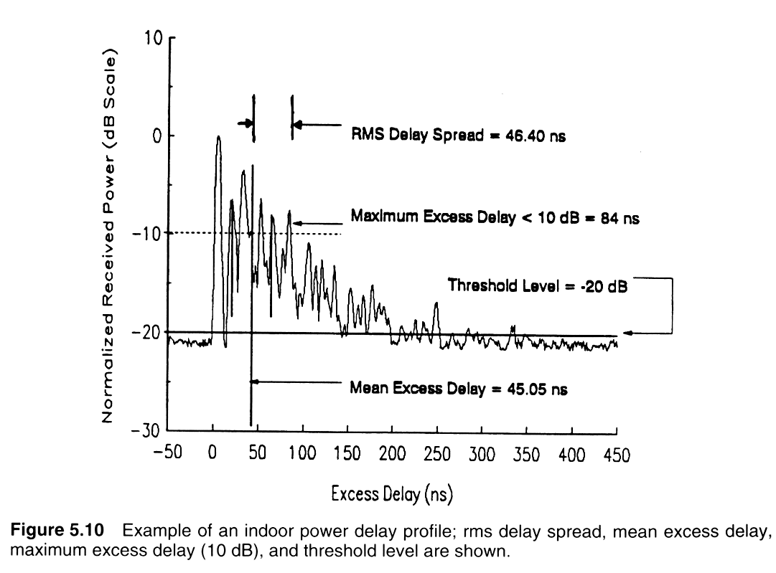
Indoor Power Delay Profile
Notes:
Fig. 2.7

Slide 15
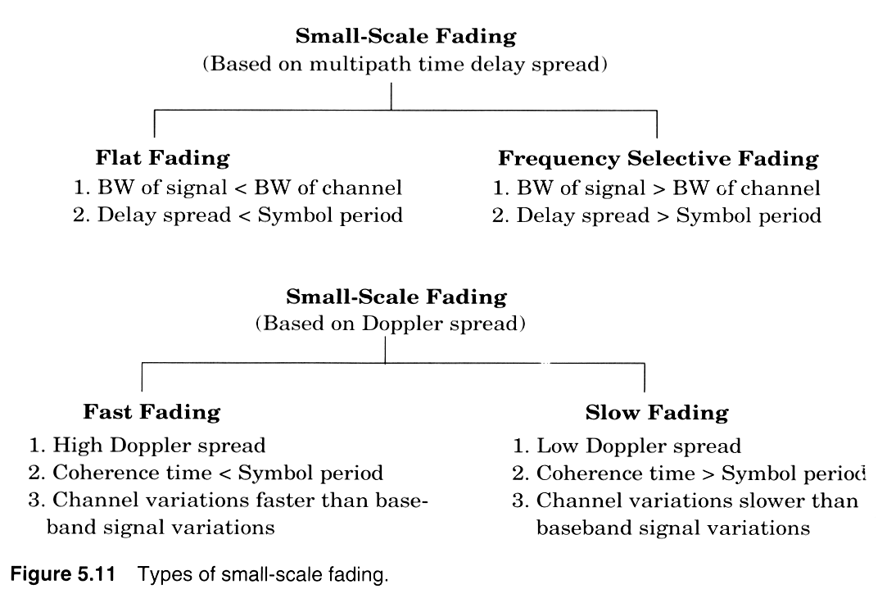
Two independent fading issues
Notes:
Fig. 2.8

Slide 16
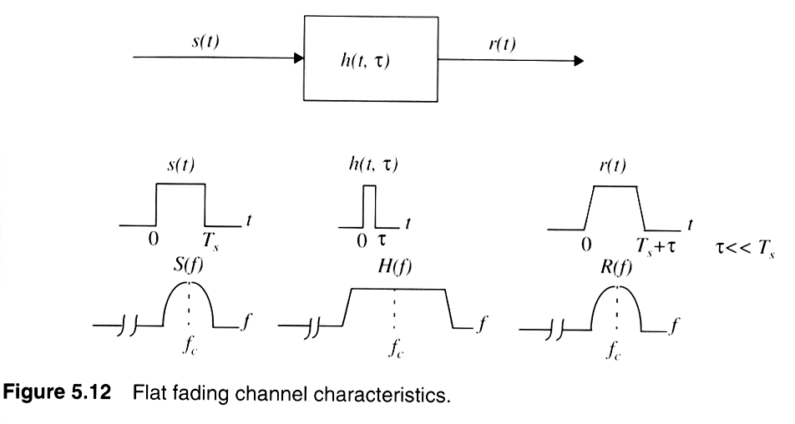
Flat-fading (non-freq. Selective)
Notes:
Fig. 2.9

Slide 17
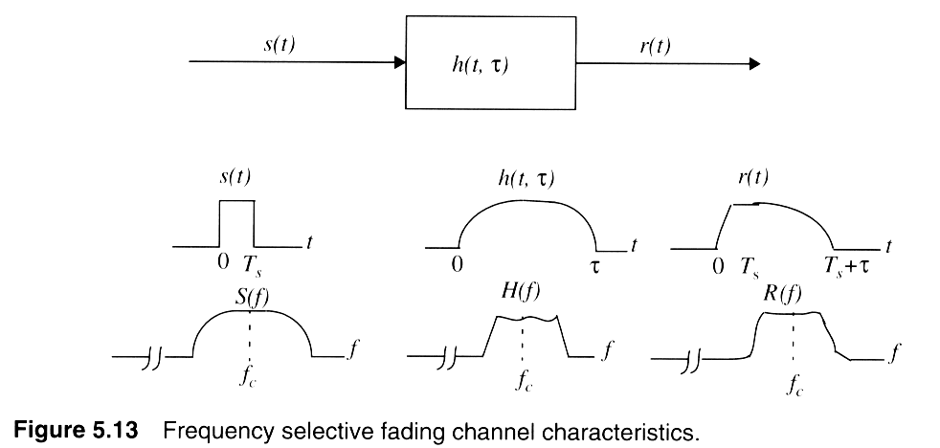
Frequency selective fading
Notes:
Fig. 2.10

Slide 18
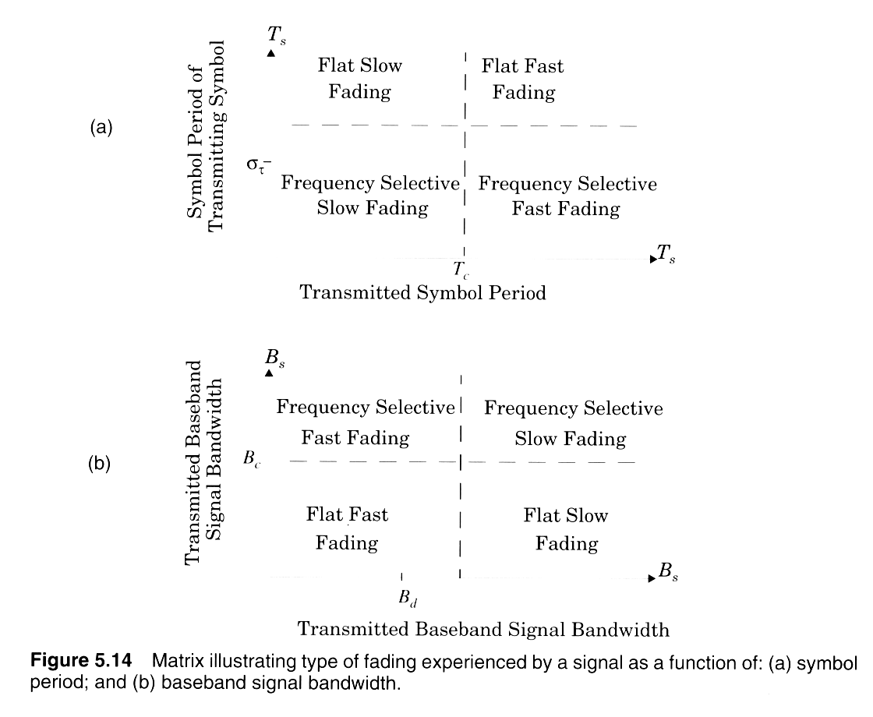
Two independent fading issues
Notes:
Fig. 2.11

Slide 19
Coherence BW and Coherence Time
Coherence Bandwidth is the range of frequencies over which the channel impulse response is constant i. e. the attenuation due to channel is constant or the channel can be considered as flat.
        Bc = 1/ 2πτ_{d}
Coherence time is the time period over which the channel impulse response is constant.
        T_{c} = 1/ 2πf_{m}

