Slide 1
MAJOR PROJECT PRESENTATION
AgroNex-Pi
Autonomous Smart Agricultural Robot
Edge-AI disease detection · GPS navigation · Smart irrigation · AWS cloud
Department of Electronics / Computer Engineering
Academic Year 2025–26
Team: Nikhil & members Guide: [Guide Name]

Slide 2
Contents
● 1. Abstract
● 9. Hardware–software integration
● 2. Introduction
● 10. Dataset (our photos)
● 3. SDGs
● 11. Model building
● 4. Literature & gap
● 12. Testing & evaluation
● 5. Components
● 13. Dashboard
● 6. Specifications
● 14. Applications & future scope
● 7. Architecture
● 15. Conclusion
● 8. Flowchart
● 16. References, thanks
AgroNex-Pi | Autonomous Smart Agricultural Robot | 02

Slide 3
Abstract
One-page summary
● Low-cost rover on Raspberry Pi 4 + Arduino Uno slave.
● Does 5 jobs: irrigate, mow, GPS navigate, detect leaf disease, send cloud data.
● AI runs on the Pi (TFLite MobileNetV2) — no internet needed for diagnosis.
● We trained on PlantVillage + our own local-plant photos.
● Safety: pump, cutter and drive motors never run together.
AgroNex-Pi | Autonomous Smart Agricultural Robot | 03

Slide 4
Introduction
Why this project?
● FAO: plant disease wastes about 10-40% of world crop yield.
● Small farms cannot hire agronomists or irrigate by hand every day.
● Flood irrigation wastes water; cloud apps fail without internet.
● AgroNex-Pi: one cheap robot that waters, mows, drives and scans leaves.
● Farmer sees live data on phone / laptop (local Flask or AWS).
AgroNex-Pi | Autonomous Smart Agricultural Robot | 04

Slide 5
Objectives
What we set out to build
● Build a low-cost rover that waters, mows, drives and scans plants.
● Detect leaf disease on the Pi (offline) using our own photos.
● Water only when soil is dry (save water vs timer irrigation).
● Show live sensors on a local dashboard and optional AWS cloud.
● Keep pump, cutter and motors from running at the same time (safety).
AgroNex-Pi | Autonomous Smart Agricultural Robot | 05

Slide 6
Sustainable Development Goals
UN Agenda 2030
SDG 2 Zero Hunger
SDG 6 Clean Water
Early disease catch + smart watering protects yield.
Pump ON only if soil < 35%. Saves water vs timers.
SDG 9 Innovation
SDG 12 Responsible use
Edge AI + IoT robot that small farms can afford.
Less chemical spray; treat only if AI confirms disease.
AgroNex-Pi | Autonomous Smart Agricultural Robot | 05

Slide 7
Literature review
What others did
Work | Idea | Gap
Mohanty 2016 | CNN on PlantVillage (~99% lab) | Lab photos, no robot, often cloud
Bac 2014 | Greenhouse harvest robot | Costly, needs structured farm
Plantix / PlantSnap | Phone app diagnosis | Needs internet every time
IoT irrigation papers | Soil sensor + pump | No AI, no navigation
GPS agri robots | Field waypoint driving | No disease + irrigation combo
AgroNex-Pi | Autonomous Smart Agricultural Robot | 06

Slide 8
Gap analysis → our work
● Gap: irrigation, mowing, GPS and AI are usually separate projects.
● Gap: lab datasets look unlike a Pi camera in a real garden.
● Gap: rural farms have weak internet — cloud-only AI fails.
● We combine all 5 jobs on one chassis.
● We photographed local plants with the same rover camera, then trained.
● Inference stays on-device; cloud is only for remote viewing.
AgroNex-Pi | Autonomous Smart Agricultural Robot | 07

Slide 9
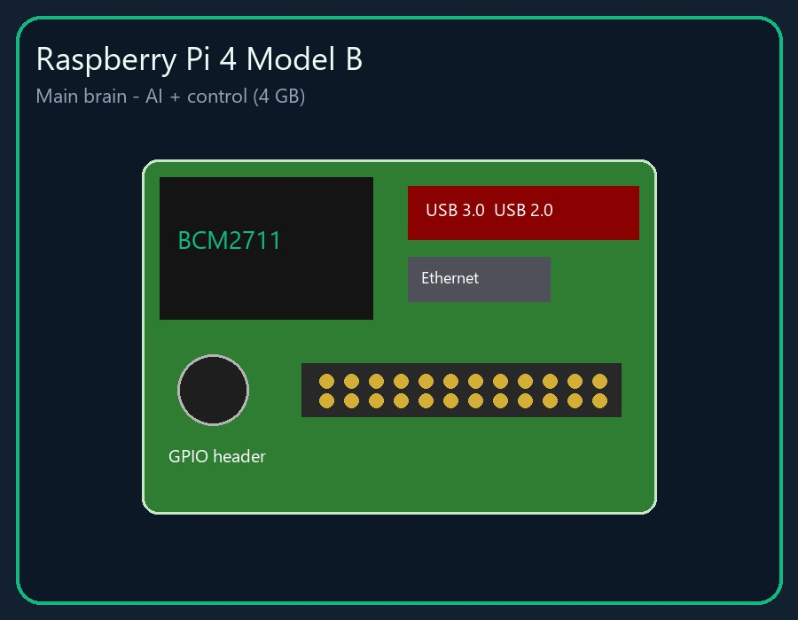
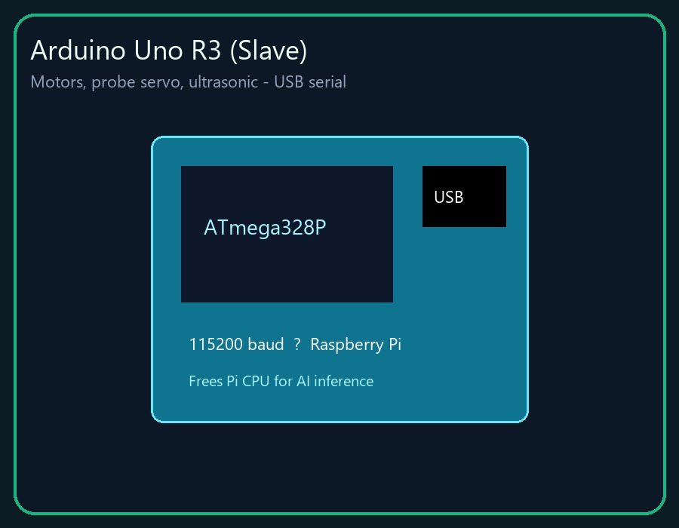
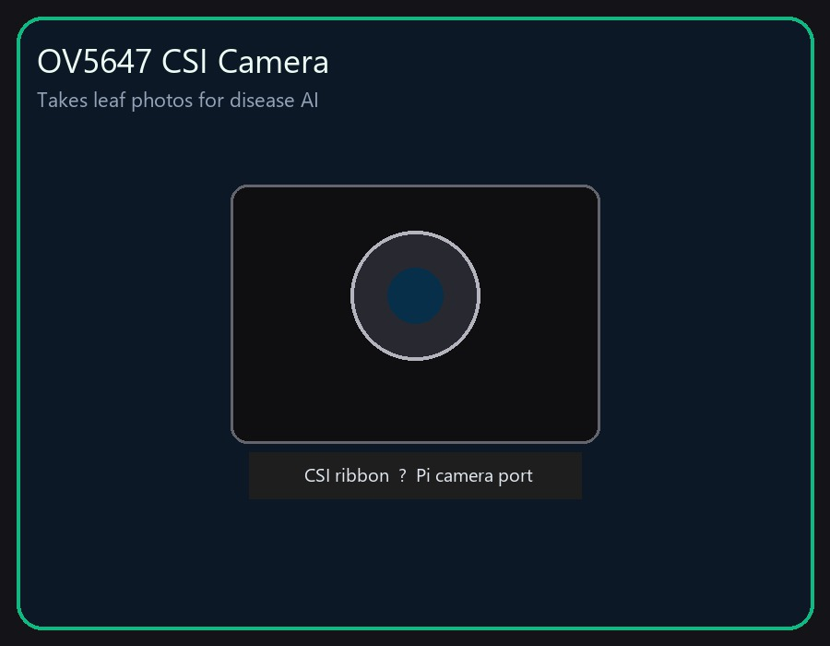
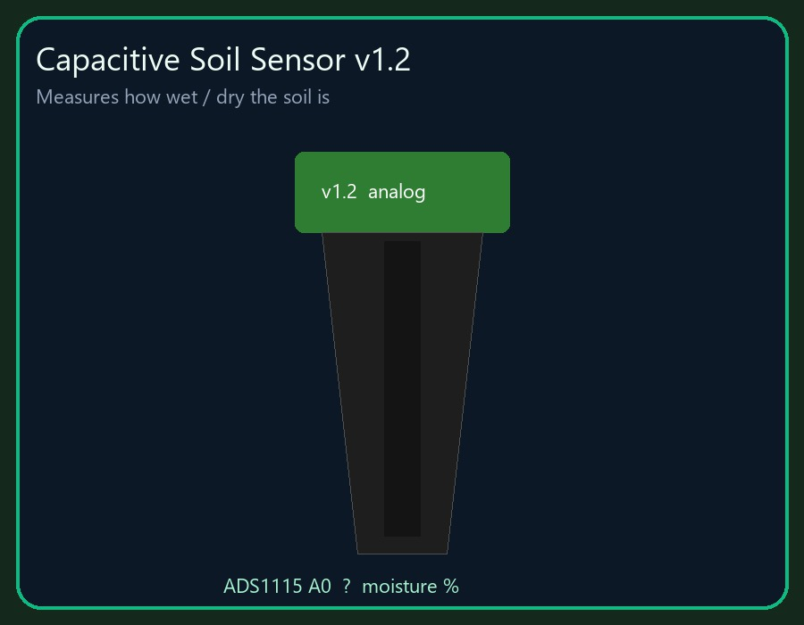
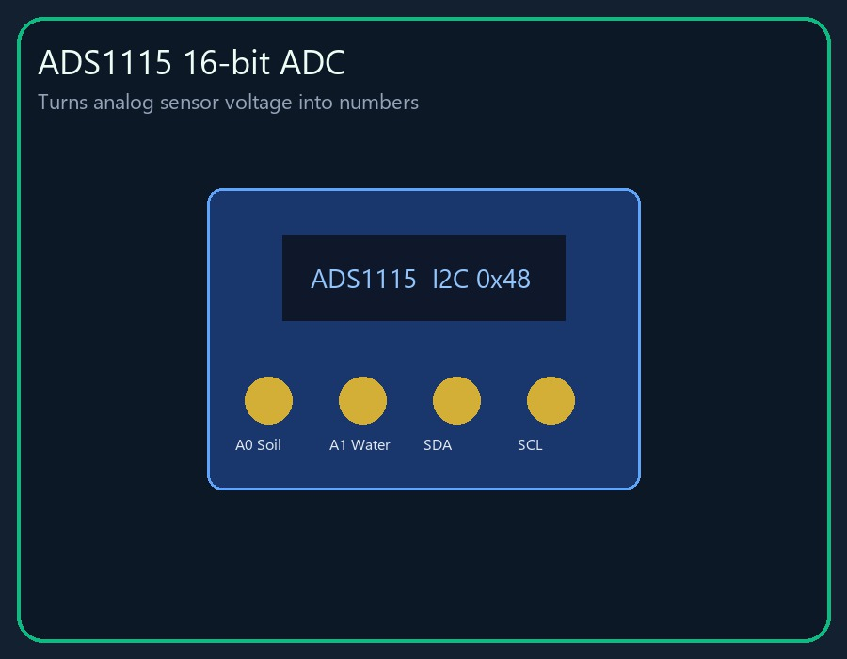
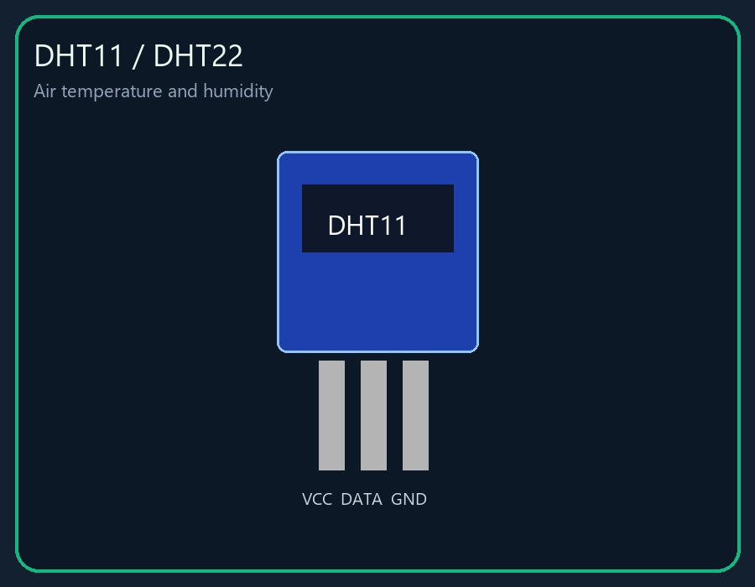
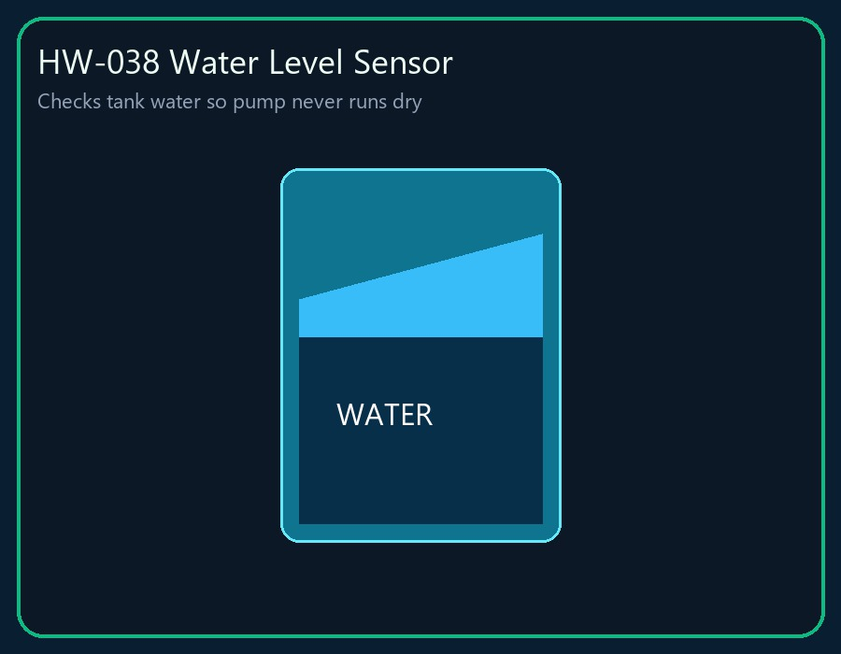
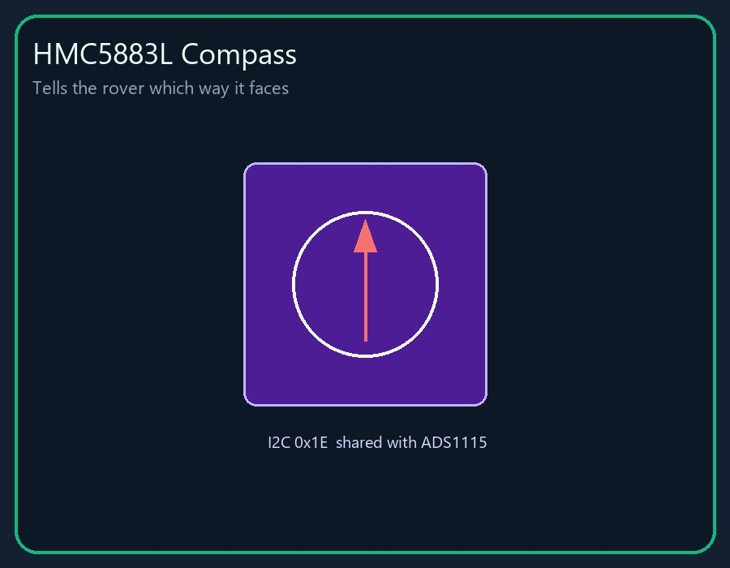
Components — brain & sensors
Raspberry Pi 4B
Arduino Uno slave
OV5647 camera
Soil moisture
ADS1115 ADC
DHT11/22
Water-level probe
HMC5883L compass
AgroNex-Pi | Autonomous Smart Agricultural Robot | 08

Slide 10
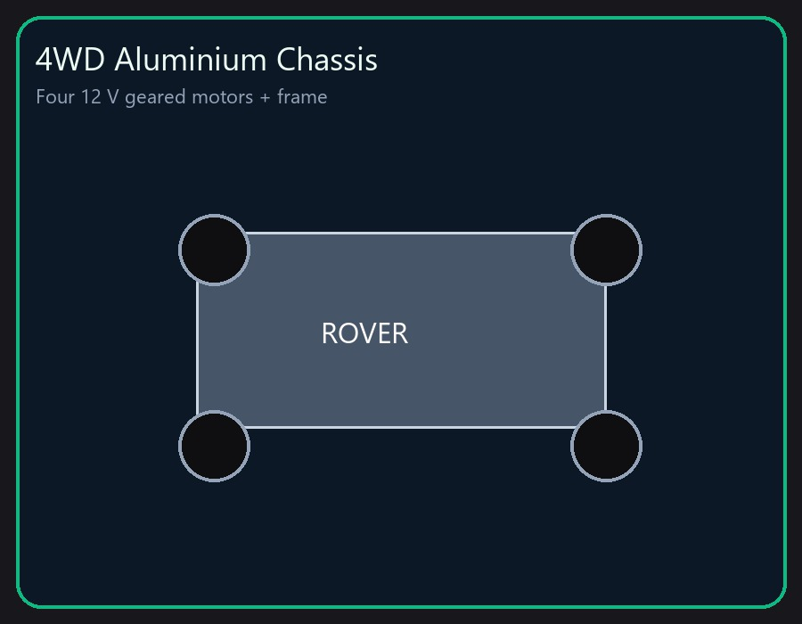
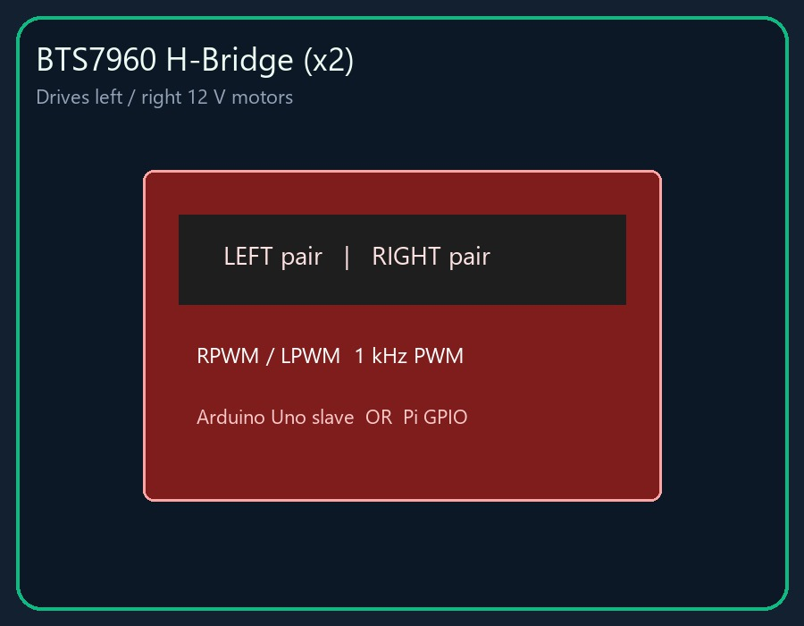
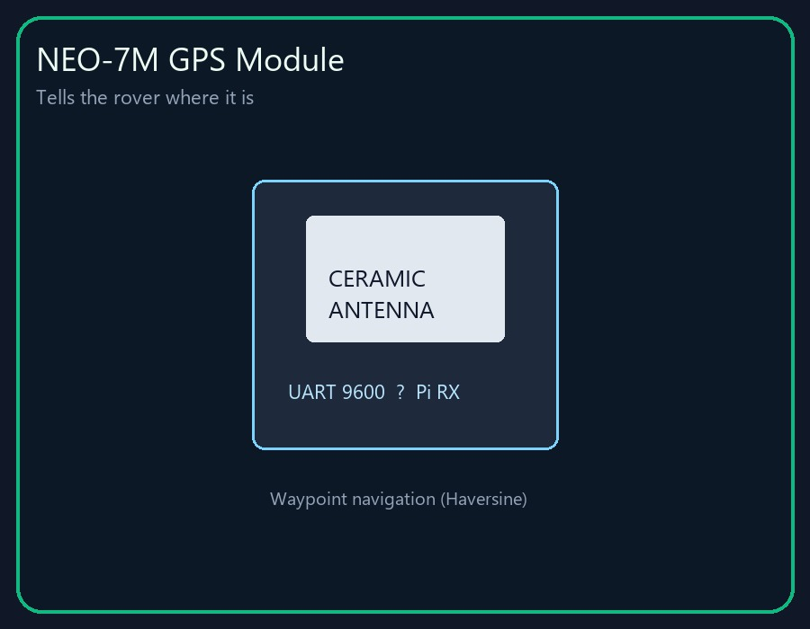
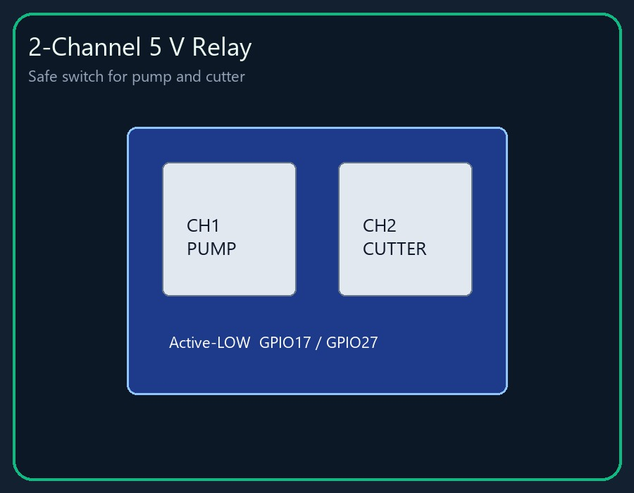
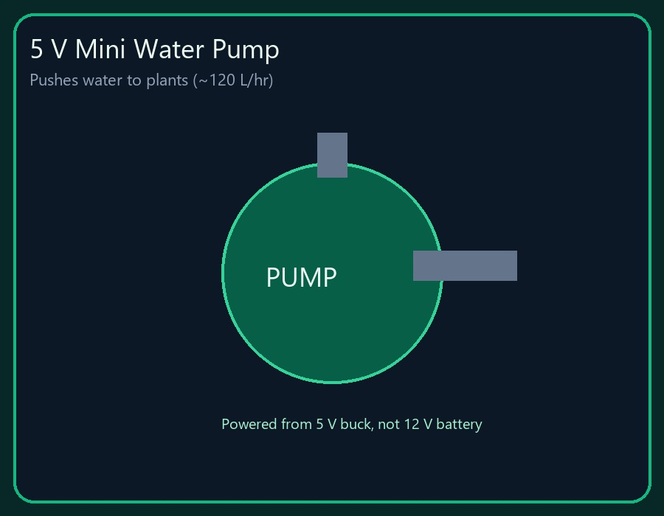
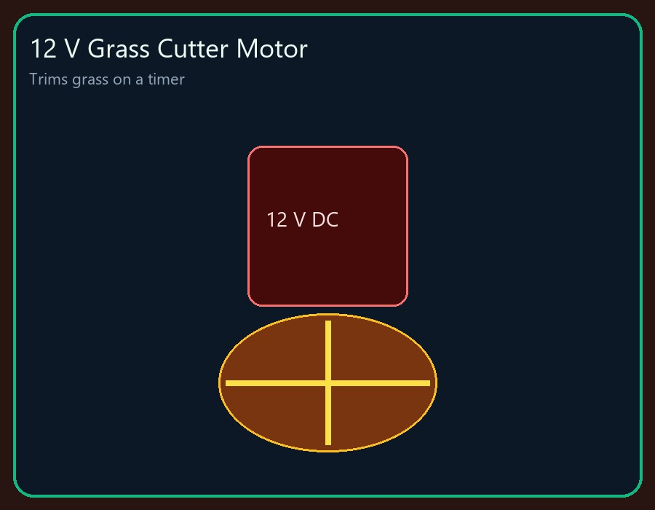
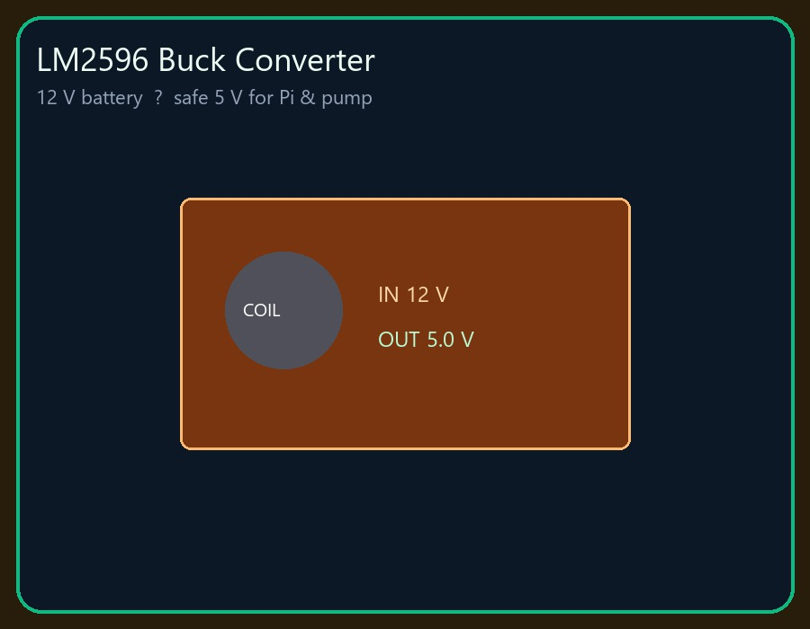
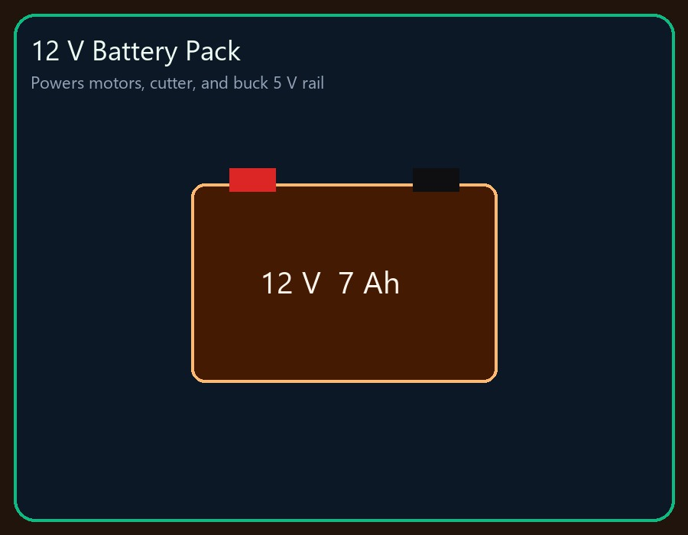
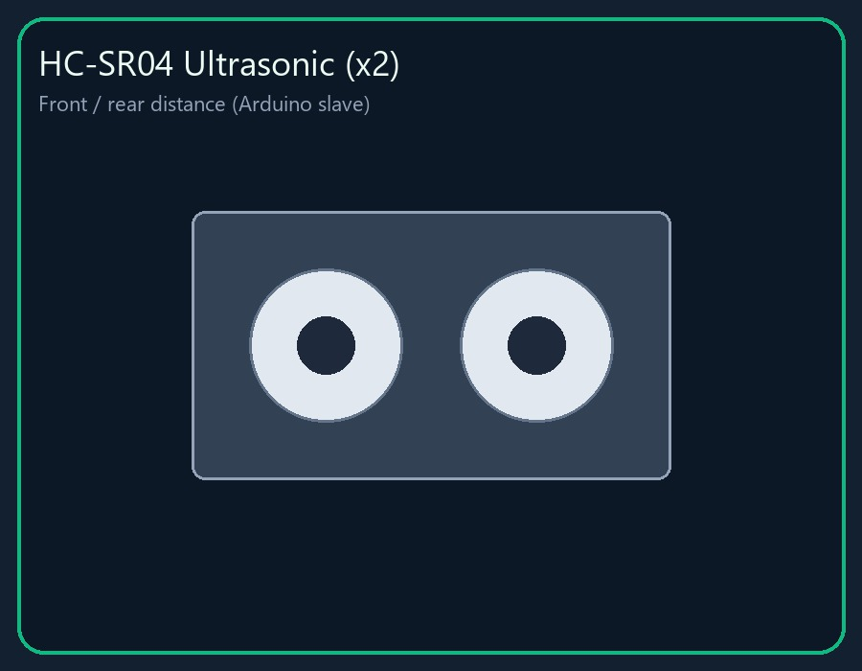
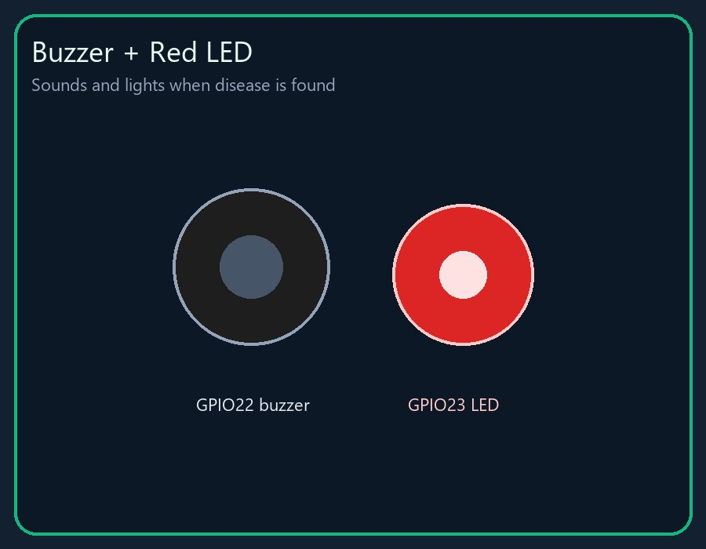
Components — drive, power, tools
4WD chassis
BTS7960 ×2
NEO-7M GPS
2-ch relay
5 V pump
12 V cutter
LM2596 5 V
12 V battery
HC-SR04 ×2
Buzzer + LED
AgroNex-Pi | Autonomous Smart Agricultural Robot | 09

Slide 11
System specification
Item | Value
Compute | Pi 4B 4 GB + Arduino Uno R3 (USB 115200)
Software | Python 3.9, 9 modules, 4 threads, FSM
AI | MobileNetV2 → TFLite, 224×224, ~280 ms / frame
Irrigation | ON < 35%, OFF ≥ 65%, 60 s max, 120 s cooldown
Disease gates | Blur + green % + 70% confidence + 3×3 vote
Navigation | NEO-7M + compass, arrive within 2.5 m
Cloud | AWS API Gateway + Lambda + S3 every 5 s
Power | 12 V battery, LM2596 5 V rail, common ground
AgroNex-Pi | Autonomous Smart Agricultural Robot | 10

Slide 12
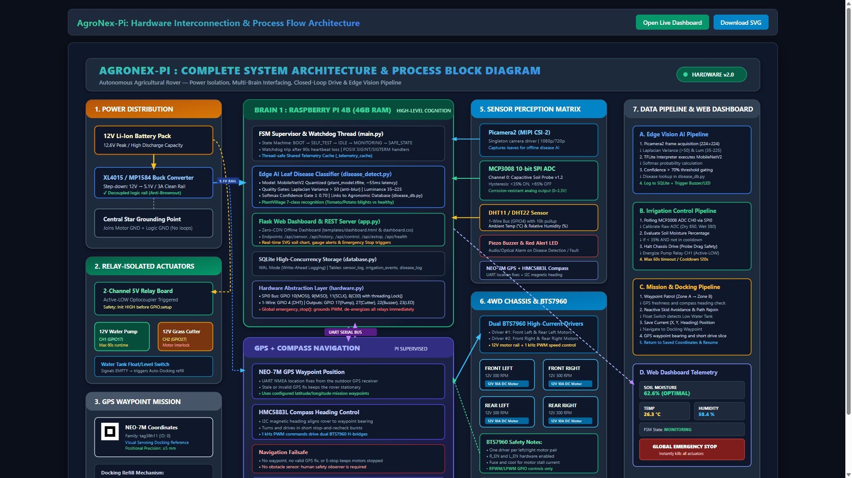
System architecture (block diagram)
AgroNex-Pi | Autonomous Smart Agricultural Robot | 11

Slide 13
Software layers (short)
● hardware.py — only file that touches GPIO / I²C / UART / camera.
● Controllers: irrigation, cutter, navigation, disease_detect.
● main.py FSM: BOOT → SELF_TEST → IDLE → MONITORING → action states.
● Threads: 3 s control loop, scanner, Flask :5000, 30 s watchdog.
● aws_relay.py + S3 dashboard for remote view / commands.
● SAFE_STATE if self-test fails: all actuators off.
AgroNex-Pi | Autonomous Smart Agricultural Robot | 12

Slide 14
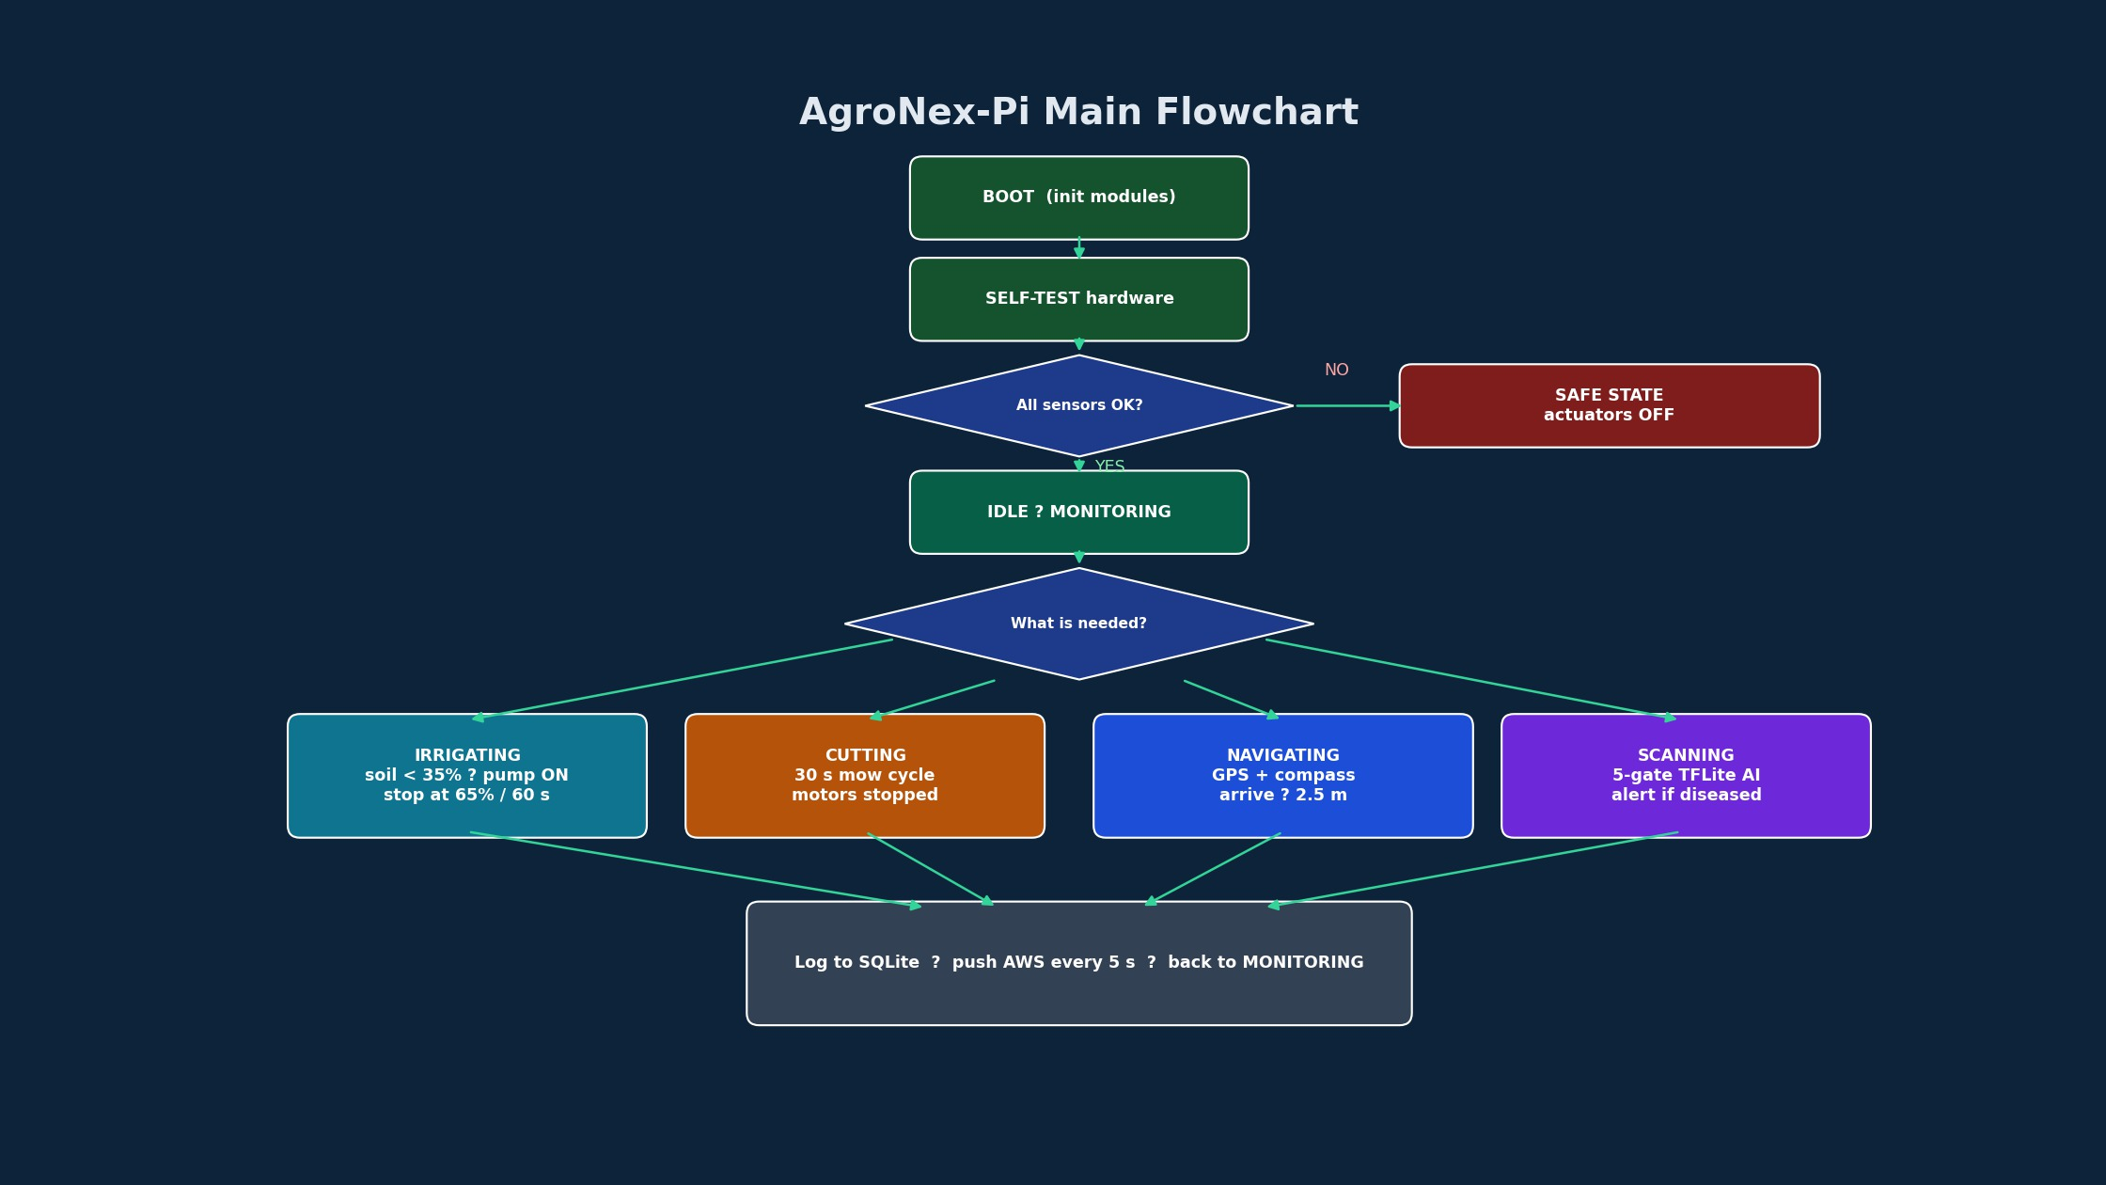
System flowchart
AgroNex-Pi | Autonomous Smart Agricultural Robot | 13

Slide 15
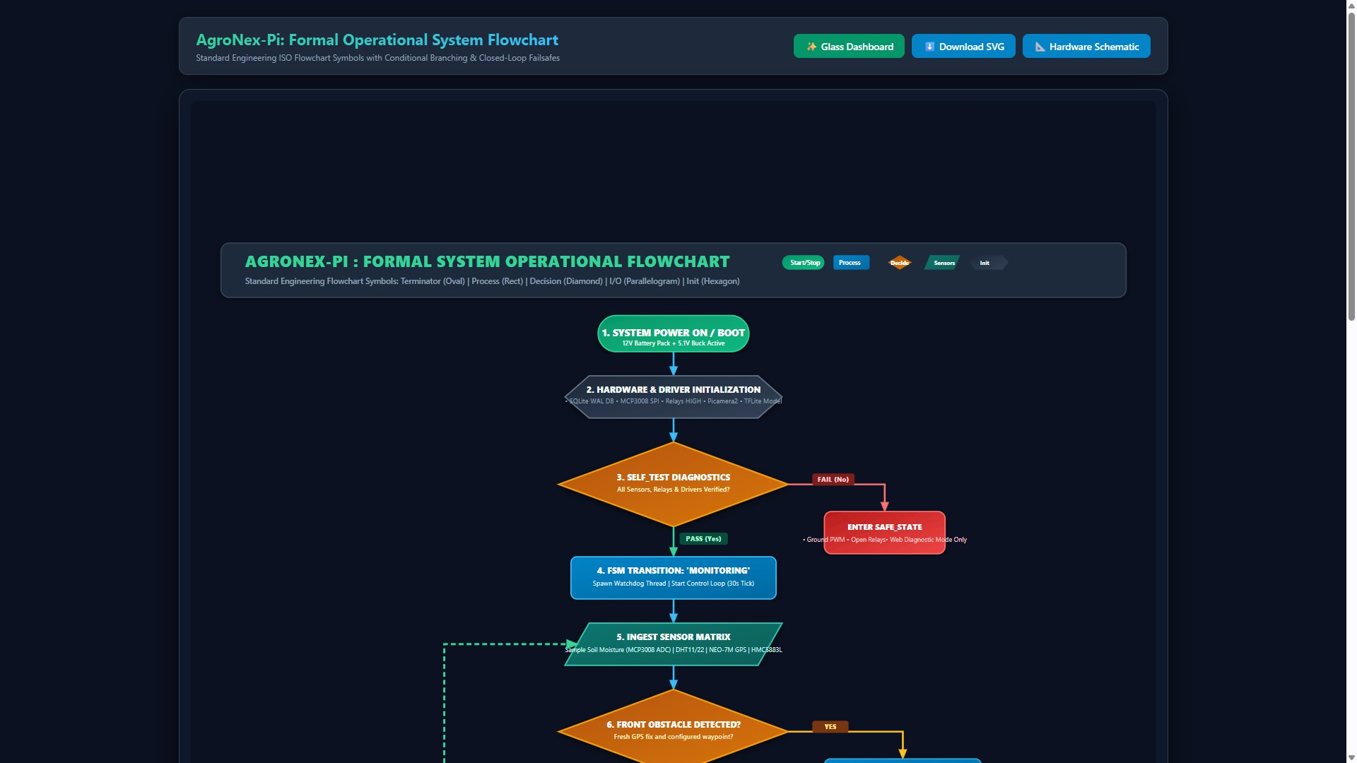
Formal operational flowchart
AgroNex-Pi | Autonomous Smart Agricultural Robot | 13b

Slide 16
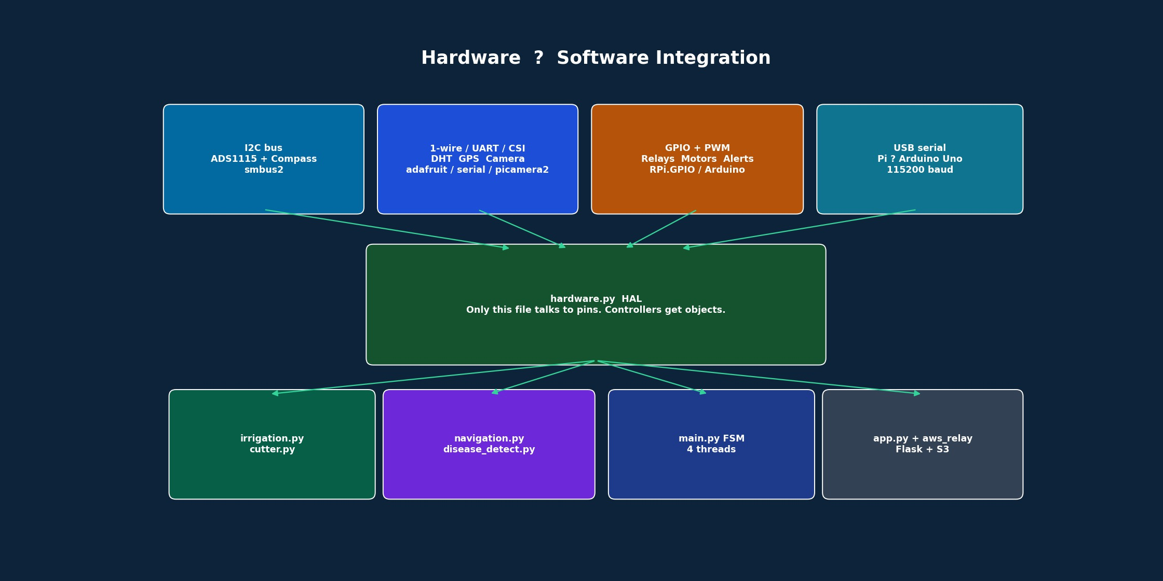
Hardware & software integration
AgroNex-Pi | Autonomous Smart Agricultural Robot | 14

Slide 17
Integration — how parts talk
● Sensors: I²C (soil, water, compass), UART GPS, CSI camera, 1-wire DHT.
● Arduino: motors, probe servo, ultrasonics — Pi sends short serial commands.
● Relays active-LOW; pins set HIGH before OUTPUT so pump/cutter stay off at boot.
● Interlock: stop wheels before pump or cutter (protects 12 V rail).
● Cloud POST every 5 s; if Wi-Fi dies, local dashboard still works.
AgroNex-Pi | Autonomous Smart Agricultural Robot | 15

Slide 18
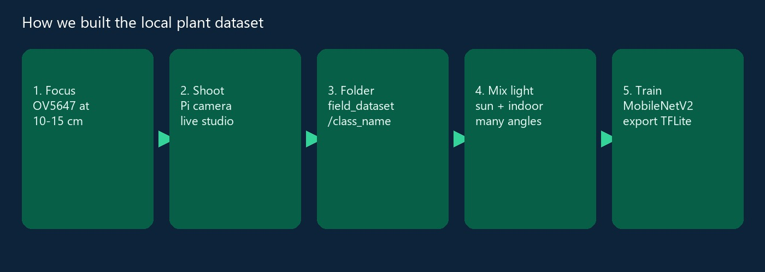
Building the dataset
We photographed local plants ourselves
● Problem: Kaggle lab photos ≠ Pi camera (blur, noise, real background).
● Fix: capture with the same OV5647 on the rover (capture_field_dataset.py).
● Classes: healthy / unhealthy / yellow / dried / not-a-leaf.
AgroNex-Pi | Autonomous Smart Agricultural Robot | 16

Slide 19
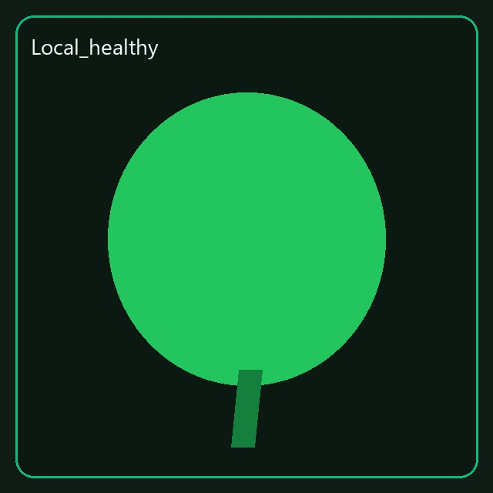
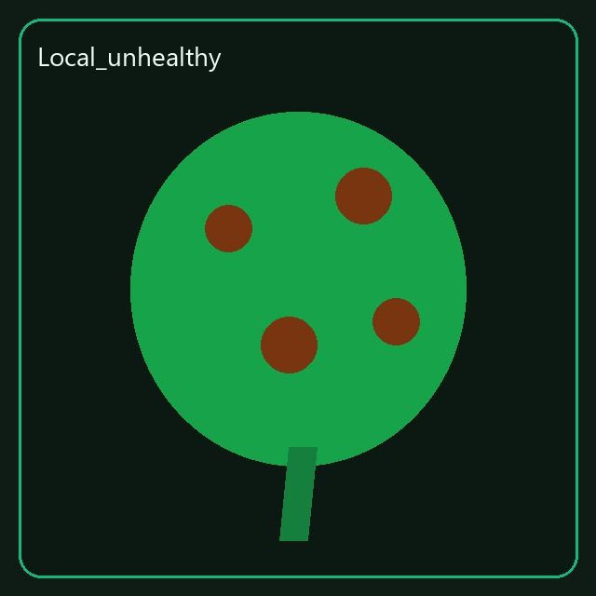
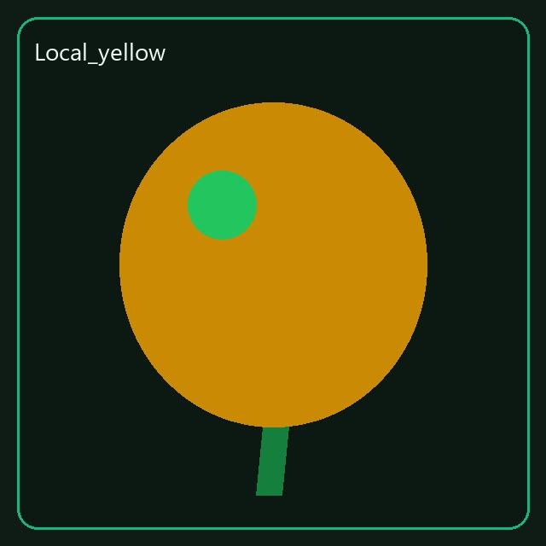
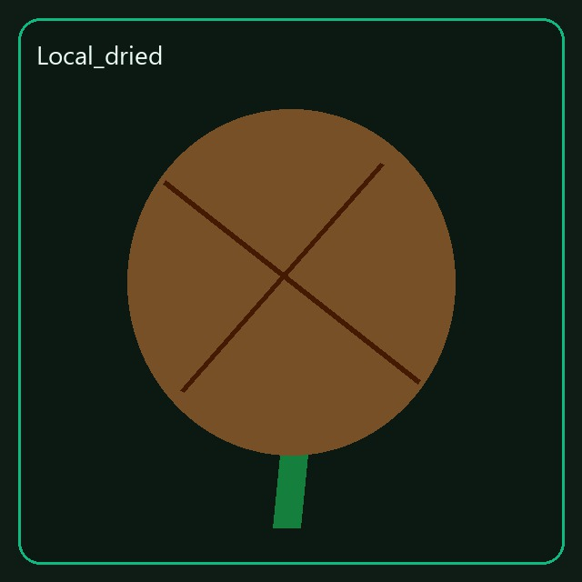
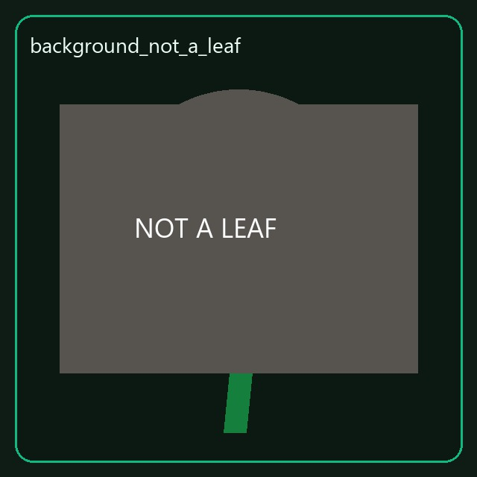
Our local classes (field photos)
Local_healthy
Local_unhealthy
Local_yellow
Local_dried
background_not_a_leaf
AgroNex-Pi | Autonomous Smart Agricultural Robot | 17

Slide 20
Dataset details
What we actually did
● Source A: PlantVillage (Kaggle) — tomato, potato, bell pepper, max 180 / class.
● Source B: our garden / campus plants with Pi camera at rover height.
● Angles: top, 15–30° tilt, 5–15 cm close-up. Sun + indoor light.
● Also shoot pots/soil/hands so the model learns “this is not a leaf”.
● Split: 80% train / 20% validation. Field images not capped.
● Folders merge into training_subset/ before training.
AgroNex-Pi | Autonomous Smart Agricultural Robot | 18

Slide 21
Building the model
Transfer learning — short version
● Start from MobileNetV2 already trained on ImageNet (knows edges, colors).
● Remove old 1000-class head. Add GAP + Dropout 0.3 + Softmax(N classes).
● Stage 1: freeze backbone, train head (Adam, LR 1e-3).
● Stage 2: unfreeze top layers, tiny LR (1e-4 / 1e-5) — fine-tune.
● Export quantized TFLite (~small file) to models/plant_model.tflite.
AgroNex-Pi | Autonomous Smart Agricultural Robot | 19

Slide 22
ML techniques used
Technique | Why we used it
Transfer learning | Few local photos; ImageNet already learned vision
Data augmentation | Flip, rotate, zoom, brightness — more variety
Class weights | Rare disease class is not ignored
Dropout 0.3 | Stops memorizing training photos
Early stopping | Stop when validation stops improving
Dynamic-range quantize | Faster, smaller model for Pi CPU
[-1, 1] normalize | Matches MobileNetV2 training math
5-gate inference | Cuts false alarms in the garden
AgroNex-Pi | Autonomous Smart Agricultural Robot | 20

Slide 23
On-device inference (5 gates)
● 1. Quality: too blurry or too dark → RETAKE, not “disease”.
● 2. Green pixels: < 15% green → skip (no leaf in view).
● 3. Split photo into 3×3 patches; classify each patch.
● 4. Vote: more than 4 of 9 patches must be diseased.
● 5. Confidence: each diseased patch needs ≥ 70% softmax.
● Then: knowledge-base advice + buzzer/LED + save JPEG.
AgroNex-Pi | Autonomous Smart Agricultural Robot | 21

Slide 24
Testing & evaluation
● Hardware scripts: soil, water, DHT, relay, motors, camera, alerts — all PASS.
● Soil dry-air ADC ~26 300 → 0%; wet ~9 500 → ~100%.
● Pump starts < 35%, stops ≥ 65% or after 60 s.
● GPS: stop-and-check bursts; waypoint done at ≤ 2.5 m.
● AI: val. accuracy typically ~88–95% after local photos (vs ~40–50% domain shift).
● Pi inference ~280 ms/frame. Interlocks verified (no dual high-current loads).
AgroNex-Pi | Autonomous Smart Agricultural Robot | 22

Slide 25
ML results (what to say in viva)
Check | Result
Custom 5-class (local plant) | Validation about 88–93%
PlantVillage 8-class mix | Validation about 91–95%
False-alarm control | Blur/green/vote/70% gates
Latency on Pi 4 CPU | ~280 ms per frame
Model file | Quantized .tflite + labels.txt
Real camera test | test_disease_camera.py live demo
AgroNex-Pi | Autonomous Smart Agricultural Robot | 23

Slide 26
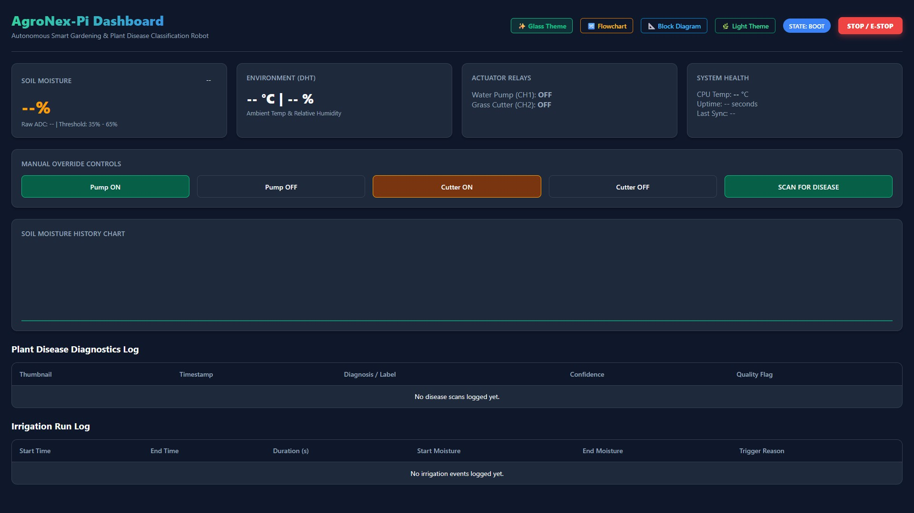
Dashboard — local Flask
AgroNex-Pi | Autonomous Smart Agricultural Robot | 24

Slide 27
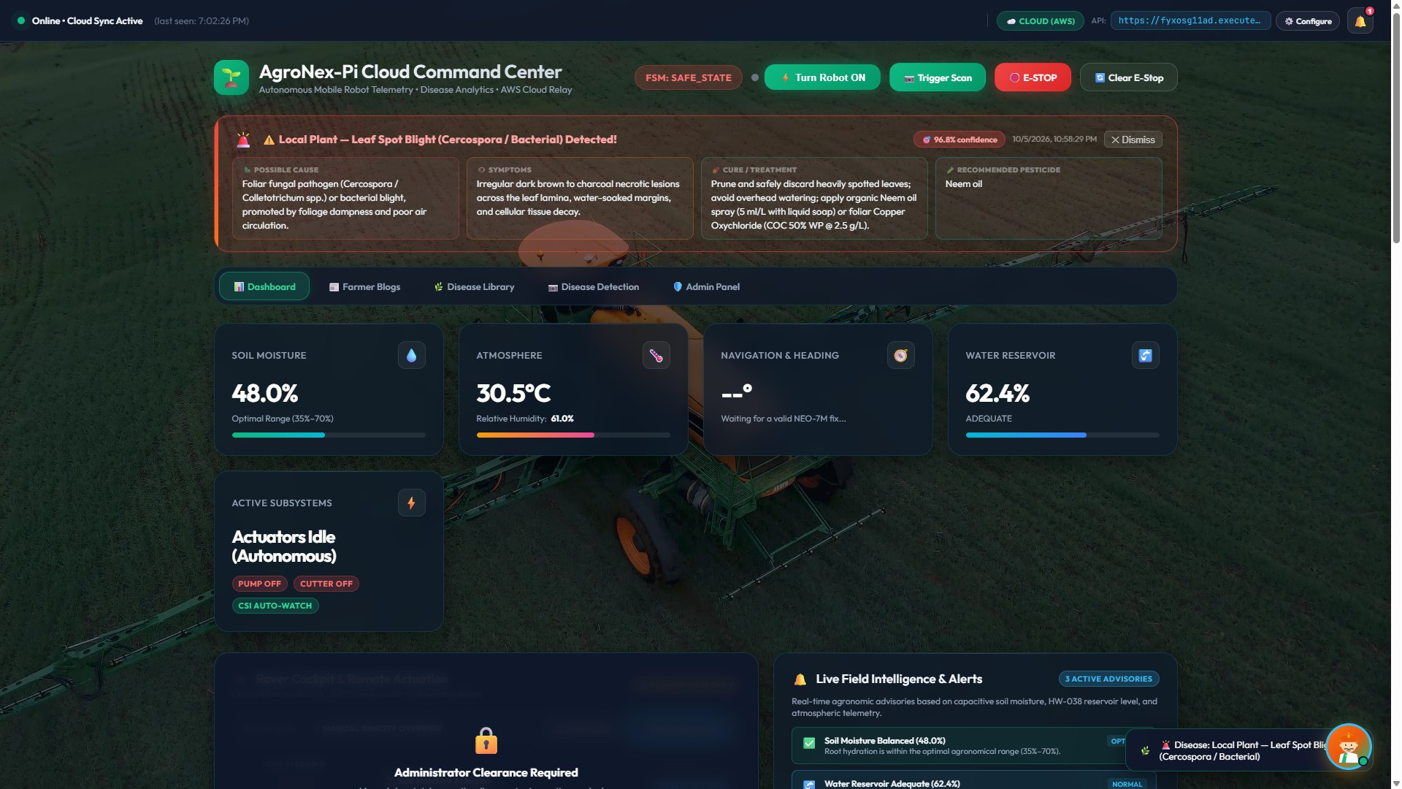
Dashboard — AWS cloud
AgroNex-Pi | Autonomous Smart Agricultural Robot | 25

Slide 28
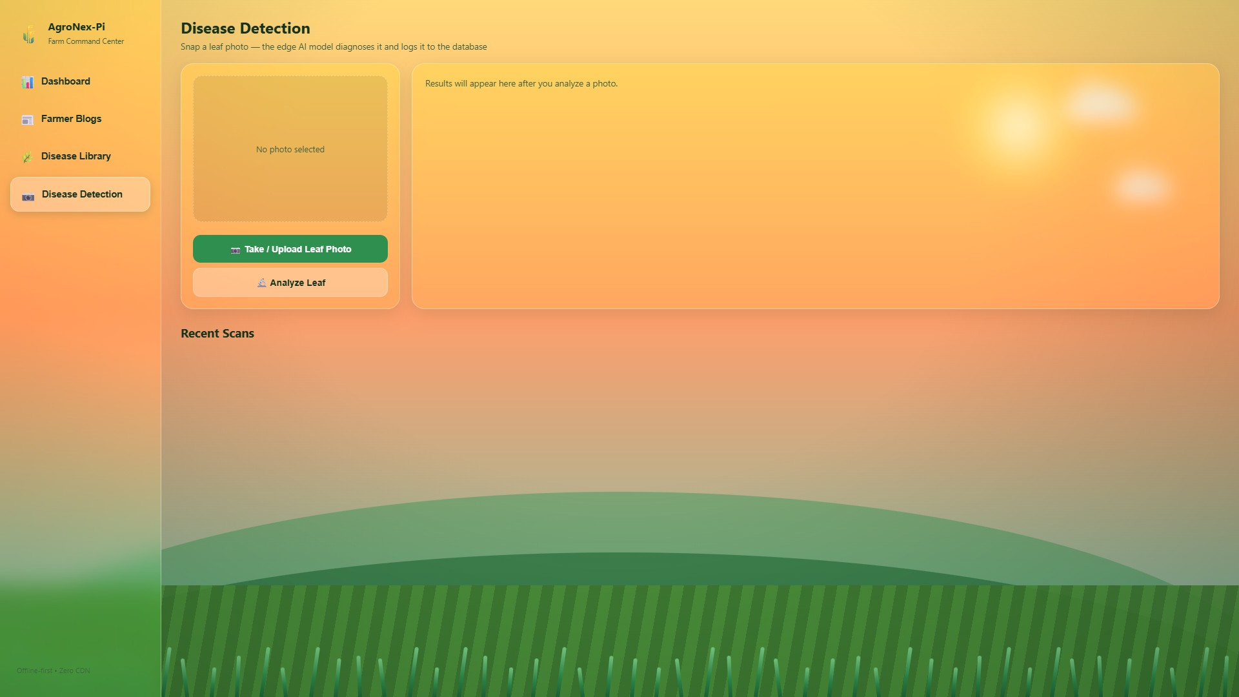
Dashboard — farm command center
AgroNex-Pi | Autonomous Smart Agricultural Robot | 26

Slide 29
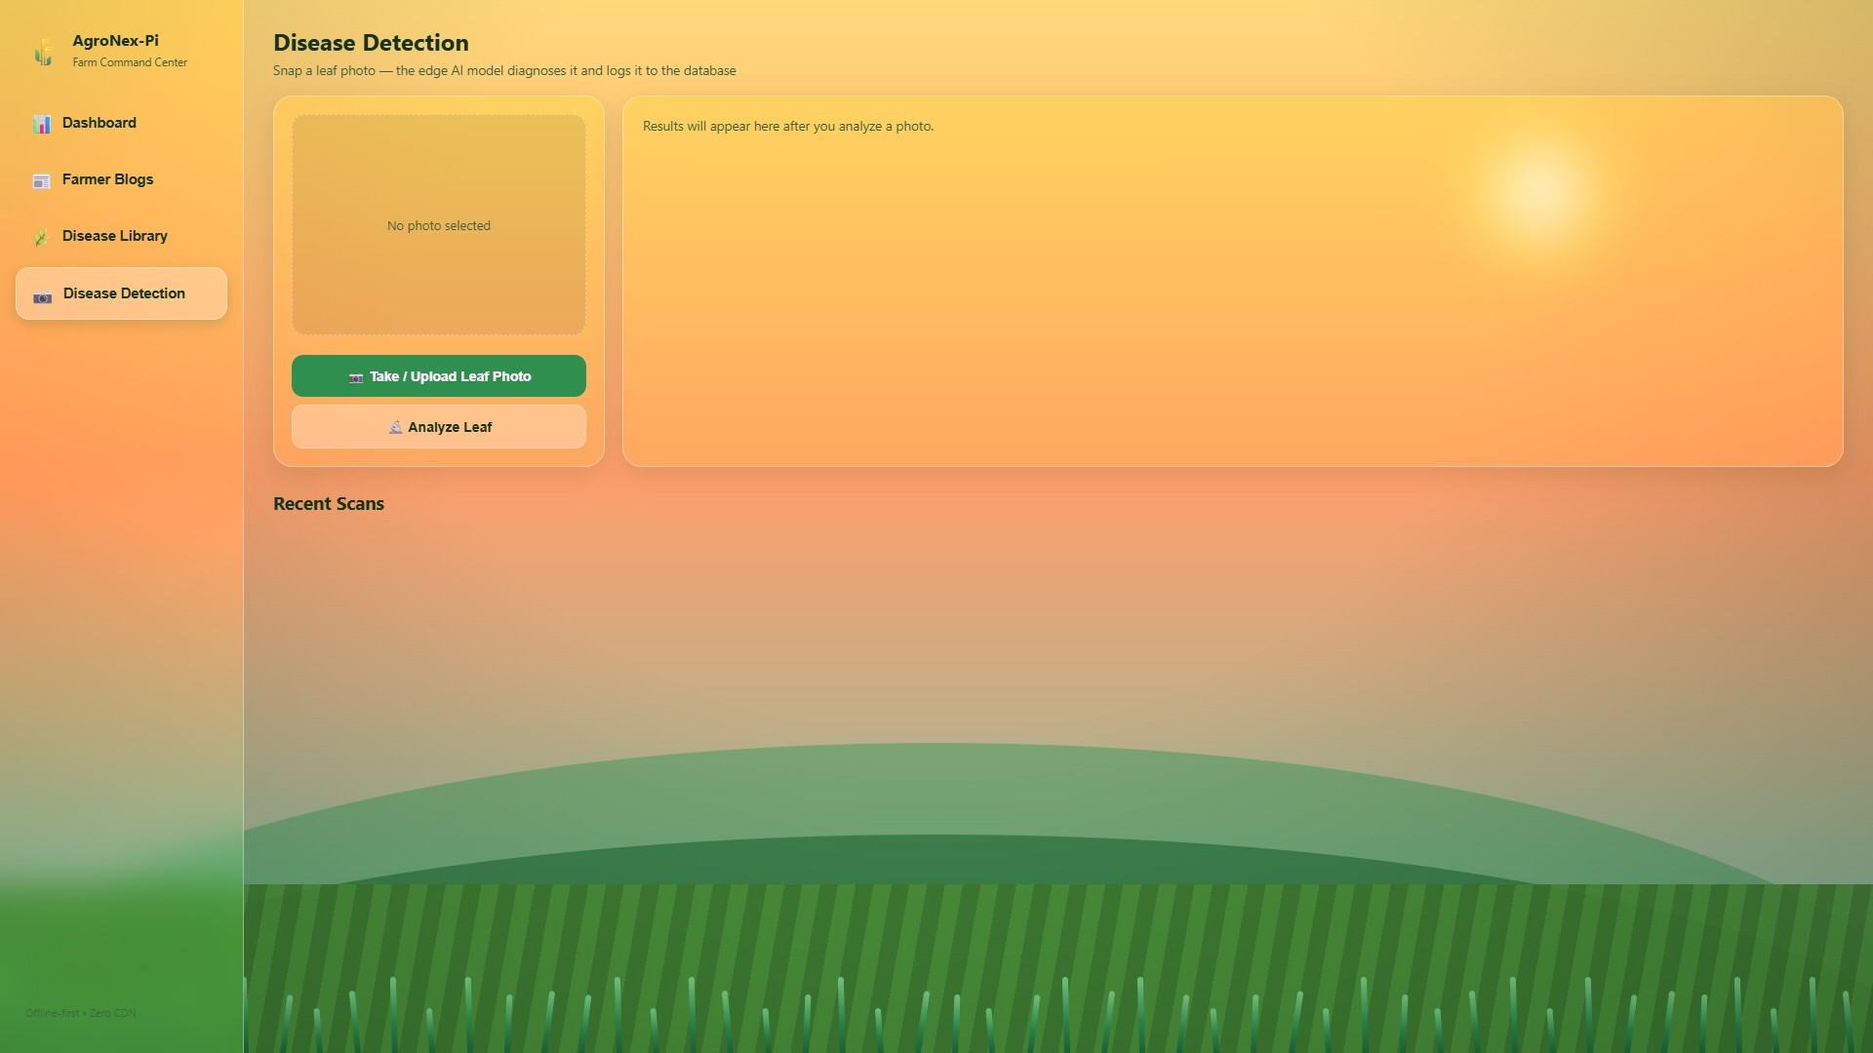
Dashboard — disease capture UI
AgroNex-Pi | Autonomous Smart Agricultural Robot | 27

Slide 30
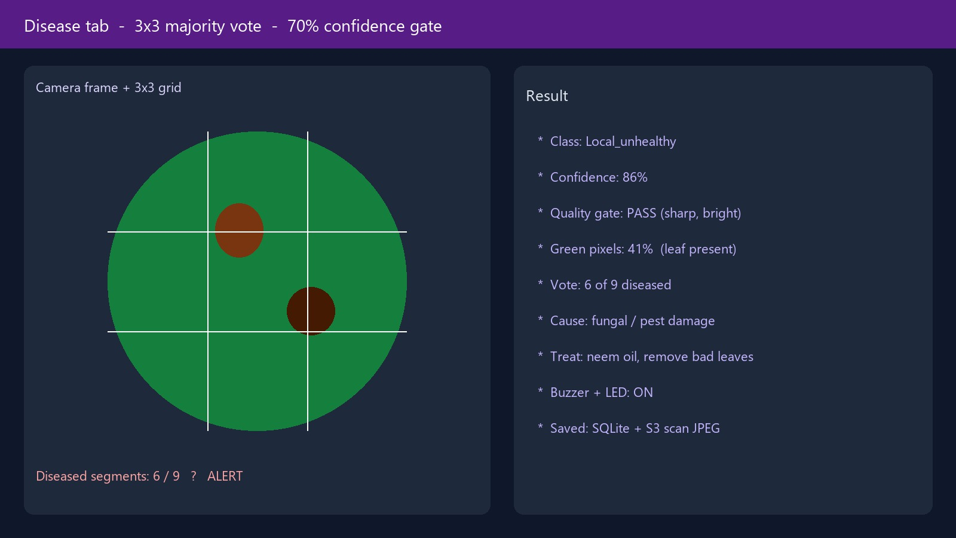
Dashboard — 3x3 disease vote
AgroNex-Pi | Autonomous Smart Agricultural Robot | 28

Slide 31
Applications
● Small farms (1–5 acre): auto water + leaf check.
● Home / terrace gardens: mow + phone monitoring.
● Nurseries: catch disease early, less chemical spray.
● Colleges: teaching IoT, robotics and edge AI.
● Off-grid: local Flask works even without internet.
AgroNex-Pi | Autonomous Smart Agricultural Robot | 27

Slide 32
Future scope
● Better obstacle sense (ultrasonic already started) + wheel encoders.
● Solar + battery monitor for full off-grid use.
● YOLO to find the leaf first, then classify disease.
● More local crops; rain-aware watering; phone app.
● INT8 / Coral TPU for faster AI.
AgroNex-Pi | Autonomous Smart Agricultural Robot | 28

Slide 33
Conclusion
● One affordable rover does irrigation, mowing, GPS and edge AI.
● Local photos + transfer learning solved the “lab vs field camera” gap.
● Safety interlocks and FSM keep high-current parts under control.
● Cloud dashboard is extra; core farming still works offline.
● Shows that smart farming is possible without expensive machinery.
AgroNex-Pi | Autonomous Smart Agricultural Robot | 29

Slide 34
References
● [1] FAO, The State of Food and Agriculture, 2021.
● [2] Sandler et al., MobileNetV2, IEEE CVPR, 2018.
● [3] Mohanty et al., DL plant disease, Front. Plant Sci., 2016.
● [4] Bac et al., Harvesting robots, J. Field Robot., 2014.
● [5] Khanna & Kaur, IoT in precision agriculture, 2019.
● [6] TensorFlow Lite guide; Raspberry Pi 4 datasheet.
● [7] PlantVillage / Kaggle plantdisease dataset.
● [8] TI ADS1115 datasheet; Honeywell HMC5883L datasheet.
AgroNex-Pi | Autonomous Smart Agricultural Robot | 30

Slide 35
Acknowledgement
● Project guide [Name] — guidance and reviews.
● HOD and department — lab, tools, and time on the rover.
● Institute — workspace and academic support.
● Families — patience during build and testing.
● Open source: TensorFlow, Raspberry Pi, PlantVillage, Python.
AgroNex-Pi | Autonomous Smart Agricultural Robot | 31

Slide 36
Thank You
Questions are welcome
AgroNex-Pi · Edge-AI · IoT · Robotics · Cloud
Raspberry Pi 4 | Arduino | TensorFlow Lite | AWS

