Slide 1
IE 403/476 Human-Computer Interaction
Week 6-Lec 2

Slide 2
Fitts’ Law
Models movement times for selection (reaching) tasks in one dimension
Basic idea: Movement time for a selection task
Increases as distance to target increases
Decreases as size of target increases

Slide 3
Components
ID - Index of difficulty
larger target => more information (less uncertainty)
Time T to move your hand to a target of size S
at distance D away is:
T = RT + MT = a + b log₂ (D/W + 1)
width (tolerance)
of target
distance
to move
bits
result

Slide 4
Components
MT - Movement time
MT is a linear function of ID
k₁ and k₂ are experimental constants
MT = k₁ + k₂*ID
MT = k₁ + k₂ *log₂ (D/W + 1)

Slide 5
Throughput
•
Fitts’ also proposed a measure called the
index of performance (IP), now called
throughput (TP)
– Computed as the difficulty of a task (ID, in bits) divided by the movement time to complete the task (MT, in seconds)
•
Thus, TP = ID/MT bits/s

Slide 6
Exact Equation
Run empirical tests to determine k₁ and k₂ in MT = k₁ + k₂* ID
Will get different ones for different input devices and device uses
MT
ID = log₂(d/w = 1.0)

Slide 7
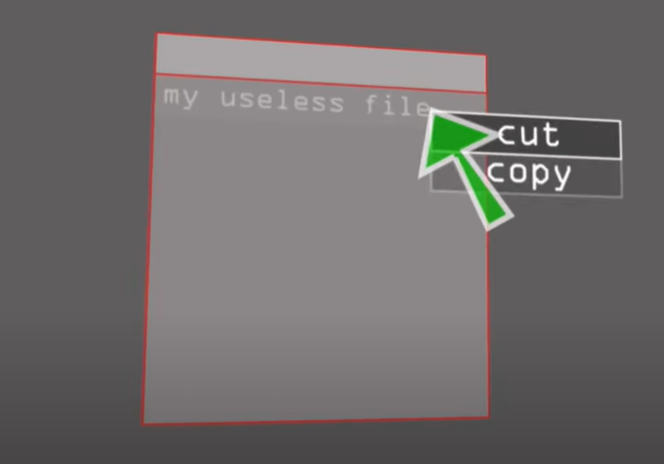
Fitts law uses
Edge of the screen space
controls at the edges of the screen,
they should be active all the way to the edge to take advantage of this effect
Pop menus relative to position
Nearest pixel pop up opens
Menu item size
Icon size
Scroll bar target size and placement
Up / down scroll arrows together or at top and bottom of scroll bar

Slide 8
Microsoft Toolbars offer the user the option of displaying a label below each tool. Name at least one reason why labeled tools can be accessed faster.

Slide 9
The label becomes part of the target. The target is therefore bigger. Bigger targets, all else being equal, can always be acccessed faster. Fitts' Law.
When labels are not used, the tool icons crowd together.

Slide 10
A right-handed user is known to be within 10 pixels of the exact center of a large, 1600 X 1200 screen. You will place a single-pixel target on the screen that the user must stop upon and point to exactly. List the five pixel locations on the screen that the user can access fastest.

Slide 11

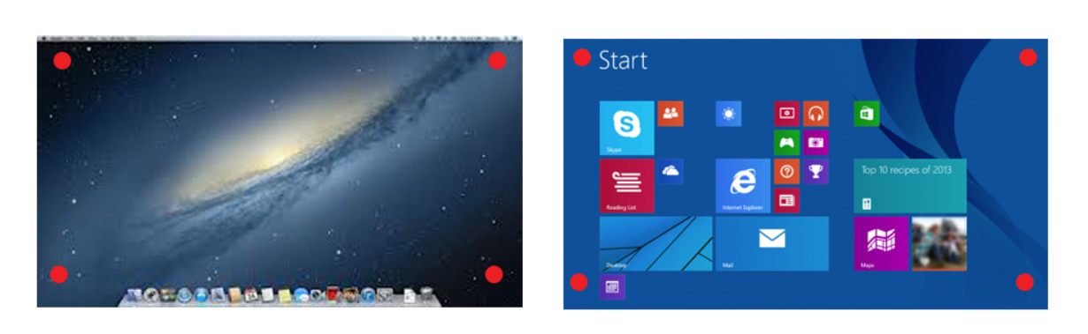
Magic pixels

Slide 12
What is the bottleneck in hierarchical menus and what techniques could make that bottleneck less of a problem?

Slide 13
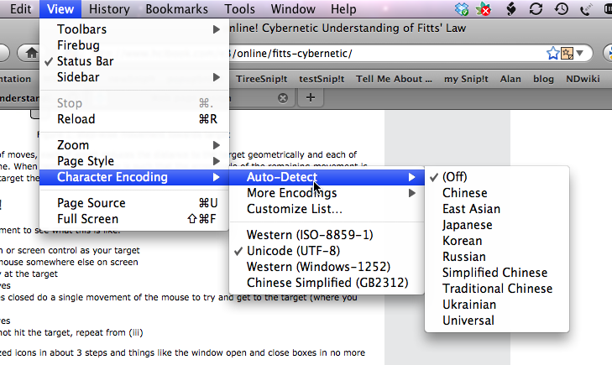
The bottleneck is the passage between the first-level menu and the second-level menu
Fitts' law is not just about target size and distance; it's also about the number of targets.
The more targets, all else being equal, the longer the task will take.
Hierarchicals automatically add one extra target.
Making it difficult to enter a second-level menu adds an additional target, the second-level menu itself.

Slide 14
Name at least one advantage circular popup menus have over standard, linear popup menus.

Slide 15
With the options displayed around you in a circle, you need to only move a pixel or two to enter the "slice of pie" you want. Less travel, good target size. Good design.
Feeding directional information into your motor memory. As long as the options are few enough, Learnability and Memorability EASY

