Slide 1


Slide 2
IE 403/476 Human-Computer Interaction
Week 6-Lec 3

Slide 3
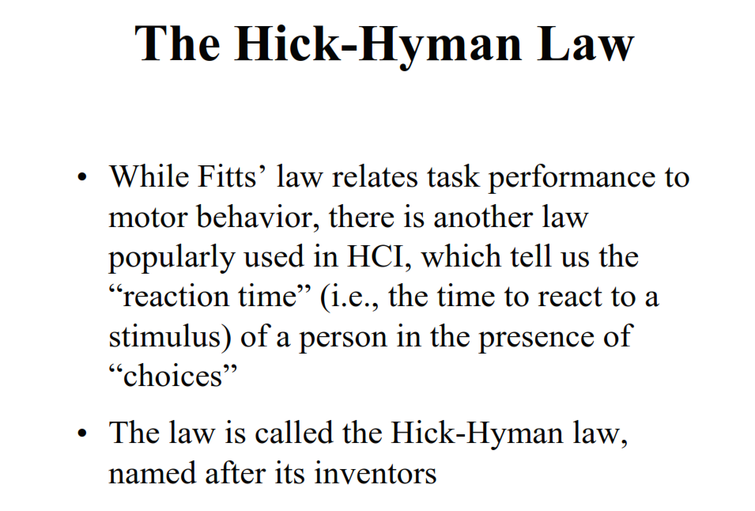

Slide 5
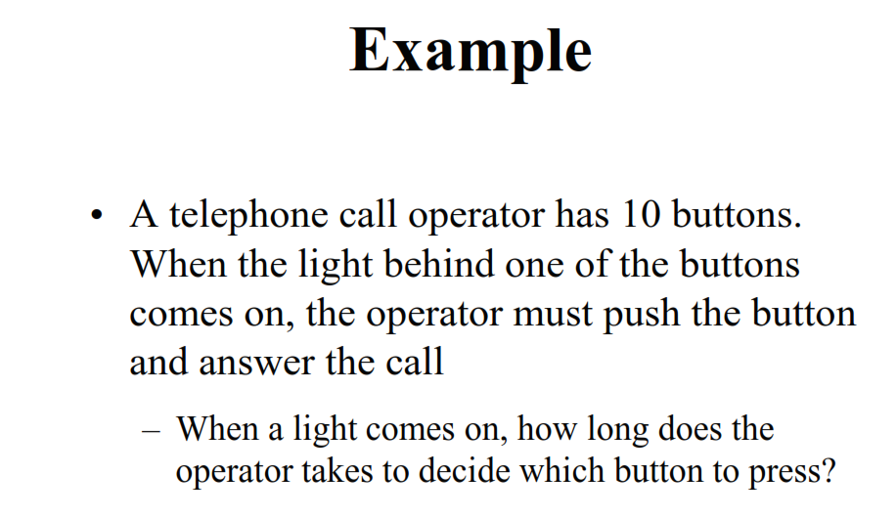
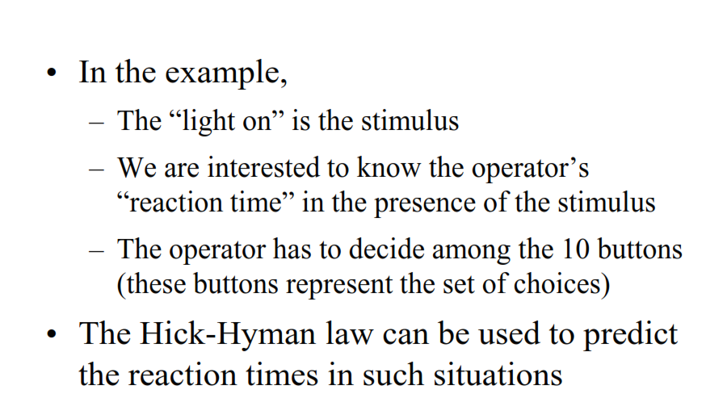

Slide 6
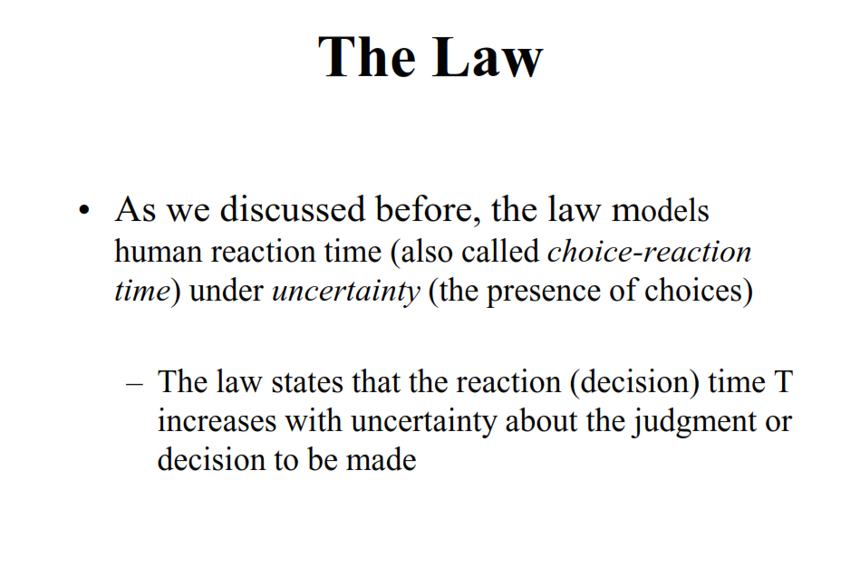
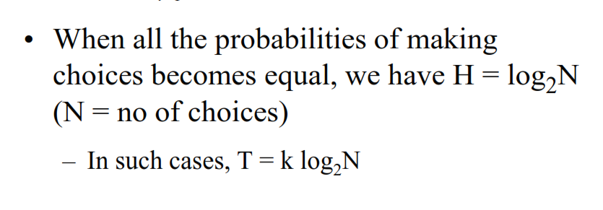

Slide 7
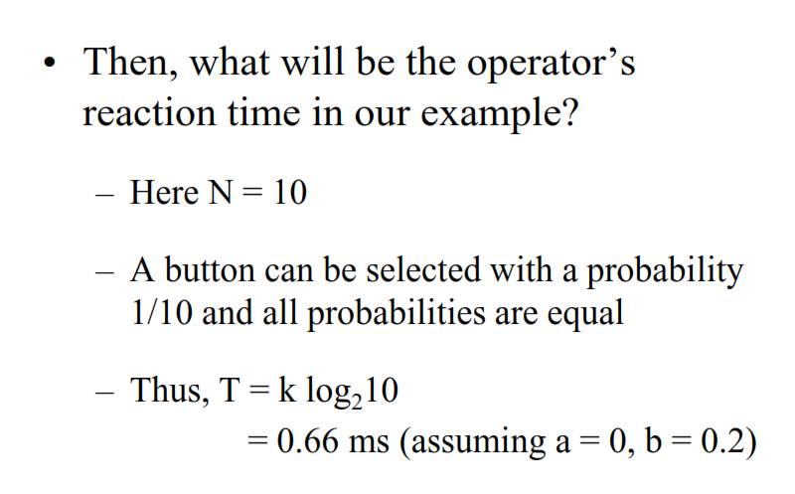

Slide 8
Essentials of UCD
User analysis: who is the user?
Task analysis: what does the user need to do?
Domain analysis: what is the context the user works in (the people and things involved)?
Requirements analysis: what requirements do the preceding three analyses impose on the
design?
Task analysis: what does the user need to do?

Slide 9
Task Analysis
Overview, utility
Types of task analysis
Example

Slide 10
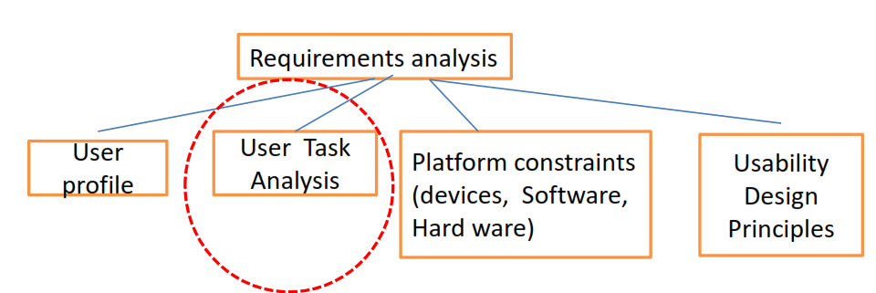
Forms an important part of User Requirements Analysis.
Study of
Users
Work flow patterns,
Conceptual frame works
Sequential execution of Interaction with the GUI
results in an user’s mental map
User breaks down ‘goals’ into a series of smaller tasks & sequences them.
Task analysis defines performance of humans & not computers
Domain analysis

Slide 11
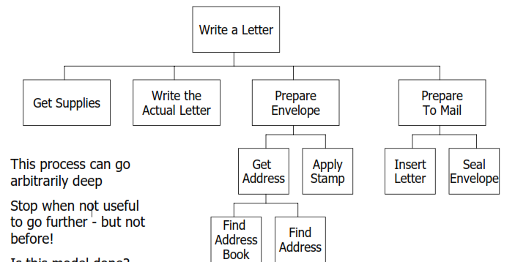
What needs to be done?
GOAL
What must be first done to make it possible?
Preconditions? Why Imp?
Subtasks on which this task depends
Prior information that the user must know?
Steps involved
Subtasks
Further break down of subtasks

Slide 12
Components
Three key components to include in discussing how people work
Activities
Artifacts
Relations
Focus NOT on computer systems but observable behaviors
Study related processes and objects in the environment that people may use and involve
Example: office environment, papers, whiteboards, etc.
User’s goal → Need, Intentions.
Understanding user’s environment
context of use.
Planning for the ‘actions’
User’s need : To communicate with a particular individual
Goal is to inform & seek feed back from that individual in a
particular context.
Actions:
Turning ‘ON’ the Phone;
Dialing the number;
Communicating;
Ending the call.

Slide 13
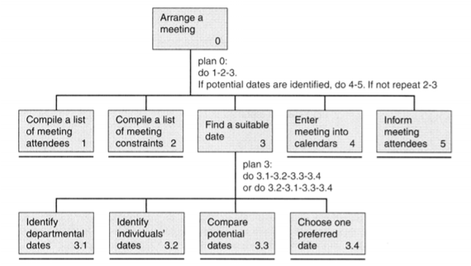
Hierarchical Task Analysis
Decomposing tasks into subtasks & analyzing the logic of sequence needed to execute the task to achieve the set goal (state) in an optimal way.
Graphical notation & decomposition of tasks
Tasks as sets of actions
Clusters of subtasks with a preferred order
and prerequisite conditions
HTA for scheduling a meeting

Slide 14
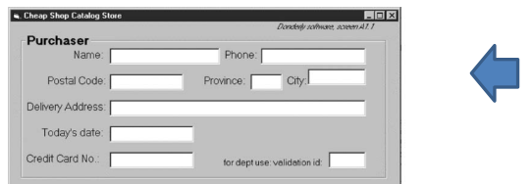
HTA
consistent logical description of the interdependencies of tasks
forms a rational framework
description of possible user interface architecture based on which a GUI is visualised
Example of a decomposition
Task 1: Feed in Address information to order book
Locate the Full Name field.
Move the insertion point to the field.
Sub task 1.1
Type the full name.
Action 1
Locate the Address Line 1 field.
Action 2
Move the insertion point to the field.
Action 3
Type the address.
Optional: Locate the Address Line 2
field.
Action 4
Move the insertion point to the field.
Action 5
Type the address.
Sub Task 1.2
Locate the Town/City field.
Move the insertion point to the field.

Slide 15
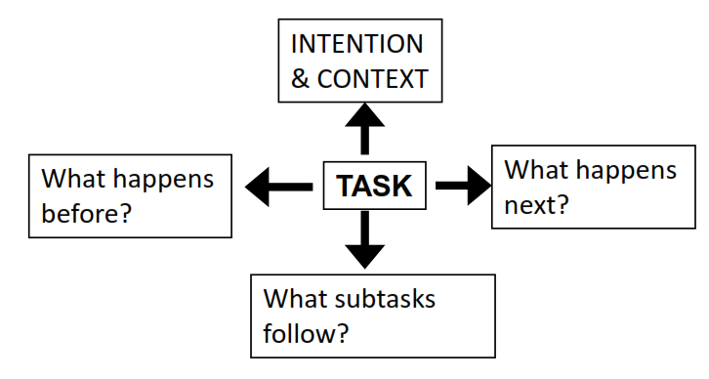
What data to collect for Task analysis?
Starting point for Task analysis is the ‘User’
Ethnography:
Observing and noting users behavior in the use context
Protocol analysis:
Observing
Documenting actions of the user by validating user’s mental thinking .
Making the user think aloud to understand the user’s mental model & logic.
Interviews
Questionnaires

Slide 16
Modeling User data for HTA-Tools
Affinity diagrams
Flow diagrams
Sequence diagrams

Slide 17
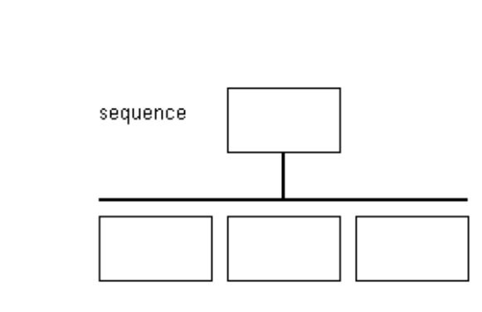
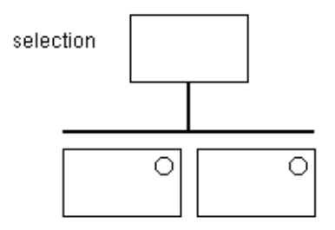
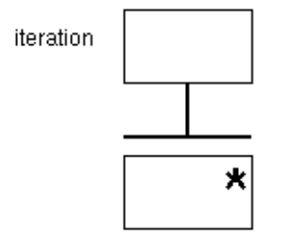
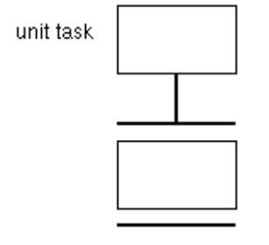
HTA Structure chart notation

Slide 18
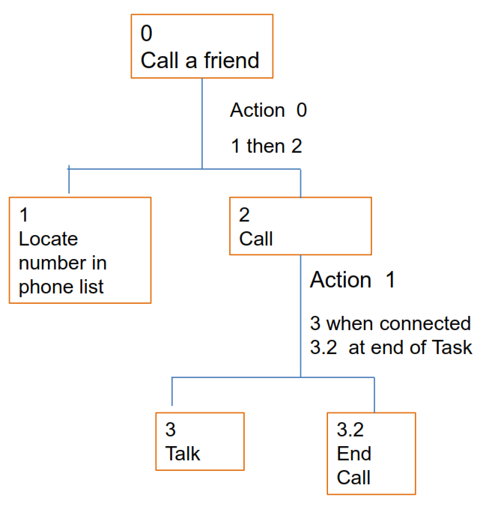
HTA for Calling a Friend

Slide 19
Case Study of a Task Analysis for a web based ticket booking system
for a culture festival on the campus named ‘Synapse’.

Slide 20
Issues leading up to a need for a Computer based seat
reserving system for performances in Synapse
Renowned celebrities & Bands who are invited to perform have
been attracting increasing number of crowds. This is causing, besides overcrowding, security problems, which have often led to suspension of events due to unmanageable crowds.
Passes get printed in thousands and are distributed all over
town. There is no exact predicting mechanism as to the strength of the attending crowd given the fact that the festival is held over three days.

Slide 21
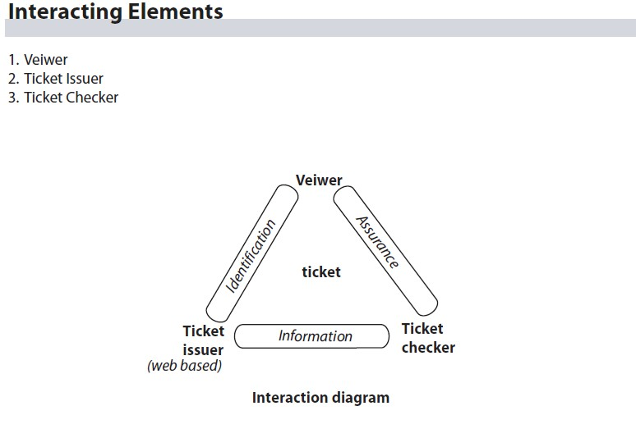
Problem Statement
To design the GUI for a web based ticket booking system for Synapse’s main stage events.
Proposed solution
A web based pre seat reservation system which can close entry to the festival once the Auditoriums & Grounds reach their holding capacity.
Based on initial data on the event following Interaction diagram
is visualised which will form the basis of the web GUI.

Slide 22
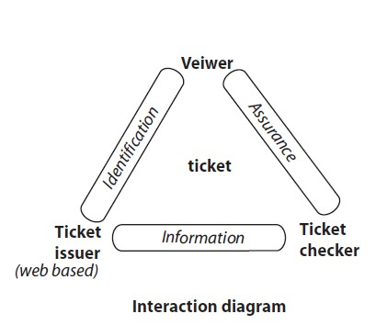
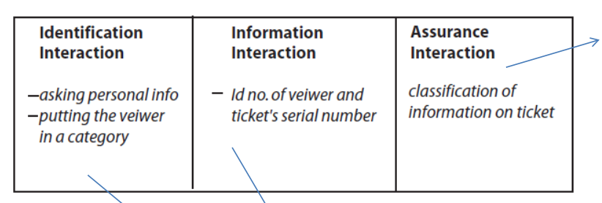
Understanding the users
and their different
classifications and needs.
Ex: DAIICT employees’ family to get priority for seat reservation over general public.
User is assured
of a seat of choice on first come first served basis for a particular event
Viewers Category
1 Faculty
2 Staff
3 Students
4 Visitors
5 VIP passes
Conceptual Model of the GUI
Get category
Display event list and allow user to tick it
Get personal information
Assign Serial number
Send ticket to user’s email

Slide 23
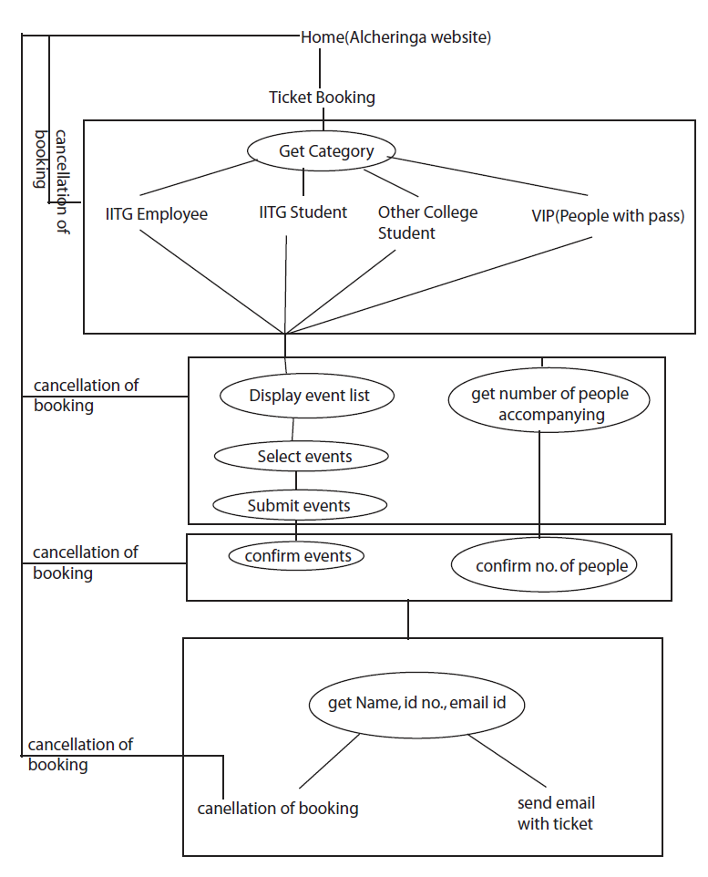
Home (Synapse website)
A first iteration of the HTA.
Faculty
Student
Visitors
VIP passes
HTA diagrams need
iterations.
The consolidated final HTA
diagram is shown in the next slide.

Slide 24
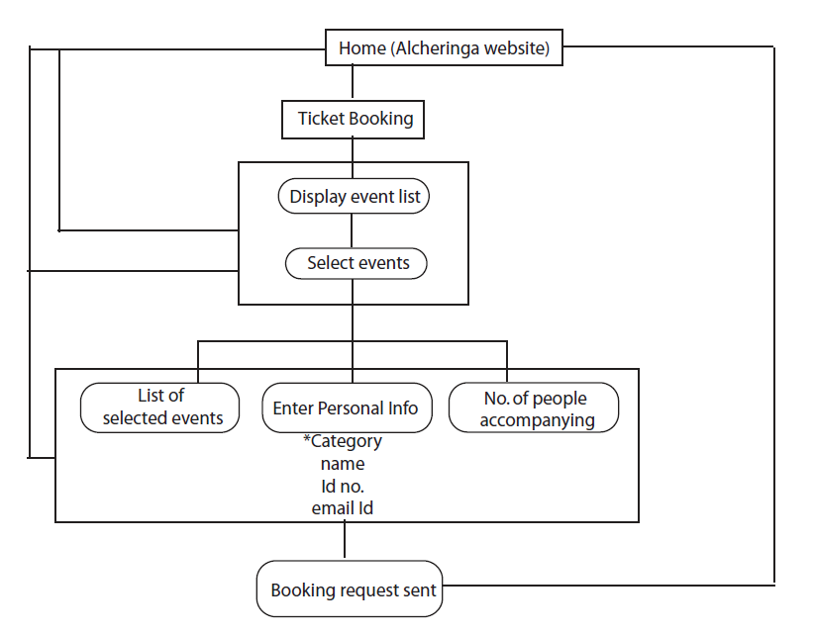
THE TASK DIAGRAM for the website to reserve a festival Seat.
Home (Synapse website)

Slide 25
Summary of TA
Determine the data you need
Gather it using various appropriate methods and techniques
Represent the tasks and subtasks, plus other related information
Use this data to improve design

