Slide 1
IE 403/476 Human-Computer Interaction
Week 8-Lec 1

Slide 2
Dialog Design

Slide 3
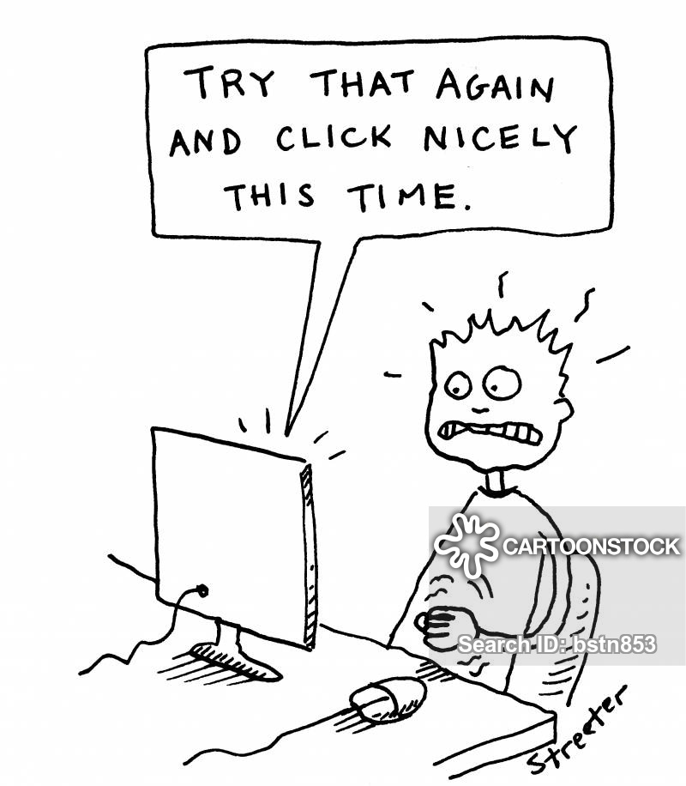
what is dialogue?
conversation between two or more parties
usually cooperative
in user interfaces
refers to the structure of the interaction
syntactic level of human–computer ‘conversation’
levels
lexical – shape of icons, actual keys pressed
syntactic – order of inputs and outputs
semantic – effect on internal application/data

Slide 4
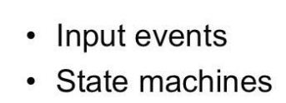

Slide 5
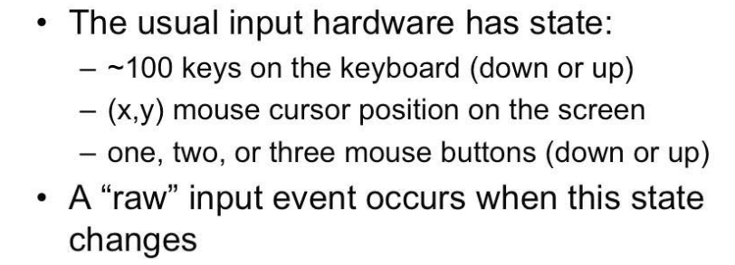
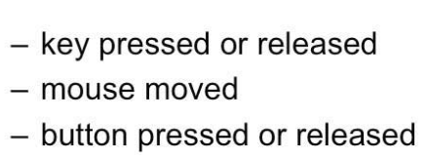
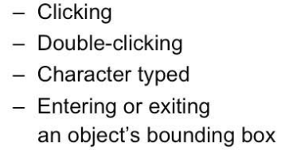
Raw Vs Translated Input Events

Slide 6



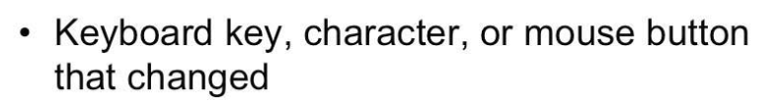
Properties of Input event

Slide 7
State Transition Diagrams/Networks
Assumes
“dialog essentially refers to a progression from one state of the system to the next in the system state space”
Procedural Vs Declarative
circles - states
arcs - actions/events

Slide 8
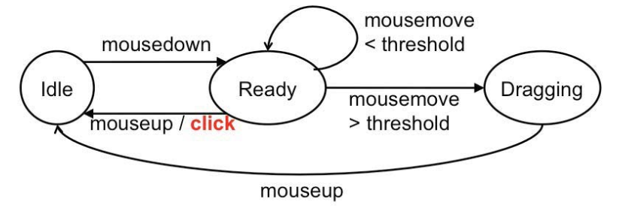
State Machine for generating Click event

Slide 9
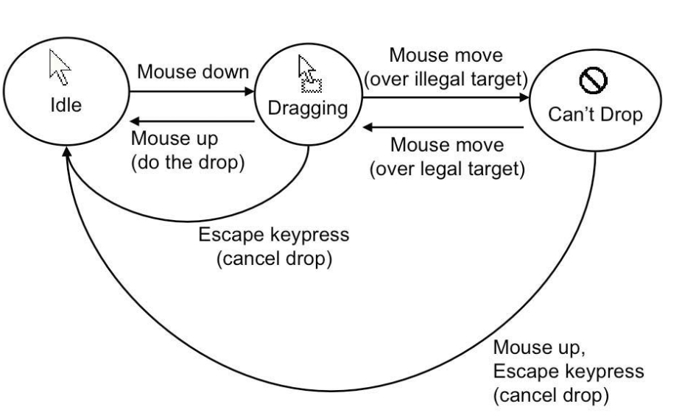
STN for Drag and Drop

Slide 10
State transition networks (STN)

Slide 11
State transition networks - events
arc labels a bit cramped because:
notation is `state heavy‘
the events require most detail

Slide 12
State transition networks - states
labels in circles a bit uninformative:
states are hard to name
but easier to visualise

Slide 13
Hierarchical STNs
Graphics Submenu
select ‘graphics’
managing complex dialogues
named sub-dialogues
Main Menu
select ‘text’
Text Submenu
Paint Submenu
select ‘paint’

Slide 14
Concurrent dialogues - I simple dialogue box
Text Style
bold
example
italic
underline

Slide 15
Concurrent dialogues - II three toggles - individual STNs
NO
bold
click on ‘bold’
bold
bold
NO
italic
click on ‘italic’
italic
italic
NO
u’line
click on ‘underline’
u’line
underline

Slide 16
Concurrent dialogues - III bold and italic combined
Text Style
bold
NO
style
click on ‘bold’
bold
only
example
italic
underline
click
on
‘italic’
click
on
‘italic’
italic
only
click on ‘bold’
bold
italic

Slide 17
Concurrent dialogues - IV all together - combinatorial explosion
Text Style
NO
style
‘bold’
bold
only
bold
example
italic
‘underline’
‘underline’
underline
‘italic’
‘italic’
u’line
only
‘bold’
bold
u’line
‘italic’
‘italic’
italic
only
‘bold’
bold
italic
‘underline’
‘underline’
italic
u’line
‘bold’
bold
italic
u’line

Slide 18
escapes
‘back’ in web, escape/cancel keys
similar behaviour everywhere
end up with spaghetti of identical behaviours
try to avoid this
e.g. on high level diagram
‘normal’ exit for each submenu
plus separate escape arc active ‘everywhere’ in submenu
Graphics Submenu
ESC
select ‘graphics’
normal
finish
Main Menu
select ‘text’
Text Submenu
ESC
normal
finish
Paint Submenu
ESC
select ‘paint’
normal
finish

Slide 19
help menus
similar problems
nearly the same everywhere
but return to same point in dialogue
could specify on STN … but very messy
usually best added at a ‘meta’ level
Circle 1
click on centre
Circle 2
click on circumference
Finish
from
Menu
rubber band
draw circle
press HELP button
press HELP button
Help Subsystem
Help Subsystem

Slide 21
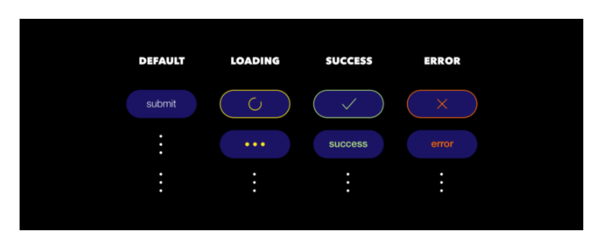
Modeling a Submit button through FSM/STN

Slide 22
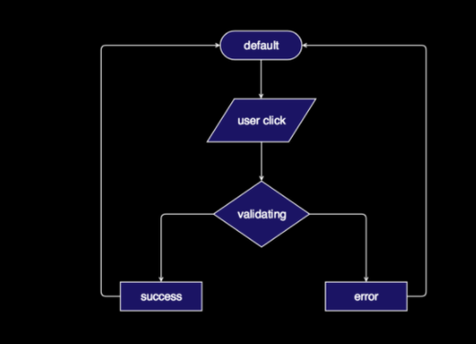
Can a flowchart help with state info?
Where is state info?
Where is indication for which state to which?
Where are the actions that indicate transition of states?

Slide 23
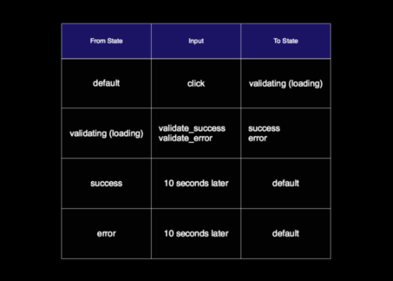
https://www.freecodecamp.org/news/designing-ui-states-and-communicate-with-developers-effectively-by-fsm-fb420ca53215/

Slide 24

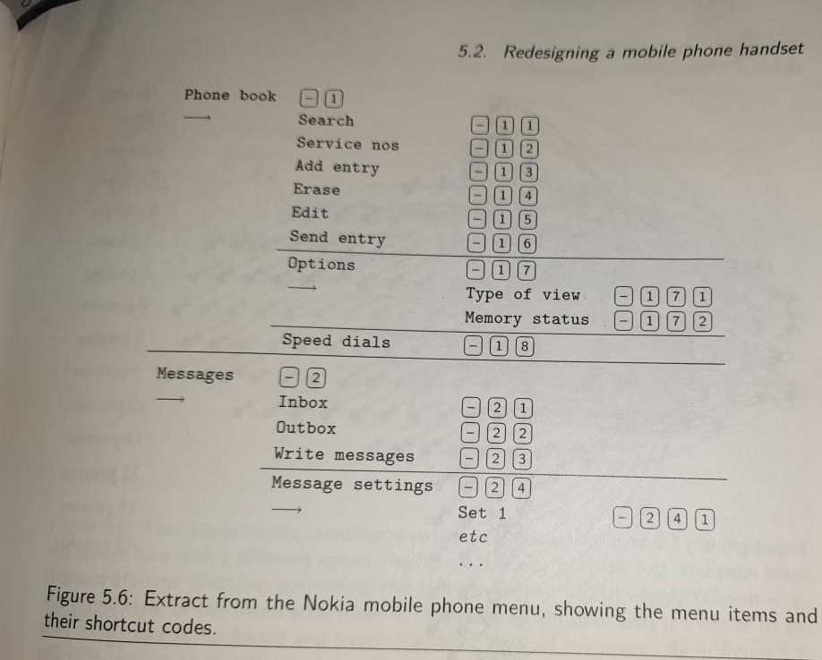
188 Menu Items
84 user selectable functions

Slide 25
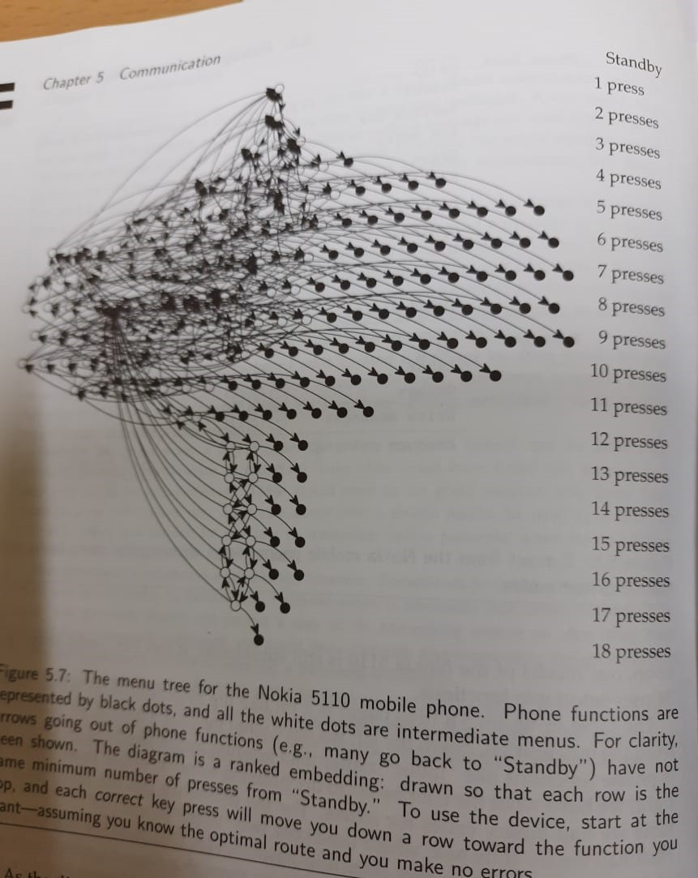

Slide 26
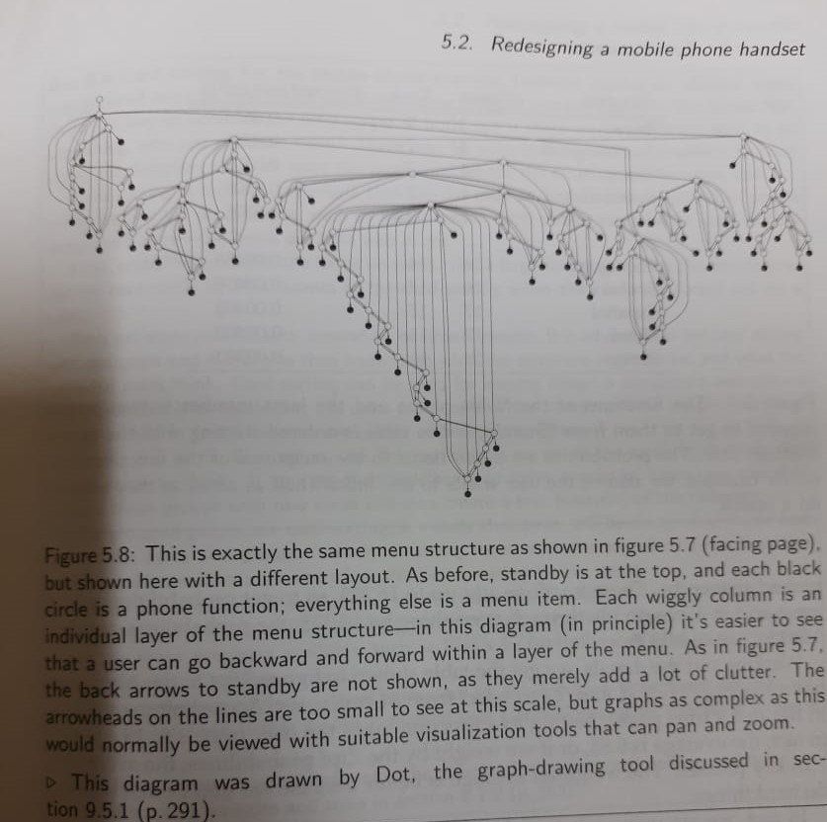

Slide 27
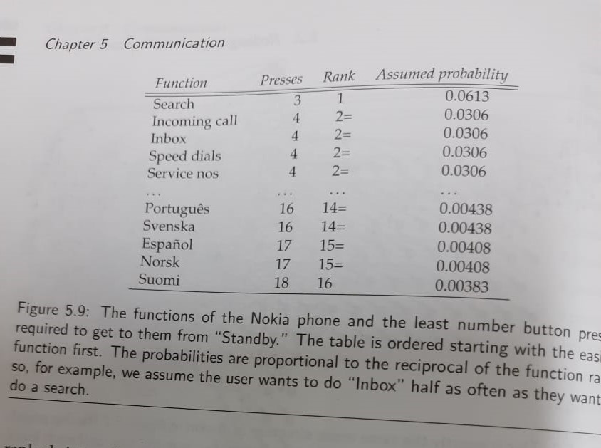

Slide 28
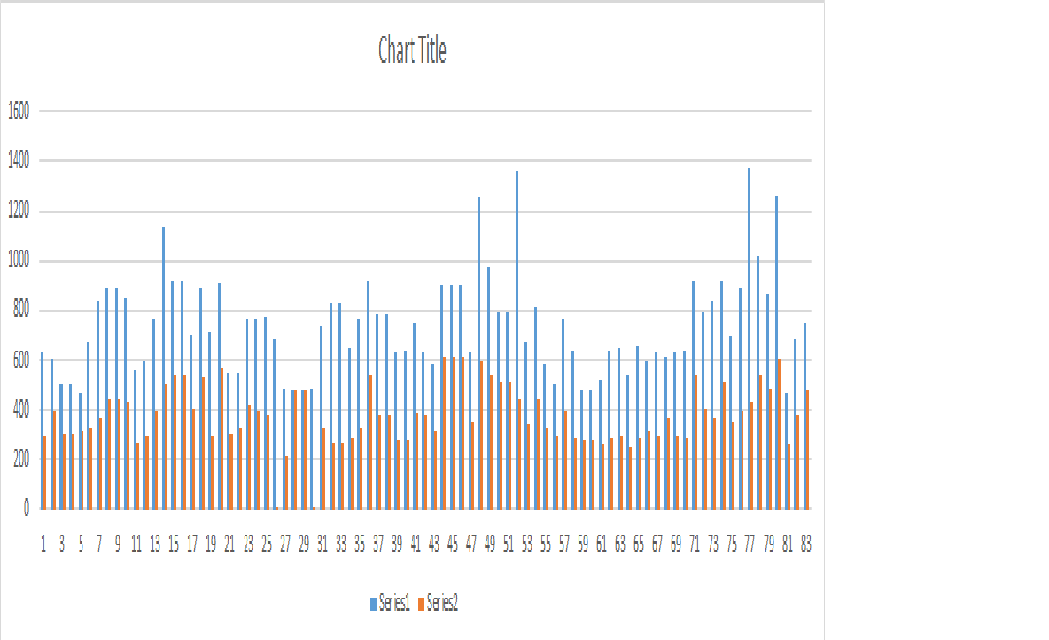

Slide 29
