Slide 1
IE 403/476 Human-Computer Interaction
Week 8-Lec 2

Slide 2
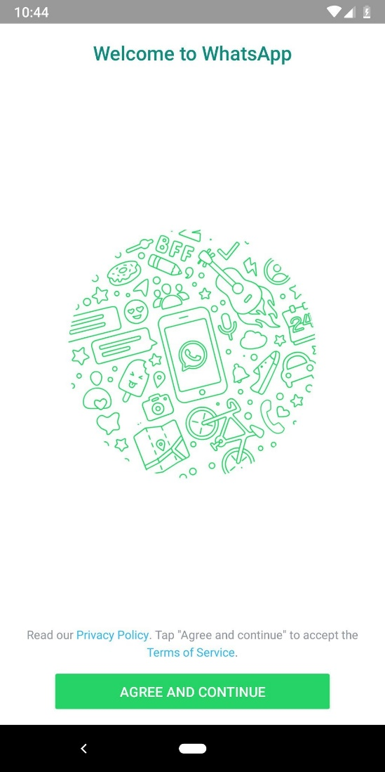
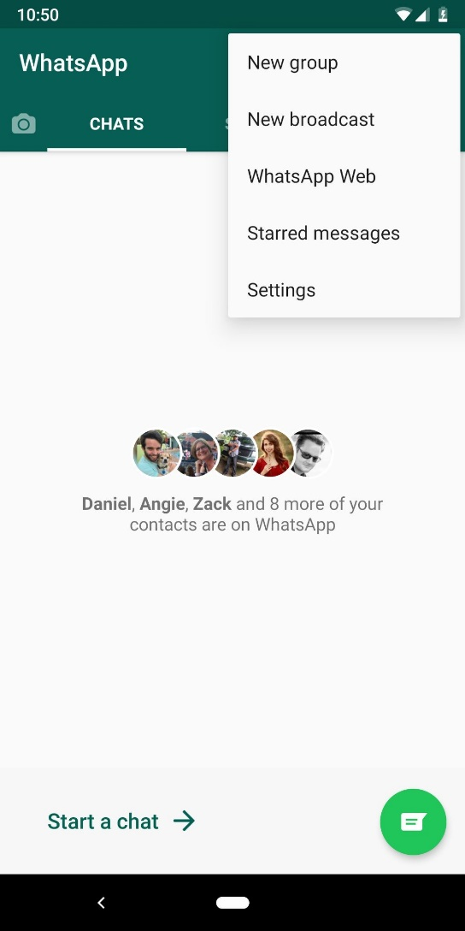
Identify the high-level state charts
screen1 to screen2.

Slide 3
Identify screen rules
Entry and exit rules
what user events cause a screen to be entered or exited?
Start application?
Close application?
Identify any modes
A mode is a state that the software can enter and where the effect of a user event changes depending on the mode
Drawing package: pencil, spray or paint brush?
read-only? Read / write?
Identify the screen items that have varying behavior/enable/disable, visible/invisible, color
Identify the screen items that have constant behavior

Slide 5
Identify states
Converting screen rules to a statechart.
Draw a statechart that defines the required behavior of each screen item as specified in the screen rules and ensure the screen items work together as a whole
Think it in an abstract way, i.e. identify the states first

Slide 6
Consolidate related behavior
Look for common events and conditions that will cause a number of screen items to change state.
What do these states represent?
Can related screen items be brought together into the same states?
ex. Cut, copy, paste can be performed by menu items, icon buttons, and key press, then these related functions can be controlled by the same part of the statechart

Slide 7
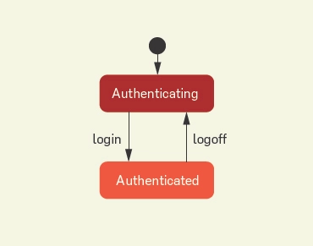
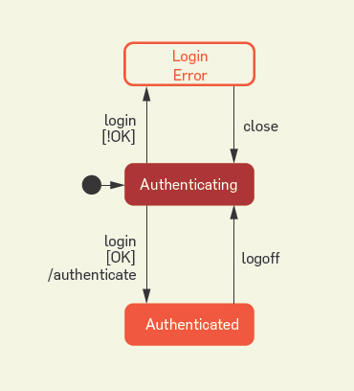
Examples of STD

Slide 9
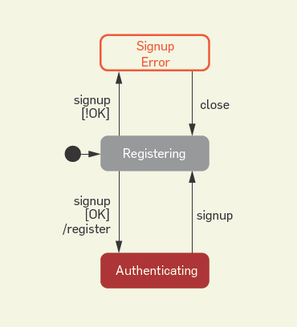
User registration

Slide 10
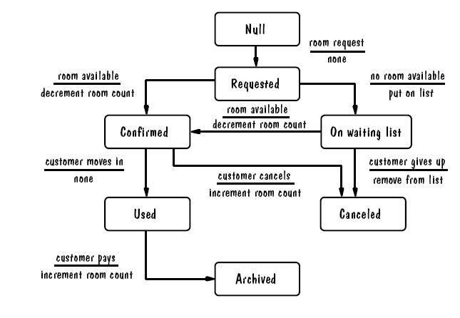
Hotel reservation system

