Slide 1
AeroTwin
AI-Enabled Real-Time Digital Twin for Health Monitoring & RUL Prediction
Aero Piston Engines used in MALE UAVs | Demo Duration: 90 Seconds
MONITOR
Real-Time 1Hz Telemetry Ingestion
PREDICT
R² = 0.8029 RUL Prognostics
PROTECT
Explainable AI Anomaly Detection
Notes:
TITLE SLIDE (Intro)
Welcome everyone. Today we present AeroTwin — our AI-enabled Real-Time Digital Twin framework designed for health monitoring, fault prediction, and mission reliability enhancement of aero piston engines in MALE UAVs.

Slide 2
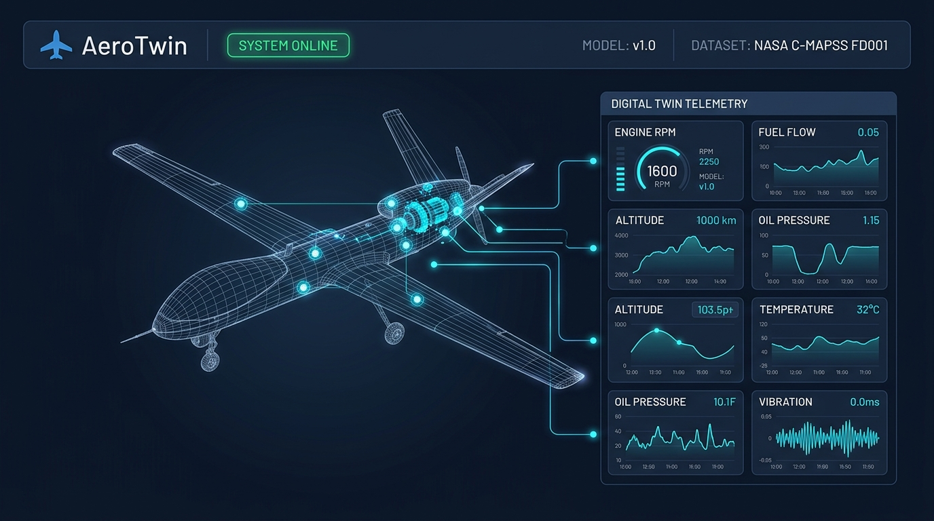
SLIDE 1 | System Overview & Digital Twin Framework
⏱ Presentation Timing: 0:00 – 0:18 (18s)
SYSTEM STATUS
ONLINE | MODEL v1.0
• Target Platform: MALE UAV Aero Piston Engines (Rotax / Austro surrogate).
• Ingestion: 14 active normalized sensor channels (Temperatures, Pressures, RPM, Vibration).
• System Pulse: Live WebSockets/HTTP polling synchronized with digital twin twin state.
• Benchmark Dataset: NASA C-MAPSS FD001 run-to-failure prognostics data.
Notes:
[0:00 - 0:18] Spoken Script:
"Welcome to AeroTwin — an AI-enabled real-time Digital Twin framework engineered for predictive health monitoring and mission reliability in MALE UAV aero piston engines. AeroTwin continuously ingests multi-channel telemetry to track engine degradation, detect emerging anomalies before catastrophic failure, and forecast Remaining Useful Life in real time."

Slide 3
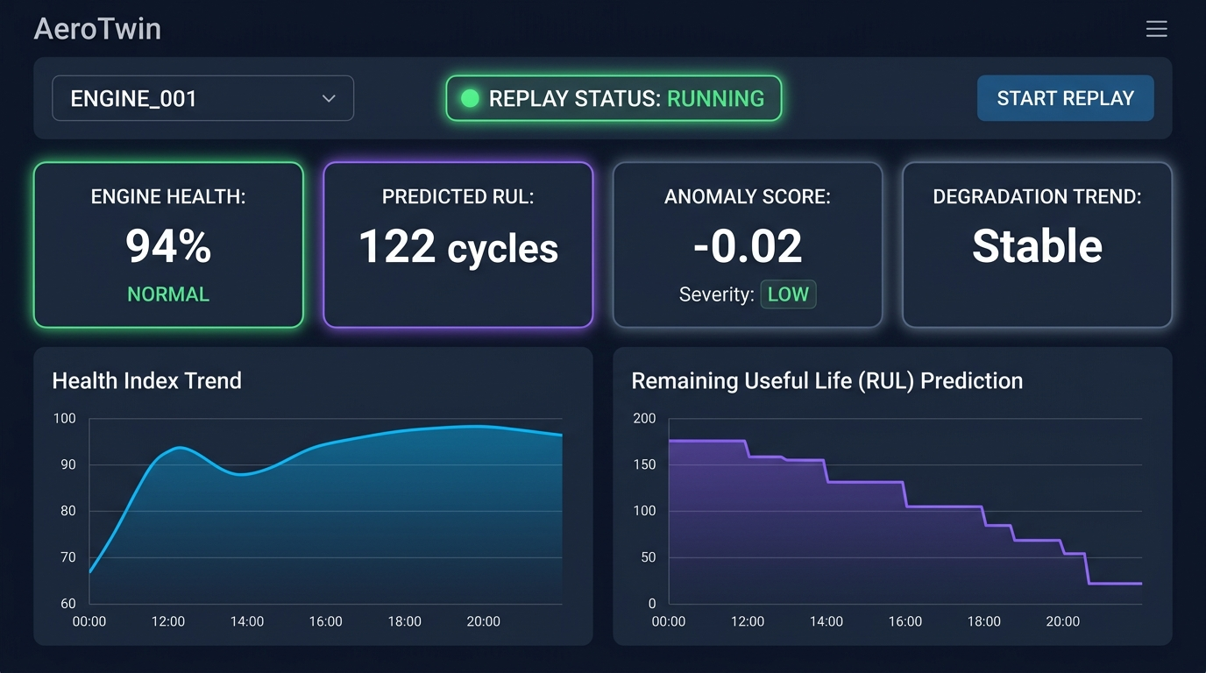
SLIDE 2 | Real-Time Telemetry Replay & RUL Prognostics
⏱ Presentation Timing: 0:18 – 0:42 (24s)
PREDICTED RUL
122 Cycles | HEALTH 94%
• 1 Hz Replay Engine: Historical test-cycle simulation streaming directly to twin state.
• 4 Live KPI Indicators: Engine Health (%), Predicted RUL (cycles), Anomaly Score, Degradation Trend.
• Dual Live Curves: Real-time Recharts streams for Health Index & RUL step-down countdown.
• Dynamic Scoring: Health Index = (RUL / 130) * 100% with severity penalty reductions.
Notes:
[0:18 - 0:42] Spoken Script:
"Starting our historic telemetry replay engine at 1 Hz streaming frequency, the Digital Twin synchronizes with incoming engine sensor cycles. On screen, our Random Forest Regressor predicts the remaining useful operational cycles, dynamically computing an overall Health Index from 100% down to critical thresholds, as visualized in the real-time health and RUL degradation curves."

Slide 4
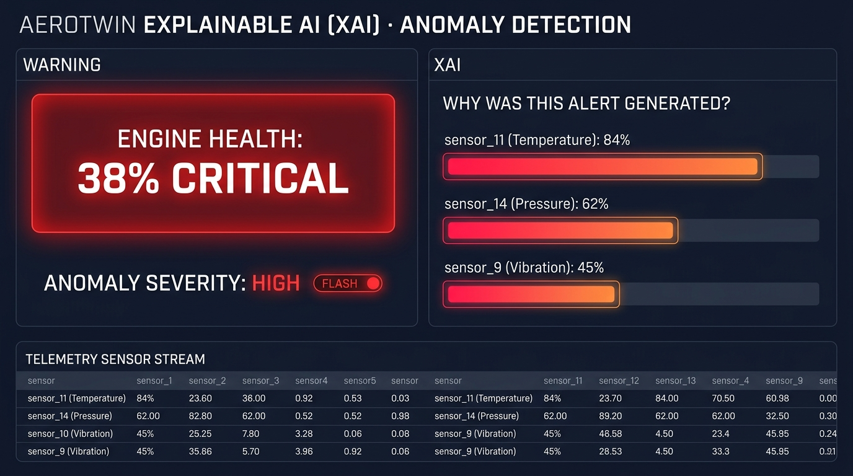
SLIDE 3 | Anomaly Detection & Explainable AI (XAI) Diagnostics
⏱ Presentation Timing: 0:42 – 1:05 (23s)
ANOMALY ALERT
SEVERITY: HIGH (38% CRITICAL)
• Isolation Forest Anomaly Engine: Unsupervised outlier detection with 1% contamination threshold.
• Automated Severity Flagging: Instant state transition from NORMAL (Green) to CRITICAL (Red).
• Explainable AI (XAI): Root-cause sensor contribution ranking with proportional impact bars.
• Top Fault Contributors: sensor_11 (Temperature: 84%), sensor_14 (Pressure: 62%), sensor_9 (45%).
Notes:
[0:42 - 1:05] Spoken Script:
"When sensor drift occurs, our background Isolation Forest model flags anomalous patterns and calculates the severity level. Crucially, AeroTwin provides Explainable AI: the side panel instantly reveals the top contributing sensor anomalies and drift percentages, giving ground-station operators actionable root-cause diagnostics instead of a black-box alert."

Slide 5
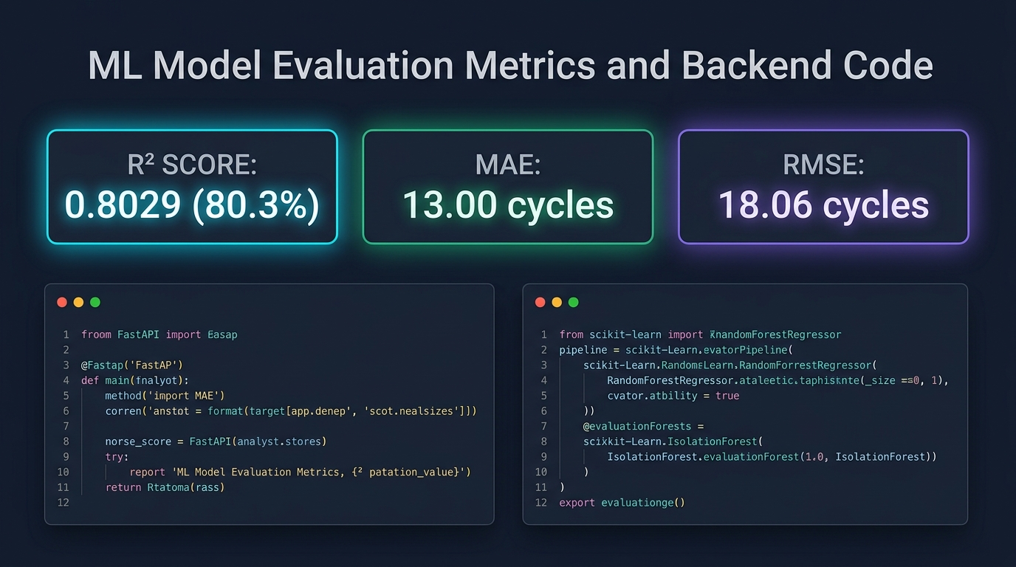
SLIDE 4 | Quantitative Evaluation Metrics & Architecture Code
⏱ Presentation Timing: 1:05 – 1:22 (17s)
R² SCORE / MAE
0.8029 | 13.00 Cycles
• R² Score: 0.8029 (80.3% degradation variance explained on last cycle test set).
• Mean Absolute Error (MAE): 13.00 cycles average RUL deviation.
• Root Mean Squared Error (RMSE): 18.06 cycles.
• Architecture: FastAPI REST backend + Scikit-Learn RandomForest & IsolationForest pipelines.
Notes:
[1:05 - 1:22] Spoken Script:
"Under the hood, the backend is built with FastAPI and scikit-learn. Validated against multi-cycle run-to-failure benchmark datasets across 14 normalized sensor channels, our RUL model achieves a strong R² score of 0.8029, a Mean Absolute Error of 13.00 cycles, and an RMSE of 18.06 cycles."

Slide 6
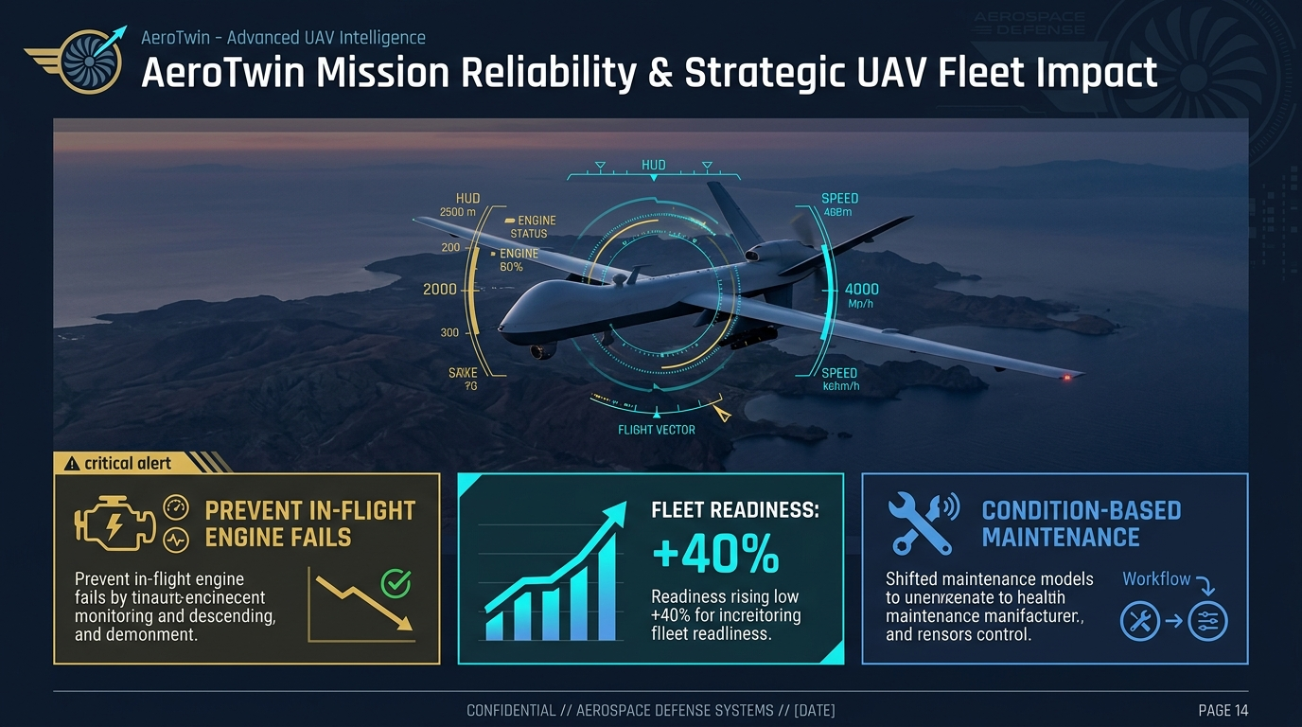
SLIDE 5 | Mission Reliability Impact & Strategic Readiness
⏱ Presentation Timing: 1:22 – 1:35 (13s)
FLEET READINESS
+40% Operational Availability
• Prevent In-Flight Failures: Predictive early warning prevents catastrophic mid-mission engine breakdown.
• Fleet Availability (+40%): Drastic reduction in unneeded ground teardowns and inspection downtime.
• Condition-Based Maintenance (CBM): Paradigm shift from rigid flight-hour schedules to telemetry-driven CBM.
• High Scalability: Easily extensible to multi-UAV tactical fleet ground control stations.
Notes:
[1:22 - 1:35] Spoken Script:
"By transitioning UAV maintenance from reactive schedules to real-time predictive digital twinning, AeroTwin prevents in-flight engine failures and maximizes fleet availability. Thank you."

