Slide 1
Payment Transaction
Anomaly Classification
A Foundational Machine Learning Approach to Fraud Risk Detection
Track 1 Final Capstone · Problem 26 · FinTech · Binary Classification

Slide 2
Problem Statement
Classify payment transactions as normal or anomalous (potential fraud) using measurable transaction characteristics.
Fraud is rare (~1-2% of transactions) — a textbook class-imbalance problem.
Goal: an interpretable, reproducible, zero-cost baseline — not a black-box production system.

Slide 3
Dataset
Source recorded in data/SOURCE.txt for citation
Designed as a drop-in pipeline for the Kaggle “Credit Card Fraud Detection” dataset (ULB Machine Learning Group).
Falls back to a realistic synthetic dataset (20,000 transactions, ~1.5% fraud rate) when the real file isn't supplied — same feature structure either way.
6 features: transaction amount, hour of day, 24h transaction frequency, merchant category risk, account age, 30-day average spend.
Deliberately includes missing values, duplicates, and outliers for genuine EDA investigation.

Slide 4
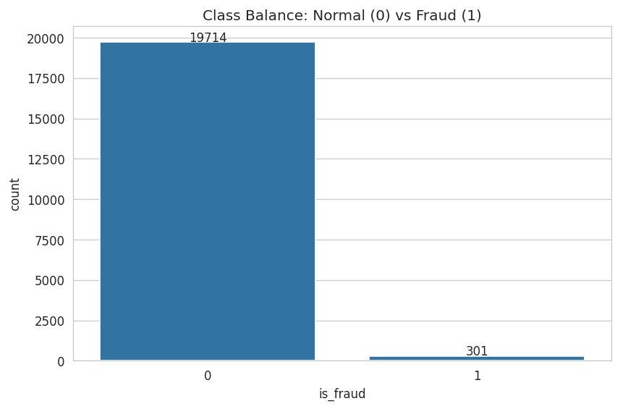
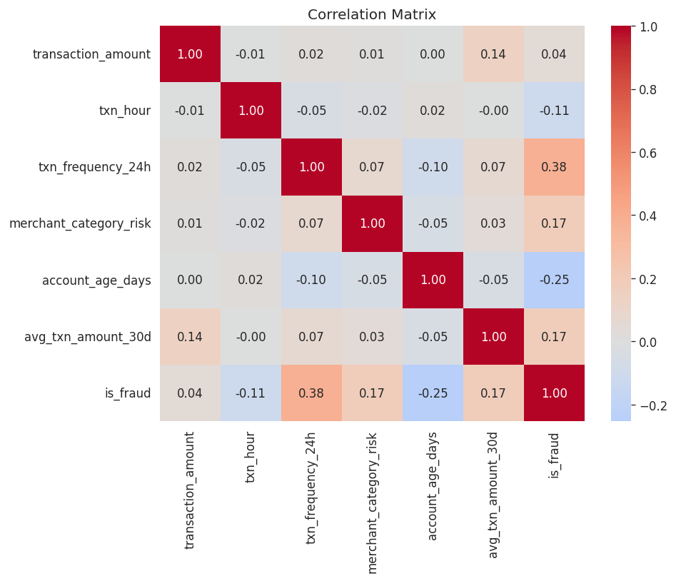
Exploratory Data Analysis
Severe class imbalance drives every downstream modeling choice

Slide 5
Methodology
Median-impute missing values; drop exact duplicates.
Log-transform skewed amount features; standardize for Logistic Regression & KNN.
Stratified 75/25 train/test split preserving the fraud rate.
class_weight='balanced' to prevent the rare class from being ignored.
Three foundational models only, per scope: Logistic Regression, KNN, Decision Tree.

Slide 6
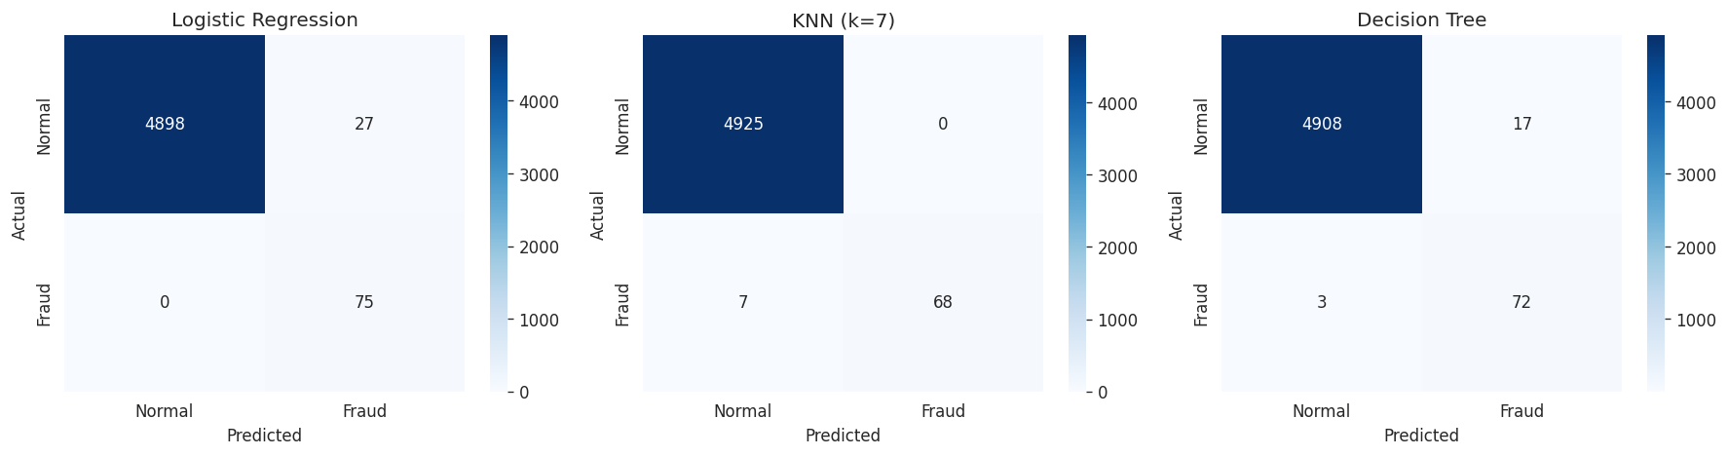
Results
Accuracy alone is misleading at 1.5% fraud — recall & precision matter most
Model | Accuracy | Precision | Recall | F1
Logistic Regression (final) | 0.995 | 0.735 | 1.000 | 0.848
KNN (k=7) | 0.999 | 1.000 | 0.907 | 0.951
Decision Tree | 0.998 | 0.809 | 0.960 | 0.878
100%
0.9999
Recall (final model)
ROC-AUC

Slide 7
Why Logistic Regression?
Highest recall (100%) on the fraud class — misses no real fraud in testing.
Fully interpretable coefficients — explainable and defensible, as the capstone rules require.
Fast to train and retrain — practical for an auditable, reproducible baseline.
Trade-off: more false positives than KNN (73.5% precision) — an acceptable cost versus missing real fraud.

Slide 8
Limitations & Future Scope
Limitation: synthetic data unless the real Kaggle dataset is supplied; only 6 engineered features used.
Limitation: single train/test split, not k-fold cross-validated.
Future: richer behavioural/device/network features; cost-sensitive threshold tuning.
Future: cross-validation, hyperparameter search, and ensemble methods (Random Forest, Gradient Boosting) as a next step beyond this capstone's scope.

Slide 9
Prototype: Streamlit App
app/app.py — run with: streamlit run app.py
Interactive form collects the six transaction features.
Validates inputs and applies the exact preprocessing used during training.
Returns a Normal / Anomalous classification with an estimated fraud probability.
Educational demo only — clearly labeled as not a production fraud system.

Slide 10
Conclusion
Delivered a complete, reproducible, zero-cost ML pipeline for payment fraud classification.
Logistic Regression baseline: 100% recall, 0.9999 ROC-AUC, fully interpretable.
All deliverables complete: code, notebook, model, app, paper, and this presentation.

