Slide 1

Clicker Questions for States of Matter: Basics
AUTHORS:
Robert Parson (University of Colorado Boulder)
Trish Loeblein (University of Colorado Boulder)
COURSE:
Introductory / Preparatory College Chemistry
COPYRIGHT: This work is licensed under a Creative Commons Attribution 4.0 International License.

Slide 2
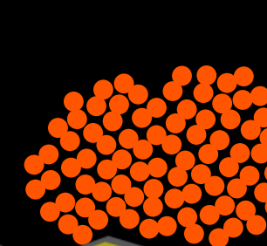

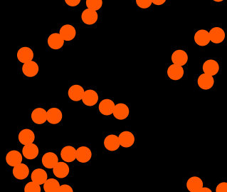
Which picture best describes oxygen gas?
a. b. c.
Notes:
Goal: Assess students’ prior knowledge and familiarity with molecular-scale representations, and their comfort with the use of these representations to describe states of matter.
Sim demo description: Prepare the sim in the background and set it to oxygen, hiding it from view. Ask this clicker question prior to any sim demo.
Correct answer: C
Representative results from pre-general chemistry: 97% correct
Follow-up discussion: Use the simulation to heat and cool the sample to demonstrate all of the states of matter.

Slide 3
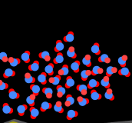
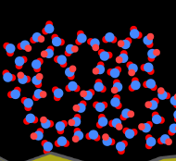
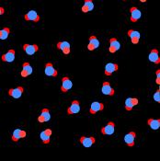
Which is most likely liquid water?
a. b. c.
Notes:
Goal: Assess students’ knowledge of the unusual properties of water ( that the liquid is more dense than the solid), and the degree to which they tie this knowledge to submicroscopic representations. Ask this question prior to showing students the simulation’s depiction of water.
Correct answer: A
Representative results from pre-general chemistry: (1st round, largely individual response) Roughly 50:50 split between A and B.
Class and peer discussion: Ask students to discuss with their neighbours about the macroscopic properties of water and ice. Possibly highlight the behaviour of ice cubes in water.
Representative results from pre-general chemistry: (2nd round, after peer discussion) 74% correct (24% B)

Slide 4

What happens if you add energy using the heater?
The atoms get larger.
The atoms move faster.
Both a. and b.
Neither a. nor b.
Notes:
Goal: Literature on student conceptions in chemistry shows that students often attribute the properties of macroscopic matter to individual atoms and molecules. This does not seem to have been an issue in this class.
Correct answer: A
Representative results from pre-general chemistry: 90% correct
Class and peer discussion: Ask students to discuss with their neighbours about the macroscopic properties of water and ice. Possibly highlight the behaviour of ice cubes in water

Slide 5
What happens if you continue to add energy using the heater?
No change other than all atoms speed up
More atoms would condense
More atoms would evaporate
Notes:
Correct answer: C
Representative results from pre-general chemistry: 79% correct

