Slide 1
Customer Segmentation
Using RFM analysis
Data Analysed by:
I030 Nikhil Joshi
I033 Pragati Bist
I034 Prakhar Sharma

Slide 2
Table of contents
01
03
02
04
Introduction to RFM
Analysis in R
RFM Analysis is a data-driven customer behavior segmentation technique based on their Recency, frequency and monetary value.
Analysis of the data using R
Database
Conclusion
Explanation of the database that is analyzed.
Conclusions drawn from the analysis.

Slide 3
Problem Statement
A retail company wants to gain insights into its customer base to develop targeted marketing strategies and improve customer retention. The company has collected data on customer transactions, demographics, and purchase history. The goal is to analyze this data to segment customers based on their purchasing behavior, identify patterns and trends, and understand the characteristics of different customer groups.
Specifically, the company aims to:
Perform RFM (Recency, Frequency, Monetary) analysis to identify valuable customers and categorize them based on their purchasing patterns.
Analyze the relationship between customer demographics (age, gender, job industry, wealth segment) and their purchasing behavior.
Identify customer segments based on detailed customer titles derived from RFM scores and other relevant factors.
Explore the distribution of customers across different states and their car ownership status.
Visualize the data and findings to gain insights into customer segmentation, purchasing patterns, and potential target markets.

Slide 4
01
Introduction to RFM

Slide 5
Introduction to RFM
RFM stands for Recency, Frequency, Monetary analysis.
Evaluates three key metrics to understand customer behavior.
Key components of RFM:-
Recency Value: Time since last customer interaction.
Frequency Value: Rate of customer interactions.
Monetary Value: Total spending by the customer.

Slide 6
Implementation of RFM Analysis
Data Collection: Gather customer data from various sources.
Scoring: Rank customers based on RFM metrics.
Segmentation: Group customers into segments.
Strategy Development: Tailor marketing strategies for each segment.
Implementation: Execute targeted campaigns based on RFM segmentation.
Evaluation: Analyze effectiveness and refine strategies.

Slide 7
Benefits of RFM Analysis
Improved customer targeting and segmentation.
Personalized marketing campaigns.
Enhanced customer engagement and loyalty.

Slide 8
Customer RFM Segments
Best Customers: High Score in all categories; loyal and high spenders.
Big Spenders: High scores in all categories; loyal and high spenders.
Loyal Customers: High frequency scorers; reward with incentives like free shipping.
Faithful Customers: High frequency but lower monetary value; engage with product recommendations and spending incentives.
At-Risk Customers: Previously top-tier customers now low in recency and frequency; target with retention-focused messages and exclusive offers.

Slide 9
02
About the Dataset

Slide 10
Data Analytics: Customer Segmentation
In this analysis the customer segment was divided into 11 groups.
The analysis will help in determining which customers segments should be targeted to enhance sales revenue for the company.
The dataset is present in an excel file which has 4 sheets:
CustomerDemographics.xlsx
NewCustomerList.xlsx
Transaction_data.xlsx
CustomerAddress.xlsx

Slide 11
Libraries Used
library(dplyr) # For data manipulation
library(ggplot2) # For data visualization
library(lubridate) # For working with dates and times
library(plotly)

Slide 12
03
Analysis in R

Slide 13
Data Quality Assessment and Data Cleaning
The first step towards generating useful insights from the data was the data preparation, quality assessment and data cleaning step.
After the cleaning process exploratory data analysis on the dataset and identification customer purchasing behaviors to generate insights can be performed.

Slide 14
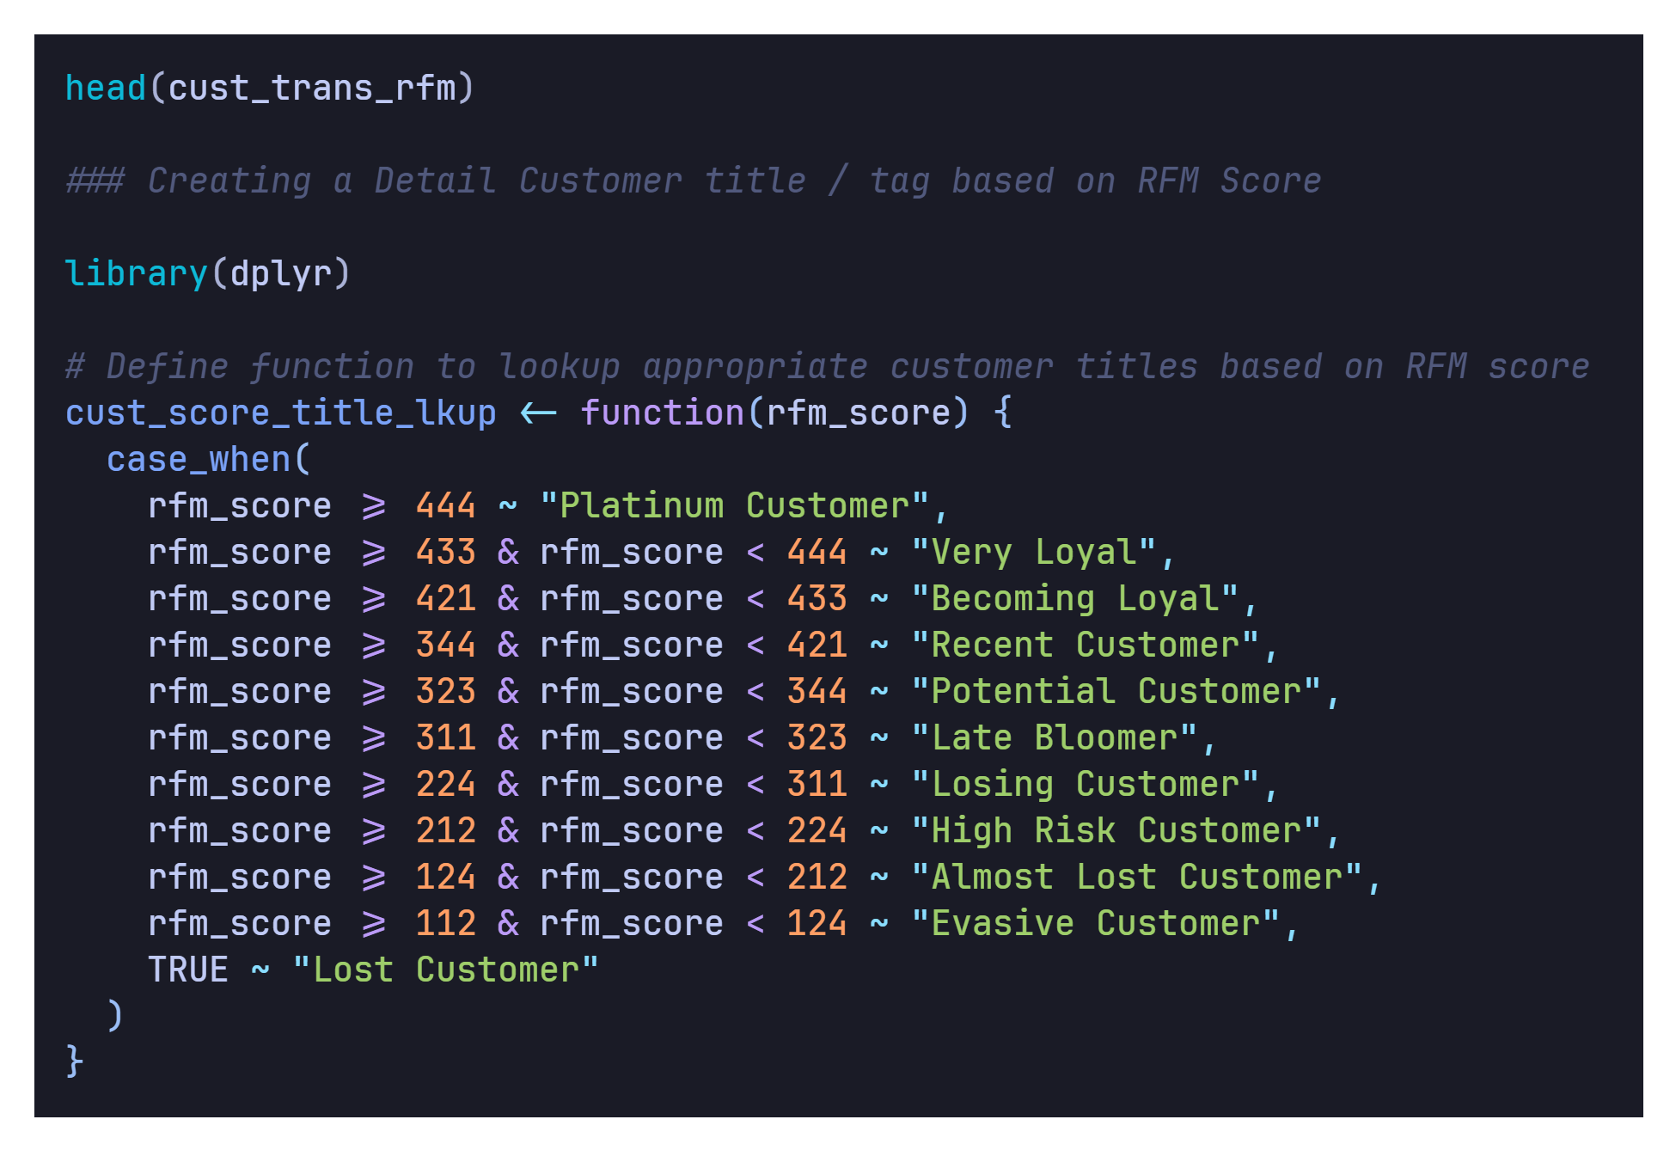
Functions

Slide 15
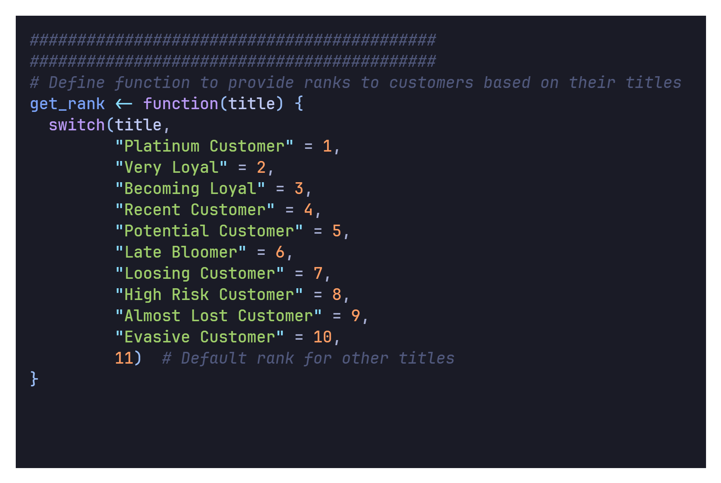
Functions (Contd.)

Slide 16
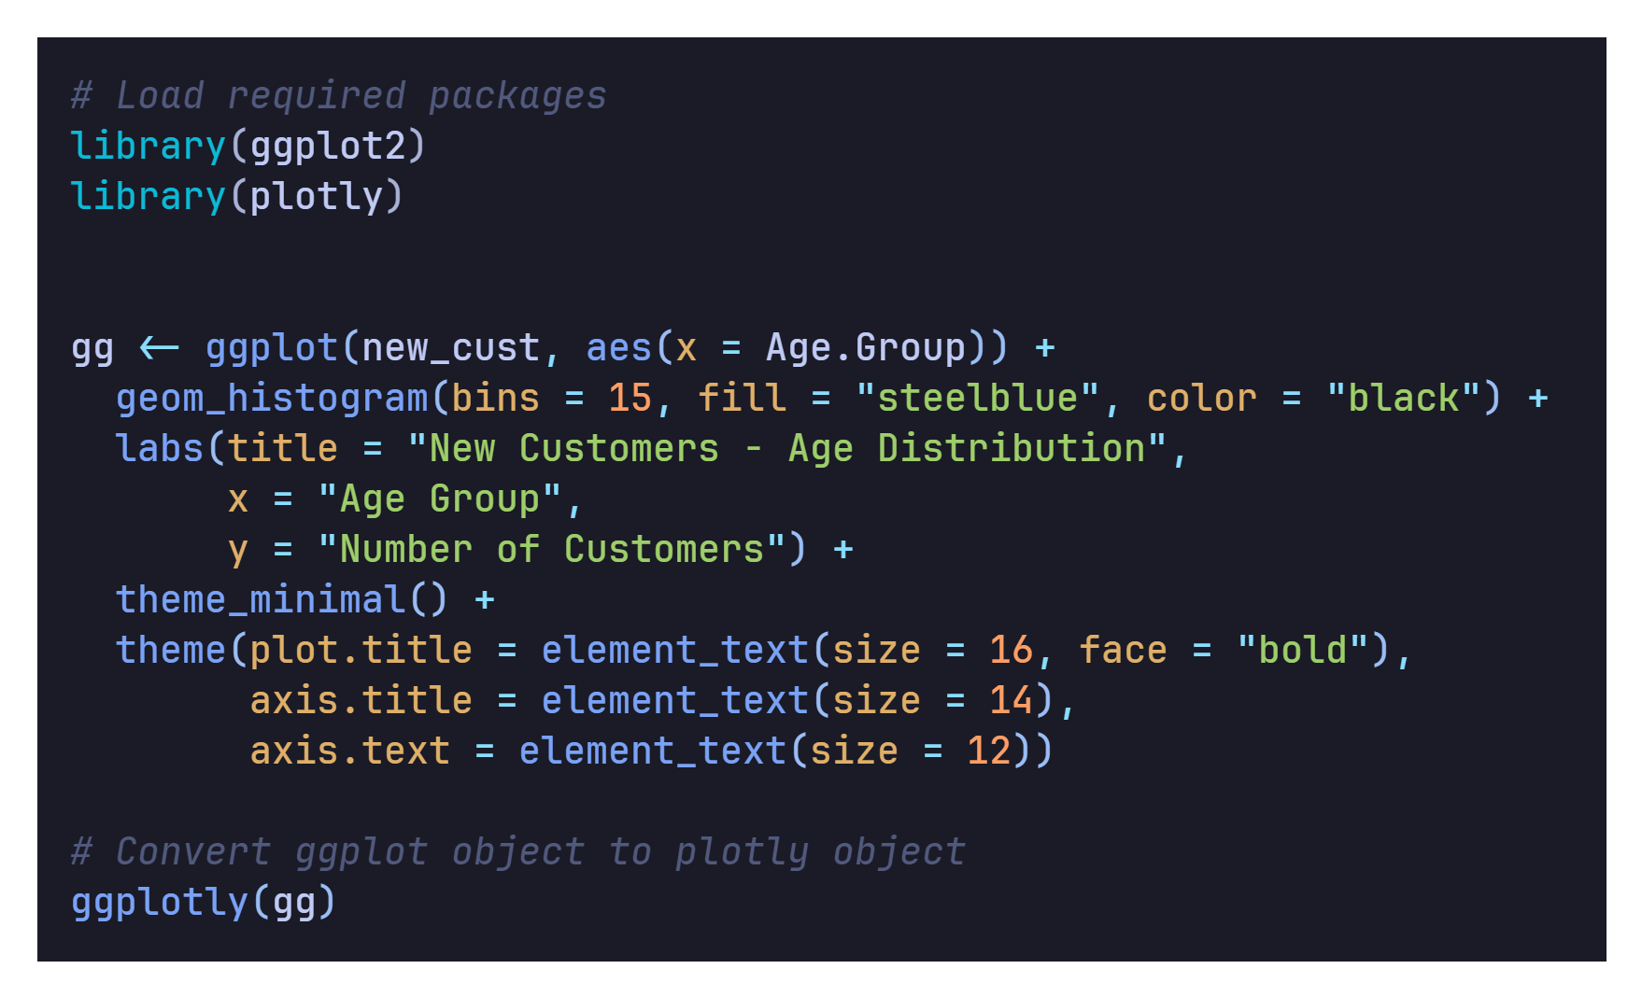
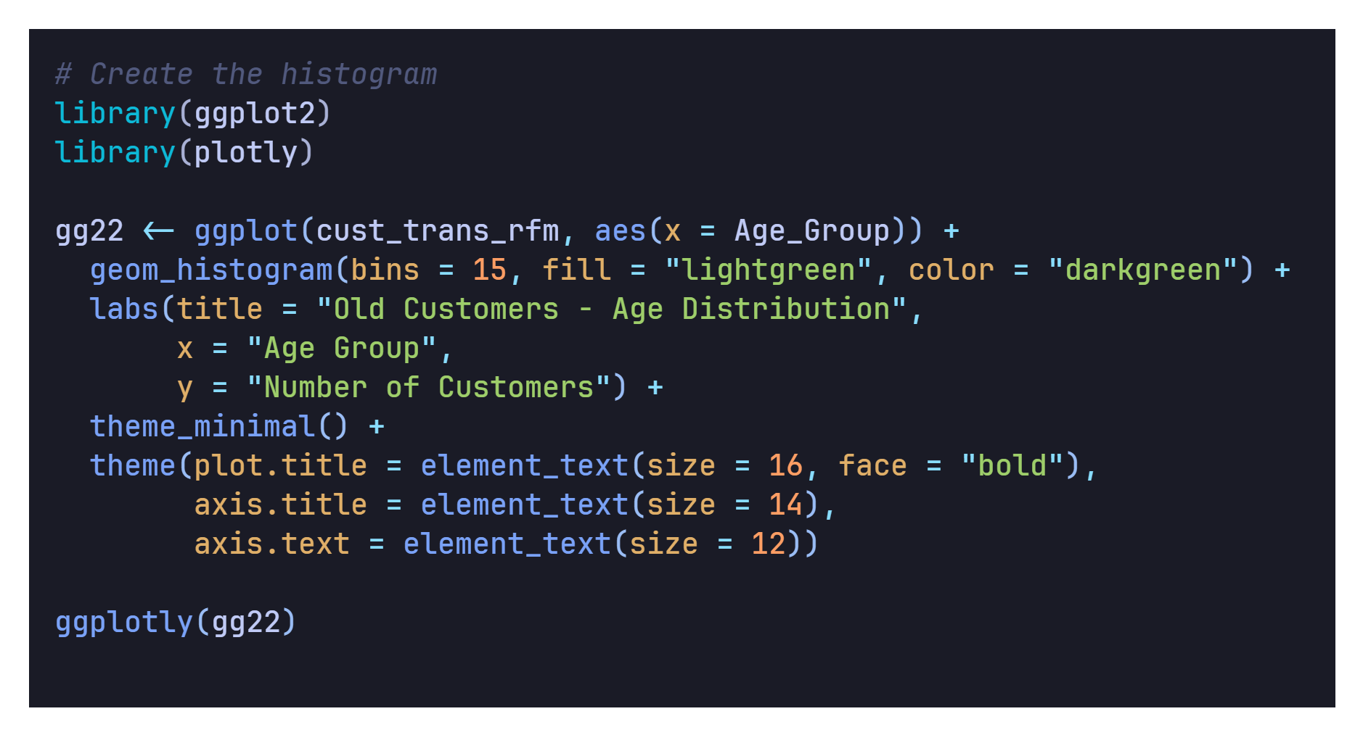
Exploratory Data Analysis on Customer Segments: New vs Old Customer Age Distribution
Old Customer by Age Dist.
New Customer by Age Dist.
HYPERLINK
HYPERLINK
HYPERLINK

Slide 17
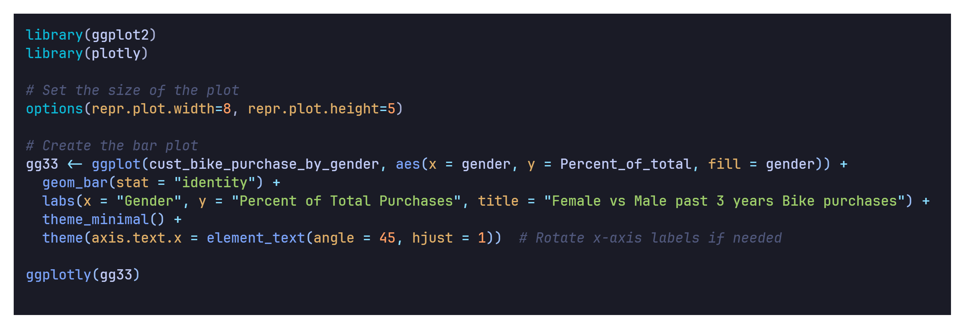
Bike Purchases Over Last 3 Years by Gender
HYPERLINK

Slide 18
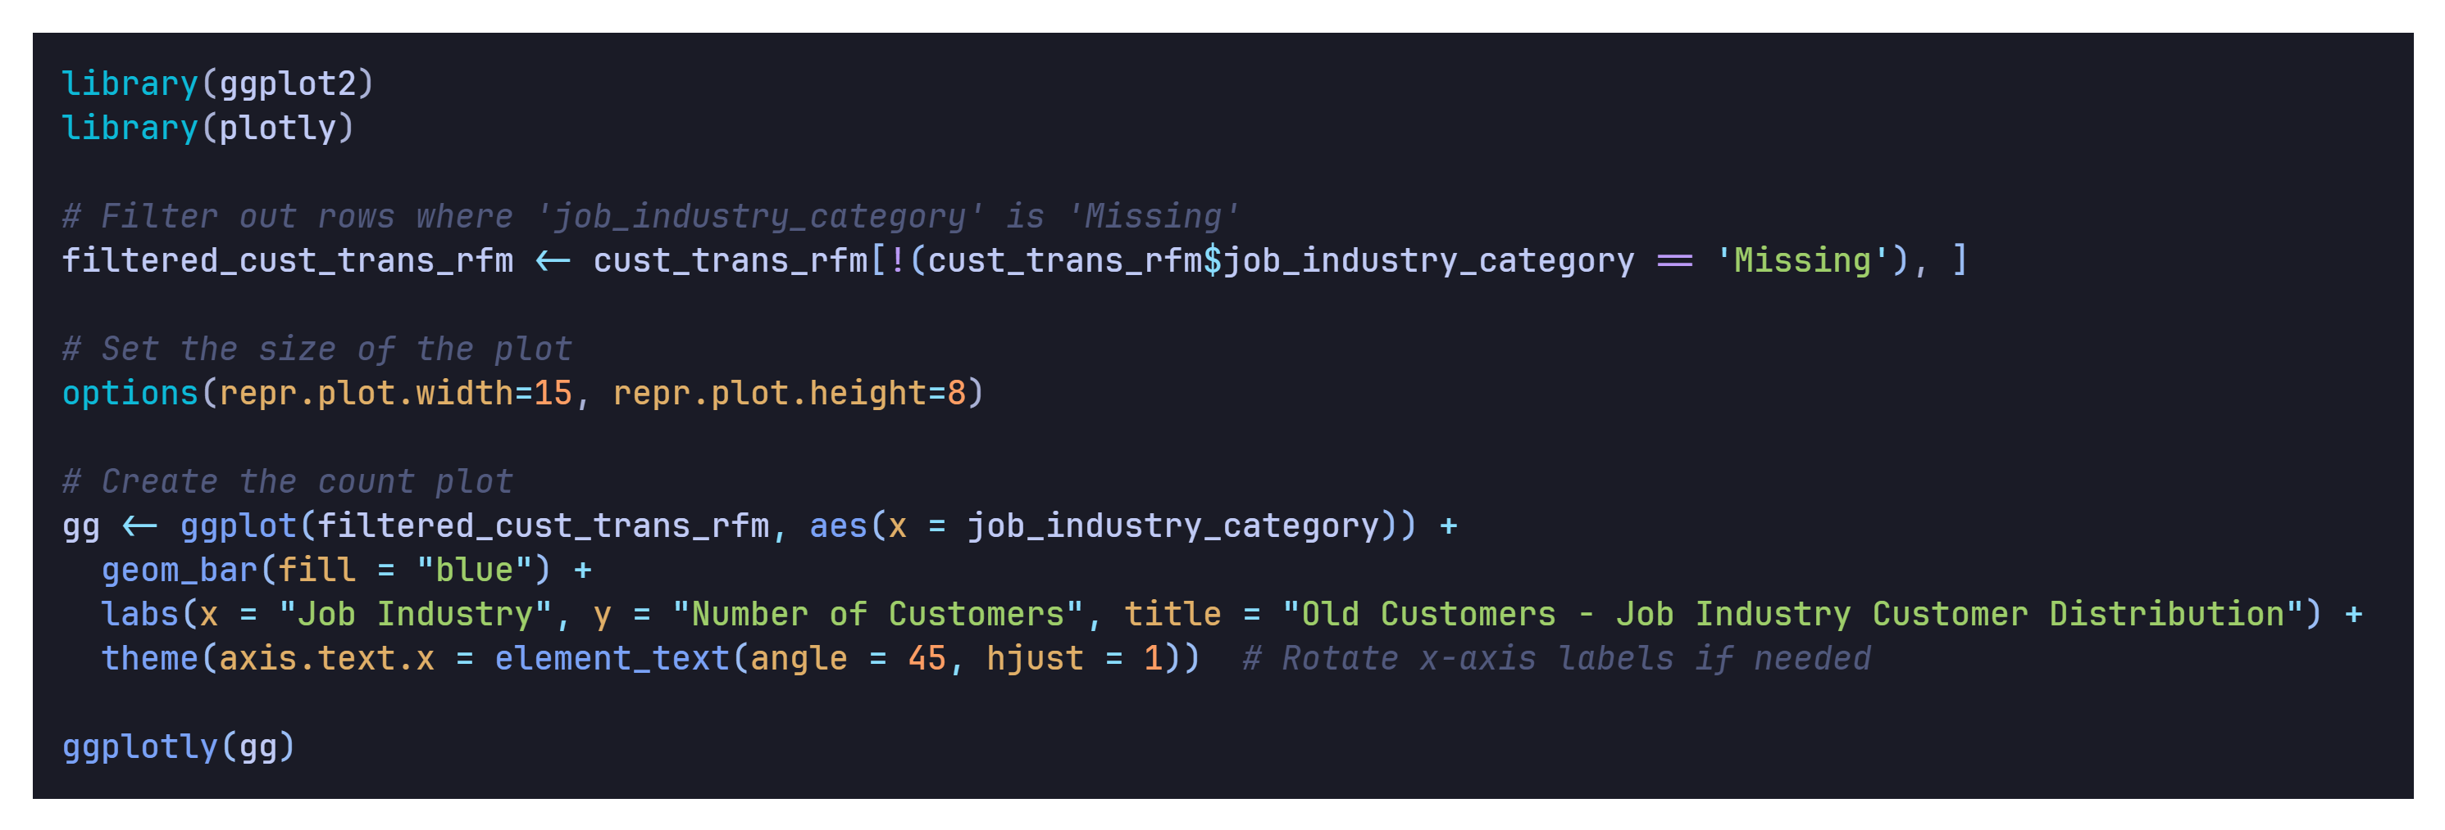
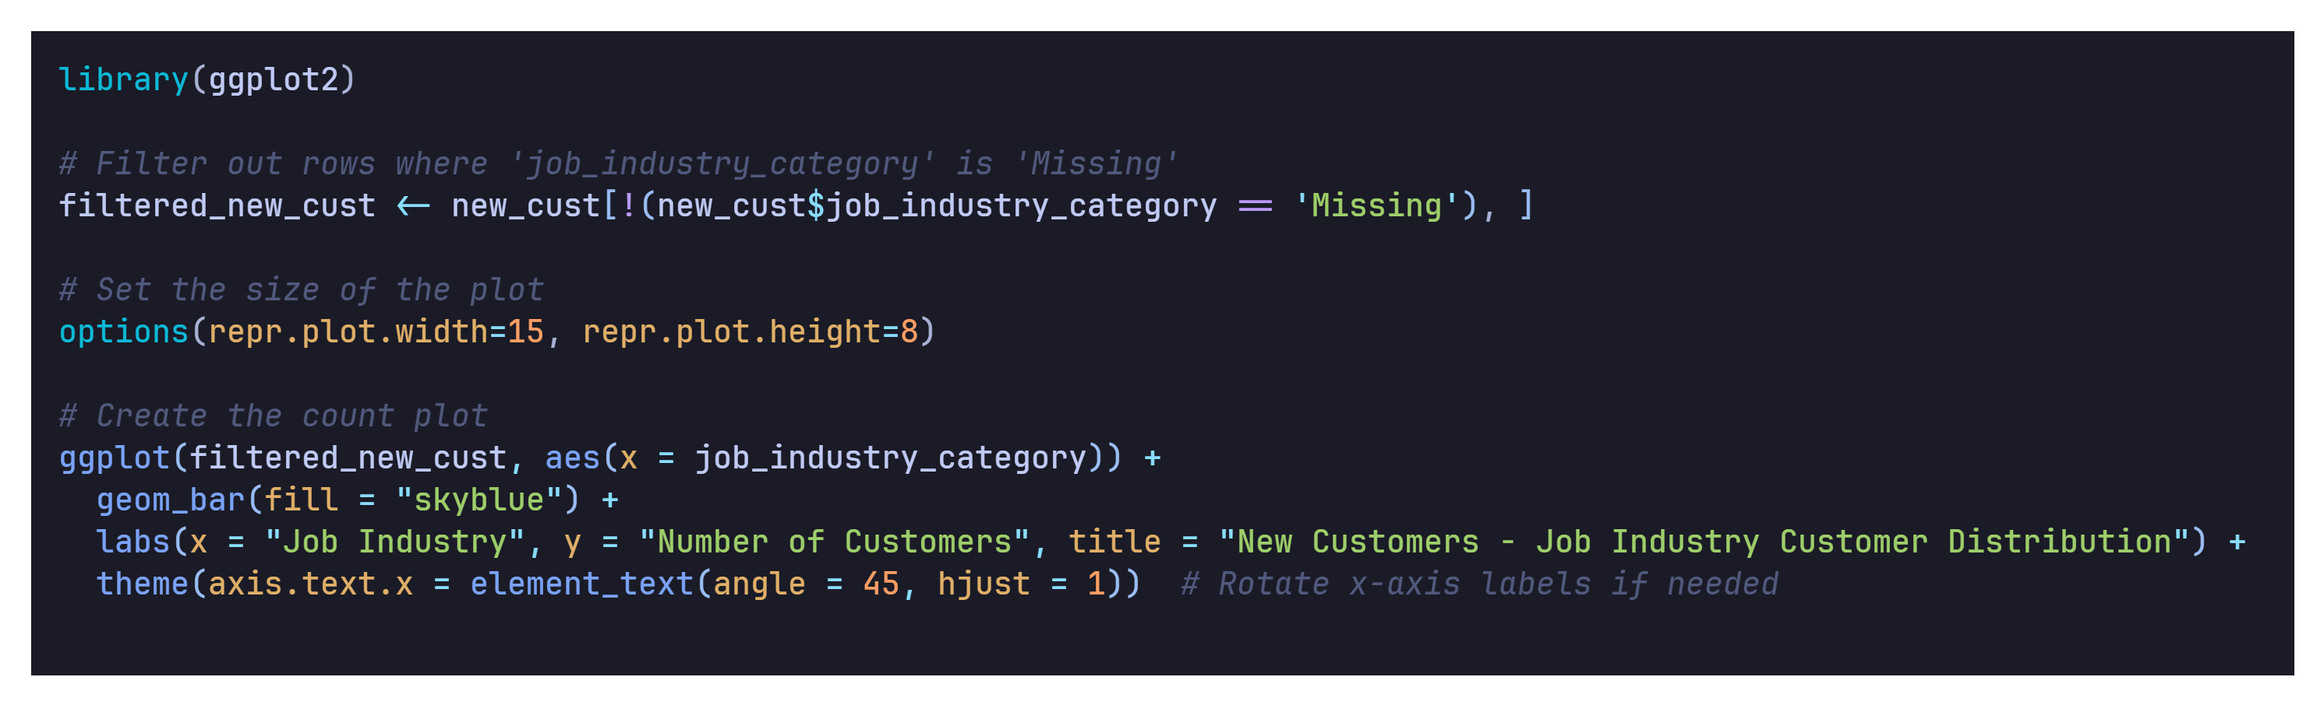
New vs Old Customers Job Industry Distribution
Old Customer by Job Industry
New Customer by Job Industry
HYPERLINK
HYPERLINK

Slide 19
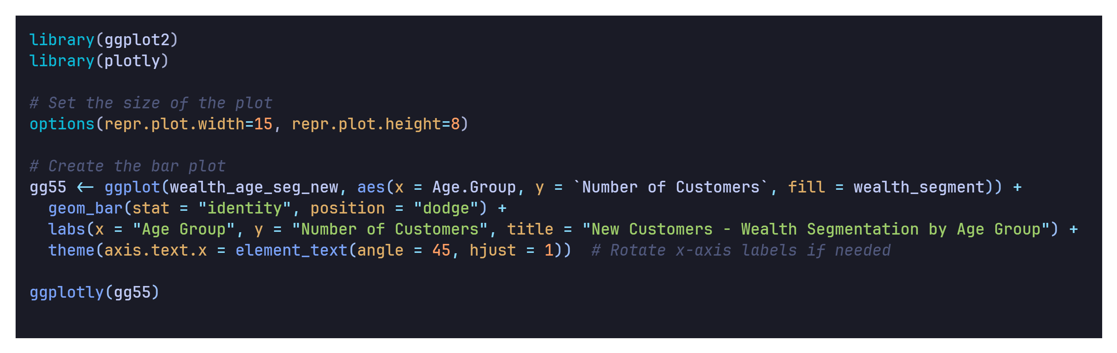
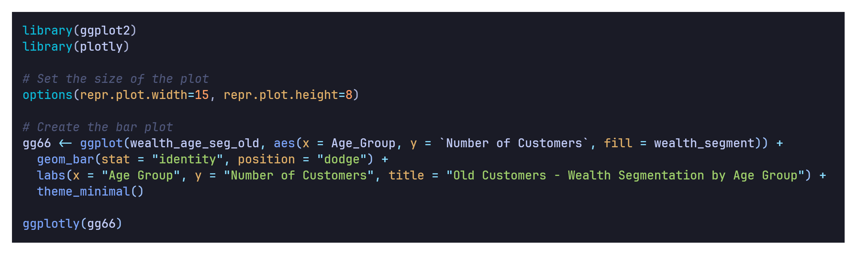
Wealth Segmentation by Age Category
Old Customers Wealth by Age Group
New Customers Wealth by Age Group
HYPERLINK
HYPERLINK

Slide 20
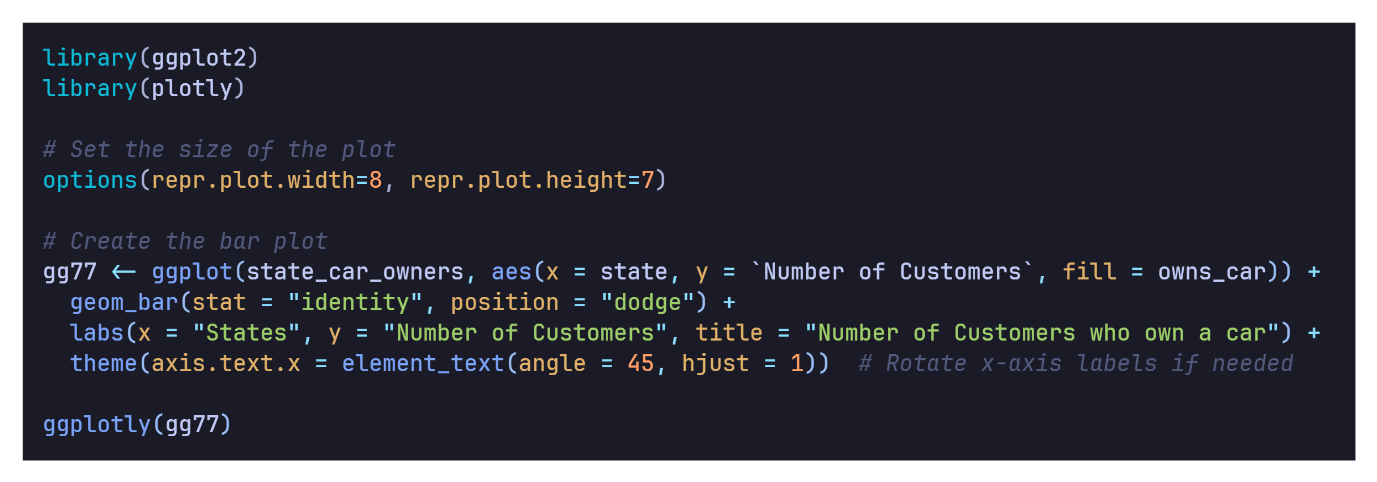
Cars owned by States
HYPERLINK

Slide 21
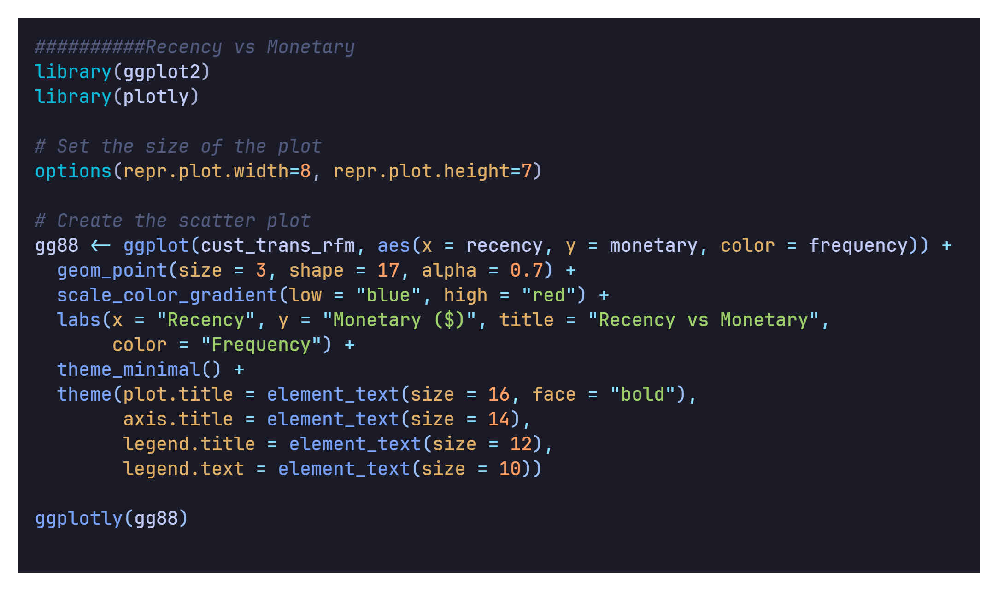
RFM Analysis Scatter Plots Recency vs Monetary
HYPERLINK

Slide 22
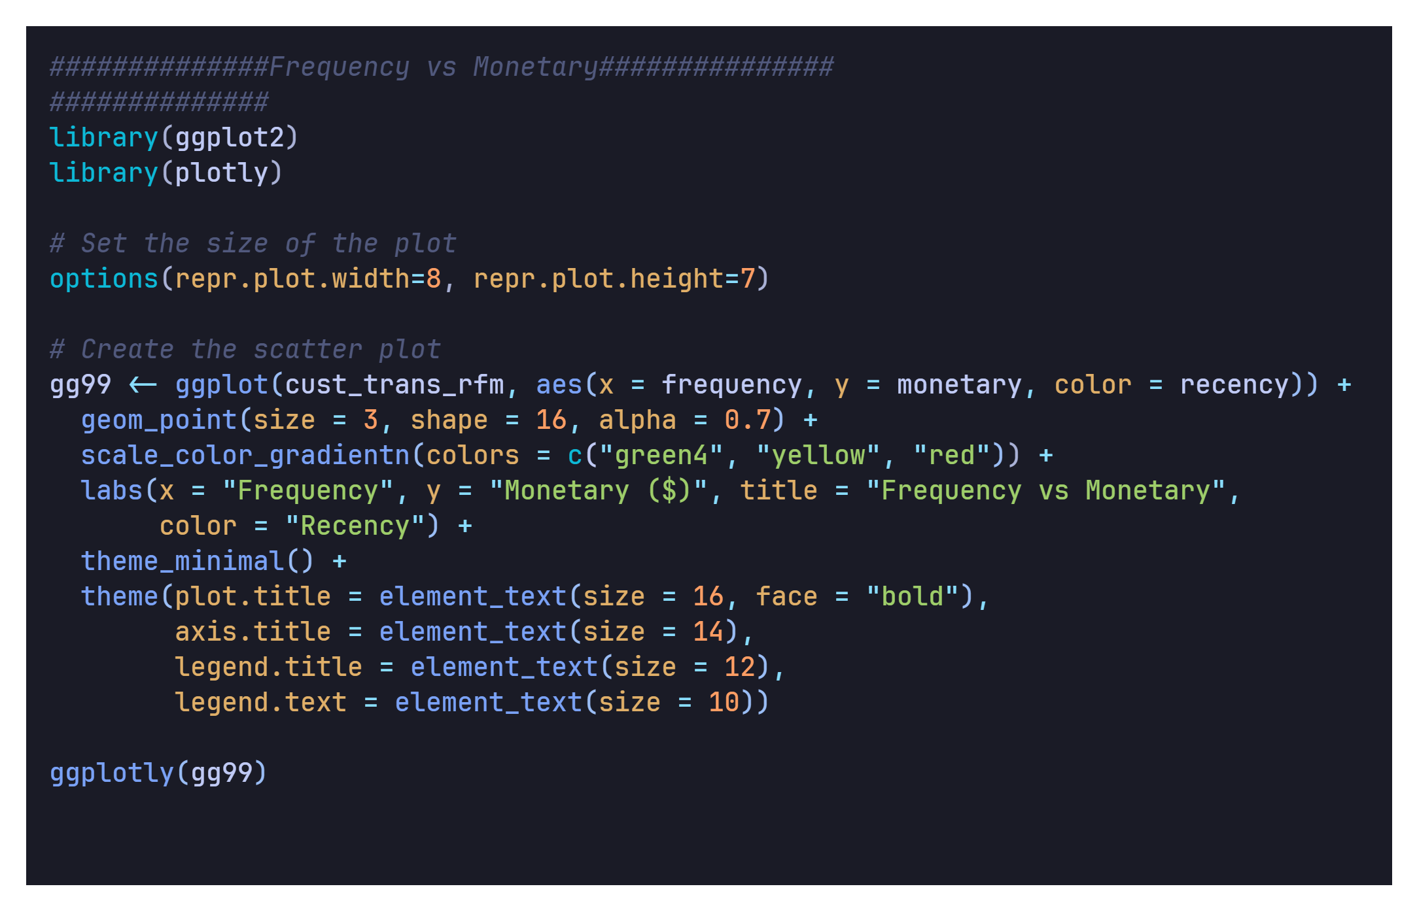
Frequency vs Monetary
HYPERLINK

Slide 23
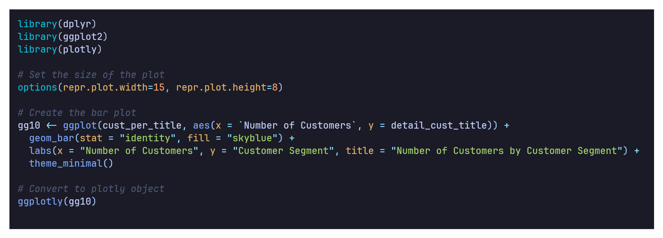
Customer Segment Distribution
HYPERLINK

Slide 24
04
Conclusion

Slide 25
Conclusion
Despite its simplicity, the RFM (Recency, Frequency, Monetary) model remains a powerful tool for marketers, providing actionable insights at the individual customer level. Combining RFM data with additional customer attributes and advanced analytics techniques unlocks its true potential, enabling:
Highly effective customer segmentation
Targeted marketing campaigns
Increased customer engagement and loyalty
Reduced churn and optimized marketing ROI
While evolving with new data sources and analytics, the RFM model's core principles remain essential for understanding customer behavior and driving targeted, data-driven marketing strategies that resonate with customers and drive business growth.

Slide 26
References
https://github.com/AbhishekGit-hash/Data-Analytics-Customer-Segmentation/blob/master/Raw_data.xlsx
https://www.actioniq.com/blog/what-is-rfm-analysis/
https://github.com/nikhiljoshi1012/Customer-Segmentation

Slide 27
Thank You

