Slide 1

Group ID: D2211
Group Name: Artisan

Slide 2







CONTENTS
Problem Statement | Introduction | Algorithm | Methodology & Implementation | Result & Analysis | Conclusion

Slide 3

Problem Statement
To make a time series using ARIMA model for forecasting number of deaths by using COVID-19 dataset
1.Determine the three parameters of ARIMA
2.Identify stationarity using ACF and PACF functions
3.Time Series forecasting based upon above parameters

Slide 4
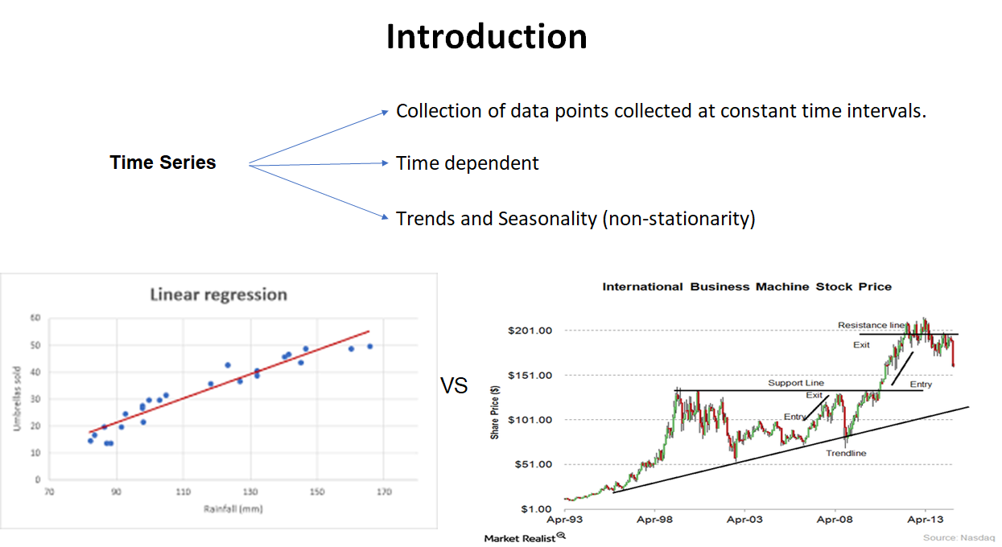
Y = ( Σ i=0 to n miXi ) + c
T = a + ( Σ i=0 to n Bi ) + e

Slide 5
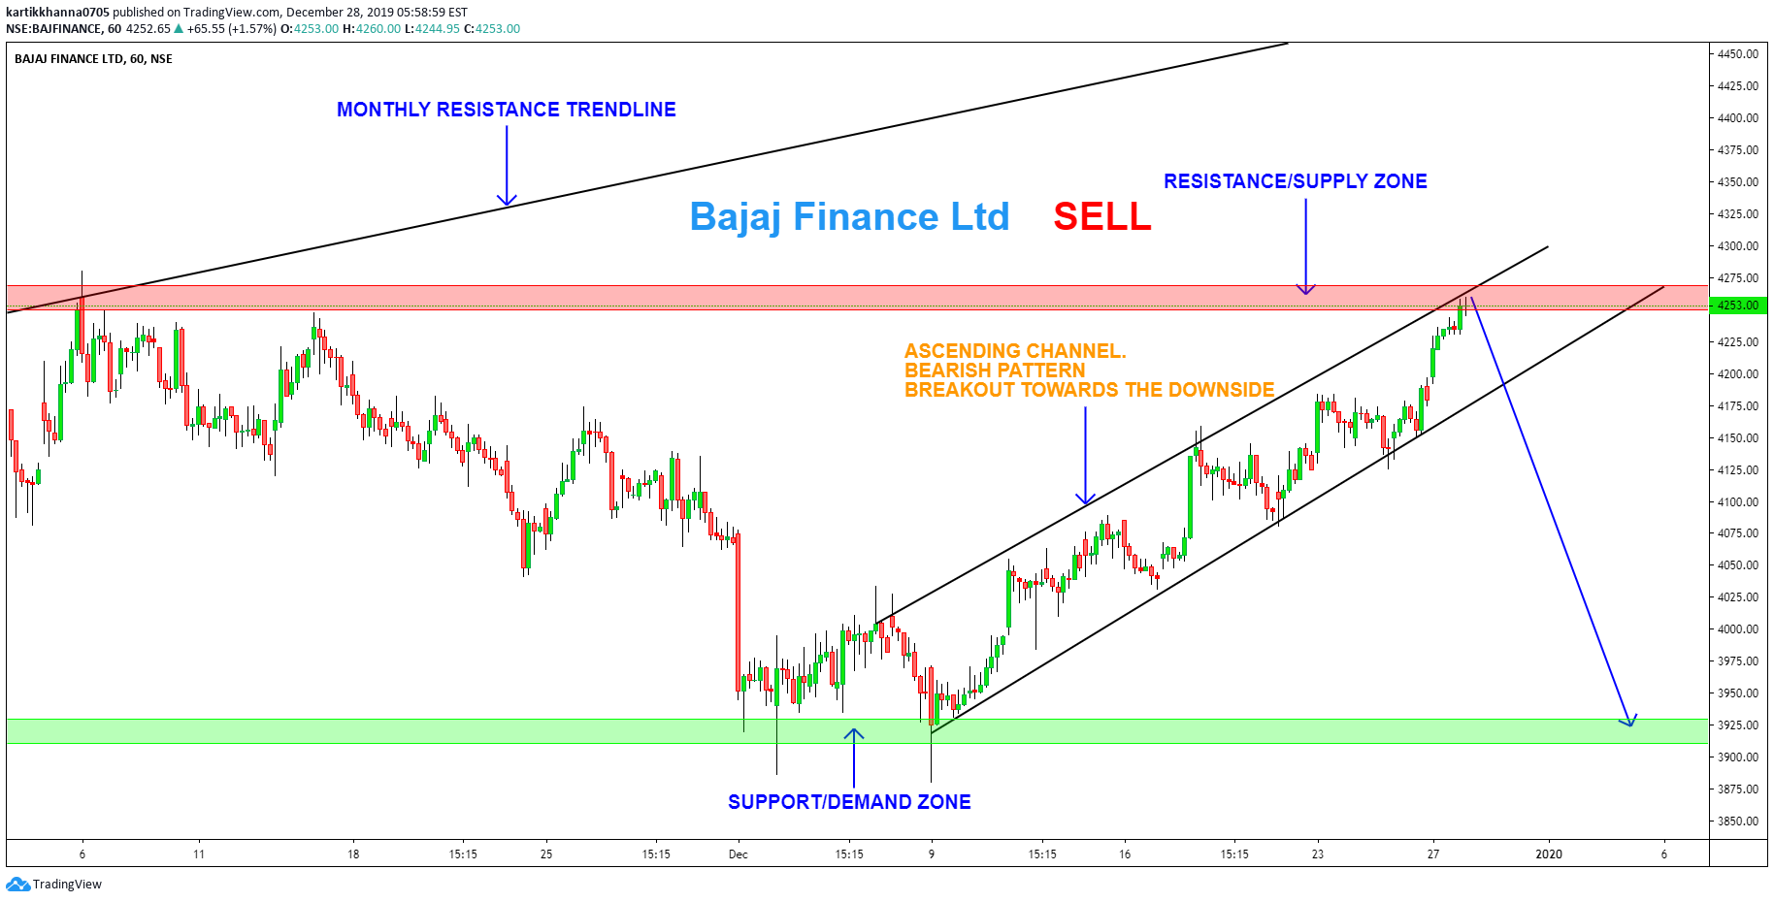

Slide 6

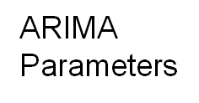

Key Terms and Algorithm
Technique for Time series modelling
Auto Regressive - past values used for forecasting the next value
Moving Average - past forecast errors used to predict the future values
p-value (premise / lag / past values) – PACF Plot
AIC and BIC values
(To determine best combination of parameters)
q-value (moving average window | MA) - ACF plot
d-value (Order of Differencing / Derivation) (to make series stationary)

Slide 7
Methodology & Implementation
The Following steps need to follow for Implementation
Load the data: The first step for model building is of course to load the dataset
Preprocessing: Depending on the dataset, the steps of preprocessing will be defined. This will include creating timestamps, converting the datatype of date/time column, making the series univariate, etc.
Determine d value: For making the series stationary, the number of times the difference operation was performed will be taken as the d value
Create ACF and PACF plots: This is the most important step in ARIMA implementation. ACF PACF plots are used to determine the input parameters for our ARIMA model
Determine the p and q values: Read the values of p and q from the plots in the previous step
Fit ARIMA model: Using the processed data and parameter values we calculated from the previous steps, fit the ARIMA model
Predict values on validation set: Predict the future values

Slide 8
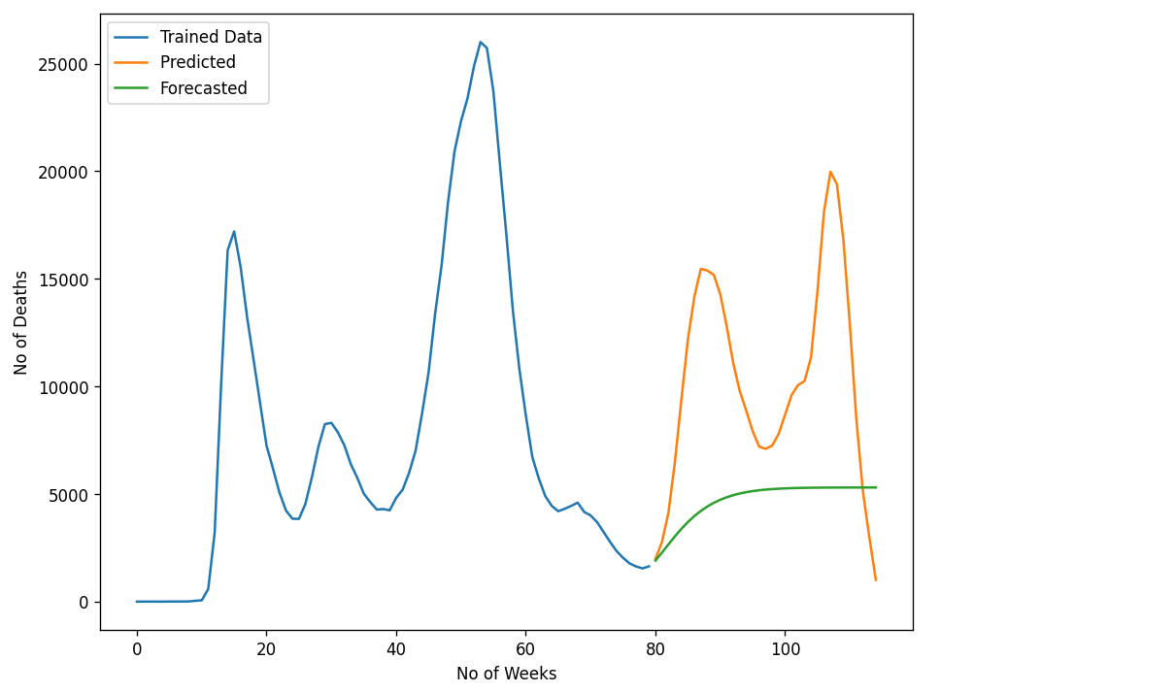
Time Series Forecasting Results (performed on validation set)
ARIMA Time Series

Slide 9
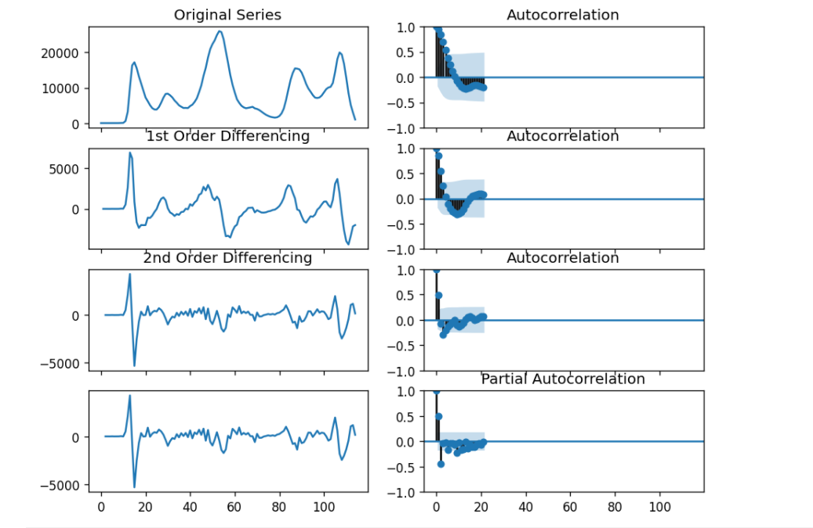
Results
ACF And PACF Functions

Slide 10
Conclusion
We Conclude here that After Successfully implementing the ARIMA Model for Forecasting Time Series,
We are now able to predict future Time Series for given dataset.
We calculated and analysed the p, d and q values w.r.t AIC & BIC
We calculated various specifications regarding the ARIMA model like AIC, BIC values ACF , PACF plots etc.
Conclusions from Results:
The Root mean squared error is approx 7000 deaths indicating a significant range
Although it simple and popular, ARIMA may not be the best model among the available AutoRegressors for Time Series forecasting
Further, extension called SARIMA (seasonal ARIMA) can be used
Holt’s Winter Model appears to be the best predictor.

Slide 11
Links
https://drive.google.com/drive/folders/1SfxtMi8ay9JIA02bd08NI8Wh7DVxp-og?usp=sharing
https://machinelearningmastery.com/autoregression-models-time-series-forecasting-python/
https://www.analyticsvidhya.com/blog/2016/02/time-series-forecasting-codes-python/
https://machinelearningmastery.com/arima-for-time-series-forecasting-with-python/

