Slide 1
Optimization of vehicle routing problem using
artificial bee colony algorithm
Advisor
Zack Butler
Author
Nikhil Keswaney

Slide 2
Problem Statement
Capacitated vehicle routing problem(CVRP) is a combinatorial optimization problem which states as follows:
“ Find the optimal delivery routes for a set of vehicles to supply the set of customers with given demands minimizing the total cost of all the routes.”

Slide 3
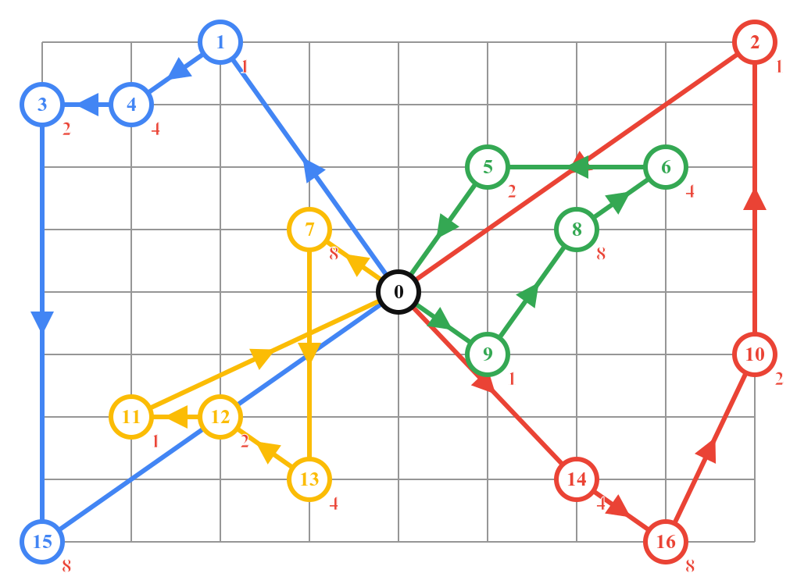
Example
Number of vehicles: 4
Vehicle Capacity: 45

Slide 4
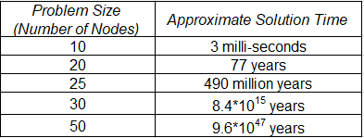
Computation complexity

Slide 5
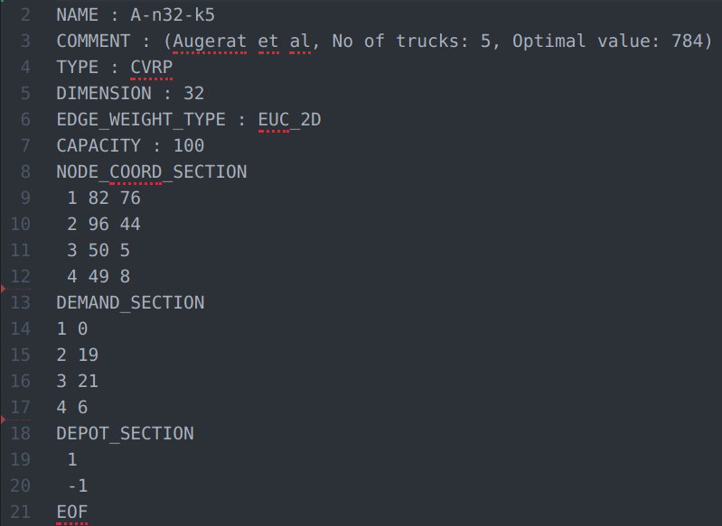
Dataset
The dataset I selected is from branchandcut.org
It has datasets for Traveling salesman CVRP etc.
It has ∼ 107 files for CVRP problem

Slide 6
Algorithm
Given a set of customers find all the ways in which the customers can be served given a set of vehicles. (Subset finder)
Out of all the the ways found what is the best way (Traveling salesman)

Slide 7
Recurrence relation
S(N, K) = k * S(N - 1, K) + S(N - 1, K - 1)

Slide 8
Problem statement
There are 4 customers numbered from 1 to 4 and let depot be 0.
Distance Matrix
Demand
 | 0 | 1 | 2 | 3 | 4
0 | 0 | 2 | 31 | 4 | 12
1 | 3 | 0 | 12 | 4 | 5
2 | 5 | 9 | 0 | 10 | 11
3 | 3 | 2 | 12 | 0 | 4
4 | 13 | 7 | 10 | 8 | 0
0 | -1
1 | 12
2 | 8
3 | 20
4 | 9

Slide 9
N = [1,2,3,4] ;; K = 2
S(N, K) = k * S(N - 1, K) + S(N - 1, K - 1)

Slide 10
N = [1,2,3,4] ;; K = 2
N = [1,2,3] ;; K = 2
N = [1,2,3] ;; K = 1
S(N, K) = k * S(N - 1, K) + S(N - 1, K - 1)

Slide 11
N = [1,2,3,4] ;; K = 2
N = [1,2,3] ;; K = 2
N = [1,2,3] ;; K = 1
N = [1,2] ;; K = 2
N = [1,2] ;; K = 1
S(N, K) = k * S(N - 1, K) + S(N - 1, K - 1)

Slide 12
N = [1,2,3,4] ;; K = 2
N = [1,2,3] ;; K = 2
N = [1,2,3] ;; K = 1
N = [1,2] ;; K = 2
[1][2]
N = [1,2] ;; K = 1
[1, 2]
S(N, K) = k * S(N - 1, K) + S(N - 1, K - 1)

Slide 13
N = [1,2,3,4] ;; K = 2
[1,3,4][2] - [1,3][2,4]
[1,4][2,3] - [1][2,3,4]
[1,2,4][3] - [1,2][3,4]
[1,2,3][4]
N = [1,2,3] ;; K = 2
[1,3][2] - [1][2,3]
[1,2][3]
N = [1,2,3] ;; K = 1
[1,2,3]
N = [1,2] ;; K = 2
[1][2]
N = [1,2] ;; K = 1
[1, 2]
S(N, K) = k * S(N - 1, K) + S(N - 1, K - 1)

Slide 14
N = [1,2,3,4] ;; K = 2
[1,3,4][2] - [1,3][2,4]
[1,4][2,3] - [1][2,3,4]
[1,2,4][3] - [1,2][3,4]
[1,2,3][4]
N = [1,2,3] ;; K = 2
[1,3][2] - [1][2,3]
[1,2][3]
N = [1,2,3] ;; K = 1
[1,2,3]
N = [1,2] ;; K = 2
[1][2]
N = [1,2] ;; K = 1
[1, 2]
S(N, K) = k * S(N - 1, K) + S(N - 1, K - 1)

Slide 15
Subset finder (Dynamic Programing)

Slide 16
N K➡️ ⬇️ | 0 | 1 | 2
0
1
2
3
4
S(N, K) = k * S(N - 1, K) + S(N - 1, K - 1)

Slide 17
BaseCases
N K➡️ ⬇️ | 0 | 1 | 2
0 | []
1 | [] | [1]
2 | [] | [1,2] | [1][2]
3 | [] | [1,2,3]
4 | [] | [1,2,3,4]
S(N, K) = k * S(N - 1, K) + S(N - 1, K - 1)

Slide 18
N K➡️ ⬇️ | 0 | 1 | 2
0 | []
1 | [] | [1]
2 | [] | [1,2] | [1][2]
3 | [] | [1,2,3] | [1,3][2] [1][2,3] [1,2][3]
4 | [] | [1,2,3,4]
S(N, K) = k * S(N - 1, K) + S(N - 1, K - 1)

Slide 19
N K➡️ ⬇️ | 0 | 1 | 2
0 | []
1 | [] | [1]
2 | [] | [1,2] | [1][2]
3 | [] | [1,2,3] | [1,3][2] [1][2,3] [1,2][3]
4 | [] | [1,2,3,4] | [1,3,4][2] [1,3][2,4] [1,4][2,3] [1][2,3,4] [1,2,4][3] [1,2][3,4] [1,2,3][4]
S(N, K) = k * S(N - 1, K) + S(N - 1, K - 1)

Slide 20
Pruned Brute Force
Truck capacity = 30
Demand = {1 : 12, 2 : 8, 3 : 20, 4 :9}
N K➡️ ⬇️ | 0 | 1 | 2
0 | []
1 | [] | [1]
2 | [] | [1,2] | [1][2]
3 | [] | [1,2,3] | [1,3][2] [1][2,3] [1,2][3]
4 | [] | [1,2,3,4] | [1,3,4][2] [1,3][2,4] [1,4][2,3] [1][2,3,4] [1,2,4][3] [1,2][3,4][1,2,3][4]

Slide 21
Pruned Brute Force
Truck capacity = 30
Demand = {1 : 12, 2 : 8, 3 : 20, 4 :11}
N K➡️ ⬇️ | 0 | 1 | 2
0 | []
1 | [] | [1]
2 | [] | [1,2] | [1][2]
3 | [] | [1,2,3] | [1,3][2] [1][2,3] [1,2][3]
4 | [] | [1,2,3,4] | [1,3,4][2] [1,3][2,4] [1,4][2,3] [1][2,3,4] [1,2,4][3] [1,2][3,4] [1,2,3][4]

Slide 22
Performance Comparison
N | Dynamic Approach | Prued Dynamic Approach | Percentage Drop
4 | 1 | 1 | 0 %
5 | 10 | 9 | 10 %
6 | 65 | 40 | 38.4 %
7 | 350 | 152 | 56.5 %
8 | 1701 | 359 | 78.8 %
9 | 7770 | 1357 | 82.5 %
10 | 34105 | 1958 | 94.2 %
11 | 145750 | 3674 | 97.4 %
12 | 611501 | 5173 | 99.1 %
For,
K = 4

Slide 23
Traveling salesman
Since I have all the ways that the customers can be served given a set of vehicle
We need to find which solution is the best
And also what order the customers should be visited

Slide 24
Traveling salesman
Distance Matrix
0
0
2
12
31
4
 | 0 | 1 | 2 | 3 | 4
0 | 0 | 2 | 31 | 4 | 12
1 | 3 | 0 | 12 | 4 | 5
2 | 5 | 9 | 0 | 10 | 11
3 | 3 | 2 | 12 | 0 | 4
4 | 13 | 7 | 10 | 8 | 0
1
4
2
3
5
7
10
2
4
1
3
2
13
3
3
`
5
0
0
0
0
Sum = 20
Sum = 22
Sum = 44
Sum = 11

Slide 25
Result
Truck1 : 0 ⇾ 1 ⇾ 4 ⇾ 0
Truck2 : 0 ⇾ 3⇾ 2 ⇾ 0
Total Cost = 31

Slide 26
Result comparison
Customers | Time taken(ms)
10 | 5.0
11 | 12.0
12 | 29.0
13 | 51.0
14 | 146.0
15 | 209.0
16 | 238.0
17 | 273.0
18 | 5026.0
19 | 8447.0

Slide 27
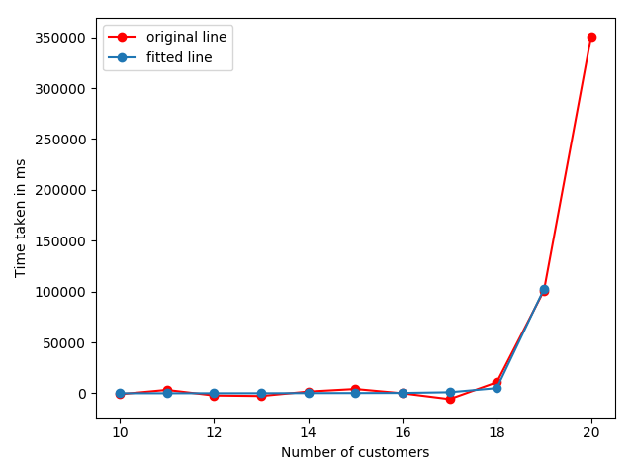
Result

Slide 28
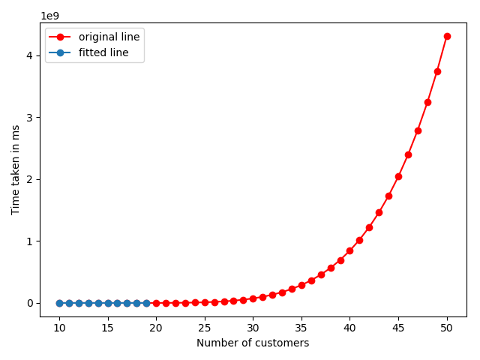
Result
50 Nodes
4.30915618e+09 ms = 49874.49282407 days = 136.64244609334247 years

Slide 29
Milestones
Milestone 1 ✔️
Finding dataset
Implementation of an exact algorithm
Milestone 2 ✔️
Implement an approximate algorithm(Artificial bee colony algorithm)
Improve the performance of artificial bee colony algorithm
Milestone 3
Parallelize the artificial bee colony algorithm
Compare and contrast the run-time of all the implementations

Slide 30
Questions?

Slide 31
Thank you.

