Slide 1
Optimization of vehicle routing problem using
artificial bee colony algorithm
Advisor
Zack Butler
Author
Nikhil Keswaney

Slide 2
Problem Statement
Capacitated vehicle routing problem(CVRP) is a combinatorial optimization problem which states as follows:
“ Find the optimal delivery routes for a set of vehicles to supply the set of customers with given demands minimizing the total cost of all the routes.”

Slide 3
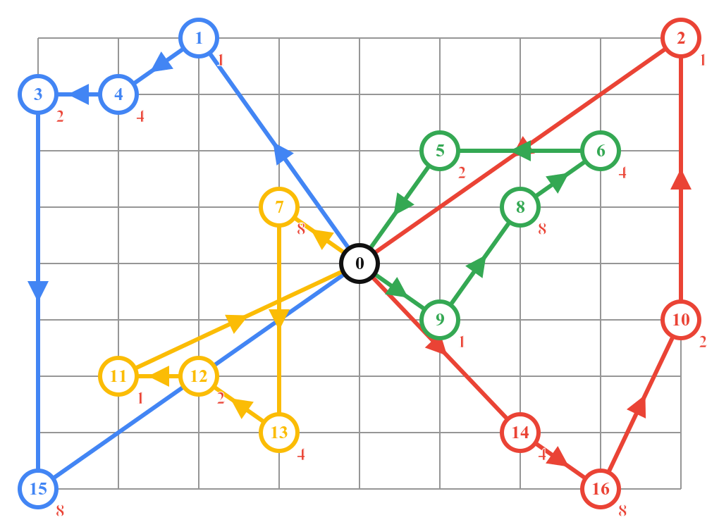
Example
Number of vehicles: 4
Vehicle Capacity: 45

Slide 4
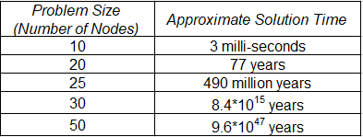
Computation complexity

Slide 5
Milestone 1
Finding dataset
Implementation of an exact algorithm

Slide 6
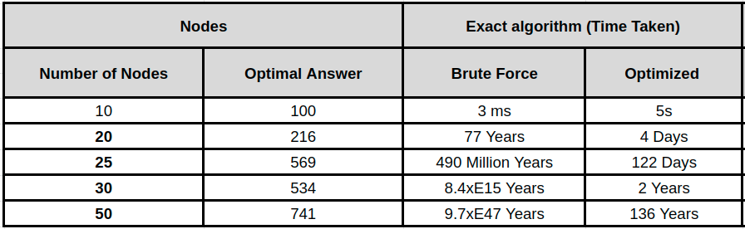
Milestone 1 - Result

Slide 7
Milestone 2
Implement an approximate algorithm (Artificial bee colony algorithm)
Improve the performance of artificial bee colony algorithm

Slide 8
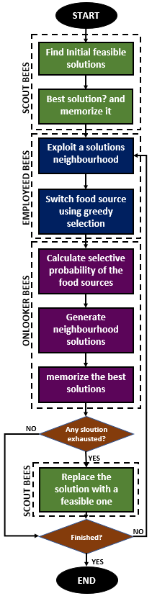
Algorithm

Slide 9
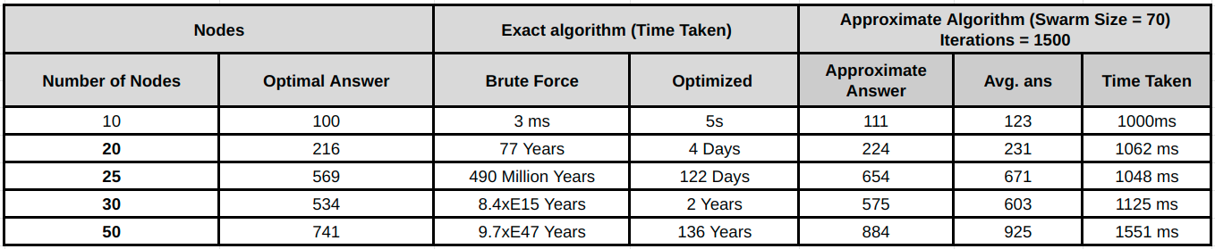
Time taken

Slide 10
Milestones
Milestone 1 ✔️
Finding dataset
Implementation of an exact algorithm
Milestone 2 ✔️
Implement an approximate algorithm(Artificial bee colony algorithm)
Improve the performance of artificial bee colony algorithm
Milestone 3 ✔️
Parallelize the artificial bee colony algorithm using CPU.
Compare and contrast the run-time of all the implementations

Slide 11
Milestones
Milestone 1 ✔️
Finding dataset
Implementation of an exact algorithm
Milestone 2 ✔️
Implement an approximate algorithm(Artificial bee colony algorithm)
Improve the performance of artificial bee colony algorithm
Milestone 3 ✔️
Parallelize the artificial bee colony algorithm using CPU and CUDA
Compare and contrast the run-time of all the implementations
GPU

Slide 12
Milestones
Milestone 1 ✔️
Finding dataset
Implementation of an exact algorithm
Milestone 2 ✔️
Implement an approximate algorithm(Artificial bee colony algorithm)
Improve the performance of artificial bee colony algorithm
Milestone 3 ✔️
Parallelize the artificial bee colony algorithm using CPU
Compare and contrast the run-time of all the implementations
GPU
CPU

Slide 13
Software & Hardware
Software:
Java, PJ2(Parallel Java 2) library.
Hardware:
tardis.cs.rit.edu cluster (12 Nodes)
Each Node has.
Two Intel Xeon E5-2603 v4 (x2) processors
Six CPU cores per processor
12 threads
1.7 GHz clock
64 GB main memory

Slide 14
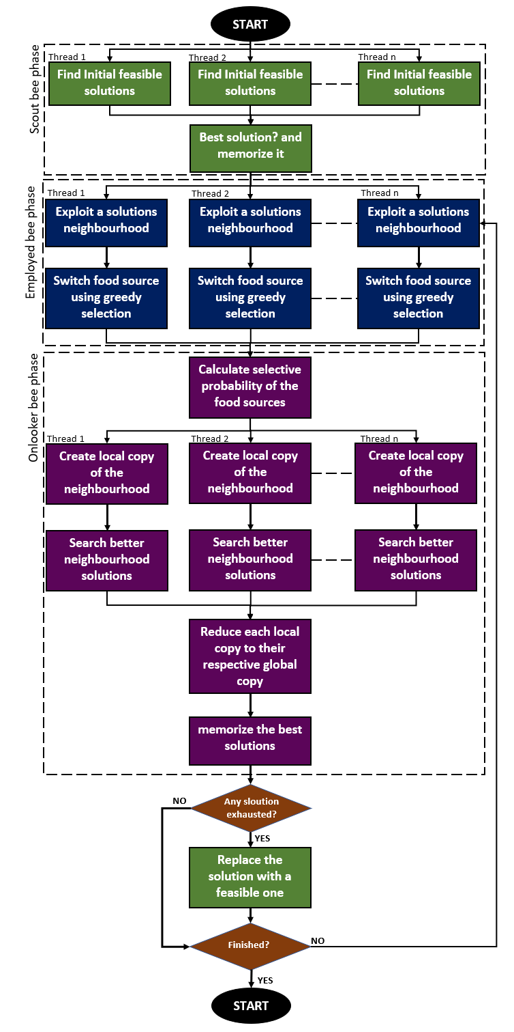
Algorithm

Slide 15
Scaling
Scaling refers to running the program on increasing numbers of cores.
Strong scaling : As the number of cores increases, the problem size stays the same. This means that the program should ideally take 1/K the amount of time to compute the answer for the same problem

Slide 16
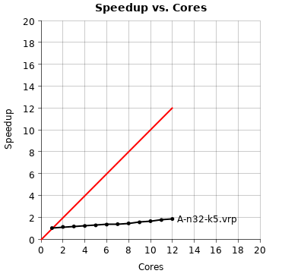
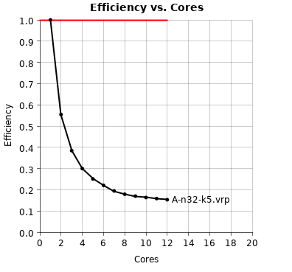
Strong Scaling Result

Slide 17
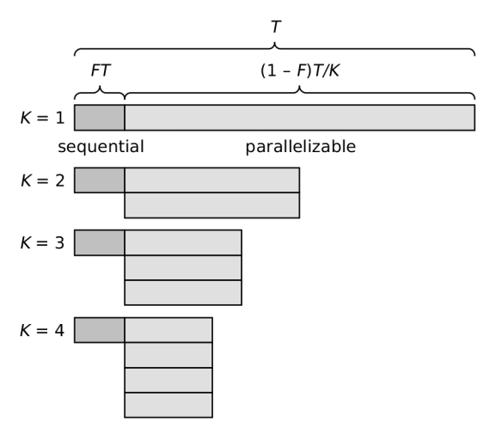
Problems
Sequential dependencies:

Slide 18
2. Week scaling : run on more cores, increase the size of the problem being solved as you increase the number of cores.
For week scaling I use the same file for the data and just increase the number of bees in the search space.

Slide 19
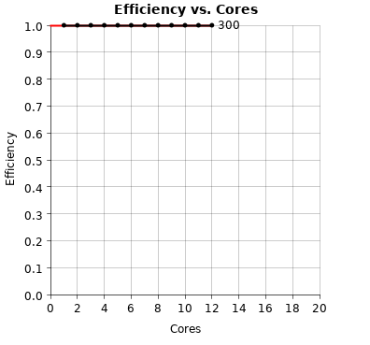
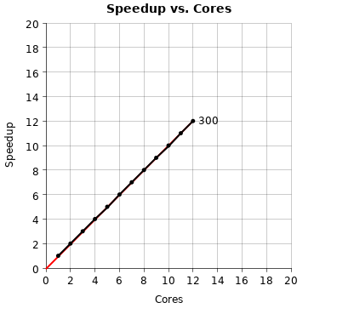
Week Scaling Result

Slide 20
This was about time taken!
What about the results?

Slide 21
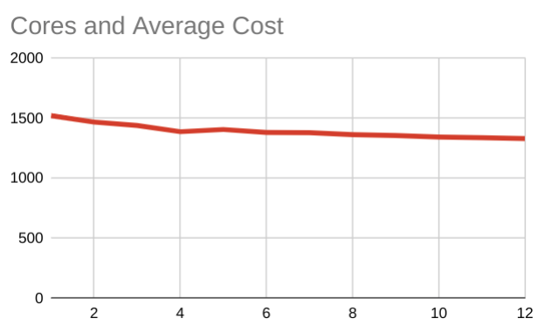
Final Result

Slide 22
Questions?

Slide 23
Thank you.

