Slide 1
Optimization of vehicle routing problem using
artificial bee colony algorithm
Advisor
Zack Butler
Author
Nikhil Keswaney

Slide 2
Problem Statement
Capacitated vehicle routing problem(CVRP) is a combinatorial optimization problem which states as follows:
“ Find the optimal delivery routes for a set of vehicles to supply the set of customers with given demands minimizing the total cost of all the routes.”

Slide 3
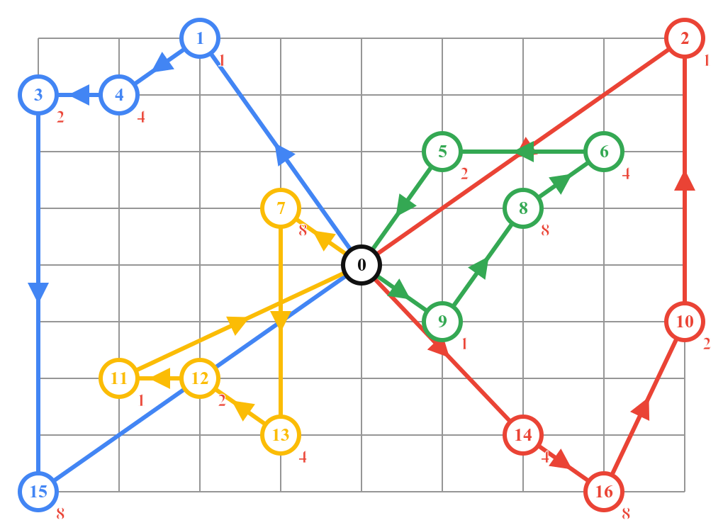
Example
Number of vehicles: 4
Vehicle Capacity: 45

Slide 4
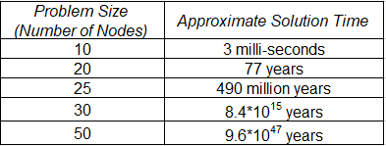
Computation complexity

Slide 5
Software & Hardware
Software:
Java
Hardware:
Processor: Intel® Core™ i7-7500U CPU @ 2.70GHz × 4
RAM: 8 GB

Slide 6
Milestone 1
Finding dataset
Implementation of an exact algorithm

Slide 7
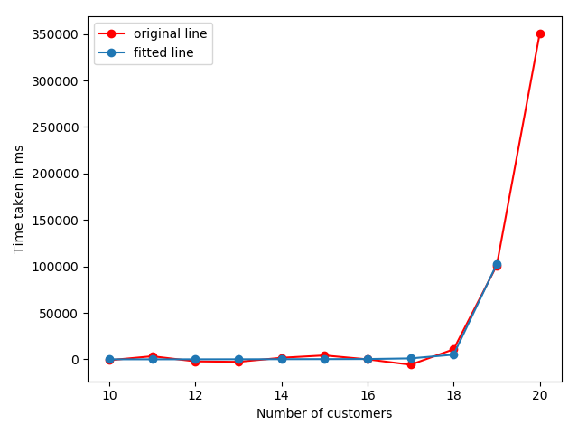
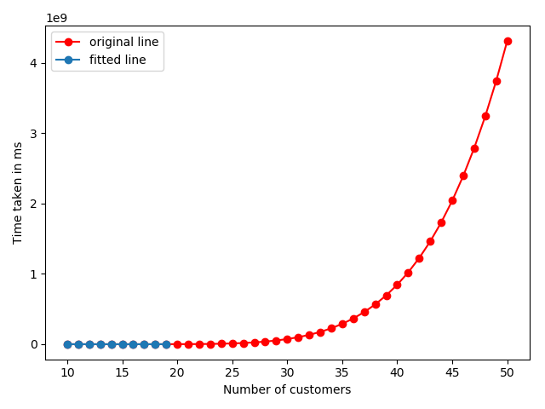
Milestone 1
(Optimized Exact algorithm)
Customers | Time taken(s)
10 | 5.0
11 | 12.0
12 | 29.0
13 | 51.0
14 | 146.0
15 | 209.0
16 | 238.0
17 | 273.0
18 | 5026.0
19 | 8447.0

Slide 8
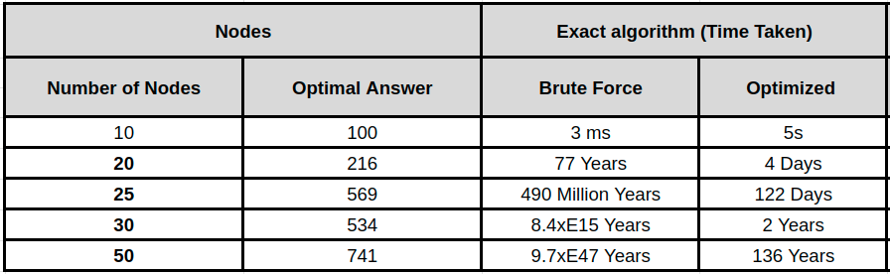
Milestone 1 - Result

Slide 9
Milestone 2
Implement an approximate algorithm (Artificial bee colony algorithm)
Improve the performance of artificial bee colony algorithm

Slide 10
Artificial Bee Colony algorithm
Artificial bee colony algorithm is based on the foraging behaviour of honey bees.
Swarm intelligence algorithm.
It’s a self organizing network.

Slide 11
Problem statement
There are 4 customers numbered from 1 to 4 and let depot be Node 0.
Distance Matrix
Demand
 | 0 | 1 | 2 | 3 | 4
0 | 0 | 2 | 31 | 4 | 12
1 | 3 | 0 | 12 | 4 | 5
2 | 5 | 9 | 0 | 10 | 11
3 | 3 | 2 | 12 | 0 | 4
4 | 13 | 7 | 10 | 8 | 0
0 | -1
1 | 12
2 | 8
3 | 20
4 | 9
Truck Capacity: 28
No. of trucks: 2

Slide 12
Search Space
Any combination of the nodes would be a potential food source.
Possible food sources(states) in the above example with 2 trucks would be
Truck1: 0 -> 1-> 2 -> 0; Truck2: 0 -> 3 -> 4 -> 0
Truck1: 0 -> 1 -> 0; Truck2: 0 -> 2 -> 3 -> 4 -> 0
Etc.

Slide 13
Phases
It is divided into 3 phases (3 types of bees):
Scout bees.
Employed Bees.
Onlooker Bees.

Slide 14
Scout Bee Phase
Scout bees are utilized to find the initial solutions
Scout bees go out and find FEASIBLE food sources.
So according to the example:
Truck1: 0 -> 3-> 4 -> 0; Truck2: 0 -> 1 -> 2 -> 0 ❌
Truck1: 0 -> 1-> 4 -> 0; Truck2: 0 -> 2 -> 3 -> 0 ✔️
3. The scout bee will find all solutions and save it in a queue.

Slide 15
Problem statement
There are 4 customers numbered from 1 to 4 and let depot be Node 0.
Distance Matrix
Demand
 | 0 | 1 | 2 | 3 | 4
0 | 0 | 2 | 31 | 4 | 12
1 | 3 | 0 | 12 | 4 | 5
2 | 5 | 9 | 0 | 10 | 11
3 | 3 | 2 | 12 | 0 | 4
4 | 13 | 7 | 10 | 8 | 0
0 | -1
1 | 12
2 | 8
3 | 20
4 | 9
Truck Capacity: 28
No. of trucks: 2

Slide 16
Employed Bee Phase
In this phase the employed bees go out and explore the food source’s neighbourhood found by the scout bee.
Take candidate set found by scout bee
Explore the neighbourhood of that set for better solutions
Two ways to do that
Swap operator
BMX operator

Slide 17

Swap Operator

Slide 18
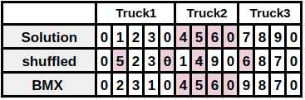
BMX Operator

Slide 19
Employed Bee Phase
How do we know that the new solution found is better than the previous one ?
We use a fitness function that determines

Slide 20



Fitness Function

Slide 21
Onlooker Bee Phase
The onlooker bees monitor the work that is performed by the employed bees
After the employed bee phase all the employed bees come back
And dance in front of the onlooker bees

Slide 22
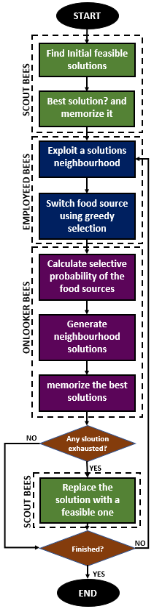
Algorithm

Slide 23
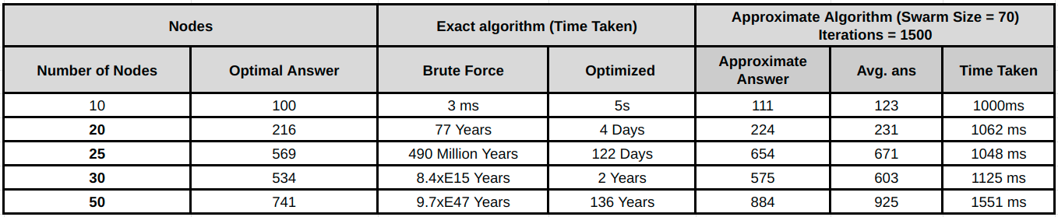
Time taken

Slide 24
Milestones
Milestone 1 ✔️
Finding dataset
Implementation of an exact algorithm
Milestone 2 ✔️
Implement an approximate algorithm(Artificial bee colony algorithm)
Improve the performance of artificial bee colony algorithm
Milestone 3
Parallelize the artificial bee colony algorithm using GPU and CUDA
Compare and contrast the run-time of all the implementations

Slide 25
Questions?

Slide 26
Thank you.

