Slide 1
GENETIC BASED DISEASE IDENTIFICATION WITH
DEEP LEARNING ON NEURAL NETWORKS

Slide 2
GROUP MEMBER INFORMATION
Akhilandeswari Vegi
700758173
Madhulika Dayal
700743206
Nikhil Reddy Kethireddy
700739505
Srusti Katla
700717867

Slide 3
ROLES AND CONTRIBUTION IN PROJECT
Akhilandeswari Vegi
Project requirements analysis & Project design
Madhulika Dayal
Project requirements analysis & Project design
Nikhil Reddy Kethireddy
Neural Network Algorithm Implementation
Srusti Katla
Data testing and Result Analysis

Slide 4
Motivation
The primary motivation of Genetic Disease Identification analysis with Deep Learning on Neural Networks is to find out the genetic disease in the hospital dataset.
In this work, the dataset containing the patient dataset will be taken into consideration.
The pre-processing will be applied in to the dataset and the noisy and null value data will be removed from the dataset. After the data will be analysed and visualized for further processing.
The Convolutional Neural Networks algorithm will be chosen to implementation process. The project evaluation can be tested with the deep learning algorithm. prediction results.

Slide 5
OBJECTIVEs
The objective of Genetic disease identification with deep learning is to detect the Genetic disease in the early stage itself with the available attributes.
In this work, the dataset containing the hospital patient dataset will be taken into consideration.
The primary contribution is to apply the deep learning to detect the genetic disease.
The pre-processing will be applied in to the dataset and the noisy and null value data will be removed from the dataset.
After the data will be analysed and visualized for further processing.
The Deep Learning neural network algorithm will be chosen to make the good accuracy prediction

Slide 6
RELATED WORK
A highlight determination strategy was implemented to decrease the number of atomic descriptors in a fair and unbiased manner.
The strategy involved two stages, namely statistical analysis and Genetic Algorithm.
In the first stage, descriptors with low standard deviation or containing similar values over half were removed.
Subsequently, a Pearson correlation analysis was carried out to determine the relationship among the descriptors and between the descriptor and the target.
This step was performed to reduce bias and eliminate descriptors with redundant information[5].

Slide 7
RELATED WORK
In the case of overlapping descriptors, the one with a weaker correlation with the target was eliminated.
In the second stage, a combination of descriptors was chosen using the Genetic Algorithm technique.
This technique follows Darwin's principles of natural evolution and uses random methods to obtain optimal non-random solutions
The descriptor selection by GA was performed by defining the solution as a collection of a whole number value in a chromosome.
In this case, the number of the value is equal to the number of the selected descriptor, where the value represents the descriptor list.
The cross-entropy loss was used as a performance metric during the feature selection[6]

Slide 8
RELATED WORK
The prediction model uses the Genetic Algorithm technique, which resembles the structure and function of the natural neural system.
The primary principle of the Genetic Algorithm is the implementation of artificial neurons, which are simple mathematical models.
Such a model has three simple sets of rules, namely reproduction, mutation, and activation.
The y-scrambling analysis ensures that the performance of the model did not correlate with an accidental relationship.
This analysis was conducted by shuffling the class centre while preserving the descriptors multiple times. T
he results of the y-scrambling demonstrate by providing the values for shuffled and un-shuffled data [7][8].

Slide 9
PROBLEM STATEMENT
The identification of gene-disease links holds immense value in the diagnosis and treatment of human diseases.
However, the process is often hindered by the limited number of crossovers in sampled families, resulting in linkage analyses that only identify chromosomal intervals containing numerous candidate genes.
The experimental validation of countless candidate genes can prove to be both time-consuming and expensive.
Finding the accuracy of genetic disorder detection is very difficult

Slide 10
LIMITATION OF EXISTING SYSTEM
Less Performance
Accuracy is very less.

Slide 11
proposed SOLUTION
The proposed methods aim to find the genetic disease with higher standard.
The accuracy levels of the identification of the genetic disease will be improved with the proposed system.
The deep learning on neural network will provide the better solution to solve the problem of identification of the genetic disease in the real world hospital data.
The Convolutional Neural Network algorithm will check the data in more compact with training and testing the data.
It will provide more accuracy as compared with the other type of techniques.
The genetic patient dataset will be taken as the input to the application and the dataset will be passed into the Convolutional Neural Network algorithm and the data will be analysed with the different visual graphs

Slide 12
ADVANTAGES OF PROPOSED SOLUTION
HIGH Performance
Good Accuracy level.
Can predict the Genetic disease with more accuracy

Slide 13
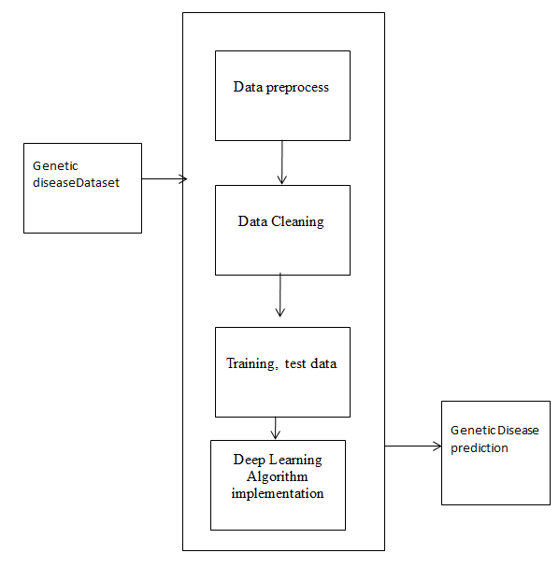
results
The work flow of the execution process.

Slide 14
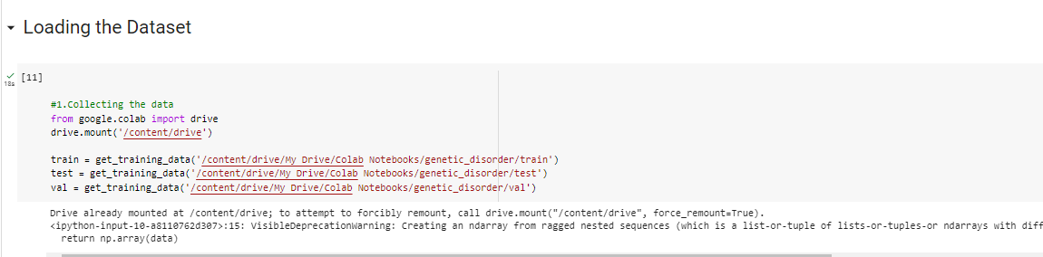
results
Load the dataset from the Google colab drive and mount into the application. .

Slide 15
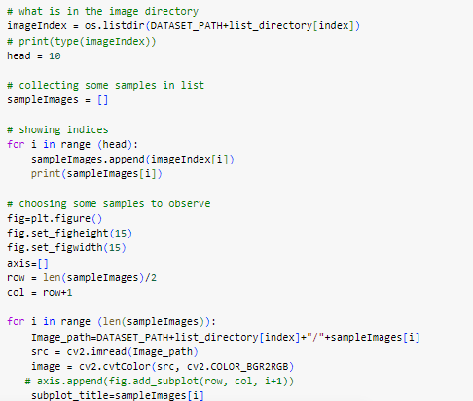
results
The image is re-shaped with the following the protocol of making the size of the image to 255 pixel range in any format types. .

Slide 16
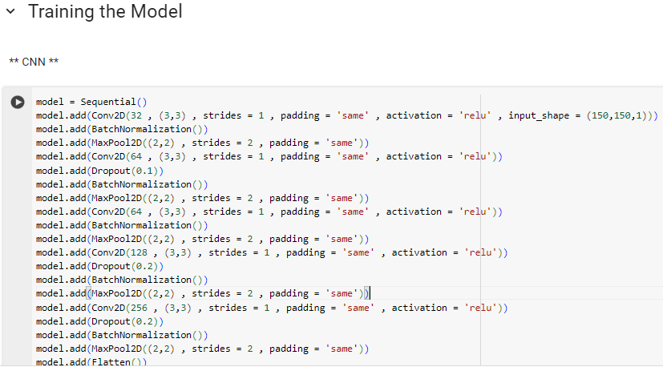
results
The Convolutional Neural Networks algorithm is applied with creating the sequential model. The output of the sequential model with layers is displayed.

Slide 17
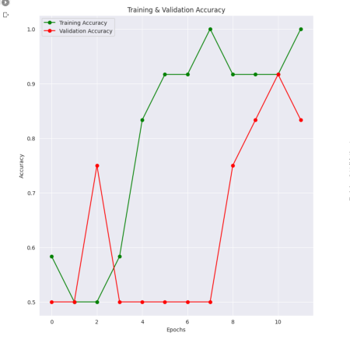
results
The final results based on the similarity and top utility items based on the profit are displayed.

Slide 18
CONCLUSION
A cutting-edge framework for detecting genetic diseases has been developed using deep neural networks and diverse medical data.
The framework employs all X-ray images with genetic information for model training and data classification.
By constructing functional intellectual networks based on signal correlation, the neural network formation is optimized using correlation coefficient information.
This methodology greatly enhances diagnostic accuracy compared to traditional approaches, demonstrating that integrating advanced deep learning with medical expertise is an effective way to diagnose neurological disorders.

Slide 19
REFERENCES
[1] Nour eldeen m. khalifa 1, mohamed hamed n. taha 1, dalia ezzat ali 1, adam slowik 2, (senior member, ieee), and aboul ella hassanien “Artificial Intelligence Technique for Gene Expression by Tumor RNA-Seq Data: A Novel Optimized Deep Learning Approach”. February 6, 2020.Digital Object Identifier 10.1109/IEEE ACCESS.2020.2970210
[2] Xiangxiang Zeng, Senior Member, IEEE, Yinglai Lin, Yuying He, Linyuan L¨u, Xiaoping Min∗, and Alfonso Rodr´ıguez-Pat´on” Deep collaborative ﬁltering for prediction of disease genes”. DOI 10.1109/TCBB.2019.2907536, IEEE/ACM Transactions on Computational Biology and Bioinformatics.
[3] W. R. J. Taylor and N. J. White, “Antimalarial drug toxicity: a review,” Drug Saf., vol. 27, no. 1, pp. 25–61, 2004, doi: 10.2165/00002018200427010-00003.
[4] E. A. Ashley et al., “Spread of artemisinin resistance in Plasmodium falciparum malaria,” N. Engl. J. Med., vol. 371, no. 5, pp. 411–423, Jul. 2014, doi: 10.1056/NEJMoa1314981.
[5] E. Tjitra et al., “Multidrug-resistant Plasmodium vivax associated with severe and fatal malaria: a prospective study in Papua, Indonesia,”. PLoS Med., vol. 5, no. 6, p. e128, Jun. 2008, doi: 10.1371/journal.pmed.0050128.

Slide 20
REFERENCES
[6] A. M. Dondorp et al., “Artemisinin Resistance in Plasmodium falciparum Malaria,” N. Engl. J. Med., vol. 361, no. 5, pp. 455–467, Jul. 2009, doi: 10.1056/NEJMoa0808859.
[7] W. O. Godtfredsen, W. von Daehne, L. Tybring, and S. Vangedal, “Fusidic Acid Derivatives. I. Relationship between Structure and Antibacterial Activity,” J. Med. Chem., vol. 9, no. 1, pp. 15–22, Jan. 1966, doi: 10.1021/jm00319a004.
[8] G. Kaur et al., “Synthesis of fusidic acid bioisosteres as antiplasmodial agents and molecular docking studies in the binding site of elongation factor-G,” MedChemComm, vol. 6, no. 11, pp. 2023–2028, 2015, doi: 10.1039/C5MD00343A.
[9] S. Tonmunphean, V. Parasuk, and S. Kokpol, “QSAR Study of Antimalarial Activities and Artemisinin-Heme Binding Properties Obtained from Docking Calculations,” Quant. Struct.-Act. Relatsh., vol. 19, no. 5, pp. 475–483, 2000, doi: 10.1002/15213838(200012)19:5<475::AID-QSAR475>3.0.CO;2-3.
[10] A. Worachartcheewan, C. Nantasenamat, C. Isarankura-Na-Ayudhya, and V. Prachayasittikul, “QSAR study of amidino bis-benzimidazole derivatives as potent anti-malarial agents against Plasmodium falciparum,” Chem. Pap., vol. 67, no. 11, pp. 1462–1473, Nov. 2013, doi: 10.2478/s11696-013-0398-5.

Slide 21
THANk YOU !!!

