Slide 1
ELECTRICITY BILL PREDICTION
Done By:
KARUMURY NAGA MADHAVA NIKHIL
220701120
Guide:
Dr.V.Auxilia Osvin Nancy.,M.Tech.,Ph.D

Slide 2
Introduction
Electricity consumption is a crucial component of daily life for both residential and commercial users.
Predicting electricity bills in advance can help users manage their energy usage more efficiently, plan their budgets, and adopt energy-saving practices.
In this project, we develop a machine learning-based model to predict monthly electricity bills based on features such as past consumption data, number of appliances, usage patterns, and environmental factors like temperature and humidity.
By leveraging supervised learning algorithms, the model learns patterns from historical data and accurately estimates future bills.

Slide 3
Literature Survey
S. Sharma and R. Gupta, “Electricity Bill Prediction Using Machine Learning Techniques,” International Journal of Advanced Computer Science and Applications, vol. 12, no. 6, pp. 45–51, 2021. → This study focuses on predicting monthly electricity bills using features such as historical consumption, household size, seasonal data, and appliance usage patterns. The authors implemented multiple machine learning models including Linear Regression, Random Forest, and XGBoost. The results showed that ensemble methods like Random Forest achieved the best accuracy, highlighting the model’s potential for practical billing applications and energy management.

Slide 4
Literature Survey
K.Khan and P.Verma
“Deep Learning Model for Forecasting Household Electricity Consumption,” IEEE Access, vol. 8, pp. 123456–123464, 2020. → This study presents an LSTM-based deep learning approach to forecast household electricity usage, which directly correlates with billing predictions. The model utilized smart meter data with temporal features such as time of day and weather conditions. Results indicated that the LSTM model outperformed traditional methods like ARIMA and SVR in long-term prediction tasks, proving suitable for accurate electricity billing systems.

Slide 5
Literature Survey
K.Rao and S. Iyer
“Smart Billing System Using Machine Learning for Energy Consumption,” International Journal of Energy Research, vol. 46, no. 5, pp. 8423–8432, 2022. → This paper introduces a machine learning-based smart billing system using Gradient Boosting Regression on IoT-generated electricity data. Features like real-time consumption, appliance-level usage, and pricing slabs were analyzed. The model achieved high accuracy and incorporated SHAP values to explain model predictions, promoting transparency and user trust in automated billing solutions.

Slide 6
Objectives
To develop a machine learning model capable of accurately predicting monthly electricity bills based on historical consumption data and other relevant features.
To analyze key factors that influence electricity consumption, such as the number of electrical appliances, usage duration, weather conditions, and time of day.
To compare different machine learning algorithms (e.g., Linear Regression, Random Forest, Support Vector Machines, etc.) to determine the most effective model for bill prediction.

Slide 7
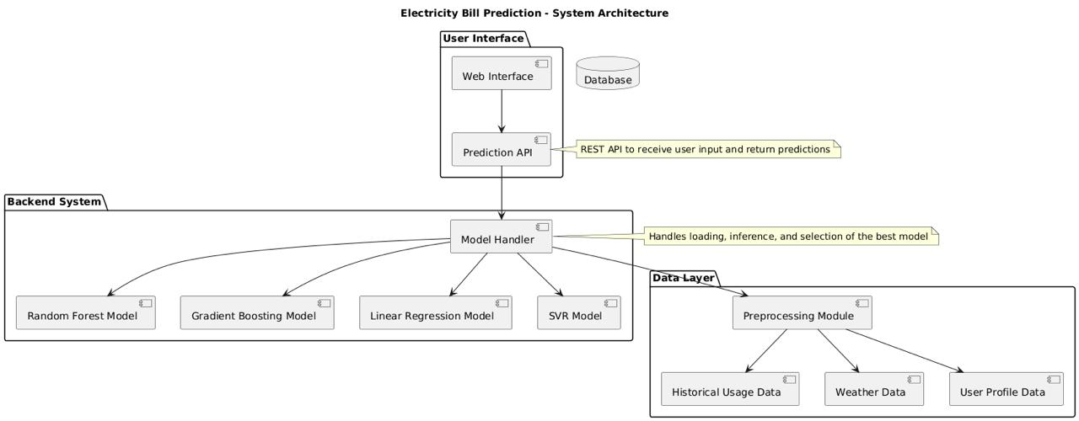
System Architecture

Slide 8
Methodology
Problem Understanding and Requirement Analysis
Define the scope of the project: predicting monthly electricity bills.
Identify necessary input features (e.g., historical usage, number of appliances, hours of use, environmental data).
Data Collection
Gather data from relevant sources such as:
Smart meters
Utility company records
Public datasets (e.g., UCI Machine Learning Repository)

Slide 9
Methodology
Data Preprocessing:
Handle missing values and outliers.
Encode categorical variables (e.g., appliance types).
Normalize or scale numerical features to bring them to a uniform
Exploratory Data Analysis (EDA):
Visualize the relationships between features and the target variable.

Slide 10
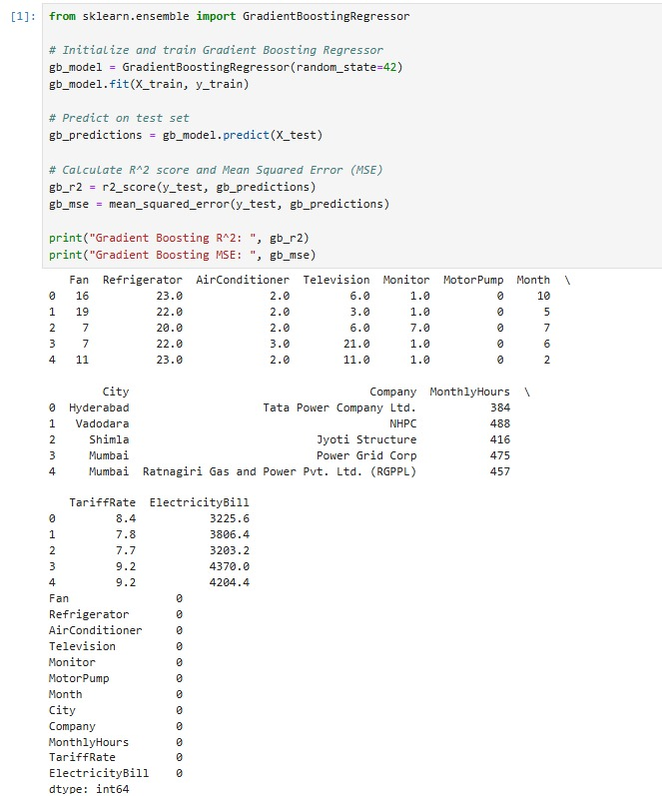
Implementation

Slide 11
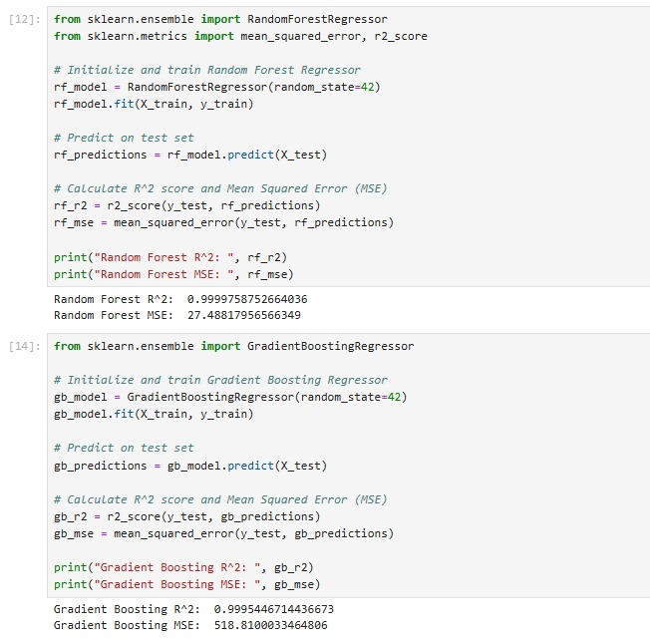
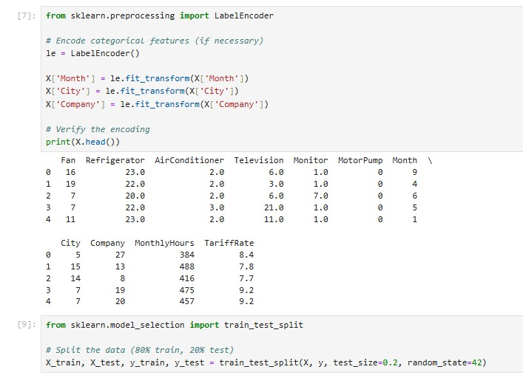
Implementation

Slide 12
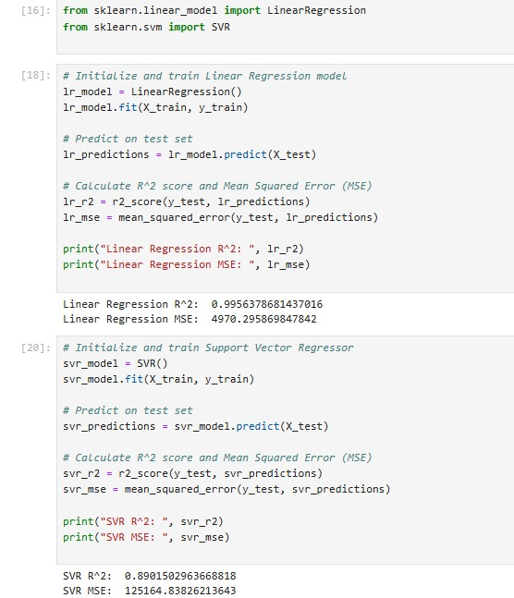
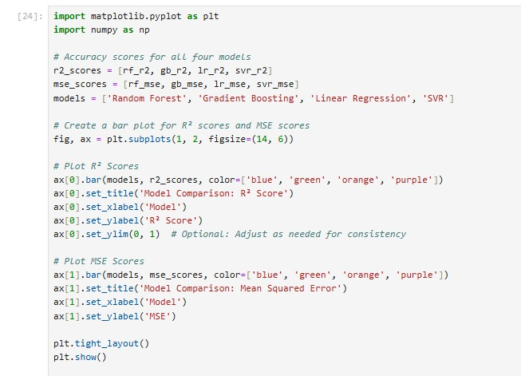
Implementation

Slide 13
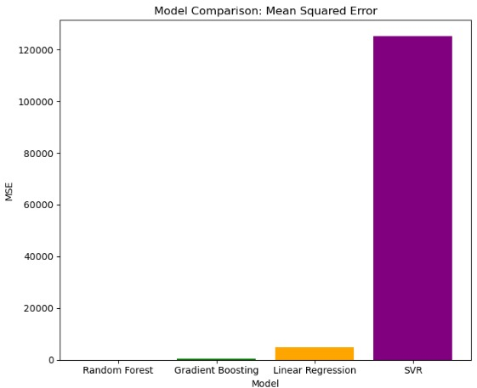
Results

Slide 14
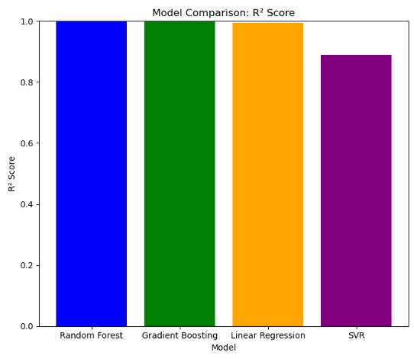
Results

Slide 15
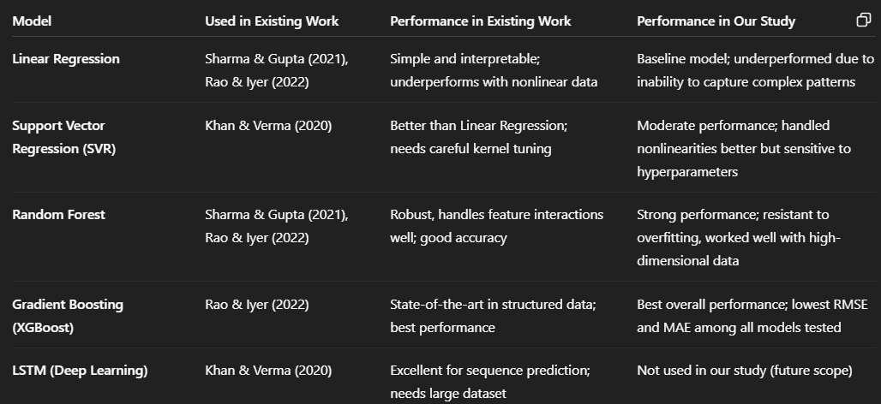
Comparison with existing work

Slide 16
Conclusion and Future Work
Conclusion
In this project, we explored the application of multiple machine learning algorithms Linear Regression, Support Vector Regression (SVR), Random Forest, and Gradient Boosting to predict electricity bills based on historical consumption data and other relevant features. The results demonstrated that tree-based ensemble models, particularly Gradient Boosting, significantly outperformed traditional linear models and SVR in terms of prediction accuracy.
Future Work
Feature Engineering Enhancements: Incorporating additional features such as appliance-level consumption, occupancy patterns, and dynamic pricing signals could further improve model performance.
Time-Series Modeling: While our models used static features, incorporating time-series methods (e.g., LSTM, Prophet, or ARIMA-based hybrids) could help capture temporal dependencies and seasonality more effectively.
Real-Time Prediction System: Developing a real-time or near-real-time prediction system using streaming data could make the model more applicable for smart home or smart grid applications.

Slide 17
Reference
Zhou, K., Yang, S., & Shao, Z. (2017).Household monthly electricity consumption pattern mining: A fuzzy clustering-based model and a case study.Journal of Cleaner Production, 141, 900–908.DOI: 10.1016/j.jclepro.2016.09.115
Ahmed, R., & Khalid, R. (2019).Electricity load and price forecasting using machine learning: A survey.Energies, 12(15), 2926.DOI: 10.3390/en12152926
Patel, A., & Shah, M. (2020).A comparative study of machine learning models for electricity consumption forecasting.International Journal of Computer Applications, 176(33), 17–23.DOI: 10.5120/ijca2020920592
Li, L., Li, X., & Wang, Y. (2021).Short-term electricity load forecasting using a stacked ensemble model based on gradient boosting decision tree.Energies, 14(3), 720.DOI: 10.3390/en14030720

Slide 18
THANK YOU

