Slide 1
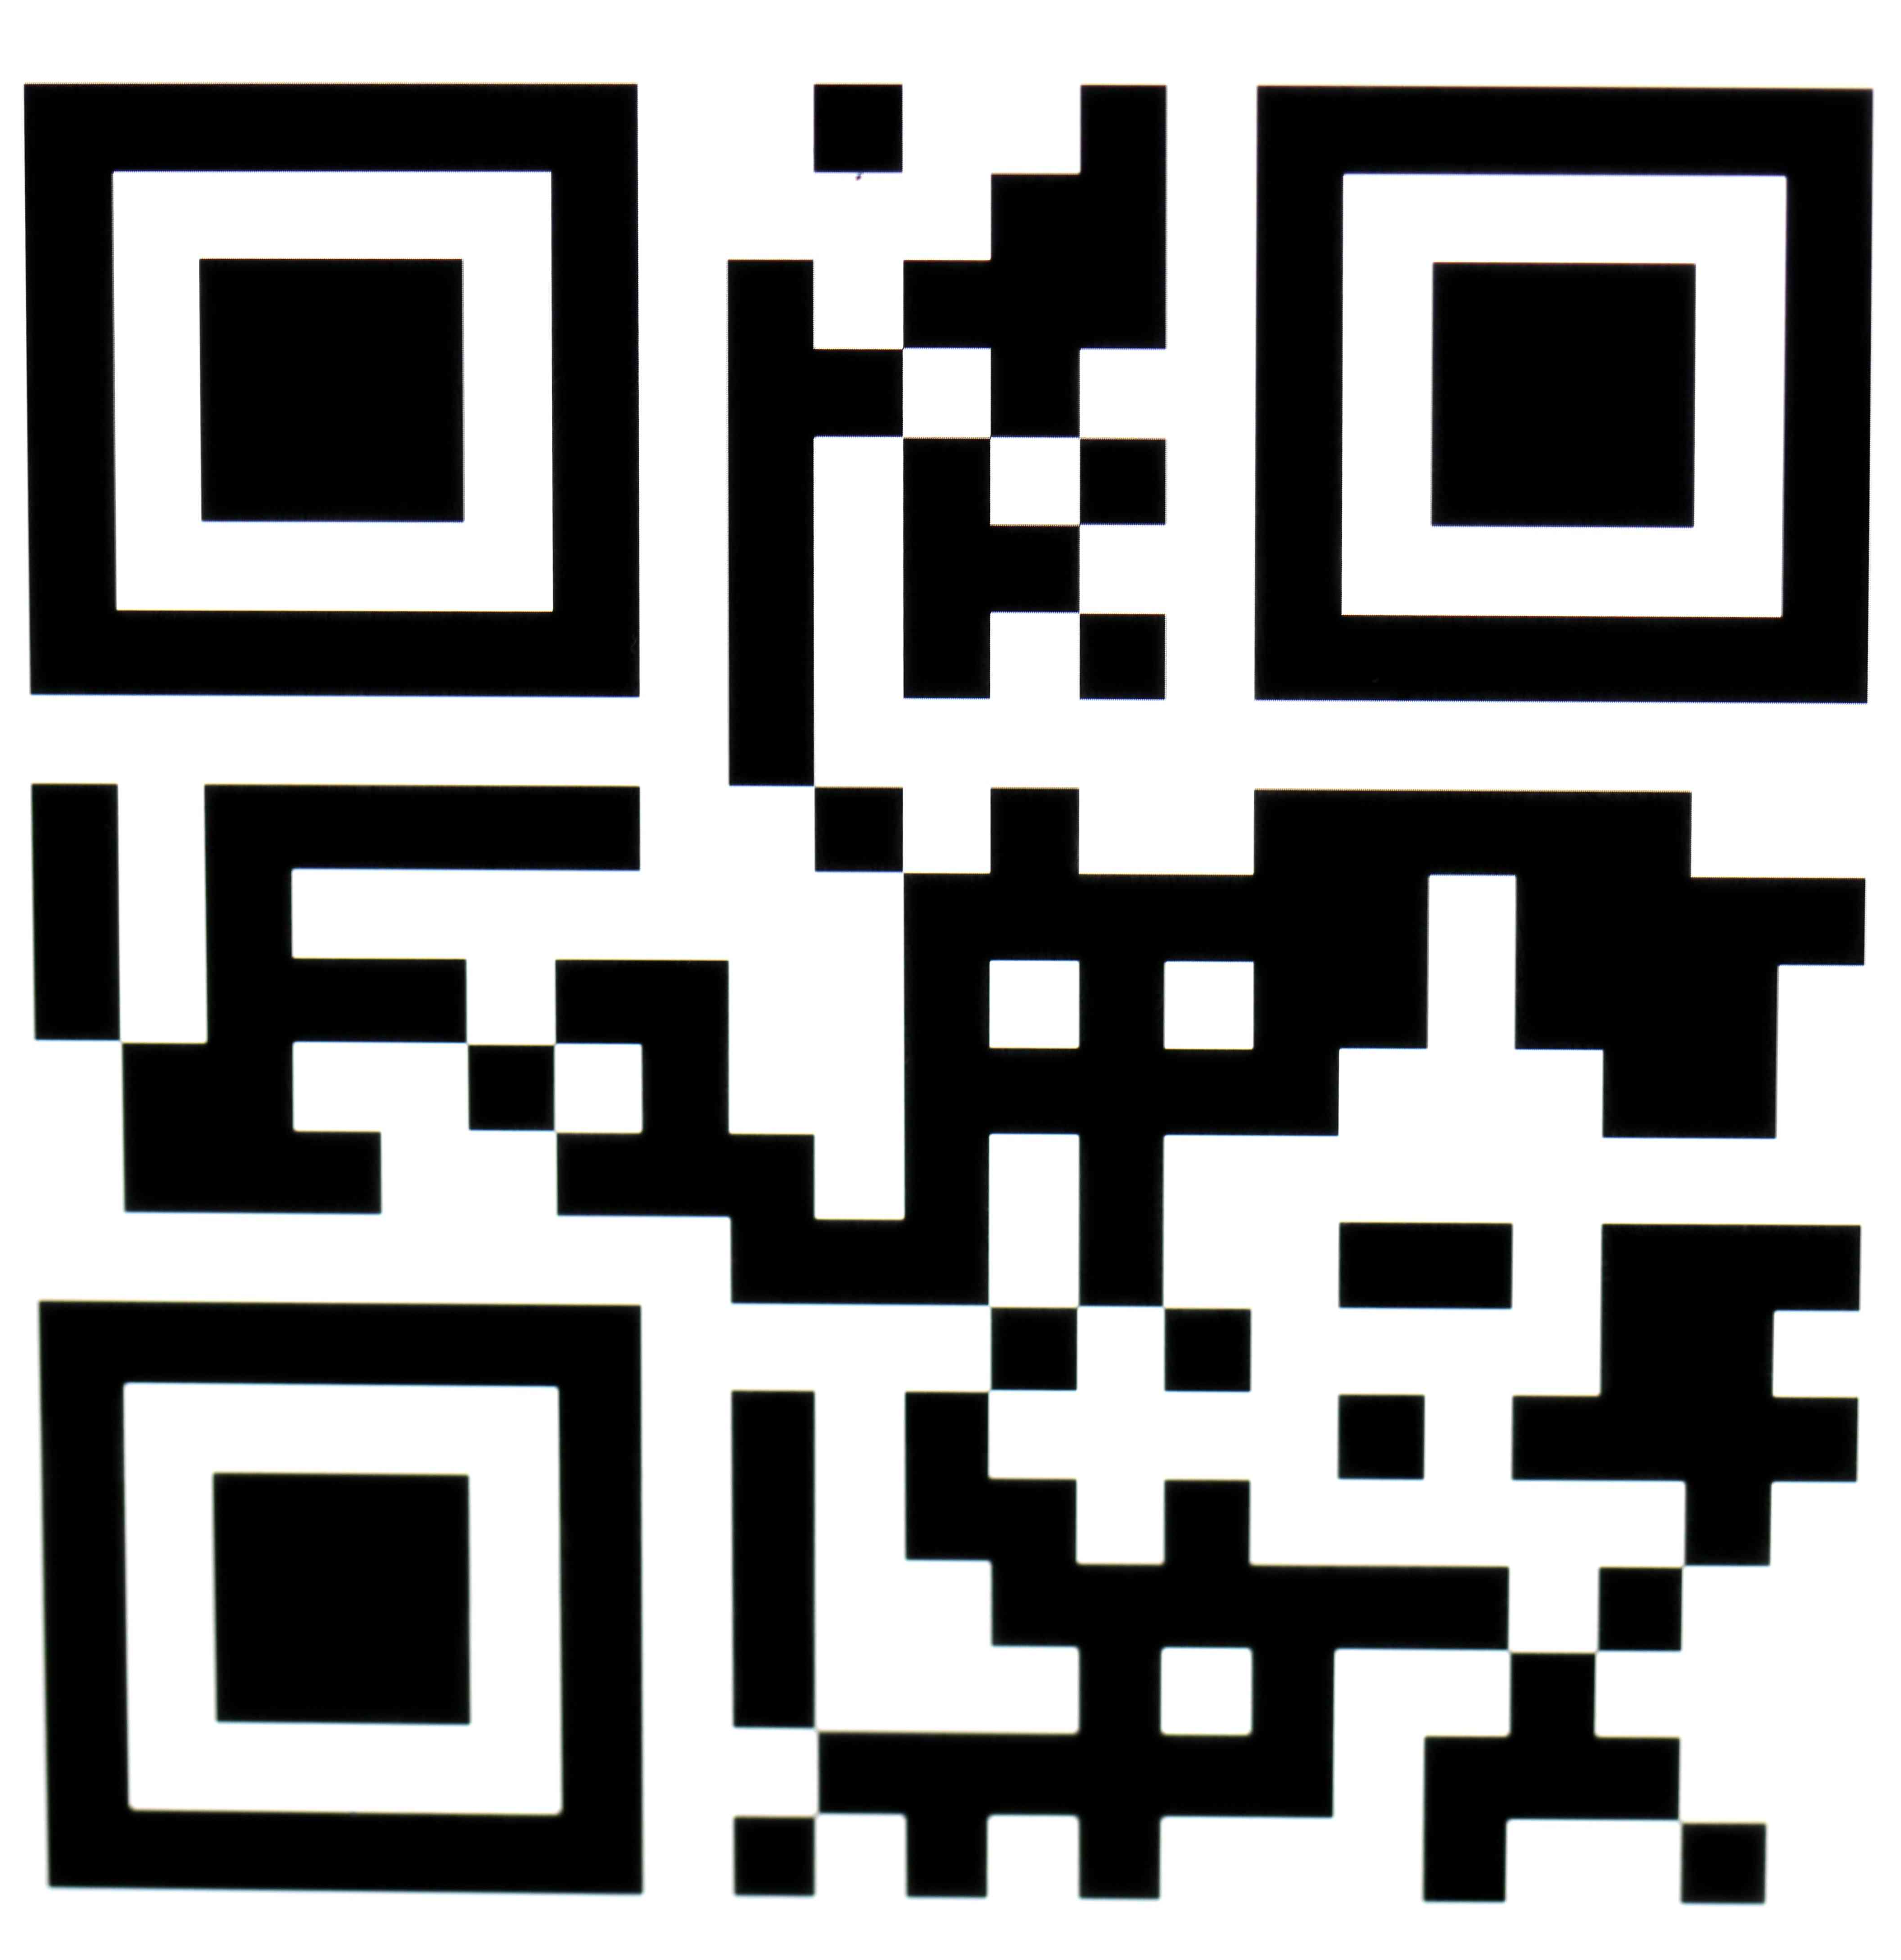
Unstoppable (U/A)
English, 3D
Mon, 18 Nov | 3:05 PM
The Opera House
1 Ticket
AUDI – 8
Seat Number: No
n
Total Amount: $442.92

