Slide 1
Real-Time Pedestrian Detection System for Intelligent Vehicles
Final Presentation
(Integration)
Team SEER -
Sumeet Singh (251055497)
Deep Singh (251122489)
Sanket Salunke (251102392)
Nikhil Komari (251086006)

Slide 2
Introduction
It is estimated that around 1.25 million deaths occur worldwide every year due to road accidents.
Majority of the victims include pedestrians and cyclists.
With the advent of autonomous vehicles, road accidents can be reduced to a great extent. However, a robust intelligent infrastructure is needed to realize this.
Our project focuses on building a real-time pedestrian detection system to avoid collision between vehicles and pedestrians.

Slide 3
Objectives
Detect Pedestrians on cross walk (Region of Interest) accurately.
Determine the number of pedestrians on cross walk.
Communicate detections to nearby intelligent vehicles to avoid collision.
Provide admin functionalities such as network and video feed monitoring.

Slide 4
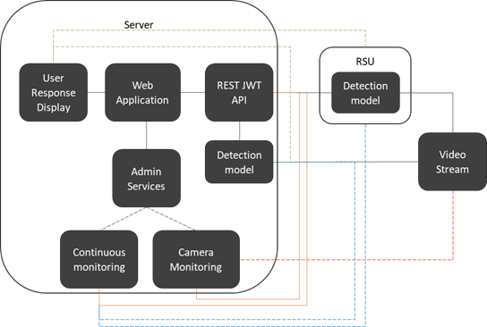
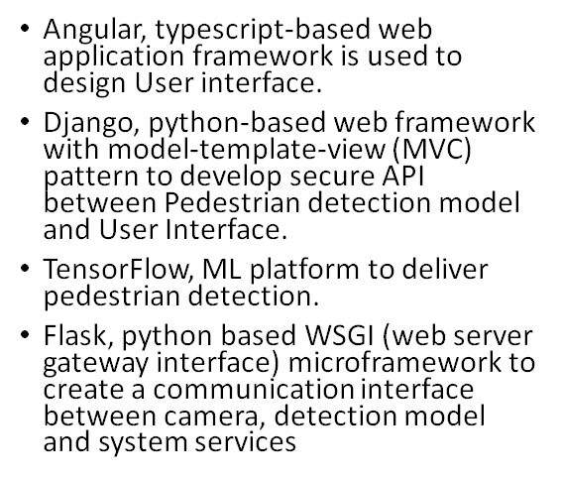
Subsystem Decomposition

Slide 5
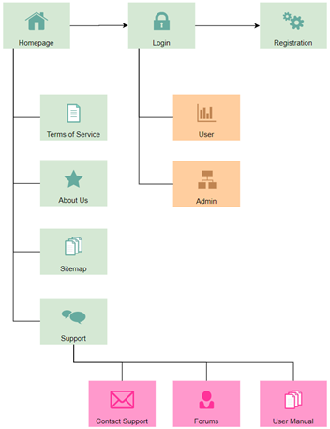
Site Map
There are four main components in UI module:
Landing
Registration
Login
Admin functions
User Response

Slide 6
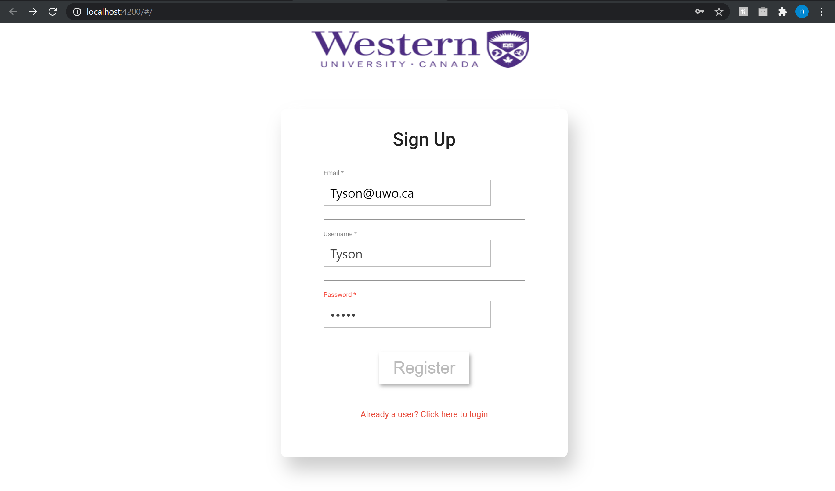
Registration Page
A user can subscribe to the services by signing up on the registration page.
Details required to sign up are email, username and password.
After signing up a user is required to login to access the services.

Slide 7
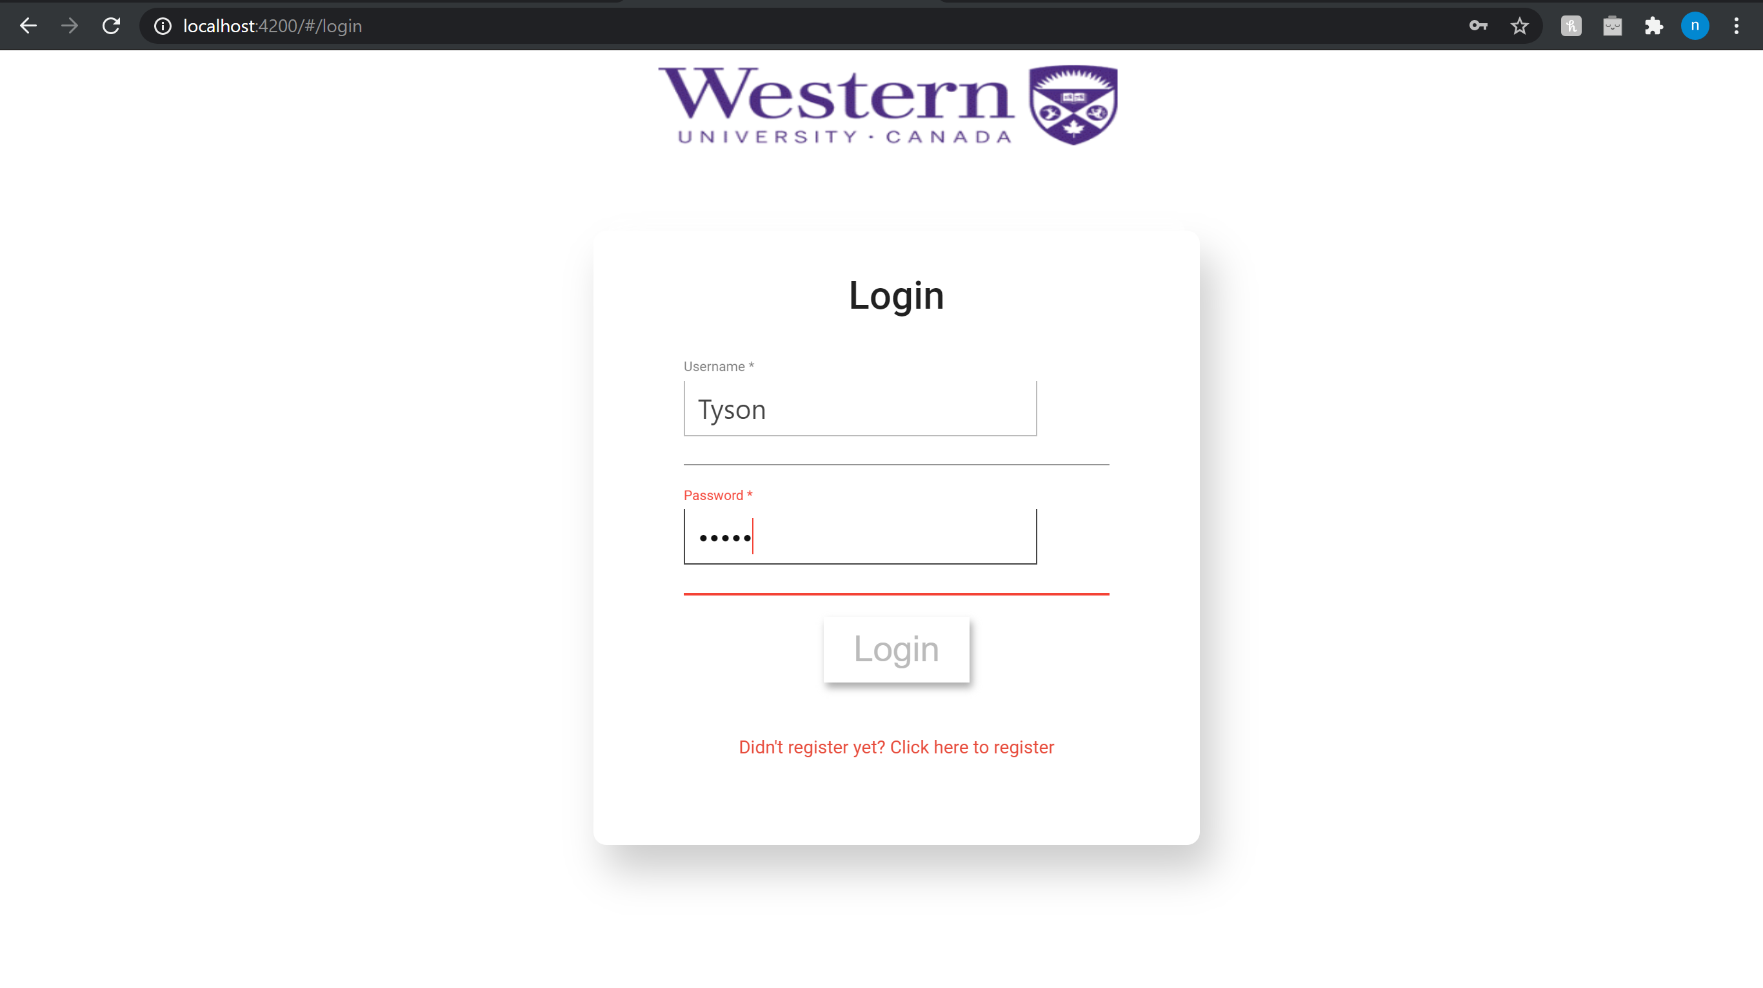
Login Page
Any registered user can access the services by signing in (involves authentication).
Details required to sign in are username and password.
After signing in a user can make decisions based on the response received from nearby RSU (involves pedestrian detection).

Slide 8
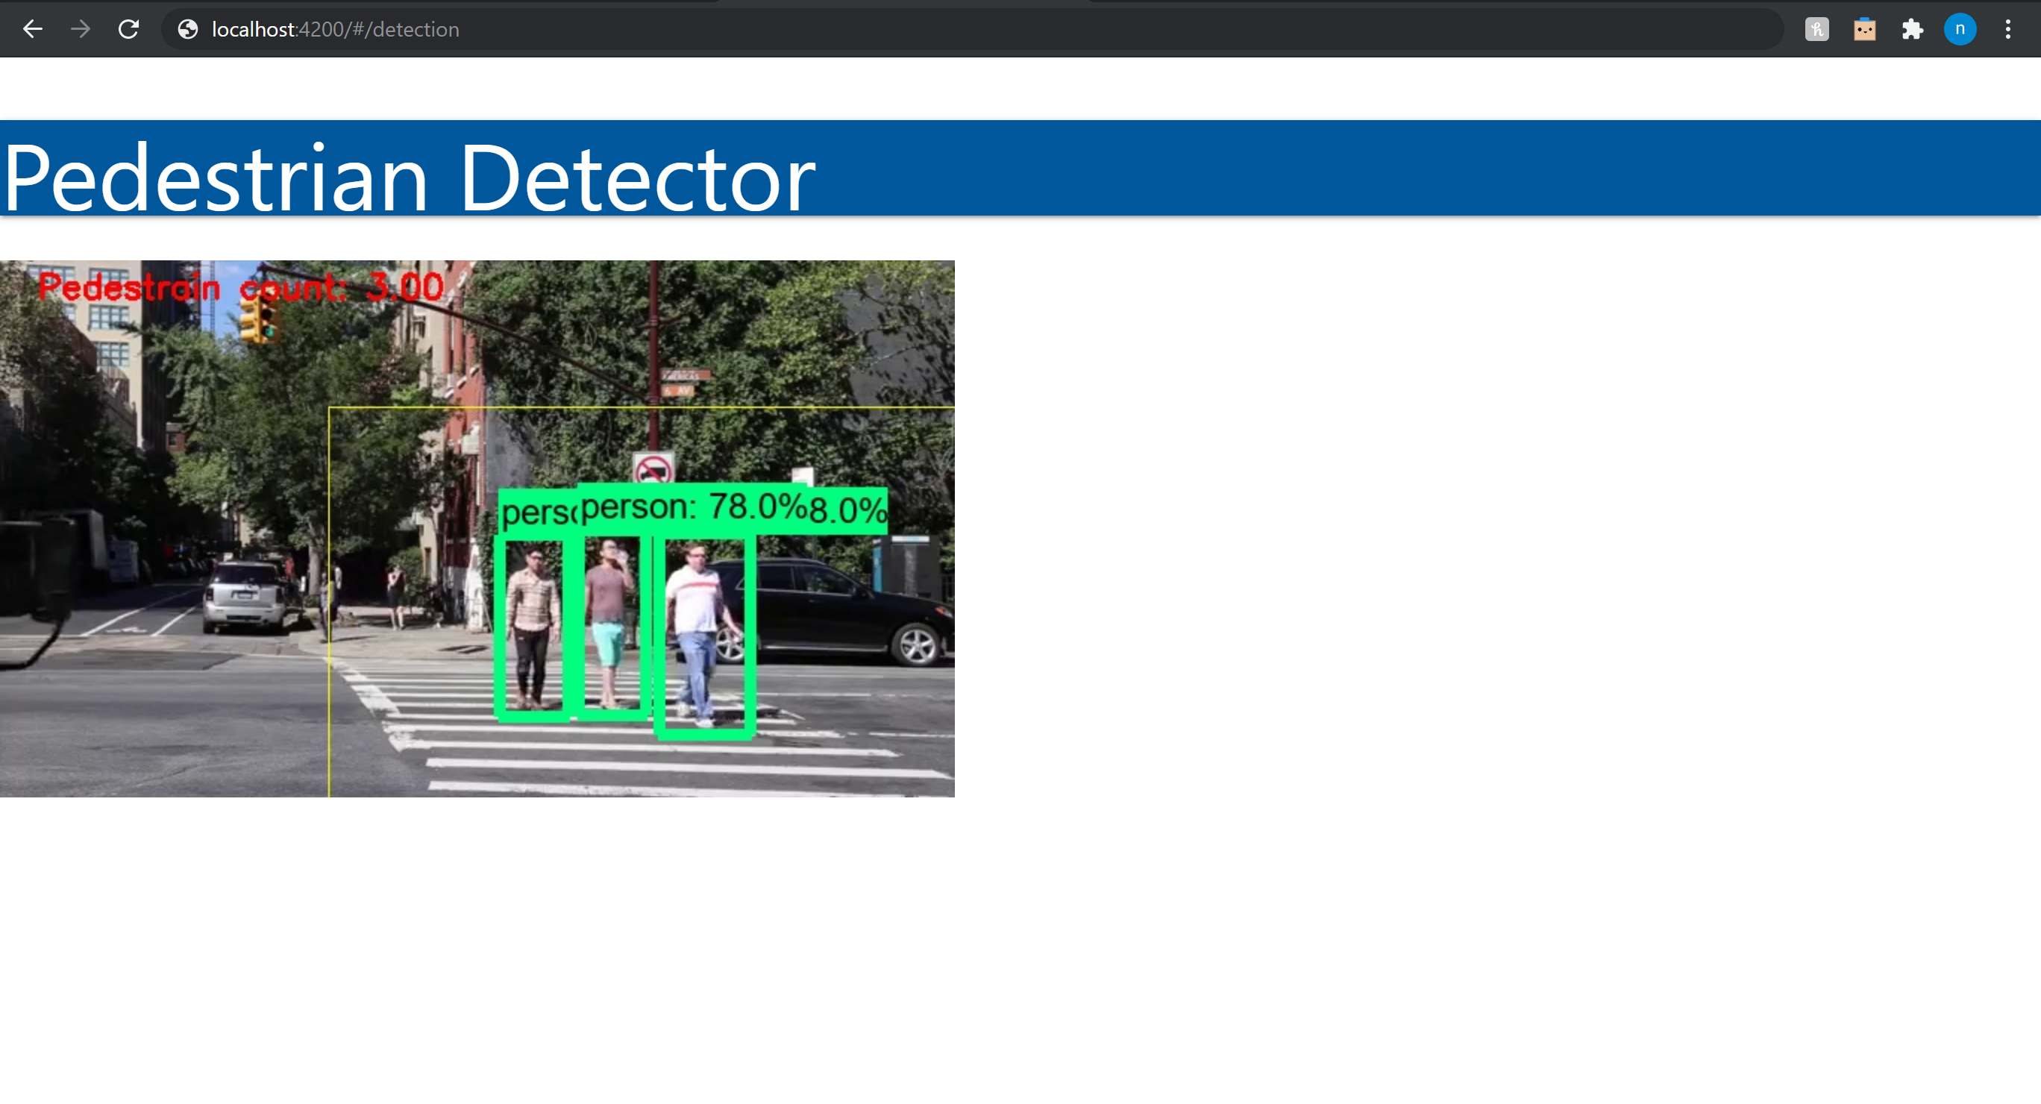
User Response (Detections)
A display of detected pedestrians on crosswalk, region of interest and pedestrian count is provided to the user.
Pedestrian count highlighted in red, ROI in yellow, and detections along with class and confidence score in green.
Therefore, the user’s (vehicle) on-board unit makes a decision based on the information (detections and count) received from the nearest RSU.

Slide 9
Summary
End-to-end integration involving object detection module, user registration, user authentication and front-end User Interface (UI) is completed, therefore, enabling user to access the information regarding pedestrian detection and count.
Admin functionalities including login, network and video monitoring, node manageability etc., are demonstrated and discussed in previous presentations, which are available on bitbucket.
We successfully deployed the object detection model and served its results to a user to enable decision making through a web application.

Slide 10

Thank You!

