Slide 1

A Real-Time Pedestrian Detection and Tracking System for Intelligent Vehicles
Custom Training Object Detection Model
Nikhil Komari (251086006)
Sumeet Singh (251055497)

Slide 2
Previously…
Object detection using various models available through darknet (tiny yolo) and TensorFlow (SSD, RCNN etc.) frameworks
Selected SSDLite Mobilenet model among others as it provides a balance between speed and accuracy.

Slide 3
Objectives
Figuring out the entire TensorFlow's Object Detection API training pipeline.
Selecting & preprocessing the dataset for our problem
Custom training the model
Evaluating the Custom-trained Model
Comparing pre-trained model with custom-trained model

Slide 4
Typical ML Flow
Dataset: what is the training Dataset?
Model Creation: which model to train ? What is model configuration ?
Loss Function: Criteria using which Model will learn (Objective)
Model Evaluation: Criteria to check how good is the model ?
Model Training: Learning Complex relationships in dataset; When to stop training ?

Slide 5
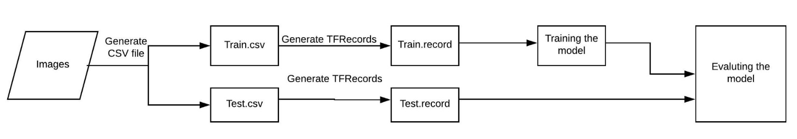
TensorFlow's Training Pipeline
Each pre-trained model has *.config file consisting of Hyperparameters of model.
Data Preprocessing
Basic Flow

Slide 6


Training Environment
Started training on local machine but switched to Google Colab after figuring out a way to train on cloud.
The training pipeline automatically takes checkpoints of model after regular intervals.
Google Colab reduced training time significantly but at the cost of Session timeout issues, RAM issues, Over-usage limits.
 | Local System | Google Colab
GPU
Compute time/step | 35 s | 0.5 s
Total Training Time | ~24 days (Estimate) | ~ 8.5 hrs

Slide 7
Dataset Selection
Identify dataset to train the custom model to detect only pedestrians in roadside scene.(Can be extended later to other objects)
Intended to find the dataset that can closely simulate the practical scenarios of our problem.
An ideal dataset should be dense and diverse enough to cover multiple weather scenarios and fair amount of small, medium and large objects in it.

Slide 8
Datasets Explored
Dataset | Properties
Caltech Pedestrian | Consist of 6 training video sequences (~1 GB each) from a moving vehicle. Very sparse dataset w.r.t our application as crosswalks in the entire dataset are very few. Also, lacks diversity.
INRIA Persons | Consists of both positive images having persons and negative images with no persons in it. Very Generic dataset of persons in image with no road specific setup; More suitable for image classification problems.
Wider Persons | Dataset with persons in Marathon, Dance, Activity, Traffic, Miscellany setup. Very Dense dataset and impossible to filter images for Road specific conditions.
ETHZ | Low Quality phone videos recorded by a pedestrian walking on crosswalks.
JAAD | Dataset designed for Autonomous Driving Problems with focus on pedestrian and driver behaviour at the point of crossings. Dataset collected in North America and Europe with urban driving and weather conditions

Slide 9
Dataset Description
Joint Attention in Autonomous Driving (JAAD) consists of 346 HD mp4 video clips 5-10 seconds long, recorded from on board camera at 30 fps.
An extensive dataset having frame wise spatial information (Bounding Boxes) in XML format, behavior information of pedestrian and context of frame recorded in variety of scenarios.
Dataset provides occlusion information of pedestrians in the frame ranging from ‘none’, ‘partly’ to ‘fully’.

Slide 10
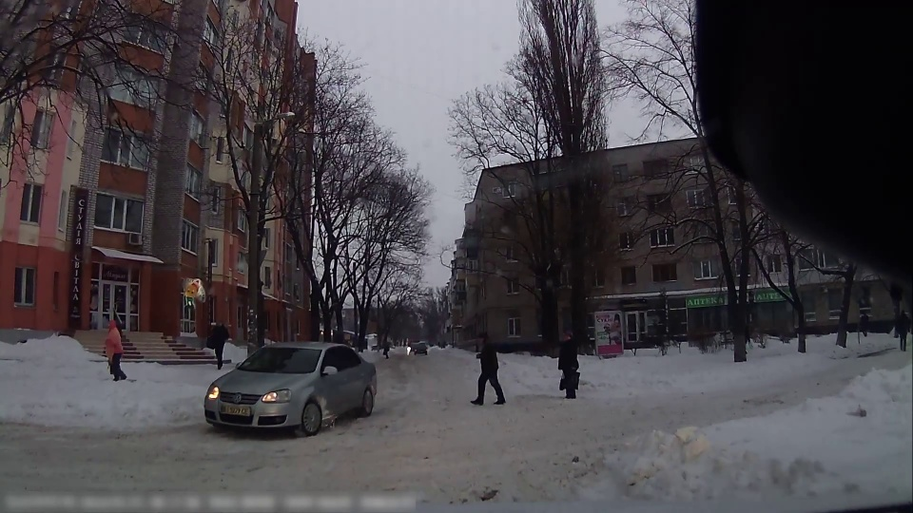
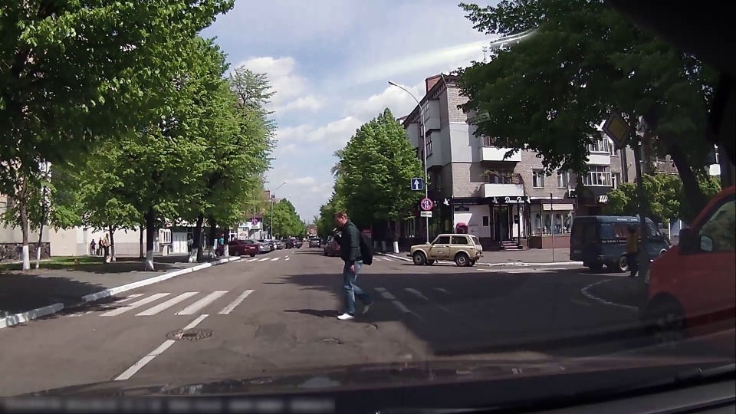
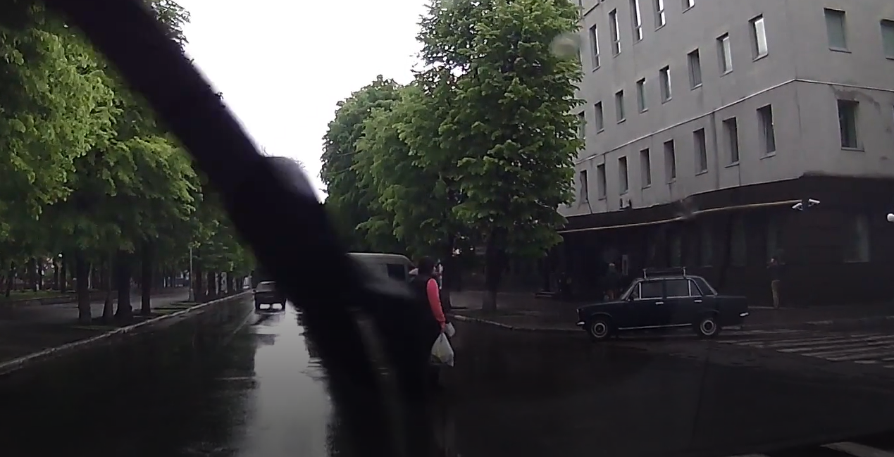
Dataset Diversity
Images ranging from Winter, Summer and Rainy seasons.
Rainy season intentionally ignored for training to maintain quality of dataset as vehicle’s windshield wipers were concealing the person.
Winter Scene
Summer Scene
Rainy Scene

Slide 11
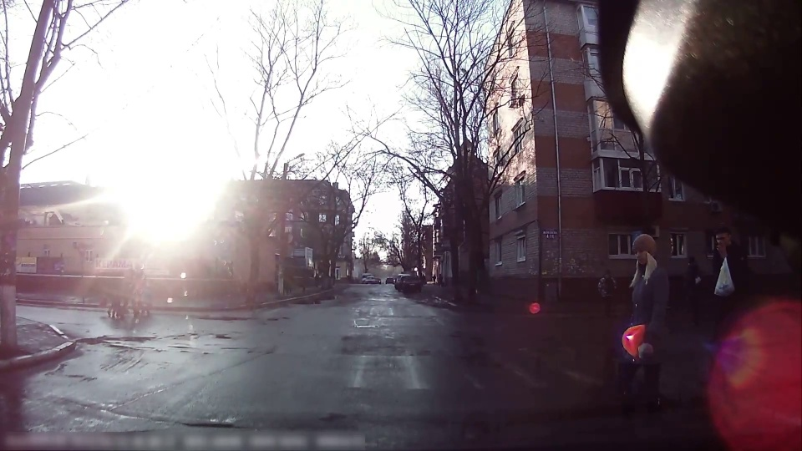
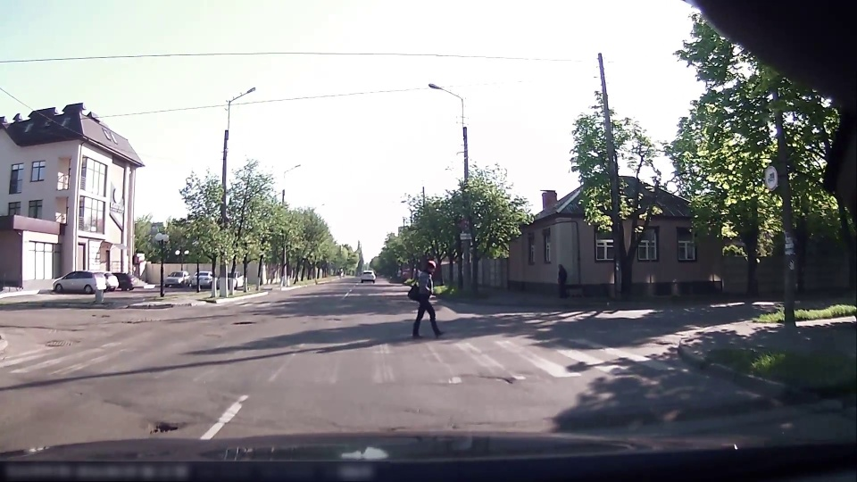
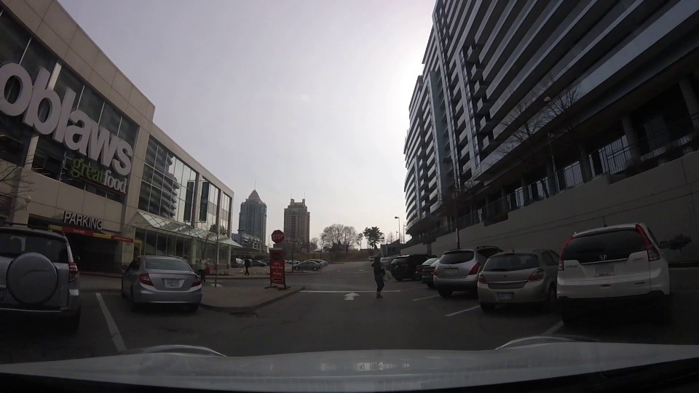
Dataset Diversity(Contd.)
Images taken in different lighting conditions and at different times of the day.
Bright Scene
Normal Scene
Shady Scene

Slide 12
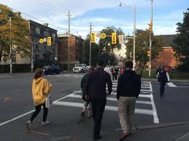
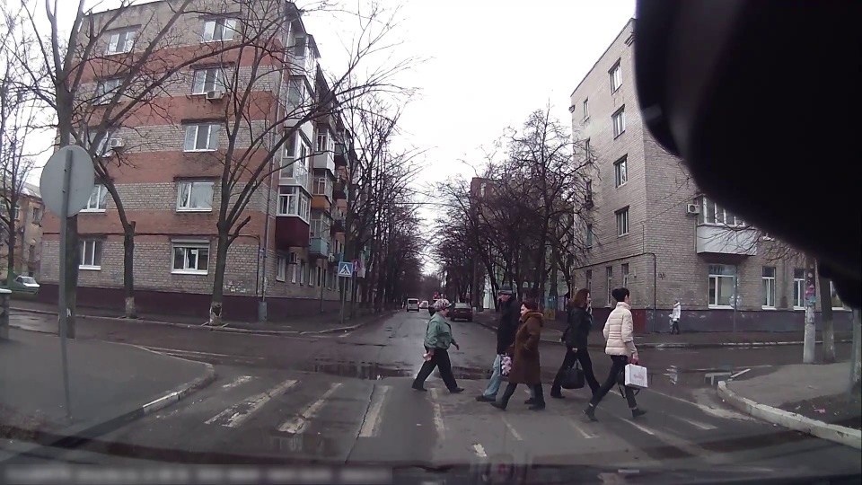
Dataset Diversity(Contd.)
Our Application needs to consider the camera angle i.e. Front view v/s Side view of pedestrians.
Most of the images cover side view of pedestrians (on board camera).
Front View (Not in JAAD)
Side View (In JAAD)

Slide 13
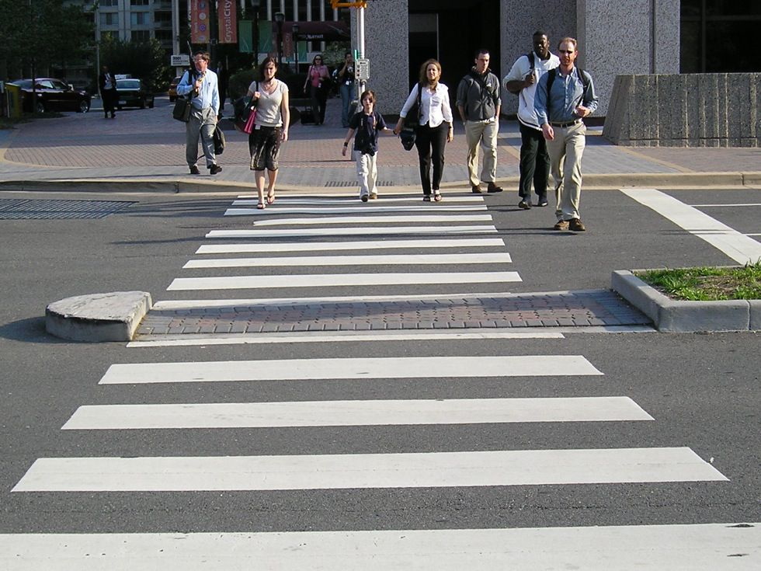
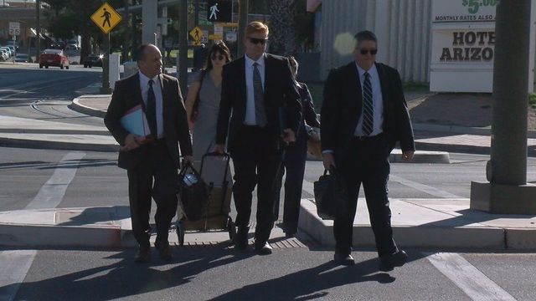
Dataset Diversity(Contd.)
Collected 208 images from Google covering the front view.
Manually labelled 630 Bounding Boxes on collected dataset and merged with JAAD.
Front View Google images

Slide 14
Dataset Preprocessing
Data Filtering
Manually selected subset of videos from entire dataset for desired scenarios.
Converted Videos to Images
Individual video is converted into respective frames using OpenCV.
Removed Non-Meaningful Data
Frames with no pedestrians are discarded during frame generation using python script. NO TRUE NEGATIVES

Slide 15
Data Preprocessing(Contd.)
TRF records generation requires annotations of bounding box in CSV format.
But dataset contains annotations in JAAD specific XML format.
Parsed XML file to generate corresponding CSV file.
Ignored objects labelled as “people”.
Frames and corresponding BB are scaled down by factor of 0.5.
Finally selected every 8th frame of video into single CSV file while maintaining a global naming convention for images and annotations.

Slide 16
Data Preprocessing(Contd.)
Train/Test Split (80:20)
Train dataset contains 1136 images with 5644 bounding boxes
Test dataset contains 238 images with 1213 bounding boxes
Finally, Train and Test Data is converted into respective *.records files using python script.

Slide 17
Typical ML Flow
Dataset
Model Creation: which model to train ? What is model configuration ?
Loss Function
Model Evaluation
Model Training

Slide 18
Model Selection
As per the previous discussion, SSD models achieved a balance between speed and accuracy compared to faster R-CNN, tiny YOLO.
Initially trained SSDLite MobileNet, but it failed to detect any objects in the scene due to version of model [1].
Finally, custom trained an SSD MobileNet model which is similar to the Lite version in terms of accuracy and speed.
[1] https://github.com/tensorflow/models/issues/2773
Model | Speed (ms) | COCO mAP | Custom-training Output
ssdlite_mobilenet_v2_coco | 27 | 22 | No boxes
ssd_mobilenet_v2_coco | 31 | 22 | Bounding Boxes

Slide 19
Model Configuration
Hyperparameter | Value
Input image size | 300 x 300
Batch Size | 24
Optimizer | RMSprop
Momentum | 0.9
Learning rate, decay | 0.004, 0.95

Slide 20
Typical ML Flow
Dataset
Model Creation
Loss Function: Criteria using which Model will learn (Objective)
Model Evaluation
Model Training

Slide 21
Loss Function
Object detection involves both classification (predicting object class) and regression (predicting bounding boxes), therefore, loss function contains two components namely classification loss and localization loss.
Localization loss is the mismatch between predicted bounding box and ground truth box. There are four parameters cx, cy, w, h of bounding box.
(cx, cy) is the offset to default (anchor) box, and w, h are width and height of the bounding box respectively.

Slide 22
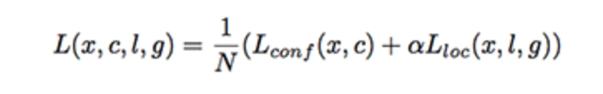
Loss Function(contd.)
Classification loss is calculated as softmax loss over confidence scores of multiple classes.
Total loss is computed as:
N = Number of positive match, x = pixel under consideration
c = class scores, l = predicted boxes, g = Ground truth boxes
α = weight for localization loss

Slide 23
Typical ML Flow
Dataset
Model Creation
Loss Function
Model Evaluation: Criteria to check how good is the model ?
Model Training

Slide 24
Model Evaluation
Since the model is originally trained on COCO dataset, custom trained model is evaluated using ‘coco_detection_metrics’ metric provided by ‘pycocotools’ package.
What does this metric do ?
uses Mean Average Precision (mAP) to compare the Object Detection models.
mAP calculation internally makes use of ‘Intersection over Union (IoU)’

Slide 25
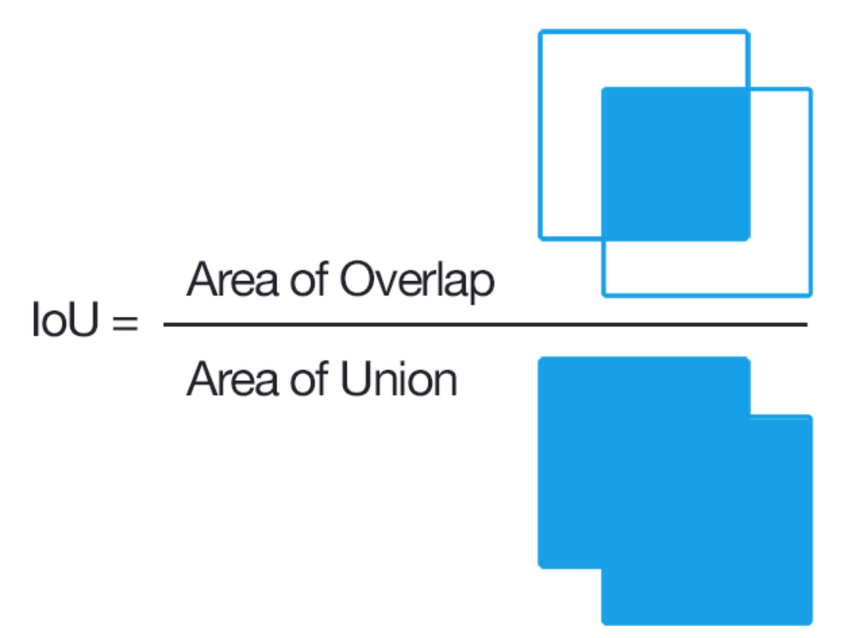
Evaluation Metrics
IoU (Intersection over Union)
Object detection Models provide Bounding Boxes(BB) as one of the outputs.
IoU depicts the extent of overlap of predicted BB to ground truth BB
Important to determine if the bounding box is TP, FP or FN.
True Positive | An IoU score > threshold with correct label
False Positive | IoU score < threshold Duplicate BB
False Negative | Model fails to detect the object An IoU score > threshold with incorrect label
True Negative | TN is not evaluated as each image is expected to have an object

Slide 26
Evaluation Metrics(contd.)
Using TP,FP and FN Precision and Recall can be calculated for each class across the test dataset.
Average Precision(AP) is calculated using the area under the PR curve.
mAP(Mean Average Precision) is the average of AP calculated for all classes.
In reference to COCO dataset, we can calculate AP in following ways:
Thresholding BB at different IoU level | AP across scales
AP: AP at IoU = 0.50: 0.05: 0.95 AP@IoU = 0.5 AP@IoU = 0.75 | AP(small): AP for small objects: area < 32² px AP(medium): AP for medium objects: 32² < area < 96² px AP(large): AP for large objects: area > 96² px

Slide 27
Typical ML Flow
Dataset
Model Creation
Loss Function
Model Evaluation
Model Training: Learning Complex relationships in dataset; When to stop training ?

Slide 28
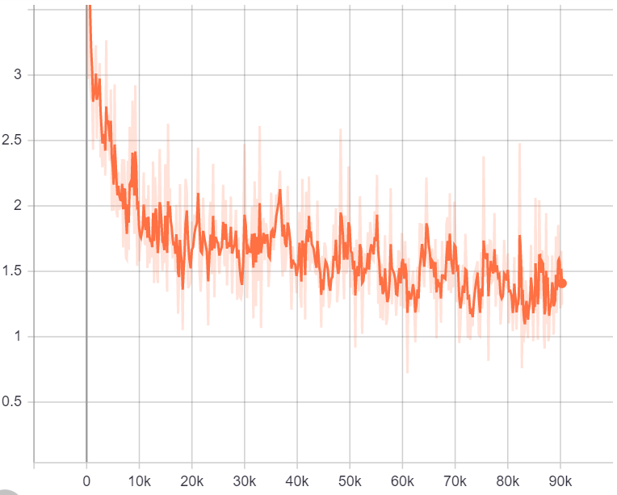
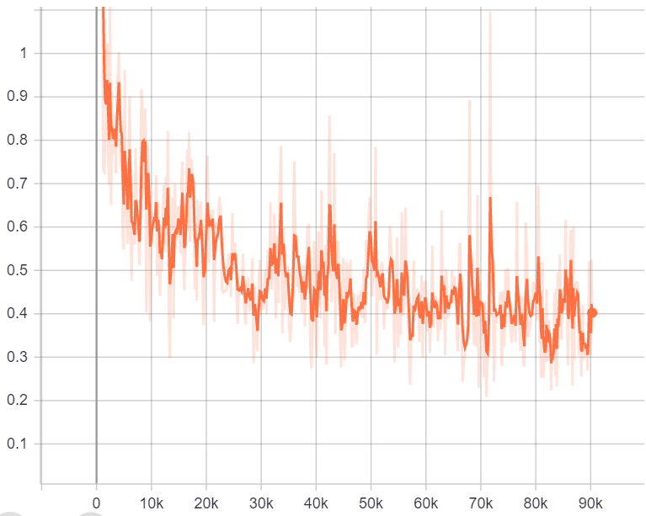
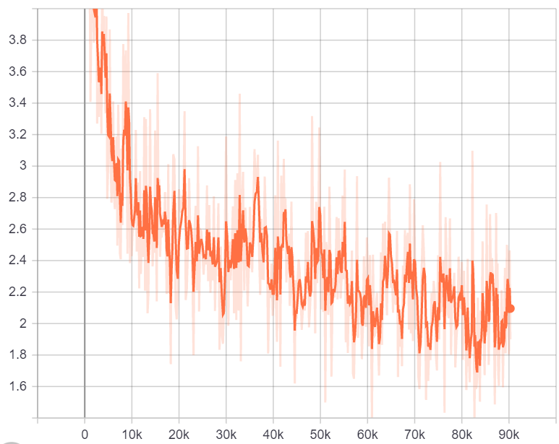
Model Training
Trained model for 80K steps. Training stopped when training loss stopped decreasing and mAP on test dataset stopped increasing.
a) Classification Loss
b) Localisation Loss
c) Total Loss

Slide 29
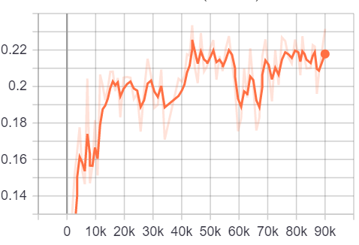
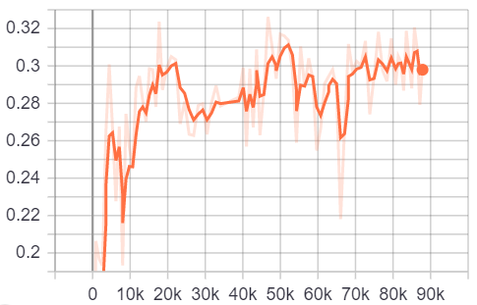
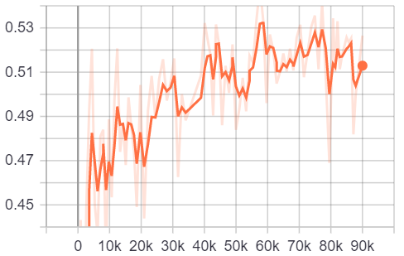
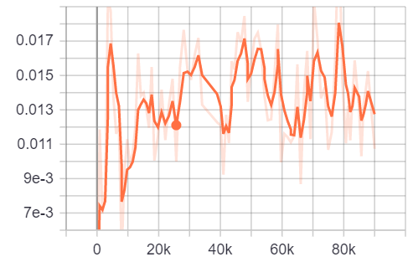
Model Evaluation
a) mAP
c) mAP (Medium)
d) mAP (Small)
b) mAP (Large)

Slide 30
Is custom-trained model better than the pre-trained model?

Slide 31
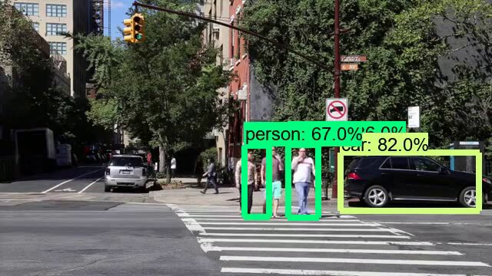
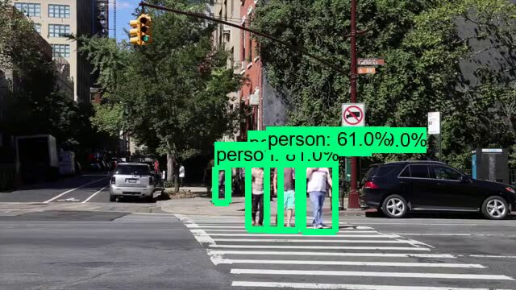
Performance Comparison – Accuracy
How to compare the accuracy pretrained model with custom trained model ?
Pretrained model is capable to detect 90 classes.
Objects other than “person” present in the image will act as False Positives for Pretrained model in JAAD dataset as no Ground Truths are available.
a) Pretrained Model
b) Custom Trained

Slide 32
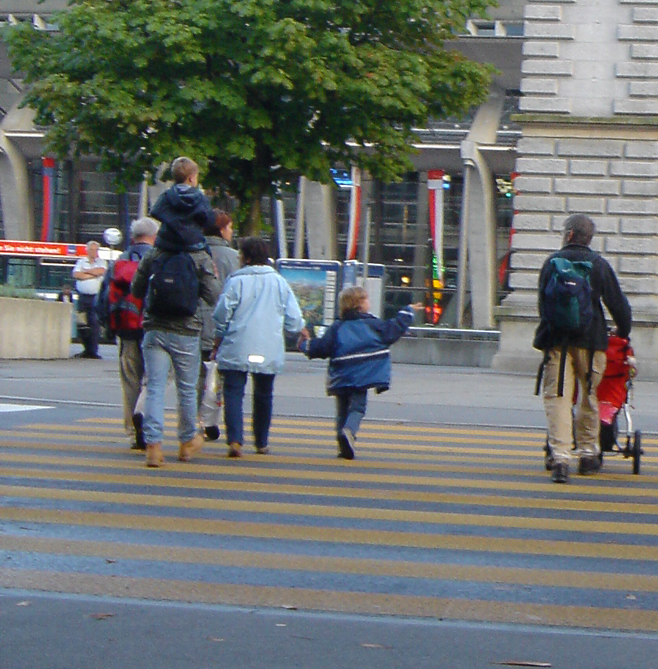
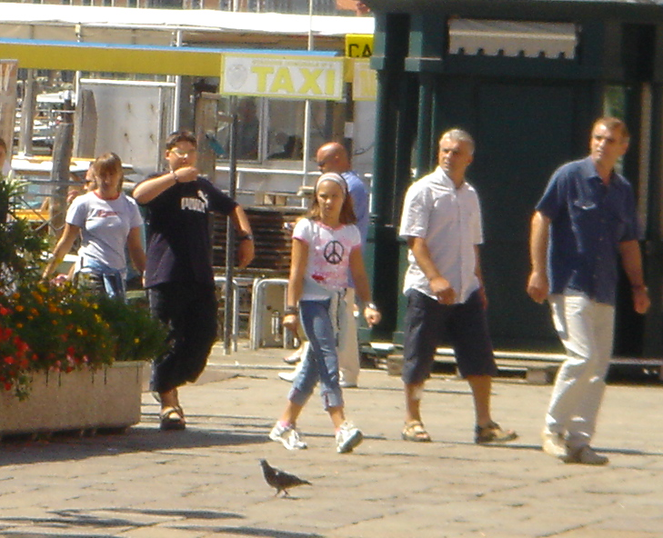
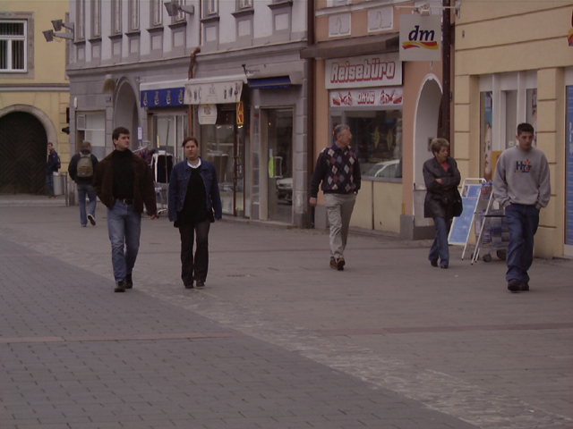
Performance Comparison – Accuracy
Handpicked images from INRIA Persons dataset that only contains “persons” in the scene.
Manually, annotated the images and evaluated performance of both pre trained and custom trained model.
Images only containing persons

Slide 33
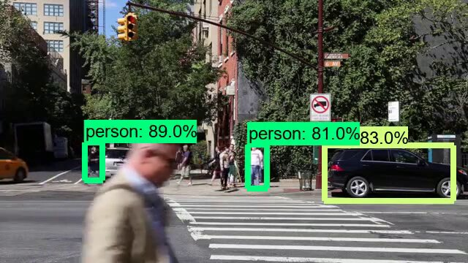
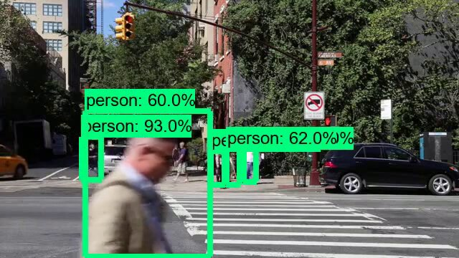
Performance Comparison - Speed
a) Pretrained Model
b) Custom Trained

Slide 34
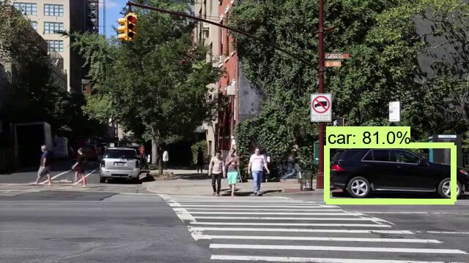
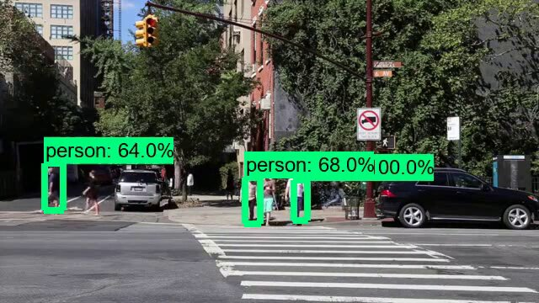
Performance Comparison - Speed
a) Pretrained Model
b) Custom Trained

Slide 35
Performance Comparison - Speed
a) Pretrained Model
b) Custom Trained

Slide 36
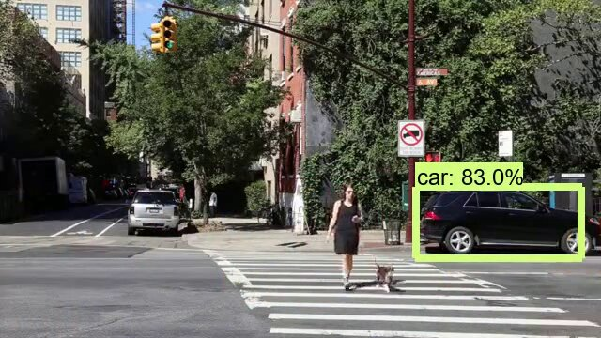
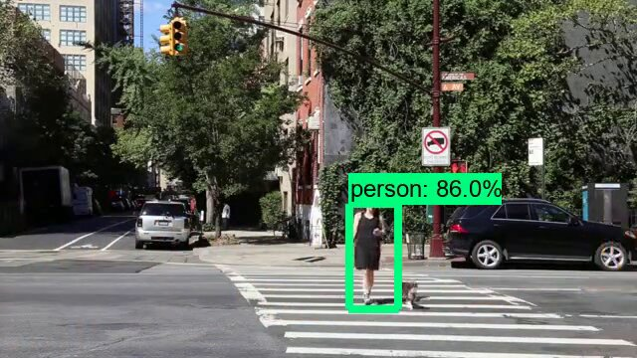
Performance Comparison - Speed
a) Pretrained Model
b) Custom Trained

Slide 37
Conclusion
Did training improve performance of the model?
Parameters | Pretrained | Custom-Trained
Speed | 9.71 fps | 12.25 fps
Accuracy | 0.89 mAP (0.5 IOU) | 0.91 mAP (0.5 IOU)

Slide 38
Status (Development Phase)
Exploring and comparing different object Detection Frameworks for our problem.
Identifying the relevant Dataset for the problem.
Training the model (Transfer Learning).
Evaluating and comparing the Pre trained and custom Trained Model.
Camera angle Selection for our problem.
In depth analysis of performance of custom trained model in different scenarios.
Deploying the model in infrastructure.

Slide 39
Thank You!

