Slide 1

A Real-Time Pedestrian Detection and Tracking System for Intelligent Vehicles
Pedestrian Detection Module
Nikhil Komari (251086006)
Sumeet Singh (251055497)

Slide 2
Previously…
Object detection using various models available through darknet (tiny yolo) and TensorFlow (SSD, RCNN etc.) frameworks
Selected SSD MobileNet model among others as it provides a balance between speed and accuracy.
Selected and pre-processed the dataset.
Custom trained SSD MobileNet model using TensorFlow’s Training pipeline (Transfer Learning).
Compared performance of custom trained model with pre-trained model.

Slide 3
Objectives
Performance analysis of Custom-Trained model in different weather scenarios.
Camera Position Selection.

Slide 4
How model performs in different scenarios ?

Slide 5
About the model….
Model is trained on JAAD Dataset and some images collected from Google.
JAAD Dataset consists of images of different weather and lighting conditions.
After model training, need to evaluate the performance of models in different conditions.

Slide 6
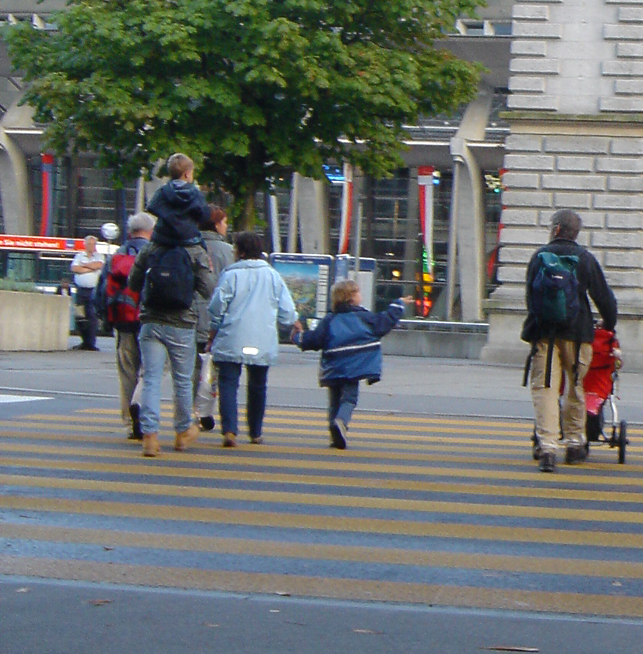
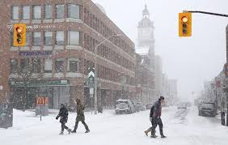
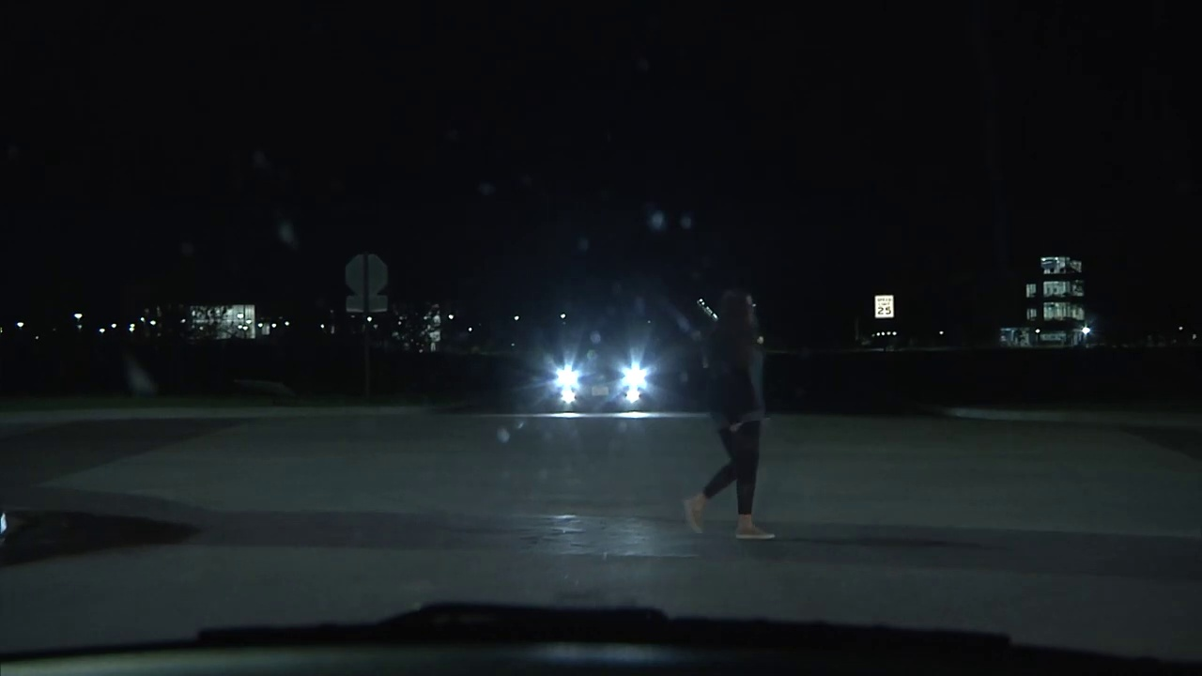
Scenarios
Identified 3 different scenarios
a) Normal Conditions
b) Snow Conditions
c) Night Scene

Slide 7
Comparisons
Weather Condition | Custom-trained model
Normal | 0.53 mAP 0.63 AR
Snow | 0.46 mAP 0.52 AR
Night | 0.32 mAP 0.49 AR
*mAP: All mAP values are recorded at IoU = 0.50 : 0.95
*AR: AR@100 Detections

Slide 8
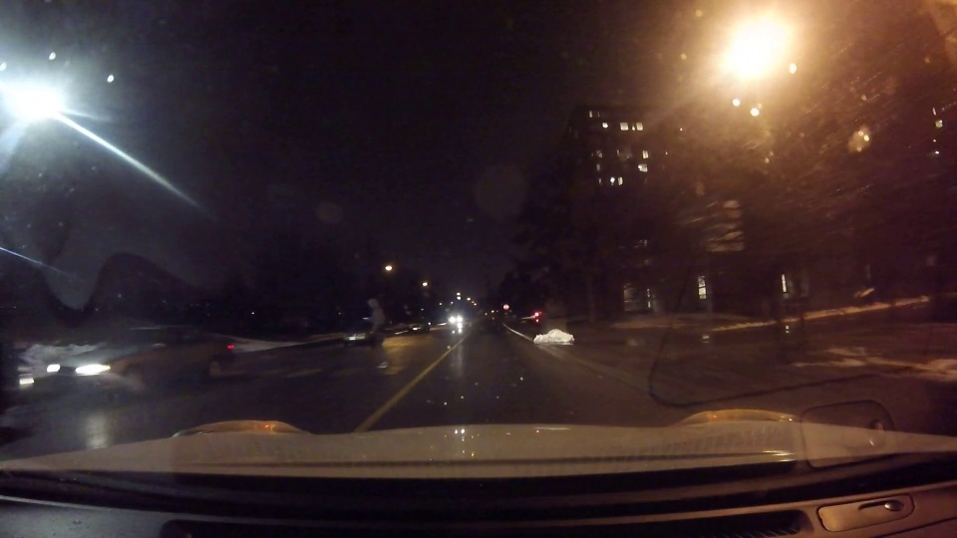
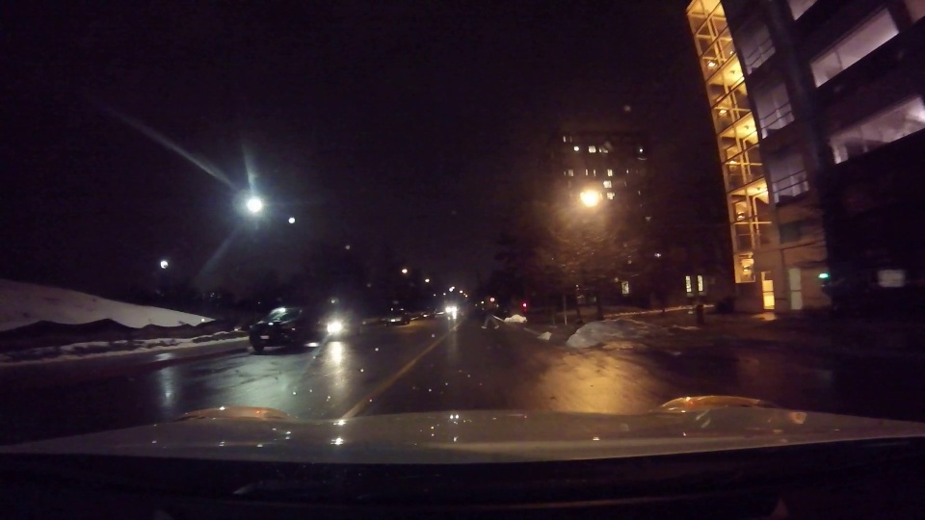
Train Model with Night images
JAAD dataset consists of night videos as well.
Prepared a new dataset consisting of night images in addition to other scenarios.
Trained a pretrained SSD MobileNet model for 80k steps and evaluated its performance in different scenarios.

Slide 9
Comparisons
Weather Condition | Custom-trained model(without Night) | Custom-trained (with Night)
Normal | 0.53 mAP 0.63 AR | 0.35 mAP 0.49 AR
Snow | 0.46 mAP 0.52 AR | 0.32 mAP 0.43 AR
Night | 0.32 mAP 0.47 AR | 0.368 mAP 0.49 AR
*mAP: All mAP values are recorded at IoU = 0.50 : 0.95
*AR: AR@100 Detections

Slide 10
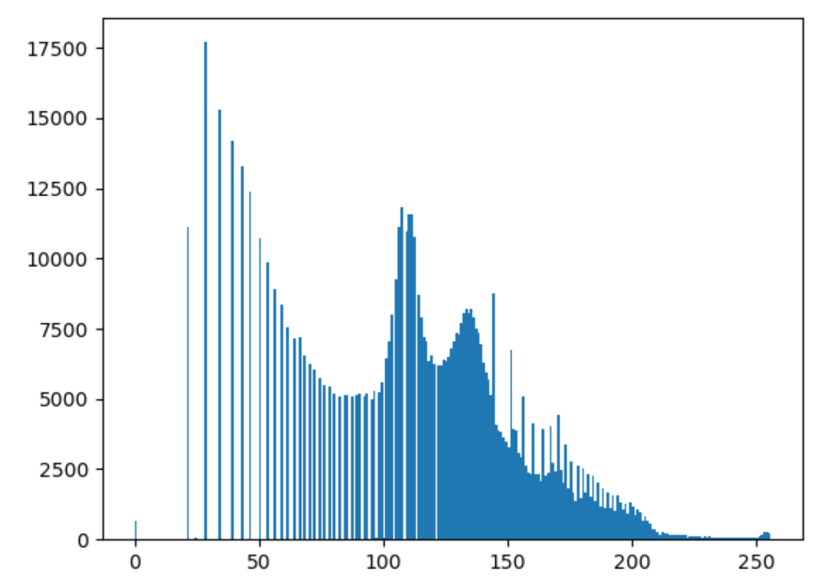
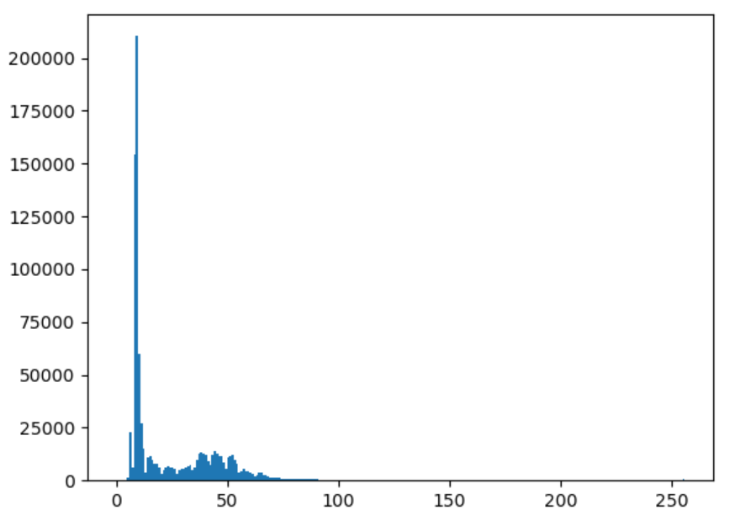
Image Analysis
a) Daylight Image
b) Night Image

Slide 11
Contrast Enhancement Techniques
Histogram Equalization
Improves the contrast in an image, in order to stretch out the intensity range.
Stretches out the intensity range considering global contrast of image.
Can lose information due to over brightness in images
CLAHE(Contrast Limited Adaptive Histogram Equalization)
Images are divided into blocks called tiles
Each block is histogram equalised as usual.

Slide 12
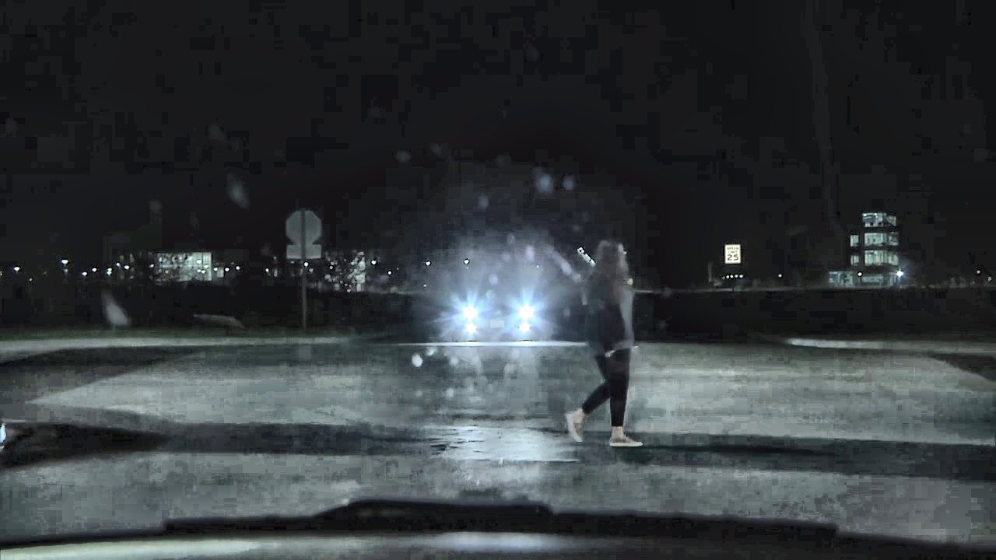
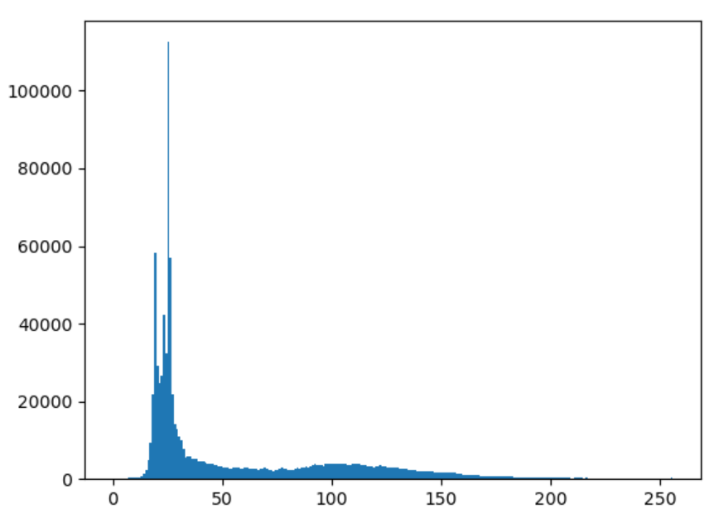
Adaptive Histogram Equalization
a) Normal Image
b) Contrast Enhanced Image

Slide 13
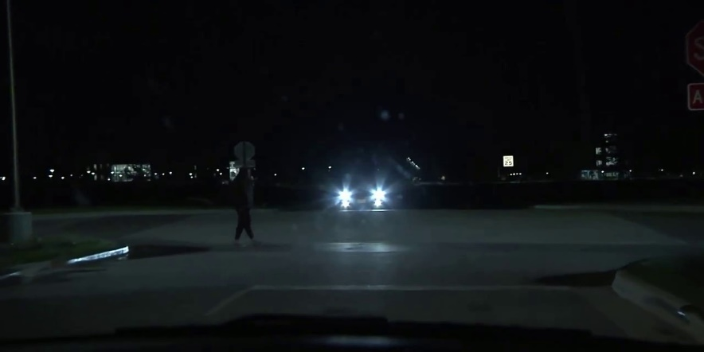
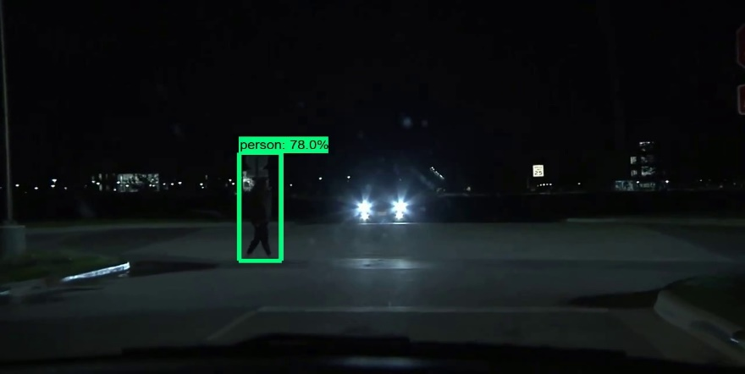
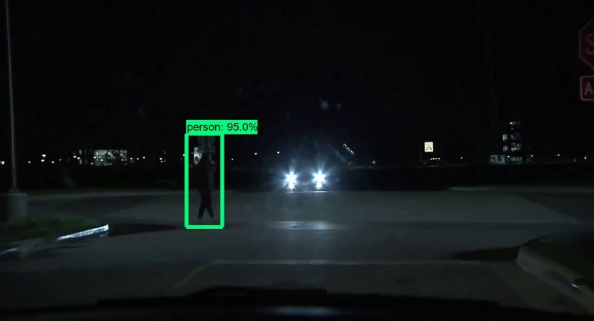
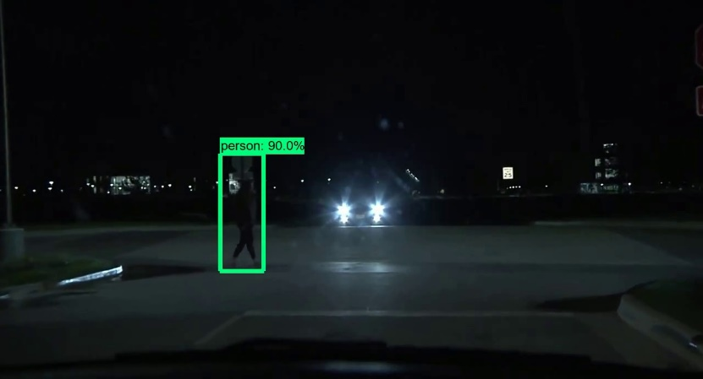
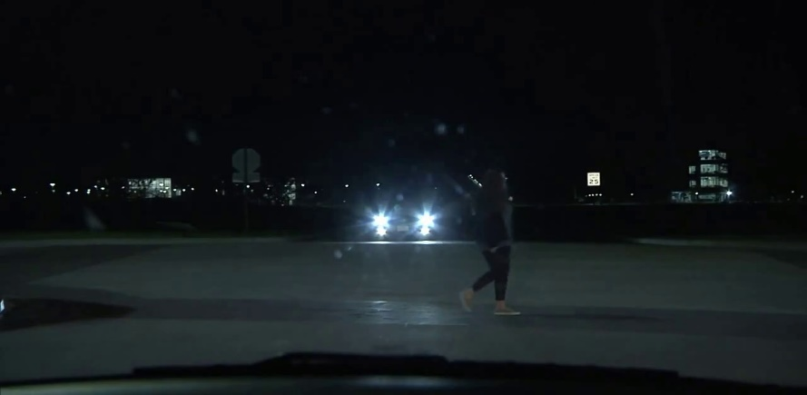
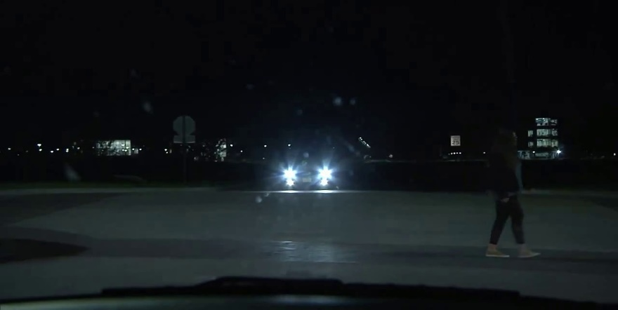
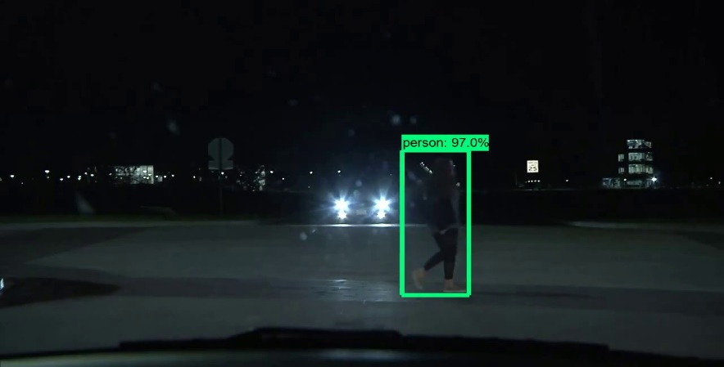
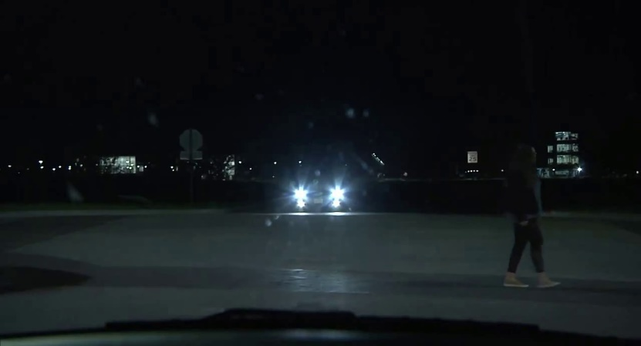

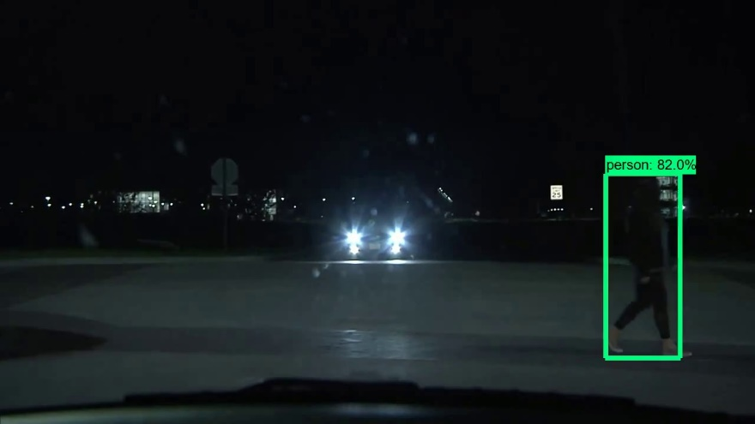
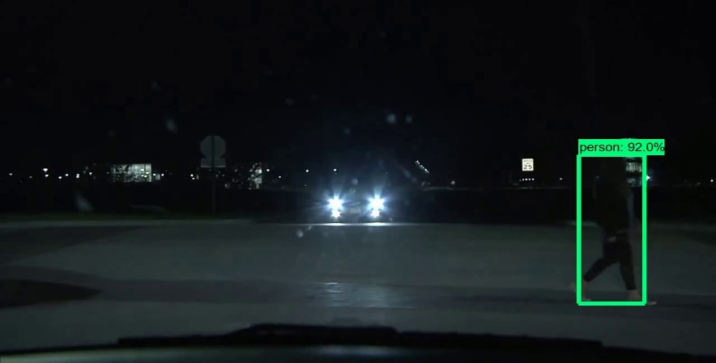

Adaptive Histogram Equalization
a) Equalized Images
a) Unprocessed Images

Slide 14
Model Performance
Parameters | Without Histogram Equalization | With Histogram Equalization
Speed | 7.27 FPS | 5.70 FPS*
Accuracy | 0.32 mAP 0.47 AR | 0.36 mAP 0.48 AR
*mAP: All mAP values are recorded at IoU = 0.50 : 0.95
*AR: AR@100 Detections
*subjected to the image size (1280 * 720)

Slide 15
Discussion
Night scenes generally have poor contrast.
Can use Histogram Equalization methods to improve the contrast.
Adaptive Histogram Equalization (CLAHE) method is an additional preprocessing steps before the inference step.
Histogram Equalization method slightly improves the night detection.
CLAHE suffers from lack of adaptability to night scenes as the optimised parameters(Clip Limit; block dimensions) can vary from scene to scene.
More the size of image; more the reduction in speed of inference.

Slide 16
What should be the best position of camera deployed for our problem ?

Slide 17
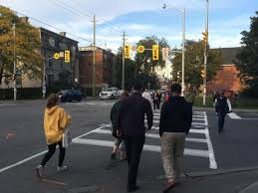
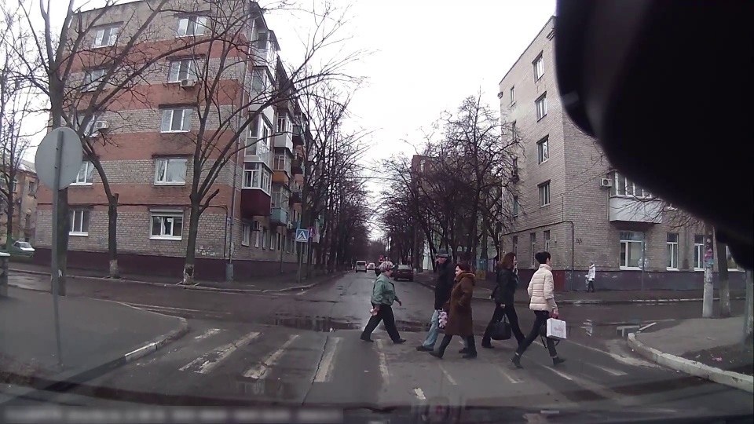
Possible Camera Positions
Camera deployed at the edge of crosswalk recording the front and back angles of pedestrians.
Camera deployed at the center of crosswalk on some pole just before the crosswalk recording the side view of pedestrians.

Slide 18
Approach
Taking SSD Mobile Net as the base model, employ Transfer Learning to train 3 different models.
Model α – train on images covering front and back view of pedestrians.
Model β – train on images covering side view of pedestrians
Model (α + β) – train on combined images of first two scenarios.
Evaluate and compare all models on separate test images of both views.

Slide 19
Training Pipeline
Acquire Training & Test Dataset
Preprocess the Datasets
Model Creation : TensorFlow SSD Mobile net (Base Model)
Loss Function: Localization loss + Classification Loss
Model Evaluation: Mean Average Precision (IoU:0.5)

Slide 20
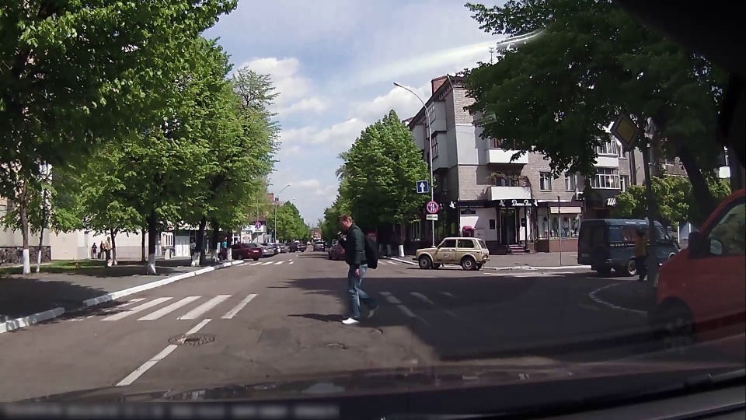
Dataset (Side View)
JAAD Dataset
Recorded from on board camera. Covers side view of pedestrians.
Annotated in JAAD specific XML format.
Preprocessed data to convert into PASCAL VOC format, suitable for TensorFlow’s Training pipeline.

Slide 21
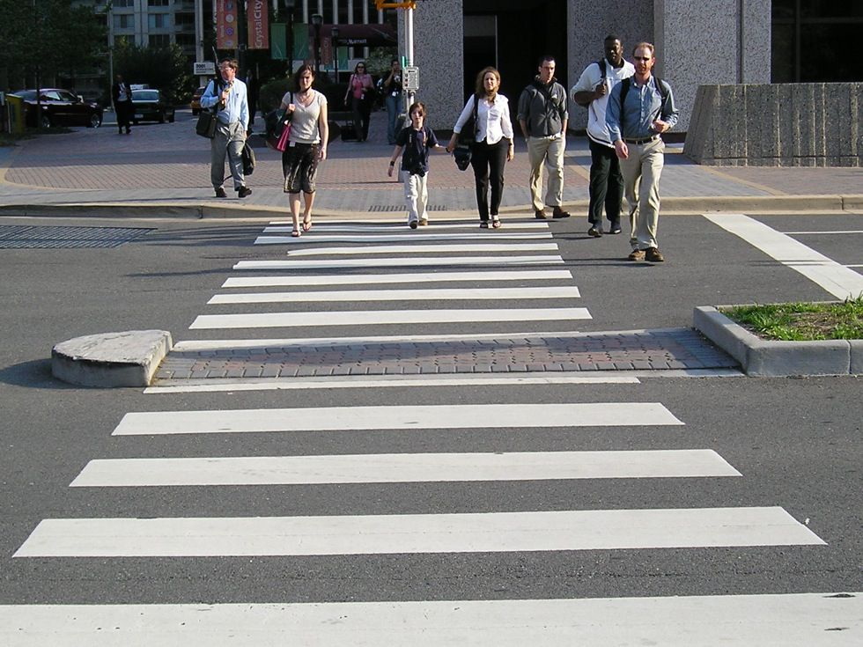
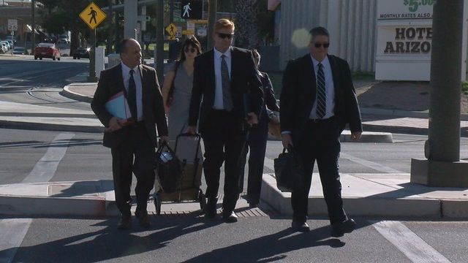
Dataset (Front view)
Images were manually gathered from the internet and labelled using LabelImg (image annotating tool).
The annotation (details) of each image is contained in the corresponding XML file.

Slide 22
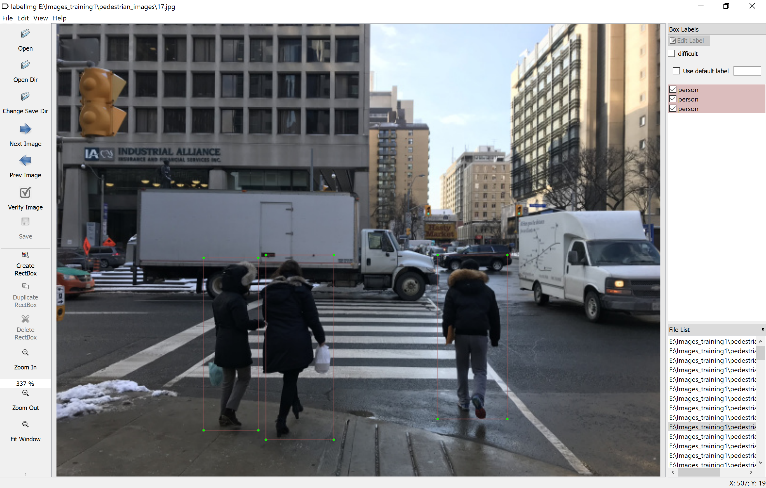
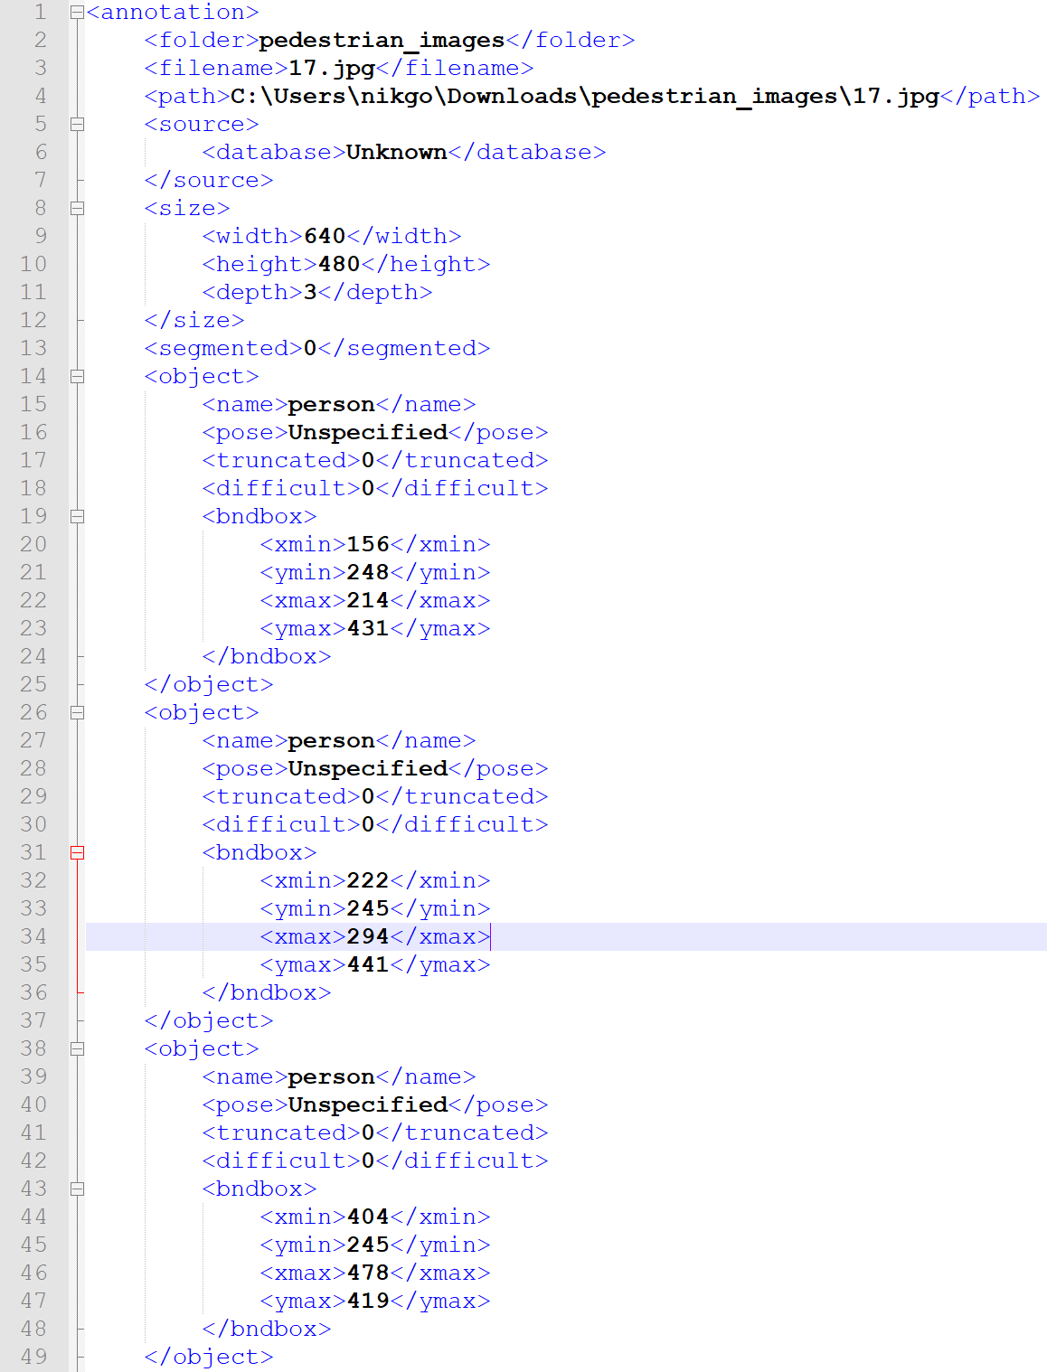
Dataset (Front view)
Sample image labelling in LabelImg and its corresponding XML file.

Slide 23
Dataset
Model α (Front) | Model β (Side) | Model (α + β)
Train Dataset: 168 images 515 Bounding Boxes Test Dataset: 40 images; 115 Bounding Boxes | Train Dataset: 235 images 1227 Bounding Boxes Test Dataset: 47 images; 251 Bounding Boxes | Train Dataset: 235 images 999 Bounding Boxes Test Dataset: 67 images; 300 Bounding Boxes

Slide 24
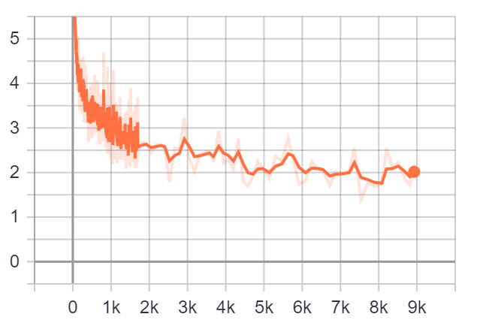
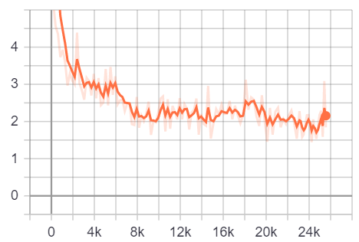
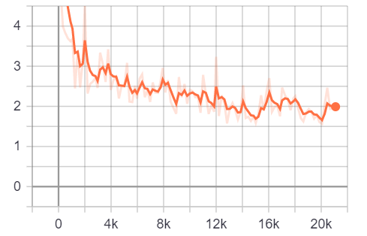
Training (Total Loss)
Model (Front) – 9K Steps
Model (Side) – 25K Steps
Model (Front + Side) – 20K steps

Slide 25
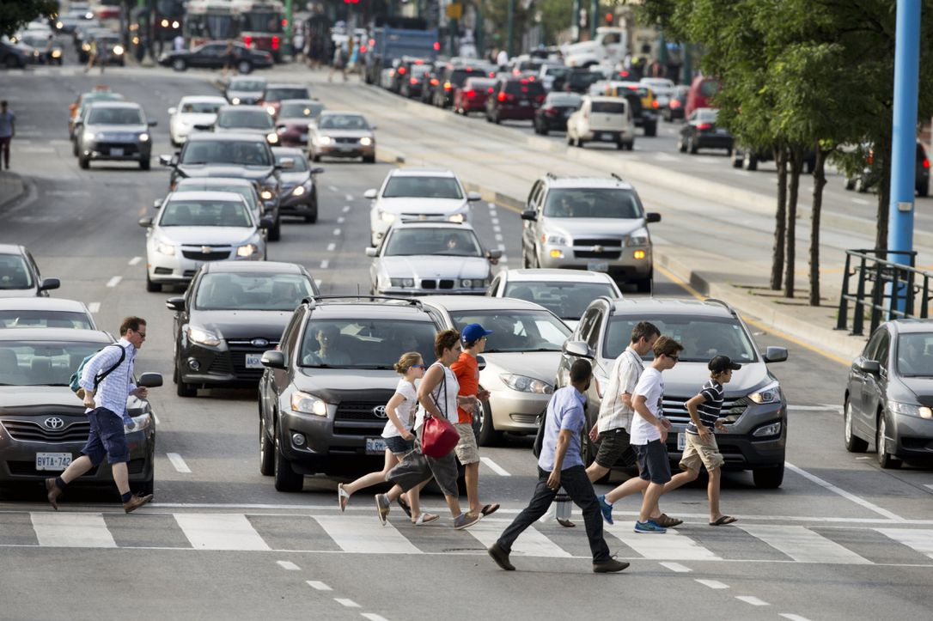
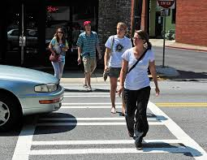
Evaluation
Models α, β and (α + β) were evaluated using two datasets, one containing side-view images and the other containing front-view images.
Side | Front
20 Images Bounding Boxes : 26 (Persons) | 20 Images Bounding Boxes: 41 (Persons)
a) Side View
b) Front View

Slide 26
Results
Angle | Model (Side View) | Model (Front View) | Model (Side + Front)
Side | 0.61 mAP* 0.39 AR | 0.65 mAP 0.41 AR | 0.69 mAP 0.40 AR
Front | 0.63 mAP 0.48 AR | 0.96 mAP 0.68 AR | 0.92 mAP 0.64 AR
*mAP: mAP @IOU=0.50
*AR: AR@100 Detections

Slide 27
Conclusion
All Models whether trained on front or side angles, performed better while detecting pedestrians in front angles.
Total number of cameras on a crosswalk is an infrastructural decision. More cameras at a crosswalk more the safety.
Also, the selected model performs more accurately in detecting large objects. Hence, less chances of false negatives on a crosswalk.
But if ever choice is to be made on deciding the position of camera, camera should be deployed on the edge of crosswalk to capture front view.

Slide 28

Tasks Completed- (Pedestrian Detection Module)
Base Model Selection.
Dataset Selection.
Data Pre-Processing.
Transfer Learning using TensorFlow’s Training pipeline.
Model performance comparison of custom trained model with pre-trained model.
Evaluating Custom trained Model’s Performance in different scenarios.
Camera Angle Selection.

Slide 29
Thank You!

