Slide 1

A Real-Time Pedestrian Detection and Tracking System for Intelligent Vehicles
Module 1: Object Detection

Slide 2
Contents
Classification vs Object detection
Models Explored
Experimental Setup
Results
Conclusions
Queries

Slide 3
Classification Vs Object Detection
Image classification involves associating a class label to the image.
Object detection involves detecting the type of object and detecting the location of the object in the image.
There can be multiple objects of different types in an image.

Slide 4
Models Explored
RCNN
Fast RCNN
Faster RCNN
Tiny YOLO
SSD MobileNet
Accuracy v/s Speed Trade-Off

Slide 5
1) R-CNN
Object detection can be performed by selecting regions from the image and classifying them.
R-CNN uses a method known as selective search to extract 2000 regions called region proposals from an image.
Each region proposal is resized to a square and fed into a CNN which acts as a feature extractor and then fed into an SVM classifier through a dense layer to classify objects in region proposals.
Additionally, the algorithm predicts four offset values to increase the precision of bounding box.

Slide 6
2) Fast R-CNN
The only difference between R-CNN and fast R-CNN is that instead of feeding 2000 region of proposals to the CNN every time, input image is fed to CNN and then region of proposals are extracted from feature map.
Therefore it is faster than R-CNN as only one convolution operation is done per image.

Slide 7
3) Faster R-CNN
Both R-CNN and fast R-CNN use selective search for generating region proposals, which is slow and time-consuming fixed algorithm.
Faster R-CNN uses region proposal network (includes learning) instead of selective search to predict region proposals, and the remaining process is similar to fast R-CNN.

Slide 8
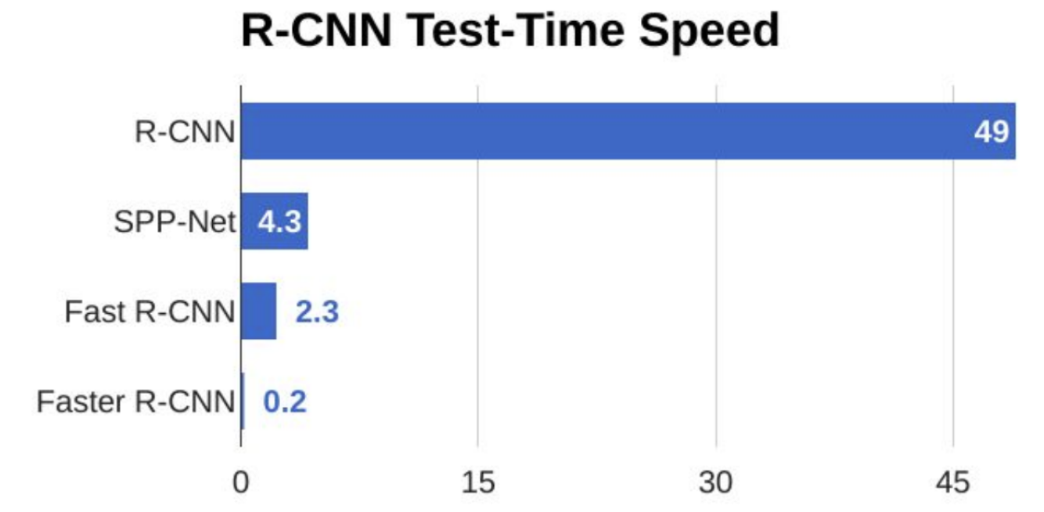
It is observed that Faster R-CNN is much faster than R-CNN and Fast R-CNN. Therefore, it can be used for real-time object detection.

Slide 9
4) Tiny YOLO
Yolo family(YOLOv1,YOLOv2,YOLOv3) is more famous for its speed.
“ On a Pascal Titan X it processes images at 30 FPS and has a mAP of 57.9% on COCO test-dev.”
Tiny Yolo
Tiny Yolo: Lighter version of Yolo
Faster than Yolo, but compromises accuracy
Input size : 416 x 416, RGB Format
Number of classes: 80 (COCO Dataset)
9 convolution Layers and 6 Max Pooling Layers

Slide 10
5) Single Shot Detectors (SSD)
Single shot detectors perform object detection in an image in a single shot unlike R-CNN where two shots are needed, one for generating region proposals and one for object detection.
Therefore SSD is faster than RPN-based models.
SSD maintains a balance between the two, speed and accuracy.

Slide 11
SSD MobileNet
MobileNets are base networks used for feature extraction, these high-level features are then used by an SSD for object detection.
SSD MobileNets are designed for resource-constrained devices such as smartphones, raspberry pi processors etc.
MobileNets use depthwise separable convolution reducing the number of parameters in the network making them faster and more efficient than other base networks.

Slide 12
Experimental Setup
Models Implemented | System Configuration | Input Type | Output
Faster RCNN | Host Machine: Processor I5 8th Gen RAM : 8 GB GPU : None Emulator: Raspberry Pi 3B RAM: 1 GB OS : Raspbian | Video File from local System | A bounding box around identified object, indicating the confidence score in the detection for a particular object.
Tiny YOLOv3
SSD Lite MobileNet

Slide 13
Results
Speed:
Accuracy:
As per the Literature, Faster RCNNs are the most accurate followed by SSD and then Tiny-Yolo. The Results were verified during implementation Phase.
Models | Framework | Frame Rate (On system) | Frame Rate (Emulator)
Tiny Yolo | Darknet | 7 | 1-2
Faster-RCNN(Inception V2) | TensorFlow | 0.8 | -
SSD Lite MobileNet | TensorFlow, TensorFlow Lite | 8 | 2

Slide 14
Detection Capabilities
Model can detect up to 80 classes of COCO dataset:
Person, Bicycle, Car, Motorcycle, Bus, Truck, Boat, Traffic Light, Bird etc.
Animals : Bird, Cat, Dog, Horse, Sheep, Cow etc.
Objects: Umbrella, Suitcase, Surfboard
And many more….
Network is further trainable, and any new object class can be added using Transfer Learning.

Slide 15
Conclusions
SSD Lite MobileNet is better in accuracy than Tiny YOLO. However, for speed the Lite version of SSD offers same speed as Tiny-Yolo.
SSD Lite MobileNet is selected as a Pedestrian Detection Model.
The Frame Rate of any Object Detection Model has dependency on the underlying Hardware(specifically GPU). Hence, hardware creates a bottleneck in the performance of overall Pedestrian Detection System.
Hardware Selection depends on the accepted frame rate for a particular application.

Slide 16
What’s Next?
Specify ROI in the frame to improve speed.
Outdoor Testing of Models using live feed.
Work on night scenes.
Integrate the finished components

Slide 17

Queries
What is the accepted frame rate for our application?
Should we make our entire application hardware specific, as the trade off between the accuracy and speed is clearly dictated by the configuration of hardware?
Suggestions on further optimizations of the models.
Does it make sense to train the model(on crosswalk specific dataset) to enhance the detection capability for existing “person” class to reduce false negatives? [As model is already detecting person in the frame]

Slide 18
Thank You!

