Slide 1

Git and GitHub
A Powerful Duo for Version Control and Collaboration
Notes:
Git and GitHub are fundamental tools for software development. Git is a version control system for tracking changes to code, while GitHub is a platform for hosting and collaborating on Git repositories.

Slide 2
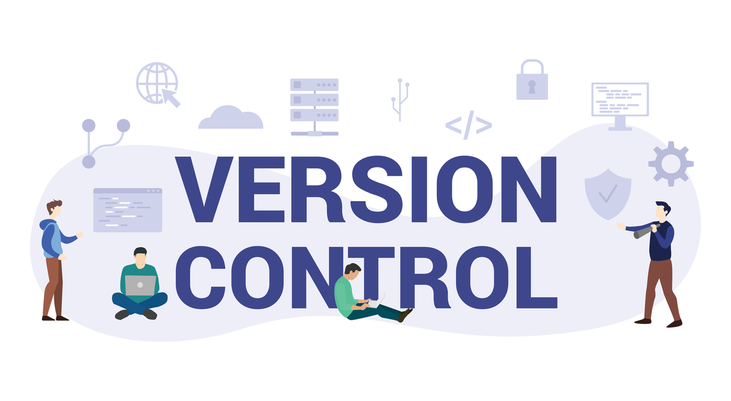
Version Control Systems
Tracking Changes
2.
Collaboration
1.
Version control systems help developers track changes to code over time.
They facilitate collaboration by allowing multiple developers to work on the same codebase simultaneously without conflicts.
3.
History Management
4.
Code Integrity
They provide a complete history of all changes, making it easy to understand how the code evolved over time.
They ensure code integrity by creating snapshots of the code at different points in time.

Slide 3
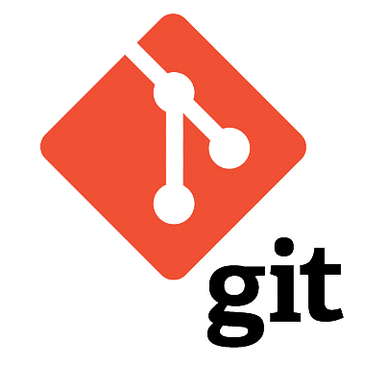
Git
About
A distributed version control system.
Created by Linus Torvalds in 2005.
Actions
Tracks changes to files and manages code versions.
Pro’s
Distributed: Full version history on every user's machine.
Fast and scalable for both small and large projects.
Efficient branching, merging, and collaboration.

Slide 4
GitHub
Hosting Platform
Collaboration Features
GitHub is a web-based platform for hosting Git repositories. It provides a central location for storing and managing code projects.
GitHub offers various collaboration features like issue tracking, pull requests, and code reviews, facilitating teamwork on software projects.
Community and Social Features
GitHub fosters a vibrant community of developers through social features such as profiles, followings, and discussions.

Slide 5
Git vs GitHub
Git | GitHub
A version control tool | A platform for hosting Git repos
Works offline | Requires an internet connection
Local repositories | Remote repositories
Used for tracking changes locally | Enables collaboration globally

Slide 6
Clone Repository
Create Branch
Make Changes
Commit Changes
Push to Remote
Basic Git
Workflow

Slide 7
GitHub Collaboration Workflow
Fork a Repository:
Create a copy of someone else's project in your GitHub account.
Clone the Repository:
Copy the remote repository to your local machine.
Make Changes Locally:
Work on your own branch and commit changes.
Push Changes to GitHub:
Push commits back to your forked repository.
Submit a Pull Request:
Propose your changes to the original repository.
Review and Merge:
The repository owner reviews and merges the pull request.

Slide 8
GitHub Key Features
Repositories:
Host public or private codebases.
Pull Requests:
Propose changes to a repository. Code reviews and discussions.
Issues:
Track bugs, feature requests, and tasks.
GitHub Pages:
Host static websites directly from your GitHub repository.
Actions (CI/CD):
Automate workflows like running tests and deployments.

Slide 9
Best Practices
Commit Frequently: Track your work in small steps.
Use Branches: Isolate new features and bug fixes.
Write Clear Commit Messages: Make your changes understandable.
Pull Before You Push: Sync your work with the latest changes.
Collaborate via Pull Requests: Code review and feedback.

