Slide 1



TEAM
MEMBERS AND ROLES
Team name
SYNTAX TERROR (TAN)
Project: Parity · MCX gold futures intelligence
Problem 03 · Commodity Derivatives Intelligence
Nikhil Kumar
Team lead · data pipeline, strategy research and backtests, dashboard
Sai Ganesh
Market research and pitch presentation
Ishaan Chhabra
Testing, data checks and documentation
Notes:
Team SYNTAX TERROR (TAN): Nikhil Kumar leads and built the data pipeline, strategies and dashboard; Sai Ganesh on market research and the pitch; Ishaan Chhabra on testing and documentation.

Slide 2
PROBLEM STATEMENT & THEME
One metal, four prices
MCX lists four gold futures that differ only in size and purity. Per gram of pure gold they should cost the same. Do they, can a gap be traded after real costs, and when is one worth a trader's attention?
GOLDM
GOLDTEN
GOLDGUINEA
GOLDPETAL
100 g bar · 995
10 g bar · 999
8 g coin · 999
1 g · 999
₹1,49,055 per 10 g
₹1,49,436 per 10 g
₹1,19,993 per 8 g
₹15,002 per 1 g
→ ₹14,980 per pure g
→ ₹14,959 per pure g
→ ₹15,014 per pure g
→ ₹15,017 per pure g
Most-traded contract of each, MCX closing prices, 1 Oct 2026. Four very different quotes become four near-equal prices per pure gram.
PROBLEM
IMPACT
THEME ALIGNMENT
Raw quotes hide whether a contract is cheap or dear
Gaps flip between structural and temporary
Typical backtests skip costs, delivery periods and unseen data
The 8 g coin is 61–72 bp dearer than GOLDM, in all 41 cycles
In the Dec 2025 – Mar 2026 crash, small contracts sat ~2.7% above GOLDM
A wrong normalisation would show a fake ~40 bp gap
Problem 03: Commodity Derivatives Intelligence
Relative value, term structure, walk-forward backtest
Trader alerts and contract lifecycle, as the brief asks
Notes:
Four contracts, one metal. Converted to rupees per gram of pure gold, they nearly match, and the gaps that remain are what Parity studies.

Slide 3
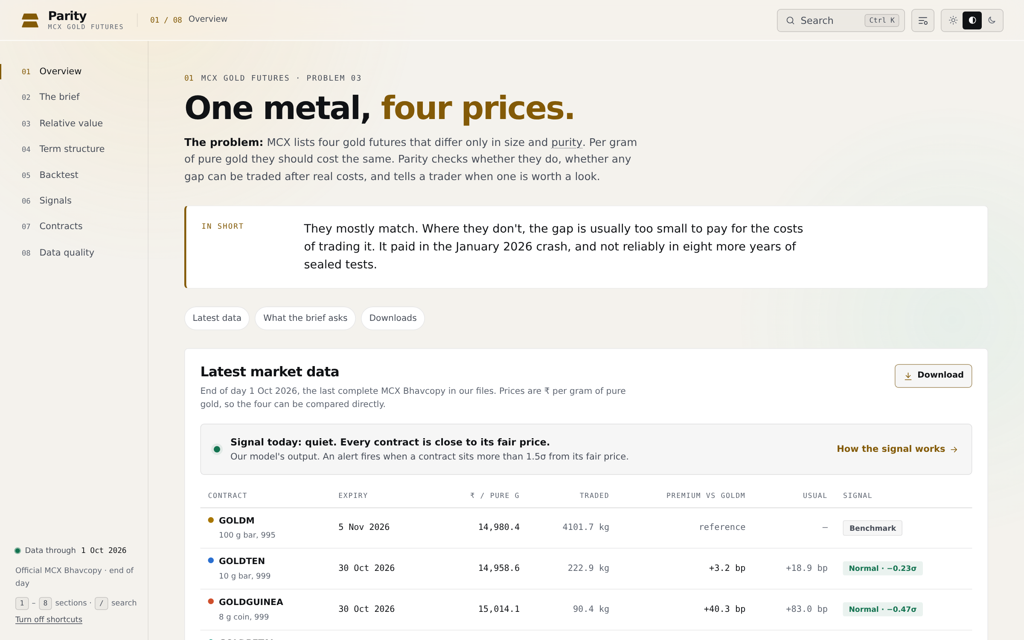
SOLUTION
Parity: is the gap real, and is it worth trading?
A dashboard and alert system that puts all four contracts in ₹ per pure gram, measures every gap, tests whether trading it pays after costs, and stays quiet when there is nothing to act on.
KEY FEATURES
Relative value all 6 pairs, 95% ranges, carry-adjusted expiries
Fair-price signal anchored on GOLDM; alert only beyond ±1.5σ
Walk-forward backtest next-day fills, MCX fees, CTT, stamp, GST, 0/5/10 bp slippage
Contract calendar listing to expiry; every trade checked against the tender period
Gap vs gold each trade's profit split into the gap and gold's own move
The Parity dashboard: 8 pages, works offline in one HTML file.
UNIQUE VALUE
Honest by design: every rule frozen in Git before its test data was read; three sealed tests, each run once; results shown even when they lose. 710 official MCX contracts, 0 unexplained data errors.
Notes:
Parity answers three questions: do the four agree, can a gap be traded after costs, and is today worth a look. Its edge over a typical backtest is honesty: rules locked first, sealed tests run once.

Slide 4
ARCHITECTURE
From exchange files to a trader's screen
MCX Bhavcopy
ingest.py
Analysis
results/*.csv
export.py
Official daily files, one contract at a time, 2003–2026
Dedupe, integrity checks, ₹ per pure gram, sealed years walled off
pairs, carry and curve, fair price, backtests, lifecycle, alerts, bootstrap
Every number written to a file, reproducible
One data.json for every output
React dashboard
8 pages, search, CSV downloads, one offline HTML file
Report PDF
17 pages, every figure from the same data
Interactive pitch
17 scenes, data-driven, offline
TECH STACK
DATA FLOW
APIS USED
Python 3, pandas, NumPy: ingest, analysis, backtests
React 19 bundled with esbuild; charts drawn in SVG, no chart library
ReportLab and Matplotlib for the PDF
Git: rules time-stamped before each test; unit tests
Daily: new Bhavcopy → ingest → signals
Signals at the close, trades at the next day's price
Sealed rows live in a separate file until one run
No paid APIs and no API keys
MCX's public Bhavcopy page, read in a browser
Runs fully offline once data is in
Notes:
One pipeline: official MCX files in, validated and converted, every analysis writes a CSV, and one export feeds the dashboard, report and pitch.

Slide 5
MARKET RESEARCH / ANALYSIS
Gold derivatives in India are growing fast
₹28,484 cr
23 tonnes
57%
average daily turnover, MCX gold futures, FY2025-26 (₹8,449 cr in FY2024-25)
gold traded per day in futures, FY2025-26 (11 tonnes the year before)
bullion's share of MCX average daily turnover, Q2 FY26 (44% a year earlier)
Sources: Business Today, 14 Aug 2026 (MCX data, FY2025-26); Business Standard, 7 Nov 2025 (MCX Q2 FY26 results).
TARGET USERS
MARKET SIZE
Gold futures traders choosing which contract to trade
Arbitrage and prop desks running spread trades
Jewellers and bullion dealers hedging with small lots
Broker research teams publishing trade ideas
MCX offers gold in 1 kg, 100 g, 10 g, 8 g and 1 g lots
Parity covers the four small contracts; in our files GOLDM trades a median 441 kg a day
MCX average daily turnover ₹4.11 lakh cr (futures and options), Q2 FY26
POTENTIAL REVENUE MODEL
EXPECTED GROWTH
Free dashboard; paid daily alerts by email or Telegram
White-label licence for brokers' research desks
Data feed of normalised prices and fair-value signals
Futures turnover more than tripled in one year
Small lots (10 g, 1 g) bring in retail hedgers
Same method extends to silver: SILVERM and SILVERMIC
Notes:
Market figures are from MCX data reported in Business Today (Aug 2026) and Business Standard (Nov 2025). The revenue model is our plan, not a measured result.

Slide 6
FUTURE SCOPE
What comes next
01
02
03
Live paper trading
Intraday data
Alerts where traders are
Run Strategy B day by day on new MCX files from October 2026, before any real money.
Replace the end-of-day close with real fills to measure slippage instead of assuming 5 bp.
Email and Telegram alerts that fire only beyond ±1.5σ, with the cost of acting shown.
04
05
06
Longer premium history
Safer rules
More metals
Measure the coin and 1 g premiums back to 2008 and 2011, now that the sealed run is done.
Price-limit filter, and a spot cross-check against IBJA's published 999 and 995 rates.
The same normalisation for silver (SILVERM, SILVERMIC) and other multi-size contracts.
Notes:
First, prove it live on paper. Then better data, alerts where traders already are, and the same method for silver.

Slide 7
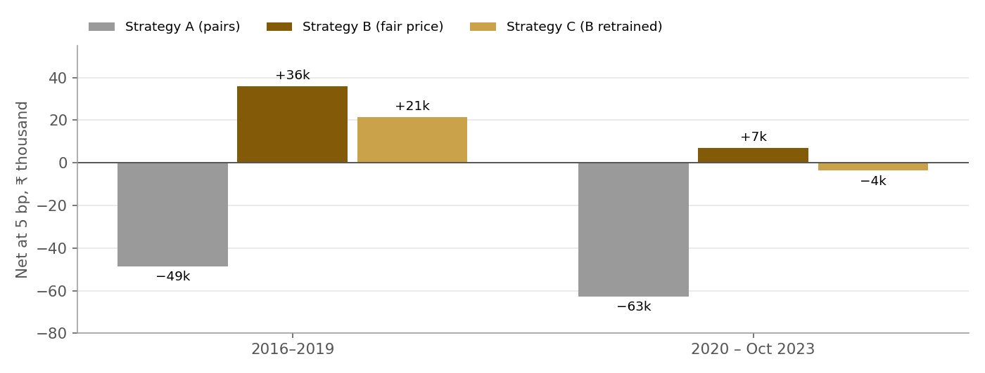
EXTRA: RESULTS
Tested on eight years it had never seen
Strategy A (pairs) is rejected: it lost in both windows even with perfect fills.
Strategy B (fair price) made money in all 3 sealed tests: ₹12,990, ₹35,873 and ₹6,962 net profit at 5 bp.
Positive, not proven: each 95% range includes zero, and it loses at 10 bp in two of three.
Crashes pay sometimes: January 2026 paid; March 2020 did not.
Net profit after all costs at 5 bp slippage, each window run once with rules frozen in Git first.
710
55,457
0
3
MCX contracts, 2003–2026
daily records checked
unexplained data errors
sealed tests, each run once
Notes:
The honest answer: a small, positive, unproven edge whose size is decided by execution. Strategy A failed; Strategy B held up modestly.

Slide 8
Thank
you!

