Slide 1
AD-IoT: Anomaly Detection of IoT Cyberattacks in Smart City Using Machine Learning
Neelampalle Nikhil Kumar - 18BEC031

Slide 2
Abstract
In recent years there has been rapid adoption in modern IoT devices which has led to concept of smart cities. Smart cities operate in real-world time to promote ease and quality of life in urban cities. The network traffic of a smart city via IoT systems is growing exponentially and introducing new cybersecurity challenges since these IoT devices are being directly connected to massive cloud servers. In order to mitigate these cyberattacks, the developers need to enhance new techniques for detecting infected IoT devices.

Slide 3
Case Study
The 2016 Mirai breach - - - - - - One of the Famous Cybersecurity Breaches in world
Using the infamous Mirai malware, they infected countless computers and Smart devices for the purpose of carrying out distributed denial of service attacks. They took control of those devices and used them to flood the servers with malicious traffic appearing from various locations. Their criminal activities culminated on October 21st, 2016, when they used their botnet to launch a DDoS attack.

Slide 4
Introduction
The number of connected IoT devices had already reached 27 billion in 2017, and these IoT devices will exponentially increase on demand of markets, so the potential has been expected to reach approximately 125 billion in 2030.
Various smart city applications connect enormous IoT devices to real-world objects, which indeed have very important benefits to urban life. However, the massive number of IoT devices over heterogeneous variety types of services, technologies, devices, and protocols leads to the complexity of managing future IoT networks.
Therefore, these integration protocols with the internet leaves serious cybersecurity threats and vulnerabilities for attacking the information of the daily activities of citizen’s lives.

Slide 5
Introduction….
There are two main security challenges in smart city applications.
The first challenge is how to detect zero-day attacks as they happen from a variety of protocols of IoT devices in a smart city’s cloud data center.
The second one is how to find a method to intelligently detect cyberattacks (e.g. IoT malware attacks, etc.) from the IoT networks before damaging a smart city architecture.
Intrusion Detection System
An Intrusion Detection System (IDS) is a network security technology originally built for detecting vulnerability exploits against a target application or computer.
an IDS can either be host-based or network-based -
Host-Based IDS (HIDS): A host-based IDS is deployed on a particular endpoint and designed to protect it against internal and external threats. Such an IDS may have the ability to monitor network traffic to and from the machine, observe running processes, and inspect the system’s logs.
Network-Based IDS (NIDS): A network-based IDS is designed to monitor an entire protected network. It has visibility into all traffic flowing through the network and makes determinations based upon packet metadata and contents. This wider viewpoint provides more context and the ability to detect widespread threats

Slide 6
Detection Method of IDS Deployment
Beyond their deployment location, IDS solutions also differ in how they identify potential intrusions:
Signature Detection: Signature-based IDS solutions use fingerprints of known threats to identify them. Once malware or other malicious content has been identified, a signature is generated and added to the list used by the IDS solution to test incoming content. However, a signature-based IDS is limited to detecting known threats and is blind to zero-day vulnerabilities.
Anomaly Detection: Anomaly-based IDS solutions build a model of the “normal” behavior of the protected system. All future behavior is compared to this model, and any anomalies are labeled as potential threats and generate alerts. This approach can even detect novel or zero-day threats.
Hybrid Detection: A hybrid IDS uses both signature-based and anomaly-based detection. This enables it to detect more potential attacks with a lower error rate than using either system in isolation.

Slide 7
Traditional IDS is not effective for IoT network devices, as these devices have limited resources and less functionality. Fog computing is designed between cloud and IoT layers to reduce energy consumption, storage, and latency. Moreover, it aims at moving the computing process near the sensors to quickly respond to the IoT applications in a wide area, such as a smart city.
So the detection in the IoT networks would be more significant to automatically alert the Internet Service Providers or administrators, when quickly and effectively detecting compromised IoT devices in the fog layer and interrupt the connection of the IoT attacks from the network of urban life.

Slide 8
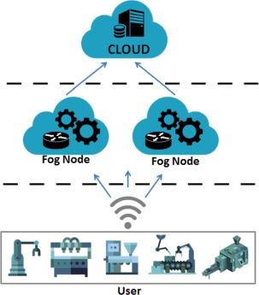

Slide 9
Proposed Model
The proposed a design of intelligent detection system called AD-IoT for detecting IoT cyberattacks or unusual activities in IoT network traffics from the fog networks distributed over the smart city.
They used anomaly detection based on fog network, using machine learning methods tried to identify attacks by extracting statistic measurement on the dataset including modern attack features.
To evaluate our model, we utilized modern dataset to illustrate the model’s accuracy

Slide 10
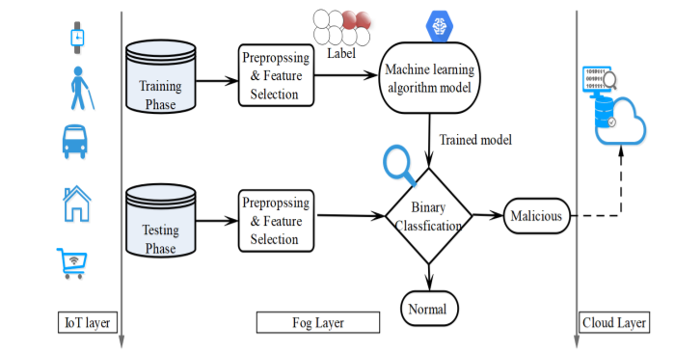
Proposed Workflow

Slide 11
We use USNW-NB15 dataset for Anomaly Detection.
Has many features.
9-attacks – Back Doors, DoS, Exploits, Worms, Fuzzers, Analysis Attacks, Shell Code Attacks, Reconnaissance Attacks, and Generic Attacks.
They have split their dataset from several types of attacks and normal traffic to reduce the huge size of 175,341 archived records for training and 82,332 records for testing.
There are other datasets like KDD99 and NSL-KDD but they do not have as many features like USNW-NB15 dataset.

Slide 12
They used the dataset and trained to Random forest classifier model,
by the classification metric was either normal or malicious.
Random forest algorithm was used because as far as their early check of how accurate was the classification using various machine learning algorithms, random forest algorithm had better accuracy in classifying.

Slide 13
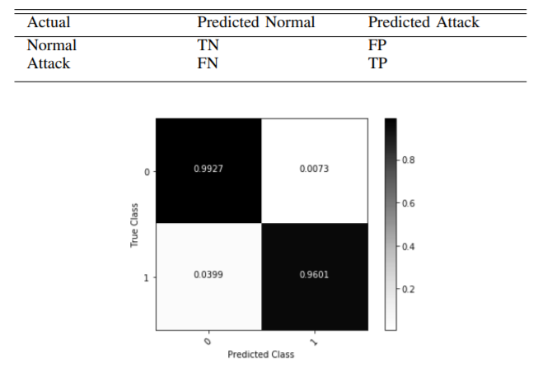
Performance metrics

Slide 14
Challenges
Challenges in anomaly detection include appropriate feature extraction, defining normal behaviours, handling imbalanced distribution of normal and abnormal data, addressing the variations in abnormal behaviour, sparse occurrence of abnormal events, environmental variations, camera movements, etc
.

Slide 15
Future Scope
An IDS can be used to help analyze the quantity and types of attacks. Organizations can use this information to change their security systems or implement more effective controls. An intrusion detection system can also help companies identify bugs or problems with their network device configurations
Zeek, Open DLP, Sagan, Security Onion etc are some of the software tools used for intrusion detection by many companies.

Slide 16


