Slide 1
Cloud Computing
Module -1

Slide 2
Contents
1.Understanding Cloud Computing
Origins and Influences
Basic Concepts and Terminology.
Goals and Benefits.
Risks and Challenges.
2. Fundamental Concepts and Models
Roles and boundaries.
Cloud Characteristics.
Cloud Delivery Models.
Cloud Deployment Models.

Slide 3
1.1 Origins and influences
A Brief History:
During 1961, John MacCharty delivered his speech at MIT that “Computing Can be sold as a Utility, like Water and Electricity.”
In 1969 Leonard Kleinrock, a Chief Scientist of the ARPANET(Advanced Research Projects Agency Network) implemented the Internet.
Mid 1990 the general people leveraging internet based utilities such search engines, e-mail services, one publishing platforms and social media.
Later 1990 sales force implemented cloud computing for enterprise.
In 2002, amazon launched amazon web services(AWS) for enterprises to store, compute and perform business functionalities remotely.
In 2006 Amazon launch Elastic Compute Cloud Commercial Service which is open for Everybody to use.
After that in 2009, Google Play also started providing Cloud Computing Enterprise Application as other companies will see the emergence of cloud Computing they also started providing their cloud services.
Thus, in 2009, Microsoft launch Microsoft Azure and after that other companies like Alibaba, IBM, Oracle, HP also introduces their Cloud Services.

Slide 4
Definitions
Gartner(2008)
“A style of computing in which scalable and elastic IT-enabled capabilities are delivered as a service to external customers using Internet Technologies”.
Forrester (2009) published by NIST
“a standardized. IT capability(services, software or Infrastructure) delivered via Internet technologies in a pay-per-use, self service way”.
NIST 2011
“Cloud computing is a model for enabling ubiquitous, convenient, on-demand network access to share pool of configurable computing resources(networks, servers, storage, applications and services) that can be rapidly provisioned and released with minimal management effort or service provider interaction. This cloud model is composed of 5 essential characteristics, 3 service models, and 4 deployment models”
Simple definition
“Cloud computing is a specialized form of distributed computing that introduces utilization models for remotely provisioning scalable and measurable resources”
“Cloud computing is an on-demand service in which shared pool of resources like storage, computing, network and applications are provided as a service over the internet based on pay-as-you-go model. “

Slide 5
Factors influences cloud computing
Business Drivers
Technology Innovations.
1. Business Drivers
The primary business drivers that exposed the need of cloud computing and led to is information include
Capacity planning
Cost reduction
Organizational agility.

Slide 6
Contin..
Capacity Planning
It a process of determining and fulfilling the future demands of an organization’s IT resources, products and services.
Capacity means the maximum amount of work that an IT resource is capable of delivering in a given time period.
A discrepancy b/w the capacity of IT resource and its demand can result system inefficient.
CP is focus on minimizing the discrepancy to achieve predictable efficiency and performance.
Three types of strategies
Lead – adding capacity to an IT resource in anticipation of demand.
Lag – adding capacity to an IT resource reaches its full capacity.
Match – adding capacity in small increments as demand increases.
Planning for capacity can be a challenge because it requires estimating usage load fluctuations.
Need to balance the usage of requirements without unnecessary over expenditure on infrastructure.

Slide 7
Contin..
Cost reduction
Difficult to maintain a trade off between IT costs and business performance.
Two costs need to be accounted for
Acquiring new infrastructure
Ongoing ownership.
Common forms of infrastructure related operating overhead includes
technical personnel required to keep the environment operational.
upgrades and patches that introduce additional testing and deployment cycles.
utility bills and capital expense investments for power and cooling.
security and access control measures that need to be maintained and enforced to protect infrastructure resources.
administrative and accounts staff that may be required to keep track of licenses and support arrangements.
The on-going ownership of internal technology infrastructure can involve some responsibilities that impose on corporate budgets.

Slide 8
Contin..
Organizational agility
The ability to adapt and evolve to successfully face change caused by both internal and external factors.
Agility is the measure of an organization’s responsiveness to change.
Limitations
An IT enterprise need to change business by scaling beyond the scope but the planning is restricted by inadequate budgets.
anticipated usage volumes does not match with runtime exceptions that bring down the servers.
lack of reliability controls within the infrastructure leads to business overall continuity is threatened.
Does not support automation

Slide 9
Contin..
2. Technology innovations
The primary technology innovations that influenced cloud computing are
Clustering
Grid computing
Virtualization.

Slide 10
Contin..
Clustering
A group of independent IT resources that are interconnected and work as a single system.
This allows workloads consisting of a high number of individual, parallelizable tasks to be distributed among the nodes in the cluster.
System failure rates are decreased and availability and reliability increases Since, redundancy and failover features are inherent to the cluster.
Requirements:
identical hardware and operating systems
High speed links
synchronization through dedicated

Slide 11
Contin..
Grid computing
computing resources are organized into one or more logical pools
These pools are collectively coordinated to provide a high performance distributed grid.
Also referred as Super Virtual computers used to perform large tasks such as analysing weather modelling.
more loosely coupled and distributed and heterogeneous.
Also by splitting tasks over multiple machines, processing time is significantly reduced to increase efficiency and minimize wasted resources.
Virtualization
Virtualization is the process of creating a virtual environment to run multiple applications and operating systems on the same server. The virtual environment can be anything, such as a single instance or a combination of many operating systems, storage devices, network application servers, and other environments.
It a technology platform used for the creation of virtual instances of IT resources. It is a virtualization software allow physical IT resources to provide multiple virtual images of themselves can be shared by multiple users.
Modern virtualization technologies emerged to over the performance, reliability and scalability limitation of traditional virtualization platforms.

Slide 12
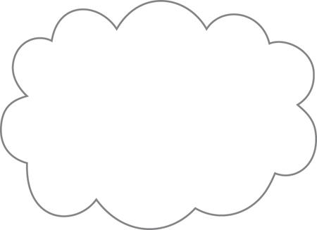
1.2 Basic Concepts and Terminology
Cloud
It refers to a distinct IT environment designed for the purpose of remotely provisioning scalable and measured IT resources.
It has a finite boundary.
There are individual clouds that can be accessed via internet.
A cloud can be based on the use of any protocols that allow for remote access to its IT resources.

Slide 13
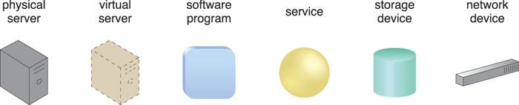
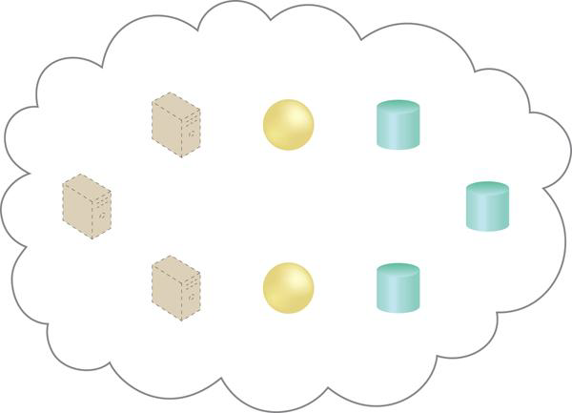
Contin..
IT resource
An IT resource is physical or virtual IT related artifact that can be either software or hardware based such as server or a custom software program or hardware based physical server or network device.

Slide 14
Contin..
On-Premise
An IT resource that is hosted in a conventional IT enterprise within an organizational boundary.
key points:
An on-premise IT resource can access and interact with a cloud-based IT resource.
An on-premise IT resource can be moved to a cloud, thereby changing it to a cloud-based IT resource.
Redundant deployments of an IT resource can exist in both on-premise and cloud-based environments.

Slide 15
Contin..
Cloud consumers
The party that provides cloud-based IT resources is a cloud provider.
Cloud providers
The party that used cloud-based IT resources is called cloud consumer.

Slide 16
Contin..
Scaling
Represents the ability of the IT resource to handle increased or decreased usage demands.
Horizontal scaling – scaling out and scaling in.
Vertical scaling -- scaling up and scaling down.

Slide 17
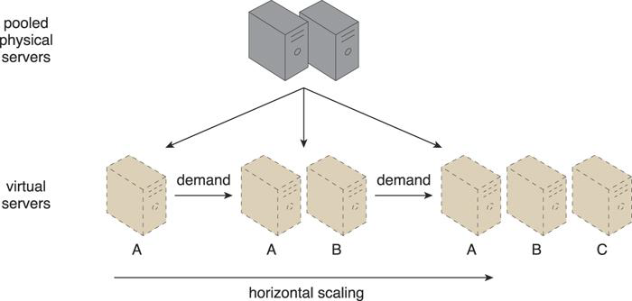
Contin..
Horizontal Scaling
The allocating or releasing of IT resources that are of same type is referred as horizontal scaling.
Most common form of scaling within cloud environments.

Slide 18
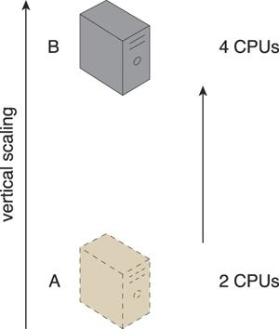
Contin..
Vertical Scaling
When an existing IT resource is replaced by another with higher or lower capacity then vertical scaling is used.
Less common in cloud environment due to the down time required while the replacement is taking place.

Slide 19
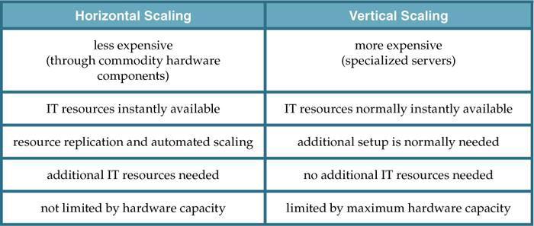
Contin..
Common pros and cons associated with horizontal and vertical scaling.

Slide 20
Contin..
Cloud Service
A cloud service is any IT resource that is made remotely accessible via a cloud.
A cloud service can exists as a simple web based software program with a technical interface invoked via messaging protocol or remote access point for administrative tools or large environments other IT resources .

Slide 21
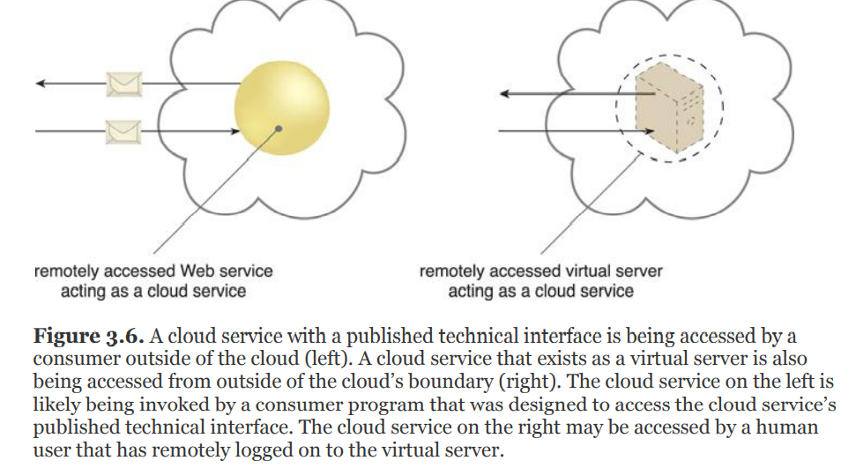
Cloud service

Slide 22
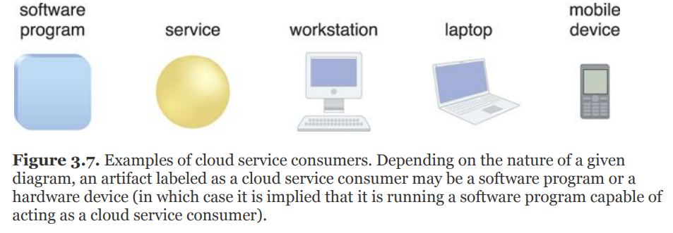
Contin..
Cloud Service Consumer
The cloud service consumer is a temporary runtime role assumed by a software program when it accesses a cloud service.

Slide 23
1.3 Goals and Benefits
The common benefits associated with cloud computing are
Reduced investments and proportional costs.
Increased scalability.
Increased availability
Increased reliability

Slide 24
Contin..
Reduced Investments and proportional costs
Cloud based IT reduces the IT investments like hardware and software purchases and ownership cost.
Decreases costs for deploying and operations of large scale data centres thus it results the capital and operational savings.
On-demand access to pay-as-you-go computing resources on a short term basis (such as processors by the hour), and the ability to release these computing resources when they are no longer needed.
The perception of having unlimited computing resources that are available on demand, thereby reducing the need to prepare for provisioning.
The ability to add or remove IT resources at a fine-grained level, such as modifying available storage disk space by single gigabyte increments.
Abstraction of the infrastructure so applications are not locked into devices or locations and can be easily moved if needed.

Slide 25
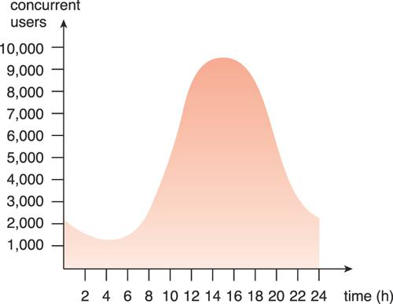
Contin..
Increased Scalability
clouds can instantly and dynamically allocate IT resources to cloud consumers, on-demand or via the cloud consumer’s direct configuration.
Automatically peaks and release IT resources automatically or manually.
An example of an organization’s changing demand for an IT resource over the course of a day.

Slide 26
Contin..
Increased Availability
An IT resource with increased availability is accessible for longer periods of time (for example, 22 hours out of a 24 hour day). Cloud providers generally offer “resilient” IT resources for which they are able to guarantee high levels of availability.
Increased Reliability
An IT resource with increased reliability is able to better avoid and recover from exception conditions. The modular architecture of cloud environments provides extensive failover support that increases reliability.
It is important that organizations carefully examine the SLA(Service Level Agreement)s offered by cloud providers when considering the leasing of cloud-based services and IT resources.

Slide 27


Contin..
MTBF-Mean time between the failures
MTTR- Mean time to recovery

Slide 28
1.4 Risks and Challenges
Several of the most critical cloud computing challenges are
Increased Security Vulnerabilities
Reduced Operational Governance Control
Limited Portability Between Cloud Providers
Multi-Regional Compliance and Legal Issues

Slide 29
Increased Security Vulnerabilities
The remote usage of IT resources requires an expansion of trust boundaries by the cloud consumer to include the external cloud.
It can be difficult to establish a security architecture that spans such a trust boundary without introducing vulnerabilities.
There can be overlapping trust boundaries from different cloud consumers due to the fact that cloud-based IT resources are commonly shared.

Slide 30
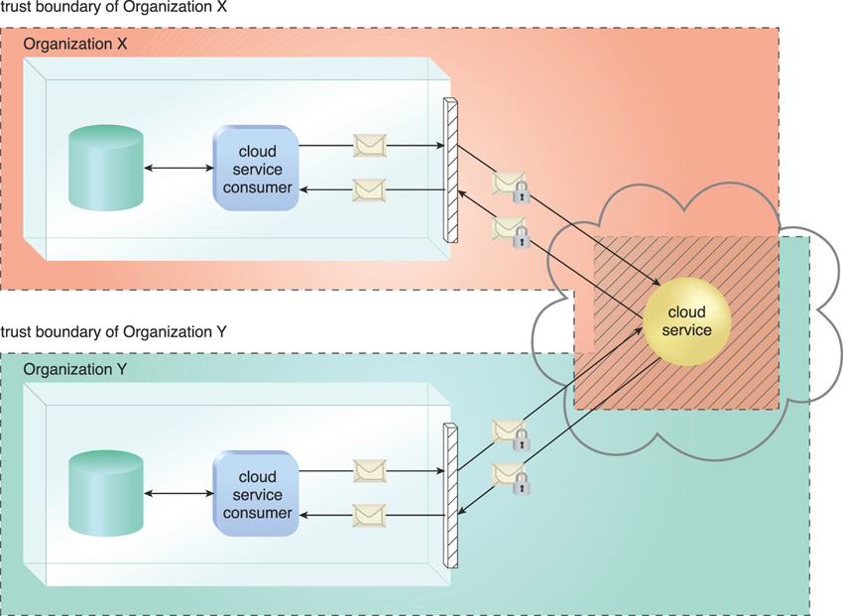
The overlapping of trust boundaries and the increased exposure of data can provide malicious cloud consumers (human and automated) with greater opportunities to attack IT resources and steal or damage business data.
A scenario whereby two organizations accessing the same cloud service are required to extend their respective trust boundaries to the cloud, resulting in overlapping trust boundaries. It can be challenging for the cloud provider to offer security mechanisms that accommodate the security requirements of both cloud service consumers.

Slide 31
Reduced Operational Governance Control
Cloud consumers are usually allotted a level of governance control that is lower than that over on-premise IT resources.
This can introduce risks associated with how the cloud provider operates its cloud, as well as the external connections that are required for communication between the cloud and the cloud consumer.
Longer geographic distances between the cloud consumer and cloud provider can require additional network hops that introduce fluctuating latency and potential bandwidth constraints.

Slide 32
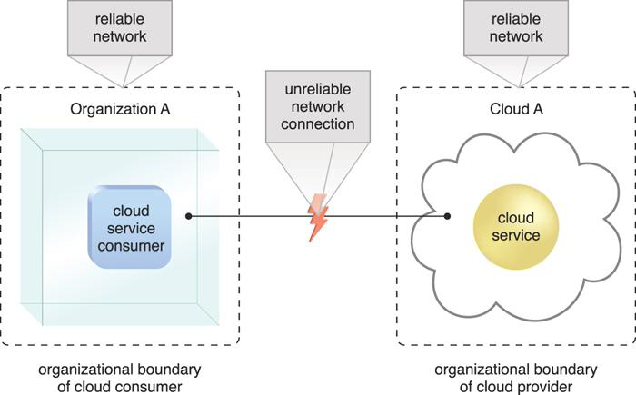
Figure: An unreliable network connection compromises the quality of
communication between cloud consumer and cloud provider environments.
A cloud governance system is established through SLAs, given the “as-a-service” nature of cloud computing. A cloud consumer must keep track of the actual service level being offered and the other warranties that are made by the cloud provider.

Slide 33
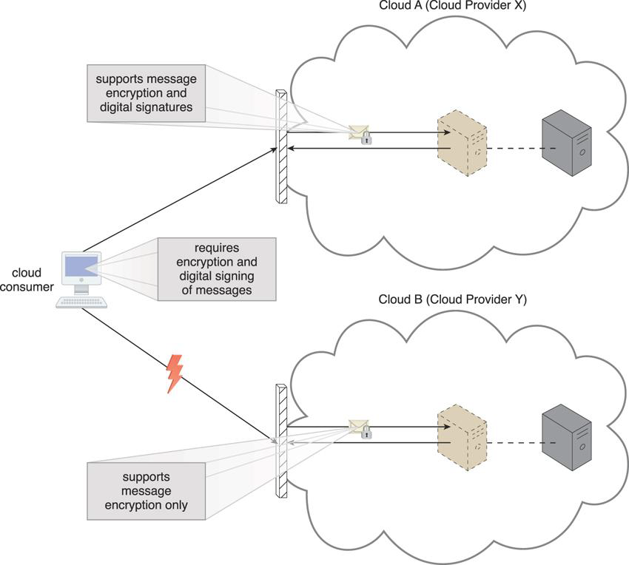

Limited Portability Between Cloud Providers
For cloud consumers that have custom-built solutions with dependencies on these proprietary environments, it can be challenging to move from one cloud provider to another.
Portability is a measure used to determine the impact of moving cloud consumer IT resources and data between clouds

Slide 34
Multi-Regional Compliance and Legal Issues
Cloud consumers will often not be aware of the physical location of their IT resources and data when hosted by public clouds.
For some organizations, this can pose serious legal concerns pertaining to industry or government regulations that specify data privacy and storage policies.
Ex: For example, some UK laws require personal data belonging to UK citizens to be kept within the United Kingdom.
Countries have laws that require some types of data to be disclosed to certain government agencies or to the subject of the data.
Ex: For example, a European cloud consumer’s data that is located in the U.S. can be more easily accessed by government agencies (due to the U.S. Patriot Act) when compared to data located in many European Union countries.

Slide 35
2. Fundamental concepts and models
2.1 Roles and boundaries
Organizations and humans have different roles depending on how they interact with cloud and its hosted IT resources.
Cloud Provider
The organization that provides cloud-based IT resources is the cloud provider.
The role of cloud service provider is to provide services to cloud consumers on SLA.
Cloud providers normally own the IT resources for lease by cloud consumers, and could also “resell” IT resources leased from other providers.

Slide 36
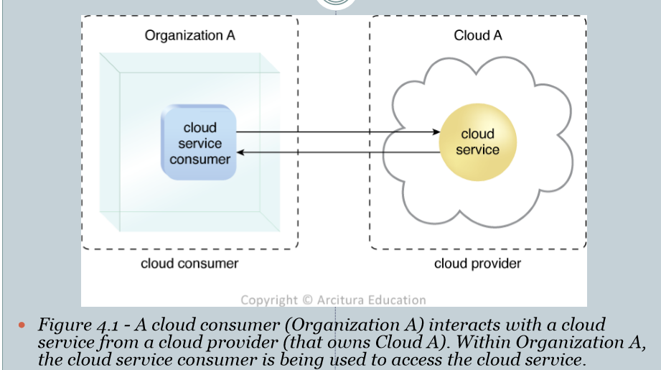
Cloud Consumer
A cloud consumer is an organization ( or a human) that has a formal contract or arrangement with a cloud provider to use IT ‘resources made available by the cloud provider.
The cloud consumer uses a cloud service consumer to access a cloud service.

Slide 37
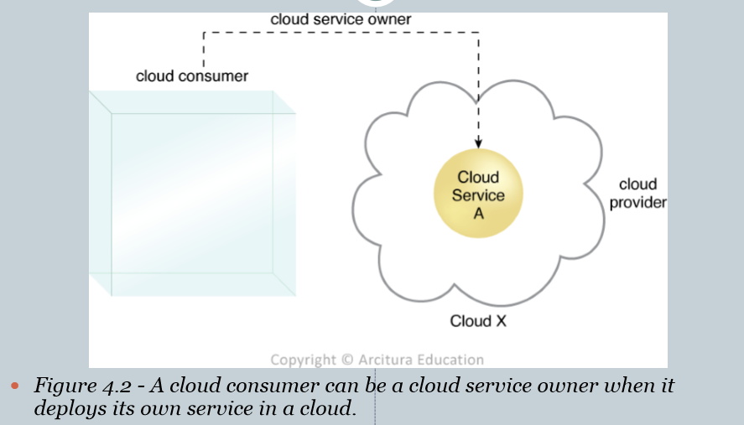
Cloud Service Owner
The person organization that legally owns a cloud service is called a cloud service owner.
The cloud service owner can be cloud consumer, or the cloud provider that owns the cloud within which the cloud service resides.
A cloud consumer that owns a cloud service hosted by a third party cloud does not necessarily need to be the user of the cloud service.
A cloud service owner ≠ a cloud resource owner

Slide 39
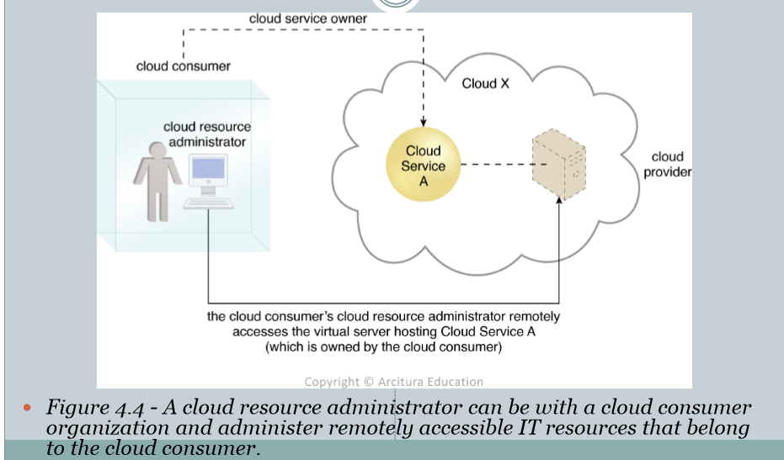
Cloud Resource Administrator
A cloud service administrator is the person or organization responsible for administering a cloud-based IT resource (including IT services).
The cloud consumer or cloud provider , or even third-party organization could be a cloud resource administrator.

Slide 40
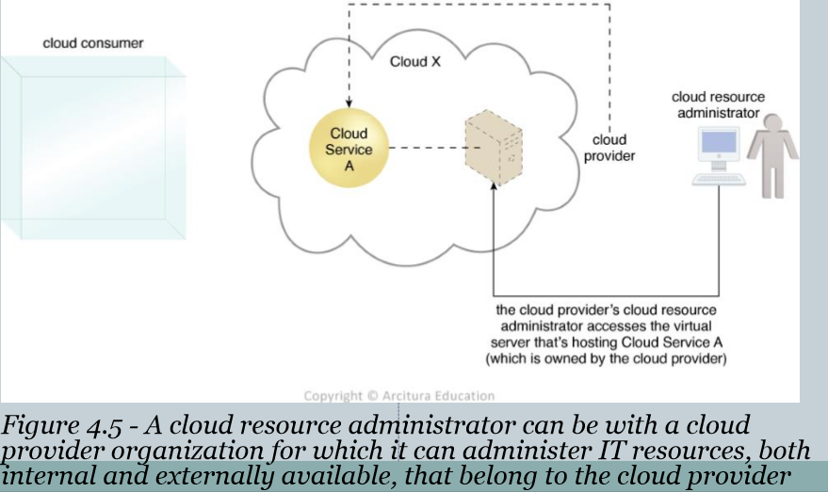

Slide 41
Additional Roles
The NIST Cloud Computing Reference Architecture defines the following supplementary roles:
Cloud Auditor
A third-party (often accredited) that conducts independent assessments of cloud environments assumes the role of the cloud auditor.
The typical responsibilities associated with this role include the evaluation of security controls, privacy impacts, and performance.

Slide 42
Cloud Broker
Mediator between cloud consumer and cloud providers. Mediation services provided by cloud brokers include service intermediation, aggregation, and arbitrage.
Cloud Carrier
The party responsible for providing the wire-level connectivity between cloud consumers and cloud providers assumes the role of the cloud carrier. This role is often assumed by network and telecommunication provider.

Slide 43
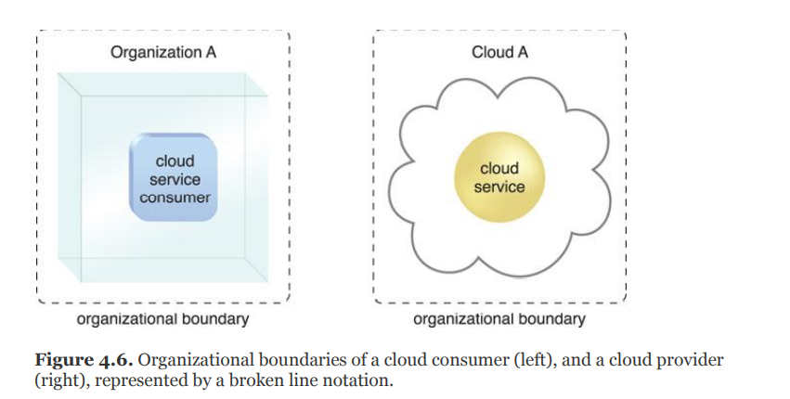
Organizational boundaries
An organizational boundary represents the physical perimeter that surrounds a set of IT resources that are owned and governed by an organization.
The organizational boundary does not represent the boundary of an actual organization, only an organizational set of IT assets and IT resources.

Slide 44
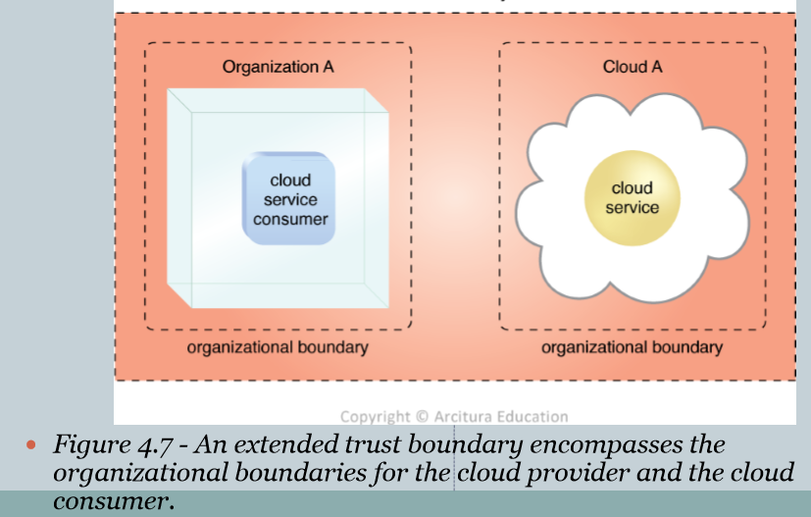
Trust Boundary
When a cloud consumer accesses could-based IT resources, it needs to extend its trust beyond the physical boundary of the organization to include parts of the cloud environment.
An trust boundary is a logical perimeter that typically spans beyond physical boundaries to represents the extent to which IT resources are trusted.
When analyzing cloud environments, the trust boundary is most frequently associated with the trust issued by the organization acting as the cloud consumer.

Slide 45
2.1 Cloud Characteristics
The following six specific characteristics are common to the majority of cloud environments:
On-demand usage
Ubiquitous usage
Multitenancy (and Resource Pooling)
Elasticity
Measured Usage
Resiliency

Slide 46
On-Demand Usage
On-demand usage is the ability of a cloud consumer to self-provision and use necessary cloud-based services without requiring cloud provider interaction.
This characteristic is related to measured usage, which represents the ability of a cloud to measure the usage of its IT resources.
Ubiquitous Access
The ability for a cloud service to be widely accessible.
Range of device, transport protocols, interfaces, and security technologies.

Slide 47
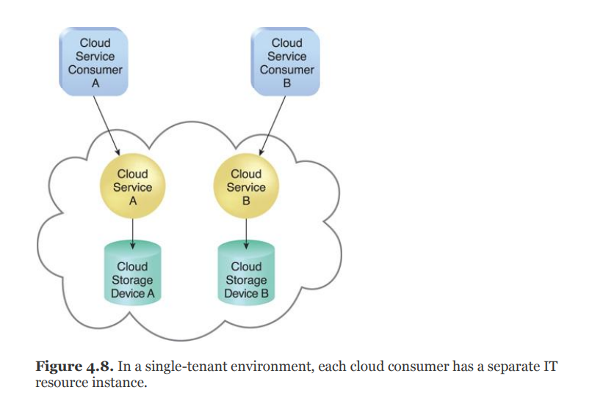
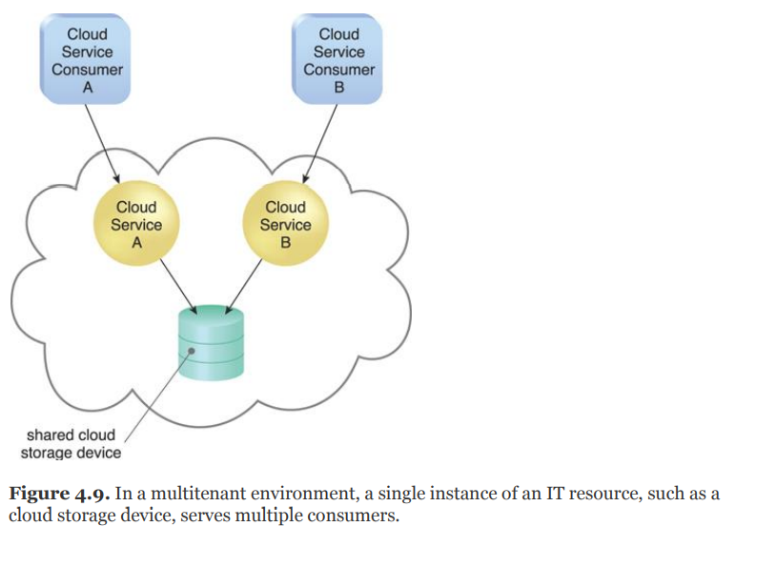
Multi-tenancy
The ability of a single instance of an IT resource to transparently serve multiple cloud consumers simultaneously.

Slide 48
Elasticity
The elasticity characteristic represents the ability of a cloud to transparently and automatically scale IT resources out or in.
It is closely associated with the reduced investment and proportional cost benefits.
Measured Usage
The ability to keep track of the usage of IT resources, primarily by cloud consumers.
Based on what is measured, the cloud provider can charge a cloud consumer only for the IT resources actually used and/or for the timeframe during which access to the IT resources was granted.
Resiliency
Is a form of failover that distributes redundant implementations of IT resources across physical locations.

Slide 49
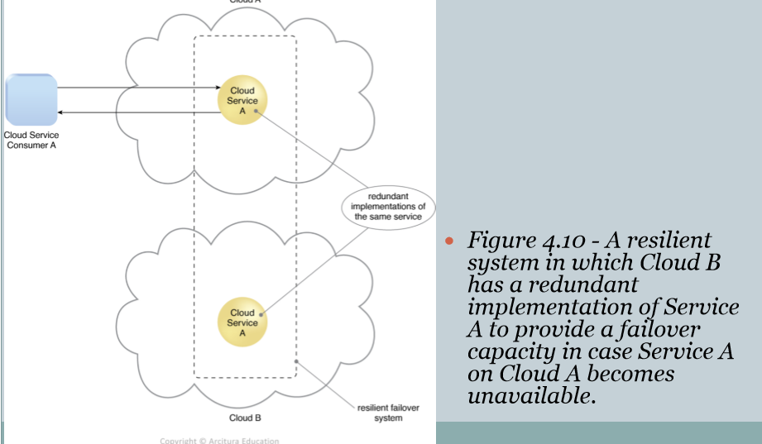

Slide 50
2.3 Cloud Delivery Models
A cloud delivery model represents a specific, pre-packaged combination of IT resources offered by a cloud provider.
Infrastructure-as-a-Service (IaaS)
Platform-as-a-Service (PaaS)
Software-as-a-Service (SaaS)

Slide 51
Infrastructure-as-a-Service (IaaS)
IaaS represents a self-contained IT environment comprised of infrastructure-centric IT resources that can be accessed and managed via cloud service-based interfaces and tools.
IaaS usually includes hardware, network, connectivity, operating systems, and other raw IT resources.
With IaaS, IT resources are typically virtualized and packaged into bundles.
Characteristics:
Highly flexible and highly scalable.
Accessible by multiple users.
Cost-effective.

Slide 52
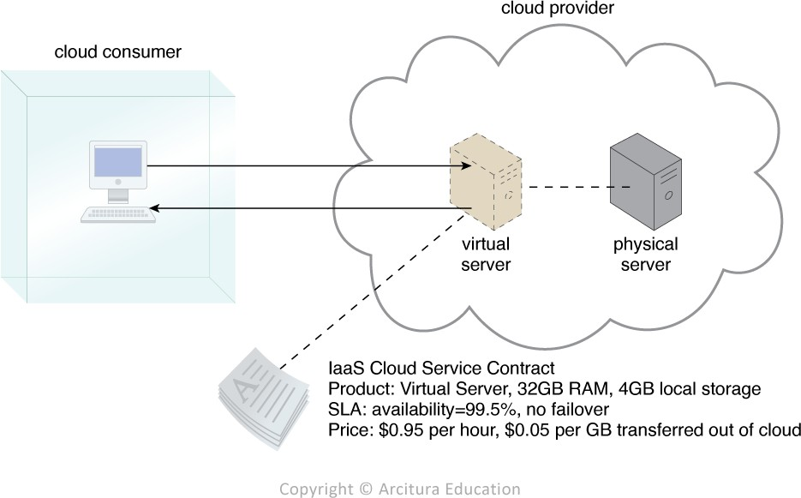
Fig - A cloud consumer is using a virtual server within an IaaS environment. Cloud consumers are provided with a range of contractual guarantees by the cloud provider, pertaining to characteristics such as capacity, performance, and availability.

Slide 53
Platform-as-a-Service (PaaS)
It represents a pre-defined ready-to-use environment typically comprised of already deployed and configured IT resources.
PaaS relies on the usage of a ready-made environment that establishes a set of pre-packaged products and tools used to support the entire delivery lifecycle of custom applications.
As an example, GAE offers a Java and Python-based environment.
Characteristics:
Accessible by multiple users.
Scalable – you can choose from various tiers of resources to suit the size of your business.
Built on virtualization technology.
Easy to run without extensive system administration knowledge.

Slide 54
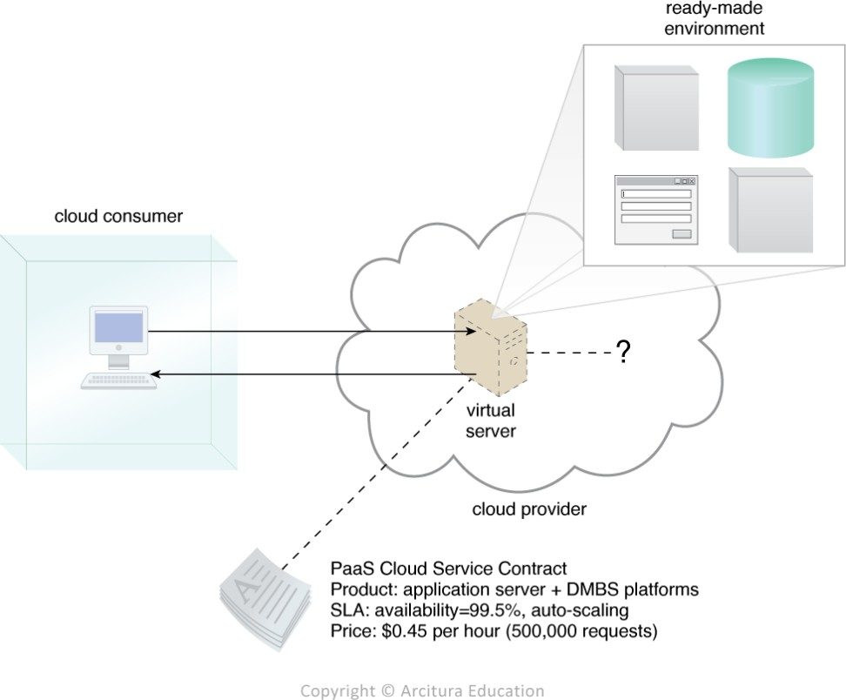
 Fig- A cloud consumer is accessing a ready-made PaaS environment. The question mark indicates that the cloud consumer is intentionally shielded from the implementation details of the platform.

Slide 55
Service-as-a-Service (SaaS)
A software program positioned as a shared cloud service and made available as a product or generic utility represents the typical profile of a SaaS offerings.
A cloud consumer is generally granted very limited administrative control over a SaaS implementation

Slide 56
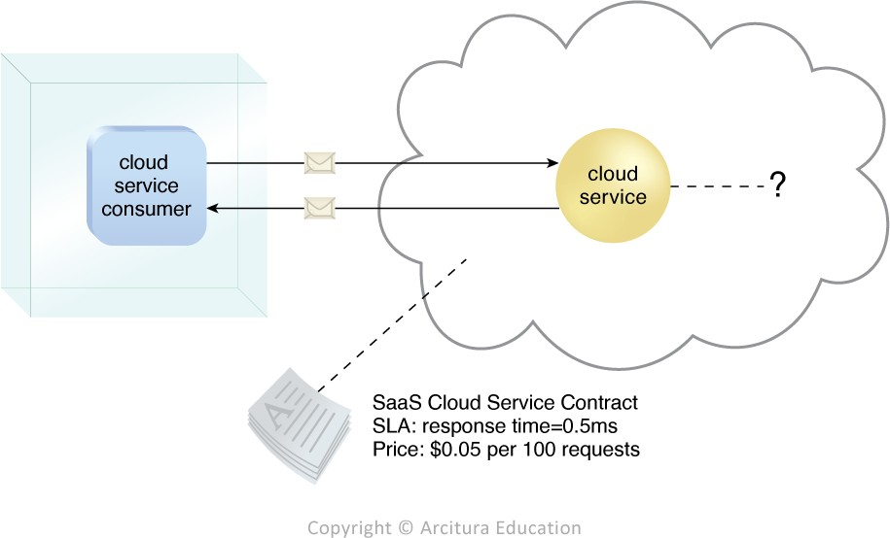
 Fig - The cloud service consumer is given access the cloud service contract, but not to any underlying IT resources or implementation details.

Slide 57
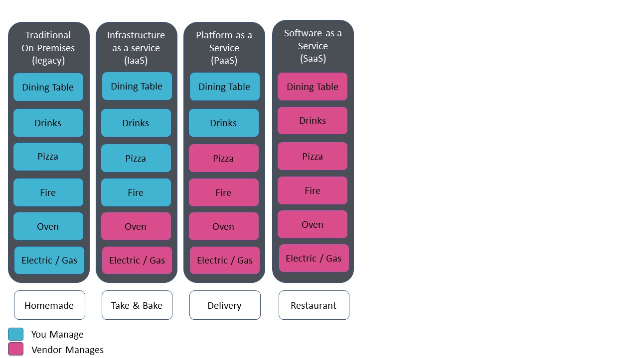
Example: Pizza-as-a-service

Slide 58
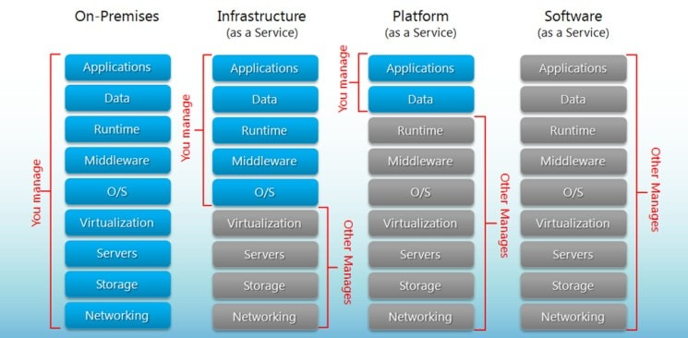

Slide 59
Examples
SaaS providers: BigCommerce, Google Apps, Salesforce, Dropbox, MailChimp, ZenDesk, DocuSign, Slack, Hubspot.
PaaS providers: AWS Elastic Beanstalk, Heroku, Windows Azure (mostly used as PaaS), Force.com, OpenShift, Apache Stratos, Magento Commerce Cloud.
IaaS providers: AWS EC2, Rackspace, Google Compute Engine (GCE), Digital Ocean, Magento 1 Enterprise Edition*.

Slide 60
Comparing Cloud Delivery models
Cloud Delivery Model | Typical Level of Control Granted to Cloud Consumer | Typical Functionality Made Available to Cloud Consumer
SaaS | Usage and usage-related configuration | Access to front-end user- interface
PaaS | Limited administrative | Moderate level of administrative control over IT resources relevant to cloud consumer’s usage of platform
IaaS | Full administrative | Full access to virtualized infrastructure-related IT resources and possibly, to underlying physical IT resources
Table 1. A comparison of typical cloud delivery model control levels

Slide 61
Cloud Delivery Model | Common Cloud Consumer Activities | Common Cloud Provider Activities
SaaS | uses and configures cloud service | implements, manages, and maintains cloud service Monitors usage by cloud consumers
PaaS | develops, tests, deploys, and manages cloud services and cloud- based solutions | pre-configures platform and provisions underlying infrastructure, middleware, and other needed IT resources, as necessary monitors usage by cloud consumers
IaaS | sets up and configures bare infrastructure, and installs, manage, and monitors any needed software | provisions and manages the physical processing, storage, networking, and hosting required monitors usage by cloud consumers
Table 2. Typical activities carried out by cloud consumers and cloud providers in relation to the cloud delivery models.

Slide 62
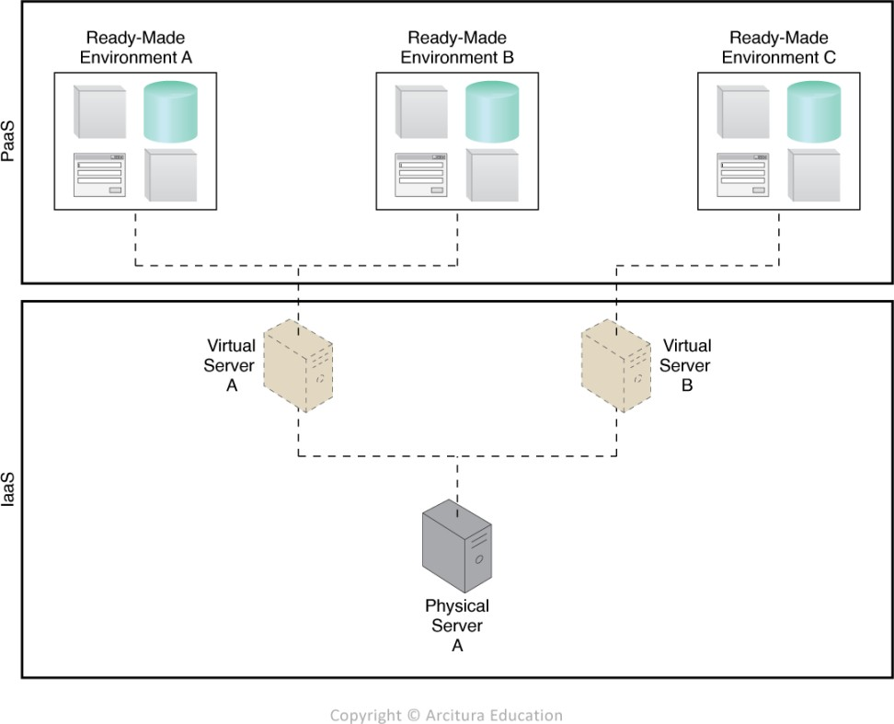
Combining Cloud Delivery Model
IaaS + PaaS
A PaaS environment will be built upon an underlying infrastructure comparable to the physical and virtual servers and other IT resources provided in an IaaS environment.
 Fig - A PaaS environment based on the IT resources provided by an underlying IaaS environment.

Slide 63
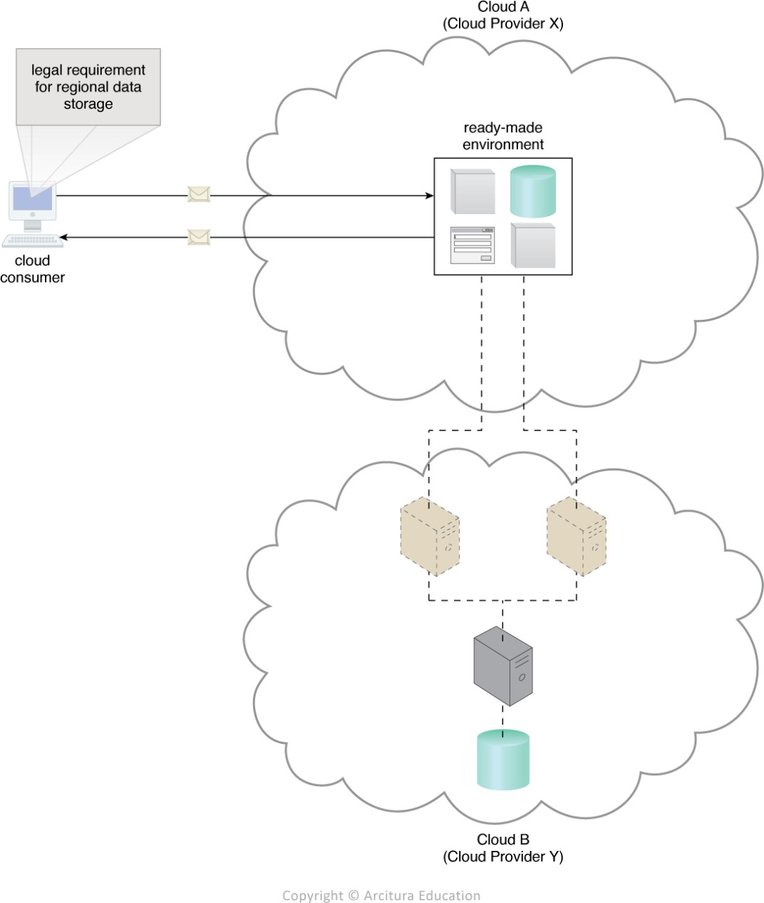
Figure - An example of a contract between Cloud Providers X and Y, in which services offered by Cloud Provider X are physically hosted on virtual servers belonging to Cloud Provider Y. Sensitive data that is legally required to stay in a specific region is physically kept in Cloud B which is physically located in that region.

Slide 64
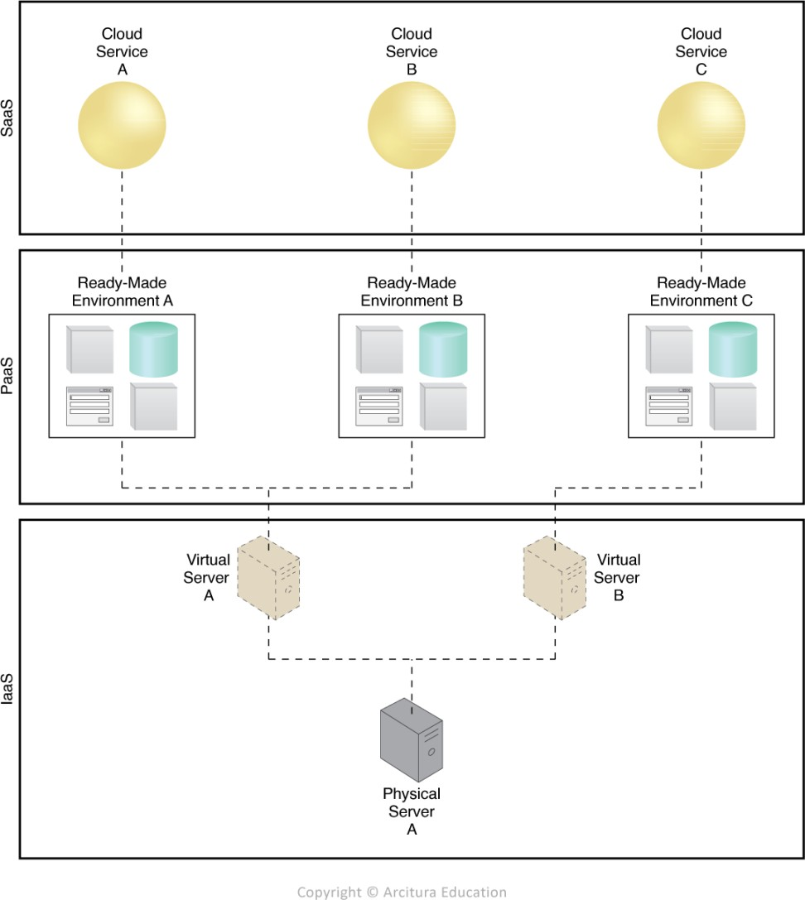
IaaS + PaaS + SaaS
For instance, by adding on to the preceding layered architecture, the ready-made environment provided by the PaaS environment can be used by the cloud consumer organization to develop and deploy its own SaaS cloud services that it can then make available as commercial products.
Figure - A simple layered view of an architecture comprised of IaaS and PaaS environments hosting three SaaS cloud service implementations.

Slide 65
2.4 Cloud Deployment Models
A cloud deployment model represents a specific type of cloud environment, primarily distinguished by ownership, size, and access.
Public clouds
Community clouds
Private clouds
Hybrid clouds

Slide 66
A public cloud is owned by a third party and generally offers commercialized cloud services and IT resources to cloud consumer organizations.
Ex: Amazon Elastic Compute Cloud (EC2), Microsoft Azure, IBM's Blue Cloud, Sun Cloud, and Google Cloud are examples of the public cloud.
A private cloud is owned by an individual organization and resides within the organization’s premises.
Ex: HP Data Centers, Microsoft, Elastra-private cloud, and Ubuntu are the example of a private cloud.
A community cloud is normally limited for access by a group of cloud consumers that may also share responsibility in its ownership.
Ex: Our government organization within India may share computing infrastructure in the cloud to manage data.
A hybrid cloud is a combination of two or more cloud deployment models.
Ex: The best hybrid cloud provider companies are Amazon, Microsoft, Google, Cisco, and NetApp.

Slide 67
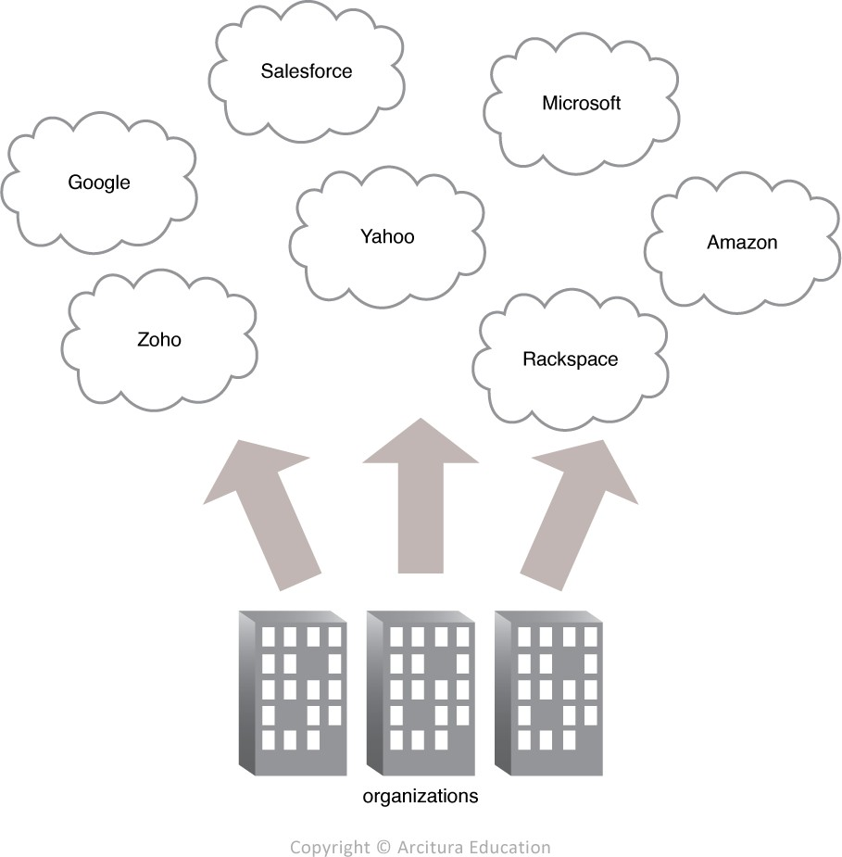
Public Cloud
Figure - Organizations act as cloud consumers when accessing cloud services and IT resources made available by different cloud providers.

Slide 68
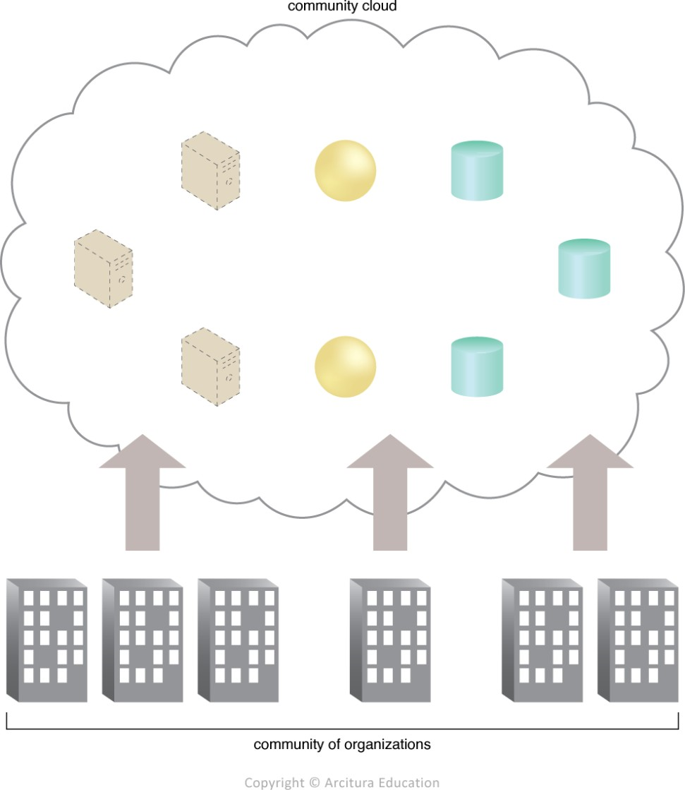
Community Cloud
Figure - An example of a "community" of organizations accessing IT resources from a community cloud.

Slide 69
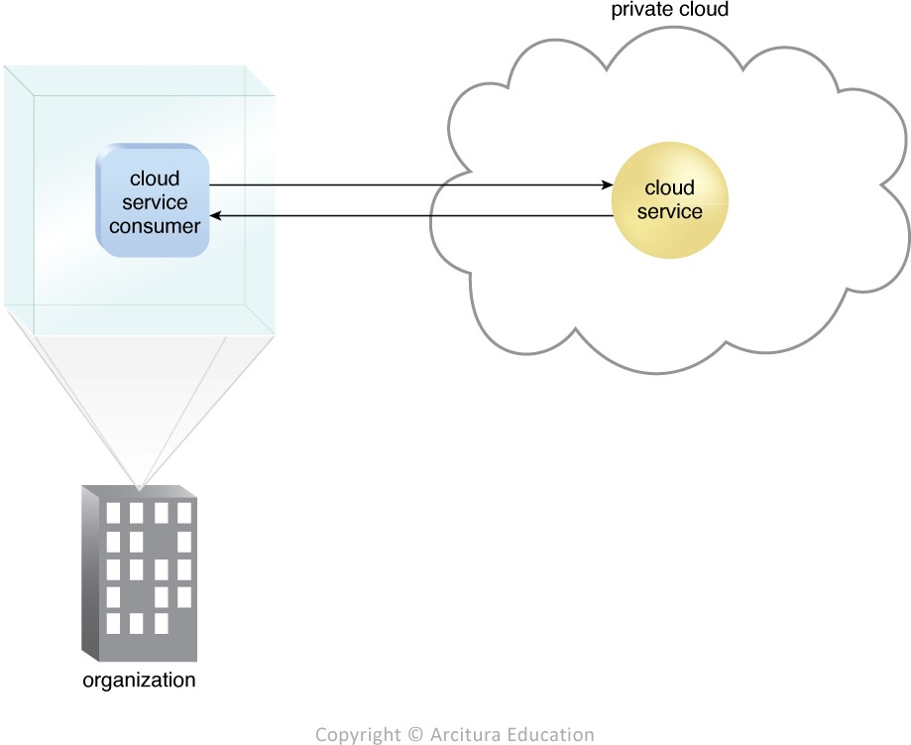
Private Cloud
Figure - A cloud service consumer in the organization's on- premise environment accesses a cloud service hosted on the same organization's private cloud via a virtual private network.

Slide 70
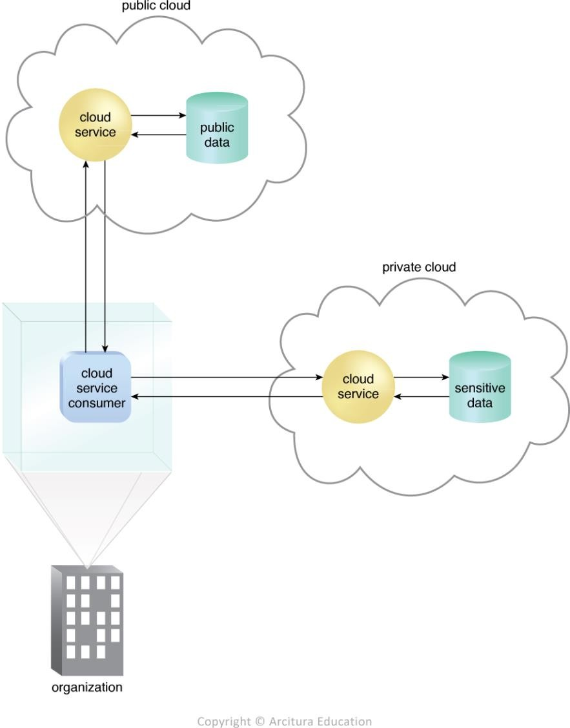
Hybrid Cloud
Fig - An organization using a hybrid cloud architecture that utilizes both a private and public cloud.

