Slide 1
Cloud Computing
Module 2 – Cloud Enabling Technology

Slide 2
Contents
Broadband Networks and Internet Architecture
Data Center Technology
Virtualization Technology
Web Technology
Multitenant Technology
Service Technology

Slide 3
2.1 Broadband Networks and Internet Architecture
All clouds must be connected to a network.
Internet allow cloud consumers to access IT resources using private and dedicated links.
Cloud platforms grows in parallel with advanced internet connectivity and quality services.

Slide 4
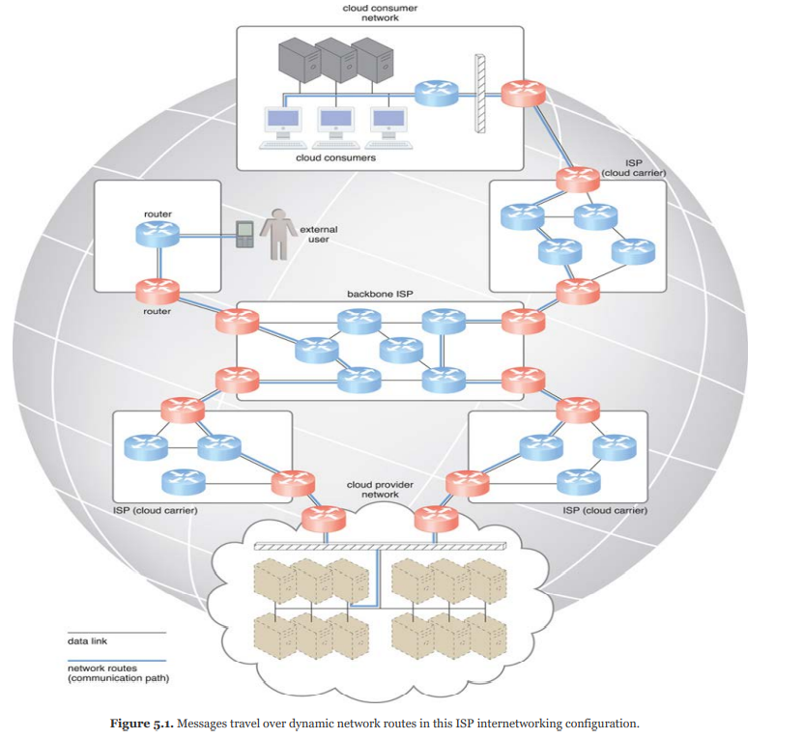
ISP(Internet Service Provider)
Internet was based in decentralized provisioning and management tool.
ISP can freely deploy, manage, and operate their networks in addition to selecting partners for ISP’s for interconnection.
There is no centralized entity to supervise and coordinate internet communications.
Governmental and regulatory laws dictates supervision in conditions for organizations and ISP’s within and outside boundaries.
The internet’s topology has become dynamic and aggregate of ISPs that are connected through high protocols.
www connectivity is enabled through hierarchy topology composed of Tier 1 ,2 and 3 shown in the Figure.

Slide 5
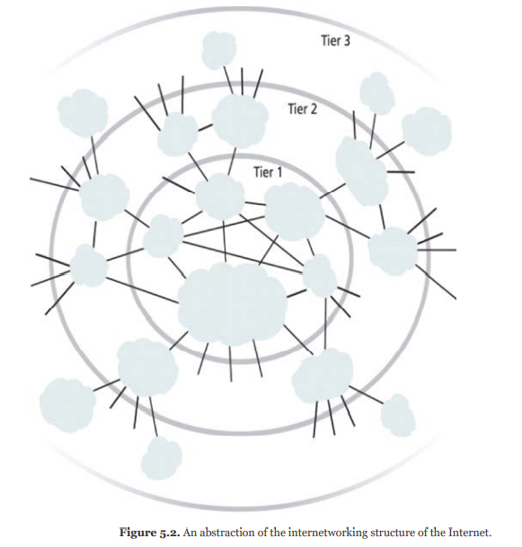
Tier1 is made of large scale, international cloud providers that connects massive global networks which are connect to Tier2 large regional providers.
Tier2 connect with Tier1 as well as local ISP’s of Tier3.
Cloud consumers and cloud providers can directly connected using Tier1 since any operational ISP enables internet connection.
The communications links and routers of the internet and ISP networks are IT resources that are distributed among countless traffic paths.
Two fundamental components needed to construct internetworking.
1. Connectionless packet switching.
2. Router based interconnectivity.

Slide 6
Connection less packet switching(Datagrams)
Data can be send in the form of packets.
Each packet contains location information such as IP(Internet Protocol) or MAC(Media access Protocol) to be processed and routed at every source , intermediary and destination node.
Router-Based Interconnectivity
A router is a device that is connected to multiple networks through which it forwards packets.
Maintains the network topology information.
Provides alternative paths.

Slide 7
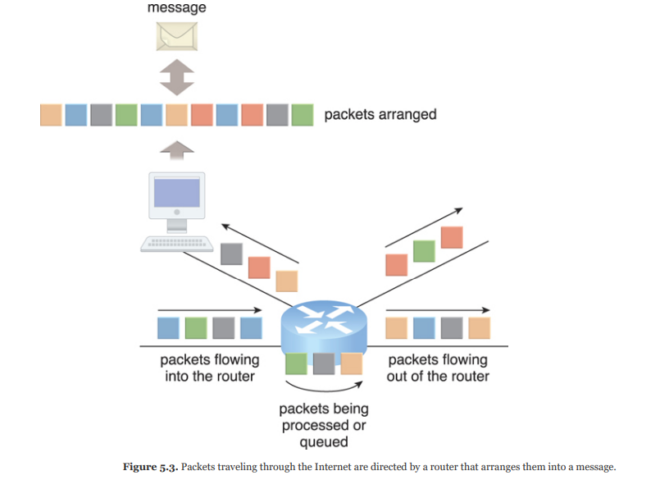

Slide 8
The communication path that connects a cloud consumer with its cloud provider may involve multiple ISP networks.
Internet mesh structure that connects internet hosts using multiple alternative network routers that are determined at runtime.
Sustained from network failures, routing fluctuations.
ISP implement the internet internetworking and interact with other network topologies as follows

Slide 9
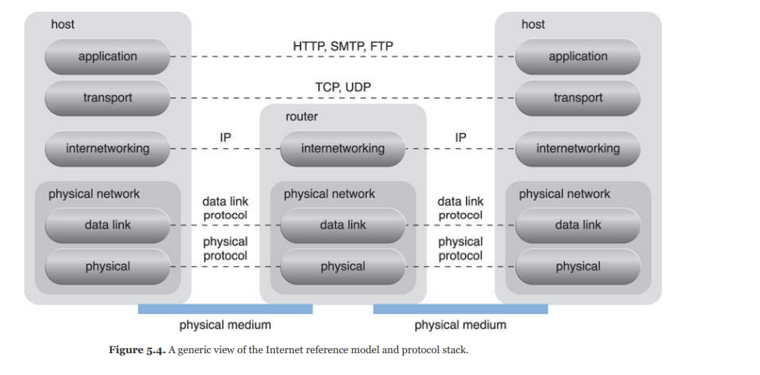

Slide 10
Physical Network
IP Packets are transmitted through physical networks that connect adjacent nodes such as Ethernet, ATM networks and Mobile HSPDA.
Consists of two layer datalink and physical layer.
Datalink layer controls data transfer between the neighbouring nodes.
Physical layer Transmits data in form of bits in both wired or wireless media.
Transport Layer
TCP(Transmission control protocol) and UDP(user datagram protocol).
Provide end-to-end communication.
Application Layer
Protocols such as HTTP, SMTP for e-mail, BitTorrent for P2P, and SIP for IP telephony use transport layer protocols to standardize and enable specific data packet transferring methods over the Internet.

Slide 11
Technical and Business conditions
Connectivity issues
On-premise deployment models, enterprise applications and data are located on own data centres.
End user devices such as Smart phones, laptops access the data centre through corporate network which provides uninterrupted internet connectivity.
TCP/IP facilitates both internet access and on-premise data exchange over LAN.

Slide 12
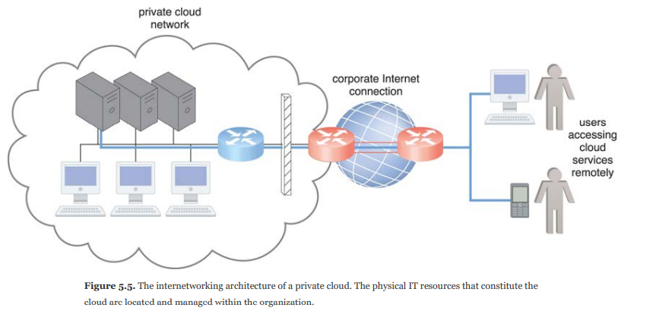

Slide 13
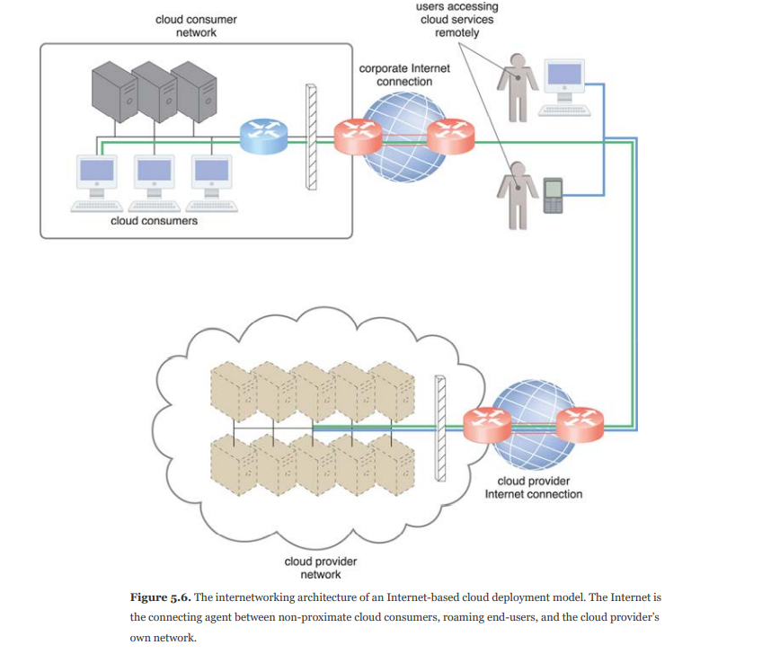
Cloud providers can easily configure cloud-based IT resources to be accessible for both internal and external users through internet connection using the same internet protocols.

Slide 14
Comparison of On-premise and cloud computing internetworking
On-Premise IT Resources | Cloud-Based IT Resources
internal end-user devices access corporate IT services through the corporate network | internal end-user devices access corporate IT services through an Internet connection
internal users access corporate IT services through the corporate Internet connection while roaming in external networks | internal users access corporate IT services while roaming in external networks through the cloud provider’s Internet connection
external users access corporate IT services through the corporate Internet connection | external users access corporate IT services through the cloud provider’s Internet connection

Slide 15
Network bandwidth and latency issues
Bandwidth means capacity of data transmitted.
ISP uses broadband network to implement guarantee end-to-end connectivity.
Latency means amount of time required to travel packet from one node to another.
Latency increases with every intermediary node on the packet’s path.
Transmission queues in the network infrastructure can result in heavy load conditions that also increase network latency.
QoS(quality of service) transmits packets on the basis of first –serve.
Congestion path suffers from service level degradation in the form of bandwidth reduction, latency increase, packet loss.
These issues are inherent to cloud networking also. So IT solutions need to be accessed business requirements that are affected by these issues.

Slide 16
Cloud carrier and cloud provider selection
The service levels of Internet connections between cloud consumers and cloud providers are determined by their ISPs.
QoS management across multiple ISPs is difficult to achieve in practice, requiring collaboration of the cloud carriers on both sides to ensure that their end to end service levels are sufficient for business requirement.
Cloud consumers and cloud providers may need to use multiple cloud carriers in order to achieve the necessary level of connectivity and reliability for their cloud applications, resulting in additional costs.

Slide 17
2.2 Data center Technology
Grouping IT resources in close proximity with one another allows for power saving, higher efficiency in sharing resources, and improve accessibility for IT personnel.
Modern data centers exist as specialized IT infrastructure used to house centralized IT resources, such as servers, databases, networking and telecommunication devices, and software systems.
It consists of the following technologies and components
1. Virtualization
2. Standardization and Modularity
3. Automation (self-configuration, recovery)
4. Remote Operation and Management
5. High Availability (through redundancy)

Slide 18
6. Security-Aware Design, Operation, and Management (outsourcing resources).
7. Facilities
8. Computing Hardware (standardized commodity servers)
9. Storage Hardware (array, hot-swapping, storage virtualization, fast data replication, SAN, NAS,…)
10. Network Hardware

Slide 19
Virtualization
Data centers consist of both physical and virtualized IT resources.
The physical IT layer refers hardware and their operating system.
The virtual layer is comprised for operational and management tools.

Slide 20
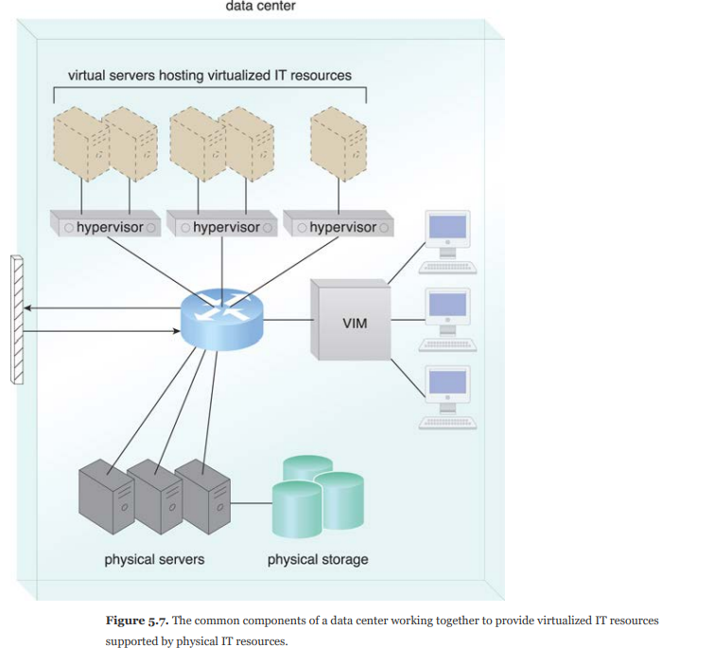

Slide 21
Standardization and modularity
Data centres are built upon standardized commodity hardware and designed with modular architectures.
Modularity and standardization are key requirements for reducing investment and operational costs.

Slide 22
Automation
Data centers have specialized platforms that automate tasks like provisioning, configuration, patching, and monitoring without supervision.
Advances in data center management platforms and tools leverage automatic computing technologies to enable self-configuration and self-recovery.

Slide 23
Remote Operation and Management
Operational and technical tasks in data centres are commanded through remote consoles and management systems.
Technical people are needed to visit the server rooms except equipment and cabling or hardware installation and maintenance.

Slide 24
High Availability
Data centers are designed to operate with increasingly higher levels of redundancy to sustain availability.
Data centers usually have redundant, uninterruptable power supplies, cabling, and environmental control subsystems in anticipation of system failure, along with communication links and clustered hardware for load balancing.

Slide 25
Security-Aware Design, Operation, and Management
Requirements for security such as physical and logical access controls and recovery strategies to be needed since they are centralized structures to store and process business data.
Outsourcing models require long term commitment and that could not provide elasticity these issues can be addressed by cloud with inherent features such as ubiquitous, on-demand, pay-per-use and elasticity.

Slide 26
Facilities
Data centre facilities are custom designed locations that are outfitted with specialized computing, storage, and network equipment.
These facilities have several functional layout areas, as well as various power supplies, cabling, and environmental control stations that regulate heating, ventilation, air conditioning, fire protection, and other related subsystems.

Slide 27
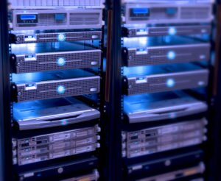
Computing Hardware
Much of the heavy processing in data centres are executed by standardized servers that have high computational power and storage capacity. The following are the hardware technologies integrated into these modular server are
Rackmount composed of several racks which interconnects for power, network, and cooling.
support for different hardware processing architectures, such as x86-32bits, x86-64, and RISC
Multi core CPU architectures with hundred of processing cores in a small single unit of racks.
Redundance and swappable components such as disks, power supplies, network interfaces and storage controllers.

Slide 28
Storage hardware
Data centres have specialized storage system to maintain large volume of information. Storage system are containers housing numerous hard disks that are organized into arrays.
It involves the following technologies
Hard disk arrays: – These arrays inherently divide and replicate data among multiple physical drives, and increase performance and redundancy by including spare disks. This technology is implemented using RAID.
I/O caching: This is generally performed through hard disk array controllers, which enhance disk access times and performance by data caching.

Slide 29
Contin..
Hot-Swappable Hard Disks – These can be safely removed from arrays without requiring prior powering down.
Storage Virtualization – This is realized through the use of virtualized hard disks and storage sharing.
Fast Data Replication Mechanisms – These include snapshotting, which is saving a virtual machine’s memory into a hypervisor-readable file for future reloading, and volume cloning, which is copying virtual or physical hard disk volumes and partitions.
Network devices – There are two types
Storage Area Network (SAN) –
Used for transferring data between the servers and the storage devices fiber channels and switches.
It allows block data storage and block access.
access using industry standard protocols, such as the Small Computer System Interface (SCSI).
2. Network-Attached Storage (NAS) –
It is a file level computer storage server connected to a network providing data access to heterogenous group of clients.
Users on LAN access the shared storage via a standard Ethernet connection.
Data access protocols like the Network File system (NFS) or server message block (SMB).

Slide 30
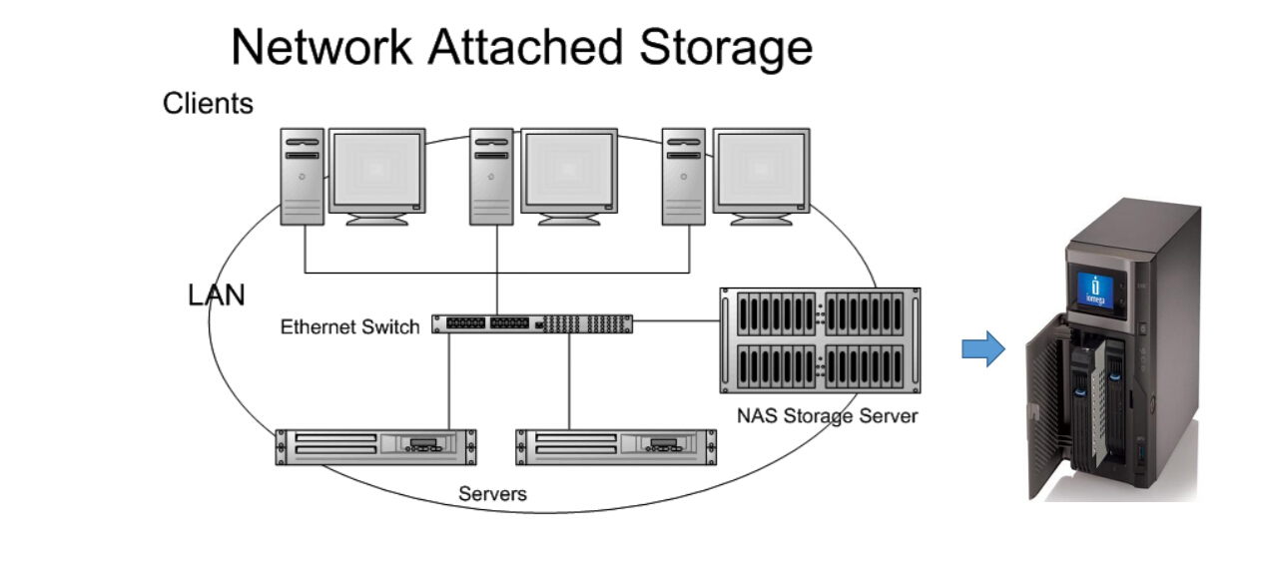
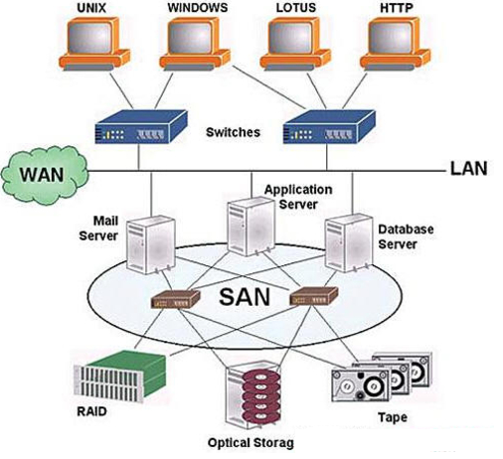

Slide 31
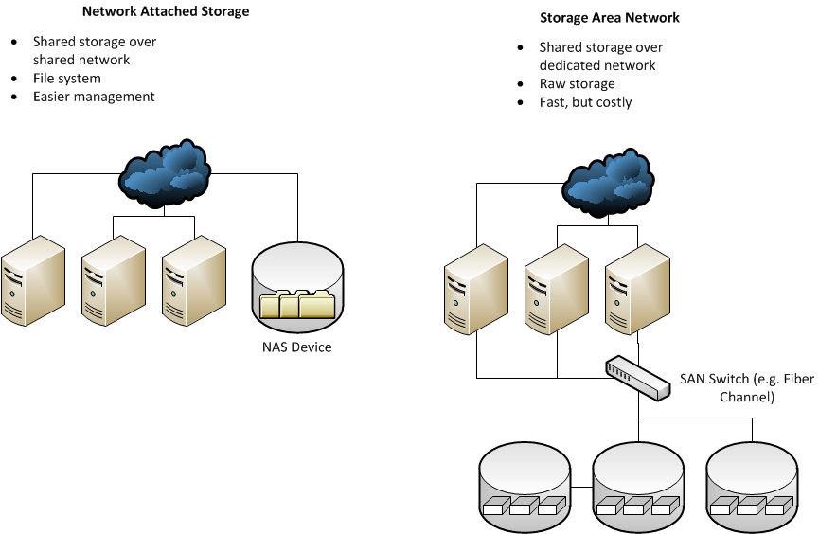
NAS vs SAN

Slide 32
NAS Benefits
Relatively inexpensive
24/7 and remote data availability
Salability
Redundant storage architecture
Automatic backups to other devices and cloud
Flexibility
SAN Benefits
Extremely fast data access
Dedicated network for storage relieves stress on LAN
Highly expandable
OS level (block level) access to files
High quality-of-service for demanding applications such as video editing

Slide 33
Network Hardware
Data centres require extensive hardware to enable multiple levels of connectivity.
It is subdivide into 5 network subsystems.
Carrier and External Networks Interconnection
Web-Tier Load Balancing and Acceleration
LAN Fabric
SAN Fabric
NAS Gateways

Slide 34
Contin..
Carrier and External Networks Interconnection
Related to internetworking infrastructure consists of routers that connects multiple WAN’s with data center LAN. It also consists of security systems such as Firewalls and VPN gateways.
Web-Tier Load Balancing and Acceleration
It consists of web acceleration devices such as XML pre-processors, encryption/decryption and switching devices.
LAN Fabric
Creates LAN and provides high performance and redundant connectivity for all the data centers network enabled resources.
It is implemented through multiple switches that provides network communication with gigabytes per second speed.
Performs several virtualization functions such as LAN segregation, link aggregation, routing control, load balancing and failover.

Slide 35
Contin..
SAN Fabric
Provides connectivity between storage systems and servers.
Implemented with fiber channel over Ethernet and InfiniBand network switches.
NAS Gateways
Provides NAS based storage devices and implements protocol conversion hardware that provides communication between SAN and NAS devices.

Slide 36
2.3 Virtualization Technology
Virtualization is the process of converting a physical IT resource into a virtual IT resource.
It resources that we can virtualize are
Servers – A physical server can be abstracted to virtual server.
Storage – A physical storage device can be abstracted into a virtual storage device or a virtual disk.
Network – Physical routers and switches can be abstracted into logical network fabrics, such as VLANs.
Power – A physical UPS and power distribution units can be abstracted into what are commonly referred to as virtual UPSs

Slide 37
Contin..
The first step in creating a new virtual server through virtualization software is the allocation of physical IT resources, followed by the installation of an operating system.
Virtualization software runs on physical server is called host or physical host.
The functionality of this software is related to virtual management so this software is also called as virtual manager(VM) or Virtual machine monitor(VMM) or hypervisor.

Slide 38
Contin..
Hardware Independence
In non virtualization environment the OS are configured for specific hardware models and requires reconfiguration if IT resources are need to be modified.
In virtualization environment there exist hardware independence. In which IT hardware is translated into emulated and standardized software copies.
Cloning and manipulating virtual IT resources are simple than physical IT resources.

Slide 39
Contin..
Server Consolidation
VMM allows multiple virtual server to be simultaneously created in the same virtualization host.
Virtualization technology enables different virtual server share only one physical server.
This process is called server consolidation which improves the hardware utilization, load balancing and optimization of the IT resources.
It supports cloud features such as On demand usage, resource pooling, elasticity, scalability and resiliency.

Slide 40
Contin..
Resource replication
Virtual servers created as virtual image disks that contains binary file copies of the hard disk content.
These can be accessed to the host OS and can easily perform all file operations.
This ease of replication and manipulation offers some advantages
Increased agility means migrating and development of virtual machine new instances.
Improves business continuity with efficient backup and restoration procedures.
Ability to rollback and restore the virtual machine in prior state.

Slide 41
Types of server virtualization
Operating system based virtualization.
Hardware based virtualization.
Operating system based virtualization
In which the virtualization software is installed over a pre-existing OS which is called host operating system.
User installs virtualization software in the host operating system that is used the create virtual servers.
This software allows user to access the virtual machines.
Host OS provide hardware devices then compatibility issues may arise. The virtualization software convert hardware IT resources that require software for operation into virtualized IT resources.

Slide 42
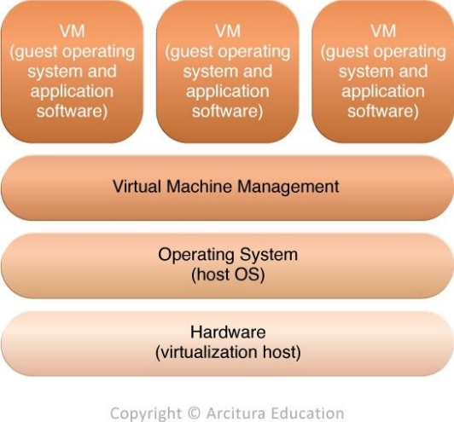
Operating system based virtualization
Figure The different logical layers of operating system based virtualization in which the VM is first installed into a full host operating system and subsequently used to generate virtual machines

Slide 43
Contin..
Some major operating system based services are
Backup and recovery.
Security management.
Integration and directory services.
Some issues and demands with OS based virtualization
The host operating system consumes CPU, memory, and other hardware IT resources.
Hardware-related calls from guest operating systems need to traverse several layers to and from the hardware, which decreases overall performance.
Licenses are usually required for host operating systems, in addition to individual licenses for each of their guest operating systems.

Slide 44
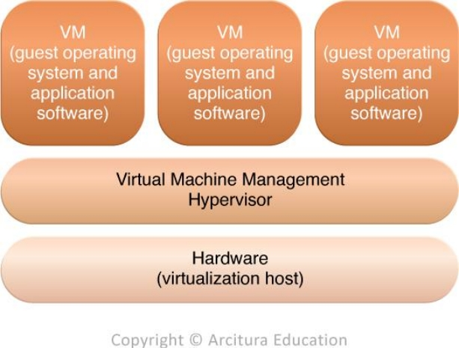
Hardware-Based Virtualization
Figure The different logical layers of hardware-based virtualization, which does not require another host operating system

Slide 45
Contin..
It allows the direct installation of virtualization software on a physical host hardware.
It allows virtual servers direct communication with the hardware.
This virtualization software is called as hypervisor.
It has a simple interface that requires less mount of storage space.
It improves the performance that enables multiple virtual servers directly interact with the physical hardware.
Issues:
Compatibility with hardware devices.
Hardware device drivers may not be as available to hypervisor platforms as they are to operating systems.

Slide 46
Virtualization management
Most administrative tasks are easily performed by virtual machines rather that physical servers.
Modern virtualization software provides advanced management function that can automate administration tasks and reduces the overall burden on virtualized IT resources.
Virtualization management is supported by Virtual Infrastructure management(VIM) tools that collectively manage the IT resources.

Slide 47
Other considerations
Performance overhead
A poorly formulated virtualization result in excessive performance overhead. To overcome this issue para-virtualization is used. It identifies the virtual machine that is not identical to hardware.
But the drawback is adapt the guest OS to the para-virtualization API, can repair the standard guest OS .
Special hardware compatibility
Many hardware vendors that distribute specialized hardware may not have device driver versions that are compatible with virtualization software.
These types of incompatibility issues can be resolved using established commodity hardware platforms and established virtualization software products.
Portability
The programmatic and management interfaces establish administration environments for a virtualization program to operate with various virtualization solutions can introduce portability issues due to incompatibilities.

Slide 48
Best virtualization software - at a glance
VMware Workstation Player
VirtualBox
Parallels Desktop
QEMU
Citrix Hypervisor
Xen Project
Microsoft Hyper-V

Slide 49
Case study 1: Financial services company running out of space
As computing needs continued to grow, an online financial services company faced a problem all too common in today’s data centers. The company was running out of space to house physical servers, and its existing cooling infrastructure couldn't keep up. New workloads meant the addition of physical systems, and valuable time was spent configuring those systems and balancing power distribution.
Finally, the company turned to server virtualization technology to help solve its space problems and improve efficiency. Today, the company is 75% virtualized and runs 200 VMs on just 10 physical servers, leading to an estimated 33% savings in power use.

Slide 50
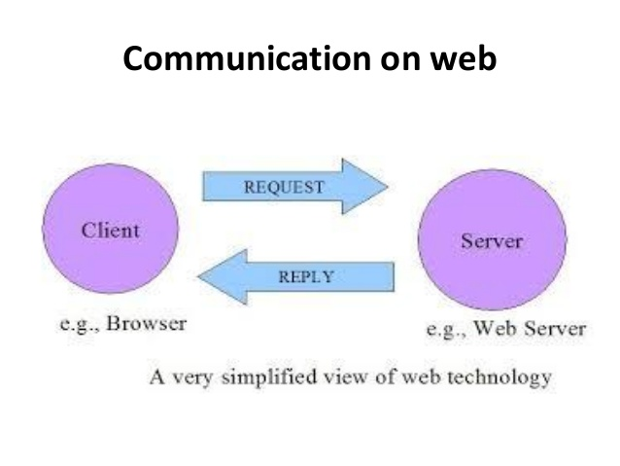
5.4 Web Technology
Computers communicate with each other using markup languages and multimedia packages.

Slide 51
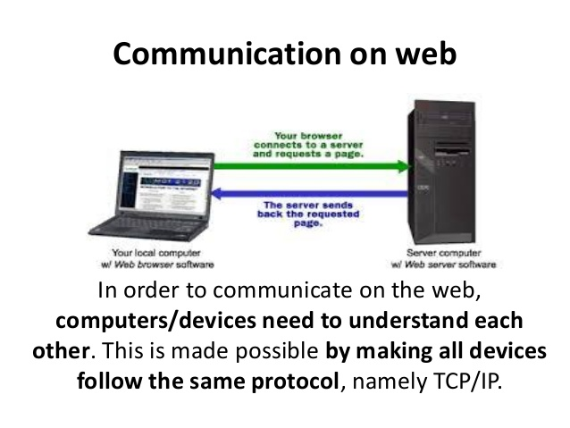

Slide 52
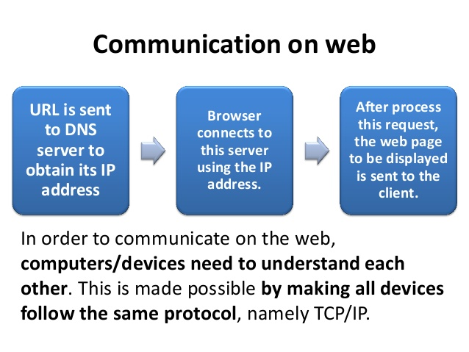

Slide 53
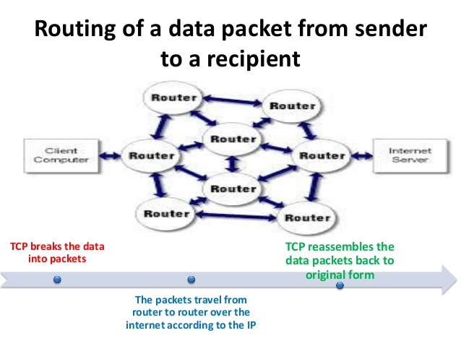

Slide 54
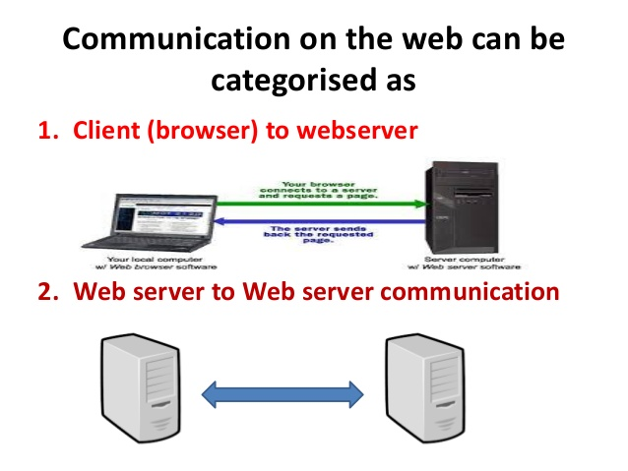

Slide 55
Basic components of web technology
Web browser.
It is a software program to access information on the world wide web.
Ex: Mozilla, Google, Opera, Internet Explorer..
Web server.
A web server is dedicated software that runs on the server-side.
That stores and delivers the contents to the web browser.
The servers communicate with browsers using Hypertext Transfer Protocol (HTTP). Web servers can also support SMTP (Simple Mail Transfer Protocol) and FTP (File Transfer Protocol).

Slide 56
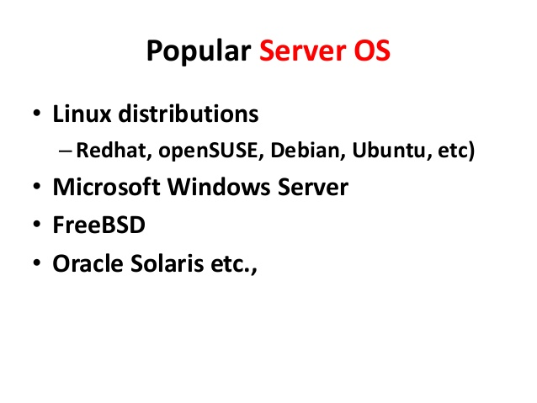

Slide 57
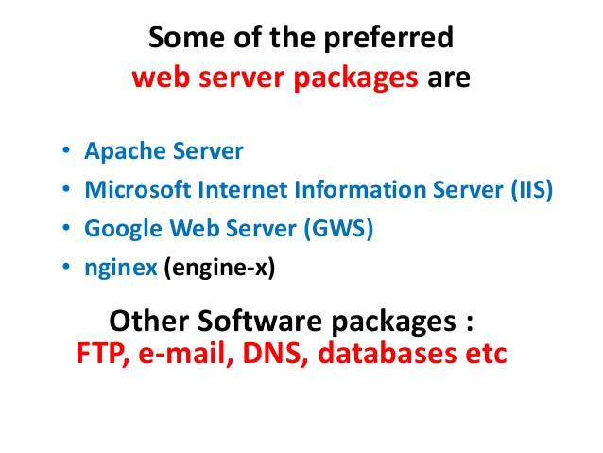

Slide 58
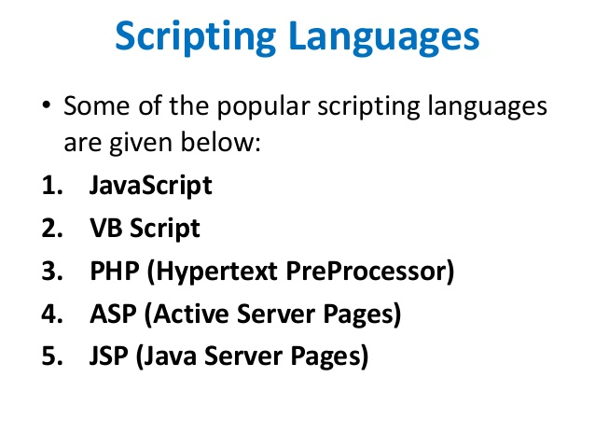

Slide 59
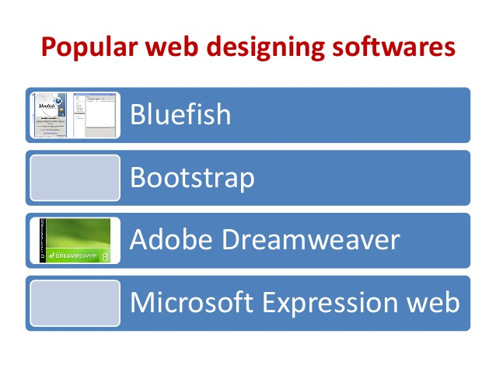

Slide 60
Web applications
A distributed application that uses Web-based technologies (and generally relies on Web browsers for the presentation of user-interfaces) is typically considered a Web application.
These applications can be found in all kinds of cloud-based environments due to their high accessibility.

Slide 61
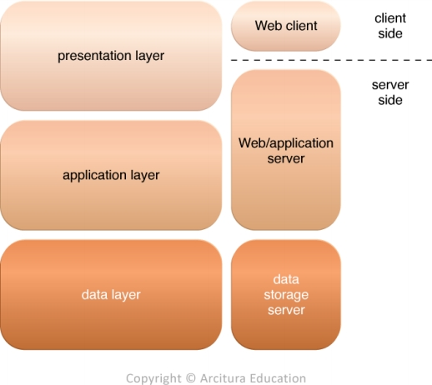
Figure - The three basic architectural tiers of Web applications.

Slide 62
Presentation layer
Which represents the user interface. Which is reside on both client and server side.
Web server receive client request and retrieve requested resources directly as static or dynamic web which is generated by application logic.
Application layer
Which implements the application logic.
Web servers interact with application logic to execute the user request.
Data layer
Which comprised of persistent data storage.
The application logic interact with the underlaying databases.
PaaS ready-made environments enable cloud consumers to develop and deploy Web applications. Typical PaaS offerings have separate instances of the Web server, application server, and data storage server environments.

Slide 63
5.4 Multitenant Technology
This technology enables multiple users allow access to same application logic.
Every tenant has its own view of the application that can use, customize which is unaware of other tenants while using the same application.
Multitenant application ensure that tenants do not have access to data and configuration information that is not their own.

Slide 64
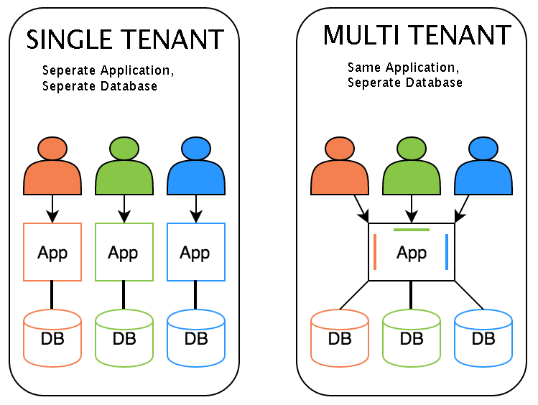

Slide 65
Tenants can individually customize features of application are
User interface
Tenants can define specialized look and feel for their application interface.
Business Process – Tenants can customize the rules, logic, and workflows of the business processes that are implemented in the application.
Data Model – Tenants can extend the data schema of the application to include, exclude, or rename fields in the application data structures.
Access Control – Tenants can independently control the access rights for users and groups

Slide 66
Characteristics of Multitenant application
Usage Isolation – The usage behavior of one tenant does not affect the application availability and performance of other tenants.
Data Security – Tenants cannot access data that belongs to other tenants.
Recovery – Backup and restore procedures are separately executed for the data of each tenant.
Application Upgrades – Tenants are not negatively affected by the synchronous upgrading of shared software artifacts.
Scalability – The application can scale to accommodate increases in usage by existing tenants and/or increases in the number of tenants.
Metered Usage – Tenants are charged only for the application processing and features that are actually consumed.
Data Tier Isolation – Tenants can have individual databases, tables, and/or schemas isolated from other tenants. Alternatively, databases, tables, and/or schemas can be designed to be intentionally shared by tenants.

Slide 67
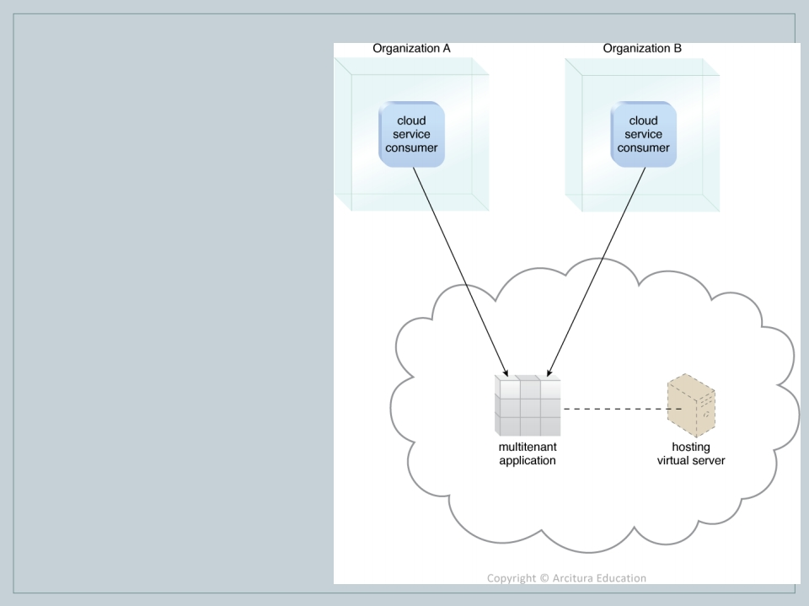
A multitenant application that is being concurrently used by two different tenants.
Figure - A multitenant application that is serving, multiple cloud service, consumers simultaneously

Slide 68
Multitenant vs virtualization
With virtualization
Multiple virtual copies of the server environment can be hosted by a single physical server. Each copy can be provided to different users, can be configured independently, and can contain its own operating system and applications.
With multitenancy
A physical or virtual server hosting an application is designed to allow usage by multiple different users. Each user feels as though they have exclusive usage of the application.

Slide 69
5.6 Service Technology
Cloud provides various service models. To provide this facility it need some components.
Web services
REST services.
Service Agents.
Service Middleware.

Slide 70
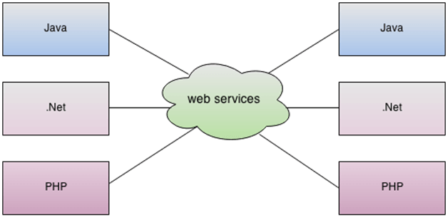
Web Services
A Web Service is can be defined by following ways:
It is a client-server application or application component for communication.
The method of communication between two devices over the network.
It is a software system for the interoperable machine to machine communication.
It is a collection of standards or protocols for exchanging information between two devices or application.

Slide 71
Components of web services
XML Schema Definition Language (XML Schema)
To tag the data or present the data.
WSDL (Web Services Description Language)
To describe the availability of service.
SOAP (Simple Object Access Protocol)
To transfer the message.
UDDI (Universal Description, Discovery and Integration)

Slide 72
SOAP
SOAP
UDDI DIRECTORY
1. Registration
2. Where the service located.
4. Using web service
SOAP
Web Application
Web Application
Request
Web service
Consumer
Response
WSDL
3. How to communicated with the web service

Slide 73
How web service work??
Consider a simple account-management and order processing system. The accounting personnel use a client application built with Visual Basic or JSP to create new accounts and enter new customer orders.
The processing logic for this system is written in Java and resides on a Solaris machine, which also interacts with a database to store information.
The steps to perform this operation are as follows −
The client program bundles the account registration information into a SOAP message.
This SOAP message is sent to the web service as the body of an HTTP POST request.
The web service unpacks the SOAP request and converts it into a command that the application can understand.
The application processes the information as required and responds with a new unique account number for that customer.
Next, the web service packages the response into another SOAP message, which it sends back to the client program in response to its HTTP request.
The client program unpacks the SOAP message to obtain the results of the account registration process.

Slide 74
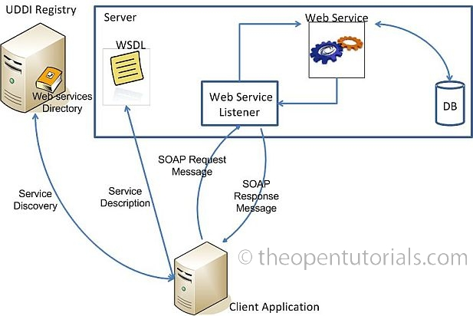

Slide 75
WSDL
This markup language is used to create a WSDL definition that defines the application programming interface (API) of a Web service, including its individual operations (functions) and each operation’s input and output messages.
This can be read by any application.
It is used to describe the web service. This description is required so that client applications are able to understand what the web service actually does.
It contains the following elements
<types> - Defines the XML schema data types used by the web service.
<message> - Defines the data elements for each operation.
<porttype> - Describes the operations that can be performed and the message involved.
<binding> - Defines the protocol and data format for each port type.

Slide 76
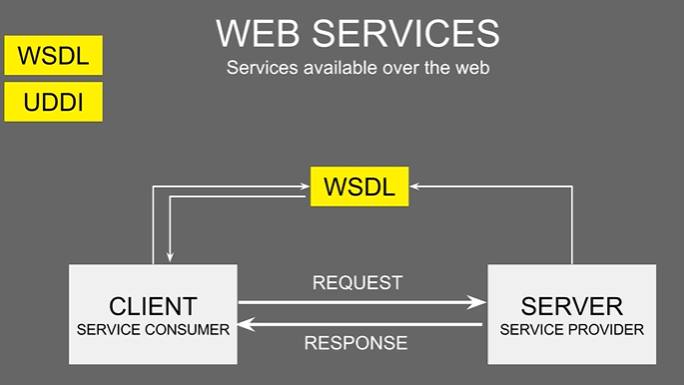

Slide 77
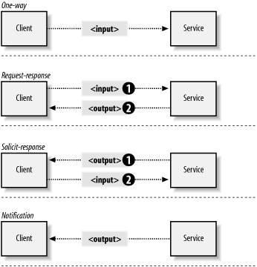
WSDL Operations
One-way: The operation can receive a message but will not return a response
Request-response: The operation can receive a request and will return a response
Solicit - response: The operation can send a request and will wait for a response
Notification: The operation can send a message but will not wait for a response

Slide 78
SOAP
SOAP is a lightweight protocol for the exchange of information in a decentralized, distributed environment.
It is an XML based protocol for accessing web services over HTTP.
SOAP is designed to be platform independent and is also designed to be operating system independent. So the SOAP protocol can work any programming language based applications on both Windows and Linux platform.
It has the following components.
<Envelope>
<Header>
<Body>
<Fault>

Slide 79
XML Schema
Messages exchanged by Web services must be expressed using XML.
XML schema defines the elements, attributes and data types.
XML schemas are created to define the data structure of the XML-based input and output messages exchanged by Web services.
XML schemas can be directly linked to or embedded within WSDL definitions.

Slide 80
UDDI
UDDI (Universal Description, Discovery, and Integration) is an XML-based registry for businesses worldwide to list themselves on the Internet.
Containing data about the web administrators.
UDDI is based on a common set of industry standards, including HTTP, XML, XML Schema, and SOAP.
It provides an infrastructure for a Web Services-based software environment for both publicly available services and services only exposed internally within an organization.
It consists of 3 directories.
UDDI white pages- Basic details of company.
UDDI yellow pages – Detailed business Data.
UDDI green pages – Information about company’s key business processes.

Slide 81
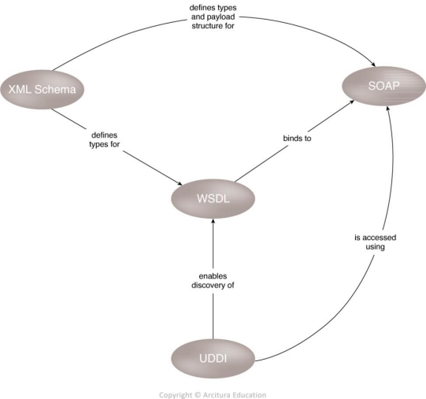
An overview of how first-generation Web service technologies commonly relate to each other

Slide 82
REST(Representational state transfer) Services
REST is a way to access resources which lie in a particular environment.
Designed for loosely coupled web applications.
Represents in Json file format.
It transfer the representation of the state of the resource(REST).
For example, you could have a server that could be hosting important documents or pictures or videos. All of these are an example of resources. If a client, say a web browser needs any of these resources, it has to send a request to the server to access these resources. Now REST services defines a way on how these resources can be accessed.
Facebook, Twitter, and Google expose their functionality in the form of Restful web services. This allows any client application to call these web services via REST.

Slide 83
REST Principles and constraints
Client server-The client send’s a request to the web service on the server. The server would either reject the request or comply and provide an adequate response to the client.
Stateless – Client sends the request to server. Then the server immediately process the response. But the server should not maintain any sort of information between requests from the client.
Cache Some time the client sends same request again. This request will got to server then server take as new request and process that request. It increases the network traffic. So cache is needed.
Layered System Middle layer is inserted between the client and actual server hosting the RESTful web service.
Interface /Uniform Contract This is the underlying technique of how RESTful web services should work. RESTful works on HTTP that uses the following methods
GET
POST
PUT
DELETE
Code in Demand In addition to the data the servers can provide executable code to client.

Slide 84
Service Agents
Service agents are event-driven programs designed to intercept messages at runtime.
There are 2 types of service agents, but common in cloud environment.
Active agents:
Active service agents perform an action upon intercepting and reading the contents of a message.
The action typically requires making changes to the message contents (most commonly message header data and less commonly the body content) or changes to the message path itself.
Passive agents
They do not change message contents.
They read the message and may then capture certain parts of its contents, usually for monitoring, logging, or reporting purposes.

Slide 85
Cloud-based environments rely heavily on the use of system-level and custom service agents to perform much of the runtime monitoring and measuring required to ensure that features, such as elastic scaling and pay-for-use billing, can be carried out instantaneously.

Slide 86
Service Middleware
Middleware platforms that evolved from messaging-oriented middleware (MOM) platforms used primarily to facilitate integration, to sophisticated service middleware platforms designed to accommodate complex service compositions.
The two most common types of middleware platforms are
Enterprise service bus (ESB)
The ESB encompasses a range of intermediary processing features, including service brokerage, routing, and message queuing.
orchestration platform.
Orchestration environments are designed to host and execute workflow logic that drives the runtime composition of services.

Slide 87
DTGOV Case Study
DTGOV has assembled cloud-aware infrastructures in each of its data centers, which are comprised of the following components:
Tier-3 facility infrastructure, which provides redundant configurations for all of the central subsystems in the data center facility layer.
Redundant connections with utility service providers that have installed local capacity for power generation and water supply that activates in the event of general failure.
An internetwork that supplies an ultra-high bandwidth interconnection between the three data centers through dedicated links.
Redundant Internet connections in each data center to multiple ISPs and the .GOV extranet, which interconnects DTGOV with its main government clients.
Standardized hardware of higher aggregated capacity that is abstracted by a cloud-aware virtualization platform.

Slide 88
Contin..
Physical servers are organized on server racks, each of which has two redundant top-of-rack router switches (layer 3) that are connected to each physical server.
These router switches are interconnected to LAN core-switches that have been configured as a cluster.
The core-switches connect to routers that supply internetworking capabilities and firewalls that provide network access control capabilities.
A view of the server network connections inside the DTGOV data center.
A view of the storage system network connections inside the DTGOV data center.
A view of how two data center are connected each other in DTGOV

Slide 89
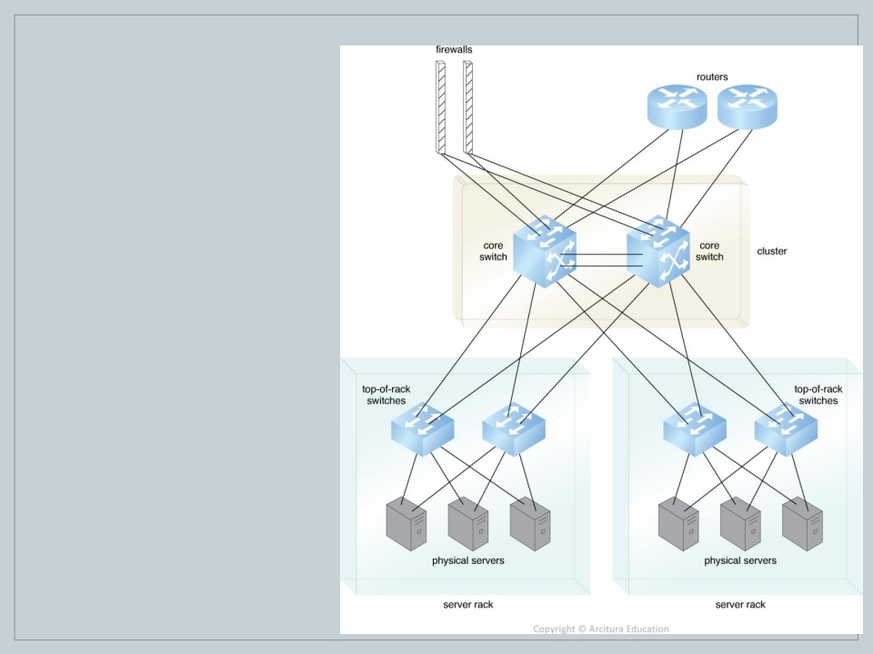
Figure - A view of the server network connections inside the DTGOV data center.

Slide 90
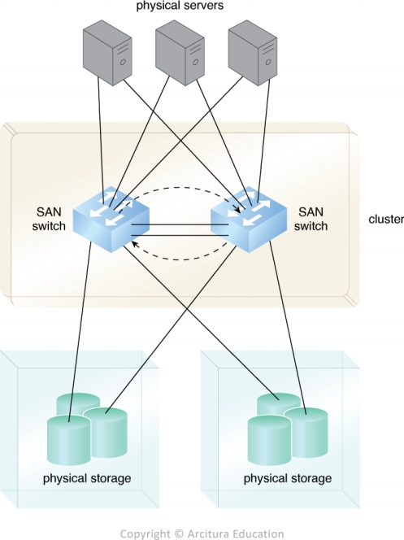
A view of the storage system network connections inside the DTGOV data center

Slide 91
