Slide 1
Integrated TPRM Oversight Deck
Cadence Financial Group - Governance & Third-Party Assurance Program
Executive Contact: Oliver Vance (o.vance@cadencefg.example, +1 (555) 998-1100)

Slide 2
Vendor Assessment Matrix
Vendor Name | Category | Relationship Lead | Contact Email
CloudStorage Pro | Hosting | Penelope Cruz-Wood | p.cruzwood@cloudstorage.example
SecureAuth IDP | IAM & SSO | Quentin Blake | q.blake@secureauth.example
Apex Core Ledger | Core Banking | Rohan Mehta | r.mehta@apexledger.example

Slide 3
Incident Management Cells
Incident Lead: Samantha Sterling
Email: s.sterling@cadencefg.example | Mobile: +1 (555) 998-1122

Slide 4
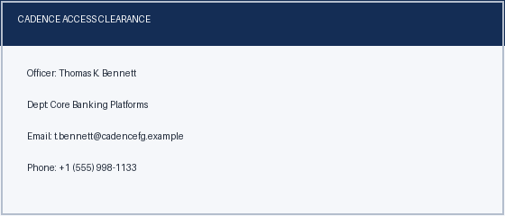
Security Authorization & Credential Verification

Slide 5
Risk Metrics & Performance

Slide 6
Governance Conclusions & Next Steps
Annual TPRM compliance report ready for Board Audit Committee submission.
Notes:
Slide Note: Final review conducted by Ursula Klein (u.klein@cadencefg.example, +1 (555) 998-1144). Approval logged in Governance Register.

