Slide 1

ANNAMACHARYA INSTITUTE OF TECHNOLOGY AND SCIENCES, RAJAMPET
(AN AUTONOMOUS INSTITUTION)
DEPARTMENT OF ARTIFICIAL INTELLIGENCE AND DATA SCIENCE
A Project Review on
LEAF CLASSIFIER: DEVELOPING A PLANT SPECIES IDENTIFICATION
MODEL WITH TRANSFER LEARNING
Under the Esteemed Guidance of
Mr P.Nagendra M.Tech
Assistant Professor,
Dept. of AI&DS,
AITS, Rajampet
Presented by
K.Nikhil Reddy (20701A3029)
M.Bhaskar Reddy (21705A3001)
S.Uzzair Mahaboob (20701A3046)
B.Krishna Reddy (20701A3020)

Slide 2
CONTENTS
Abstract
Introduction
Existing System
Problem statement
Disadvantages
Proposed System
Advantages
Work Flow Diagram
Hardware & Software Requirements

Slide 3
ABSTRACT
This project uses deep learning techniques, specifically the VGG19 model in TensorFlow, to efficiently identify plant species based on their visual characteristics.
The system categorizes plants into seven types, including crops, fruits, industrial plants, medicinal plants, nuts, tubers, and vegetable plants.
The project's success is measured by metrics like accuracy, precision, recall, F1-score, and user feedback.
The user-friendly application provides real-time identification results and information on plant uses in healthcare.
The system is designed with scalability in mind, allowing for the inclusion of more plant species and categories in the future as the dataset and knowledge base expand

Slide 4
INTRODUCTION
This project harnesses deep learning techniques, specifically the VGG19 model in TensorFlow, to revolutionize the identification of plant species based on their visual features.
It encompasses a comprehensive spectrum of plant types, categorizing them into seven distinct groups, ranging from essential crops to medicinal herbs.
To measure its success, the project employs a wide array of metrics, including accuracy, precision, recall, F1-score, and the valuable feedback of real users.
Beyond mere identification, the user-friendly application also serves as an educational resource by providing insights into the practical applications of identified plants in healthcare.
In a world where botanical diversity is vital for agriculture and healthcare, this project emerges as a powerful tool for quick and accurate plant species identification, thanks to the advances in deep learning technology.

Slide 5
PROBLEM STATEMENT
The precise and effective identification of distinct plant species based on visual traits is the main issue that the research seeks to address. The goal of the project is to create a strong system capable of classifying plant images into seven different categories, including crops, fruits, industrial plants, medicinal plants, nuts, tubers, and vegetable plants. It does this by utilizing the power of deep learning, specifically the VGG19 model in TensorFlow. The goal is to develop a trustworthy tool that can help scientists, farmers, and environmentalists quickly and accurately identify plant species for agricultural, conservation and ecological purposes, as well as provide insightful information about their potential uses in medicine and other areas.

Slide 6
EXISTING SYSTEM
Traditional methods of plant species identification have relied on Convolutional Neural Networks (CNNs) within the domain of Machine learning. These CNNs are trained on labeled images, allowing them to extract and analyze visual information effectively.
Through the process of training, CNNs become proficient in learning distinctive features from image data, which is crucial for distinguishing various plant species accurately.
One of the significant advantages of this approach is its ability to rapidly classify plant species, making it a promising technology for revolutionizing plant species identification.
The application of CNNs in plant species identification has the potential to offer valuable support to botanists, researchers, and conservationists. It aids in their efforts to better understand and preserve the diverse array of plant species in our ecosystem.
This technology bridges the gap between advanced deep learning techniques and the field of botany, enhancing the capacity to identify and conserve plant species efficiently.

Slide 7
DISADVANTAGES
Dependency on labeled data for training, which can be time-consuming and costly. Suffers an expensive cost processing search
Limited ability to generalize to unseen or novel plant species.
Sensitivity to variations in image quality, affecting accuracy.
Lack of fine-grained information about specific plant attributes or parts.

Slide 8
PROPOSED SYSTEM
In this study, a dataset is divided into seven different categories of plants: crops, fruits, industrial plants, medicinal plants, nuts, tubers, and vegetable plants.
The VGG19 model in the TensorFlow framework then improves accuracy by extracting nuanced information from pictures, and CNN is used to identify the species of plants
The system forecasts plant species and offers thorough details on their advantages, uses, and possible applications.
This method aids decision-making in a variety of sectors for researchers, medical professionals, and environmentalists.

Slide 9
ADVANTAGES
Enhanced Accuracy in Plant Identification
Comprehensive Information on Plant Species.
Wide Applicability Across Various Sectors.
Facilitating Informed Decision-Making.
Support for Researchers in Botany and Agriculture.
Valuable Resource for Medical Professionals.

Slide 10
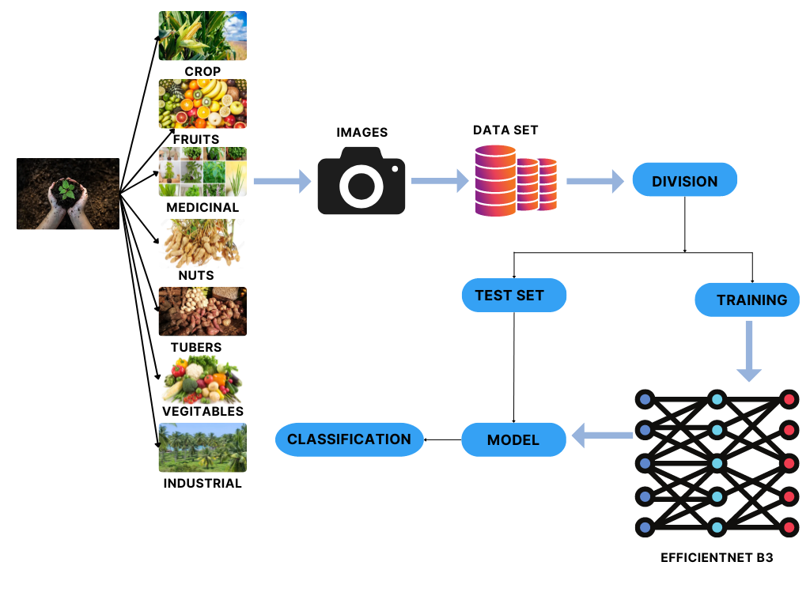
WORK FLOW DIAGRAM
VGG19

Slide 11
HARDWARE REQUIREMENTS
Hardware requirements shows what the system does and not how it should be implemented.
Processor : Intel Core i5 or equivalent
Hard disk : 250 GB or higher
RAM : 4 GB(minimum)
GPU : NVIDIA GeForce GTX series
Keyboard : 110 keys enhanced

Slide 12
SOFTWARE REQUIREMENTS
Software requirements is useful in estimating cost, planning team
Operating system : Windows 10
Model : CNN (VGG19)
Framework app : Streamlit
Coding Language : Python
Database : SQL
Software Tool : Google Colab or Jupiter NoteBook

Slide 13


