Slide 1

DEVIATHON 2.0
National Level Hackathon | GLA University, Mathura
TITLE PAGE
Problem Statement Title – Proctoring that does not punish a shared room
PS Number – [ enter PS number ]
Organisation – Integraminds
Theme / Track – Mission Bharat / Software
Team Name – [ enter team name ] Team ID – [ enter team ID ]
Team Member Names – [ enter names of all members ]
Contact – [ team lead e-mail · phone ]
Our solution: FairProctor
An integrity score that treats the room as context and only behaviour as evidence — a ranked review queue with time-stamped proof, reasons and appeal for every candidate, and a phone pre-check.
Notes:
(15 s) We are [team]. Our problem statement from Integraminds, under Mission Bharat, is proctoring that punishes candidates for their room instead of their behaviour. Our solution, FairProctor, separates the environment from what the candidate actually does, ranks the review queue with evidence, explains every flag to the candidate, and helps them fix the camera before the test starts.

Slide 2









PROBLEM UNDERSTANDING
[Team Name]
Today's rules flag the room, not the cheating
Our reading of the problem statement
Existing solutions and the gap
IMAP's webcam and browser rules (two faces, looking away, no face, tab switch, paste) assume one person in a bright room on broadband. Shared homes, cyber cafés and phones on 2G raise hundreds of flags that are mostly noise; the commonest real method, a second phone below the camera, raises none. Goal: score behaviour, not the room; rank the queue with evidence; explain results; cut flags with a phone pre-check.
Approach | Where it fails our users
Rule-based webcam flags | Every frame is a flag: dim rooms, phones and 2G raise the most; a phone under the camera raises none
Face / gaze deep models | Trained on lab video, need GPU and clear frames; at 2G resolution an eye is ~9 px wide
Live human proctors | Expensive; cannot scale to lakhs of candidates in one window
Code plagiarism tools | Similarity only — no behaviour, no context, no explanation
Who it hurts, and how they will use FairProctor
Candidates from small towns and rural areas
Pain: rejected for their room, never told why, no way to appeal.
Use: phone pre-check → test on 2G → result with reasons → appeal on exact moments.
The gap: nothing separates environment from behaviour, uses camera-free signals (timing, focus, paste, shared wrong answers), shows the evidence, or lets candidates answer back.
Assessment reviewers
Pain: hundreds of flags per test; cannot watch them all, so honest people fail and cheaters pass.
Use: ranked queue → evidence timeline → confirm / clear in minutes.
Constraints we design for (PS guardrails)
Companies and universities
Pain: results they cannot trust or defend.
Use: live monitor, close & score, fairness report for every sitting.
CPU-only scoring
DPDP Act 2023
2G, phones
No face recognition*
No sensitive inference**
English + हिन्दी
* only matching the candidate to their own ID photo ** no gender, religion, caste or region
Notes:
(45 s) The rules were tuned for one person in a bright room on broadband. Real candidates test from shared homes, cyber cafes, on phones over 2G. On our own shared-room test videos a flag-everything proctor raised 120 to 390 alerts an hour — none of it cheating. Meanwhile the most common real method, a second phone below the camera, raises nothing. Three groups pay: candidates from small towns who are rejected for their room and never told why; reviewers who cannot watch every flag; and the companies and universities who cannot trust the results. Existing tools either count frames, need clear video and GPUs, or don't scale. Our constraints: CPU scoring, DPDP Act, no face recognition beyond the ID match, no sensitive inference, and 2G phones.

Slide 3
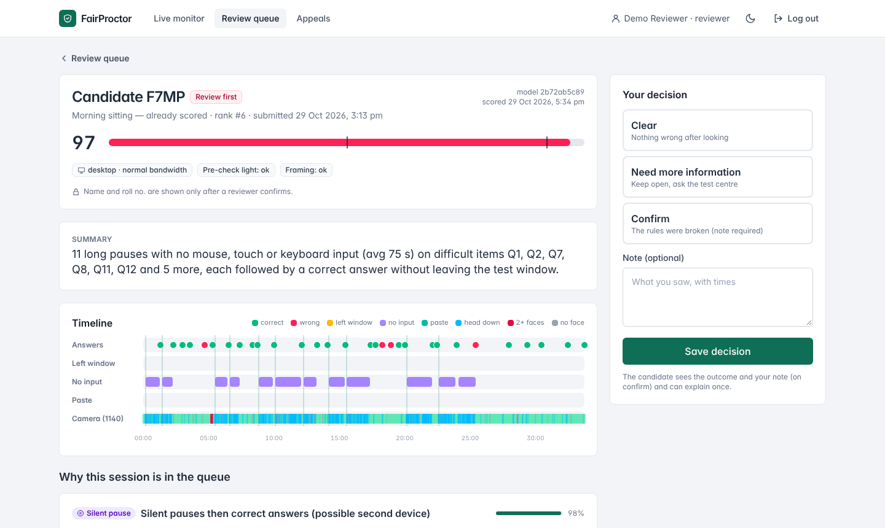



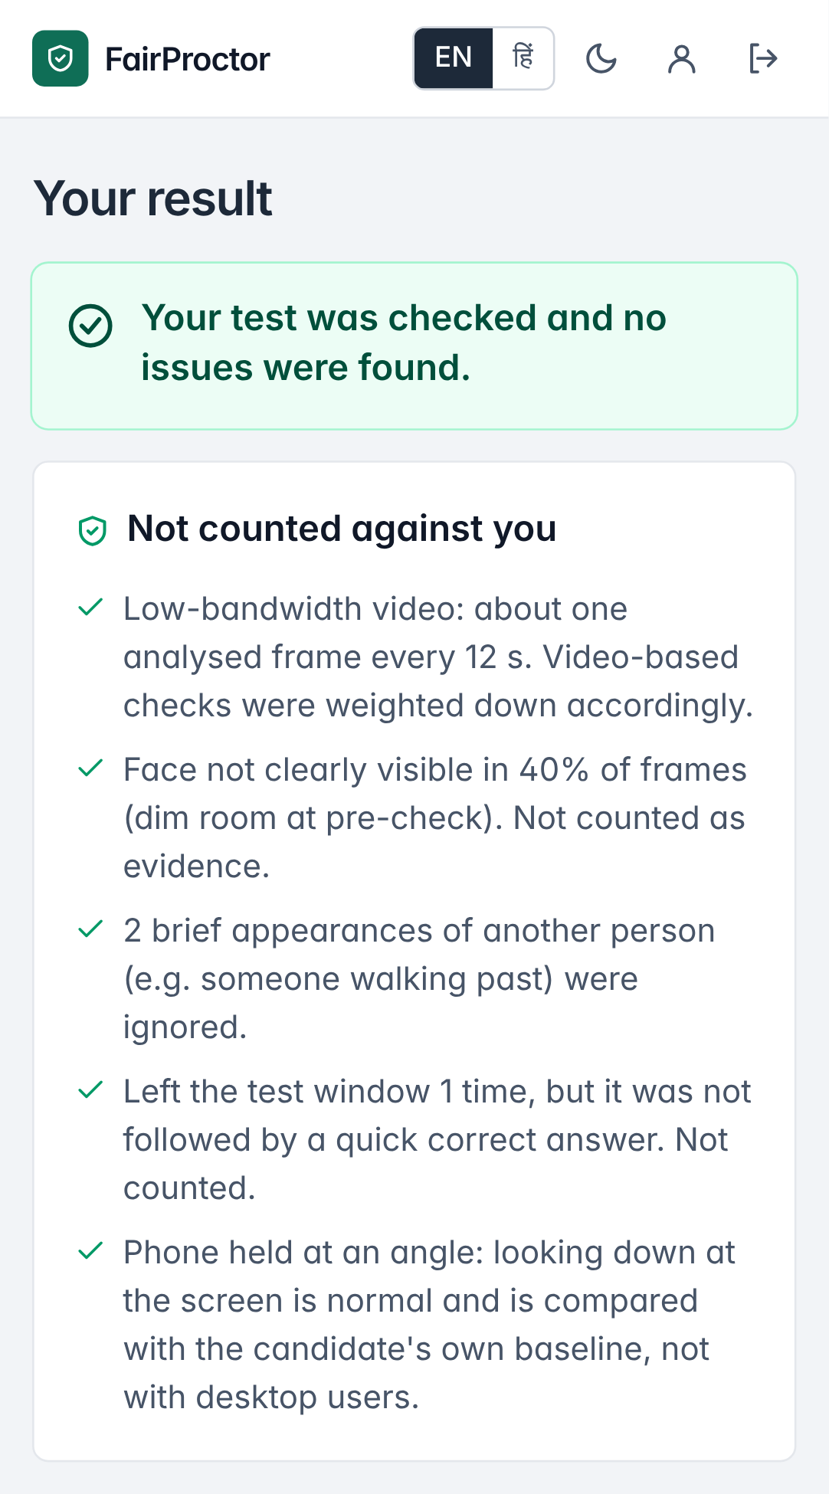
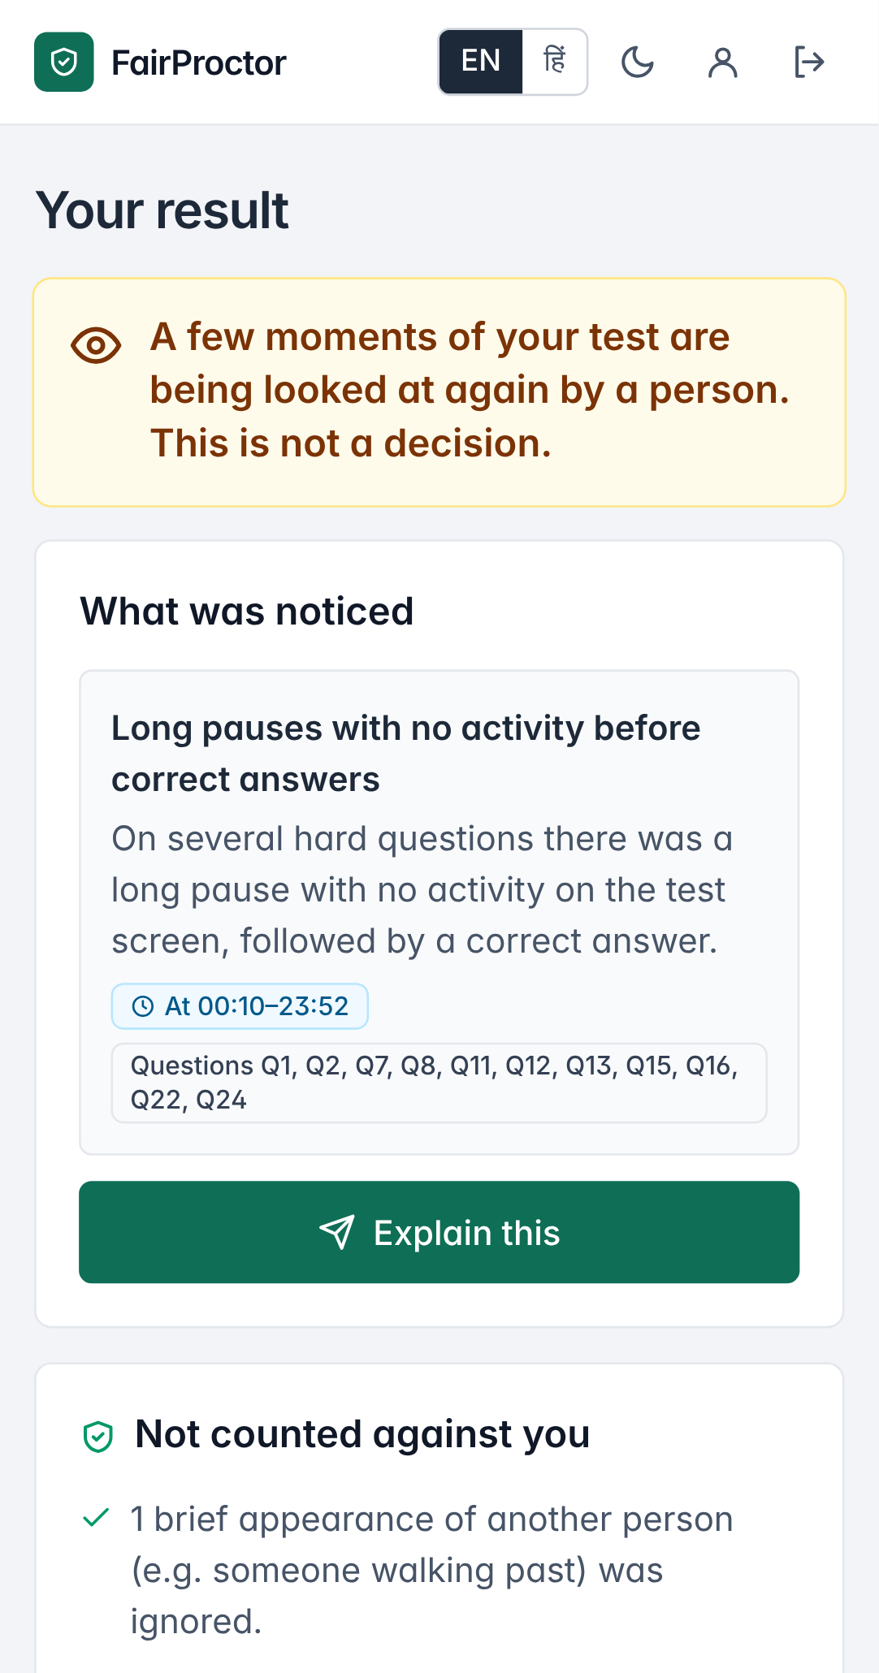
PROPOSED SOLUTION
[Team Name]
FairProctor: the environment is context, behaviour is the evidence
1 Environment-neutral score
2 Camera-free signals find the second phone
Light, blur, frame rate and face visibility only change how far video is trusted — they can never add suspicion. Missing video = no evidence. Bandwidth and device are not model inputs at all.
Silent pause (no touch, no keys) on a hard item → correct answer; head-down vs the candidate's own baseline; timing vs ability; rare wrong answers shared across candidates; paste length.
3 Ranked queue, every flag with proof
4 Candidates can see it and answer back
“Review first” band for the likeliest cases. Each flag links to its moments: “11 long pauses on Q1–Q24, each followed by a correct answer; head down 76% vs 5%”.
Result shows what was noticed and what was NOT counted (English / हिन्दी); appeal against exact moments. A phone pre-check fixes light and framing before the clock starts.
Also built: coding tests (Python, C++, Java, JS; MOSS-style code similarity + typing patterns) · live monitor with alerts · fairness report per sitting · audit log
Reviewer console: Rahul (second phone) — score 97, Review first, with the moments
Candidate view (phone)
Priya — honest, 2G, dim shared room: cleared, with 5 things not counted. Old rules ranked her #9 of 202.
Rahul — told what was noticed; can ‘Explain this’.
Expected outcome (measured on the labelled sample)
6% → 91.5%
95% vs 47%
+3 vs +44
6% of sessions (“Review first”) hold 91.5% of all cases, at 90% precision
precision of the first 100 reviewed: ours vs old rules
pts extra flagging of honest 2G candidates: ours vs old rules
Notes:
(60 s) Four ideas. One: the environment only changes how much we trust the video; it can never add suspicion, and missing video is no evidence. Bandwidth and device are not even model inputs. Two: the signals that carry the weight don't need a camera — a silent pause with no input on a hard question followed by a correct answer is the fingerprint of a second phone; we also use timing against the candidate's ability and rare wrong answers shared between candidates. Three: the reviewer gets a ranked queue, and every flag links to the exact moments. Four: the candidate sees what was noticed and what was not counted, and can appeal against a moment. Example from our demo: Priya, honest, on 2G in a dim shared room — the old rules rank her ninth of 202; we clear her. Rahul, with a second phone — the old rules rank him around 82nd; we put him sixth, in Review first, with the evidence.

Slide 4


TECHNICAL APPROACH
[Team Name]
Architecture, workflow and scoring algorithm
Candidate device
FastAPI backend (CPU)
Scoring engine
Reviewer console
Candidate result
React, phone-first, EN/हिं
Pre-check: light, backlight, face, sharpness, speed
Answers, timing, focus, paste length
On-device face detector → numbers only, ~every 5 s
Offline queue: 2G-safe resend
HTTPS + JWT, 3 roles
Idempotent event ingest (sequence no.)
PostgreSQL event store
Live re-score every 45 s
Close & score a whole sitting
1 Features → episodes, not frames
2 Answer match across sitting (rarity, both sides, rings)
3 Gradient-boosted trees, monotonic
4 Subtract environment-only effect
5 Isotonic calibration → bands
Ranked queue + filters
Evidence timeline, moments
Confirm / clear / need more
Appeals, live monitor
Fairness report per sitting
What was noticed, when
What was NOT counted
Appeal on exact moments
Coding marks
Retention: 90 days
Scoring algorithm (CPU, explainable)
Technology stack and why
score = f(behaviour, env) − [ f(honest, env) − f(honest, typical env) ]
Layer | Choice | Why
Frontend | React 19 + TypeScript + Tailwind | Phone-first, offline queue, Hindi, light/dark
Backend | FastAPI (Python) | Same language as the ML; typed validation; API docs
Data | PostgreSQL (SQLite for local) | Reliable, free tiers (Neon)
ML | scikit-learn gradient boosting | Trains in 10 s, 0.04 ms/session on CPU
Vision | Browser FaceDetector / MediaPipe | Runs on the phone; no images leave it
Security | JWT (HS256) + scrypt hashes | Revocable logins; candidate/reviewer/admin
Monotonic constraints: more behavioural evidence can never lower the score
Environment subtraction: a dark room or 2G can lower trust in video, never raise the score
Explanations: per-feature contribution + the time-stamped moments behind it
Bands: Review first (≥90% precision) · Review · Cleared; humans decide
Validated: 5-fold cross-validation grouped by sitting (no leakage)
Privacy by design: numbers, not images · paste length, not text · no bandwidth or device in the model
Notes:
(50 s) The phone does the camera work: it sends numbers every few seconds — faces in view, face visible, head direction, brightness — never images. Answers, timing, focus and paste length go through an offline queue that is safe on 2G. The FastAPI backend stores events and scores on CPU. Shared answers need the whole sitting, so final scoring runs at close; a live monitor reruns the same model every 45 seconds. The core trick is the environment subtraction: we take the score and subtract what the environment alone would add for an ordinary candidate, so a dark room can lower trust in video but never raise the score. Gradient-boosted trees with monotonic constraints, isotonic calibration, and per-feature explanations. Stack: React, FastAPI, PostgreSQL, scikit-learn — all on CPU.

Slide 5



FEASIBILITY AND VIABILITY
[Team Name]
Already built, tested and measured — and every risk has a plan
37
6
0.04 ms
1 frame / 5 s
Implementation plan and milestones
24–25 Oct Done
Scoring engine + evaluation on 5,000 labelled sessions; checks on 5 public datasets
backend tests pass on SQLite and PostgreSQL
browser test suites (Playwright), end to end
to score a session on CPU; training 10.5 s
still usable: AUC 0.9915 vs 0.9918
Key risks / assumptions → mitigation
26–27 Oct Done
Web app: FastAPI + PostgreSQL + JWT roles; React candidate flow, reviewer console, live monitor
Risk / assumption | Mitigation
Model trained on synthetic data (real IMAP data not shared yet) | Pilot kit with secret roles and a sealed key; map IMAP schema and retrain — every number regenerates
Honest look-alike answers flagged | Rarity weighting, checked from both sides; human decides; candidate appeals with moments
2G drops data mid-test | Answers saved on the phone; resend; idempotent ingest by sequence number
Privacy / DPDP | Consent screen; numbers not images; paste length not text; 90-day deletion; no sensitive inference
Code-runner abuse | CPU, memory, output limits; unprivileged user; jail (nsjail / Judge0) at scale
Copying with no timing trace | Stated as a known limit; reviewer uses outside evidence
27–29 Oct Done
Coding tests, fairness report, demo story, Docker + CI, pilot kit (rehearsal passed)
Before Round 2 Next
Real pilot with 10–20 people (‘hostel pilot’ set up); deploy on Render + Neon + Vercel; demo video
After the event Later
Map the IMAP schema, retrain on real verdicts; per-client thresholds; cross-sitting rings; ID-photo match
Viability: CPU only — scoring a 5,000-session sitting takes under a second; a pilot runs on free tiers. Fits IMAP as an API or as a reviewer console; per-assessment pricing.
Notes:
(45 s) This is not just an idea: it is built and tested — 37 backend tests on SQLite and PostgreSQL, six browser suites, CPU scoring at 0.04 ms a session, and it still works when video drops to one frame every five seconds. The biggest assumption is that our labelled sample is simulated, because the IMAP data was not available. So we built a pilot kit — real people, secret role cards, a sealed key — and the pipeline retrains on the IMAP data as soon as the schema is mapped. Other risks: honest look-alike answers (rarity weighting, human decision, appeal), 2G drops (offline queue), privacy (DPDP by design), and code-runner abuse (limits, a jail at scale). Next: the real pilot, deployment and the demo video.

Slide 6


IMPACT AND BENEFITS
[Team Name]
Value created — measured against the PS “Done when”
PS “Done when” | Our result (out of fold)
Cut the review queue by ≥ half, surfacing every confirmed case | All 294 cases in the top 44.9% → 55% cut (old rules flag 100%)
Every flag links to its moments | 100% of queued sessions have time-stamped moments and a written reason
Usable at one frame every 5 s | AUC 0.9915 (full video 0.9918); every confirmed case still caught
Phone pre-check in plain language | Built: light, backlight, framing, sharpness, connection; EN + हिन्दी; tested at 390 px
False-flag rate by bandwidth | Low 48.4% vs normal 45.3% (old rules at same workload 76.4% vs 32.6%)
Out-of-fold results on the 5,000-session labelled sample (synthetic, as the IMAP data was not shared). Real-pilot numbers will be added after the pilot.
Who benefits
Candidates — social
Reviewers — economic
Institutions — trust
Mission Bharat
An honest 2G candidate is treated like one on broadband (+3 pts, not +44). Reasons, appeal and Hindi build trust; the pre-check prevents flags.
Start with 6% of sessions that hold 91.5% of cases; a 55% smaller queue; evidence to read instead of hours of video.
Decisions they can defend: a fairness report per sitting, audit log, DPDP by design, cheap CPU scoring.
Fair access to jobs and admissions for small-town and rural India, without buying a better room or connection.
Notes:
(45 s) Against every 'Done when' item: the queue is cut by 55% while every confirmed case is still in it; every flag has its moments; the score holds at one frame every five seconds; the pre-check runs on a phone; and the false-flag rates are reported separately — 48 versus 45 percent for us, 76 versus 33 for the old rules at the same workload. The judges weight the top of the queue: of the first 100 sessions we send, 95 are real cases, against 47 for the old rules. For candidates that means an honest 2G candidate is treated like a broadband one; for reviewers, 6% of sessions hold 91% of the cases; for institutions, decisions they can defend.

Slide 7
RESEARCH AND REFERENCES
[Team Name]
Every design choice was checked on real public data
Dataset [ref] | What we found | Design decision
Students suspicious behaviours [2] | A lab-trained model (AUC 0.999) calls honest head-down or a passer-by cheating with ~100% certainty | Never train on lab frames; camera is weak evidence
Cheating Scenario Dataset [1] | At 2G resolution (160×120) an eye is ~9 px wide; old ‘move closer’ rule nagged 36% of good frames | No gaze; coarse head direction vs own baseline; framing rule 13%
EdNet-KT1 (6 lakh answers) [3] | Synthetic timing matches real learners; 17% of honest tests have 4+ fast correct answers | Timing alone never flags
ESC-50 + MUSAN audio [4][5] | Detector hears 87% of speech but fires on 23% of home/street sounds | Audio is opt-in and only supporting
Our 3 shared-room videos | Flag-everything proctor: 120–390 alerts/hour; FairProctor: 0 | Count a 2nd person only if 25 s+ while answering
References
[1] Cheating Scenario Dataset in Online Exam, Mendeley Data, doi:10.17632/mjrfmvsh7d.1 (CC BY 4.0)
[2] Students Suspicious Behaviors Detection Dataset, Mendeley Data (CC BY 4.0)
[3] Choi et al., EdNet: A Large-Scale Hierarchical Dataset in Education, AIED 2020 — github.com/riiid/ednet (CC BY-NC 4.0)
[4] K. J. Piczak, ESC: Dataset for Environmental Sound Classification, ACM MM 2015 (CC BY-NC 3.0)
[5] D. Snyder, G. Chen, D. Povey, MUSAN: A Music, Speech, and Noise Corpus, arXiv:1510.08484, 2015
[6] F. Pedregosa et al., Scikit-learn: Machine Learning in Python, JMLR 12, 2011
[7] S. Schleimer, D. Wilkerson, A. Aiken, Winnowing: Local Algorithms for Document Fingerprinting (MOSS), SIGMOD 2003
[8] G. Rasch, 1960 (ability model); E. B. Wilson, JASA 1927 & R. G. Newcombe, Stat. Med. 1998 (intervals)
[9] Digital Personal Data Protection Act, 2023, Government of India
[10] Integraminds, PS “Proctoring that does not punish a shared room”, Deviathon 2.0
[11] Software: React, TypeScript, Vite, Tailwind CSS, FastAPI, PostgreSQL, pandas, NumPy, PyJWT, highlight.js, Playwright (open-source licences)
[12] Face detection: browser FaceDetector API; MediaPipe Tasks Vision (Apache 2.0); YuNet in OpenCV (Apache 2.0)
[13] Icons: Tabler Icons (MIT) via react-icons
[14] Images: all screenshots are from our own FairProctor prototype (demo data; every person is made up); chart from our results
[15] Slide template, Deviathon 2.0 and GLA University logos: organiser template
Datasets were used only to test design choices, never to train the score. Code, demo and reports: [ GitHub repository link ] · analysis scripts in analysis/, reports in reports/.
Notes:
(30 s) We did our homework on real data. A model trained on a lab proctoring dataset calls an honest candidate looking down at their phone a cheater with near certainty — that is the failure the PS describes. At 2G resolution an eye is 9 pixels wide, so we don't use gaze. Real learner timing from EdNet shows fast answers alone are normal, so timing never flags on its own. Audio hears speech but also cows and pressure cookers, so it only supports. All sources, datasets, libraries, icons and images are listed here; every screenshot is from our own working prototype. Thank you.

