Slide 1

International Conference on Smart Systems for applications in Electrical Sciences ICSSES-2024
Siddaganga Institute of Technology, Tumakuru
Association of Electrical Sciences
“Alzheimer’s Disease Detection from MRI
using Histogram of Oriented Gradients and Support
Vector Machine”
By
Nikhil K G
Date: 04/05/2024
Paper ID: 363

Slide 2
Contents
Introduction
Literature Review
Methodology
Results and Discussion
Conclusion
Reference

Slide 3
Introduction
Early detection of AD is a tedious and costly process since a lot of data is required and sophisticated tools are used for prediction.
Automated systems are more accurate than human assessment and are not subject to human errors.
Magnetic Resonance Imaging (MRI) of brain is used as dataset for detection of AD in training ML and DL models.
The performance of the models are measured with parameters like accuracy, precision, recall and f1-score.

Slide 4
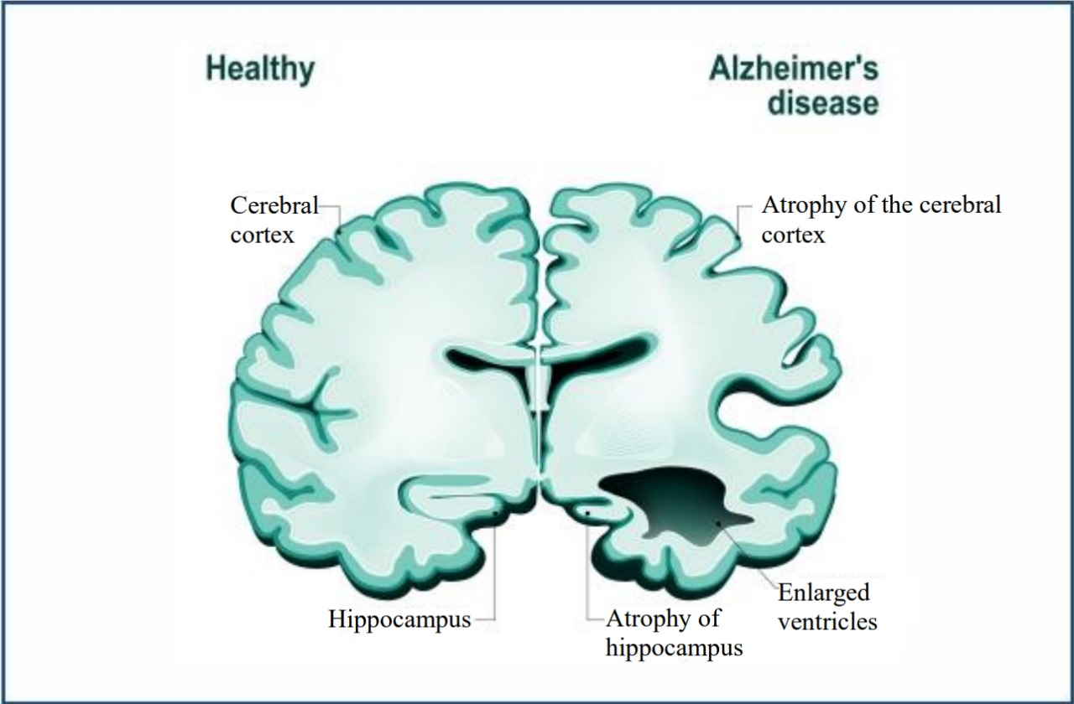
Introduction (Contd…)
Figure 1: The comparison of a healthy brain (left part) and brain with Alzheimer’s disease (right part) (Courtesy: medicoverhospitals.in)

Slide 5
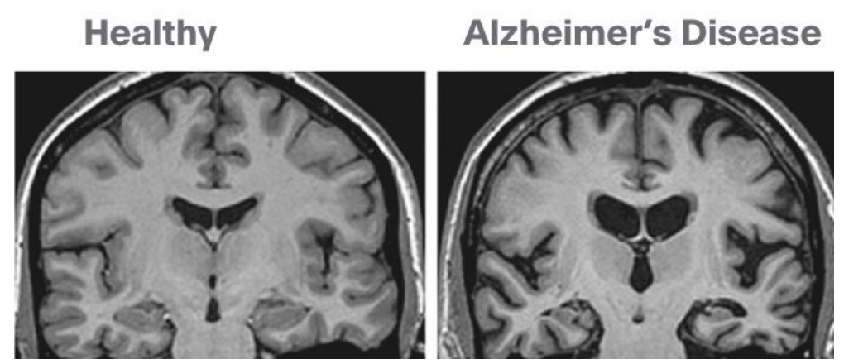
Introduction (Contd…)
Figure 2: The comparison of a healthy brain (left part) and brain with Alzheimer’s disease (right part) (Courtesy: omegapds.com)

Slide 6
Literature Review
Author | Title | Remarks
Kongala Nageswara Rao ,Bakka Rajeev Gandhi ,M Venkateswara Rao , Sravanthi Javvadi , Sai Srinivas Vellela | Prediction and Classification of Alzheimer’s Disease using Machine Learning Techniques in 3D MR Images. 2023 International Conference on Sustainable Computing and Smart Systems (ICSCSS). IEEE, June 2023. | Highlight the impact of early detection on patient care and emphasize the clinical and research importance. Exploring the growing role of machine learning, specifically in the context of 3D MRI scans for accurate Alzheimer's prediction.
Shukla, A, Tiwari, R, Tiwari S. | Review on Alzheimer Disease Detection Methods: Automatic Pipelines and Machine Learning Techniques. Sci , vol 5, March 2023. | Explore modern diagnostic methods, focusing on automated pipelines, machine learning, and multimodal approaches. Address limitations, particularly in distinguishing between AD and MCI, emphasizing the complexities in multi-class classifications.
Dara, O.A, Lopez-Guede, J.M. Raheem, H.I, Rahebi, J, Zulueta, E, Fernandez-Gamiz, U. | Alzheimer’s Disease Diagnosis Using Machine Learning. Applied Sciences , vol 13, July 2023 | Highlights diverse factors, machine learning models, and challenges.

Slide 7
Literature Review
Author | Title | Remarks
Mangala Shetty, Deekshitha, Manisha Bhat, Manisha Devadiga | Detection of Alzheimer’s Disease Using Machine Learning. 2022 International Conference on Artificial Intelligence and Data Engineering (AIDE). IEEE, Dec 2022. | Machine learning algorithms were used in predicting progression from mild cognitive impairment to dementia, offering valuable insights for clinicians and researchers.
Nakul Pranao D, Harish M V, Dinesh C, Sasikala S, Arun Kumar S, | Alzheimer’s Disease Prediction Using Machine Learning Methodologies. 2022 International Conference on Artificial Intelligence and Data Engineering (AIDE). IEEE, Dec 2022. | Different approaches were given in this paper and performance evaluation is measured.
Battineni, Gopi | Improved Alzheimer’s disease detection by MRI using multimodal machine learning algorithms. Diagnostics, vol. 11 Nov. 2021. | Discuss historical reliance on clinical criteria, limitations (85% accuracy), and need for definitive methods. Highlight the paradigm shift using MRI and machine learning for faster, more accurate AD diagnosis.

Slide 8
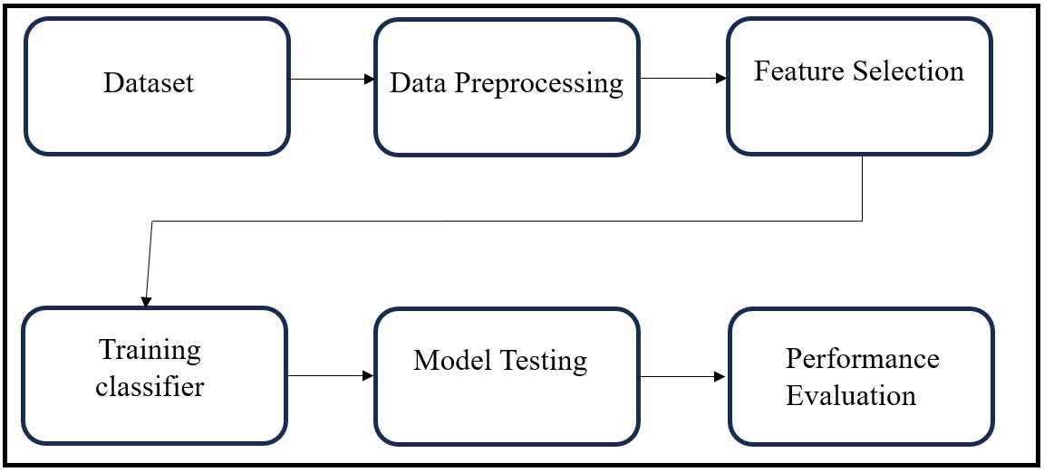
Methodology: ML model using HOG and SVM
Figure 3 : Machine Learning model flow diagram

Slide 9
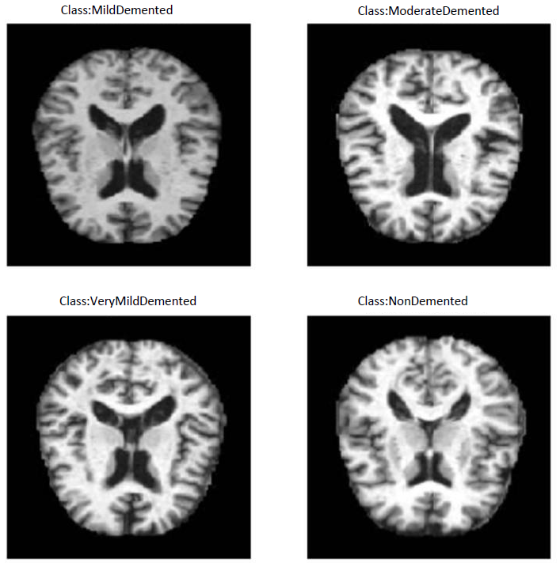
Methodology: ML model (Contd…)
Figure 4 : Four classes of MRI images classified

Slide 10
Methodology: ML model (Contd…)
Data Preprocessing and Feature Extraction (HOG)
Conversion of RGB images into grayscale images.
Histogram of Oriented Gradients (HOG) is used for feature extraction which computes pixel wise gradient and orientation.
HOG stores values in a vector and plots them on a histogram.
Equation 1 and 2 gives the gradient of the pixel present in (x,y) location.
G_{X(x,y)} = I_{(x+1,y)} − I_{(x−1,y)} (Eq 1)
G_{Y(x,y)} = I_{(x,y+1)} − I_{(x,y-1)} (Eq 2)

Slide 11
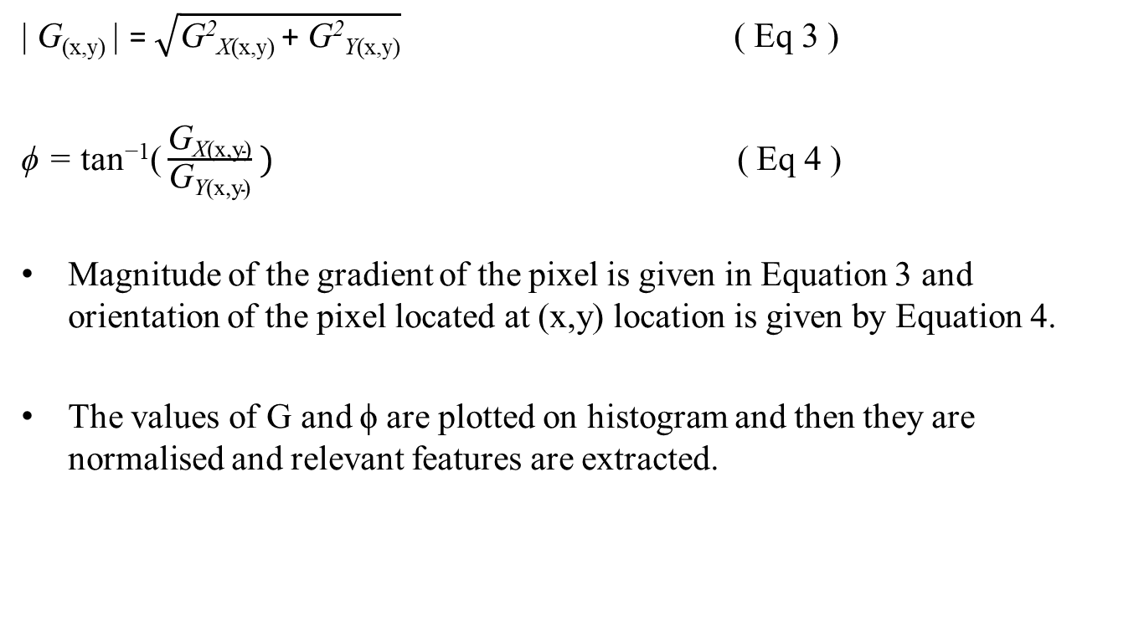
Methodology: ML model (Contd…)
$\text{| }\text{G}\text{(}\text{x}\text{,}\text{y}\text{) | }\text{=} \sqrt{\text{G}\text{2}\text{X}\text{(}\text{x}\text{,}\text{y}\text{) }\text{+ }\text{G}\text{2}\text{Y}\text{(}\text{x}\text{,}\text{y}\text{)}}$ ( Eq 3 )
ϕ = tan⁻¹( $\frac{\text{G}\text{X}\text{(}\text{x}\text{,}\text{y}\text{)}}{\text{G}\text{Y}\text{(}\text{x}\text{,}\text{y}\text{)}} )$ ( Eq 4 )
Magnitude of the gradient of the pixel is given in Equation 3 and orientation of the pixel located at (x,y) location is given by Equation 4.
The values of G and ϕ are plotted on histogram and then they are normalised and relevant features are extracted.

Slide 12
Methodology: ML model (Contd…)
Data splitting
Divide the dataset into training, and testing sets.
Model Training, Performance Evaluation
Support Vector Machine (SVM) classifier is trained on the training data.
The trained model is tested on unseen data to assess its accuracy and effectiveness.
Performance metrics such as accuracy, precision, recall, and F1-score are computed.

Slide 13
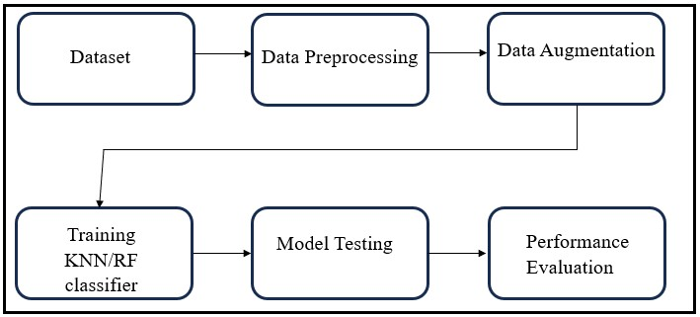
Methodology: ML model (Contd…)
ML model using Random Forest and K-Nearest Neighbor as classifiers.
Figure 6 : Machine Learning model flow diagram

Slide 14
Methodology: ML model (Contd…)
Data Preprocessing and Data Augmentation
Each image is resized to a fixed target size.
Data augmentation techniques including horizontal flipping, random rotation, and random zoom are applied to increase the dataset's diversity.
Augmented images are generated and added to the dataset.
Features extracted from the preprocessed and augmented images are combined.
Labels are assigned to each sample based on the corresponding category of dementia severity

Slide 15
Methodology: ML model (Contd…)
Model Training and Evaluation:
The dataset is split into training and testing sets.
Two classifiers, Random Forest and K-Nearest Neighbors, are trained on the training data.
The trained models are evaluated using various performance metrics such as accuracy, precision, recall, and F1-score.

Slide 16
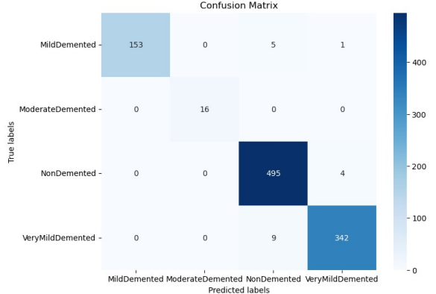
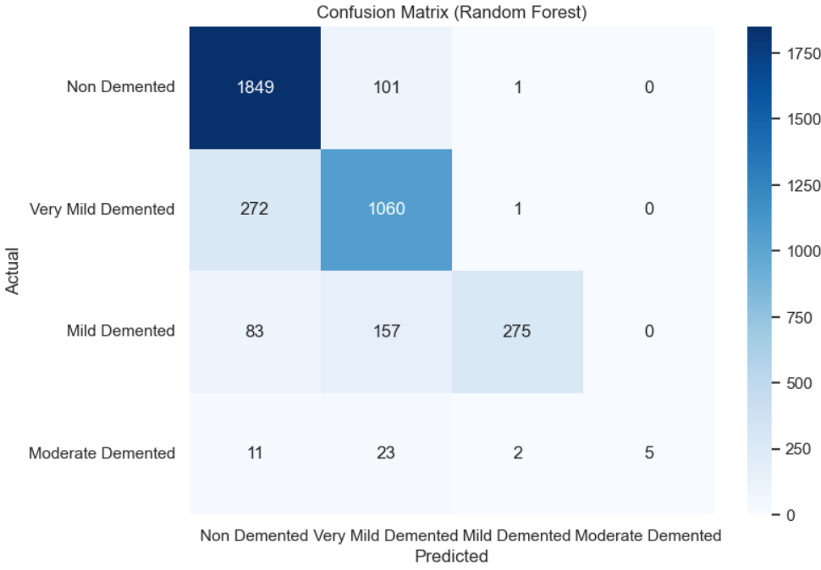
Results and Discussion
Figure 7 : Confusion Matrix of HOG with
SVM as classifier
Figure 8 : Confusion Matrix obtained
using RF as classifier

Slide 17
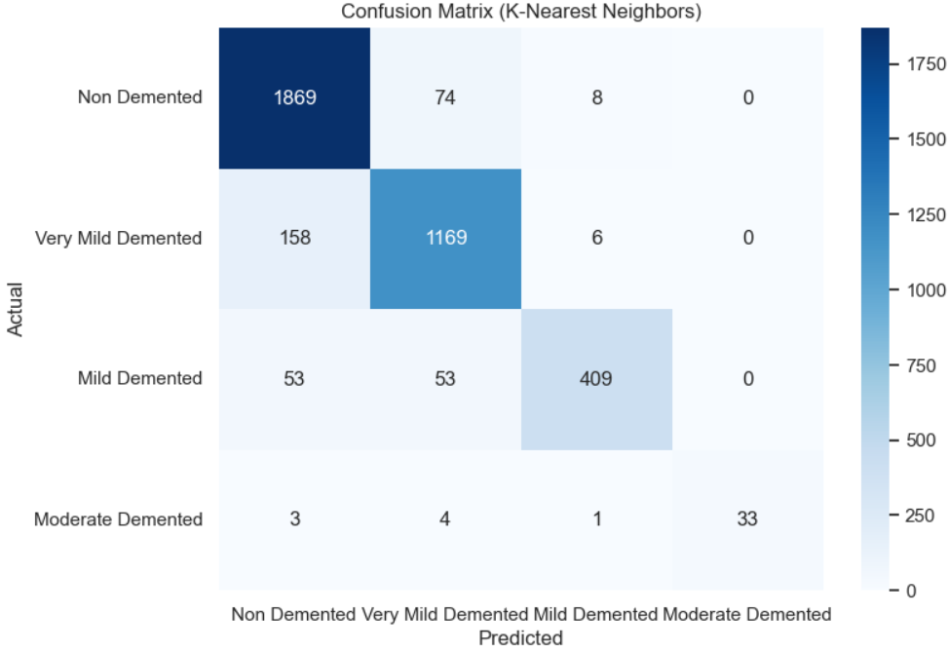
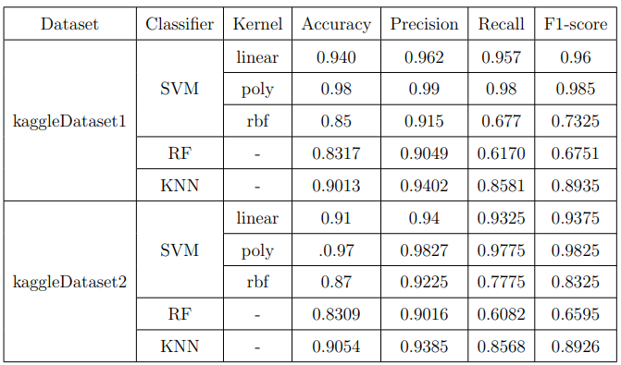
Results and Discussion
Figure 8 : Confusion Matrix obtained
using KNN as classifier.
Table 1: Performance of the ML models that are
tested against two datasets.

Slide 18
Conclusion
Two ML models are developed and compared to achieve better accuracy.
First ML model takes HOG for feature extraction with SVM as classifier.
Second ML model uses RF and KNN as classifiers with data augmentation as additional part for data preprocessing.
HOG with SVM achieves highest accuracy of 98% for kaggledataset1.

Slide 19
References
Shetty, Mangala, Manisha Bhat, and Manisha Devadiga. “Detection of Alzheimer’s Disease Using Machine Learning.” 2022 International Conference on Artificial Intelligence and Data Engineering (AIDE). IEEE, Dec. 2022.
Devvi Sarwinda and Alhadi Bustamam. “3D-HOG Features –Based Classification using MRI Images to Early Diagnosis of Alzheimer’s Disease.” IEEE ICIS 2018, June 6-8, 2018.
Kavitha C, Mani V, Srividhya SR, Khalaf OI, Tavera Romero, “EarlyStage Alzheimer’s Disease Prediction Using Machine Learning Models.” Front. Public Health, Mar. 2022.
Nakul Pranao D, “Alzheimer’s Disease Prediction Using Machine Learning Methodologies.” 2022 International Conference on Computer Communication and Informatics (ICCCI). IEEE, Jan. 2022.
Rao, Kongala Nageswara, et al. “Prediction and Classification of Alzheimer’s Disease using Machine Learning Techniques in 3D MR Images.” 2023 International Conference on Sustainable Computing and Smart Systems (ICSCSS). IEEE, June 2023.

Slide 20
References
Amrutesh, Aniverthy, et al. ”Alzheimer’s Disease Prediction using Machine Learning and Transfer Learning Models.” 2022 6th International Conference on Computation System and Information Technology for Sustainable Solutions (CSITSS). IEEE, Dec. 2022.
Shukla, Amar, Rajeev Tiwari, and Shamik Tiwari. “Review on alzheimer disease detection methods: Automatic pipelines and machine learning techniques.” Sci , vol 5, March 2023.
Basha, SK Masthan, et al. ”A Study and Recognition of Alzheimer’s Disease Using Machine Learning.” 2023 IEEE 8th International Conference for Convergence in Technology (I2CT). IEEE, Apr 2023.
Roobaea Alroobaea, Seifeddine Mechti, Mariem Haoues et al. ”Alzheimer’s Disease Early Detection Using Machine Learning Techniques” Research Square, June 2021.
Shahbaz, Muhammad, et al. ”Classification of Alzheimer’s Disease using Machine Learning Techniques.” Data, July 2019.

