Slide 1
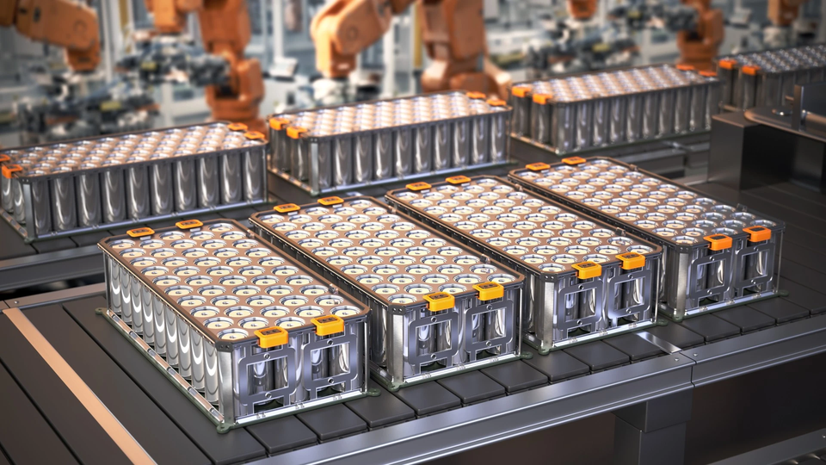
Presentation on
The process of EV Charging
DATE - 26/09/2026
By Nikhil Kushwah
EE, 7th Sem, SATI Vidisha
E-Mail : nikhilkushwah078@gmail.com
Mo. NO. : 7987260228

Slide 2
  What people thinks about the ev chaging
  what ev charging actually is
  ev charging station
  ev charging onboard system
large batteries, single chargers etc
set of small battery connected in series, lithium can not go above 4.2v
converting the low voltage to high voltage dc and provide balanced supply buy comuniaciton to the bms
how the bms monitor the voltage of each cell and and bypass the extra current ,
why we can not seperatly charge each battery

Slide 3
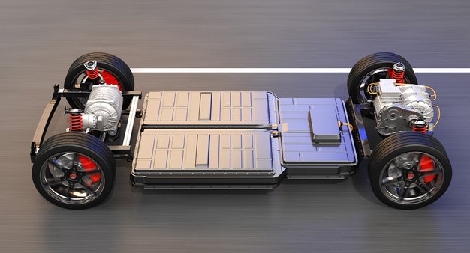
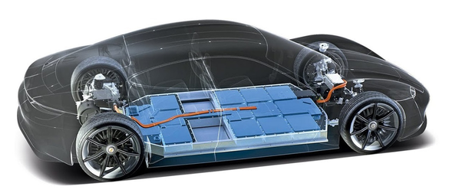
What Do We Usually Think About EV Charging ?
  An EV has one huge battery.
  The battery is just 12 V.
  A fast charger simply supplies more current.The battery is charged as one unit.
  The charging circuit is inside the EV

Slide 4
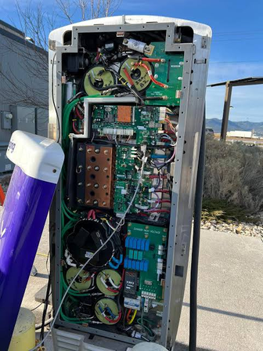
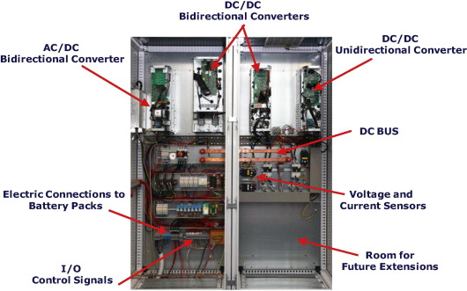
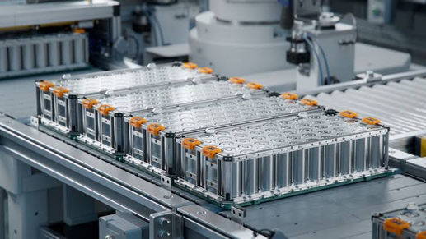
What Is EV Charging Actually
  EV battery is the combination of multiple small cells
  EV Batteries Operate at High Voltage (≈ 600 V)
  Main charging system is outside the EV in charging station

Slide 5

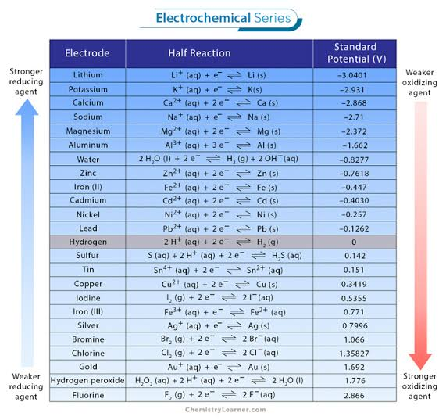
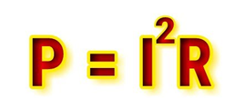
Why Not Use One Giant Battery Cell ?
The operating voltage of a lithium-ion cell is fundamentally constrained by the electrochemical potential of its electrode materials and the stability window of its electrolyte.
Electrochemical Series
Due to very high current the battery produce significantly very high amount of heat
Because of low voltage we need higher current for high power which increase the losses

Slide 6
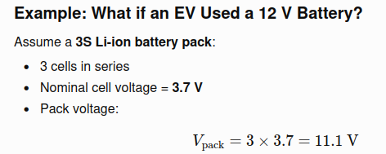
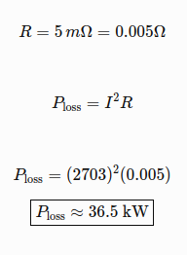
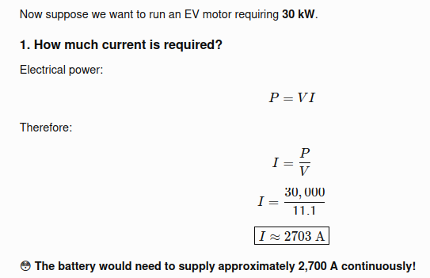
Extremely inefficient and thermally impractical

Slide 7
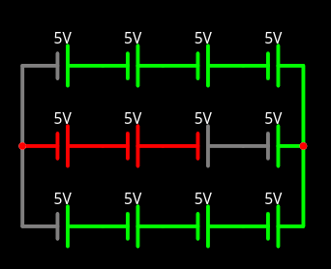
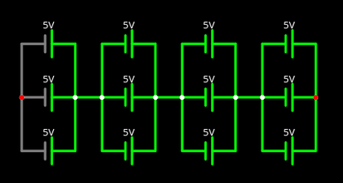
Topology of EV battery packs -
  First series then parallel
Both has same voltage and current rating
  First Parallel then series
But still the most of the EV battery pack uses the First parallel then series combination

Slide 8
Problems with the first series then parallel combination -
  First series then parallel need more complex BMS design to control the voltage of each cell
  If a cell become short circuited then it create the voltage imbalance between strings
  A weak cell limits the entire series string
Cell 1 → Cell 2 → Cell 3 → ... → Cell 107 → Cell 108
↑
weak/aged cell
Example -
String A: 108 cells in series → 402 V
String B: 108 cells in series → 398 V
String C: 108 cells in series → 400 V
String D: 108 cells in series → 397 V
Large equalization currents can flow between the strings because they are at different voltages.

Slide 9
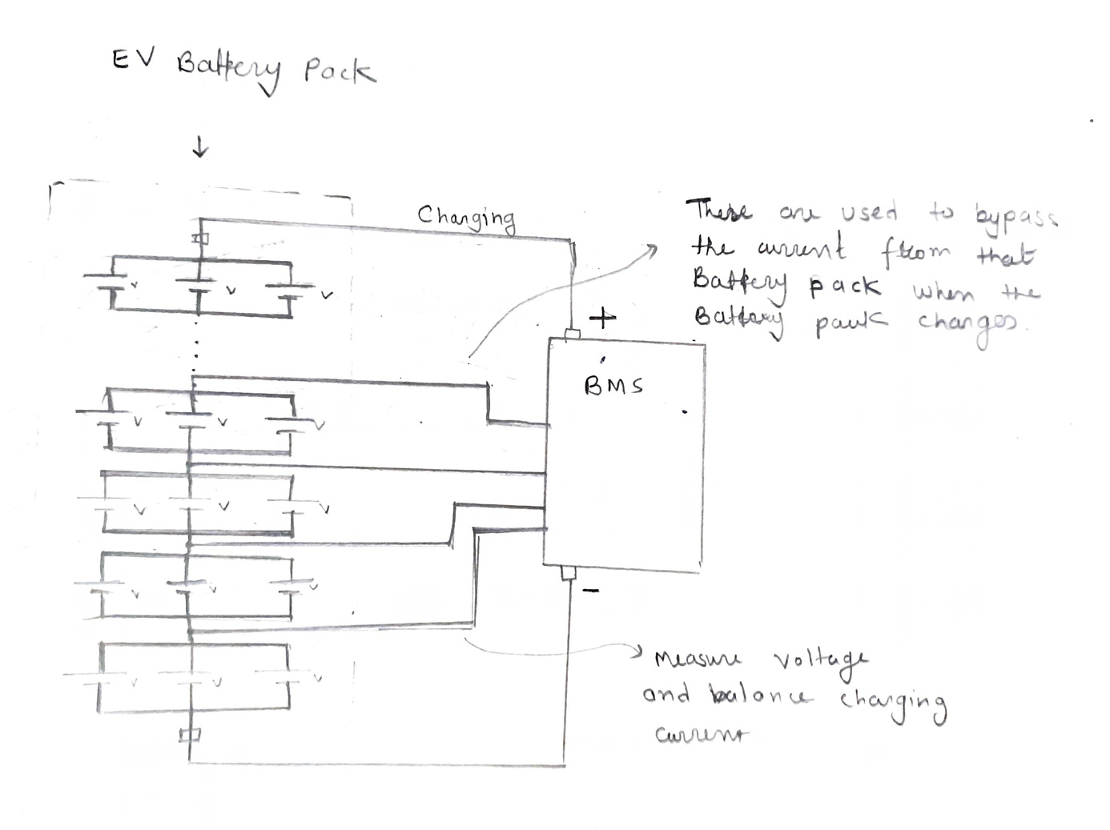
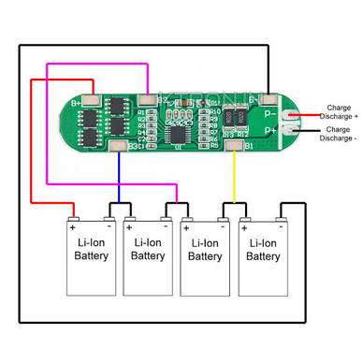
Battery Management System (BMS) Of EV -
A BMS is an electronic system that monitors and controls a battery pack by managing parameters such as voltage, current, temperature, and state of charge to ensure safe, efficient, and reliable operation.
These are use to measure the voltage and bypass the charging current when a particular set of battery

Slide 10
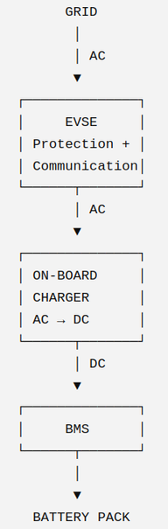
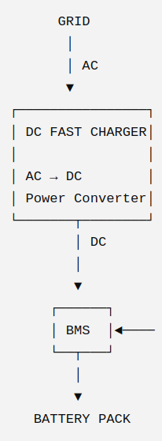
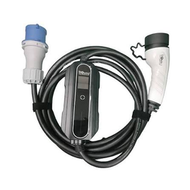
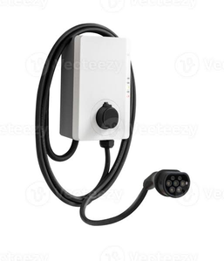
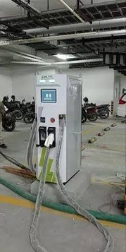
EV Battery Charging System -
EV CHARGING
│
┌───────────┴────────┐
│ │
AC Charging DC Charging
│ │
┌──┴─────┐ DC Fast Charging │ │ │
Level 1 Level 2 High Power
AC charging architecture
DC charging architecture
AC Charging -
Grid AC → EV onboard charger → DC → Battery
Level 1 - Single phase charging
Level 2 - Three phase charging
DC Charging -
Grid AC → external charger → controlled DC → Battery
Level 1 charger
Level 2 charger
DC Fast Charger

Slide 11
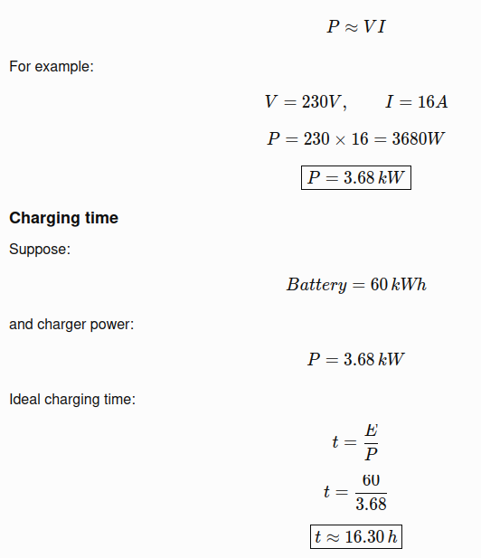
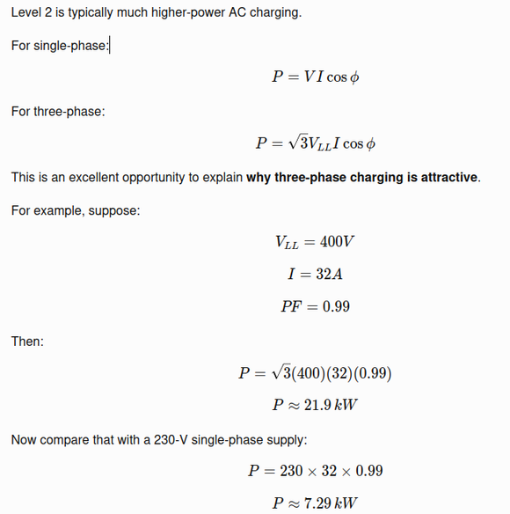
Level 1 Charging
Level 2 Charging
Using three phase system
Very low power
Generate significantly more power
Take very long time to charge

Slide 12
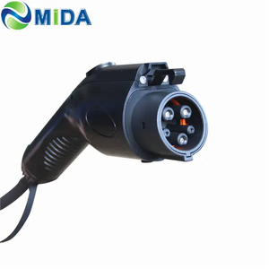
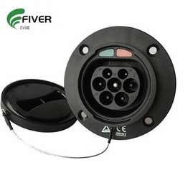
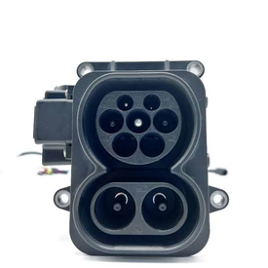
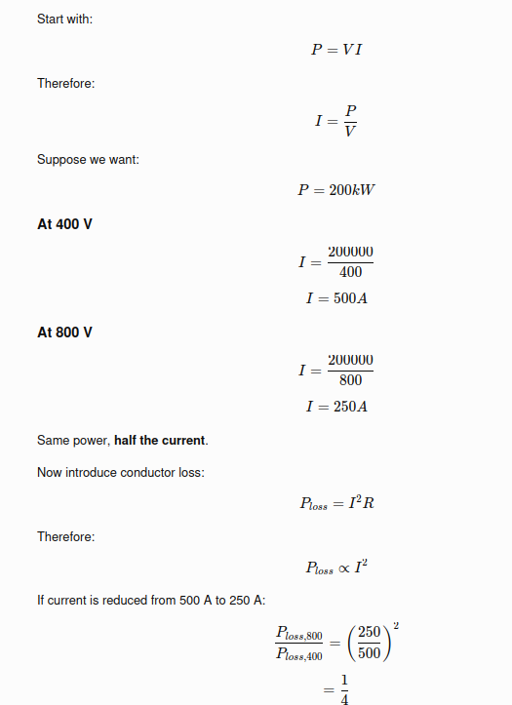
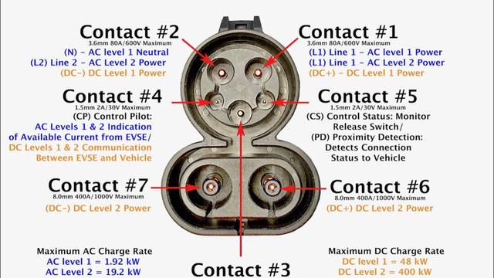

DC Charging
Level 1 Charger
Level 2 Charger
DC Charger
Decreasing current by increasing the voltage
Source: https://www.youtube.com/watch?v=jZBsOud4O9Q
WaberAuto
Increasing the voltage twice reduce the power loss by 1/4th

Slide 13
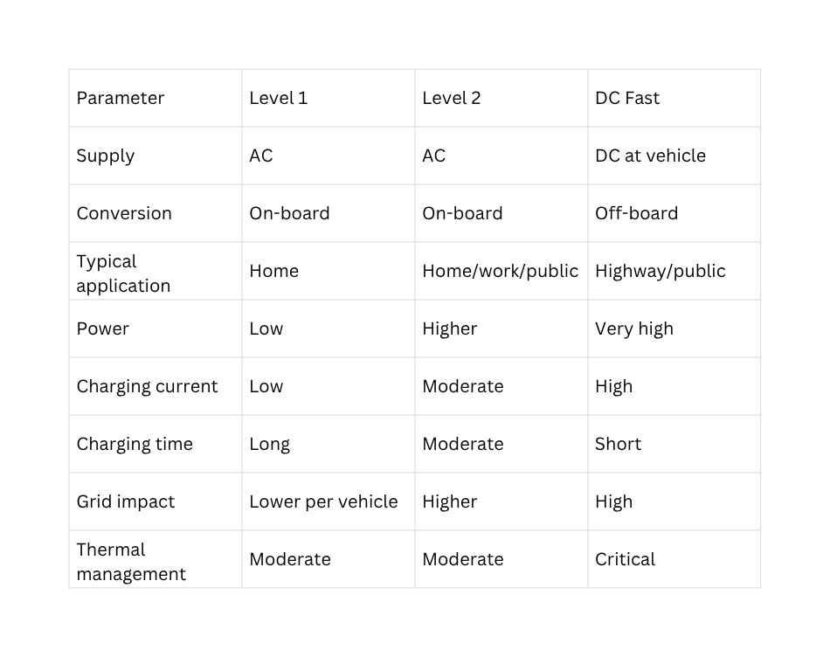
Comparison table -

Slide 14
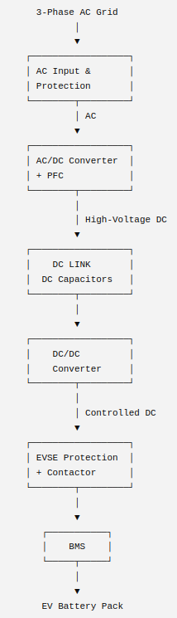
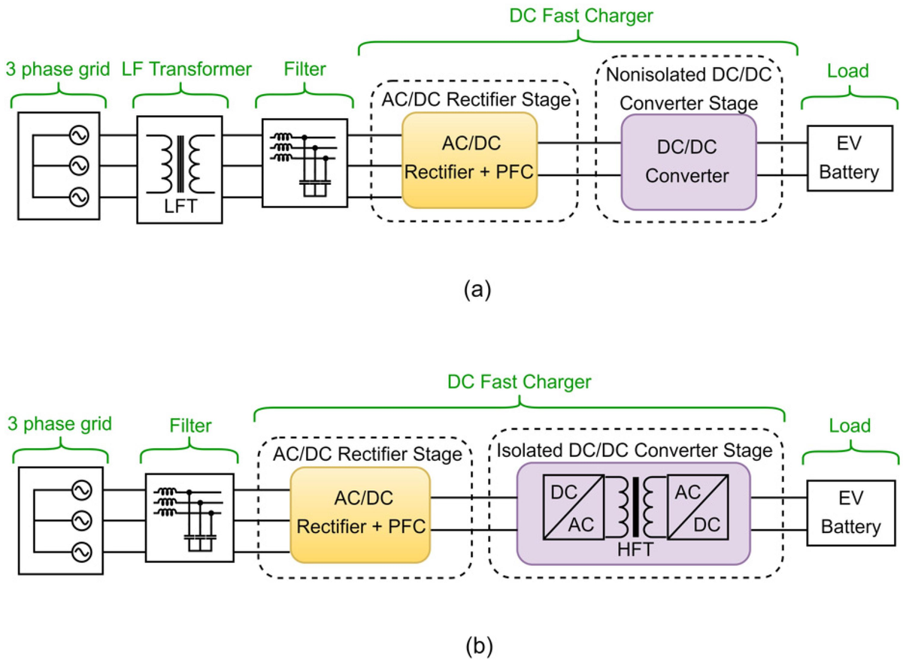
DC Charging Topology -
  First we convert the AC into DC and then we use high frequency DC to DC converter to step up the voltage
  we convert the first AC to DC then step up the voltage because the EV battery voltage will vary too much
  And due to high frequency switching we need small ferrite core transformers instead on large iron core transformer which create huge loss

Slide 15
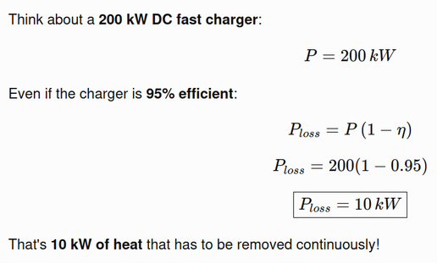
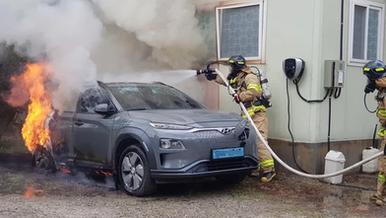
Why fast EV Chargers are very big in size -
  They handle hundreds of kilowatts of electrical power.
  High current causes significant I2R losses.
  Large heat sinks, fans, or liquid-cooling systems are needed.
  Large rectifiers, switches, inductors, and capacitors are required.
These energy losses create lots of heat

Slide 16
Thank You ! :)

