Slide 1
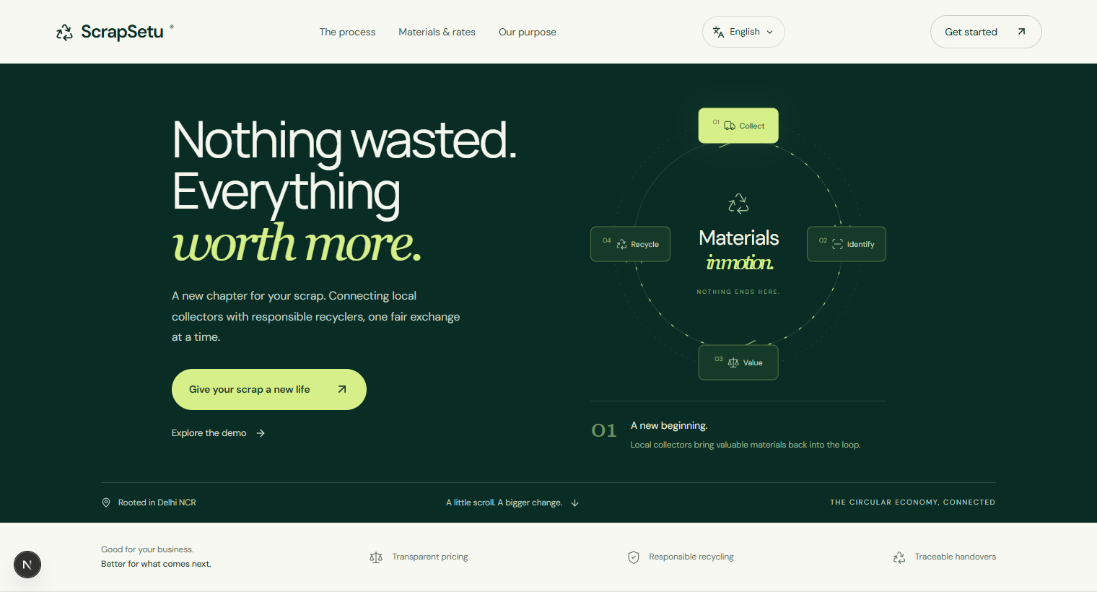
SMART INDIA HACKATHON 2026
ScrapSetu
AI assisted e-waste collection, fair valuation and traceable recycling
Nothing wasted. Everything worth more.
Problem Statement ID 26229
Problem Statement Automated e-waste classification and informal collector formalization
Theme Clean & Green Technology
Category Software
Organization JNARDDC / Ministry of Mines
Team Name ScrapSetu
LIVE PROTOTYPE
Citizen intake, collector operations, recycler matching and regulator oversight in one responsive product.
#CircularEconomy #EPR #VernacularTech #ResponsibleRecycling
SIH IDEA SUBMISSION
Notes:
Project metadata and implementation details: ScrapSetu repository README.
SIH format reference: https://www.sih.gov.in/letters/Idea%20ppt.pptx
Live prototype: https://scrapsetu.vercel.app

Slide 2
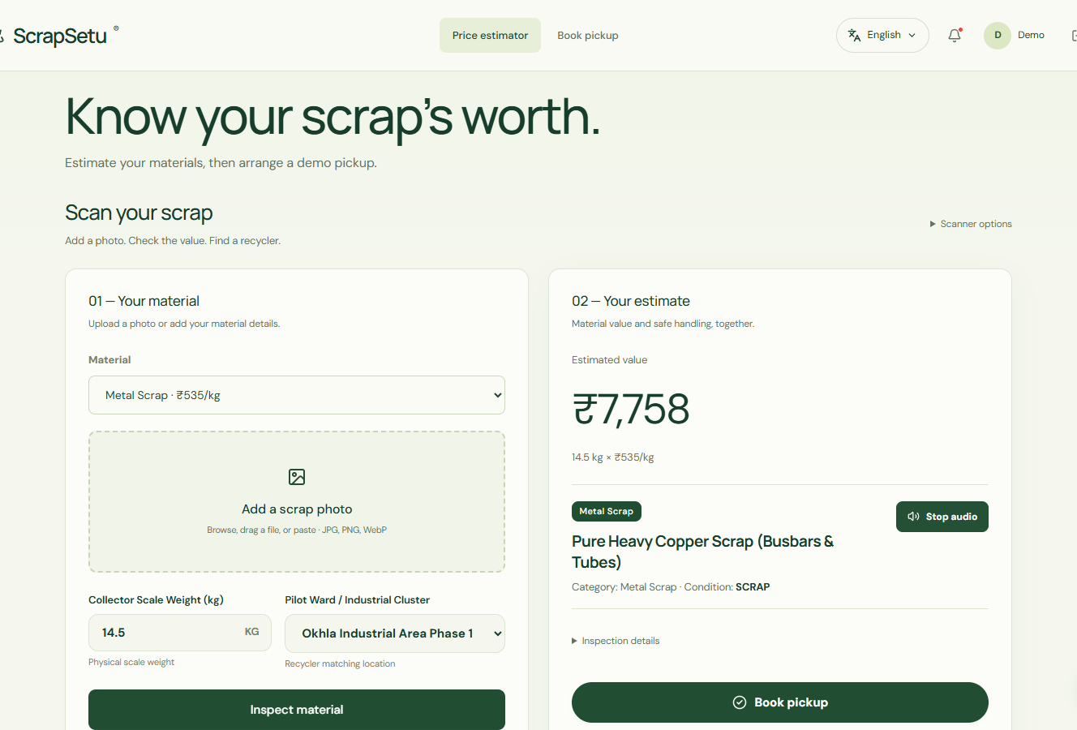
SMART INDIA HACKATHON 2026
02
IDEA TITLE / PROPOSED SOLUTION
ScrapSetu connects fragmented e-waste collection with the formal recycling chain
The operating gap
Collectors often price and sort material without reliable benchmarks or hazard guidance.
Authorized recyclers receive fragmented supply with limited proof of origin and weight.
Regulators cannot audit handovers when transactions remain offline and undocumented.
What ScrapSetu changes
One guided workflow for citizens, collectors, recyclers and regulators.
Multilingual access in English, Hindi and Marathi with voice support.
Fairer exchange through material classification, benchmark pricing and direct matching.
Photo or voice input
Price estimate
Pickup booking
SCRAPSETU | PS 26229 | SOFTWARE
scrapsetu.vercel.app
Notes:
Product behavior and interface: ScrapSetu repository and live prototype.
Live prototype: https://scrapsetu.vercel.app/citizen
Repository: https://github.com/nikhillakra2007-tech/scrapsetu/tree/frontend

Slide 3
SMART INDIA HACKATHON 2026
03
TECHNICAL APPROACH
A traceable path from material intake to EPR reporting
01
02
03
04
05
06
Capture
Classify
Value
Match
Verify
Report
Photo, voice or material details
CPCB category, condition and hazards
Weight × Delhi benchmark rate
Location, category and recycler rate
Weighbridge check and QR handover
Chain of custody and EPR export
Technology stack
INTERFACE
INTELLIGENCE
DATA
DELIVERY
Next.js 16, React 19, TypeScript
Gemini 2.5 Flash with grounded fallback
Supabase Postgres with geo matching design
Vercel production deployment in Mumbai region
SCRAPSETU | PS 26229 | SOFTWARE
scrapsetu.vercel.app
Notes:
Architecture and technology stack: ScrapSetu repository README and package.json.
Gemini API documentation: https://ai.google.dev/gemini-api/docs
Next.js documentation: https://nextjs.org/docs
Supabase documentation: https://supabase.com/docs

Slide 4
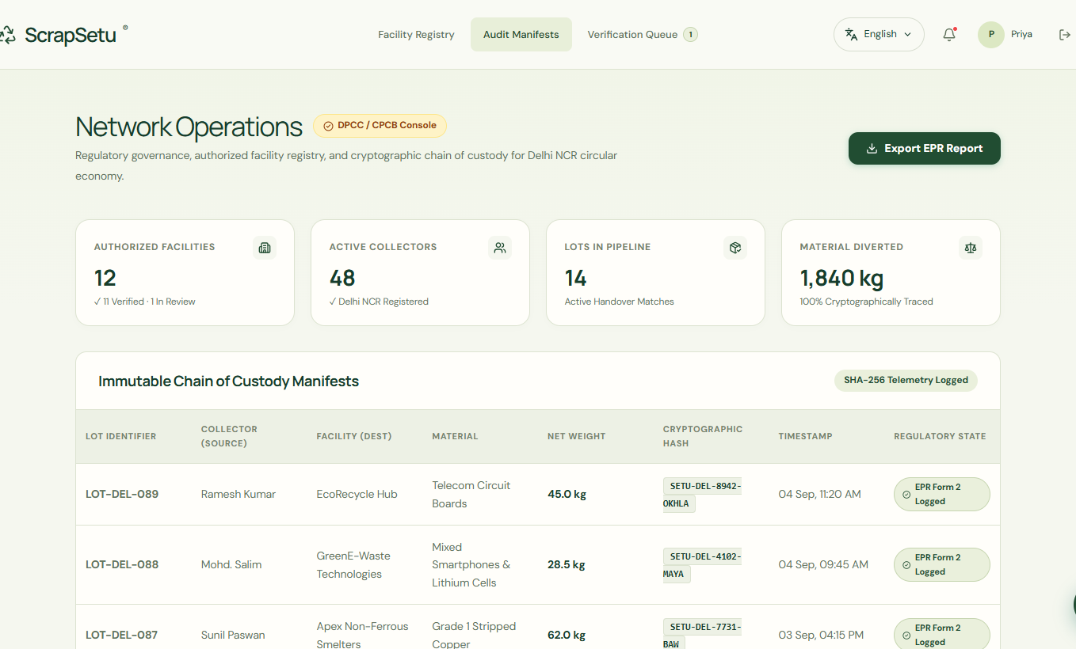
SMART INDIA HACKATHON 2026
04
FEASIBILITY AND VIABILITY
The working prototype already covers the pilot's core operational loop
Working today
Responsive citizen, collector, recycler and regulator workspaces
Scrap scanner, price estimator and multilingual voice guidance
Citizen pickup booking linked to collector operations
Recycler matching, weighbridge verification and QR handover
Exportable audit manifest for EPR reporting
Dependencies and safeguards
AI availability Grounded classification fallback when the Gemini key or network is unavailable.
Pilot data Replace demonstration rates with verified recycler feeds before field rollout.
Compliance Validate manifest fields and operating roles with DPCC and authorized recyclers.
Pilot path
1
5 Delhi clusters
2
Authorized recycler onboarding
3
Measured handovers
4
EPR integration review
SCRAPSETU | PS 26229 | SOFTWARE
scrapsetu.vercel.app
Notes:
Implemented feature inventory: ScrapSetu repository README and application routes.
Live regulator prototype: https://scrapsetu.vercel.app/admin
The rates and records shown in the prototype are demonstration data. Production rollout requires verified feeds and regulator review.

Slide 5
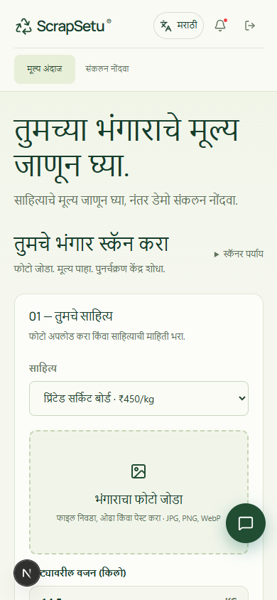
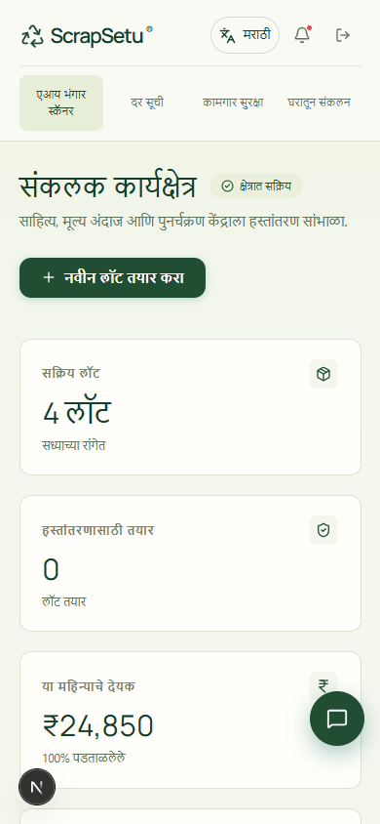
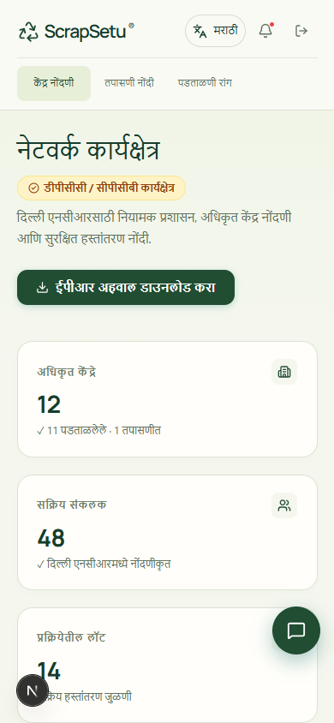
SMART INDIA HACKATHON 2026
05
IMPACT AND BENEFITS
Each participant gains a clear next action and a shared record of the handover
01
CITIZENS
Estimate value and book a pickup without learning scrap categories.
02
COLLECTORS
Use benchmark prices, safety prompts and direct recycler matching.
03
RECYCLERS
Receive classified lots with weight, condition and hazard context.
04
REGULATORS
Review authorized facilities and export a traceable audit manifest.
Pilot measures
CITIZEN
COLLECTOR
REGULATOR
Estimate time Price variance Authorized routing Traceable handovers
English, Hindi and Marathi across operational pages
SCRAPSETU | PS 26229 | SOFTWARE
scrapsetu.vercel.app
Notes:
Target audiences and product benefits are derived from the implemented citizen, collector, recycler and admin workflows.
Repository: https://github.com/nikhillakra2007-tech/scrapsetu/tree/frontend
Live prototype: https://scrapsetu.vercel.app

Slide 6
SMART INDIA HACKATHON 2026
06
RESEARCH AND REFERENCES
Regulatory sources, technical documentation and working project links
Regulation and programme format
Technology and project
01
E-Waste (Management) Rules, 2022
05
Google Gemini API
moef.gov.in/uploads/2022/11/E-Waste-Management-Rules-2022.pdf
ai.google.dev/gemini-api/docs
06
Next.js App Router
02
CPCB EPR guidance and portal information
nextjs.org/docs
cpcb.nic.in/e-waste/
07
Supabase platform
03
SIH idea presentation template
supabase.com/docs
sih.gov.in/letters/Idea%20ppt.pptx
08
ScrapSetu source
github.com/nikhillakra2007-tech/scrapsetu/tree/frontend
04
SIH college and submission guidance
sih.gov.in/letters/Guidelines-College-SPOC.pdf
09
ScrapSetu live prototype
scrapsetu.vercel.app
SIH format followed: six slides including title, concise points and diagrams, with the final submission exported as PDF on the portal.
SCRAPSETU | RESEARCH NOTES INCLUDED IN THE DECK
scrapsetu.vercel.app
Notes:
References used in this presentation:
https://moef.gov.in/uploads/2022/11/E-Waste-Management-Rules-2022.pdf
https://cpcb.nic.in/e-waste/
https://www.sih.gov.in/letters/Idea%20ppt.pptx
https://www.sih.gov.in/letters/Guidelines-College-SPOC.pdf
https://ai.google.dev/gemini-api/docs
https://nextjs.org/docs
https://supabase.com/docs
https://github.com/nikhillakra2007-tech/scrapsetu/tree/frontend
https://scrapsetu.vercel.app

