Slide 1

01 / 10
YUVA YODHA ENERGY TECH HACKATHON 2026
KISAN URJA
किसान ऊर्जा
Autonomous Agricultural Intelligence & Solar Irrigation Platform
"Connecting crop water intelligence with solar-powered irrigation."
☀️ Solar-Synchronized
🌾 FAO-56 Physics
🛰️ Sentinel-2 Canopy
Challenge: Sustainable Agriculture
kisanurja.vercel.app

Slide 2
02 / 10
THE PROBLEM
Farm irrigation is a water problem
AND an energy problem.
● When to irrigate? — Farmers must judge timing from weather, soil moisture, and crop stage—often separately.
● How much water? — Fixed schedules miss changing field conditions, risking over- or under-irrigation.
● Energy cost — Pumping consumes electricity or diesel. Tariff timing and solar availability are rarely factored in.
● Fragmented signals — Weather, soil, crop, water, and energy are treated as disconnected datasets.
● No unified recommendation — Farmers need one actionable decision, not five separate dashboards.
🌦️
🪨
🌾
Weather
Soil
Crop
💧
⚡
Water
Energy
↓ fragmented decisions ↓
KISAN URJA brings these signals together.
KISAN URJA — Yuva Yodha 2026
kisanurja.vercel.app

Slide 3
03 / 10
OUR SOLUTION
One intelligence layer for water, crops and energy.
INPUTS
OUTPUTS
🧠
🌤️ Microclimate — Open-Meteo weather
🚿 Irrigation recommendations
INTELLIGENCE ENGINE
🪨 Soil properties — ISRIC SoilGrids 250m
→ FAO-56 Penman-Monteith ET₀
→ Pedotransfer soil hydraulics
→ Root-zone water balance
→ Crop water stress (Kₛ / CWSI)
→ Solar generation modeling
→ Tariff-aware scheduling
→ Traceability chain engine
📊 Water stress insights (CWSI)
🛰️ Satellite — Copernicus Sentinel-2 (10m)
⚡ Solar pumping windows
🌾 Crop/field — Species, stage, rooting depth
💰 Financial/energy insights
☀️ Solar/pump — PV capacity, pump HP, tariff
🔗 Traceable reasoning chain
KISAN URJA — Yuva Yodha 2026
kisanurja.vercel.app

Slide 4
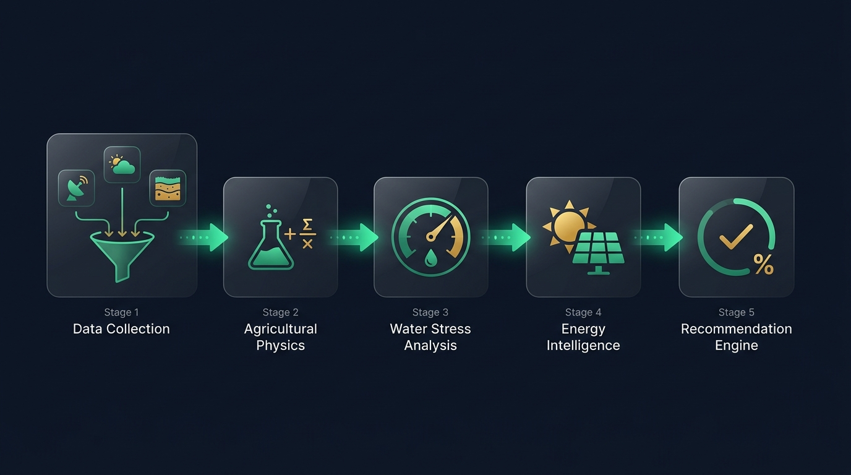
04 / 10
THE PIPELINE
From raw observations to an explainable irrigation decision.
Every recommendation is traceable: input → calculation → assumption → output.
KISAN URJA — Yuva Yodha 2026
kisanurja.vercel.app

Slide 5
05 / 10
THE SCIENCE
Built on agricultural physics—not a black box.
● FAO-56 Penman-Monteith — deterministic reference evapotranspiration from net radiation, vapor pressure deficit, wind speed, and psychrometric constants.
● Saxton-Rawls pedotransfer — converts SoilGrids texture (sand%, clay%) into field capacity (θFC), wilting point (θWP), and available water capacity.
● Root-zone water balance — daily depletion mass model tracking Dr against USDA-SCS effective rainfall and adjusted ETc.
● Crop water stress — Kₛ coefficient and CWSI derived from depletion vs. readily-available water thresholds.
● Effective rainfall — USDA-SCS methodology separating surface runoff from infiltrating precipitation.
FAO-56 Penman-Monteith Reference ET₀
ET₀ = [0.408·Δ·(Rn − G) + γ·(900/(T+273))·u₂·(eₛ − eₐ)]
/ [Δ + γ·(1 + 0.34·u₂)]
Root-Zone Depletion & Stress
Dr,i = Dr,i−1 − Peff − I + ETc,adj
CWSI = 1 − Kₛ
Scientific calculations remain traceable from
input → calculation → assumption → output.
KISAN URJA — Yuva Yodha 2026
kisanurja.vercel.app

Slide 6
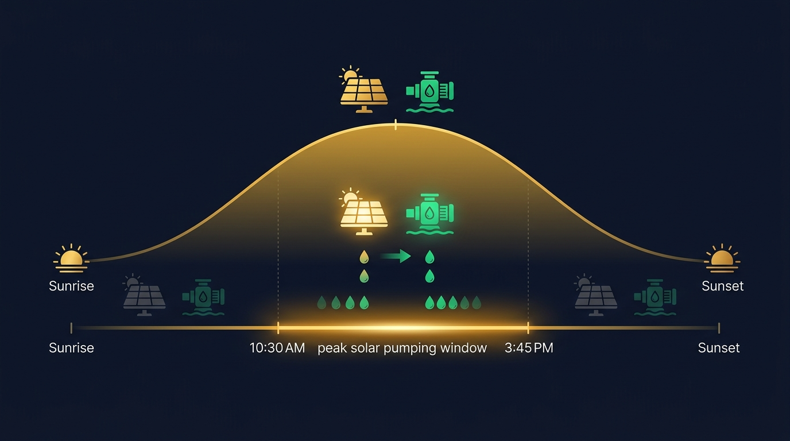
06 / 10
THE ENERGY INNOVATION
Water intelligence meets solar intelligence.
Instead of treating irrigation demand and energy cost as separate decisions, KISAN URJA connects them. The platform models when solar PV generation is sufficient to power irrigation pumps—synchronizing water delivery with available renewable energy.
DECISION FUSION
💧 Crop Water Need
+
🪨 Soil Water Status
+
☀️ Solar Availability
+
⚙️ Pump Capacity
+
💰 Energy Cost / Tariff
→ OPTIMAL IRRIGATION WINDOW
Demo profiles model savings scenarios (e.g., ₹94,200/yr for a 5HP solar pump in Haryana). These represent modeled scenarios, not independently measured field results.
KISAN URJA — Yuva Yodha 2026
kisanurja.vercel.app

Slide 7
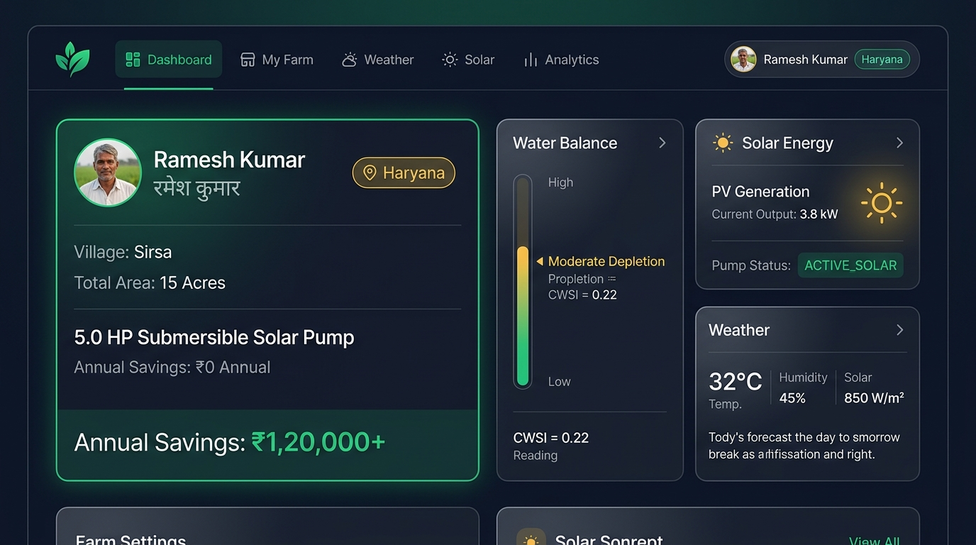
07 / 10
PRODUCT — LIVE DEMO
An intelligence console built for the farmer.
👨‍🌾 Farmer Identity Card
Full profile with state badge, farm name, solar pump specs, and modeled savings. Multi-state switching.
💧 Water Balance & CWSI
Live root-zone depletion bar, stress index, ET₀, and adjusted crop water demand.
☀️ Solar Energy & Pump
PV generation, pump status (ACTIVE_SOLAR / STANDBY), tariff savings.
⚡ Live Simulation
Interactive telemetry: Peak Sun, Rainfall, Heatwave—demonstrating dynamic response.
🛰️ Satellite Scanner
4-band spectral switcher (NDVI, CWSI, NDRE, True Color) with zone hotspots.
Live: kisanurja.vercel.app
React 19 + Vite 8 · Obsidian Slate Theme · Lenis Smooth Scroll

Slide 8
08 / 10
ACCESSIBILITY & TRUST
Advanced intelligence, without hiding the reasoning.
🇮🇳 FARMER ACCESSIBILITY
🔒 TRUST & TRACEABILITY
● Hindi/Hinglish transliterator — real-time Devanagari conversion with agricultural dictionary (khet → खेत, paani → पानी)
● Hindi voice synthesis — Web Speech API reads recommendations aloud
● Sunlight high-contrast mode — toggle for outdoor field visibility
● Font size scaling — adjustable text size controls (+/−)
● Farmer-first interface — clear recommendation cards with urgency badges
● Data provenance — every record tagged EXTERNAL_RETRIEVED, OBSERVED, or CALCULATED
● SHA-256 raw archiving — all external API payloads cryptographically hashed before parsing
● PostgreSQL Row-Level Security — tenant isolation via JWT claim enforcement
● Full traceability chains — each recommendation includes inputs, equations, assumptions, confidence, limitations
● Zero fabricated telemetry — no synthetic data presented as observed measurements
"Farmers should understand not only what the system recommends, but why."
KISAN URJA — Yuva Yodha 2026
kisanurja.vercel.app

Slide 9
09 / 10
IMPLEMENTATION
From concept to working full-stack system.
SYSTEM ARCHITECTURE
VERIFIED IMPLEMENTATION
🖥️ React 19 + Vite 8 + Lenis
77
25
↕
⚡ FastAPI 0.115+ (10 Domain Routers)
Relational Entities
Verified Migrations
↕
🧠 Agricultural Intelligence Engine
10
15/15
↕
API Domain Routers
Test Suites Passing
🗄️ PostgreSQL 18 + PostGIS 3.6
↕
● Docker Compose full-stack orchestration
● NIST PBKDF2-HMAC-SHA256 auth & JWT
● Multi-tenant RLS isolation per farmer
● Production deployed on Vercel (frontend)
● Pipeline orchestrator with deduplication
📡 Open-Meteo · SoilGrids · Sentinel-2
GitHub: nikhillakra2007-tech/yuva-energy
15/15 backend test suites passing — documented in README

Slide 10
10 / 10
IMPACT & FUTURE
Toward autonomous, sustainable irrigation.
💧
☀️
👨‍🌾
Water
Energy
Farmer
More informed irrigation decisions.
Better visibility into root-zone depletion and crop stress.
Greater alignment between irrigation timing and solar availability.
Designed to reduce reliance on expensive pumping.
Actionable, explainable recommendations in Hindi/English.
Traceable decisions that build trust.
✅ NOW — Working Prototype
🔜 NEXT — Validation & Expansion
→ Full-stack platform deployed live
→ FAO-56 physics engine verified
→ 15/15 test suites passing
→ 4-state benchmark profiles
→ Interactive simulation engine
→ Real-world field validation
→ Localized agronomic models
→ Expanded region/crop coverage
→ Stronger live data integration
→ Progressive irrigation autonomy
KISAN URJA · kisanurja.vercel.app

