Slide 1

Seminar on
Internship Presentation
(Salesforce and Prerequisite)
Presented By
Nikhil Lanjewar
Guided by
Sagar Pradhan Sir

Slide 2
Contents
Introduction to Salesforce Administration
Need of Salesforce ?
Objects, Field and Data Types
Objects Relationship and System Security
Validation Rule and Data Security
Apex Classes
Conclusion

Slide 3
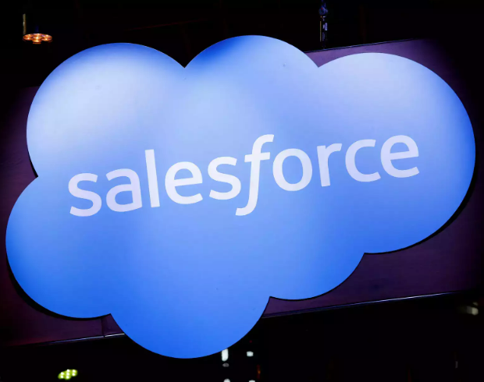
Introduction
Salesforce Administration is the process of managing and maintaining a company’s CRM System using the Salesforce Platform. It Involves Configuring the System to meet the unique needs of the organization, creating custom objects and fields setting up security measures and ensuring data accuracy and integrity.

Slide 4
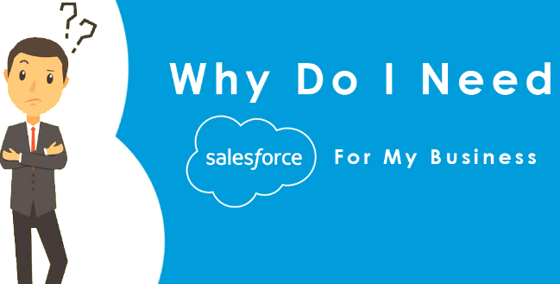
Need of Salesforce ?
Centralized Data Management
Improved Sales and Marketing
Enhanced Customer Service
Customization and Flexibility
Analytics and Reporting

Slide 5
Objects, Field and Data Types
In Salesforce, an object is a table that stores data. Each object represent a type of information that you want to track such as account, contacts or opportunities.
Fields are the individual pieces of data within an objects such as a contact’s name, email address or phone number.
Salesforce supports various data types that you can use to store and manage different kinds of information.

Slide 6
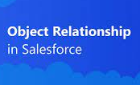
Objects Relationship and System Security
In object relationships we learned how to create relation between two or more objects. It is used to maintain data integration. There are two types of relationship in salesforce :
Lookup Relationships
Master - Detail Relationship
System Security: We are using system security for data protection and data encryption. This includes user authentication, authorization, etc.

Slide 7
Validation Rule and Data Security
Validation Rule : After studying about validation rule we are well Aware that how to use validation rule. It is used to ensure data accuracy, consistency, and adherence to business rules by preventing users from saving records that don't meet specific criteria. Criteria, Error Message, Preventing Save, Scenario these are all types of validation rule.
Data Security : We can easily secure our data by using data security level. It has four types of data security level organization level, object and filed level.

Slide 8
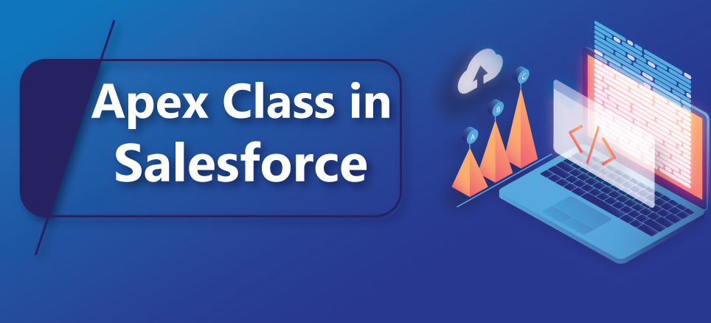
Apex Classes
Apex classes are a powerful tool for customizing and extending the capabilities of the Salesforce platform according to your application requirements.

Slide 9
Conclusion
In conclusion, my internship experience in managing Salesforce was very enlightening and beneficial. You learned how to effectively manage data, optimize user experience, enforce data integrity, and maintain data security. As a Salesforce administrator, I am confident in my ability to leverage the full potential of the Salesforce platform to help my organization achieve its goals. The knowledge and skills I gained from this internship will definitely be valuable.

Slide 10
Thank you

