Slide 1
WHARTON DATA SCIENCE ACADEMY · CAPSTONE 2026
When Tariffs Stop
Moving Trade
A predictive test of tariff effectiveness across two US–China trade-war episodes
Nikhil Muthukumar
Data: UN Comtrade · Bown (2021) · WTO Tariff Actions
Notes:
Today I'm going to show you something that I think is genuinely surprising. We started with a question: can a model trained on the 2019 US-China trade war predict what happened in 2025? The short answer is no. But the reason why is more interesting than the failure itself.

Slide 2
DATA & PIPELINE
This took serious engineering
3
3,201
3,164
100%
18
data sources
products (2019)
products (2025)
match rate
scripts
Comtrade · Bown
WTO Tariff Actions
HS6 subheadings
Trump 1 analysis
HS6 subheadings
Trump 2 analysis
tariff-to-product
both episodes
fully reproducible
renv-locked
Sources: UN Comtrade API · Bown (2021) HS6 tariffs · WTO Tariff Actions Nov-2025
Three independent sources · 100% primary match rate · every number is reproducible.
Notes:
Before the findings, a word on the data. This project pulls from three independent sources — UN Comtrade for the actual trade flows, Chad Bown's Section 301 dataset for the 2019 tariff rates, and the WTO Tariff Actions database for the 2025 rates. Eighteen scripts, fully reproducible. The match rate between the tariff data and the trade data is 100% for both episodes. Every number in this deck traces back to a documented source.

Slide 3
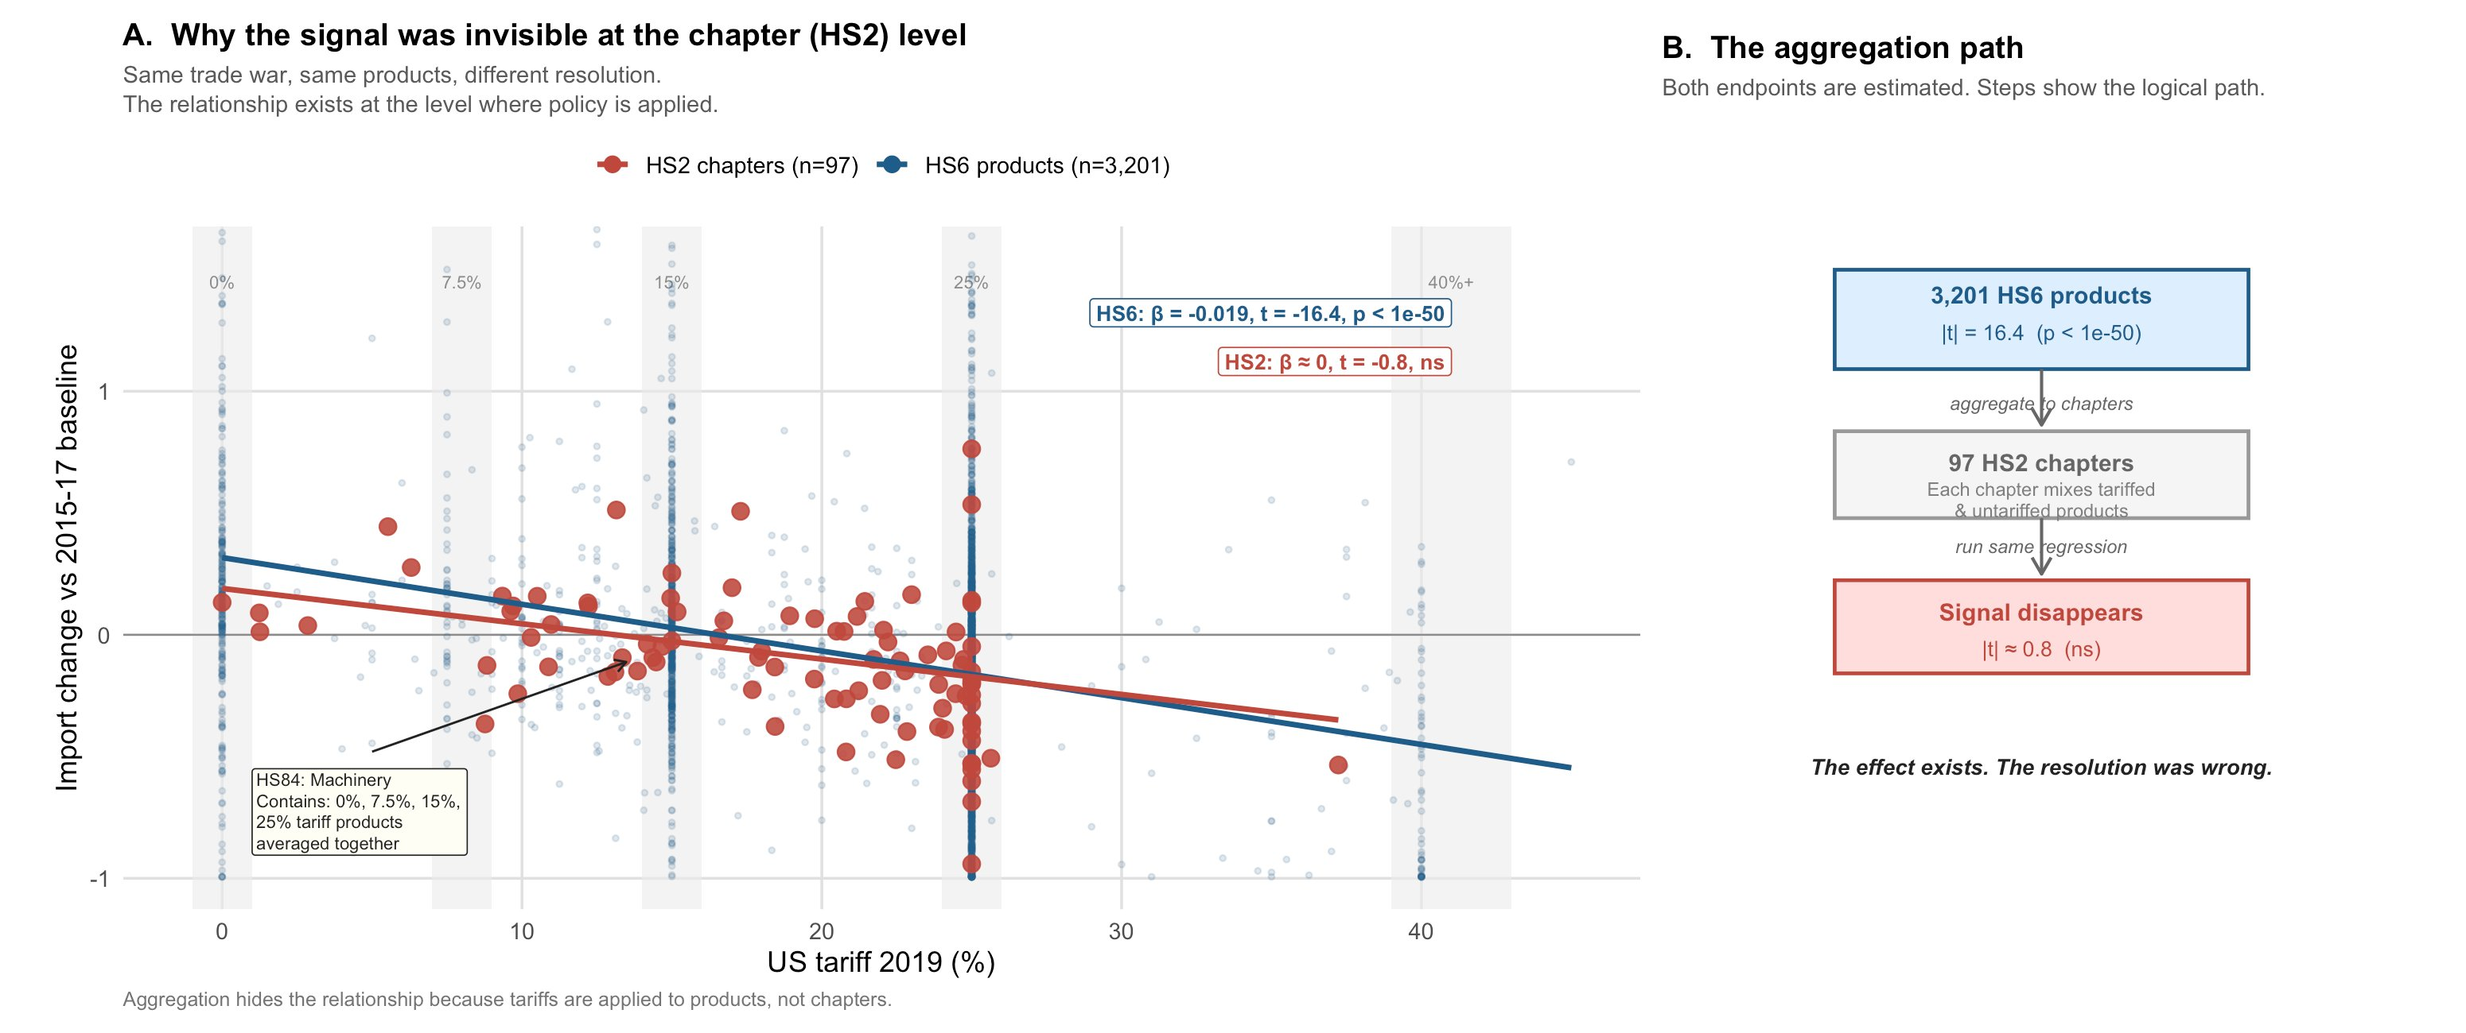
RESOLUTION
Why did earlier studies miss the signal?
Same trade war.
Same tariffs.
Different
resolution.
HS2 chapters
(n=97)
signal invisible
HS6 products
(n=3,201)
signal strong
Much of the signal is lost when products are aggregated into broad chapters.
Notes:
Here's the first finding, and it's methodological. The blue line is the HS6 relationship — 3,201 individual products. Clear negative slope. The red dots are the same data aggregated to 97 broad chapters — essentially invisible. Same trade war, same tariffs, two different resolutions. The reason the signal weakens at the chapter level is that each chapter contains a mix of tariffed and untariffed products. Averaging them together dilutes the effect. Much of the signal is lost when products are aggregated into broad chapters. The relationship becomes much clearer at the level where the policy is actually applied.

Slide 4
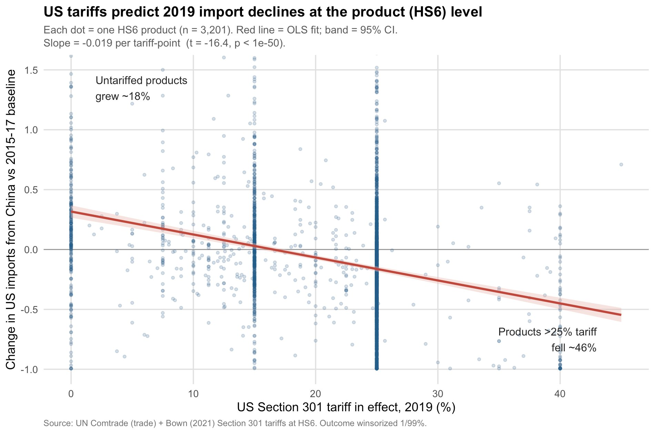
TRUMP 1 · 2019
Was there really a tariff effect?
t = −16.4
Strongest signal
in the study
64pp spread
+18% untariffed
−46% highest tariff
across tariff distribution
Yes. At the product level, the 2019 relationship is unmistakable.
Notes:
At the product level, the 2019 relationship is unmistakable. Products with no tariff grew about 18% above baseline. Products facing the highest tariffs fell about 23%. That's a clear dose-response: higher tariffs, larger declines. Statistically, the relationship is extremely strong — you can see that in the tight confidence band around the regression line. This is the model we're about to test on 2025 data.

Slide 5
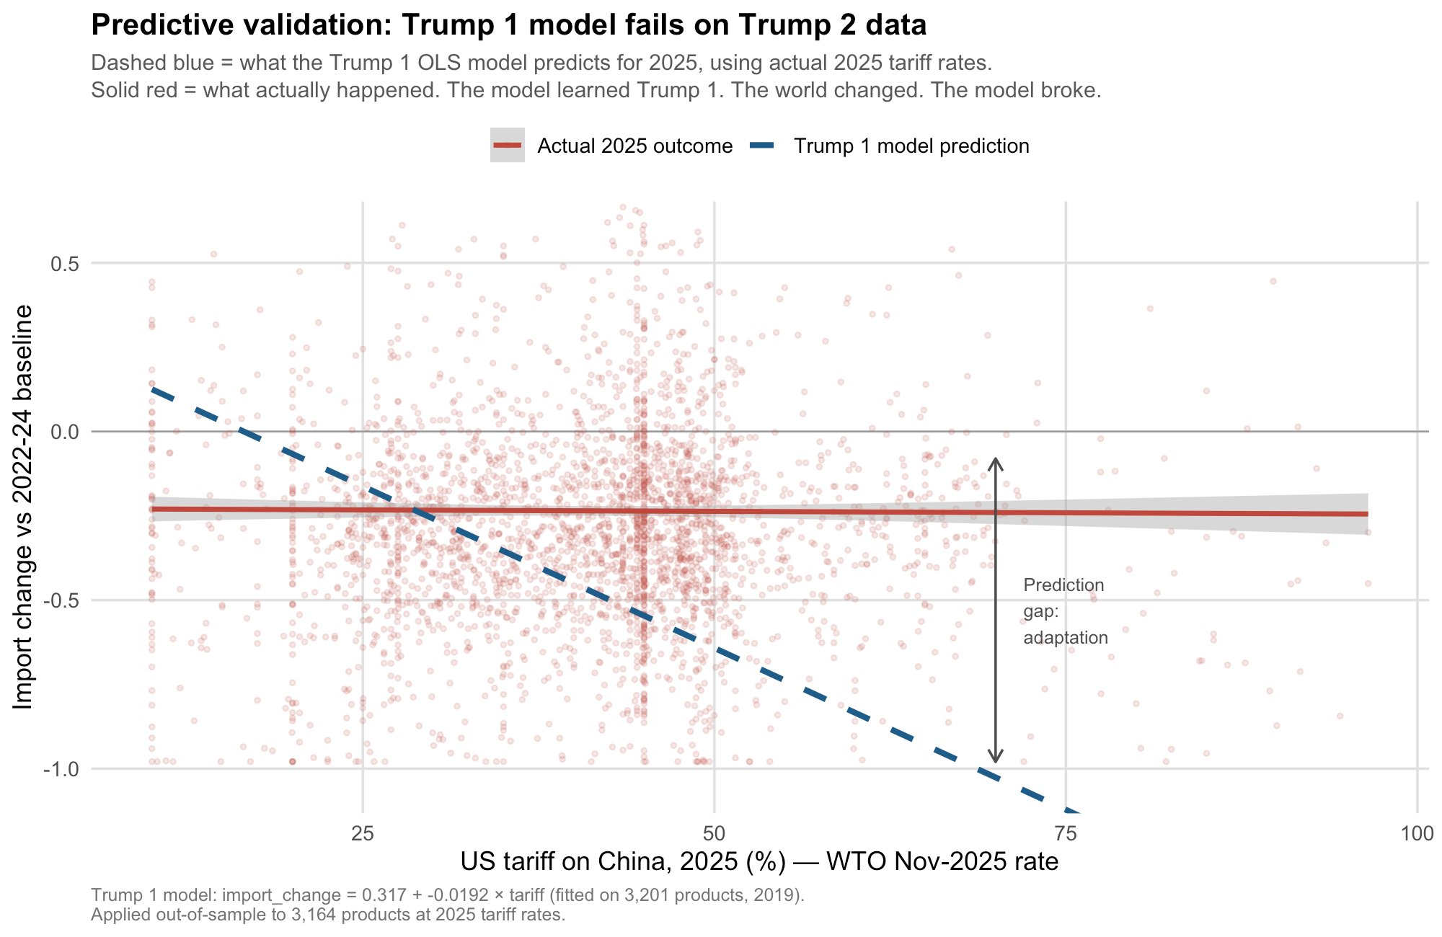
PREDICTIVE VALIDATION
Could the effect predict the future?
−84%
model predicted
>50% tariff products
−26%
actual decline
(same products)
+58pp
prediction gap
= adaptation
The model learned Trump 1. The world changed. The model broke.
Notes:
We took that Trump 1 model and applied it out-of-sample to 3,164 products at actual 2025 tariff rates. The dashed blue line is what the model predicted. The solid red line is what actually happened. For products facing the highest tariffs, the model predicted a decline of 84%. The actual decline was 26%. That's a 58 percentage point gap.
[Pause.]
The model learned Trump 1. The world changed. The model broke.

Slide 6
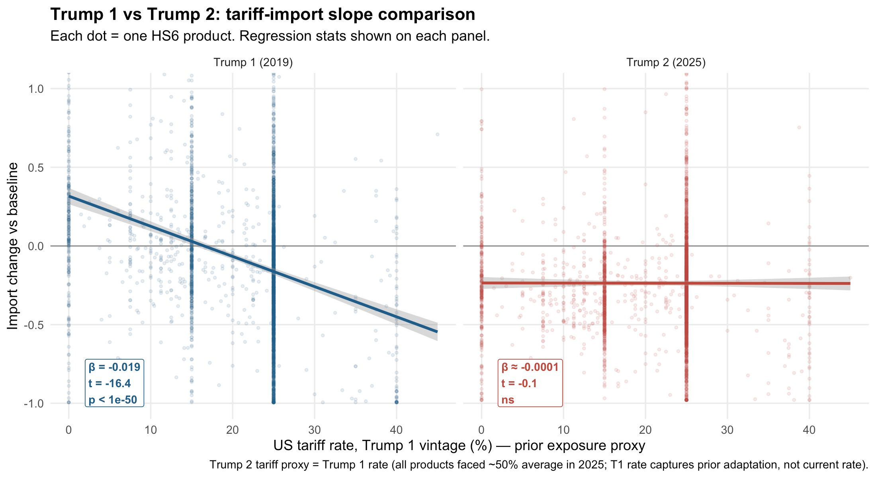
EXPLANATION · PART 1
Why did prediction fail?
The simplest explanation is that the underlying relationship changed.
Notes:
So why did it fail? The left panel shows the Trump 1 relationship — steep negative slope, strong signal. The right panel shows the same regression on 2025 data. Essentially flat. Not significant. The simplest explanation is that the underlying relationship changed. The assumption that higher tariffs correspond to larger import declines stopped being true by 2025.

Slide 7
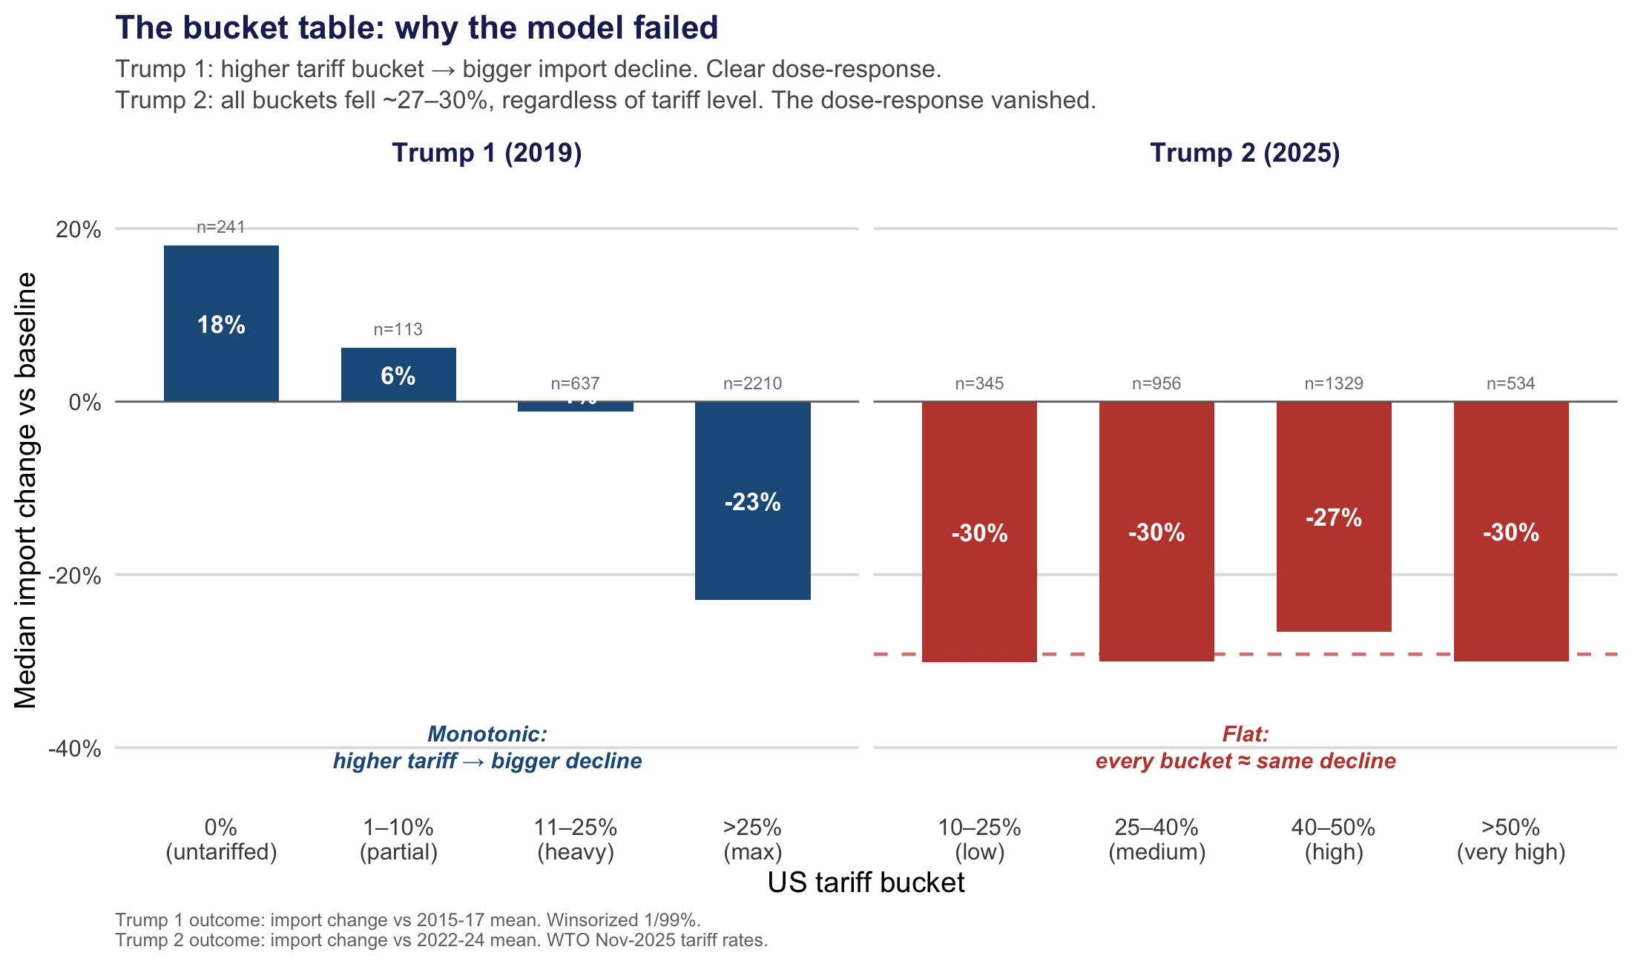
EXPLANATION · PART 2
What changed?
No model. No p-values. The dose-response simply vanished.
Notes:
This slide makes the same point without any regression at all. No model, no p-values. Just a simple question: do higher tariffs still correspond to bigger declines? In 2019 — yes. Clear staircase on the left. Untariffed products grew. Heavily tariffed products fell. In 2025 — no. Every bucket on the right falls roughly the same amount, regardless of tariff level. Low tariff, high tariff, makes no difference. The dose-response vanished.

Slide 8
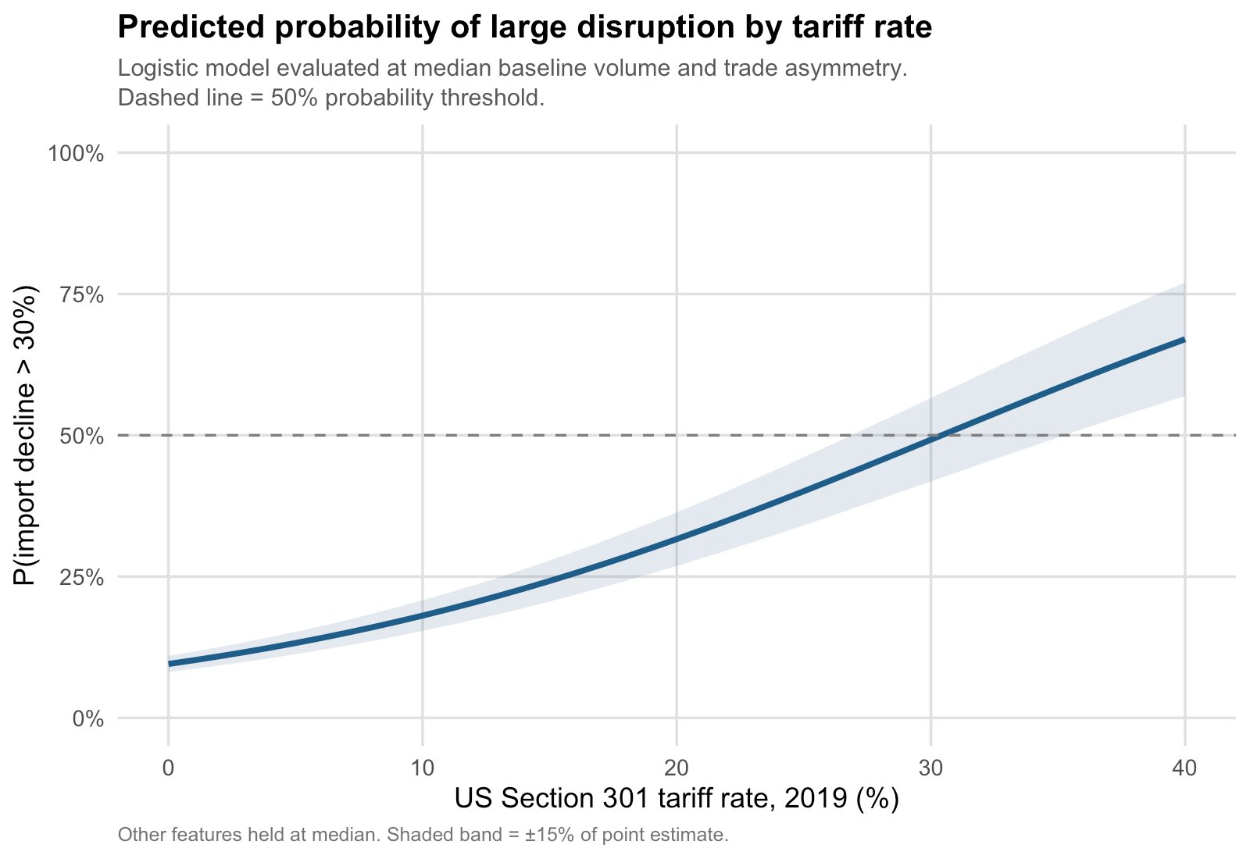
CLASSIFICATION
How predictable was disruption in 2019?
At 30% tariff — a coin flip. Useful signal, but not a precise instrument.
Notes:
Before asking why the relationship disappeared, it's worth asking how predictive it actually was in 2019. A logistic model trained on three features gives an AUC of 0.689. The S-curve here shows the predicted probability of a large import decline as a function of tariff rate. At zero tariff, roughly 10% chance. At 30% tariff, roughly 50% — a coin flip. The model is useful but not precise, which is honest given we're working with annual cross-sectional data.

Slide 9
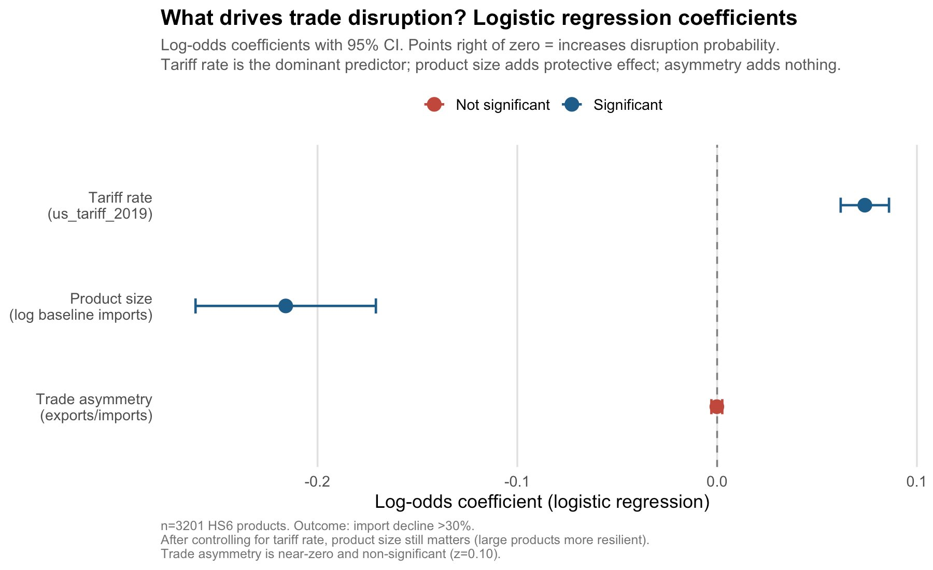
CLASSIFICATION
What mattered most?
Tariff rate
yes
Product size
yes
Trade asymmetry
no
Tariff rate dominates. Larger products appear more resilient after controlling for tariff rate.
Notes:
What drives the logistic model? Tariff rate dominates — that's the point on the far right, well clear of zero with a tight confidence interval. Product size has a significant negative effect — larger products appear more resilient after controlling for tariff rate. Trade asymmetry adds essentially nothing to the prediction.

Slide 10
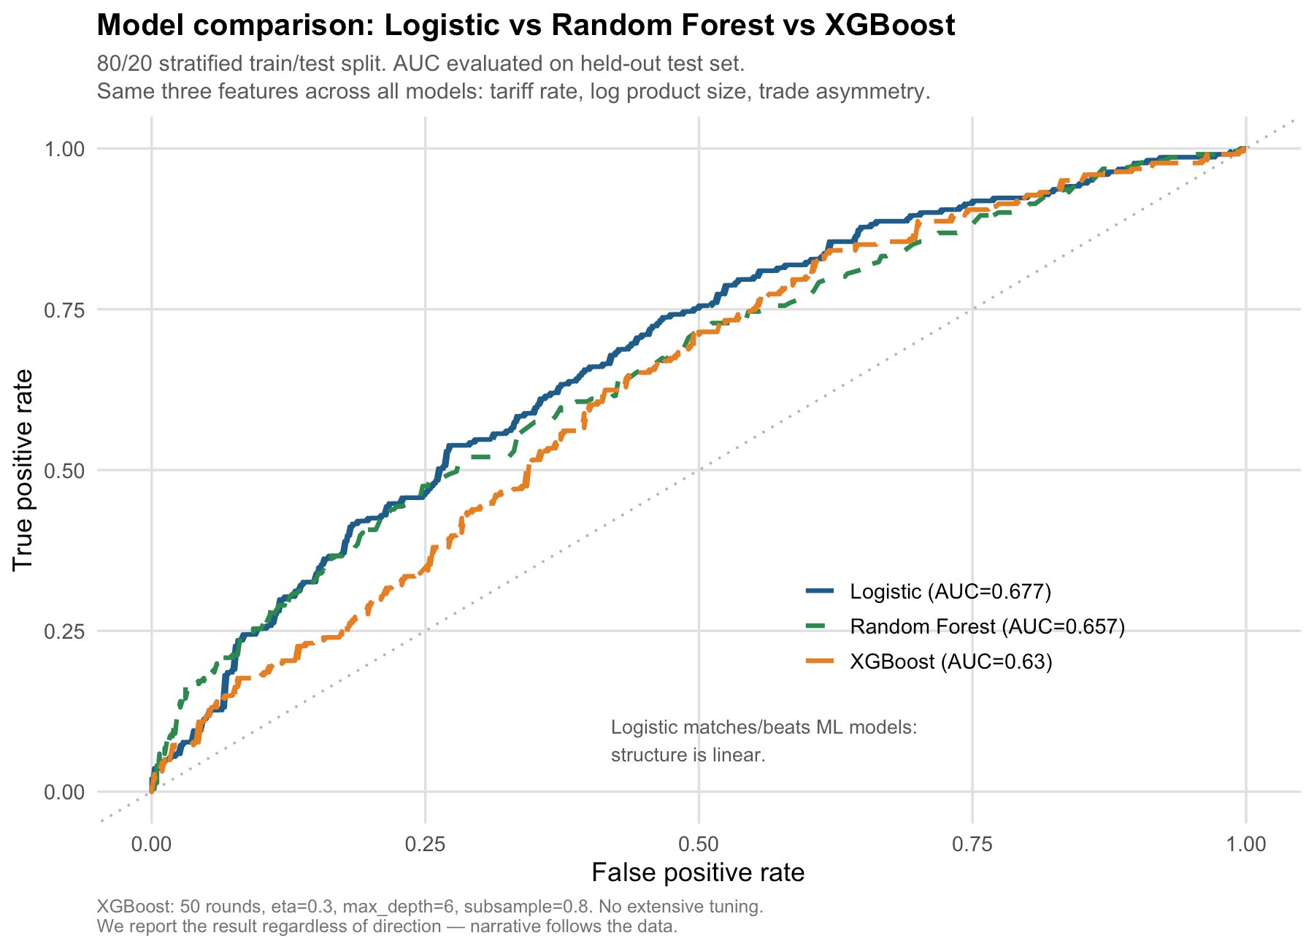
MODEL COMPARISON
Did machine learning help?
No.
Logistic
AUC = 0.677
Random Forest
AUC = 0.657
XGBoost
AUC = 0.630
At least with these features, additional complexity did not improve predictive performance.
Notes:
We compared the logistic model against Random Forest and XGBoost using the same three features and the same train-test split. Logistic: 0.677. Random Forest: 0.657. XGBoost: 0.630. The simpler model performs best. At least with these features, additional model complexity does not improve predictive performance.

Slide 11
Four lessons
When Tariffs Stop Moving Trade
Resolution matters.
1
The HS6 relationship (t = −16.4) was invisible at HS2. The signal lives where tariffs are applied.
Tariffs predicted disruption in 2019.
2
+18% untariffed, −46% heavily tariffed. A logistic model predicts disruption with AUC 0.689.
The relationship disappeared by 2025.
3
Elastic products exited disproportionately (t = −6.33, p < 0.001). Even among survivors, dose-response was absent.
Simpler models were enough.
4
Logistic (0.677) outperforms RF (0.657) and XGBoost (0.630). The mechanism is interpretable.
Preliminary elasticity evidence suggests selection explains part of the change, but not all of it. The next question is why.
Notes:
Four things to take away. One: the signal lives at the resolution where the policy is applied — HS6, not HS2. Two: in 2019, tariffs strongly predicted disruption. The relationship was real. Three: that relationship largely disappeared by 2025. Products that disappeared from US-China trade by 2025 were significantly more elastic than those that remained. But even among the elastic products that stayed, tariff intensity no longer predicted outcomes. Selection explains part of the story. Not all of it. Understanding what changed in the remaining trade flows is the next stage of this research. Four: simple models outperformed complex ones with these features. Trade adapted faster than the original tariff model predicted.

Slide 12
LIMITATIONS & NEXT STEPS
What we know — and what we don't yet.
What we know
What we don't yet know
· The tariff-response relationship disappeared by 2025.
· Supply-chain restructuring
· Trade diversion
· Elastic products exited disproportionately (t = −6.33, p < 0.001).
· Tariff circumvention
· Even among elastic survivors, the dose-response was absent.
· Other firm-level adaptation
Three caveats
1. Product-level analysis only — we observe trade outcomes, not how individual firms adapted.
2. Elasticity results are preliminary, covering ~85% of products. They suggest one mechanism, not the whole story.
3. Cross-sectional associations at annual frequency — not causal identification.
Notes:
Three important caveats. First, this is a product-level analysis, not a firm-level one. We can observe trade outcomes, but not how individual firms adapted. Second, we can document the disappearance of the tariff-response relationship, but we cannot fully separate supply-chain restructuring, trade diversion, tariff circumvention, and other adaptation mechanisms. Third, our elasticity results are preliminary and cover about 85% of products. They suggest one mechanism, but not the whole story.

Slide 13
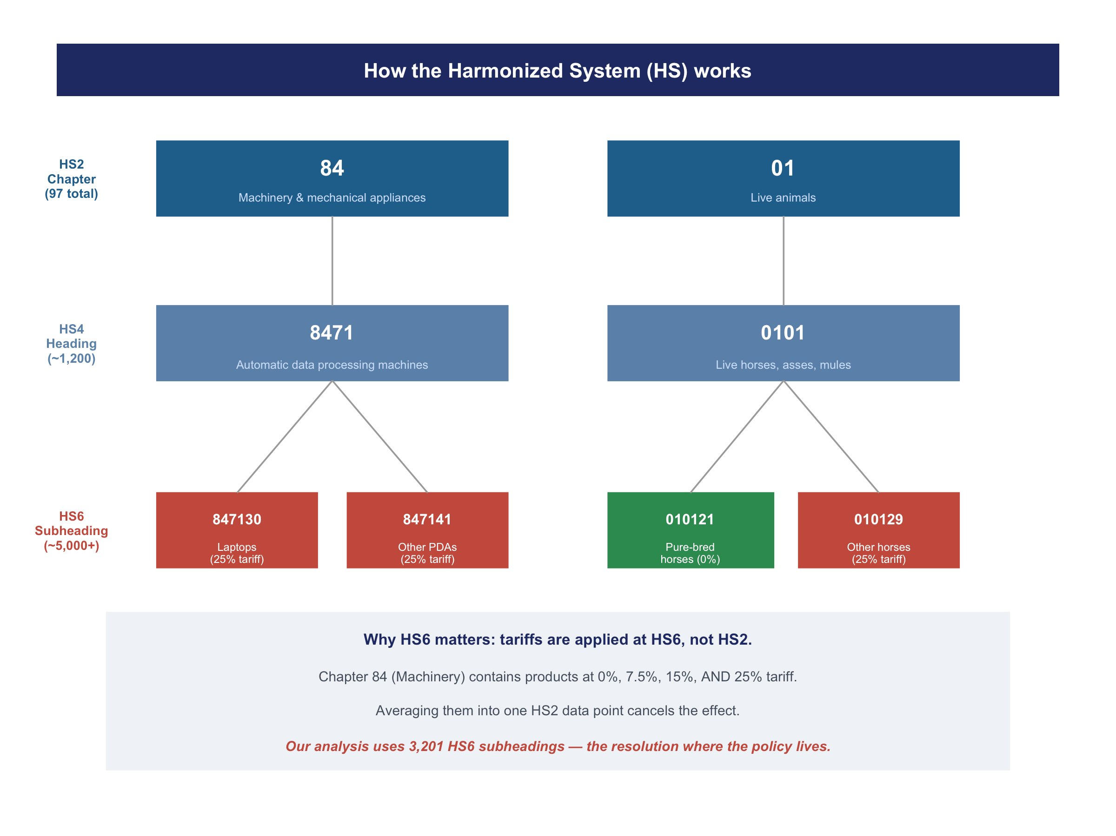
APPENDIX A1 · How the Harmonized System works — HS2 vs HS6
Notes:
The Harmonized System classifies every traded product. HS2 gives us 97 broad chapters — Machinery, Live Animals, Chemicals. HS6 gives us over 5,000 subheadings. Tariffs are applied at HS6. Our analysis uses 3,201 HS6 products with matched tariff and trade data.

Slide 14
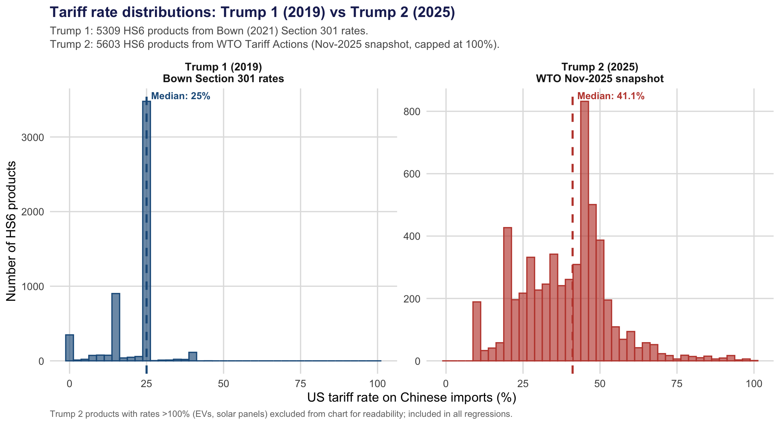
APPENDIX A2 · Tariff rate distributions: Trump 1 vs Trump 2
Run scripts/21_appendix_methods.R then re-upload figA2_tariff_distribution.png
Notes:
Trump 1 tariffs clustered at discrete levels — 0, 7.5, 15, and 25% — reflecting the three Lists under Section 301. Trump 2 is a much broader distribution with a median of 41%, reflecting the layering of Section 301 plus IEEPA tariffs. These are genuinely different policy regimes, not just a larger version of the same thing.

Slide 15
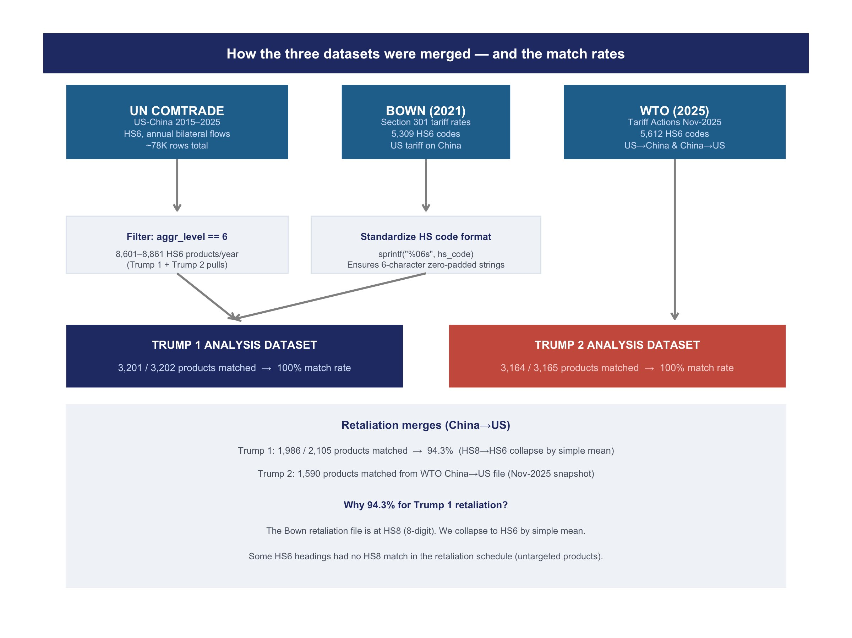
APPENDIX A3 · Data merge flow and match rates
Notes:
Three source datasets, two analysis datasets. The key technical step is standardizing HS6 codes to six characters before joining — without that, the same product appears under different code formats and the merge fails. Match rates of 100% for both primary tariff merges.

Slide 16
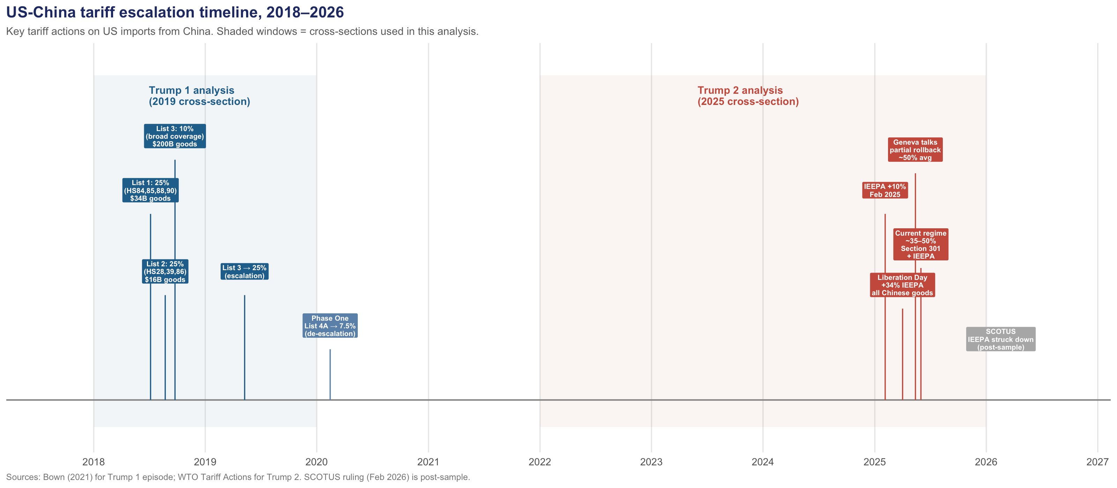
APPENDIX A4 · US-China tariff escalation timeline, 2018–2026
Notes:
The blue shaded window is our Trump 1 cross-section — 2019 outcomes against a 2015-17 baseline. The red window is Trump 2 — 2025 outcomes against a 2022-24 baseline. The timeline shows the full escalation path and why we chose the November 2025 snapshot — rates had stabilized after the Geneva talks partial rollback earlier that year.

Slide 17
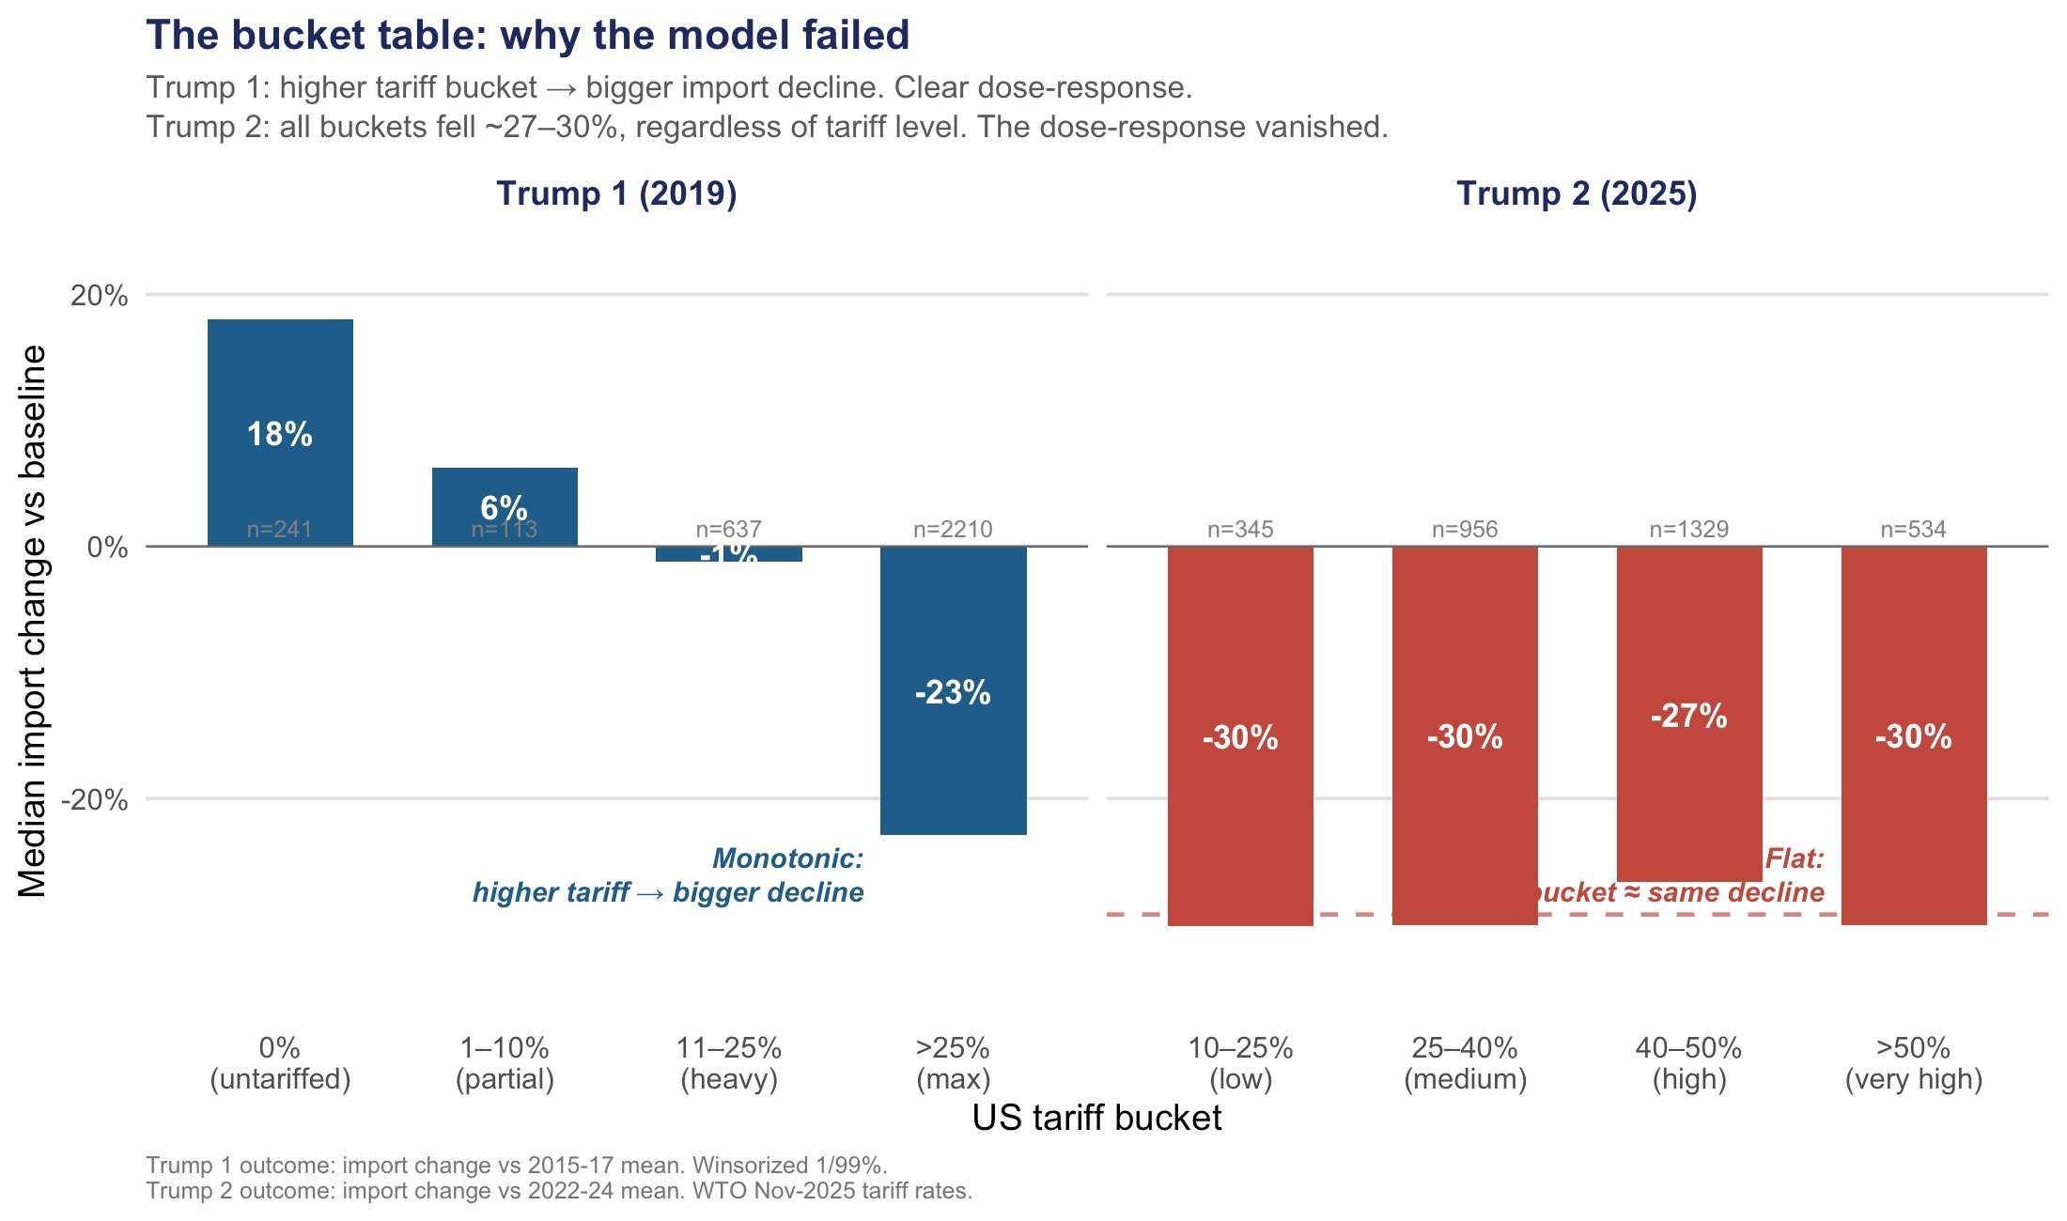
APPENDIX A5 · Trump 1 vs Trump 2: dose-response by tariff bucket
Notes:
This is the single strongest piece of backup evidence in the project. No assumptions, no model. Just: did higher tariffs correspond to bigger declines? The answer changed from yes in 2019 to no in 2025. If someone challenges the regression results, this slide still holds.

Slide 18
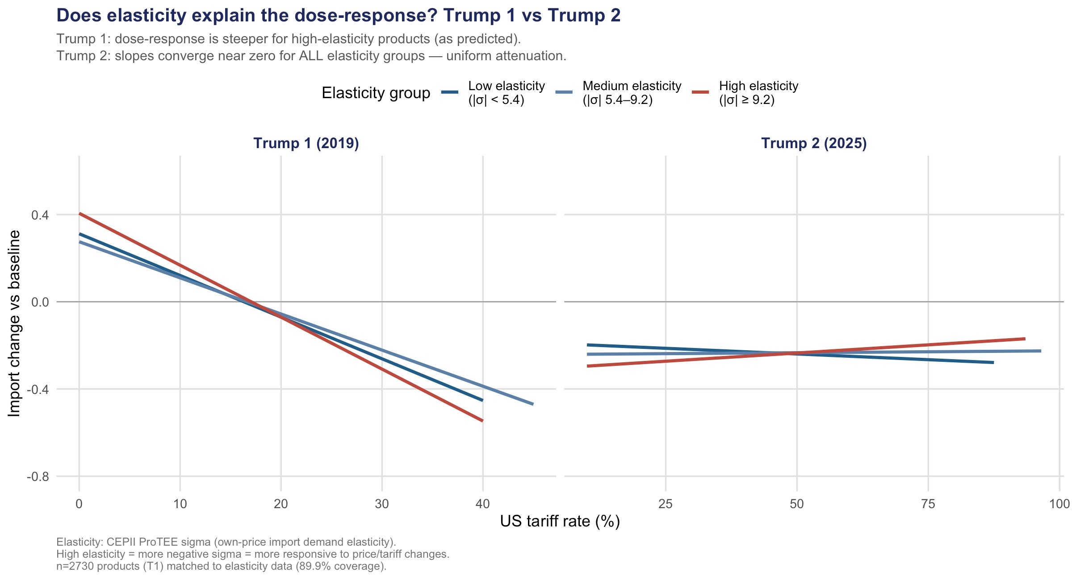
APPENDIX A6 · Elasticity extension: CEPII ProTEE × tariff dose-response
Exited products
Surviving products
Difference
σ = −11.6
σ = −8.7
t = −6.33
more elastic
less elastic
p < 0.001
Selection explains who exited. It does not explain why survivors stopped responding.
Notes:
Products that disappeared from US-China trade by 2025 had a mean elasticity of minus 11.6. Products still trading had minus 8.7. That difference is statistically very strong. So the more price-sensitive products exited first — exactly what the selection story predicts. But look at the right panel: even among the most elastic surviving products, the slope in 2025 is essentially zero. Selection explains who exited. It doesn't fully explain why the survivors stopped responding. That's where the research goes next.

