Slide 1
Consumer Surplus Factor (CSF) study skad
KHC – UK : Brown Sauce
June 2025

Slide 2
Executive Summary
Overall
Overall CSFs are healthy in Supermarket, Tesco & Convenience – implying satisfied consumers with low switching tendency
Iceland CSFs are relatively lower due to price sensitive consumers, limiting consumer stickiness in that channel
HP Brown Sauce
HP Brown Sauce retains pricing power across Supermarket, Tesco & Iceland
  Consumers are less likely to switch to other brands when HP increases price – instead, they tend to exit the category or channel altogether. HP can consider strategic price increases to gain value share
HP is the only brand available in the Convenience channel
  With no branded competition and a channel price elasticity of -0.82, HP faces relatively inelastic demand — meaning volume is less sensitive to price changes. This provides room to modestly increase prices without significant volume loss, allowing HP to improve margins while still preserving channel volume
Competition
Private Label has the strongest CSF in Supermarket and Tesco despite 7–10% price increases
  However, PL has limited price interaction with HP, reducing immediate switching risk
PPG
Discontinuation of Large Variant in Daddies and Private Label, only HP retains the Large Variant; However, within HP PPGs, the Large Variant’s CSF is low in Supermarket and Tesco, suggesting limited consumer preference for the size

Slide 3
UK – Brown Sauce – Market Context - (Mar’23 – Feb’24 v/s Mar’ 24 – Feb’25)
Supermarkets
Change in: Value = -3.4%; Volume = -3.5%; Price = 0.1%
Tesco
Change in: Value = -1.8%; Volume = 3.7%; Price = -5.3%
 | MS% | % Change | Avg. Price | % Change |  |  | MS% | % Change | Avg. Price | % Change
HP | 77.0% | 0.1% | 6.02 | -3.5% |  | HP | 79.9% | -2.1% | 5.93 | -4.5%
Small | 9.8% | -0.3% | 7.02 | -6.8% |  | Small | 8.4% | -0.6% | 7.19 | -3.9%
Medium | 45.2% | 3.2% | 5.97 | -5.5% |  | Medium | 51.2% | 5.0% | 5.96 | -8.7%
Large | 21.9% | -2.8% | 5.73 | 0.7% |  | Large | 20.3% | -6.5% | 5.48 | 0.5%
DADDIES | 10.3% | -1.0% | 4.23 | 11.4% |  | DADDIES | 12.0% | -0.6% | 3.75 | -1.7%
Medium | 10.1% | 2.2% | 4.24 | 3.3% |  | Medium | 11.9% | -0.6% | 3.76 | -1.7%
Large** | 0.2% | -3.2% | 3.65 | 13.0% |  | Large** | 0.0% | 0.0% | 2.50 | -1.8%
BRANSTON | 1.4% | -0.1% | 4.49 | 5.9%
Small | 1.4% | -0.1% | 4.49 | 5.9%
PRIVATE LABEL | 9.5% | 0.9% | 2.27 | 7.8% |  | PRIVATE LABEL | 7.5% | 2.7% | 2.40 | 10.8%
Medium | 9.5% | 1.5% | 2.27 | 6.8% |  | Medium | 7.5% | 4.0% | 2.40 | 3.4%
Large** | 0.0% | -0.6% | 2.08 | 10.6% |  | Large** | 0.0% | -1.3% | 1.96 | 7.2%
REST | 1.8% | 0.0% | 2.62 | 3.8% |  | REST | 0.7% | 0.0% | 1.50 | -3.1%
Overall value of Brown Sauce category is declining across all Channels
HP has maintained a relatively stable market share within Supermarkets and Tesco
  However, HP has lost distribution in Medium Variant of Iceland Channel which seems to be the cause of losing share in that Channel
Medium Variant increasing in Market Share across channels indicating increasing consumer preference towards that PPG
Both, Daddies and Private Label, have discontinued Large Variant completely
Private Label Medium variant is gaining market share in Supermarket and Tesco, despite recent price increases.
Iceland
Change in: Value = -4.1%; Volume = -3.4%; Price = -0.7%
Convenience
Change in: Value = -5.6%; Volume = -6.8%; Price = 1.3%
 | MS% | % Change | Avg. Price | % Change |  |  | MS% | % Change | Avg. Price | % Change
HP | 61.4% | -4.3% | 5.71 | -4.3% |  | HP | 98.7% | 3.0% | 6.28 | -0.4%
Medium | 18.5% | -21.2% | 5.82 | -2.7% |  | Medium | 71.9% | -1.7% | 6.46 | -0.4%
Large | 43.0% | 16.9% | 5.66 | -4.6% |  | Large | 26.8% | 4.7% | 5.84 | 1.1%
DADDIES | 28.5% | 0.6% | 3.75 | 17.1% |  | DADDIES** | 1.2% | -0.7% | 4.12 | 0.0%
Medium | 28.5% | 5.9% | 3.75 | 14.1% |  | Medium** | 1.2% | -0.7% | 4.12 | 0.0%
Large** | 0.0% | -5.3% | 1.64 | -43.0%
GOLD STAR | 3.5% | -0.4% | 1.85 | 6.4%
Large | 3.5% | -0.4% | 1.85 | 6.4%
REST | 6.6% | 4.2% | 2.33 | -13.8%
**PPGs that have been discontinued (as inferred via distribution numbers)

Slide 4
CSF & MCV Trend – Supermarket – HP hasn’t been able to increase MCV in proportion to it’s price
HP’s MCV Index to Private Label has decreased more than the Price Index over time
Feb 2023
Feb 2024
Feb 2025
MCV
CSF
Price
 | MCV Index to PL | Price Index to PL
Feb-23 | 339 | 291
Feb-24 | 275 | 296
Feb-25 | 259 | 265

Slide 5
HP has healthy CSF across channels; Private Label emerging as a huge threat
Supermarkets
Tesco
Iceland
Convenience
MCV
CSF
Price
C. MS% | 77.0% | 10.3% | 1.4% | 9.5% | 79.9% | 12.0% | 7.5% | 61.4% | 28.5% | 3.5% | 98.7%
MSP | 0.3% | -0.4% | 0.0% | 0.2% | 0.4% | -0.8% | 0.5% | 0.3% | -0.8% | 0.1% | 0.0%
Current RPI | 100 | 142 | 134 | 265 | 100 | 158 | 247 | 100 | 152 | 308 | 100
HP’s Inflection RPI | 100 | 147 | - | 274 | 100 | 166 | 259 | 100 | 154 | 312 | 100
HP has healthy CSF and will continue to grow in terms of Market Share
Private Label has the highest CSF in Supermarket and Tesco and is in a strong competitive position

Slide 6
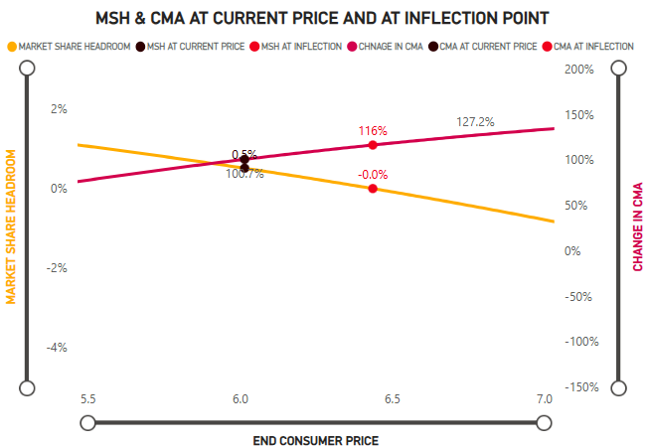
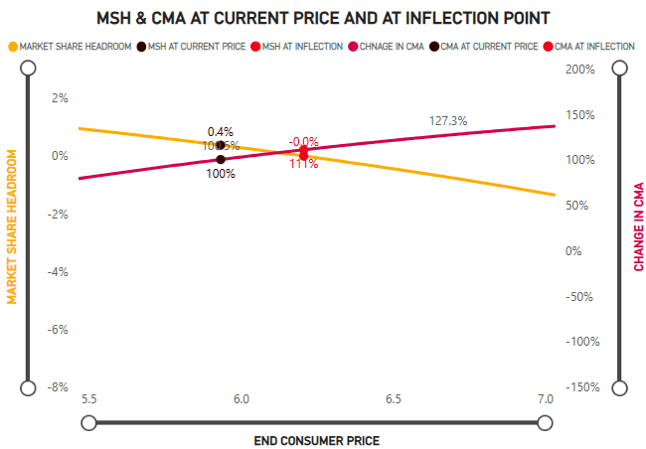
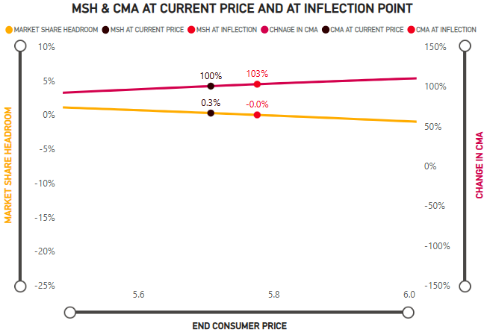
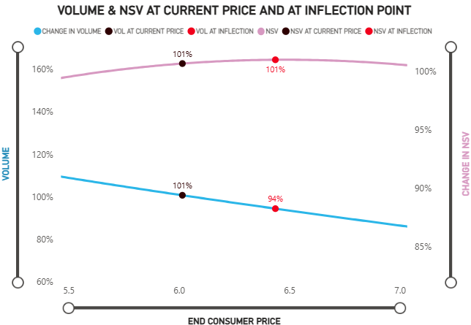
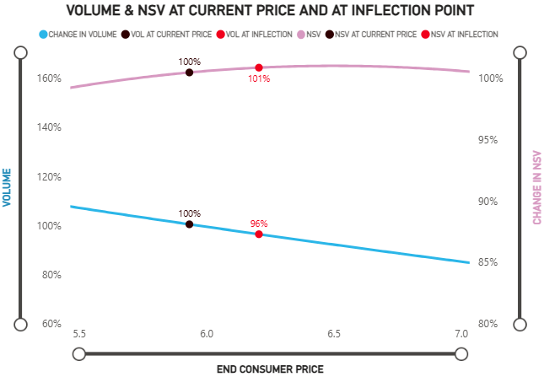
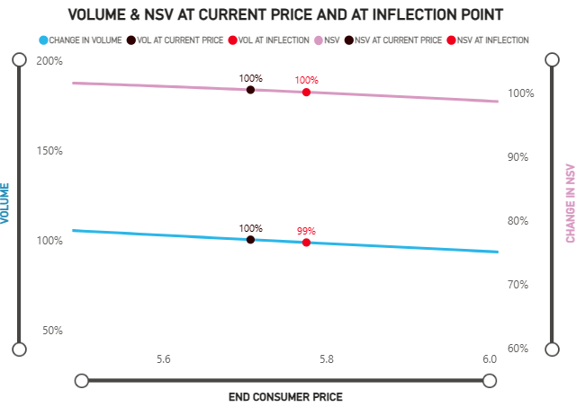
HP has pricing power across Supermarket, Tesco and Iceland
Medium
Supermarket
Tesco
Iceland
Price: 6.02
RPI PL: 265
RPI Daddies: 142
Price: 6.22
RPI PL: 274
RPI Daddies: 147
Price: 5.93
RPI PL: 247
RPI Daddies: 158
Price: 6.21
RPI PL: 259
RPI Daddies: 166
Price: 5.71
RPI Goldstar: 308
RPI Daddies: 152
Price: 5.78
RPI Goldstar: 312
RPI Daddies: 154
L12M
Inflection

Slide 7
Supermarket- HP Medium has healthy CSF; HP Small PPG can reduce prices
Small- 11.3% Val. MS
Medium- 64.9%
Large- 21.9%
MCV
CSF
Price
C.MS% | 9.8% | 1.4% | 45.2% | 10.1% | 9.5% | 21.9%
MSP | -0.2% | 0.0% | 1.5% | -0.4% | 0.2% | -1.0%
RPI* | 143 | 92 | 122 | 87 | 46 | 117
Inflection RPI* |  | - |  | - | -
HP’s growth will come from it’s Medium Variant; HP Small can cut prices slightly to prevent loss of MS%
Private Label and Daddies have discontinued their Large PPGs
*RPI metric is calculated keeping Entire Channel as reference

Slide 8
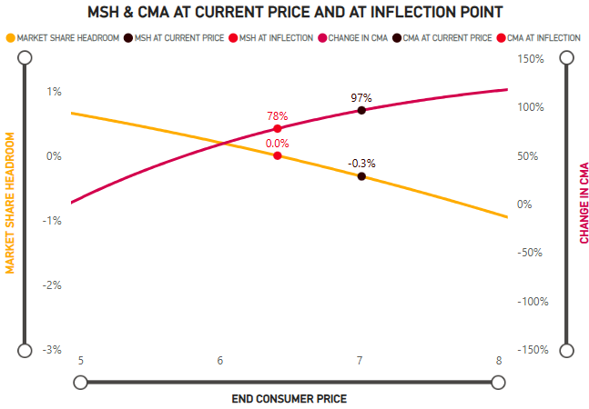
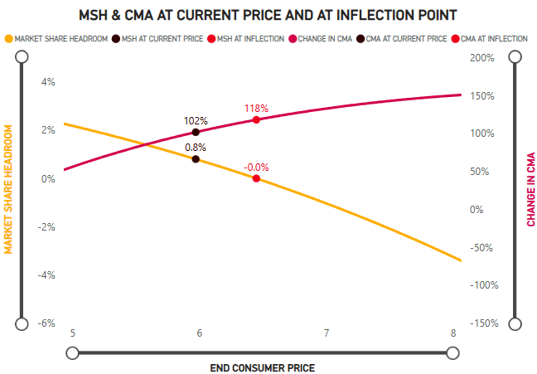
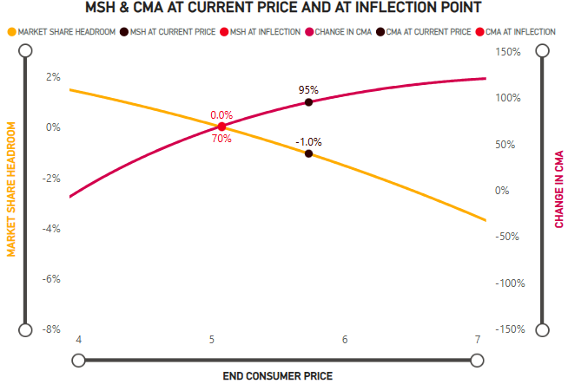
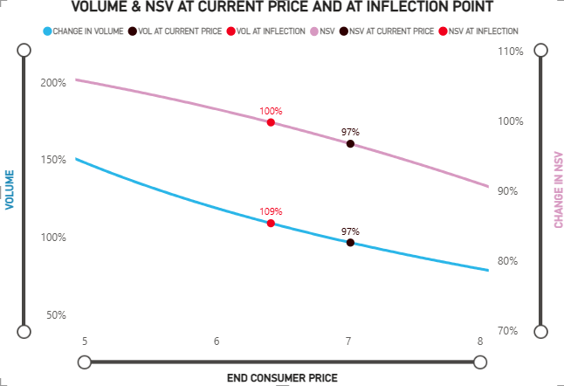
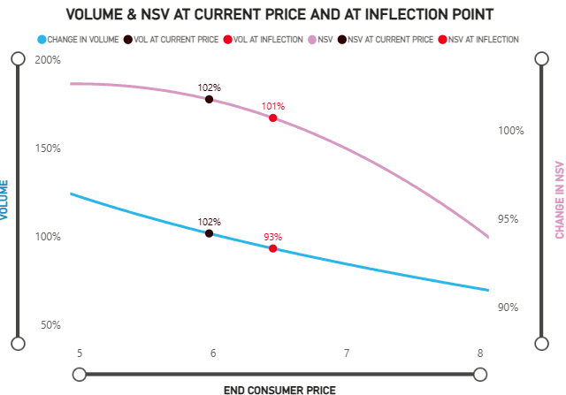
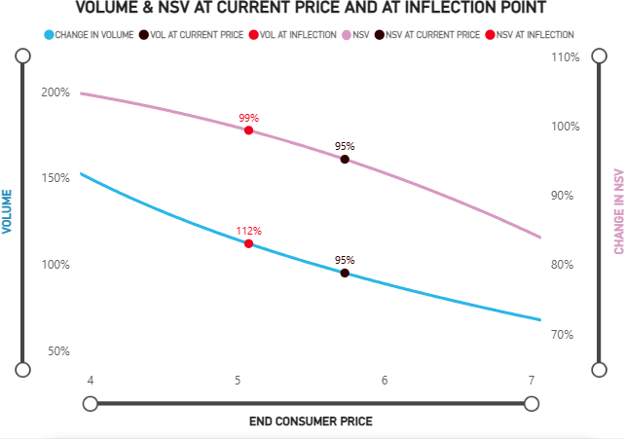
Supermarket- Medium PPG should be the major driver in increasing overall brand prices
Medium
Small
Medium
Large
Price: 6.77
Price: 7.02
Price: 5.97
Price: 6.71
Price: 5.08
Price: 5.73
L12M
Inflection

Slide 9
Tesco - HP Medium has healthy CSF; HP Large PPG can reduce prices
Small- 8.4% Val. MS
Medium- 70.6%
Large- 20.3%
MCV
CSF
Price
C.MS% | 8.4% | 51.2% | 11.9% | 7.5% | 20.3%
MSP | 0.1% | 1.4% | -0.8% | 0.5% | -1.1%
RPI* | 145 | 121 | 76 | 48 | 111
Inflection RPI* |  |  | - | -
HP’s growth will come from it’s Medium Variant; HP Large can cut prices slightly to prevent loss of MS% since it’s RPI to Category has gone up from 104 to 111
Private Label and Daddies have discontinued their Large PPGs
*RPI metric is calculated keeping Entire Channel as reference

Slide 10
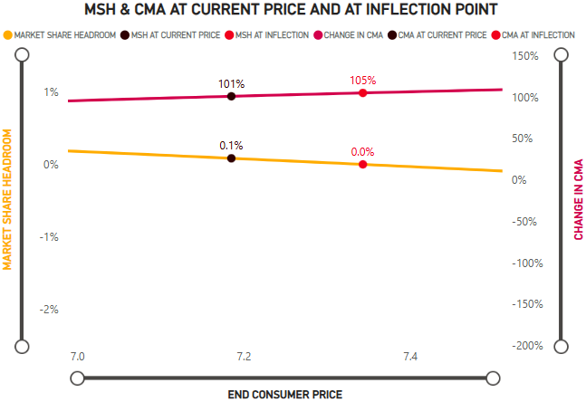
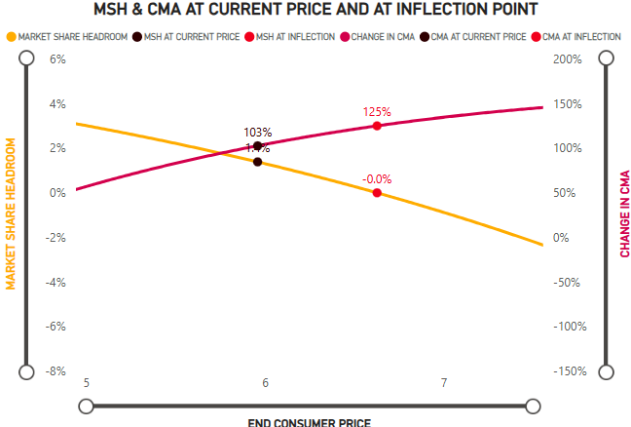
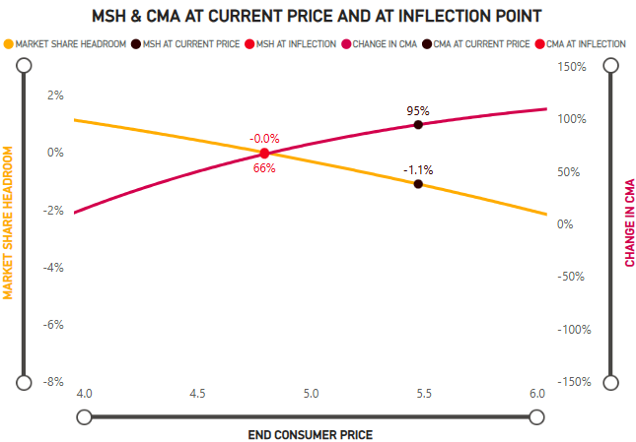
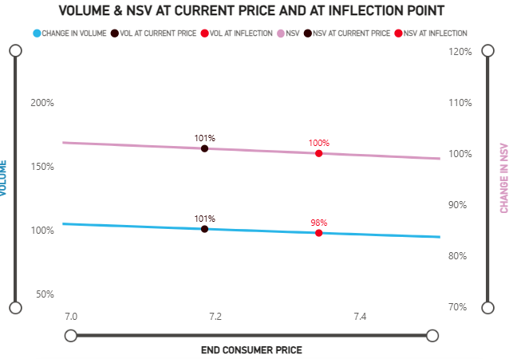
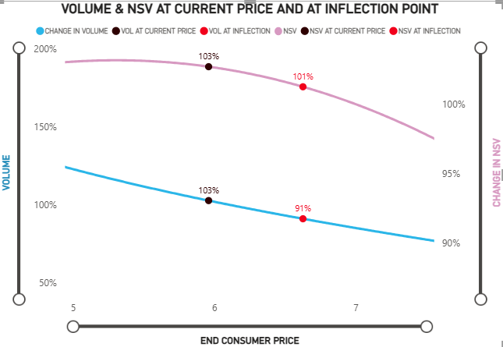
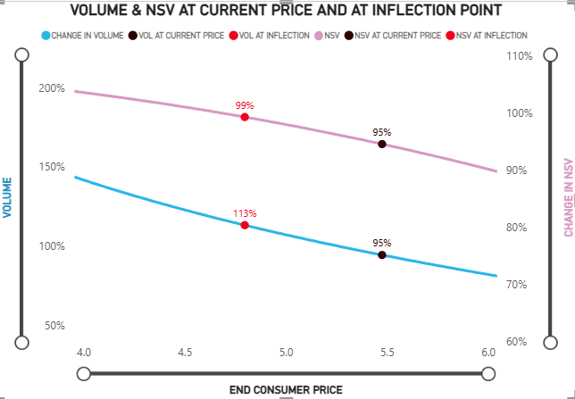
Tesco- Large PPG needs price reduction; Small and Medium can increase prices
Medium
Small
Medium
Large
Price: 7.19
Price: 7.34
Price: 5.96
Price: 6.63
Price: 4.8
Price: 5.48
L12M
Inflection

Slide 11
Iceland – Gold Star has the highest CSF in Iceland and is in a strong competitive position
Medium- 47.0%
Large- 46.5%
MCV
CSF
Price
C.MS% | 18.5% | 28.5% | 43.0% | 3.5%
MSP | 0.0% | -0.8% | 0.2% | 0.1%
RPI* | 134 | 86 | 130 | 43
Inflection RPI* |  | - |  | -
HP Medium PPG is facing distribution loss which likely has caused it’s M.S. to decrease; On the contrary, it’s Large PPG has increased it’s distribution
Both, Daddies and Gold Star’s RPI to Category has increased; Gold Star, despite being very small in M.S., has a healthy CSF
*RPI metric is calculated keeping Entire Channel as reference

Slide 12
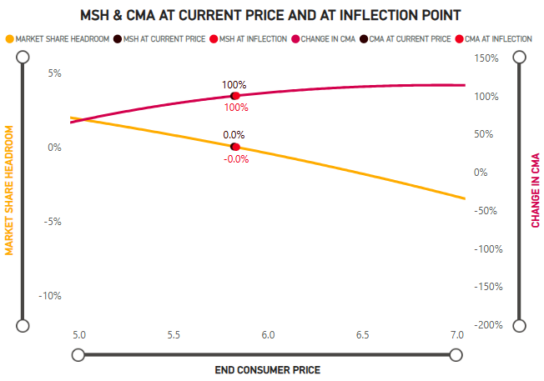
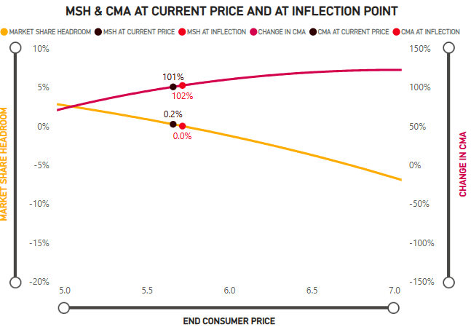
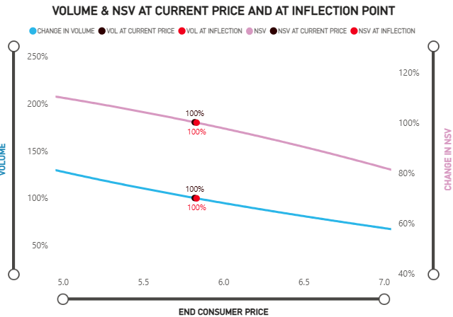
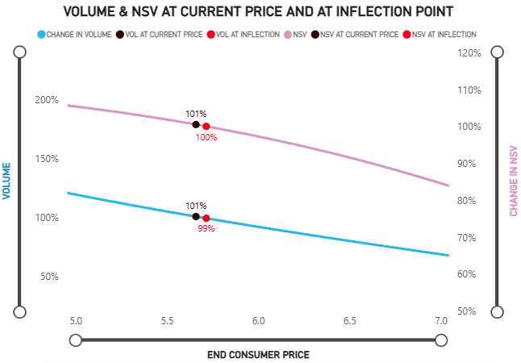
Iceland- Both PPGs can choose to retain current prices to not lose Volumes
Medium
Medium
Large
Price: 5.66
Price: 5.72
Price: 5.83
L12M
Inflection

Slide 13
Convenience – HP can increase overall prices via Medium PPG due to inelastic demand
Medium- 71.9%
Large- 26.8%
MCV
CSF
Channel Price Elasticity: (-0.82)
Price
C.MS% | 71.9 | 26.8
MSP | 0.2% | -0.2%
RPI* | 104 | 94
Inflection RPI*
HP is the only current brand available in Convenience Channel
At current prices, channel price elasticity is < than 1, implying that demand is inelastic; Brand can increase prices through Medium PPG
*RPI metric is calculated keeping Entire Channel as reference

Slide 14
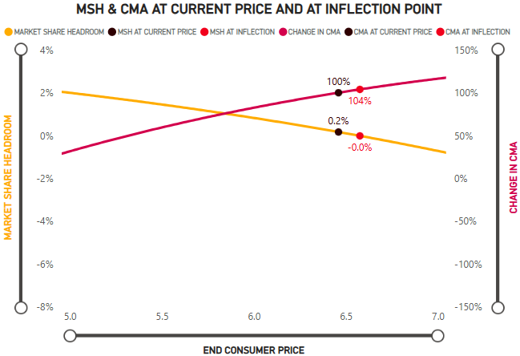
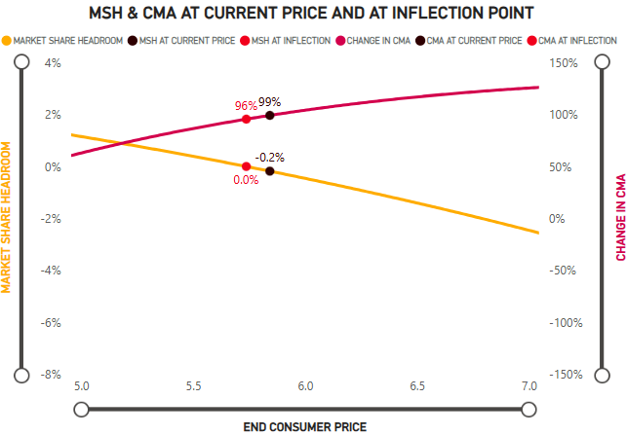
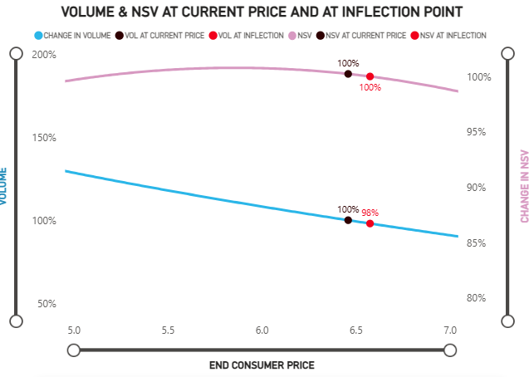
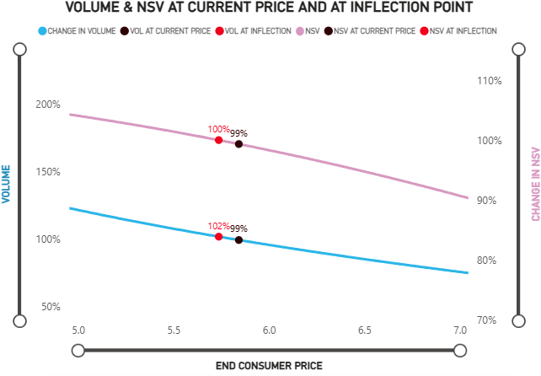
Convenience- Both PPGs can choose to retain current prices to not lose Volumes
Medium
Medium
Large
Price: 6.58
Price: 5.74
Price: 5.84
Price: 6.46
L12M
Inflection

Slide 15
Thank You

