Slide 1



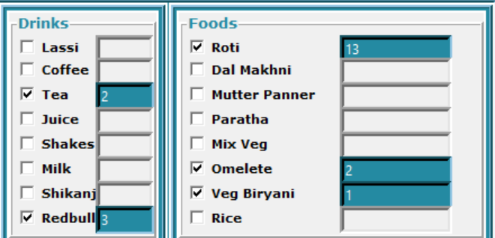





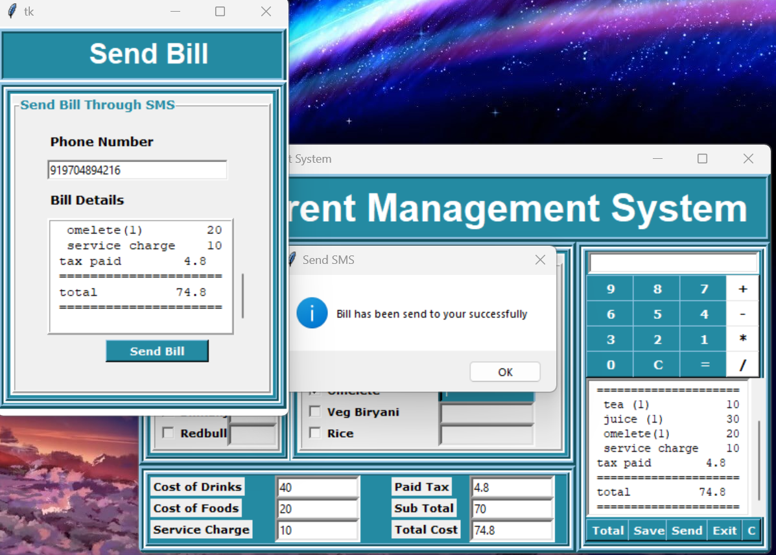



RESTAURENT MANAGEMENT SYSTEM
Select here!!
MODULES
Tkinter : GUI toolkit for creating graphical interfaces.
Requests : Library for making HTTP requests.
JSON : Format for data interchange and storage.
Datetime : Module for working with dates and times.
GUI
PROCESSING
DATA
Empowers users with convenient food ordering via Tkinter-based GUI, calculating inclusive bills &
The UI sends the total bill, including tax, and food details to the customer's mobile number upon inputting the number
MESSAGE
Architecture: Backend server connects to remote menu database; frontend GUI for customers.
GUI Interaction: GUI displays dynamic menu, allows item selection and quantity.
Order Process: GUI confirms order, sends request to backend, calculates total cost.
Order Summary: GUI shows JSON response with item details, quantities, prices, total cost.
Message received!

