Slide 1
RESTAURANT MANAGEMENT SYSTEM

Slide 2
ABSTARCT
The "Restaurant Management System" project in Python employs the `requests`, `json`, and `tkinter` modules to facilitate food ordering at a restaurant. The system consists of a backend server connecting to a remote food menu database and a frontend GUI for customers. The GUI showcases the menu, allowing customers to select items and quantities. Upon order confirmation, the GUI sends requests to the backend, which calculates the total cost and returns it in JSON format. The GUI then displays an order summary containing item details, quantities, prices, and the total cost. The system ensures real-time communication, dynamic menu display, and error handling for a seamless user experience. By integrating backend-server interaction with an intuitive GUI, the project demonstrates how Python can efficiently enhance the restaurant food ordering process.

Slide 3
Introduction to Project
our project harnesses the capabilities of Python to orchestrate this intricate dance between reservations and food orders. The backend logic handles reservation scheduling, availability management, and order processing. The user-friendly frontend provides an elegant and responsive interface for customers to interact with the system effortlessly.
Throughout the development of this project, we encountered various challenges, from designing an intuitive user interface to creating a robust database that stores menu items, reservations, and order details. By overcoming these challenges, we have created a holistic solution that caters to both the restaurant's operational needs and the customers' desire for a seamless dining experience.

Slide 4




tkinter
MODULES USED
requests
datetime
json

Slide 5

Tkinter : Tkinter is a standard GUI (Graphical User Interface) library for creating interactive and visually appealing desktop applications.
Requests : The Requests module is used for making HTTP requests, allowing Python programs to communicate with web services and retrieve data.
JSON : The JSON module provides methods to encode and decode data in JSON format, facilitating data interchange between different systems.
Datetime : The Datetime module offers classes and methods to work with dates and times, making tasks like time-based calculations and formatting simpler.

Slide 6
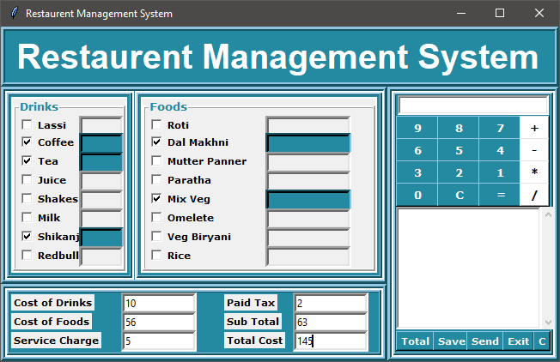
This project empowers users to conveniently place food orders via a user-friendly GUI built with Tkinter. The system calculates the total bill, including taxes, enhancing the ordering experience.
Total Bill

Slide 7
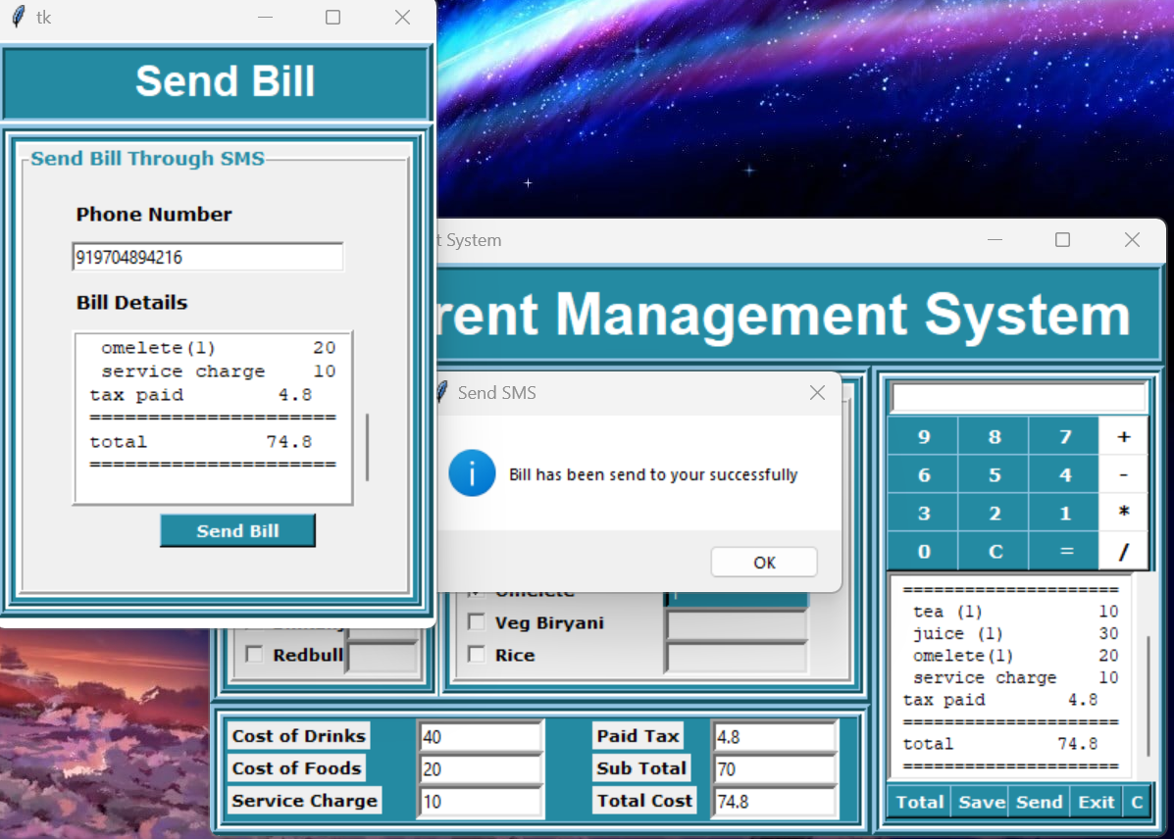
The UI sends the total bill, including tax, and food details to the customer's mobile number upon inputting the number.

Slide 8
THANK YOU!

