Slide 1

Project Title - Seasonal Agriculture Performance Analysis
Student Name – Nikhil Maurya
College Name- Faculty Of Engineering & Technology, University of Lucknow
AICTE STU ID - STU679b1410183791738216464

Slide 2

PROBLEM STATEMENT
Agricultural activities are influenced by seasonal variations in environmental conditions, farming practices, resource availability and market conditions. As a result, agricultural performance may differ from one season to another. However, raw agricultural data does not clearly explain how agricultural performance changes across seasons or what patterns can be observed in different seasonal conditions. The problem is to analyze the given agricultural dataset and investigate seasonal differences in agricultural performance by identifying meaningful patterns, trends, relationships and variations within the available data.

Slide 3
Project Description
This project analyzes a dataset of 4,000 farm records spanning three Indian cropping
seasons — Kharif, Rabi and Zaid — across 8 states, 10 districts and 8 crops. The goal is
to understand how agricultural performance changes across seasons and to uncover
patterns in environmental conditions, resource usage, yield and economic outcomes.
The analysis was carried out in Python using Pandas, NumPy, Matplotlib, Seaborn and
SciPy. It covers data cleaning (handling missing values, checking for duplicates and
outliers), exploratory data analysis, statistical significance testing
(Kruskal-Wallis tests), correlation analysis, and comparison across seasons, states,
crops and irrigation methods.

Slide 4
Key Findings
Key results: seasonal yield and profit differences are statistically significant
(p < 0.05). Kharif has the highest average profit and highest share of profitable farms
(57.8%), while Zaid shows the lowest (35.5% profitable, with a negative average profit).
Environmental conditions follow expected seasonal patterns — Kharif is wettest and most
humid, Zaid is hottest and driest. The analysis also found that high yield does not
guarantee profitability: 5.2% of farms had top-quartile yield but still ran at a loss,
highlighting cost management as a distinct lever from productivity.
The project concludes with data-driven recommendations for season-specific input
planning, cost control alongside yield improvement, and region-aware seasonal
advisories.

Slide 5

WHO ARE THE END USERS?
Farmers and agricultural cooperatives — for season-specific crop, input and irrigation
planning.
State agricultural departments and extension officers — to design season- and
region-specific advisories.
Agri-business and agri-input companies — to plan fertilizer, pesticide and irrigation
product demand by season.
Agricultural researchers and students — as a reference analysis of seasonal
performance patterns.
Policy makers and planning bodies — for evidence-based seasonal agricultural policy
and resource allocation.

Slide 6

Technology Used
Language: Python 3
Environment: Google Colab / Jupyter Notebook
Data handling: Pandas, NumPy
Visualization: Matplotlib, Seaborn
Statistical analysis: SciPy (Kruskal-Wallis test, Pearson correlation)
Dataset: seasonal_agriculture_performance_dataset.csv (4,000 records, 28 columns)

Slide 7
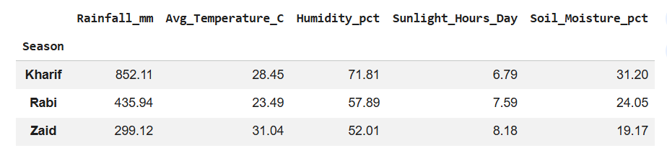
RESULTS
Environmental Conditions by Season

Slide 8
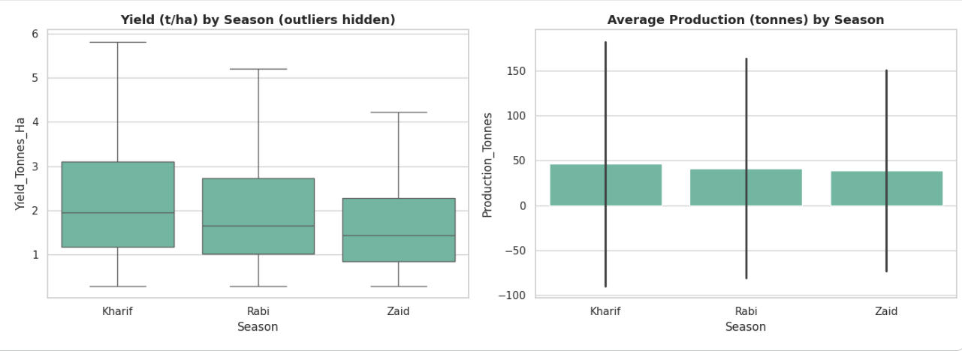
RESULTS
Yield & Production by Season

Slide 9
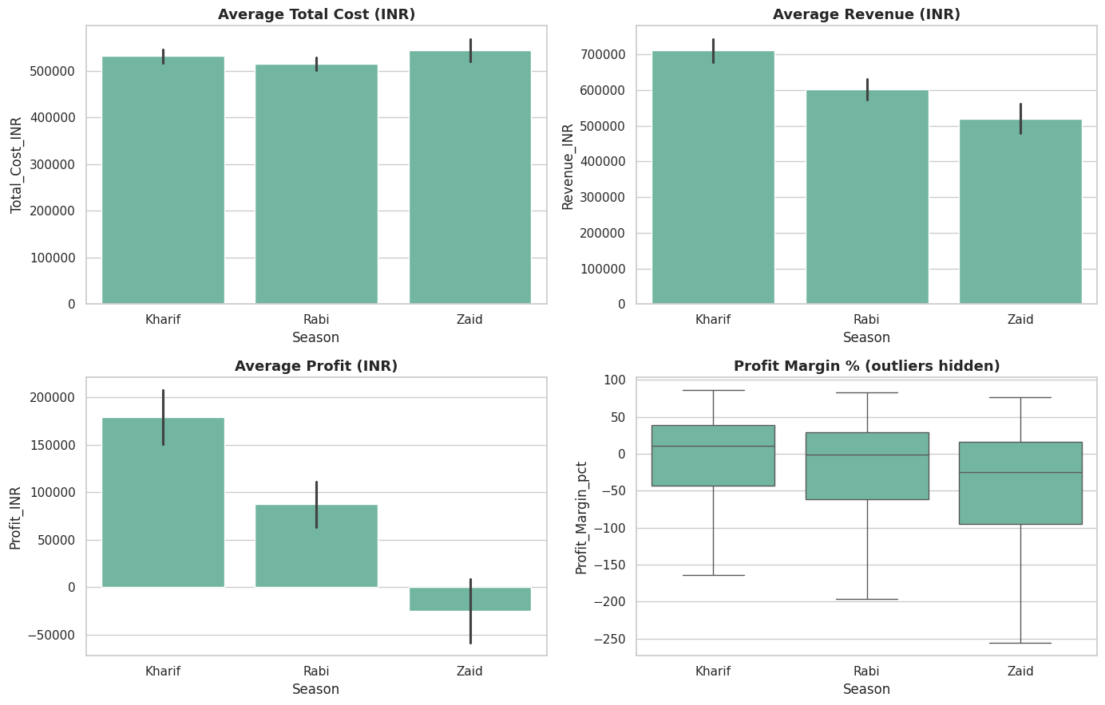
RESULTS
Economic Performance by Season

Slide 10
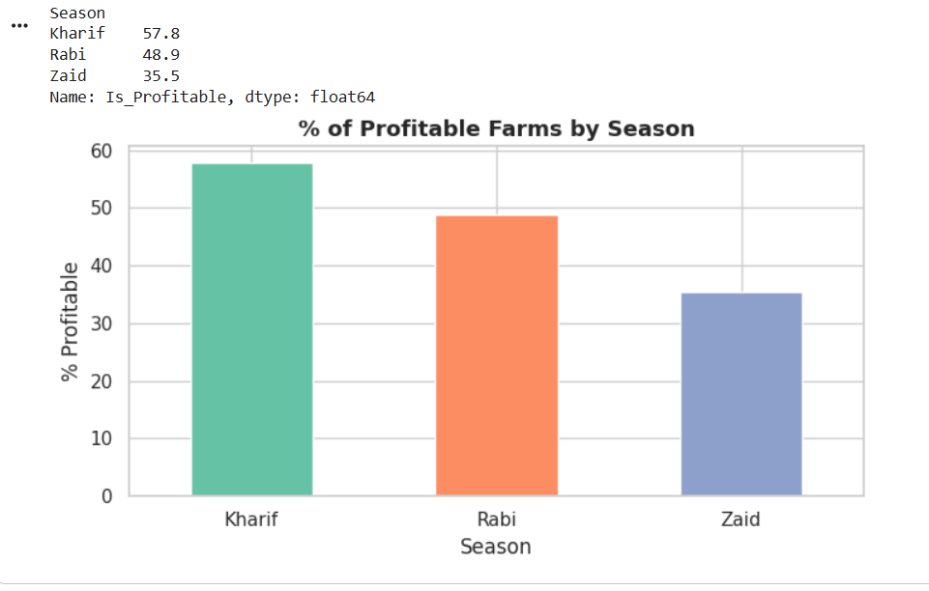
RESULTS
Profitability by Season

Slide 11
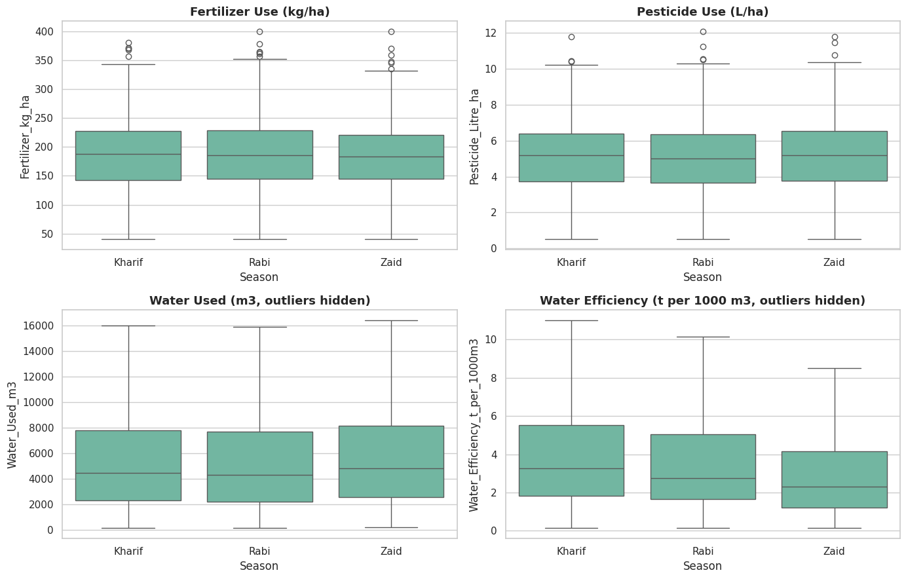
RESULTS
Resource Usage by Season

Slide 12
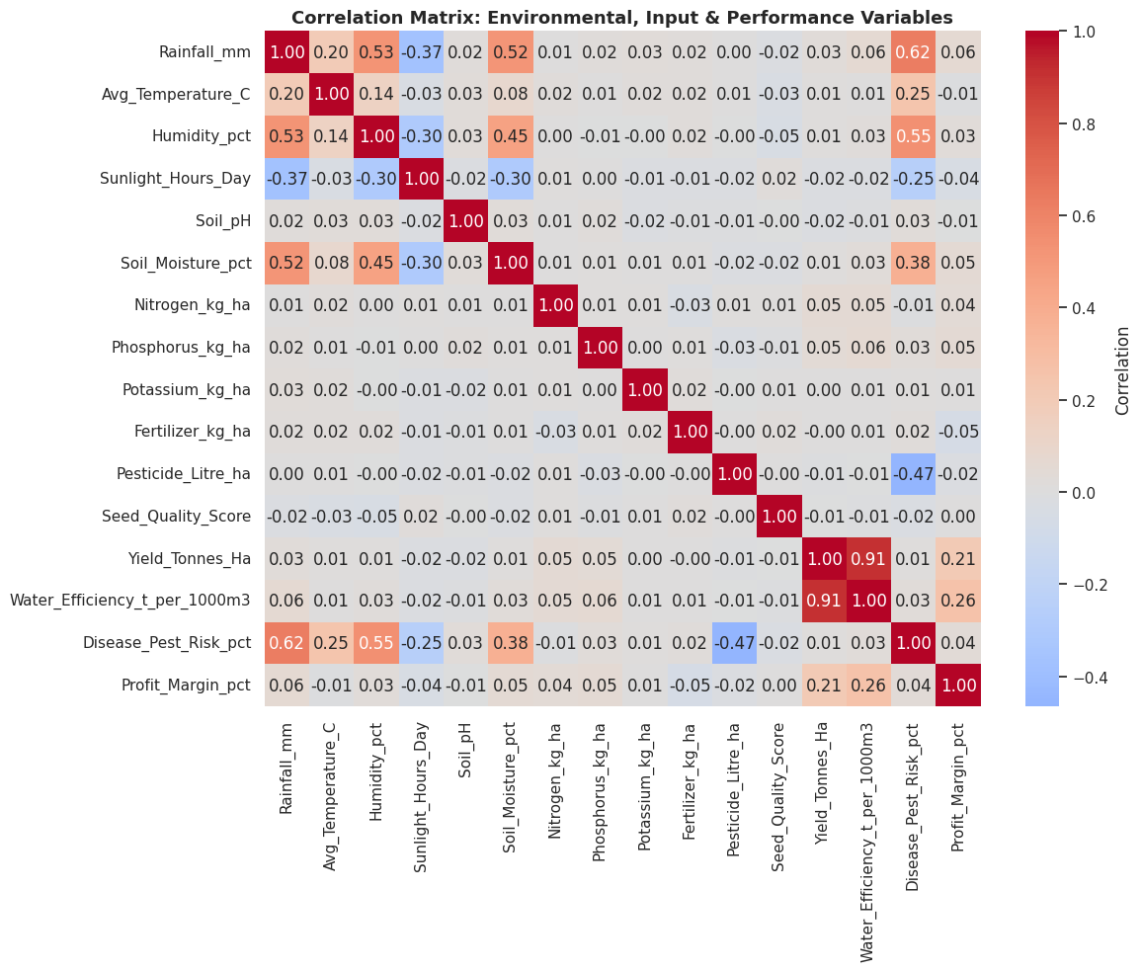
RESULTS
Correlation Between Variables

Slide 13
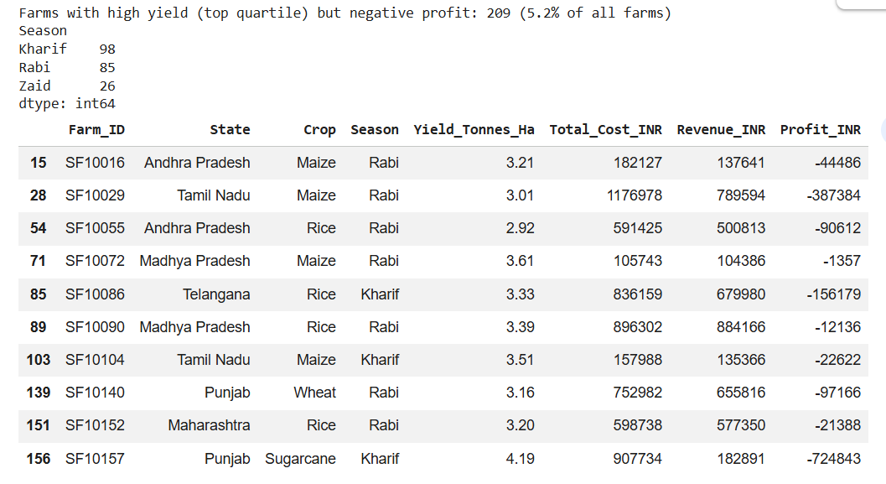
RESULTS
Unusual Pattern — High Yield, Low Profit

Slide 14
Future scope
Extend the analysis with multivariate regression to isolate the individual effect of
each factor (season, crop, region) on yield and profit while controlling for the
others.
Incorporate additional years of data to study year-over-year seasonal trends, not just
a single-year snapshot.
Build a simple predictive model (e.g. profit or yield forecasting) to support
proactive seasonal planning.
.
Add satellite/weather API data for real-time seasonal advisories.
Deploy the analysis as an interactive dashboard (e.g. Streamlit or Power BI) for use
by extension officers and farmers.

Slide 15
GitHub Link
https://github.com/nikhilmaurya78/Seasonal-Agriculture-Performance-Analysis.git

Slide 16

VOIS Course completion certificate -

Slide 17
Thank you
.
.

