Slide 1
International Data Encryption Algorithm
By
How-Shen Chang

Slide 2
Overview
DES algorithm has been a popular secret key encryption algorithm and is used in many commercial and financial applications. However, its key size is too small by current standards and its entire 56 bit key space can be searched in approximately 22 hours
IDEA is a block cipher designed by Xuejia Lai and James L. Massey in 1991
It is a minor revision of an earlier cipher, PES (Proposed Encryption Standard)
IDEA was originally called IPES (Improved PES) and was developed to replace DES

Slide 3
Overview (cont’)
It entirely avoids the use of any lookup tables or S-boxes
IDEA was used as the symmetric cipher in early versions of the Pretty Good Privacy cryptosystem

Slide 4
Detailed description of IDEA
IDEA operates with 64-bit plaintext and cipher text blocks and is controlled by a 128-bit key
Completely avoid substitution boxes and table lookups used in the block ciphers
The algorithm structure has been chosen such that when different key sub-blocks are used, the encryption process is identical to the decryption process

Slide 5
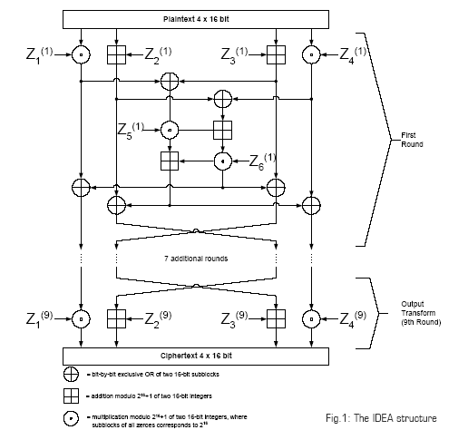
Key generation
The 64-bit plaintext block is partitioned into four 16-bit sub-blocks
six 16-bit key are generated from the 128-bit key. Since a further four 16-bit key-sub-blocks are required for the subsequent output transformation, a total of 52 (= 8 x 6 + 4) different 16-bit sub-blocks have to be generated from the 128-bit key.

Slide 6
Key generation process
First, the 128-bit key is partitioned into eight 16-bit sub-blocks which are then directly used as the first eight key sub-blocks
The 128-bit key is then cyclically shifted to the left by 25 positions, after which the resulting 128-bit block is again partitioned into eight 16-bit sub-blocks to be directly used as the next eight key sub-blocks
The cyclic shift procedure described above is repeated until all of the required 52 16-bit key sub-blocks have been generated

Slide 7
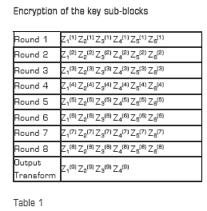
Encryption of the key sub-blocks
The key sub-blocks used for the encryption and the decryption in the individual rounds are shown in Table 1

Slide 8
Encryption
the first four 16-bit key sub-blocks are combined with two of the 16-bit plaintext blocks using addition modulo 2¹⁶, and with the other two plaintext blocks using multiplication modulo 2¹⁶ + 1
At the end of the first encryption round four 16-bit values are produced which are used as input to the second encryption round
The process is repeated in each of the subsequent 7 encryption rounds
The four 16-bit values produced at the end of the 8th encryption round are combined with the last four of the 52 key sub-blocks using addition modulo 2¹⁶ and multiplication modulo 2¹⁶ + 1 to form the resulting four 16-bit ciphertext blocks

Slide 9
Decryption
The computational process used for decryption of the ciphertext is essentially the same as that used for encryption
The only difference is that each of the 52 16-bit key sub-blocks used for decryption is the inverse of the key sub-block used during encryption
In addition, the key sub-blocks must be used in the reverse order during decryption in order to reverse the encryption process

Slide 10
Modes of operation
IDEA supports all modes of operation such as:
  Electronic Code Book (ECB) mode
  Cipher Block Chaining (CBC)
  Cipher Feedback (CFB)
  Output Feedback (OFB) modes
For plaintext exceeding this fixed size, the simplest approach is to partition the plaintext into blocks of equal length and encrypt each separately. This method is named Electronic Code Book (ECB) mode. However, Electronic Code Book is not a good system to use with small block sizes (for example, smaller than 40 bits)

Slide 11
Implementation
Although IDEA involves only simple 16-bit operations, software implementations of this algorithm still cannot offer the encryption rate required for on-line encryption in high-speed networks
  Software implementation running on a Sun Enterprise E4500 machine with twelve 400MHz Ultra-Hi processor, performs an encryption rate of 147.13Mb/sec, still cannot be applied to applications such as encryption for 155Mb/sec Asynchronous Transfer Mode (ATM) networks

Slide 12
Implementation (cont’)
Hardware implementations offer significant speed improvements over software implementations
In addition, they are likely to be cheaper, have lower power consumption and smaller footprint than a high speed software implementation
A high performance implementation of the IDEA presented by Leong uses a novel bit-serial architecture to perform multiplication modulo 2¹⁶ + 1; the implementation occupies a minimal amount of hardware

Slide 13
Implementation (cont’)
The bit-serial architecture enabled the algorithm to be deeply pipelined to achieve a system clock rate of 125MHz
An implementation on a Xilinx Virtex X CV300-4 was successfully tested, delivering a throughput of 500Mb/sec. With a X CV1000-6 device, the estimated performance is 2.35Gb/sec

Slide 14
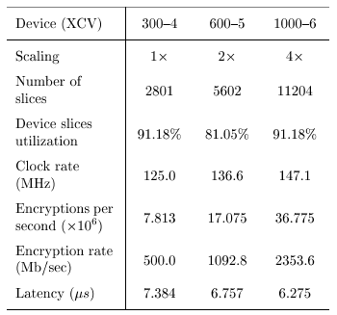
Leong’s experiment result

Slide 15
Applications of IDEA
Today, there are hundreds of IDEA-based security solutions available in many market areas, ranging from Financial Services, and Broadcasting to Government
The IDEA algorithm can easily be embedded in any encryption software. Data encryption can be used to protect data transmission and storage. Typical fields are:
  Audio and video data for cable TV, pay TV, video conferencing, distance learning
  Sensitive financial and commercial data
  Email via public networks
  Smart cards

Slide 16
Conclusion
As electronic communications grow in importance, there is also an increasing need for data protection
When PGP was designed, the developers were looking for maximum security. IDEA was their first choice for data encryption
The fundamental criteria for the development of IDEA were military strength for all security requirements and easy hardware and software implementation

